Slide 1


Backend workshop
Q U A R K U S

Slide 2
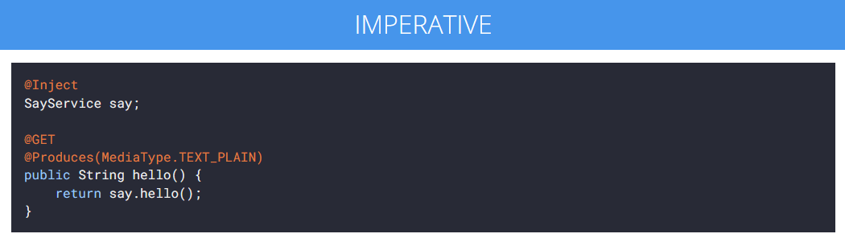
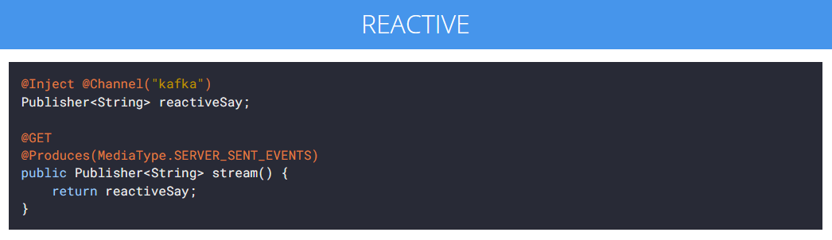
Quarkus: what?
Java framework (JEE)
Proven standards (CDI, JAX-RS, JPA, JTA)
Small memory footprint
Reduced boot time
Both imperative and reactive

Slide 3
Quarkus vs. Spring Boot?
 | Spring Boot | Quarkus
Memory at startup | ~47 MB | ~27 MB
Number of classes loaded | ~7100 | ~5100
Maven jar | 11,1 sec | 4,7 sec
Docker | 18,2 sec | 2,4 sec
50-60% more lightweight
Quarkus uses AOT compilation
https://medium.com/@cresloga_68978/spring-boot-vs-quarkus-82ab6256271d
https://dzone.com/articles/quarkus-vs-spring-boot-performance

Slide 4
Quarkus: why?
Cloud-native
Built from the ground up with microservices in mind
Developer joy
Live reload
Streamlined for 80% of use cases, flexible for the remaining 20%
Ability to compile to native images using GraalVM
Based on MicroProfile standards (metrics, config, resilience, etc)

Slide 5
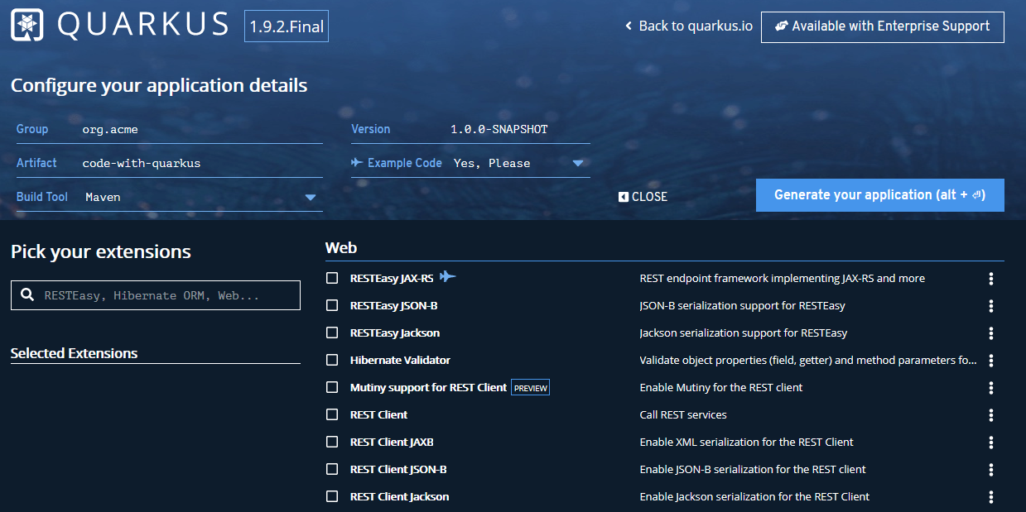
Getting started
https://code.quarkus.io/
https://quarkus.io/guides/

Slide 6
Starting the app
mvn compile quarkus:dev
(gradle build quarkusDev)
Enables live coding

Slide 7
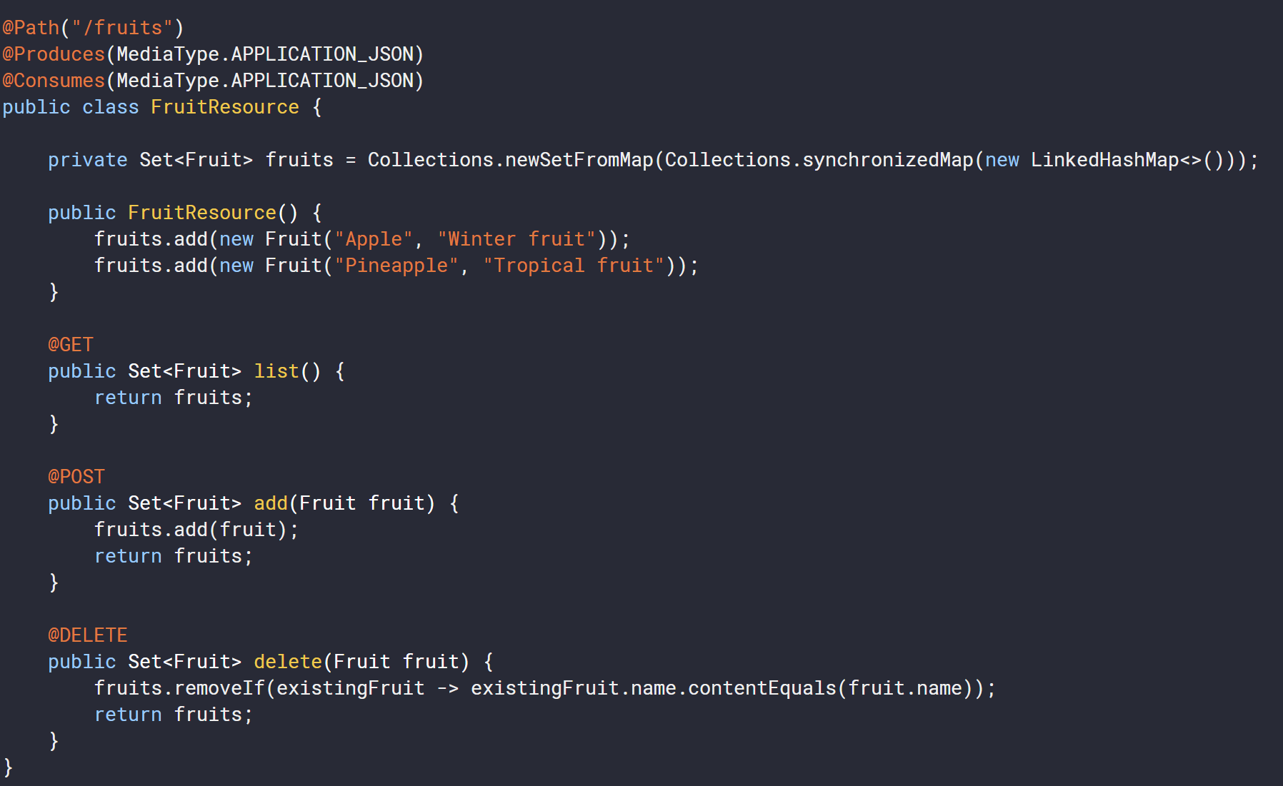
Controller
No need to create an Application class. It’s supported, but not required.

Slide 8
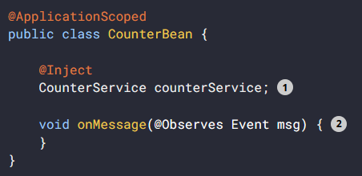
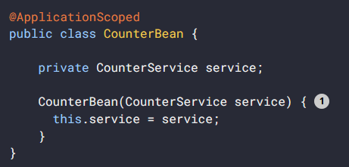
CDI
In GraalVM all relevant members must be registered for reflection explicitly.
Quarkus DI to access a private member it has to use reflection.
Encouraged not to use private members in their beans.

Slide 9
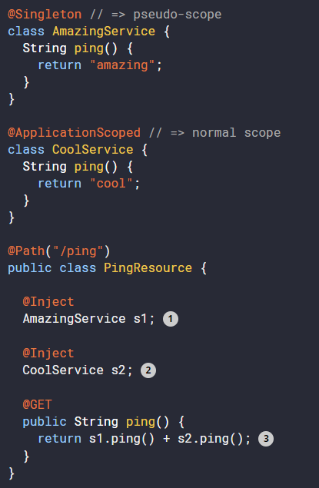
CDI
It tells the container which context to associate the bean instance with.
@Singleton
@Dependent
@ApplicationScoped
@RequestScoped
@SessionScoped

Slide 10
Configuration
Everything is in application.properties
quarkus.http.port=9090
#override for “dev” profile
%dev.quarkus.http.port=8181
Default profiles*
dev - Activated when in development
test - Activated when running tests
prod - Activated when not running in development or test mode
Custom profile
quarkus.http.port=9090
# set QUARKUS_PROFILE=staging
%staging.quarkus.http.port=9999

Slide 11
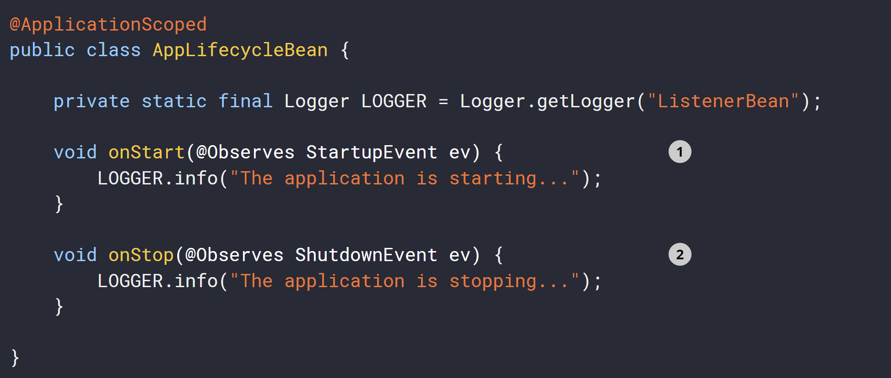
Application start and stop events

Slide 12
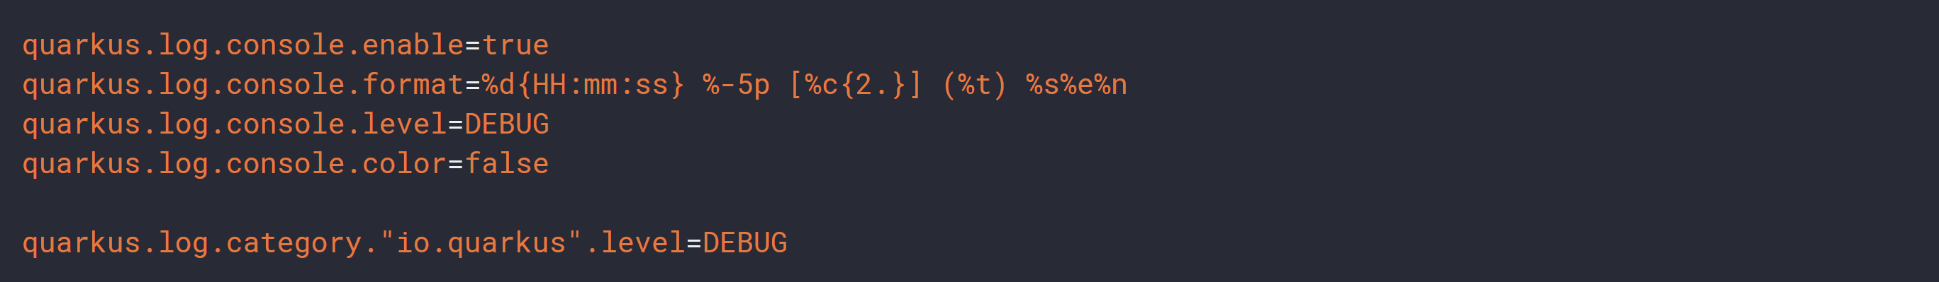
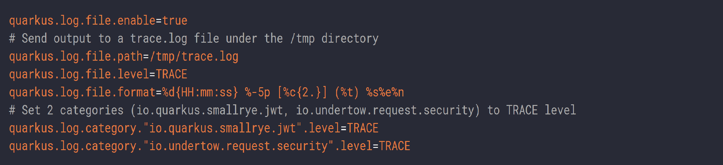
Configuring Logging
Console
File-based

Slide 13
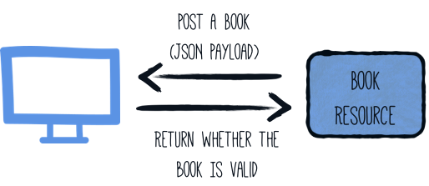
Validation

Slide 14
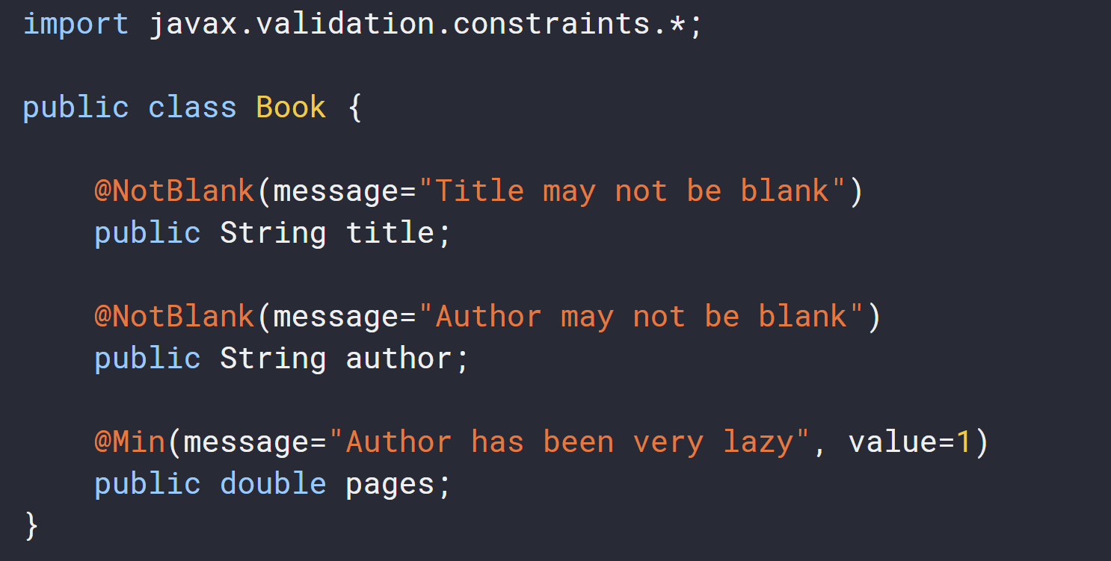
Validation
Model validation
Bean validation 2.0: JSR-380 (Hibernate validator)

Slide 15
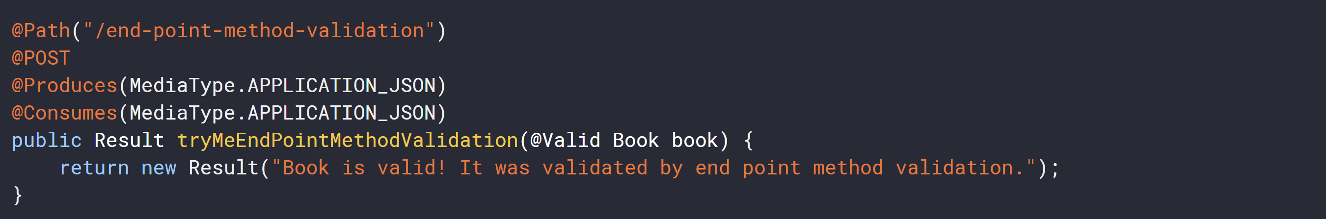
Validation
Validation on REST endpoint
When validation error, a violation report is generated and serialized as JSON

Slide 16
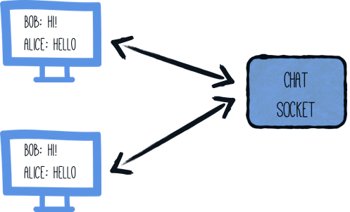
Websockets

Slide 17
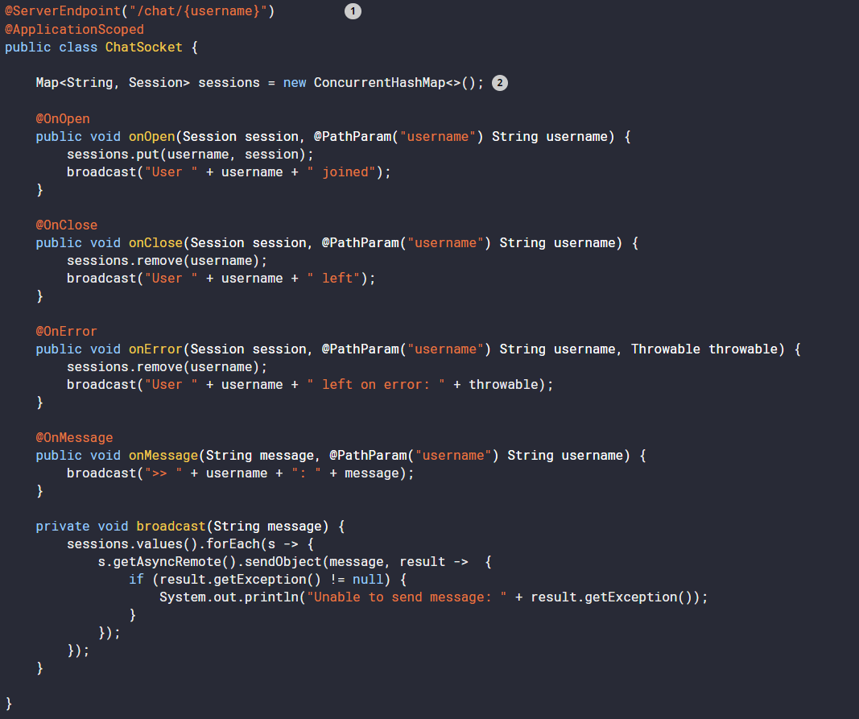
Websockets

Slide 18
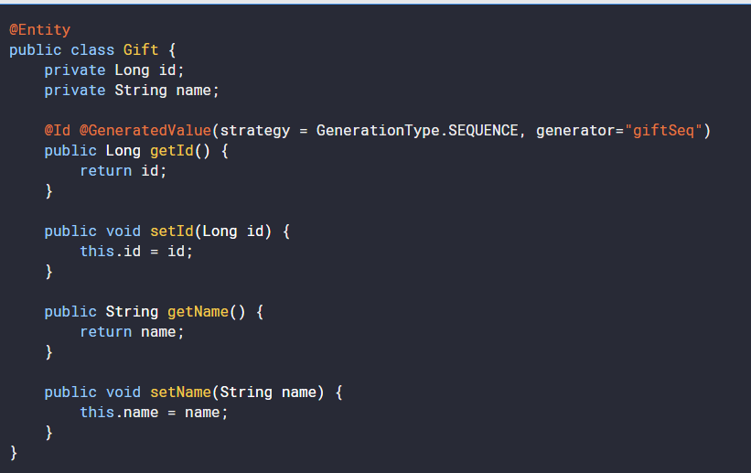
Persistency

Slide 19
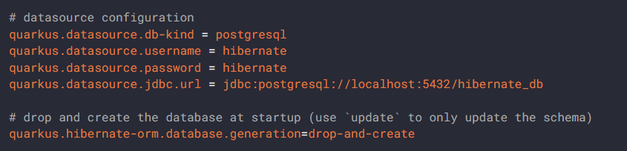
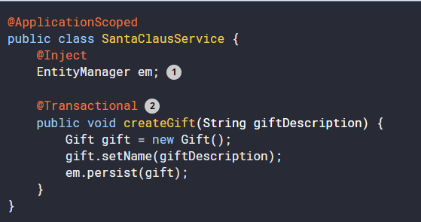
Persistency

Slide 20
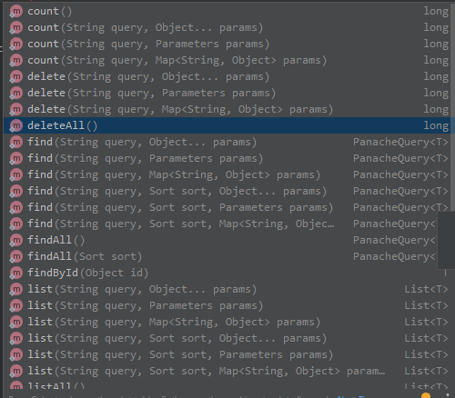
Improved persistency with Panache
@Entity public class Conference extends PanacheEntity { private String name; public String getName() { return name; } public void setName(final String name) { this.name = name; }
@Singleton public class ConferencePanacheRepository { public List<Conference> getAllConferences() { return Conference.listAll(); }
@Transactional public void save(final Conference conference) { conference.persist(); }

Slide 21
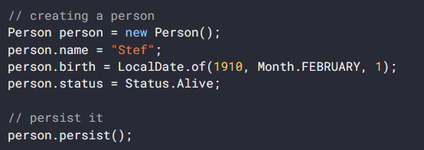
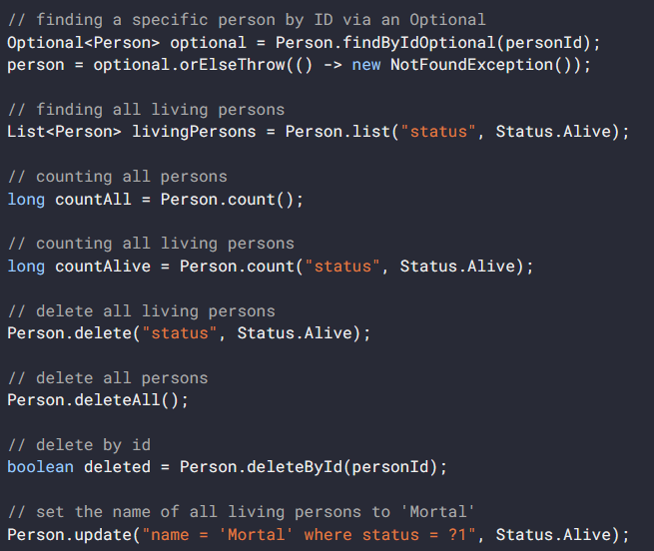
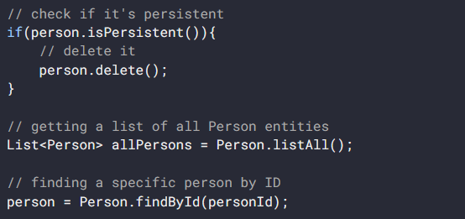
Improved persistency with Panache

Slide 22
Eclipse MicroProfile
https://microprofile.io/

Slide 23
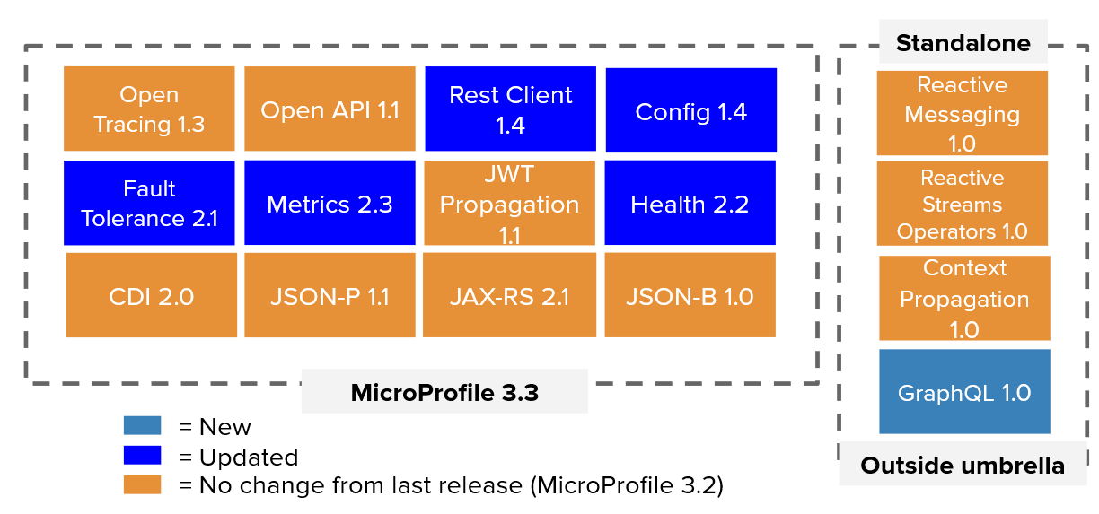
Eclipse MicroProfile Specification 3.3

Slide 24
Config
@ConfigProperty(name = "greeting.message")
String message;
application.properties
# Your configuration properties
greeting.message = hello
@ConfigProperties(prefix = "greeting")
public interface GreetingConfiguration {
@ConfigProperty(name = "message“, defaultValue=“john”)
String message();

Slide 25
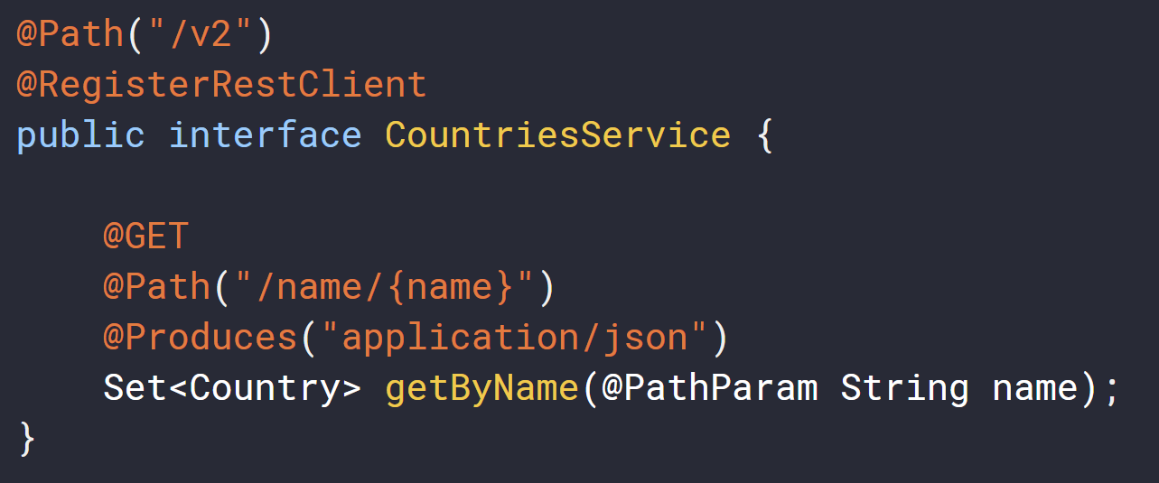
REST Client
# Your configuration properties
org.acme.restclient.CountriesService/mp-rest/url=https://restcountries.eu/rest
org.acme.restclient.CountriesService/mp-rest/scope=javax.inject.Singleton

Slide 26
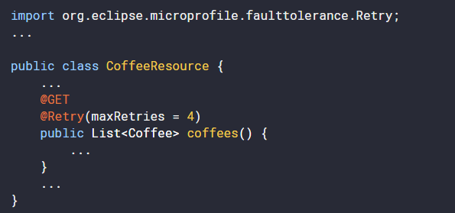
Fault Tolerance
Retry

Slide 27
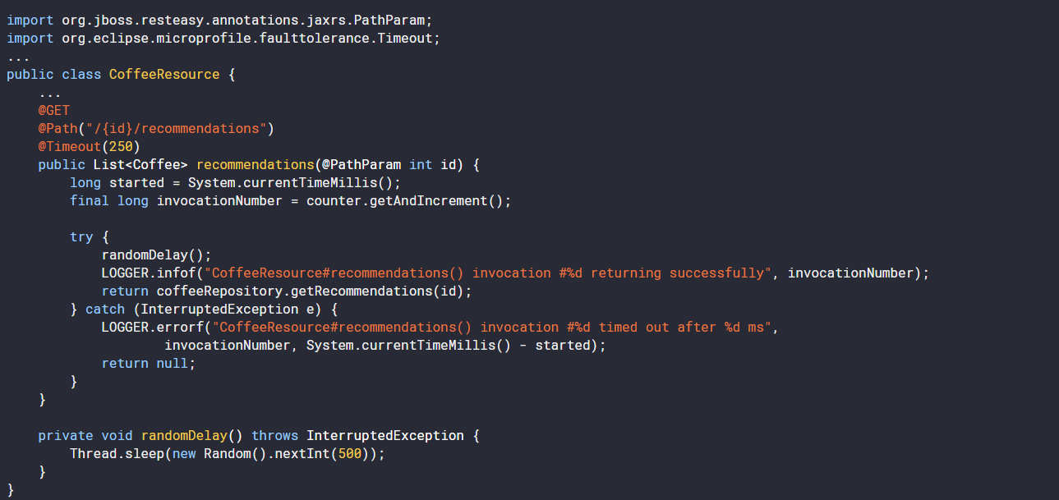
Fault Tolerance
Timeout

Slide 28
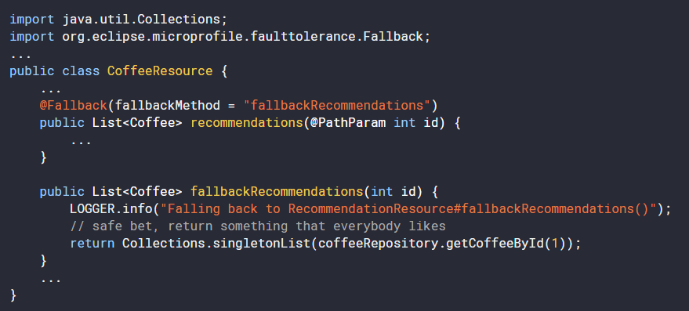
Fault Tolerance
Fallback

Slide 29
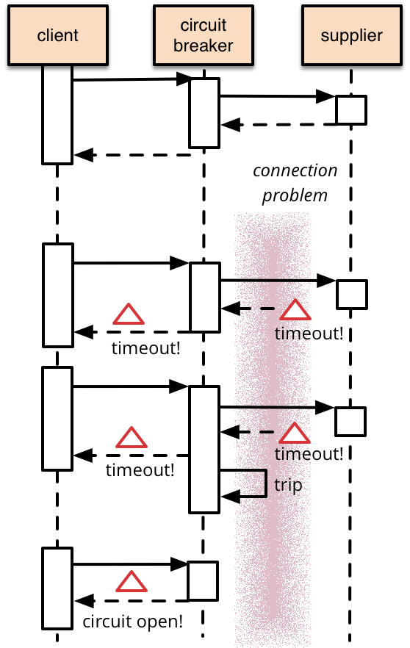
Fault Tolerance
Circuit breaker

Slide 30
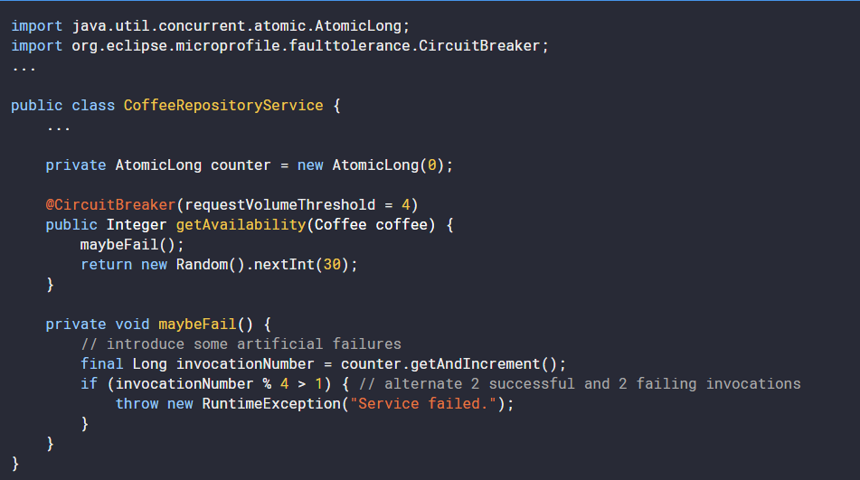
Fault Tolerance
Circuit breaker

Slide 31
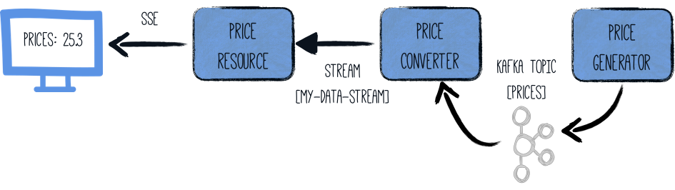
Reactive Messaging

Slide 32
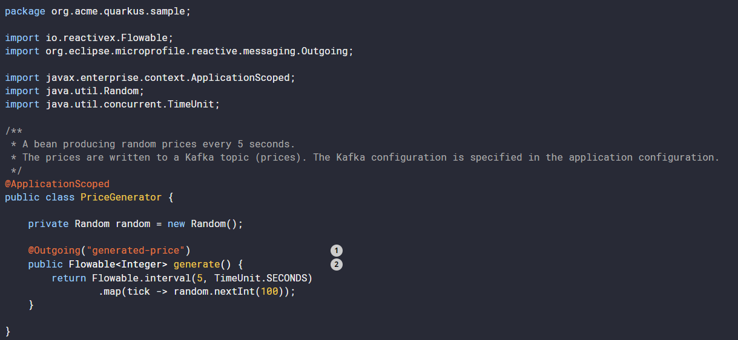
Reactive Messaging - Outgoing

Slide 33
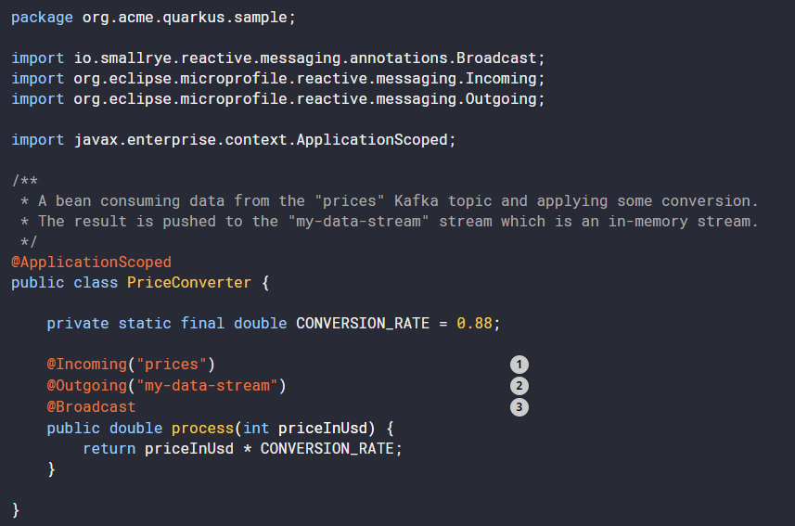
Reactive Messaging – Incoming

Slide 34
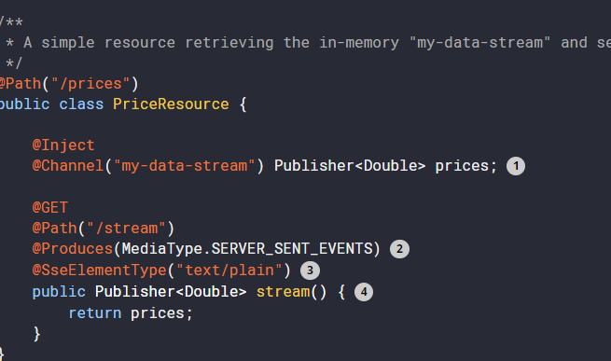
Reactive Messaging – Publisher

Slide 35
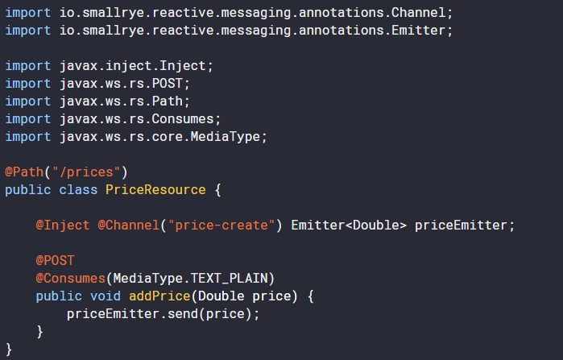
Reactive Messaging – Emitter

Slide 36
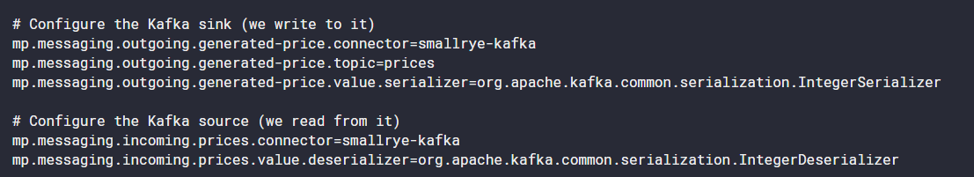
Reactive Messaging - Apache Kafka config

Slide 37
Health
Standard when importing smallrye-health dependency
/health/live - The application is up and running.
/health/ready - The application is ready to serve requests.
/health - Accumulating all health check procedures in the application.

Slide 38
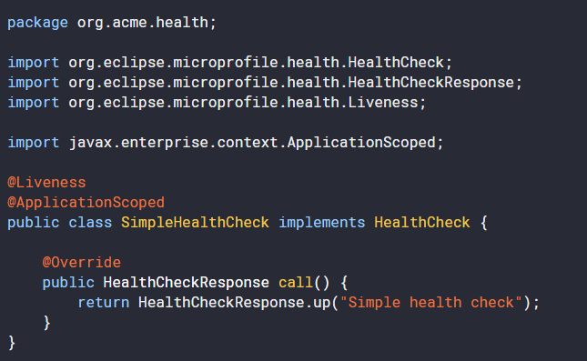
Health
Create your own health endpoint (shows up on health/live but not on health/ready)

Slide 39
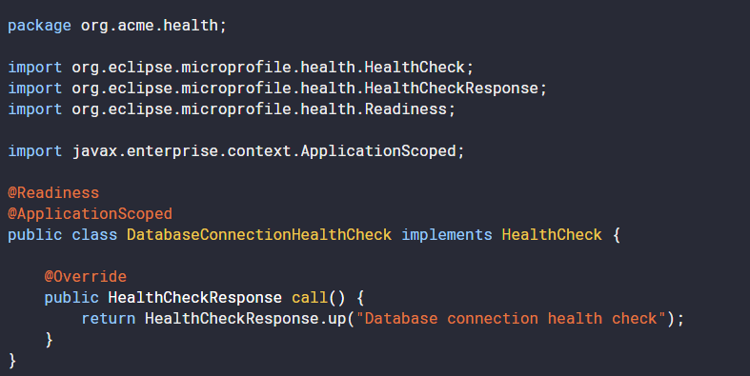
Health
Readiness Endpoint

Slide 40
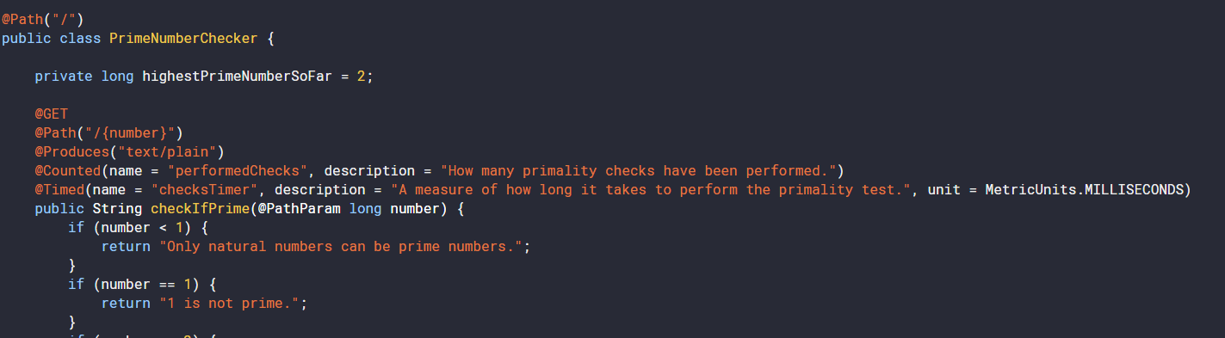
Metrics
Exposed on /metrics/application

Slide 41
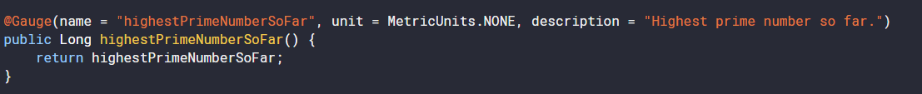
Metrics
Exposed on /metrics/application
Gauge – custom metric

Slide 42
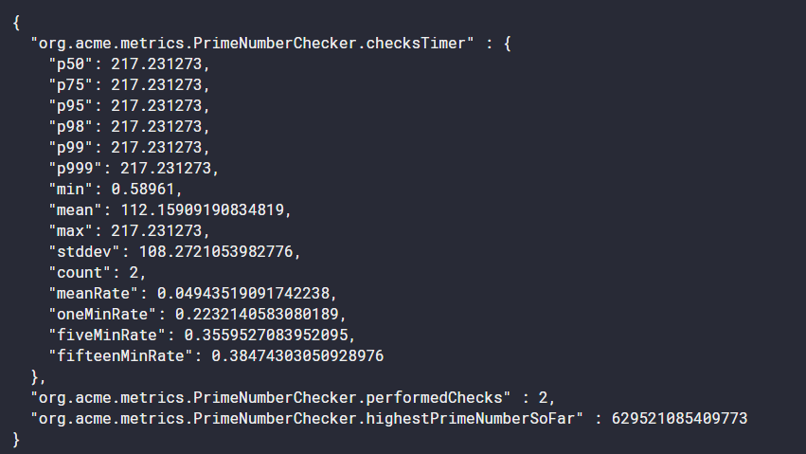
Metrics
http://localhost:8080/metrics/application

Slide 43
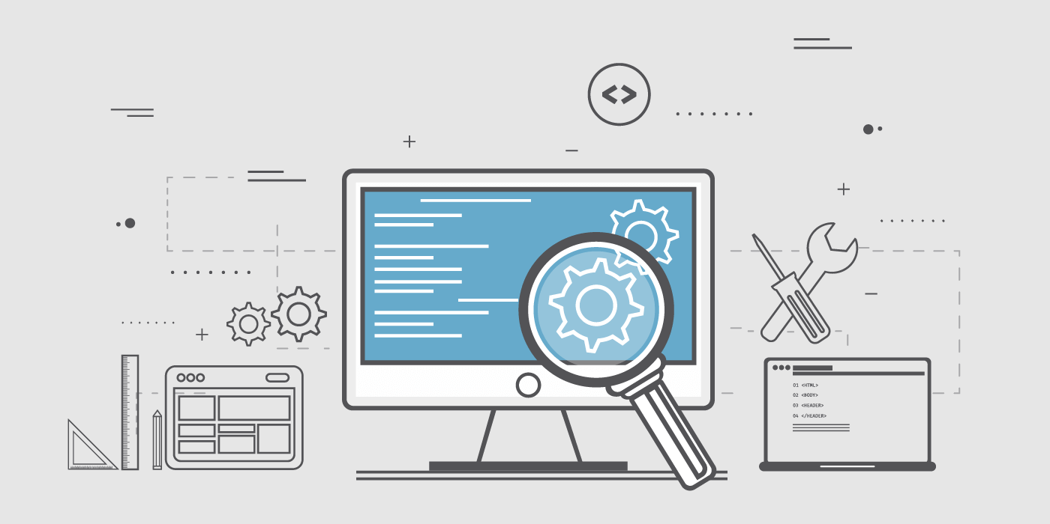
Testing

Slide 44
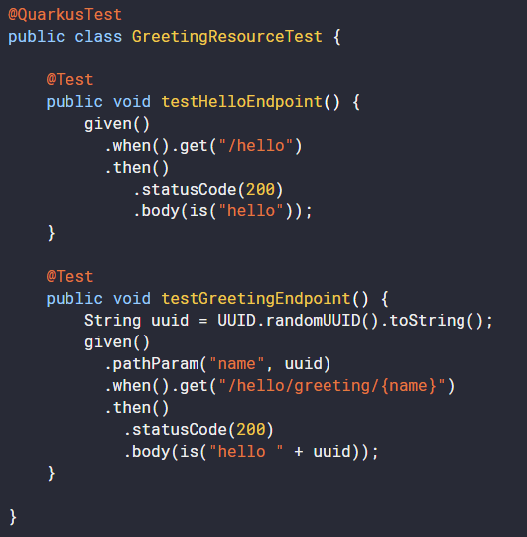
Testing
Spins up complete Quarkus application
Way faster than Spring Boot IT tests
application.properties
quarkus.http.test-port=xxxx / 0

Slide 45
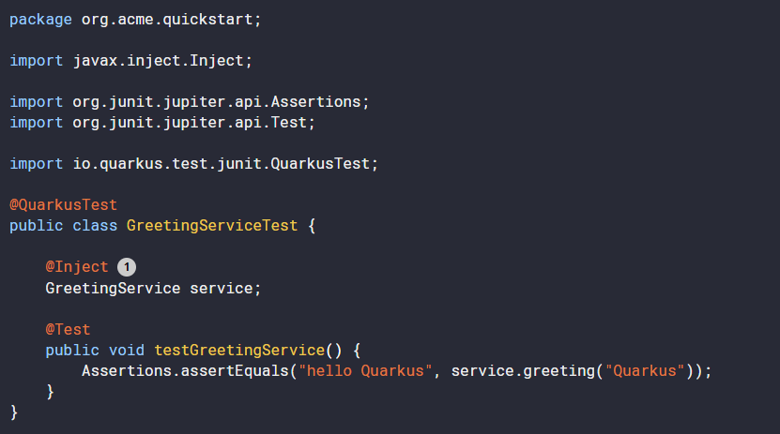
Testing
Injecting beans into your tests

Slide 46
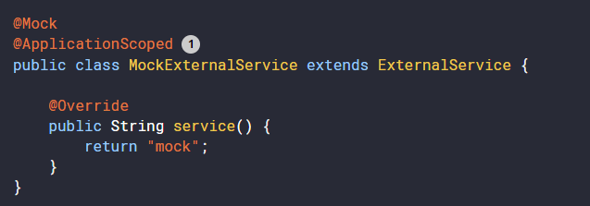
Testing
Mocking beans

Slide 47
Testing
Using helper resources
@QuarkusTestResource(TestResource.class) @QuarkusTest public class MyIntegrationTest {
public class TestResource implements QuarkusTestResourceLifecycleManager { @Override public Map<String, String> start() { } @Override public void stop() {
… } }
Start() returns a map of system properties that should be set

Slide 48

Building native images

Slide 49
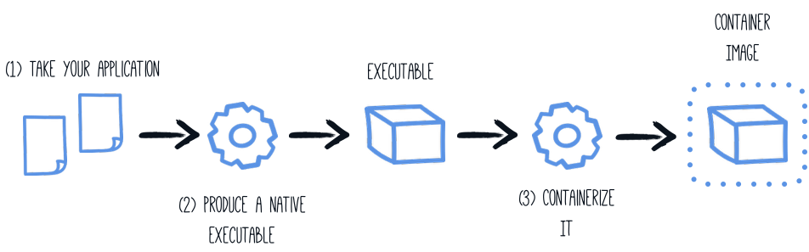
Building native images
2
./mvnw package -Pnative -Dquarkus.native.container-build=true
3
docker build -f src/main/docker/Dockerfile.native -t quarkus/myapp .
Run with:
docker run -i --rm -p 8080:8080 quarkus/myapp

Slide 50
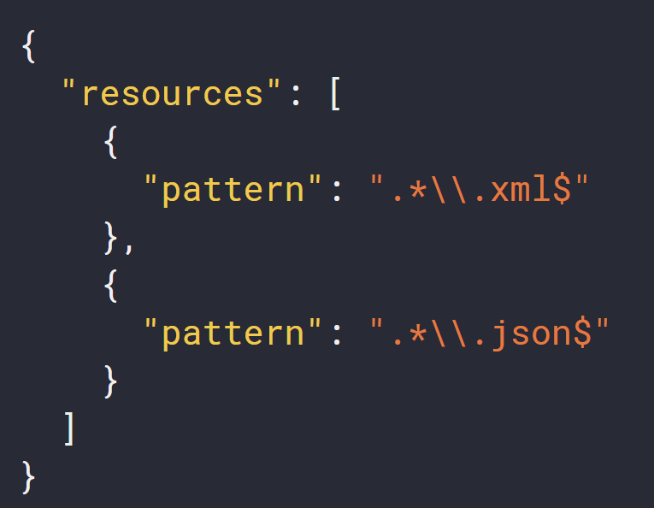
Building native images – including resources
src/main/resources/resource-config.json
application.properties
quarkus.native.additional-build-args =-H:ResourceConfigurationFiles=resources-config.json

Slide 51
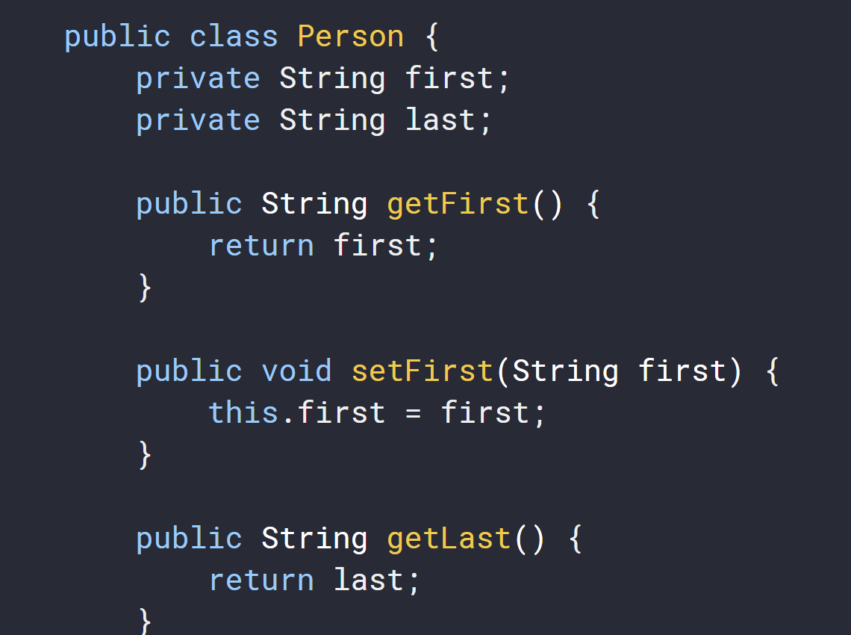
Building native images – register for reflection
GraalVM works on “closed-world” assumption

Slide 52
Building native images – register for reflection
Exception handling request to /person: org.jboss.resteasy.spi.UnhandledException: javax.json.bind.JsonbException: Can't create instance of a class: class org.acme.jsonb.Person, No default constructor found
Solution:
@RegisterForReflection
public class Person {
}

Slide 53

Assignment

