Slide 1
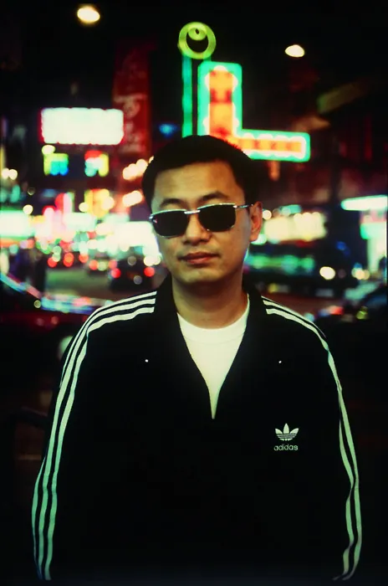
User Persona
Wong Kar-wai website

Slide 2
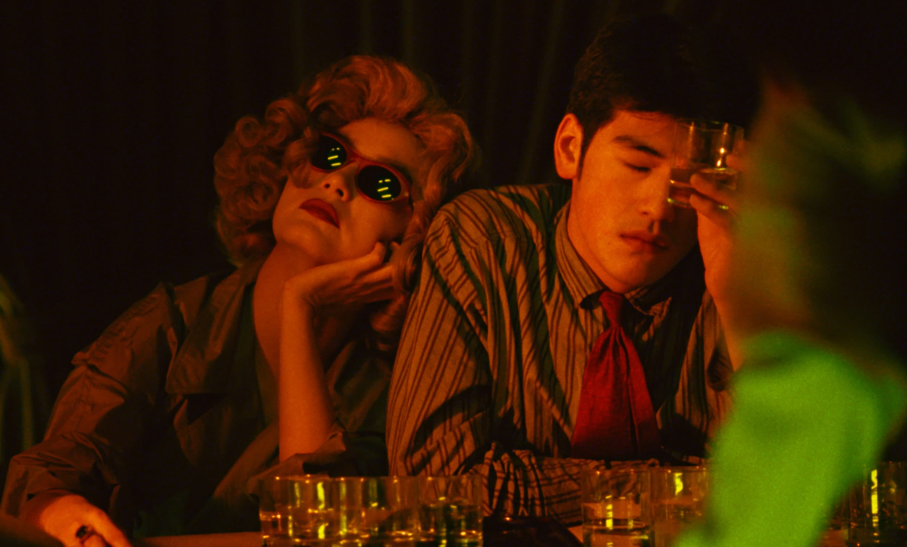
Typical User Persona
Personal Info
Affinities
- Has a passion for storytelling and unique narratives.
- Keeps up with the latest trends and developments in the film industry.
- Values the use of music and cinematography to create emotional impact.
- Has an interest in exploring different cultures and perspectives through films.
- Name: Wei Chen
- Age: 32
- Occupation: Filmmaker
- Location: Hong Kong
- Gender: Male
Values & Fears
Needs
- Seeks inspiration and learns from other renowned filmmakers and artists.
- Desires a platform to showcase and promote his films, creating a connection with potential collaborators, distributors, and fans.
- Requires a user-friendly website that effectively communicates his artistic style, filmography, and upcoming projects.
- Values creative freedom and expression in filmmaking.
- Seeks recognition and appreciation for his work.
- Fears losing his artistic vision or compromising his creative integrity.

Slide 3
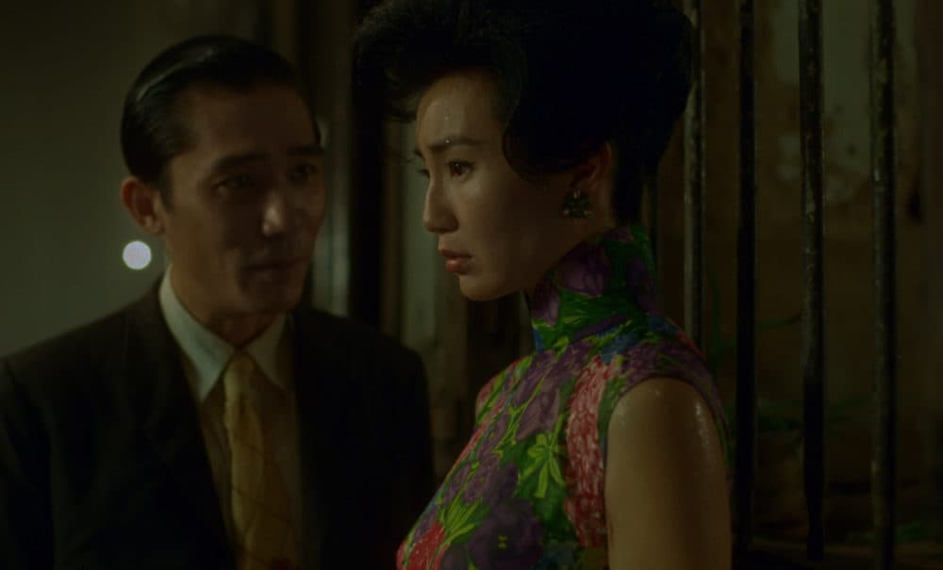
Atypical User Persona
Personality
Dislikes
- Dislikes traditional narrative structures and predictable storytelling.
- Isn't fond of films with excessive dialogue or exposition.
- Dislikes films that rely heavily on special effects or action sequences.
- Name: Lucas Rodriguez
- Age: 26
- Occupation: Software engineer
- Location: San Francisco
- Gender: Male
Goals
Frustrations
- Wants to explore non-linear storytelling and experimental approaches to filmmaking.
- Aims to incorporate distinctive visual aesthetics and atmospheric sound design in his films.
- Wishes to challenge conventional storytelling methods and push boundaries in the film industry.
- Disappointed by the lack of recognition and appreciation for unconventional and daring filmmaking styles.
- Frustrated by the challenges of finding collaboration opportunities and funding for his projects.

