Slide 1
Memory Leakage Detector for C Applications
Git Hub Project Link:
https://github.com/lazyswan/C-Memory-Leakage-Detector
Swanand Sapre

Slide 2
Features
Detects the Memory Leaks in any C-application.
Time Complexity: O(n)
Handles Abnormal Termination of Application as well as Normal Termination.

Slide 3
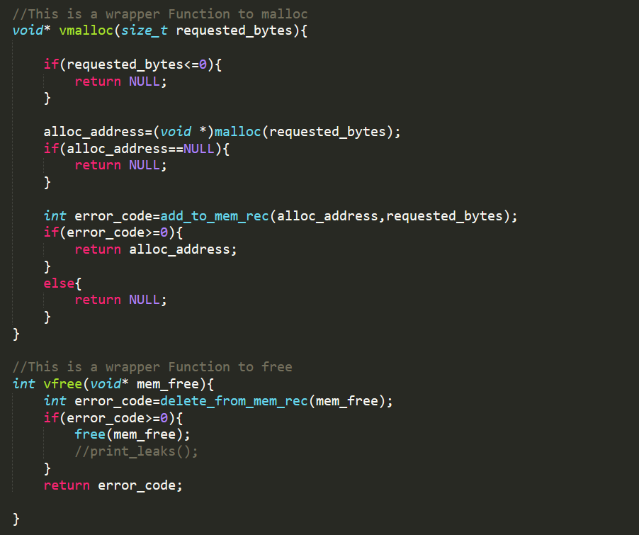
Wrapper Function to standard Malloc and Free
Calls

Slide 4
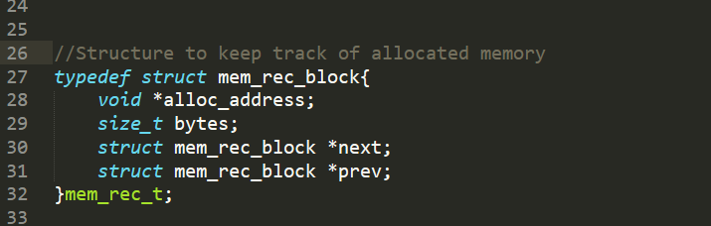
New Doubly Linked List based data structure to store the records of dynamically allocated memory.

Slide 5
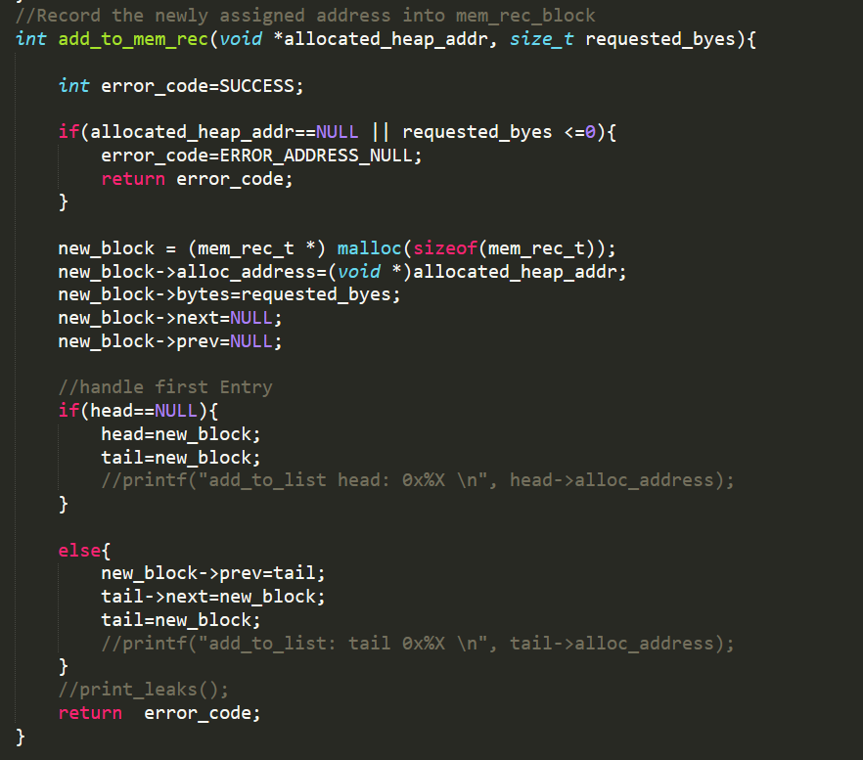
The vmalloc() wrapper function maintains the record of allocated heap memory using add_to_mem_rec() function

Slide 6
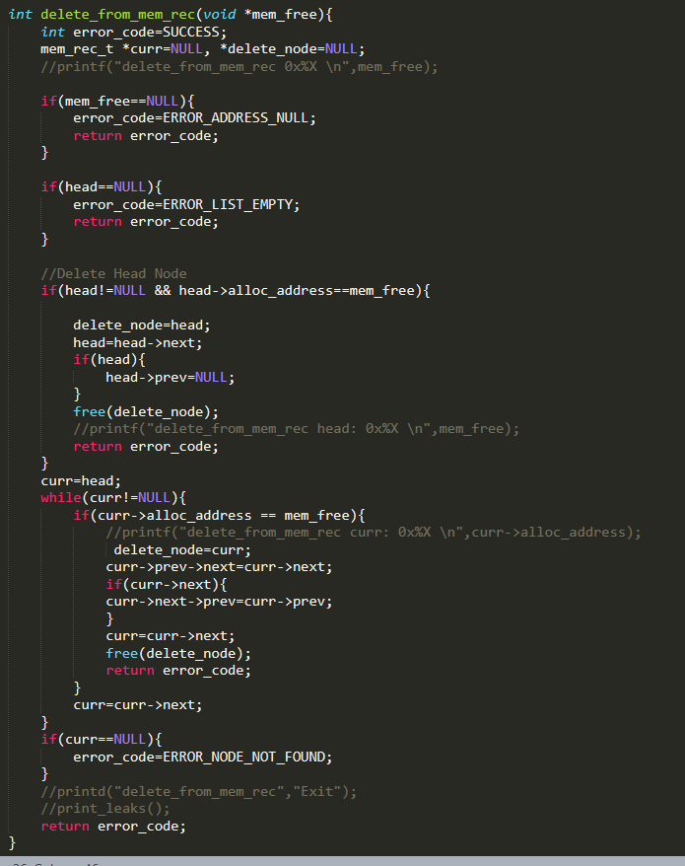
The vfree() wrapper function free the allocated heap memory as well as deletes the record from mem_rec list using delete_from_mem_rec() function

Slide 7
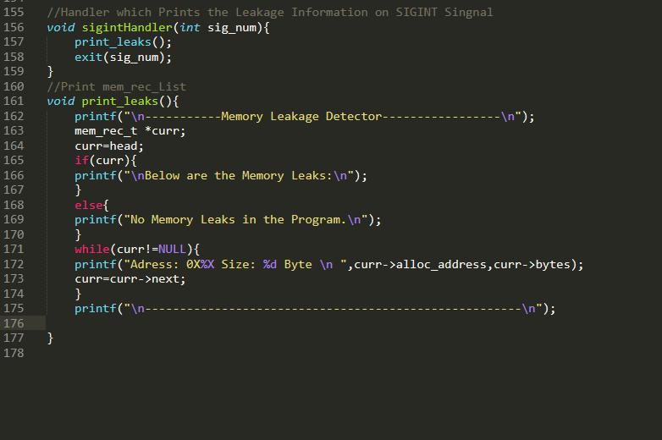
siginitHandler() is signal handler which handles the abnormal termination.
It prints the details of leak memory using print_leaks()
function

Slide 8
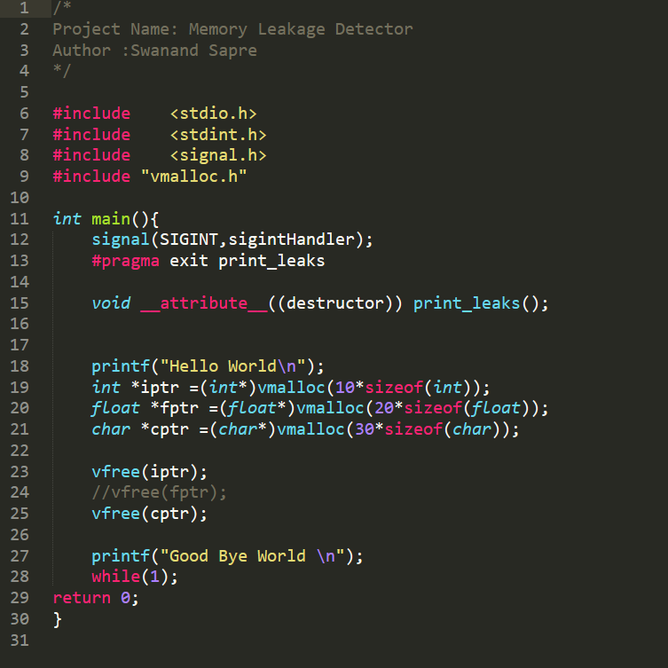
Main Function
#pragma exit print_leaks
Executes the print_leaks()
And displays the memory leaks during normal termination of application.

Slide 9
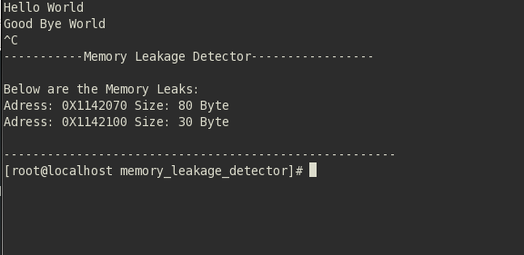
OUTPUT

