Slide 1
Attempt to Design a Real Time Operating System
Github Link for the Project:
https://github.com/lazyswan/Kernel_Components
Swanand Sapre
scsapre@gmail.com
669-226-7772

Slide 2
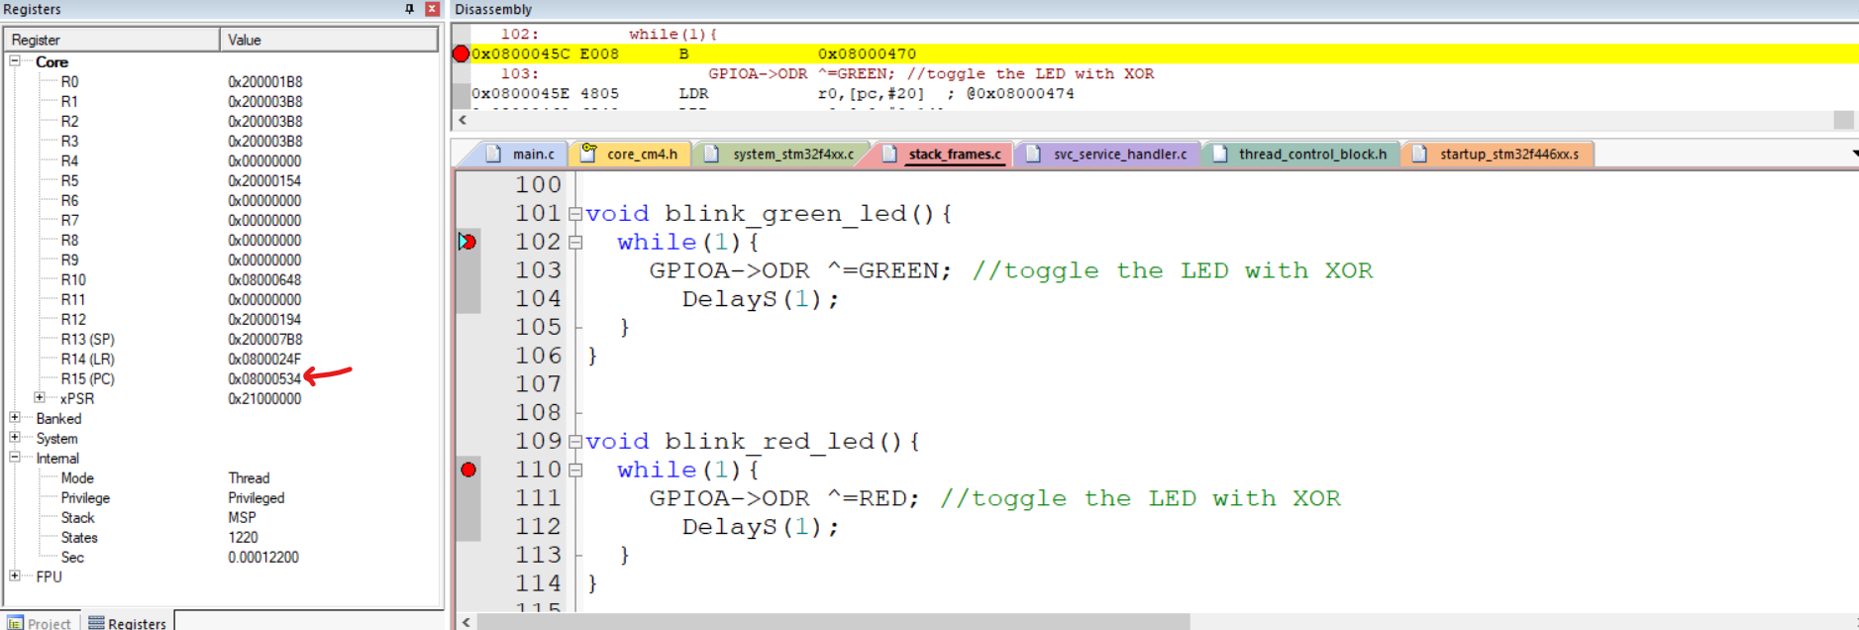
crappy way of task-switch
Address of Thread blink_green_led() : 0x0800045C
Address of Thread blink_red_led() : 0x08000478
Load PC with one of this address to perform switch,
But its not context switch, since we are not switching context(registers) just the PC and program might crash.

Slide 3
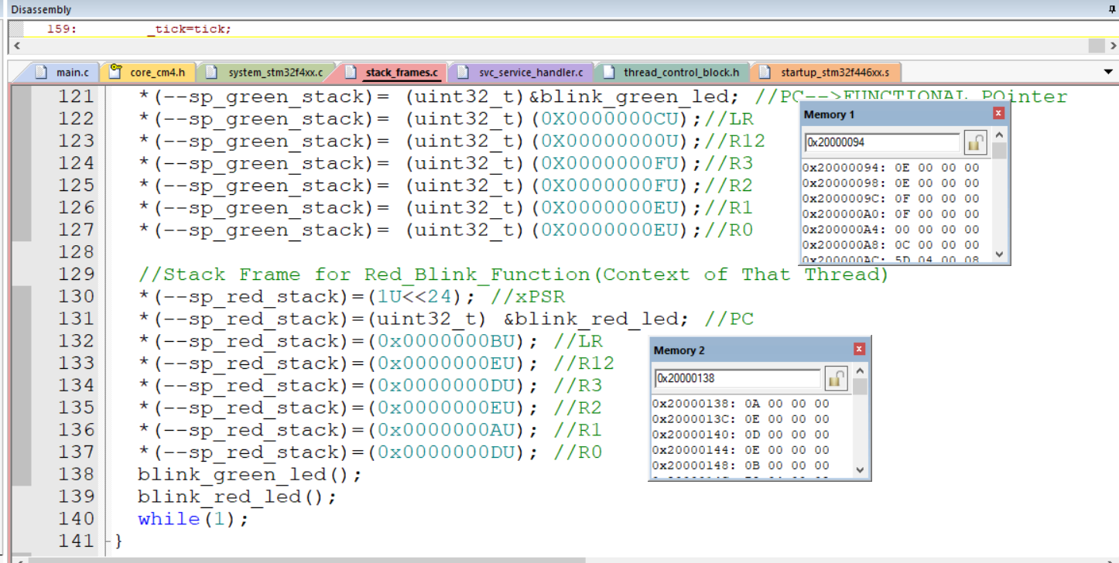
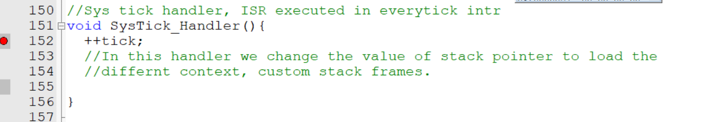
Initialising Stack Frames and changing SP in ISR_handler

Slide 4
Building Kernel internals__ Simple kernel with just 3 threads .
Supported Features:
3 Threads.
Round Robin Scheduler.
Task Yield Functionality to support Co-operative Scheduling
Semaphore.
Cooperative Semaphore.

Slide 5
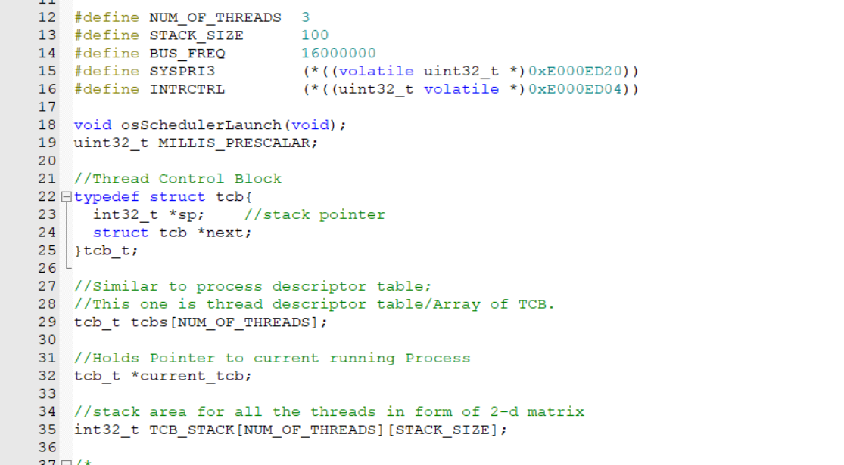
Thread Control Block

Slide 6
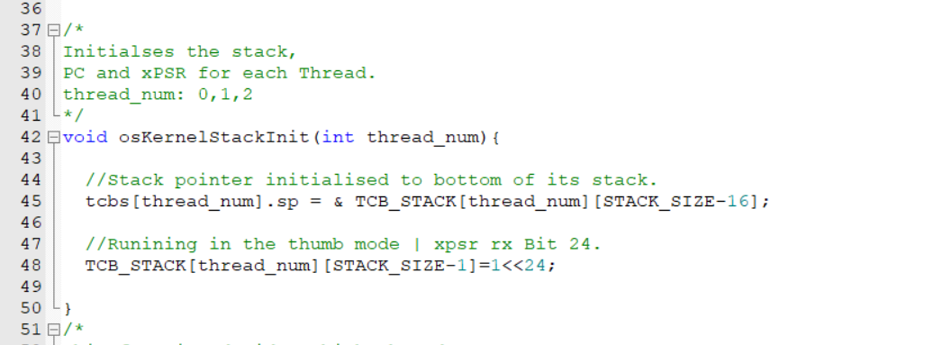
kernel stack init

Slide 7
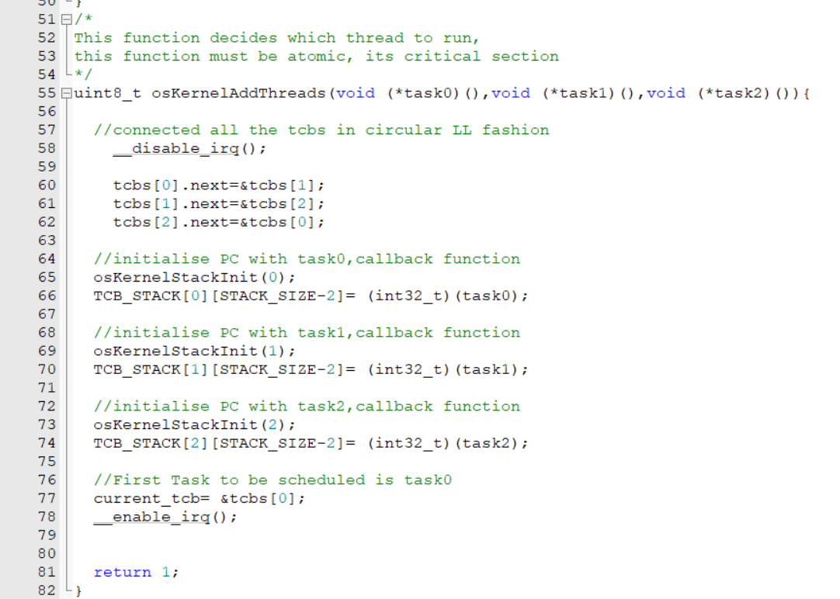
Creating Threads

Slide 8
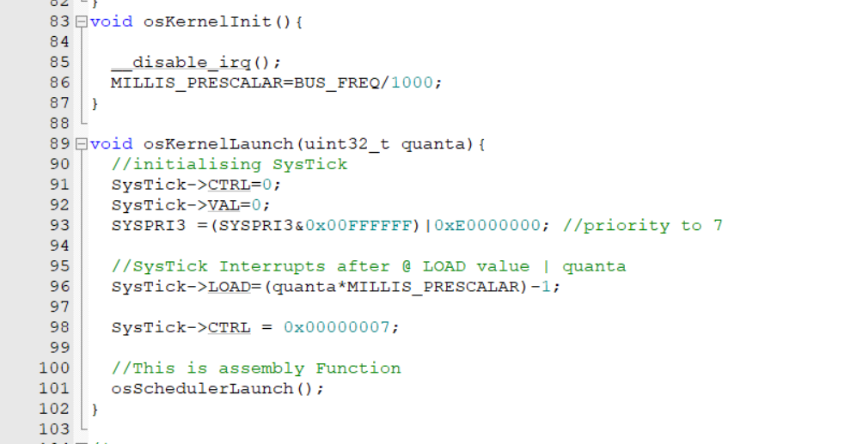
Kernel launch

Slide 9
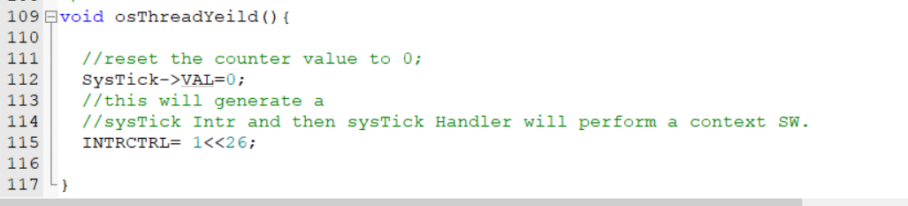
Task YEILD

Slide 10
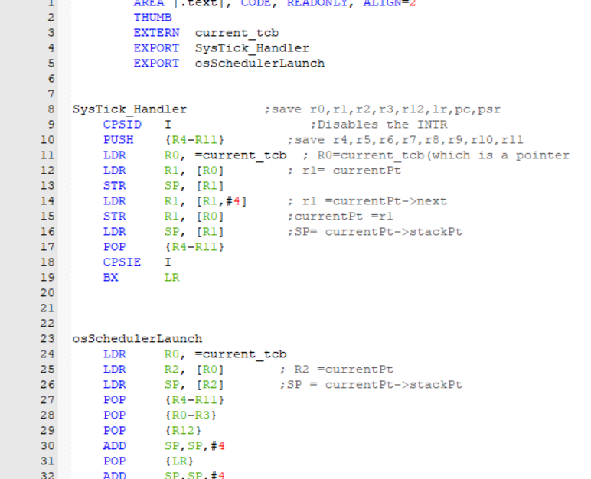
Assembly code

Slide 11
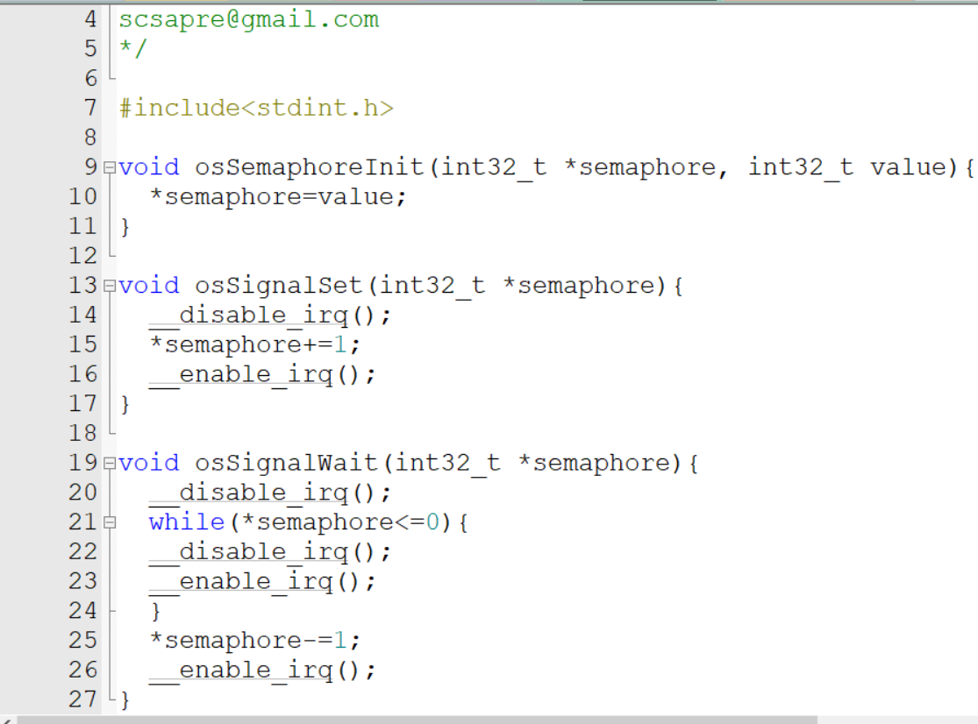
SEMAPHORE

Slide 12
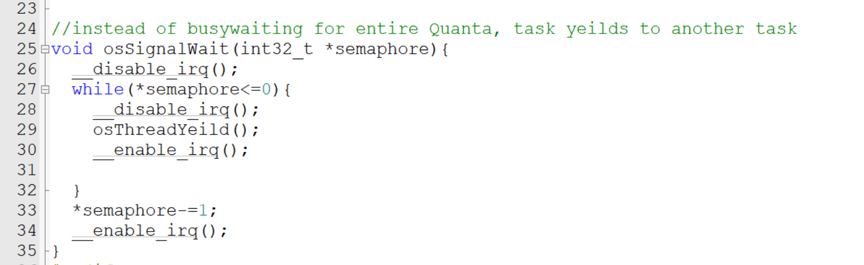
COOPERATIVE SEM

Slide 13
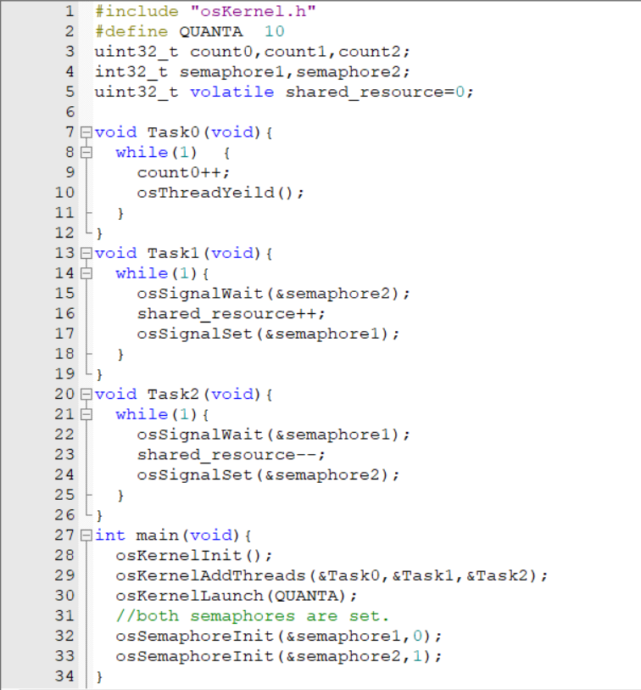
Main Function

Slide 14
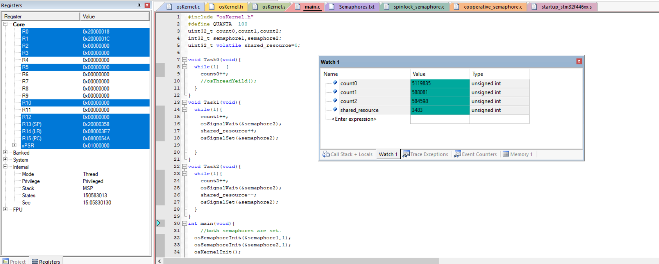
output

Slide 15
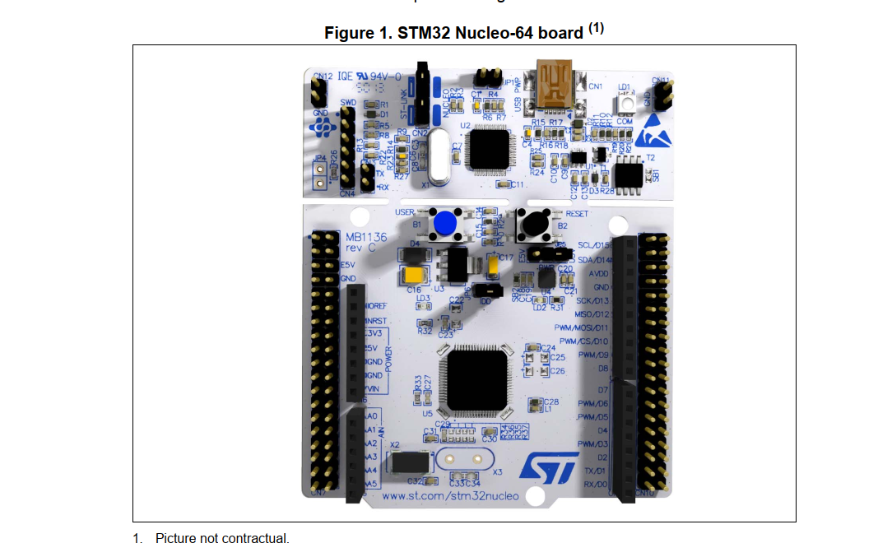
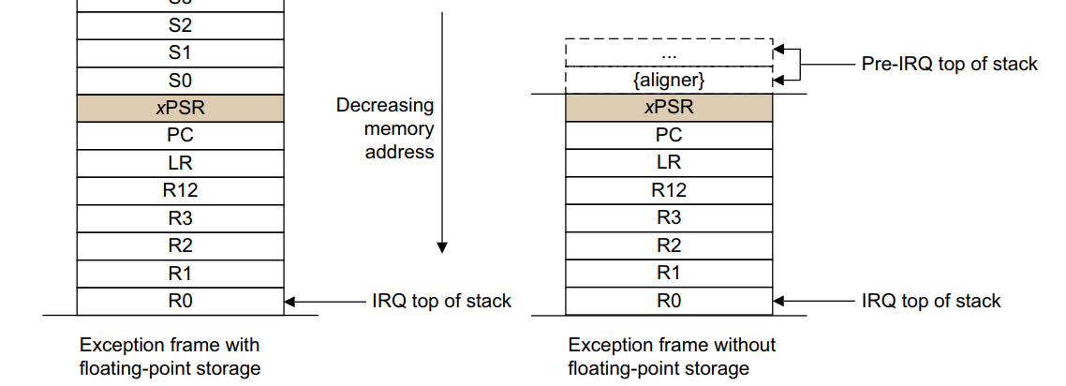
References

