Slide 1
Pipeline for Object Segmentation, Text Extraction, and Summarization
Aditya Sharma mail2sharma.aditya@gmail.com

Slide 2
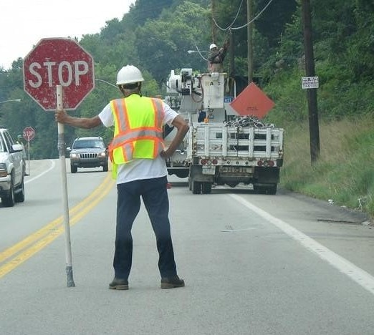
Project Overview
Objective: Segment objects in images, extract text data, generate summaries, and produce a ﬁnal annotated report.
Key Steps:
Image Segmentation Object Identiﬁcation
Text Extraction using OCR Summarization using AI
Final Report Generation

Slide 3
Technology Stack
Python Libraries:
streamlit pillow
opencv-python tensorﬂow
tensorﬂow_hub matplotlib pandas requests
numpy
python-docx
pytesseract replicate
Frameworks and Tools:
TensorFlow Hub: Pre-trained COCO2017 Faster R-CNN for Image Segmentation.
Tesseract OCR: For text extraction with Otsu's preprocessing.
Salesforce BLIP (via Replicate API): For image summarization and description
Streamlit: For Frontend UI and project demonstration.

Slide 4
Implementation Steps
Step 1: Image Segmentation Segmented and
USED -
Identify objects within the image and saved them as individual images.
faster_rcnn/inception_resnet_v2
Step 2: Text Extraction Used Tesseract to extract textual information from segmented objects.
Tesseract OCR
Step 3: Summarization and Mapping Generated descriptions for objects using the Salesforce BLIP model.
Salesforce BLIP
Step 4: Final Report Created a visual summary with annotated images and a data table

Slide 5
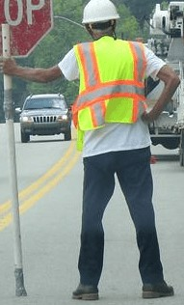
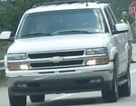
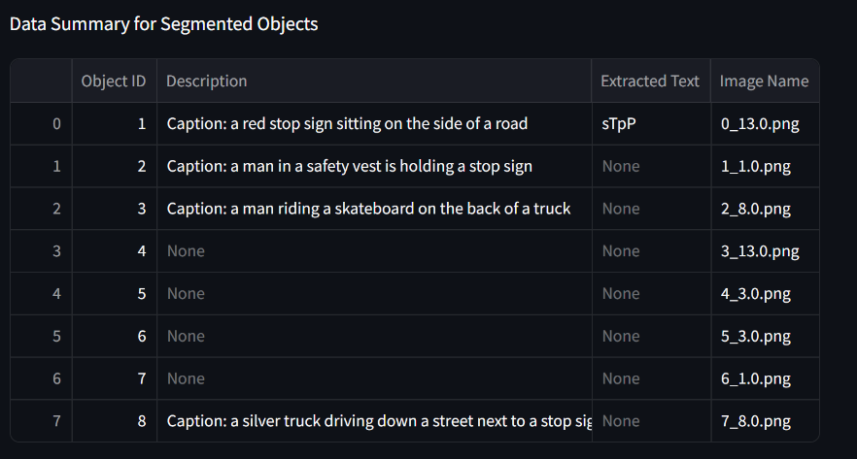
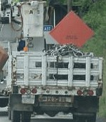
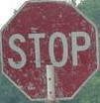
Results and Final Output
Example Segmented Images:
Output Table:
NOTE: Ran DESCRIPTION model for only Image 1,2,3,8 and EXTRACTION model for Image 1 only.

