Slide 1
Knapsacks COSC 320: Project 3
By:
Lela Bones

Slide 2



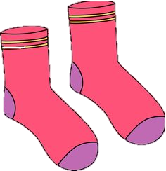
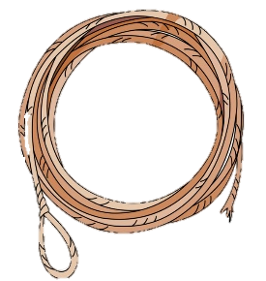


What is it?

Slide 3
More About Knapsacks
1897 Tobias Dantzig
Knapsack 0-1
Bounded Knapsack
Unbounded Knapsack

Slide 4



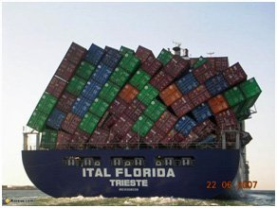
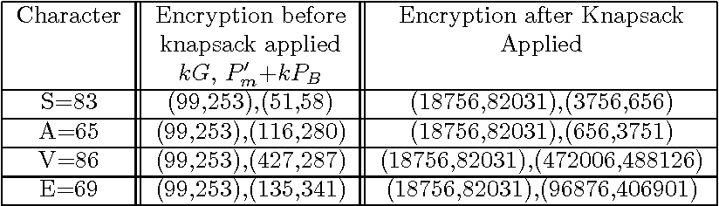
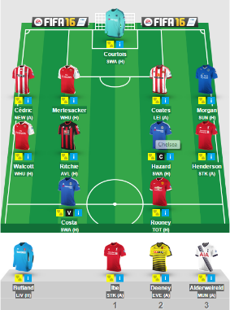
Real World Applications
Packing for trips
Loading cargo ships
Encrypting messages
Choosing fantasy sport teams

Slide 5
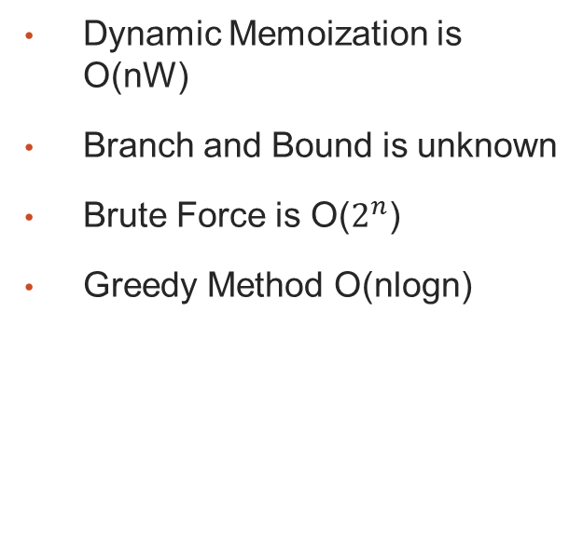
Approaches
Time Complexities
Dynamic Memoization is O(nW)
Branch and Bound is unknown
Brute Force is O($2^{n}$)
Greedy Method O(nlogn)

Slide 6
My Solution
Dynamic Memoization
Bottom-Up Approach
Solves for smaller Knapsacks
Stores solutions in hash table

Slide 7
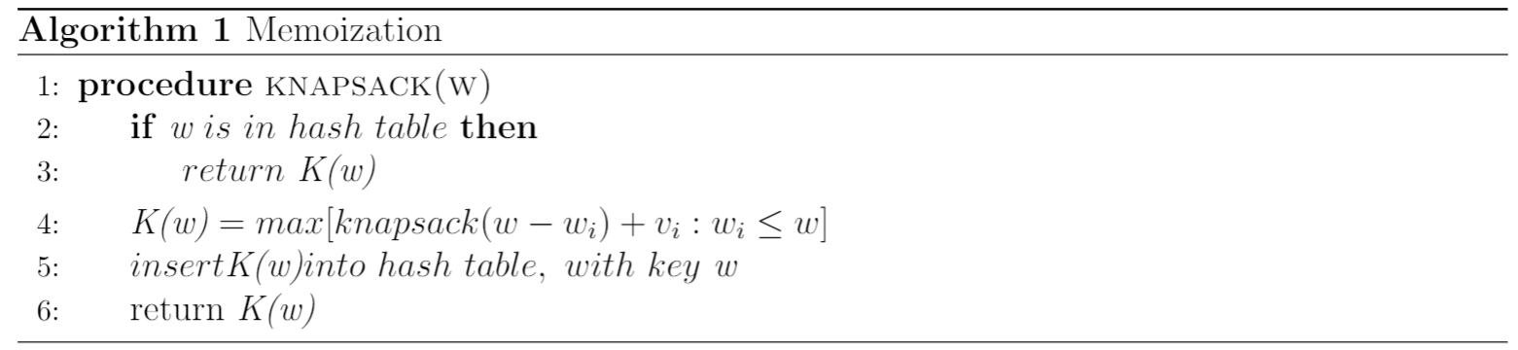
Pseudo Code

Slide 8
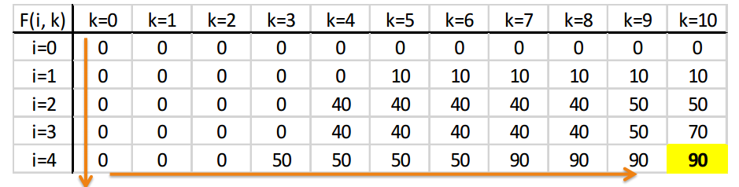
Hash Table

Slide 9
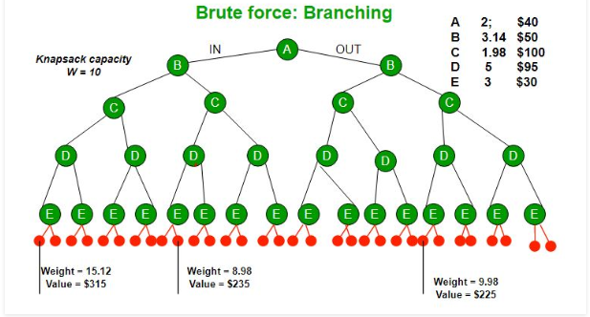

Slide 10
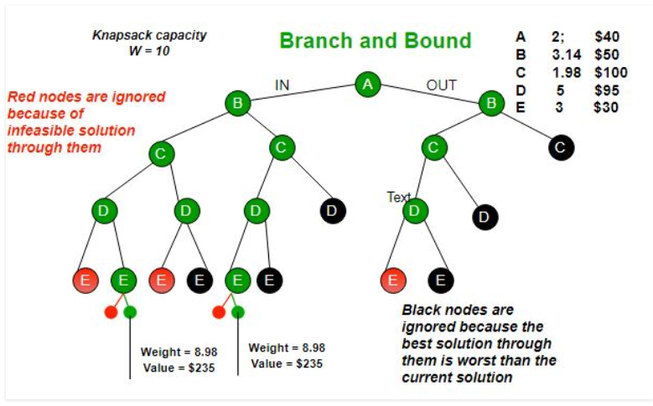

Slide 11
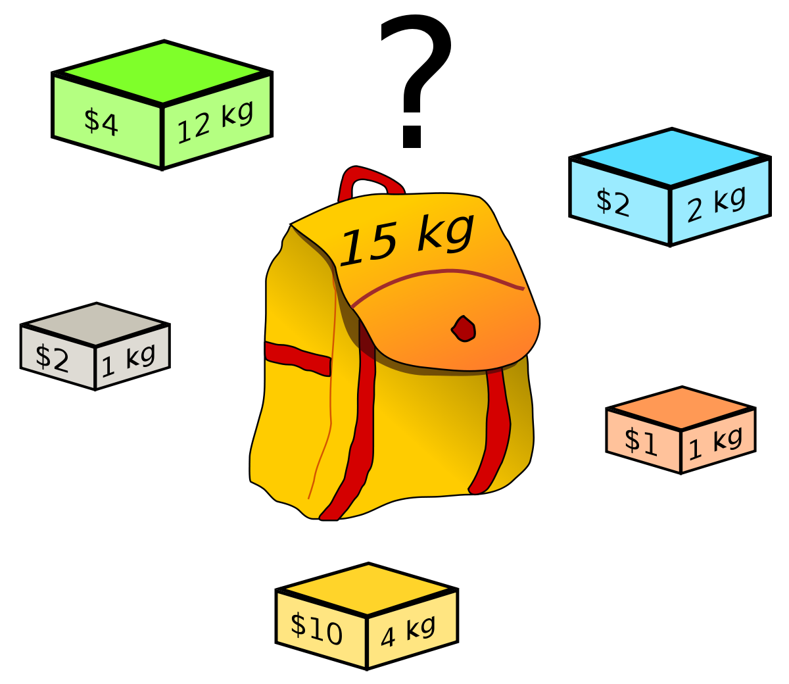

Slide 12
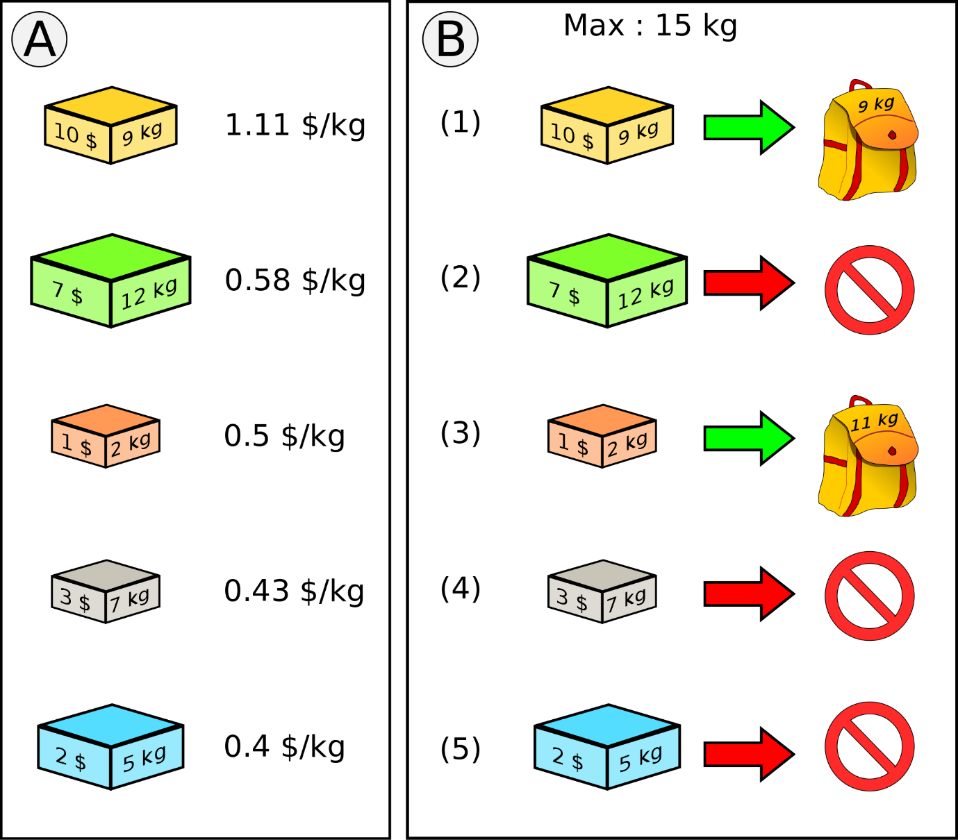


Slide 13
Fun Facts
There is a hidden DAG in the table and the solution to the knapsack problem is the longest path in the DAG
Memoization beats other forms of dynamic programming because it doesn’t solve every possible option

Slide 14

The End

