Slide 1
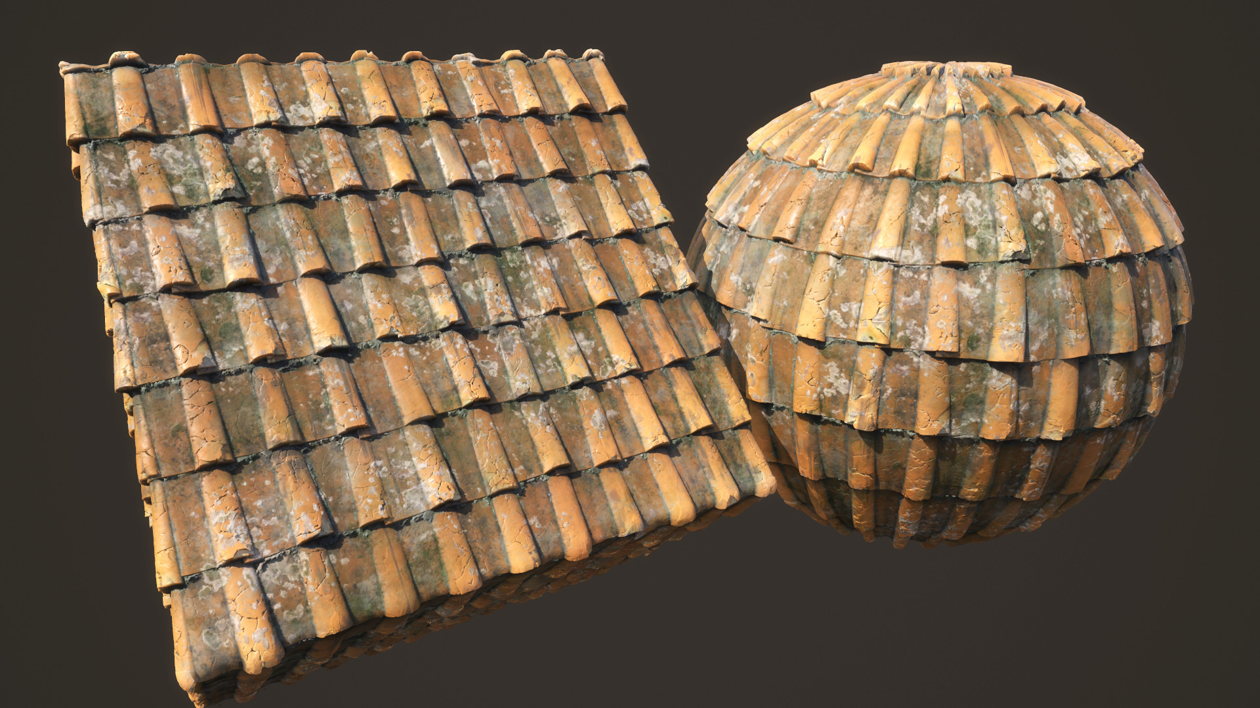

Material Designer
by Lasantha M Senanayake

