Slide 1

Computing for, in, and of the Humanities
an Oxford perspective
Definitions
A Parochial View
The Big Picture
Towards a theory...
http://info.ox.ac.uk/oucs/humanities/

Slide 2
Some definitions of Humanities Computing
How do we validate what is done in its name?
HC has no theory
HC is a set of methodologies
HC is an accident of history and funding policies
HC is a renaissance art

Slide 3
My rewriting of history
HC was an empirical response to the existence of the "two cultures"
It still has to serve traditional academic goals
  sharing and exchange of information
  creation of reusable resources
  improvement of pedagogic practice
  preservation of cultural values
… or perish

Slide 4
What has HC been?
concordancing, indexing, lexical analysis...
mechanistic determination of style, authorship etc.
word-processing in funny fonts
changing modalities:

Slide 5
IT usage
email etc.
a lot
teaching
some
research
none
time
1960
1970
1980
1990

Slide 6
What HC has tended to define itself against
computational linguistics/ AI/ NLP
database analysis, information retrieval
computer science
applications of IT in the creative arts
mathematical modelling
sociological/statistical approaches
word processing, CALL

Slide 7
Some tensions in HC
evangelism vs. relevance
technology pull vs. pedagogic push
expectation vs. reality
discipline vs. profession

Slide 8
What HC offers
a means of communication
support for a fragmented, nonlinear, decentred, view of text and textuality
a new perspective on how language works
a neutral medium for description, distribution, and analysis of all kinds of artefact

Slide 9
a parochial view

Slide 10

Humanities Computing at Oxford
a strange planet...
  sciences and arts differ in their organization
University IT strategy
  distribute computing to the desktop
  centralise some core services
  where does support go?

Slide 11
Technical support in the humanities
low level/generic
  college based (if you're lucky)
  faculty based (increasingly)
  centrally (decreasingly)
high level/discipline-specific
  should be faculty based
  but this is often economically infeasible

Slide 12
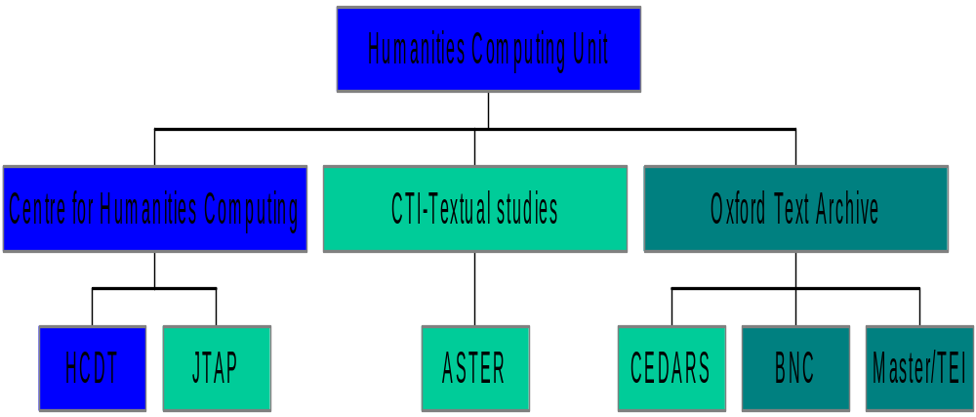
Committee for Computing in the Arts
External funders and collaborators

Slide 13
Centre for Humanities Computing
3 FTEs
a local focus of expertise
equipment, resources, publications
integrated (faculty-based) courses and course components
training days, seminars, faculty visits
home for distributed IT support staff
http://info.ox.ac.uk/oucs/humanities/chcindex.html

Slide 14
Humanities Computing Development Team
3 FTEs
application development for specific projects
balance between teaching and research
development as a partnership
must become self-funding
http://www.oucs.ox.ac.uk/hcdt

Slide 15
CTI Centre for Textual Studies
3 FTEs
promoting and training in pedagogic uses of IT
one of eleven national discipline-based centres
publications, workshops and conferences, site visits...
http://info.ox.ac.uk/ctitext

Slide 16
Oxford Text Archive
3 FTEs
one of six national centres making up the Arts and Humanities Data Service
  resource provision
  resource description and discovery
  resource conservation
  Guides to good practice
http://ota.ahds.ac.uk

Slide 17
Current research foci
varieties of the digital library...
  Virtual Seminars for Teaching Literature
  British National Corpus
… and their exploitation
  Aster
  CEDARS
  Master

Slide 18
Consciousness raising
training
  specialist courses
  training days, seminars, workshops
  faculty-based prolegomena
  guest lectures
outreach
  One day colloquia (Beyond…)
  Text Encoding Summer School (97,98...)
  DRH conferences (96,97)
  TALC conference (98)

Slide 19
Our solutions
working together
  cross fertilization
  mutual support
an infrastructure for support and training
joint appointments that distribute expertise to the desktop
research projects that advance our understanding

Slide 20
the big picture

Slide 21
Digital resources in the UK
report of an AHDS-commissioned survey of “user needs” in the Humanities (Greenstein & Porter, 1998)
derived from series of UK-wide workshops and consultations
  perceived opportunities
  perceived obstacles
  recommendations
http://ahds.ac.uk

Slide 22
Perceived opportunities
accessibility
  multi-user, multi-site
  implications for distance learning
heritage and preservation
multi-media capabilities
  integration and innovation
improved analytic methods

Slide 23
Perceived obstacles
lack of coherent infrastructure
ignorance and confusion
lack of coherent training and awareness
lack of professional recognition

Slide 24
Recommendations (1)
Cross-sectoral co-ordination
  integration at point of delivery
  standardization in production
  inter-operability of resources and of resource discovery
User-driven production
  implies need for...

Slide 25
Recommendations (2)
training and awareness
  as a part of institutional strategies
  co-ordination of training materials
  cross-sectoral but discipline-specific (eg "subject gateways")
some specific problem areas
  funding sources
  project management
  legal and social issues
  data creation best practice

Slide 26
Recommendations (3)
Professionalization
  encourage recognition of value and quality of digital resources
  encourage take up of standards
  involve learned and professional societies
and much more besides!

Slide 27
Strategic directions for HC
integration
  subject-focussed training
  collaborative research
evaluation
  development of effective metrics
standardization
  in resource production, delivery, preservation, and discovery

Slide 28
towards a theory

Slide 29
The dyers hand effect
Technology is not neutral: it affects our view of the achievable
Quantitative changes approximate to qualitative effects
Two examples:
  a new view of language
  a new way of doing hermeneutics

Slide 30
Corpus linguistics
the formal study of language-in-use
  patterns of lexis -- and other linguistic phenomena
a no-longer emergent discipline
  "not a branch of linguistics: but a route into linguistics" (Hoey)
unthinkable without computers!

Slide 31
Corpus linguistics
provides new kinds of evidence
not limited by individual intuition
of particular value in lexicography, and language learning
  we are all language learners
pragmatic, but not devoid of theory

Slide 32
What will be the effects of widespread digitization?
new kinds of evidence
continuing trends
  more, and more varied, readers
  more, and more varied, resources
  cultural sensitivities, decanonization
convergence of media

Slide 33
Training for the digital age?
Major components of existing humanities masters:
  methodological issues
  hermeneutic issues
    culminating in the critical edition

Slide 34
at present….
humanities computing squeezes into the methodological component
digitization is undertaken piecemeal and uninformed by theory

Slide 35
towards the uncritical edition
the insights of critical editing/edition philology need to be re-discovered and re-applied in a new context
A fruitful synergy
  semiotics
  textuality
  hermeneutics

Slide 36
Some qualititative differences in our interactions with digital resources (1)
decentred, non-linear, fragmented, and associative modes of cognition are favoured
differences of scale

Slide 37
Some qualititative differences in our interactions with digital resources (2)
statistical apprehension of decontextualized language use
plasticity of format and presentation

Slide 38
Cultural objects (are those which) require an explication
resources are invested with meaning by our use of them
explication confers value
we need to interpret interpretations more than to interpret things (Derrida, citing Montaigne)

Slide 39
Digitization reifies an explication
to encode a resource, it must first be decoded
decoding implies selection of features
and their re-encoding in unambiguous terms

Slide 40
Resources
encoding
abstract
model
digital resources
analysis

Slide 41
Whose explication?
the observer effect
  a novelty in the sciences
  central to the humanities
hermeneutics 'r us
  computers are for symbolic manipulation, not just for calculation

Slide 42
Transmitting the hermeneutic
scholarship depends on continuity
it is not enough to preserve an encoding
there must also be a continuity of comprehension

Slide 43
Digital resources can only be preserved by migration
this separation of medium and message implies
  selection
  potential information loss or transformation at each step
hence the need for media-independent encodings

Slide 44
Conclusions
Far from being peripheral or in opposition to the humanistic endeavour, encoding and digitization are central to it.
Encoding is the best tool at our disposal for ensuring that the hermeneutic circle continues to turn, that our cultural traditions endure.

