Slide 1
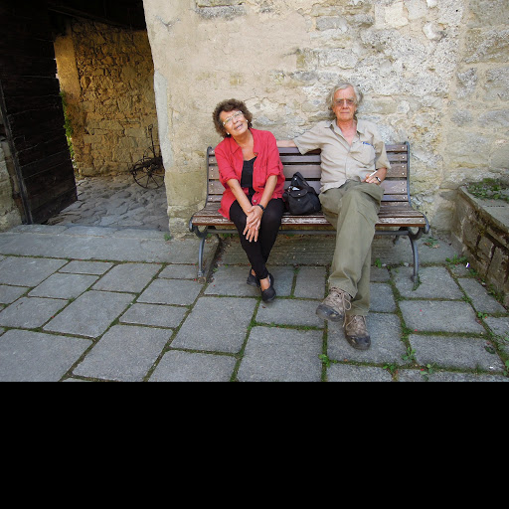


‘We’ll be soon arriving into Reading’
Explorations in recent language change
Gordon Tucker
Cardiff University

Slide 2
My talk and Guy
‘arriving into’ first heard on a train
Corpus Linguistics – learning and understanding through corpus investigation – BNC (Aston and Burnard)
Septuagenerian conservativism versus linguistic observation (prescription versus description)
Edge Hill University (Ormskirk, UK) – our last days together

Slide 3

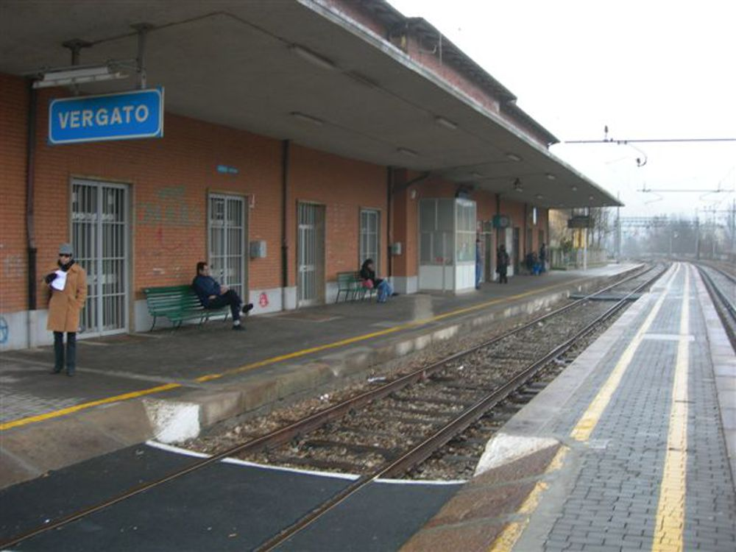
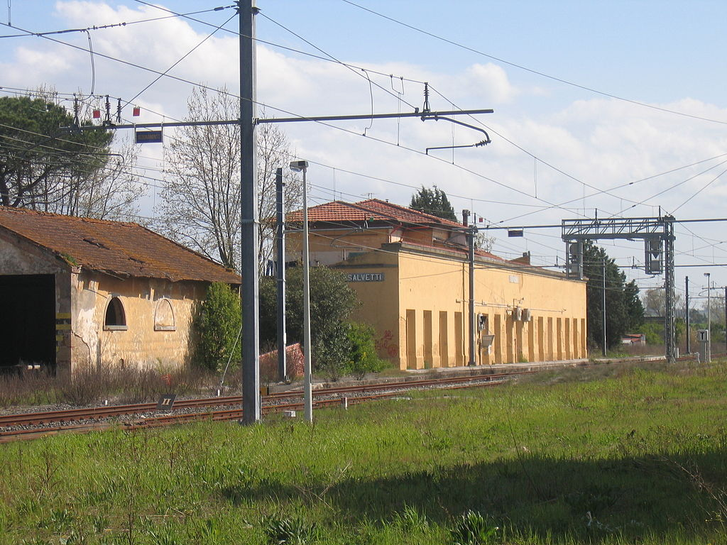
Guy – the king of the branch line!
Liserna (BO)
Colognole (LI)
Stazione FFSS Vergato (BO)
Stazione FFSS Collesalvetti (LI)

Slide 4
understanding and accommodating contemporary lexicogrammatical change
lexical change: neologisms – obsolescence – re-semanticisation - error
lexicogrammatical change:
conservative ‘negative’ reaction (even among ‘older’ linguists!)
what’s changing structurally and semantically?
what are speakers wanting to mean?
important for the foreign/second language learning/teaching/testing community

Slide 5
“We shall shortly be arriving into Reading”

Slide 6
“Often, when getting the train to work in the morning, shortly before arriving at our terminus the conductor will announce "Good morning ladies and gentlemen, we will shortly be arriving into London Euston”.
This sounds so wrong to me, but so many of the different conductors say it that I'm now starting to doubt myself.
Is what they're saying correct? As far as I'm concerned they should say "We will shortly be arriving at London Victoria“ (sic).
Posted on English Language & Usage Stack Exchange

Slide 7
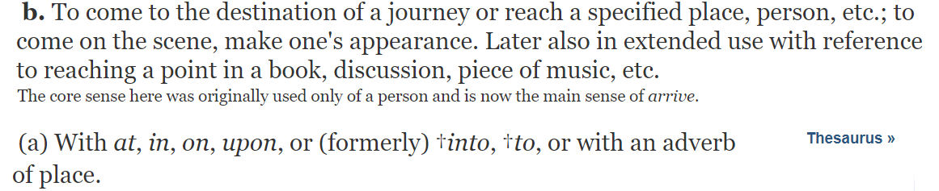
ARRIVE in the OED
Notes:
The positions in some respects are not so very different, which makes reconciliation or accommodating one in the other quite feasible

Slide 8
INTO in the OED

Slide 9
NUMBER OF RELEVANT PREPOSITIONS FOLLOWING THE LEMMA ARRIVE IN THE BNC (TOTAL 13,617 INSTANCES OF LEMMA)
arrive + at | 3552
arrive + in | 2414
arrive + on | 613
arrive + to | 23
arrive + into | 3
Notes:
The positions in some respects are not so very different, which makes reconciliation or accommodating one in the other quite feasible

Slide 10
Arrive + to (BNC)

Slide 11
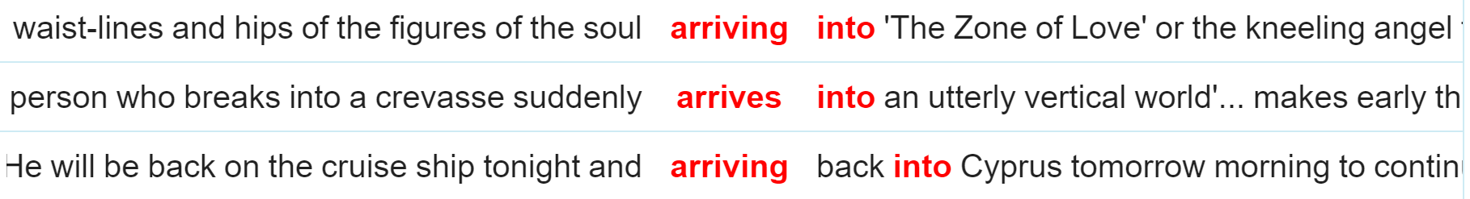
ARRIVE + into (BNC)
Notes:
The positions in some respects are not so very different, which makes reconciliation or accommodating one in the other quite feasible

Slide 12
What’s changing?
‘We shall shortly be arriving into Reading’
‘We shall shortly be arriving in/at Reading’
or
‘We shall shortly be pulling/coming into Reading’
Notes:
The positions in some respects are not so very different, which makes reconciliation or accommodating one in the other quite feasible

Slide 13
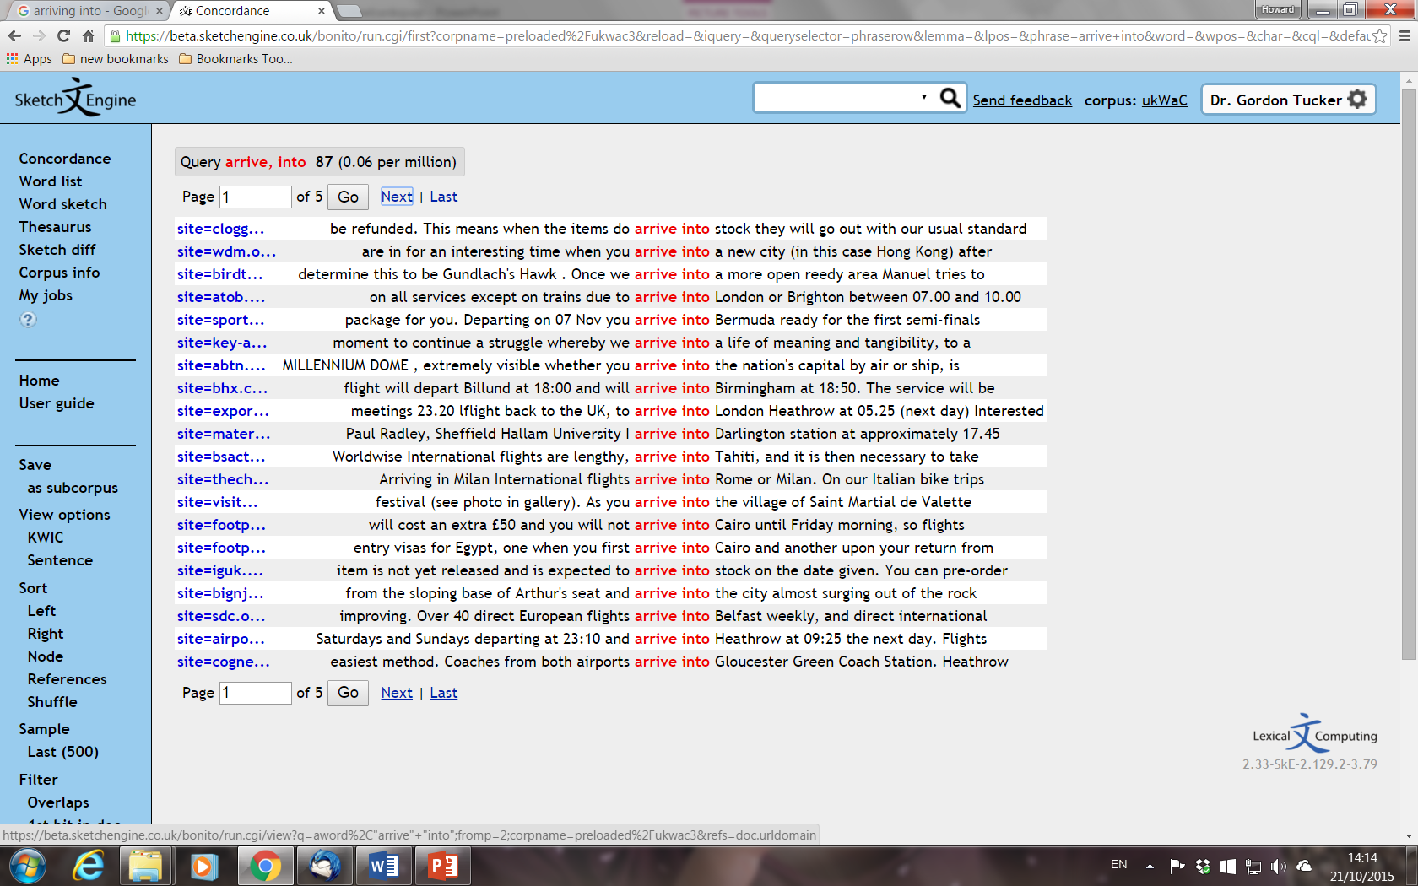
arrive into - English Web Corpus (UK) 2015 (EWC-UK 2015)

Slide 14
What’s changing? Semantic Coercion?
ARRIVE INTO
Notes:
The positions in some respects are not so very different, which makes reconciliation or accommodating one in the other quite feasible

Slide 15
What’s changing? Semantic Coercion?
ARRIVE INTO
Notes:
The positions in some respects are not so very different, which makes reconciliation or accommodating one in the other quite feasible

Slide 16
INTO causing coercion in the Aktionsart/Aspectual Type normally associated with the Process?
I drove into Vergato to see Guy
I went into Vergato to see Guy
I came into Vergato to see Guy
I walked into Vergato to see Guy
I travelled into Vergato to see Guy
I arrived into Vergato to see Guy
Notes:
The positions in some respects are not so very different, which makes reconciliation or accommodating one in the other quite feasible

Slide 17
ASPECTUAL TYPE/AKSIONSART Nonstative Durative Activities (Levin 2009)
3.1.1 Subdividing durative verbs
• Many verbs describe events that take time, but have no inherent temporal endpoint; such events could go on indefinitely, at least if real world limitations or conventions weren’t a consideration.
a. Pat ran.
b. Kim wiped the counter
c. Sam poured the milk
Such events are known as ACTIVITIES.
(go, travel, sail, fly, drive)
Notes:
The positions in some respects are not so very different, which makes reconciliation or accommodating one in the other quite feasible

Slide 18
ASPECTUAL TYPE/AKSIONSART Nonstative Durative Accomplishment (Levin 2009)
3.1.1 Subdividing durative verbs
• There are some verbs which also describe events that take time, but these events have an inherent endpoint, also known as a “culmination” or “telos” at which a result state comes about. The duration of the event up to the endpoint is occupied by the process that leads up to the result state, although the nature of this process is left unspecified by the verb.
a. Pat drew a picture of the vase of flowers
b. Kim cleaned the counter
c. Sam filled the pitcher (with the milk)
Such events are known as ACCOMPLISHMENTS.
Notes:
The positions in some respects are not so very different, which makes reconciliation or accommodating one in the other quite feasible

Slide 19
ASPECTUAL TYPE/AKSIONSART Nonstative Punctual Achievements (Levin 2009)
• Some verbs, such as explode or break, describe events that are punctual; they describe the moment at which there is a transition to a result state. Thus, they are like accomplishments in being defined by a result state.
a. Carey broke the window.
b. The gas main exploded.
c. The train arrived at the station.
d. The appraiser noticed the flaw in the glass.
Such events are known as ACHIEVEMENTS
DIFFERENT TRANSITION
LENGTHS
Notes:
The positions in some respects are not so very different, which makes reconciliation or accommodating one in the other quite feasible

Slide 20
The ARRIVE time-line
D
*’We’re arriving’
ARRIVE AT/IN
Notes:
The positions in some respects are not so very different, which makes reconciliation or accommodating one in the other quite feasible

Slide 21
The DRIVE time-line
‘We’re driving into Reading’
D
‘We’re driving’

Slide 22
Is this a recent phenomenon?
How recent is it?
Can corpus investigation help?
Data from different periods

Slide 23
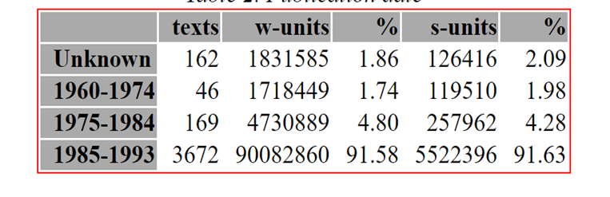
DISTRIBUTION IN TIME PERIODS OF TEXTS IN THE BNC
Notes:
The positions in some respects are not so very different, which makes reconciliation or accommodating one in the other quite feasible

Slide 24
Comparison of ‘ARRIVE + preposition’ in British National Corpus (BNC) – British Web Corpus 2007 (BWC 2007) – English Web Corpus (UK) 2015 (EWC-UK 2015)
Sample of 13,617 occurrences of lemma ARRIVE

Slide 25
Other motion achievement verbs?
Notes:
The positions in some respects are not so very different, which makes reconciliation or accommodating one in the other quite feasible

Slide 26
Notes:
The positions in some respects are not so very different, which makes reconciliation or accommodating one in the other quite feasible

Slide 27
Possible interpretations
1. User error or misunderstanding
2. Portmanteau expressions / anacoluthon / semantic conflation
3. Intentional semantic reduction in the difference between the prepositions in and into
4. into as a more dynamic alternative to in
Notes:
The positions in some respects are not so very different, which makes reconciliation or accommodating one in the other quite feasible

Slide 28
Portmanteau Construction / Anacoluthon
Notes:
The positions in some respects are not so very different, which makes reconciliation or accommodating one in the other quite feasible

Slide 29
(intentional) semantic reduction in the difference between the prepositions in and into
Notes:
The positions in some respects are not so very different, which makes reconciliation or accommodating one in the other quite feasible

Slide 31
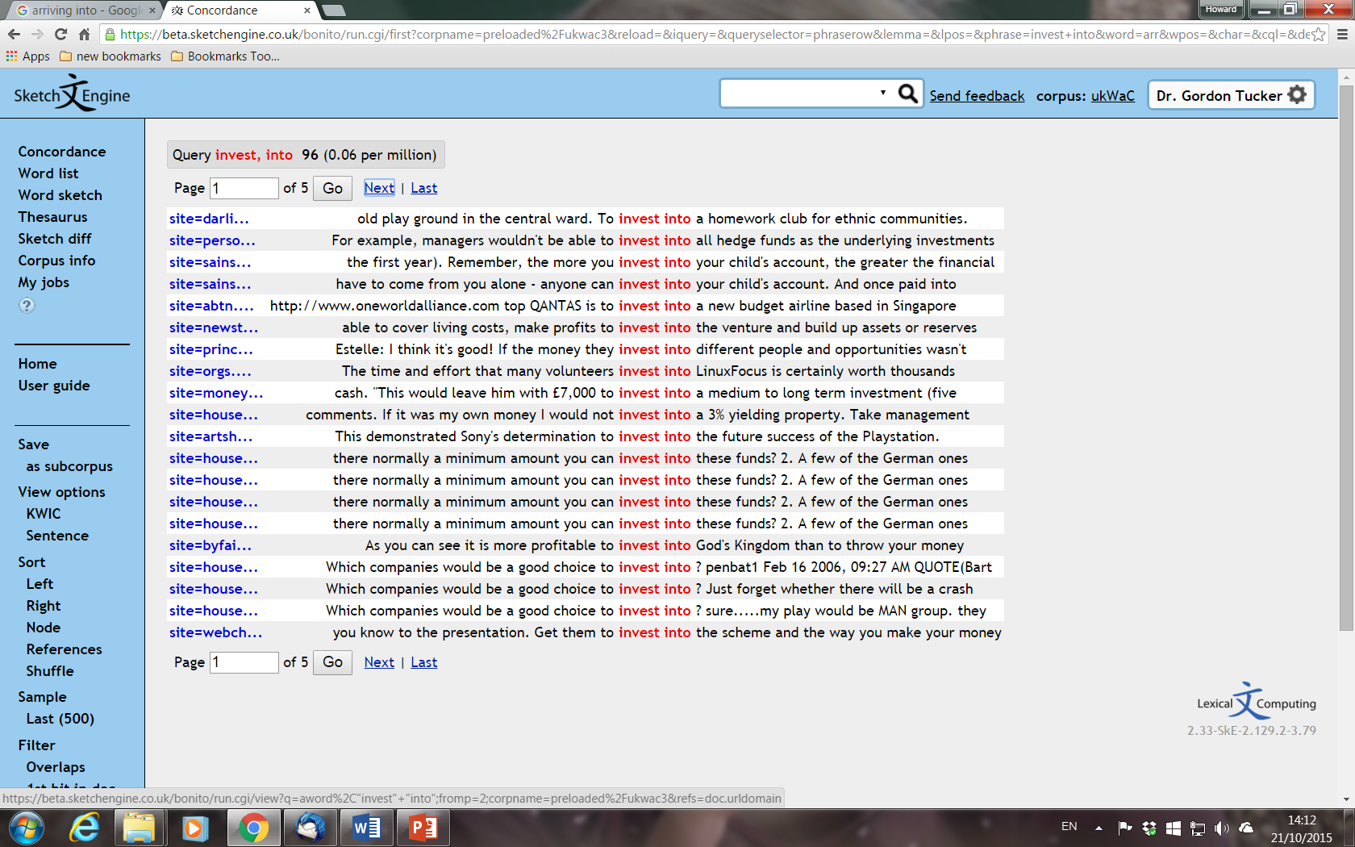

Slide 32
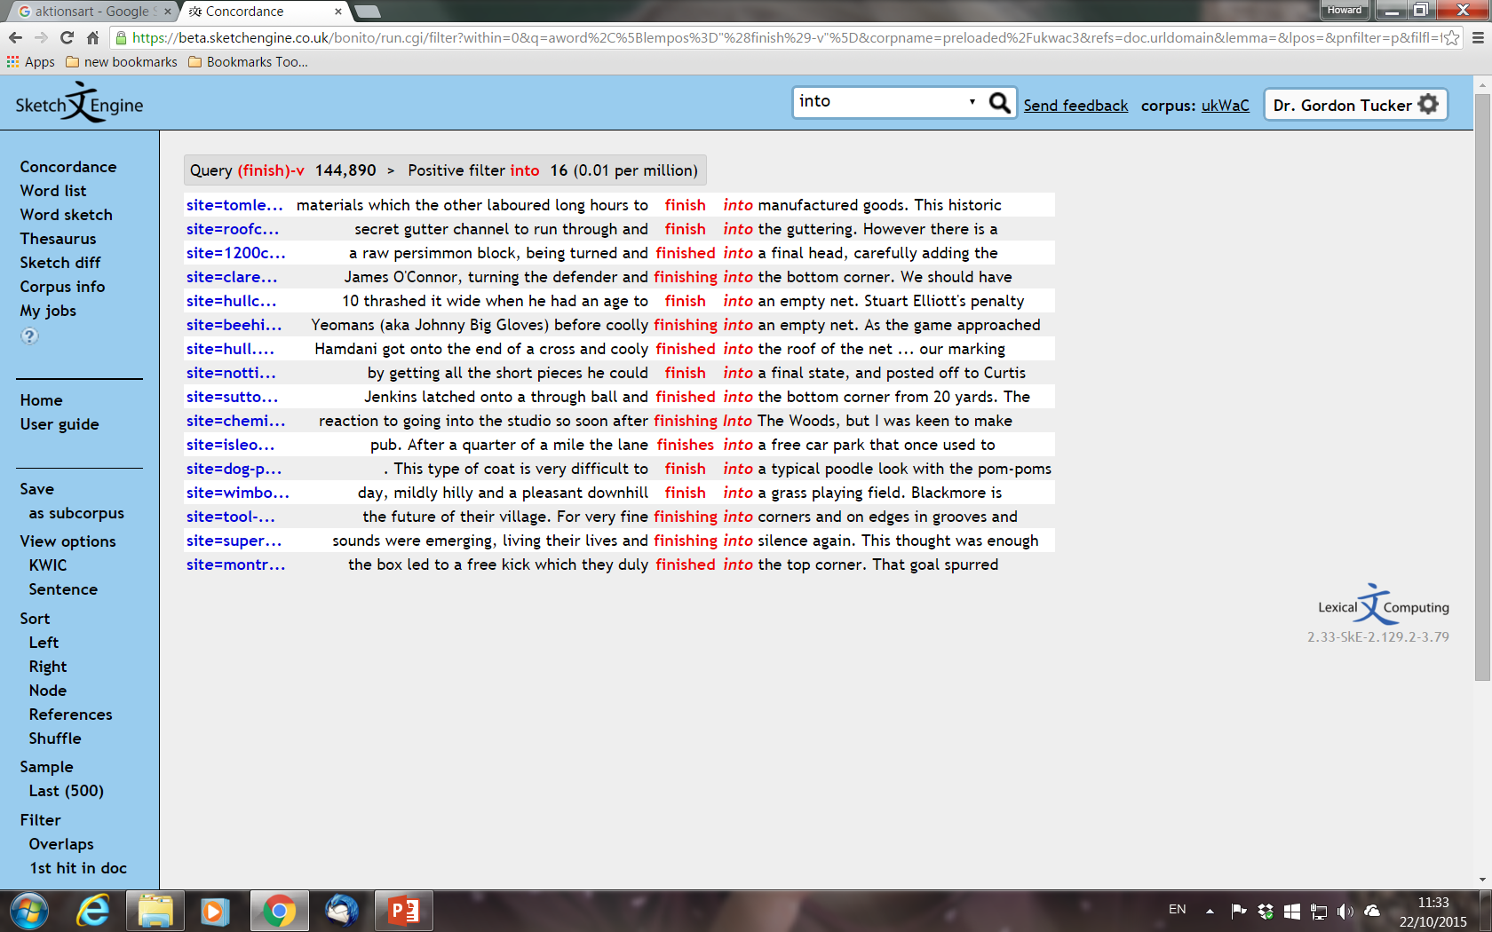

Slide 33
‘he’ll be back into training on Monday morning’
(Bath Rugby Club coach talking on BBC radio about a player who was away in Spain)
‘We’ve still got time into this game’
(Commentary on Cardiff versus Pontypridd rugby match)

Slide 34
conclusions
Your guess is as good as mine!
lexicogrammatical change does occur over short periods of time
understand it, chart it and build it into descriptions
include it and explain it in second/foreign language teaching
remember that linguists are human
remember that linguists are linguists
Notes:
The positions in some respects are not so very different, which makes reconciliation or accommodating one in the other quite feasible

Slide 35
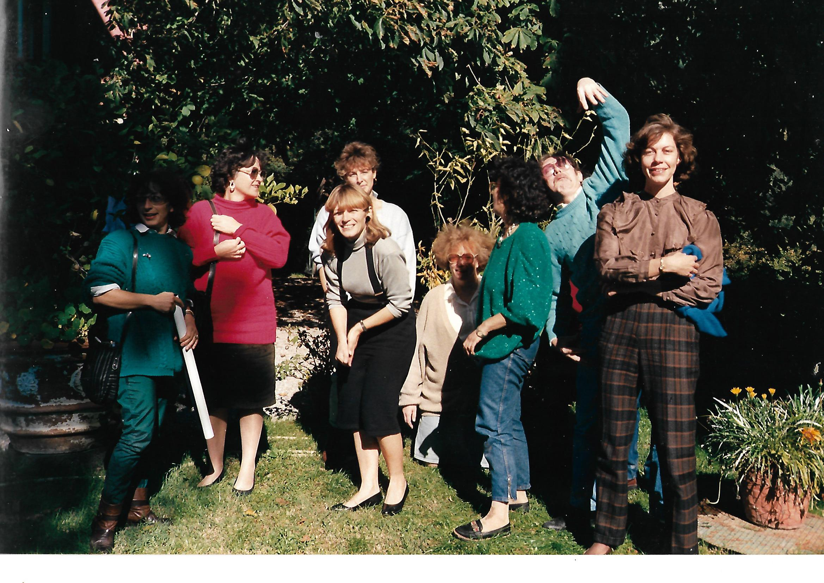
For Guy – The Pixie-maker

