Slide 1
Infrastructure as a Service by using Ansible
Cloud Native is AWS

Slide 2
CONTENTS OF THIS Project
We are going to develop the complete aws cloud infrastructure by using ansible , Once we have done the infrastructure and deploying an application into it .
We are following Infrastructure as a service (IAAS):Infrastructure as a Service, sometimes abbreviated as IaaS, contains the basic building blocks for cloud IT and typically provide access to networking features, computers (virtual or on dedicated hardware), and data storage space.

Slide 3
TABLE OF CONTENTS
01
04
02
05
03
06
About the Project
Sneak Peek
We are going to develop complete aws cloud infra
We can scale up and down as app requires
Major Requirements
Project Stages
Aws account , ansible installed VM , SSH key setup
We devide the stages according to the Project
Project Goals
Project Workflow
It is going to maintain the complete infa with single inventory file
Workflow details

Slide 4
ABOUT THE PROJECT
We are going to develop an infrastructure in aws by using ansible automation and once we have infrastructure ready in Aws cloud and we are going to deploy a sample application on it .

Slide 5
ABOUT THE PROJECT
We can scale up and scale down according to the App need’s and users of the Particular app with inventory file in the ansible
For Extra mile , we are going to include Devops tools to deploy into cloud , we are going to use Jenkins to deploy the app into the Aws cloud

Slide 6
MAJOR REQUIREMENTS
01
02
03
Cloud Account
Aws account creation
Automation
For automation of Infrastructure, we need ansible installed VM
Deployment
This is Extra mile for the project , App Deployment in cloud

Slide 7
Project Goals
The goals of the project will be craeting infrastructure in Cloud ,And automating the infrastructure by usuing ansible with sample file called inventory file once we have done that we have to create a deployemnt in the cloud Ansible cluster

Slide 8
Sneak Peek
AWS Auto Scaling monitors your applications and automatically adjusts capacity to maintain steady, predictable performance at the lowest possible cost. Using AWS Auto Scaling, it’s easy to setup application scaling for multiple resources across multiple services in minutes

Slide 9
Sneak Peek
The service provides a simple, powerful user interface that lets you build scaling plans for resources including Amazon EC2 instances and Spot Fleets, Amazon ECS tasks, Amazon DynamoDB tables and indexes, and Amazon Aurora Replicas

Slide 10
PROJECT STAGES
02. VM with ansible installed
01. Cloud InfraSetup
Aws account creation
Any node that should install ansible
03. Inventory
04. App deployement
We have list of nodes In inventory for Aws server’s
Sample app deployment

Slide 11
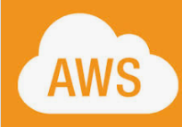


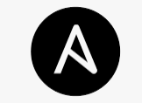
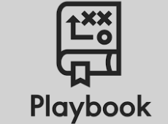
Workflow Of Project
Infrastructure in Aws
Automation with Inventory file
Autoscaling
Ansible
Playbook

Slide 12
TIMELINE
Venus is the second planet from the Sun
Mercury is the closest planet to the Sun
2013
2016
2012
2015
2019
Despite being red, Mars is a cold place
Saturn is composed of hydrogen and helium
Neptune is the farthest planet from the Sun

Slide 13
THANKS
Do you have any questions?
Name:
Please keep this slide for attribution.

Slide 14
ALTERNATIVE RESOURCES
Find more illustrations like these on Stories by Freepik

