Slide 1
Quantum Search with Wildcards
Alec Landow and Liam Adams

Slide 2

Motivation
Pattern matching is an important component of DNA sequencing, search engines and AI.
Classically the problem of finding the closest match of a pattern is O(MN), and exact match is O(M + N)
Quantum computers can find a match without searching the entire input string
We implemented an algorithm for finding the closest match of a pattern in a string, with wildcards
This is useful in applications where data can mutate over time, an example of such data is DNA
The quantum algorithm we implemented returns the starting index of the closest match for a pattern in a string in iterations.

Slide 3
Algorithm Outline
The algorithm consists of 3 main components: the initial state, oracles, and diffuser
We create a quantum register for each character in the pattern.
The state of the register represents the index of the character in the overall string.
The pattern can only begin in N-M locations, so each register only needs to encode those positions
“Compile Once, Run Many” Approach
During each of the iterations, a random character (register) from the pattern is selected, its oracle is applied, and diffusion is applied to amplify the state amplitude

Slide 4
Algorithm Outline
Selecting a character from the pattern at random rather than passing the characters in order allows us to find the closest match
The initial state is created so that the state of the second register is one position beyond the first and so on
The oracles for the characters are diagonal matrices containing a -1 where that character appears in the string
After the oracle is applied Grover diffusion is used to amplify the amplitude of the state
Diffuser only applied to first register as that is the only state we are interested in measuring
The state measured most frequently is the starting index of the pattern in the string

Slide 5
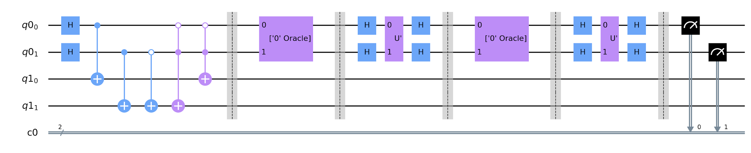
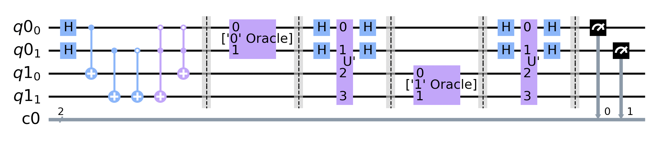
Circuit Examples
“Single Oracle”, Matrix Diffuser
Input String: 0101
Pattern: 01
Oracle for '0'
[[-1. 0. 0. 0.]
[ 0. 1. 0. 0.]
[ 0. 0. -1. 0.]
[ 0. 0. 0. 1.]]
U’
[[-1. 0. 0. 0.]
[ 0. 1. 0. 0.]
[ 0. 0. 1. 0.]
[ 0. 0. 0. 1.]]
Notice: No ‘1’ Oracle in this run
Notes:
No ‘1’ Oracle because the pattern char is chosen randomly for ~sqrt(N) runs. If N >> M, there is a high probability all pattern chars have oracles applied

Slide 6
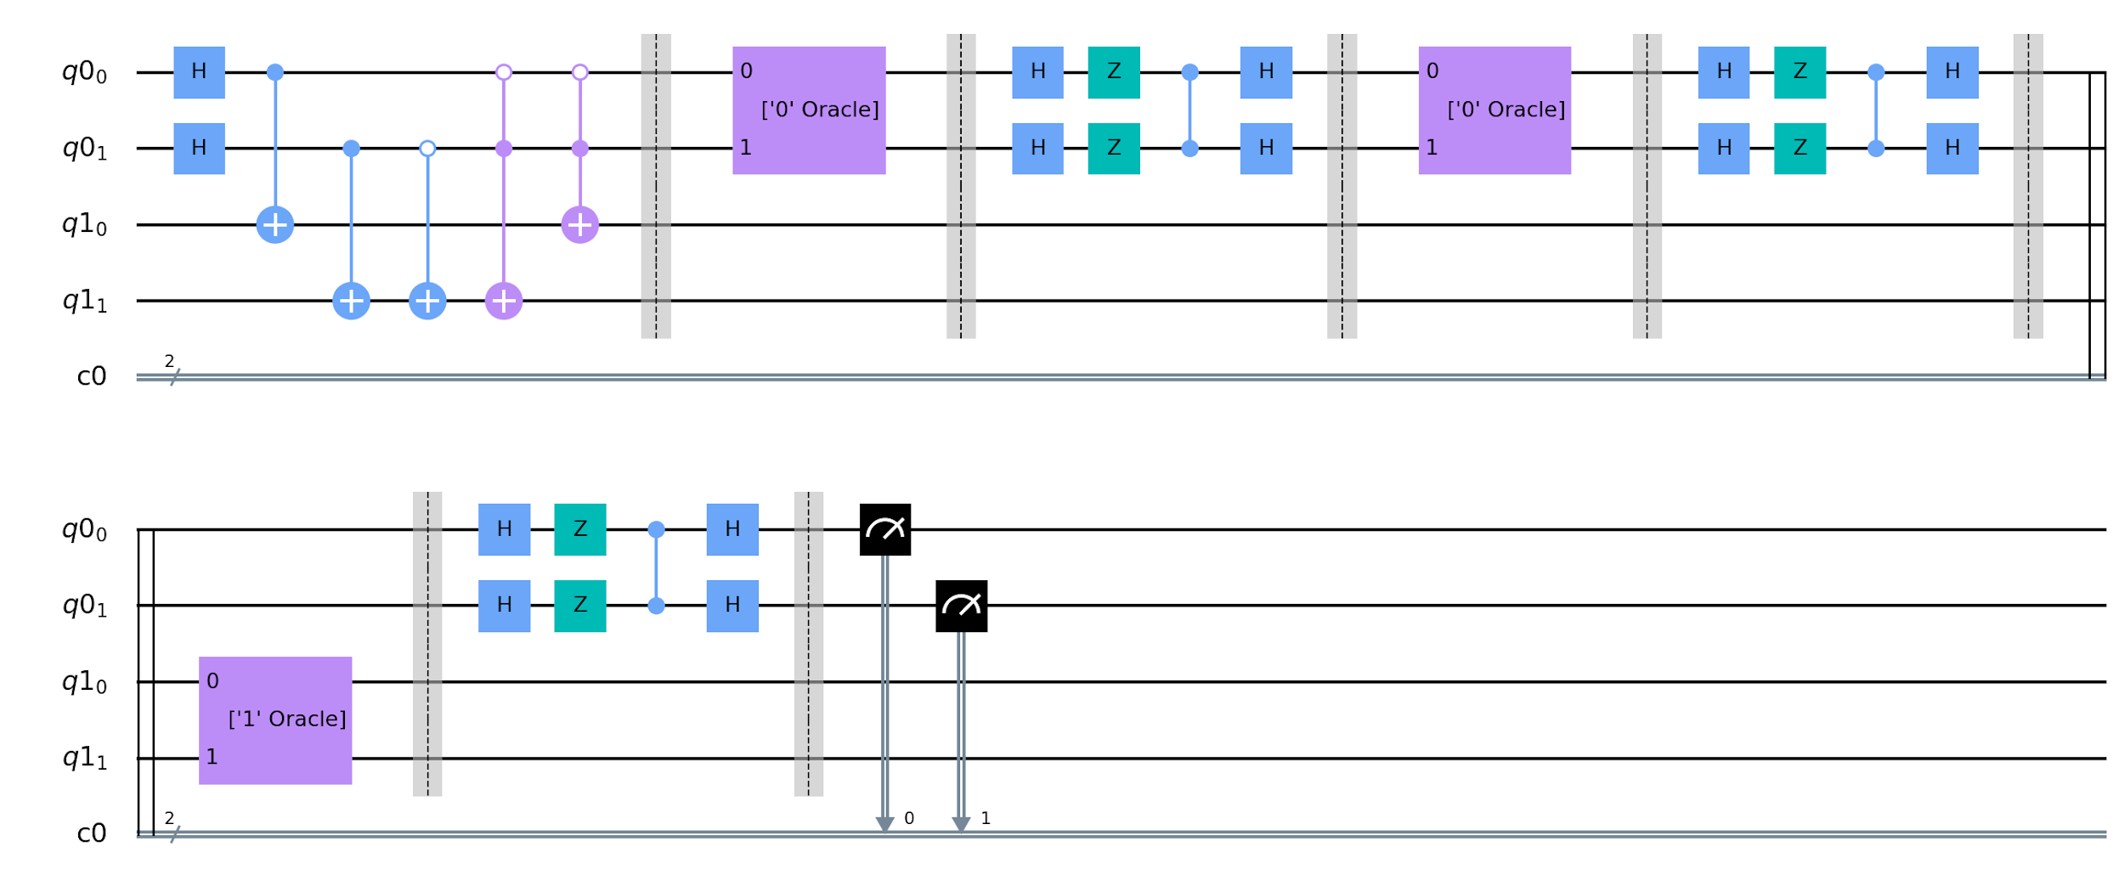
“Many Oracles”, Gate Diffuser
Oracle for '1'[1]
[[ 1. 0. 0. 0.]
[ 0. -1. 0. 0.]
[ 0. 0. 1. 0.]
[ 0. 0. 0. 1.]]
Oracle for '0'[0]
[[-1. 0. 0. 0.]
[ 0. 1. 0. 0.]
[ 0. 0. 1. 0.]
[ 0. 0. 0. 1.]]
Oracle for '0'[2]
[[ 1. 0. 0. 0.]
[ 0. 1. 0. 0.]
[ 0. 0. -1. 0.]
[ 0. 0. 0. 1.]]
Input String: 0101
Pattern: 01

Slide 7
Testing
Latin Alphabet, Single-Character Patterns
 | “Many Oracles” | “Single Oracles”
Gate Diffuser | Fail: 23.33 % Match: 76.67 % | Fail: 26.67 % Match: 73.33 %
Matrix Diffuser | Fail: 26.67 % Match: 73.33 % | Fail: 15.83 % Match: 74.17 %
Case: The characters in the pattern occur only in the matches, not in any other part of the input.
Example:
Input : bcatdfgh
Pattern: cat
Theoretical Match Percentage:
25%
** Tests included only patterns that existed in the input string
Latin Alphabet, Multiple-Character Patterns
 | “Many Oracles” | “Single Oracles”
Gate Diffuser | Fail: 65.45 % Match: 34.55 % | Fail: 71.36 % Match: 28.64 %
Matrix Diffuser | Fail: 70.00 % Match: 30.00 % | Fail: 69.55 % Match: 30.45 %
Notes:
We also tested alphabet of {0,1}, which had poorer results since there were partial matches

Slide 8
Open Problems
Unclear if diffuser should be applied to all registers
Description of oracle by authors as transposition operator using Gray codes
Detecting patterns in alphabet consisting of only 0s and 1s
Implementing exact pattern match detection

