Slide 1
Nutrient diversity in the food system
Sold diversity
System diversity
Catch diversity
Consumption diversity
Nutrient diversity in household diets
Biomonitoring data
Catch and consumption data
Nutrient database

Slide 2
Core relationships of interest
Relationships we can observe in our data
Relationships we cannot observe in our data (or sometimes ever)
Nutrient diversity in the food system
Sold diversity
System diversity
Catch diversity
Consumption diversity
Nutrient diversity in household diets
Body size
Nutrient quality
Relative abundance
Effort
Marketing opportunities
Consumption preferences

Slide 3
Core relationships of interest
Relationships we can observe in our data
Relationships we cannot observe in our data (or sometimes ever)
Nutrient diversity in the food system
Sold diversity
System diversity
Catch diversity
Consumption diversity
Nutrient diversity in household diets
Body size
Nutrient quality
Relative abundance
Effort
Marketing opportunities
Consumption preferences

Slide 4
Core relationships of interest
Relationships we can observe in our data
Relationships we cannot observe in our data (or sometimes ever)
Nutrient diversity in the food system
Sold diversity
System diversity
Catch diversity
Consumption diversity
Nutrient diversity in household diets
Effort
Marketing opportunities
Abundance
Consumption preferences

Slide 5
Core relationships of interest
Relationships we can observe in our data
Relationships we cannot observe in our data (or sometimes ever)
Nutrient diversity in the food system
Sold diversity
System diversity
Catch diversity
Consumption diversity
Nutrient diversity in household diets
Effort
Marketing opportunities
Abundance
Consumption preferences

Slide 6
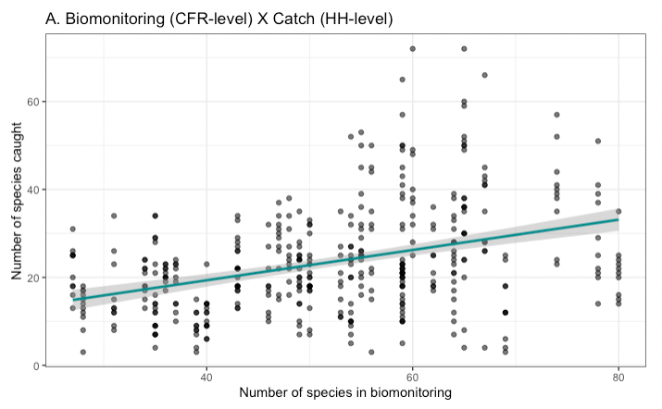
Nutrient diversity in the food system
Sold diversity
System diversity
Catch diversity
Consumption diversity
Nutrient diversity in household diets
Slope = 0.384

Slide 7
Nutrient diversity in the food system
Sold diversity
System diversity
Catch diversity
Consumption diversity
Nutrient diversity in household diets
Show relationship between a system diversity index and catch diversity index?

Slide 8
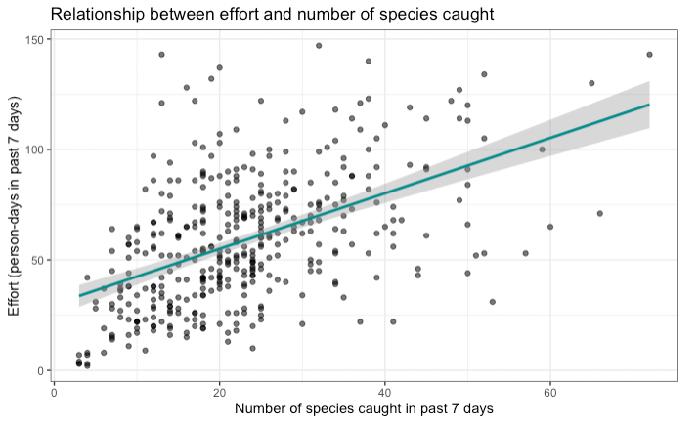
Core relationships of interest
Relationships we can observe in our data
Relationships we cannot observe in our data (or sometimes ever)
Nutrient diversity in the food system
Sold diversity
System diversity
Catch diversity
Consumption diversity
Nutrient diversity in household diets
Effort
Marketing opportunities
Abundance
Consumption preferences
Slope = 0.505

Slide 9
Core relationships of interest
Relationships we can observe in our data
Relationships we cannot observe in our data (or sometimes ever)
Nutrient diversity in the food system
Sold diversity
System diversity
Catch diversity
Consumption diversity
Nutrient diversity in household diets
Show how abundance mediates the relationship between system diversity and catch diversity?
Effort
Marketing opportunities
Abundance
Consumption preferences
Slope = 0.505

Slide 10
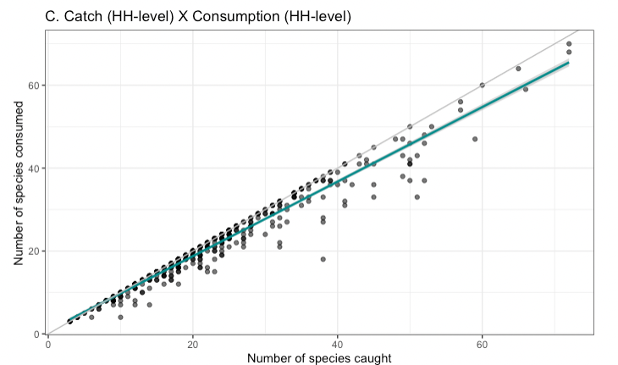
Nutrient diversity in the food system
Sold diversity
System diversity
Catch diversity
Consumption diversity
Nutrient diversity in household diets
Slope = 0.979

Slide 11
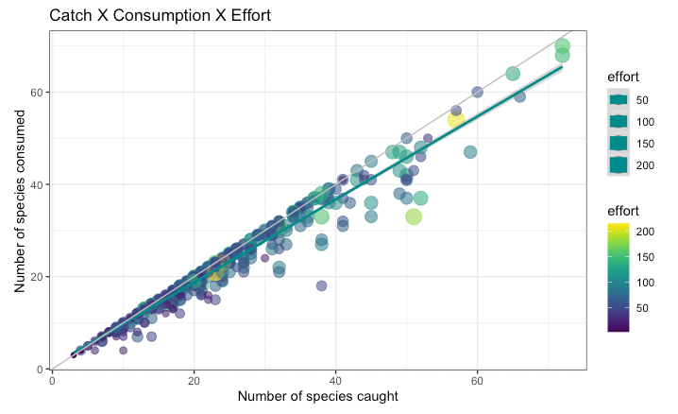
Core relationships of interest
Relationships we can observe in our data
Relationships we cannot observe in our data (or sometimes ever)
Nutrient diversity in the food system
Sold diversity
System diversity
Catch diversity
Consumption diversity
Nutrient diversity in household diets
Effort
Marketing opportunities
Abundance
Consumption preferences

Slide 12
Nutrient diversity in the food system
Sold diversity
System diversity
Catch diversity
Consumption diversity
Nutrient diversity in household diets
Show relationship between household level catch diversity index and household-level consumption diversity index?
(I wouldn’t expect much difference unless there’s something unexpected happening with biomass)
Slope = 0.979

Slide 13
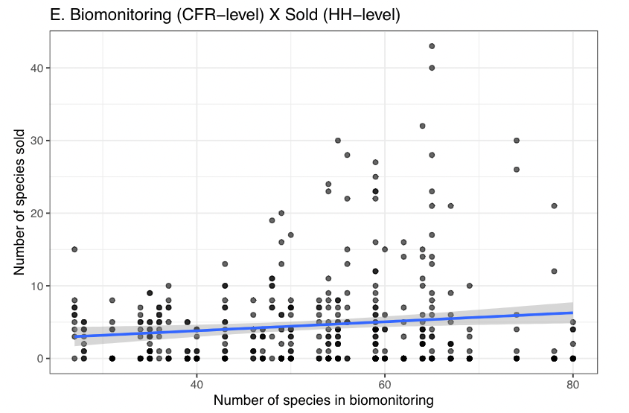
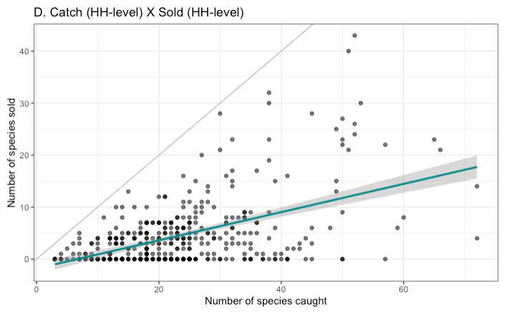
Market is more selective. Does it only take specific species?
CV of abundance over time as inherent stability of species (trait)
Nutrient diversity in the food system
Sold diversity
System diversity
Catch diversity
Consumption diversity
Nutrient diversity in household diets
Slope = 0.397

Slide 14
Nutrient diversity in the food system
Sold diversity
System diversity
Catch diversity
Consumption diversity
Nutrient diversity in household diets
Show relationship between household level catch diversity index and household-level sold diversity index?
Slope = 0.397

Slide 15
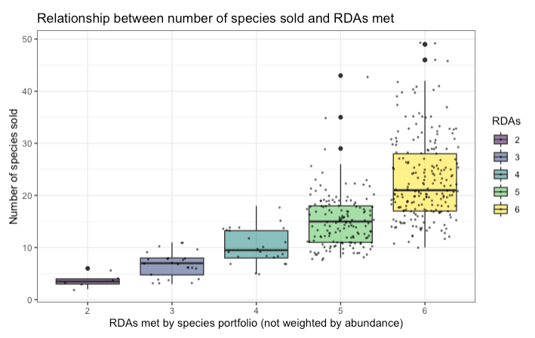
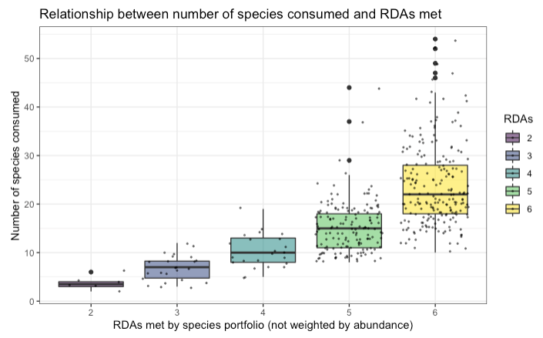
Nutrient diversity in the food system
Sold diversity
System diversity
Catch diversity
Consumption diversity
Nutrient diversity in household diets
Slopes if RDAs treated as continuous:
0.701 (sold)
0.697 (consumed)

Slide 16
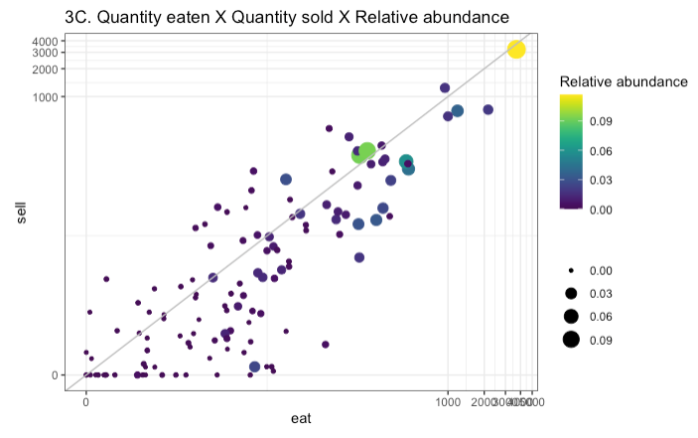
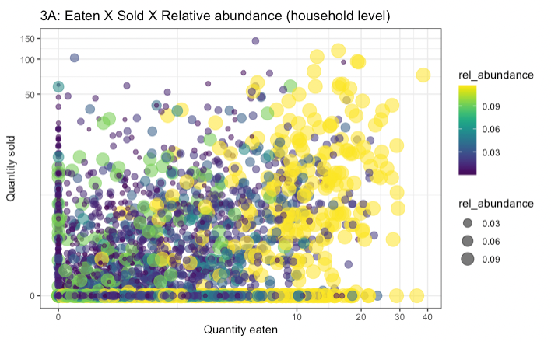
Nutrient diversity in the food system
Sold diversity
System diversity
Catch diversity
Consumption diversity
Nutrient diversity in household diets

Slide 17
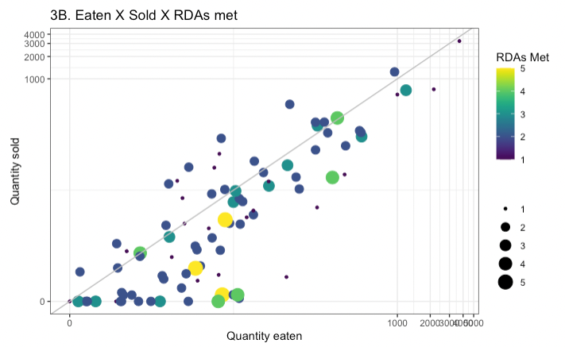
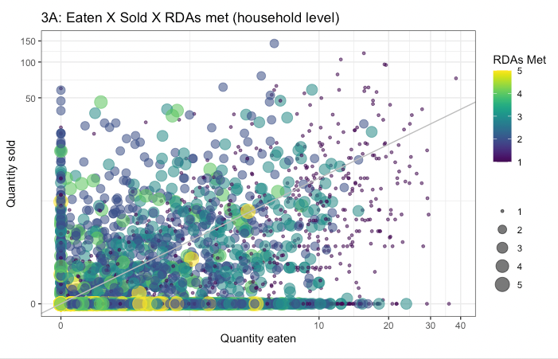
Nutrient diversity in the food system
Sold diversity
System diversity
Catch diversity
Consumption diversity
Nutrient diversity in household diets

Slide 18
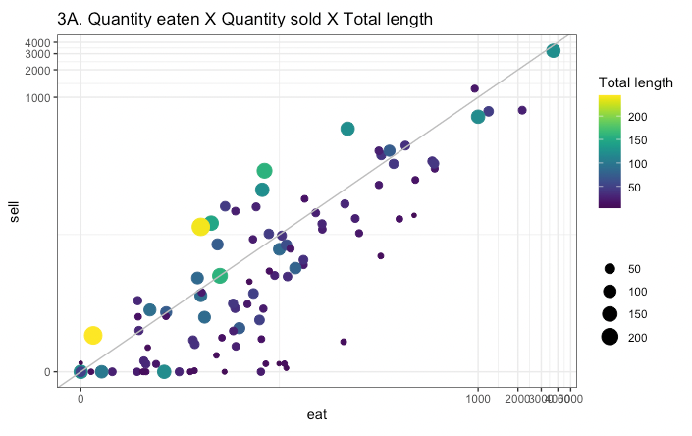
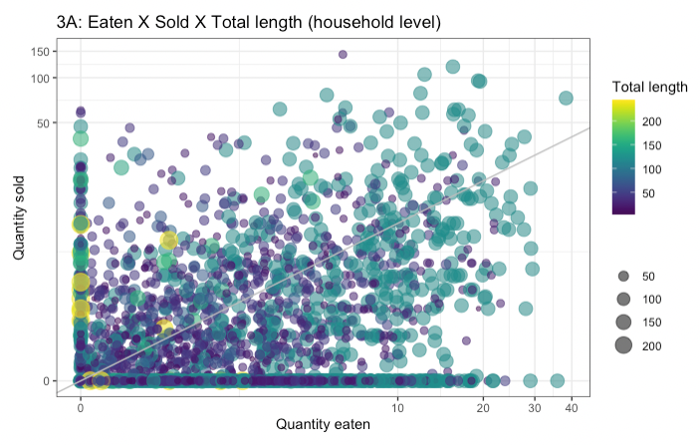
Nutrient diversity in the food system
Sold diversity
System diversity
Catch diversity
Consumption diversity
Nutrient diversity in household diets

