Slide 1


Market Share Forecasting on New Product Launch
Philip Morris International
Enterprise Analytics and Data
Enterprise Data Science – Use Case 2
Louis BALIGAND
10 January 2019

Slide 2
Dataset
Pre-Processing
Model & results
Takeaways & Next Steps

Slide 3
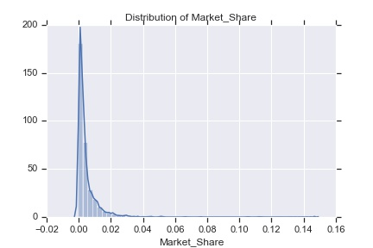
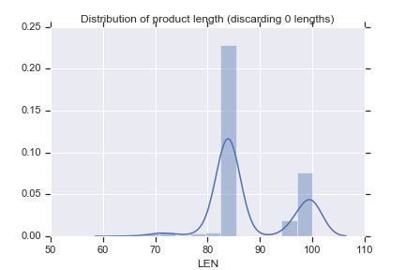
Dataset
Longitudinal dataset: we collect observations from the same entity over time, i.e. stock price
Success rate on sample (threshold 0,7%): 18,94% - Skewed distribution

Slide 4
Pre-Processing
Categories: nominal or ordinal
Missing values

Slide 5
Data Exploration
Feature | Assumption | Example | Note
REGION | 4 Continents | la&c, eu, eema, asia
MARKET | Geo, laws | Swiss Canton
BRM, BRANDEDMARKET, BRANDONMARKET | Set of attributes defining the product | Cigarettes, Marlboro, flavor, Menthol, Length | Highly correlated
BLDIMAGE | Blend Image
BRANDDIFFERENT. |  | Blondes, Red, Flavor+
BRANDFAMILY (SUB..) |  | Marlboro (Gold etc…) | Highly correlated
CHARINDICATOR | Charcoal Indicator
BRMID | ID |  | 2 clusters
RTYPE | Filter type? |  | Many NA
INTERNATIONALINDIC | Indicator in English?
ITEMSHAPE | Product Shape | Rigid (for packets)
ITEMSCODE | Number of cigarettes | 20
LEN | Length of cigarettes | 85
LENCATEGORY | Length size | King Size, 100s

Slide 6
Data Exploration
Feature | Assumption | Example | Note
PRICECLASS, ON | Price range, currency?
LOCALCLASS | Local price class?
MINDICATOR | Menthol Indicator | Y/N
NCON | Nicotine Content | 0,6
NPLLAUNCHDATE | New Product Launch | Jan 2008
NPLLAUNCHYEAR |  | 2008
PCKT | Packet Type?
TCLASS | Trademark?
RETAILPACKPRICE | Local price |  | Unstandardized
TRCONTE | Content?
THICATEGORY | Thickness | Regular
TIPCOLOR | Color (butt)?
TRACKINGSTATUS

Slide 7
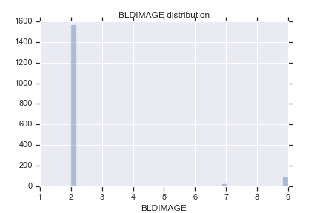
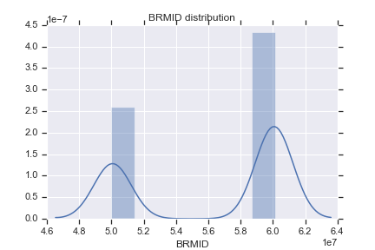
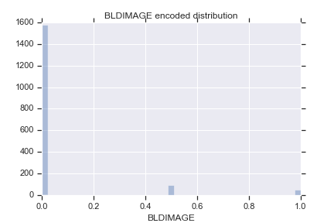

Slide 8
Feature Selection
Anova

Slide 9
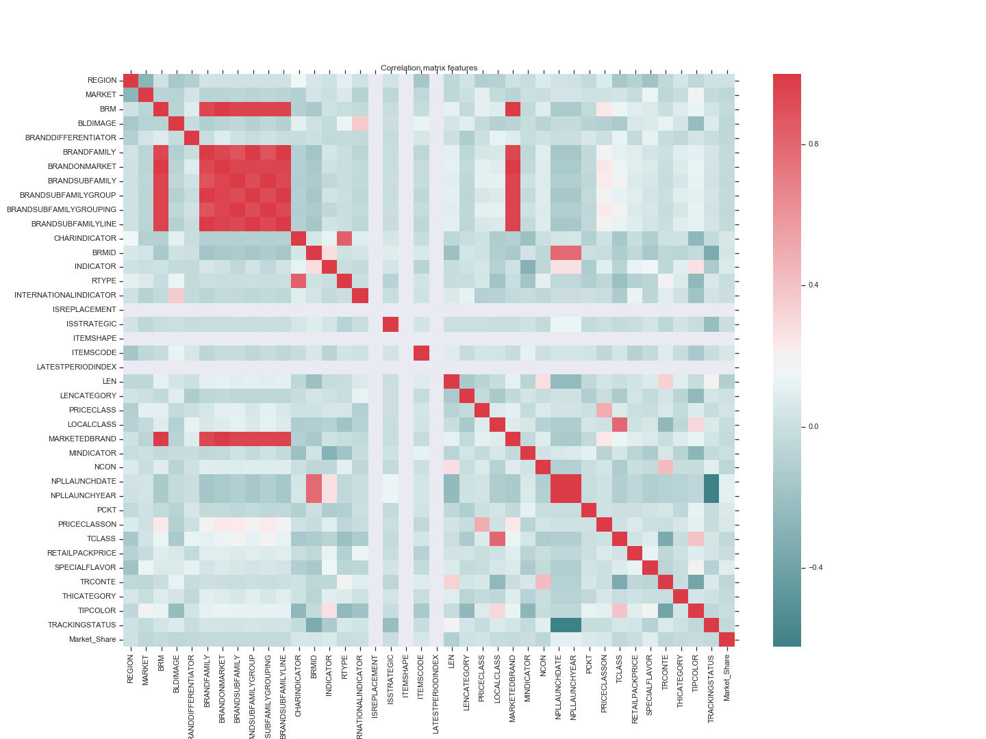

Slide 10
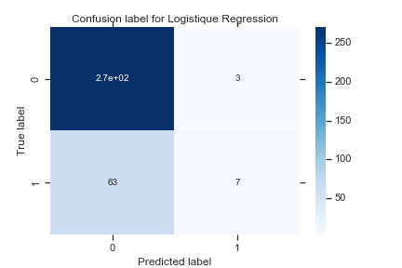
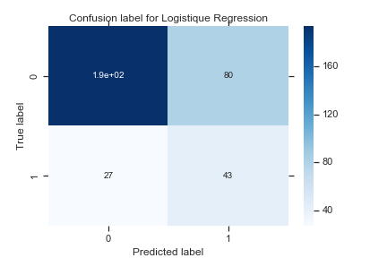
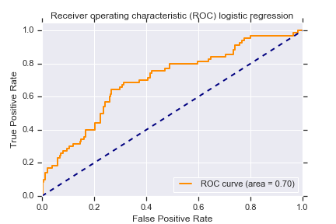

Initial Results
Classification – Logistique Regression
 | Precision | Recall | F1 Score
Failure | 81% | 99% | 89%
Success | 70% | 10% | 17%
 | Precision | Recall | F1 Score
Failure | 88% | 71% | 78%
Success | 35% | 61% | 45%

Slide 11
Results
Classification – Model Selection

Slide 12
Results
Classification – SGDClassifier Elastic-Net penalty (linear SVM loss function)
 | Precision | Recall | F1 Score
Failure | 81% | 99% | 89%
Success | 70% | 10% | 17%

Slide 13
Initial Results
Regression
Model | MAE | MSE | R2
Linear Regression (OLS) – Random train/test split 20% | 0,365% | 0,003% | 5,675%
OLS CV 5-fold | 0,442% +- 0,029% | 0,009% +- 0,003% | 1,457% +- 2,136%

Slide 14
Takeaways

Slide 15
Next Steps
Fetch external data: PMI-related events, global market events
Product Review

