Slide 1


Market Share Forecasting on New Product Launch
Philip Morris International
Enterprise Analytics and Data
Enterprise Data Scientist – Use Case 2
Louis BALIGAND
10 January 2019

Slide 2
Dataset
Pre-Processing
Model & results
Takeaways & Next Steps

Slide 3
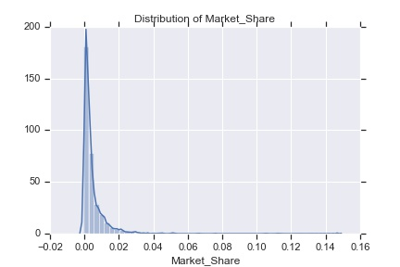
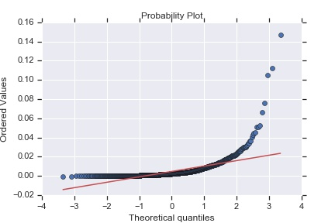
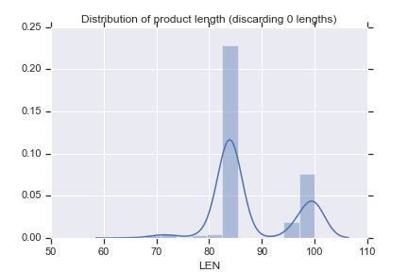
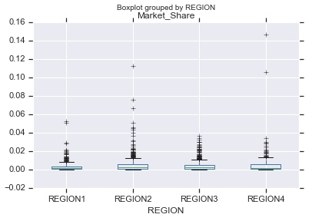
Data Exploration
PMI related products
Mostly categorical features
Success rate on sample (threshold 0,7%): 18,94% - Positively Skewed distribution

Slide 4
Data Exploration
Feature | Assumption | Example | Note
REGION | 4 Continents | la&c, eu, eema, asia
MARKET | Geo, laws | Swiss Canton
BRM, BRANDEDMARKET, BRANDONMARKET | Set of attributes defining the product | Cigarettes, Marlboro, flavor, Menthol, Length | Highly correlated
BLDIMAGE | Blend Image
BRANDDIFFERENT. |  | Blondes, Red, Flavor+
BRANDFAMILY (SUB..) |  | Marlboro (Gold etc…) | Highly correlated
CHARINDICATOR | Charcoal Indicator
BRMID | ID |  | 2 clusters
RTYPE | Filter type? |  | Many NA
INTERNATIONALINDIC | Indicator in English?
ITEMSHAPE | Product Shape | Rigid (for packets)
ITEMSCODE | Number of cigarettes | 20
LEN | Length of cigarettes | 85
LENCATEGORY | Length size | King Size, 100s

Slide 5
Data Exploration
Feature | Assumption | Example | Note
PRICECLASS, ON | Price range, currency?
LOCALCLASS | Local price class?
MINDICATOR | Menthol Indicator | Y/N
NCON | Nicotine Content | 0,6
NPLLAUNCHDATE | New Product Launch | Jan 2008
NPLLAUNCHYEAR |  | 2008
PCKT | Packet Type?
TCLASS | Trademark?
RETAILPACKPRICE | Local price |  | Unstandardized
TRCONTE | Content?
THICATEGORY | Thickness | Regular
TIPCOLOR | Color (butt)?
TRACKINGSTATUS

Slide 6
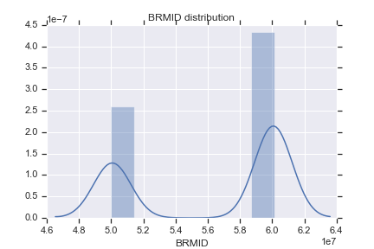
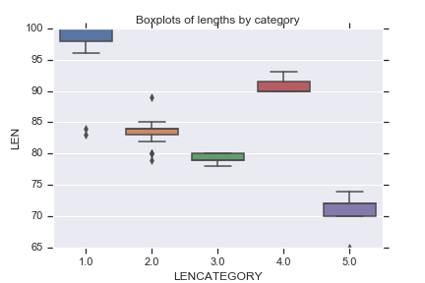
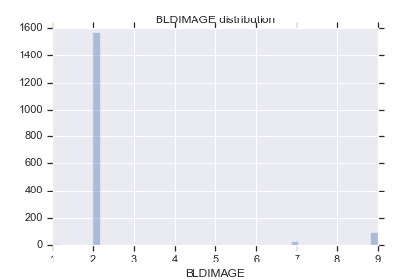
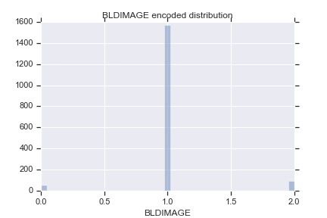
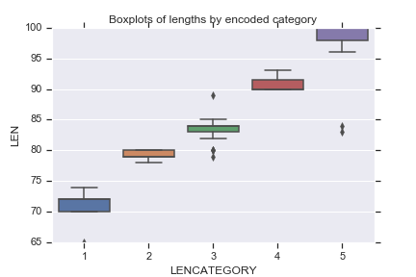
Pre-Processing
Category & Encoding
Nominal
Binary: 0/1 Encoding, e.g. CHARINDICATOR, MINDICATOR…
Low Cardinality: One Hot Encoder (K-1 binary classes), e.g. REGION
High Cardinality highly skewed: OHE on 0,95 percentile of sample and new class for OTHER 5%, e.g.
High Cardinality uniformly distributed: Hashing Encoder, e.g. MARKET, BRM, BRANDDIFFERENTIATOR, BRANDFAMILY
(1716, 40) (1716, 138)
Ordinal
(NPLLAUNCHYEAR, PRICECLASS?, THICATEGORY?)

Slide 7
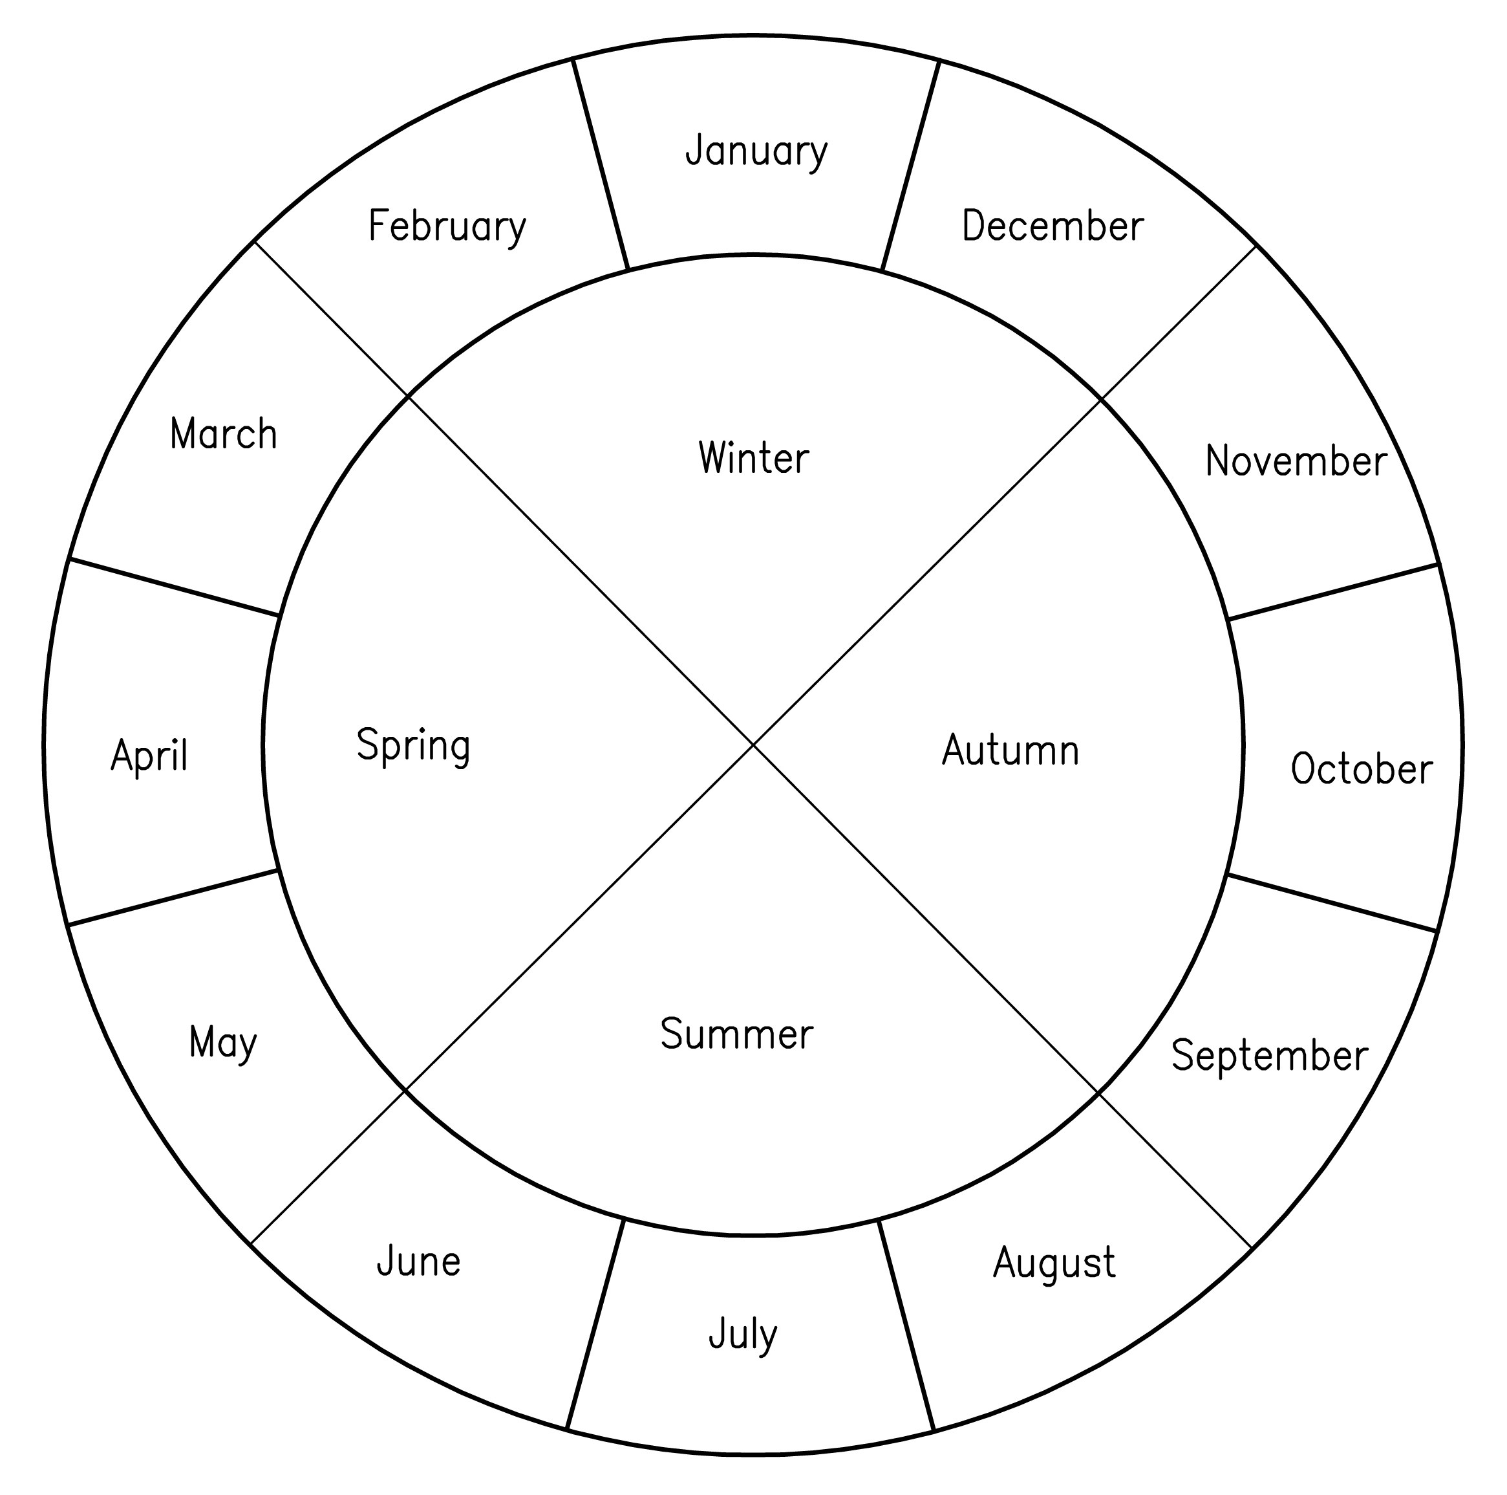
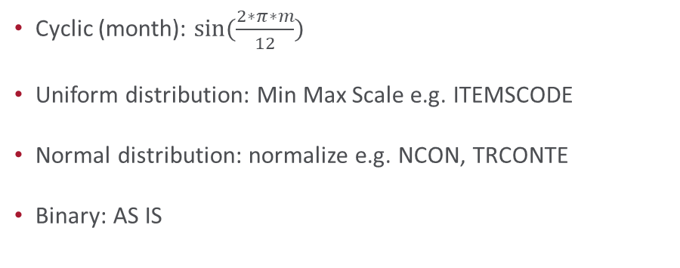
Pre-Processing
Missing Values & Standardization
Variable | # NA / 1716
RTYPE | 1243
ITEMSHAPE | 912
SPECIALFLAVOR | 1042
TIPCOLOR | 842
For each variable add one Category indicating NA
Cyclic (month): $\sin{(\frac{2∗π∗m}{12})}$
Uniform distribution: Min Max Scale e.g. ITEMSCODE
Normal distribution: normalize e.g. NCON, TRCONTE
Binary: AS IS

Slide 8
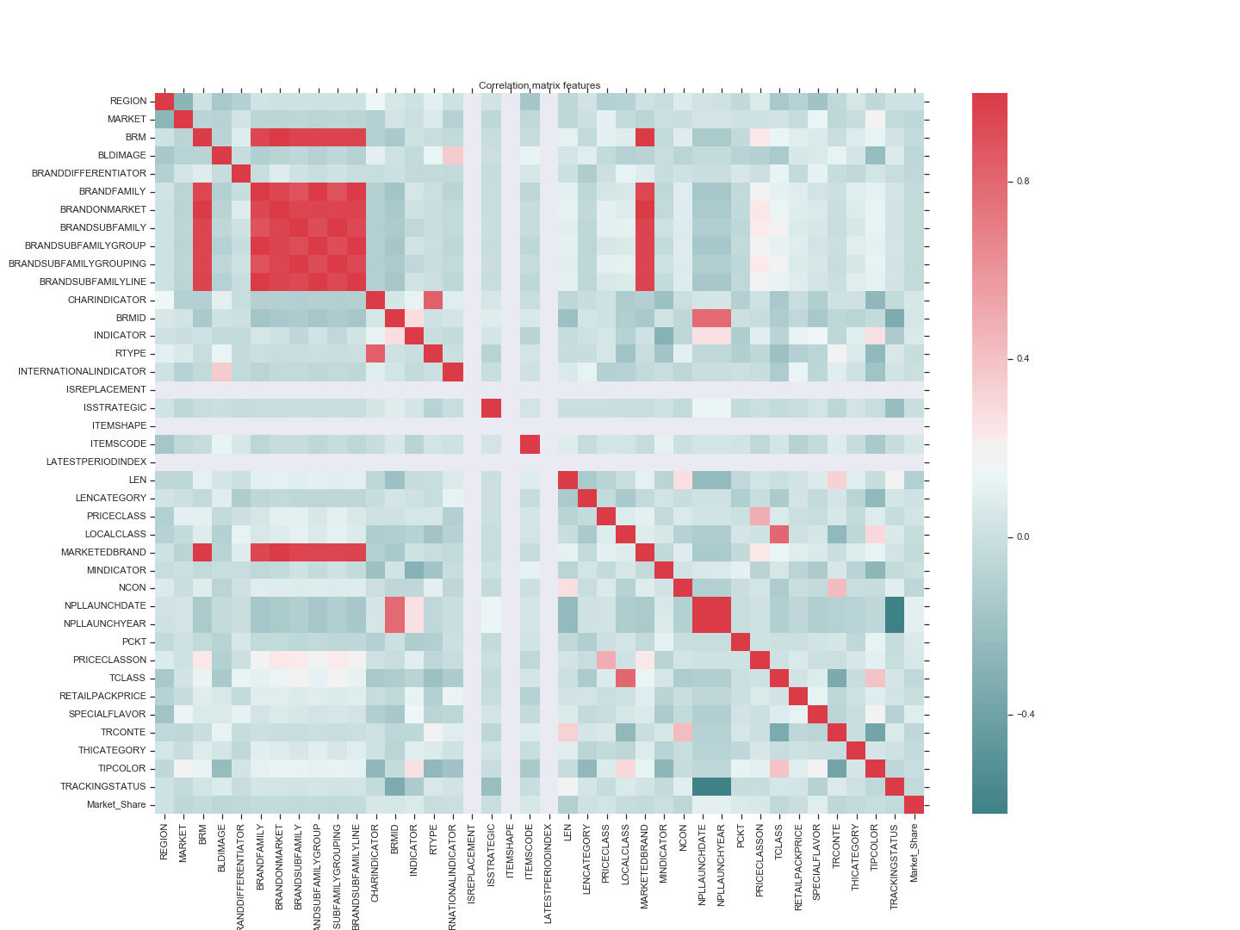
Pre-Processing
Feature Selection

Slide 9
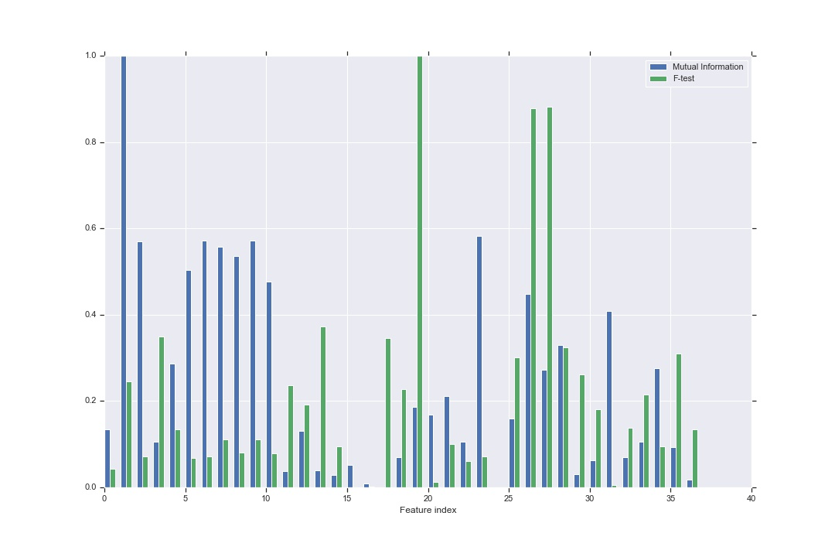
Pre-Processing
Feature Selection
Zero variance features, e.g. LATESTPERIODINDEX, ISREPLACEMENT
Highly correlated features (sub families/group/line, BRM = MARKETTEDBRAND): Transform column to 0/1 (1 if differs)
Univariate analysis Anova: Better representation with median (than mean) – Kruskal Wallis Test
ANOVA with Quantile Transformation
Feature | KW statistic | pvalue
Before encoding
NPLMONTH | 0.72 | 39,69%
TIPCOLOR | 3,42 | 6,45%
After encoding
BRANDSUBFAMILYGROUP | 0,95 | 32,99%
PCKT28 | 0,74 | 39,12%

Slide 10
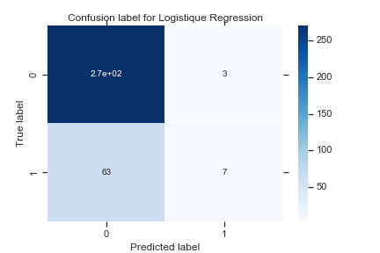
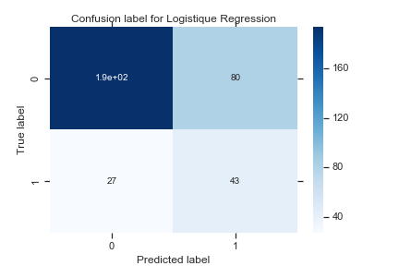
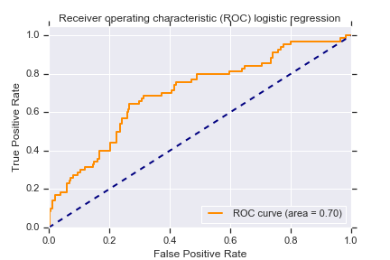

Initial Results
Classification – Logistique Regression
 | Precision | Recall | F1 Score
Failure | 81% | 99% | 89%
Success | 70% | 10% | 17%
 | Precision | Recall | F1 Score
Failure | 88% | 71% | 78%
Success | 35% | 61% | 45%

Slide 11
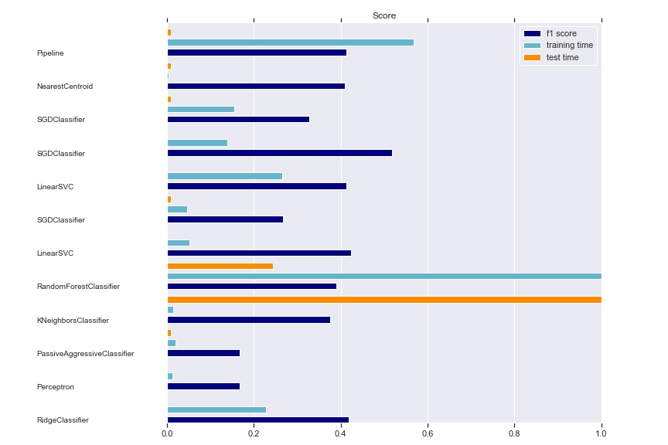
Results
Classification – Model Selection

Slide 12
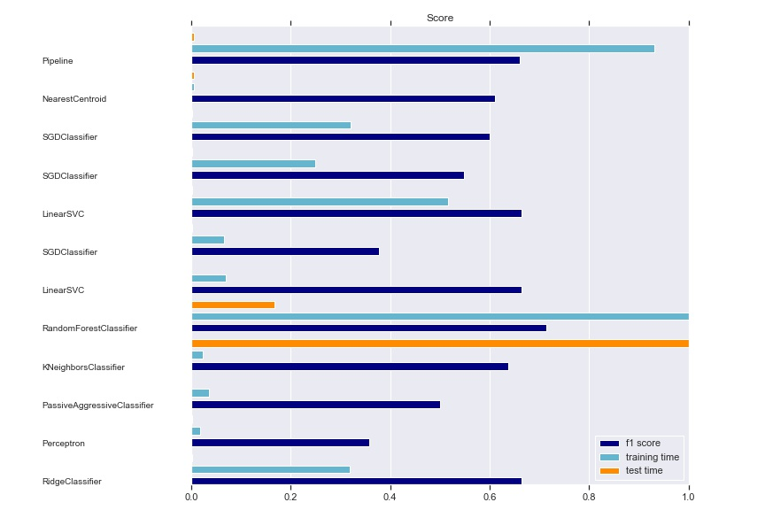
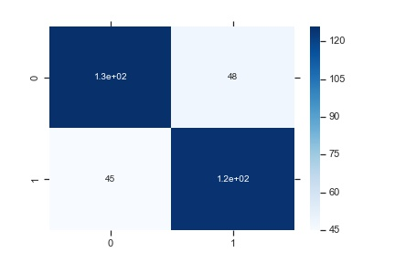
Results
Classification – Median Threshold: Balanced classes

Slide 13

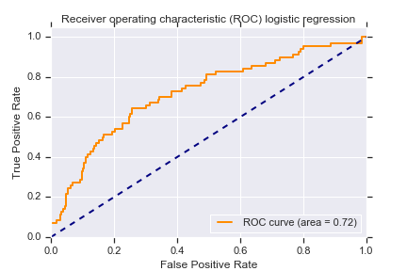
Results
Best model – SGDClassifier Elasticnet pen. (.15 l1 ratio), 2.3018e-04, balance weights, log loss
 | Precision | Recall | F1 Score
Failure | 89% | 99% | 81%
Success | 38% | 64% | 48%

Slide 14
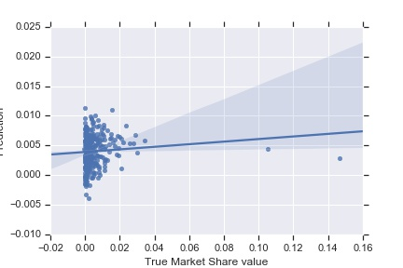
Results
Regression
Model | MAE | MSE | R2
Linear Regression (OLS) – Random train/test split 20% | 0,365% | 0,003% | 5,675%
OLS CV 5-fold | 0,442% +- 0,029% | 0,009% +- 0,003% | 1,457% +- 2,136%
Baseline (mean) | 0.431% +- 0.037% | 0.007% +- 0.003% | -1.152% +- 1.971%
Baseline(median) | 0.370% +- 0.049% | 0.007% +- 0.004% | -9.859% +- 4.146%
Ridge Regression | 0.408% +- 0.034% | 0.006% +- 0.003% | 1.392% +- 5.404%

Slide 15
Takeaways & Next Steps
Fit a gamma distribution instead
This metric should not be used as a go/no go indicator:
Consider strategic and financial consequences
Trend, marketing and competition
Support decision making
For new market entries:
Good predictors: NCON, MARKET, LEN, PRICECLASS, INDICATOR, NPLLAUNCHYEAR, BRANDFAMILY and PCKT (7 and 11)
Bad predictors: ISSTRATEGIC
Fetch external data:
Macro economics features to take into account system effects
PMI-related events, global market events

