Slide 1
Front End Engineering-I Project
Team Details:
Kritika Verma, 2310990469
Laksha Bansal, 2310990472
Kunika, 2310990471
Kuhu, 2310990470
Faculty Coordinator: Mr. Neeraj Singla
:
Chitkara University Institute of Engineering and Technology,
Chitkara University, Punjab

Slide 2
Table of Contents :-
Introduction
Problem Statement
Technical Details
Key Features
Project Highlights
Conclusion
References/Links used

Slide 3
Introduction :-
A blog is a website used for a chronological listing of blog posts.
A blog has the most recent content shown first followed by the previously updated content.
In a blog there are multiple categories and posts written by a large number of authors

Slide 4
Problem Statement :-
In the dynamic landscape of online content consumption, the need for an engaging and seamlessly functional blog page is paramount. Developing an effective blog platform involves addressing various challenges to ensure a positive user experience, optimal performance, and adherence to modern design standards.
Objective: The primary objective of this project is to design and implement an intuitive, responsive, and feature-rich blog page that caters to the diverse needs of users. This includes not only providing an aesthetically pleasing interface but also optimizing performance, ensuring accessibility, and incorporating essential functionalities that enhance user engagement

Slide 5
Key Challenges:
User-Friendly Interface: Designing an interface that is not only visually appealing but also user-friendly poses a significant challenge. The layout should facilitate easy navigation, making it effortless for users to find and consume content.
2. Mobile Responsiveness: With the increasing use of mobile devices for content consumption, ensuring seamless responsiveness across various screen sizes and devices is crucial. The blog page should adapt gracefully to different resolutions without compromising on usability.
3. Performance Optimization: Load times play a critical role in user satisfaction. Optimizing the blog page for performance, including fast loading times and minimal latency, is essential for retaining user interest.

Slide 6
4. Content Management: Implementing an efficient content management system (CMS) that allows easy creation, editing, and organization of blog posts is a challenge. This includes features such as categorization, tags, and a user-friendly editor.
5. Search Engine Optimization (SEO): Enhancing the visibility of the blog in search engine results is vital for attracting organic traffic. Implementing SEO best practices, such as meta tags, sitemaps, and clean URLs, is a critical aspect of the development process.
6. Security: Safeguarding user data and the integrity of the blog platform is of utmost importance. Implementing robust security measures to prevent vulnerabilities, data breaches, and unauthorized access is a constant challenge.

Slide 7
7. Integration of Multimedia: Incorporating multimedia elements, such as images and videos, seamlessly into blog posts while ensuring optimal loading times and compatibility across devices adds another layer of complexity.
Deliverables: The successful completion of this project will result in a fully functional, aesthetically pleasing, and user-centric blog page. The deliverables will include a responsive design, efficient content management features, optimized performance, and adherence to SEO and security best practices.

Slide 8
Technical Details :-
Tools
Notepad++ (v 7.1)
2. XAMPP (v 3.2.2)
Languages
SQL
PHP (v 7.0.4)
HTML (v 5)
CSS (v 3)5. Java script

Slide 9
Key Features :-
The system we have developed allows users to create their own blogs, where users can publish their own opinions.
• In this system there are admins who take care of the Blog.
• If anyone wants to post first they will have to create a new blog as well as a site account.
The posts may verified by the admins.
There is a category list where posts can be saved by relevant category.

Slide 10
Key Features :-
People can like, comment, and share the posts
Full responsive, Compatible with pc, tab, and mobile devices
Like, Comment featured
Has a pagination feature

Slide 11
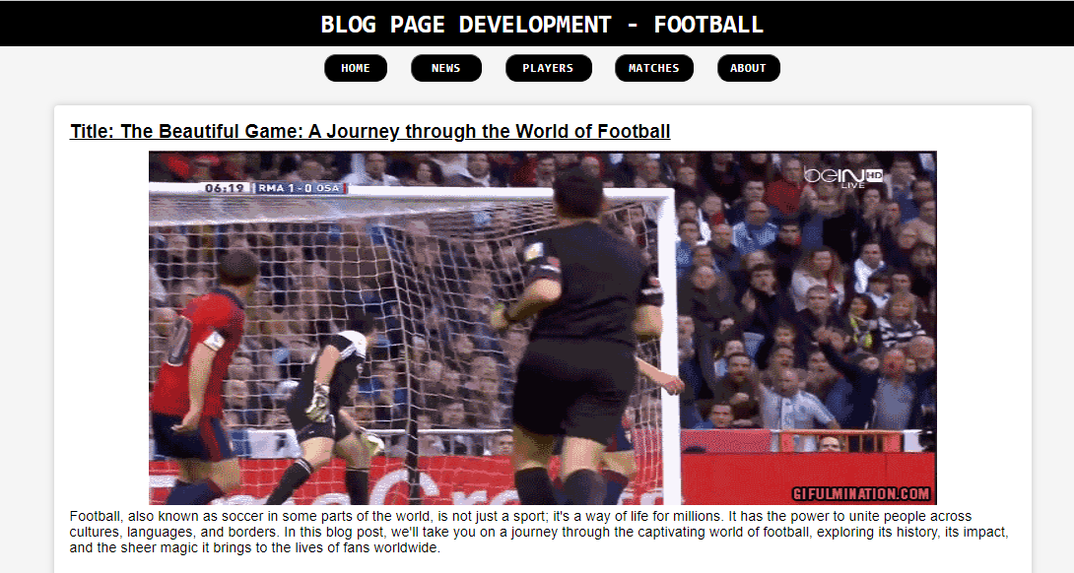
Project Highlights :-

Slide 12
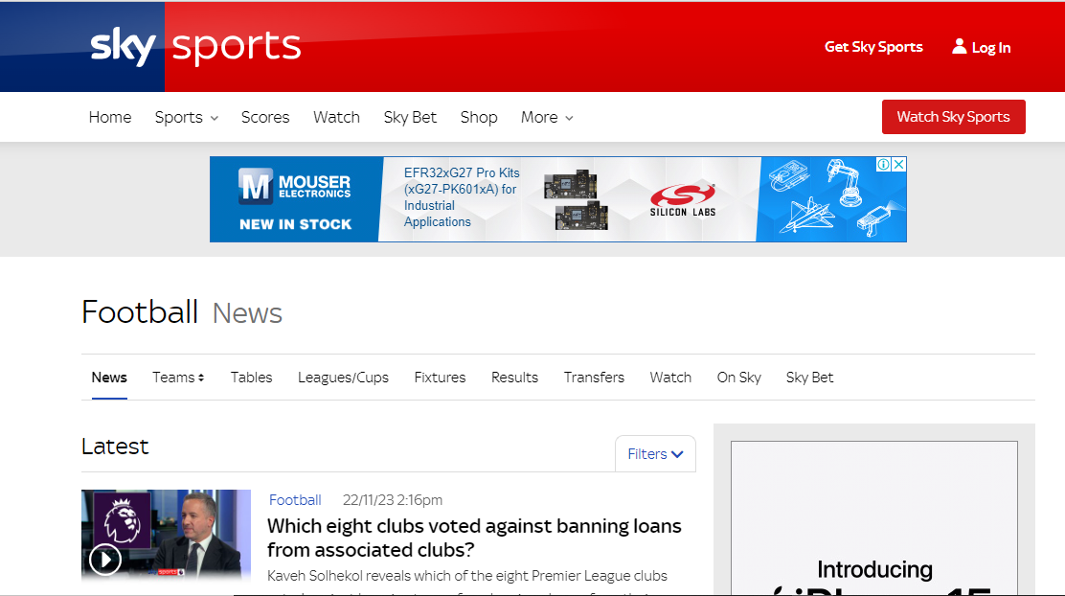
News

Slide 13
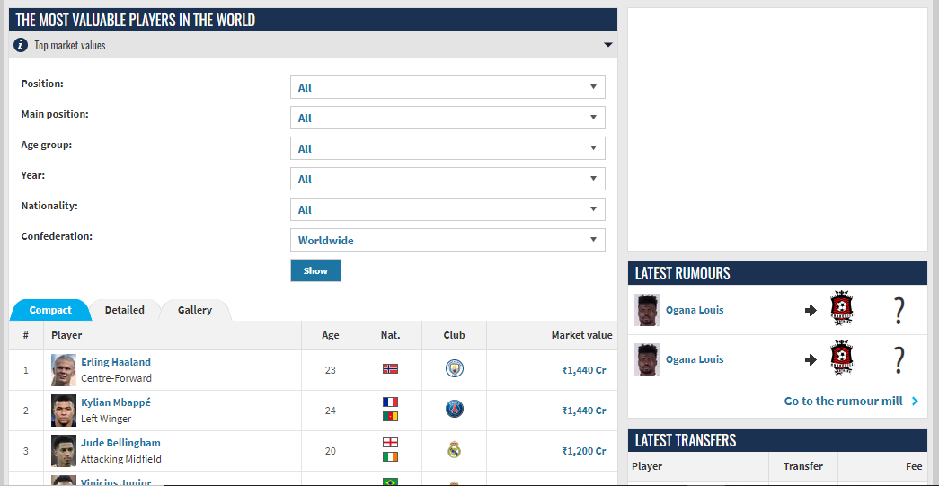
Detailed
Info
about
players

Slide 14
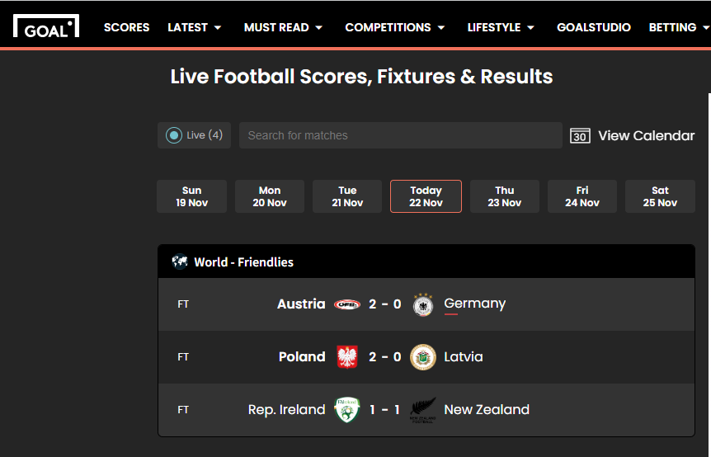
Enjoy
Live
Matches !!

Slide 15
Conclusion :-
Mail confirmation function implementation was not possible due to the localhost server but we tested it.
It wasn't our plan but we worked on adding profile pictures and images on posts.

Slide 16
References/Links used :-
Links:
https://www.skysports.com/football/news
https://www.transfermarkt.co.in/spieler-statistik/wertvollstespieler/marktwertetop/mw
https://www.goal.com/en-in/live-scores

Slide 17


