Slide 1
OPERATING SYSTEMS
History and Hardware
Jerry Breecher

Slide 2
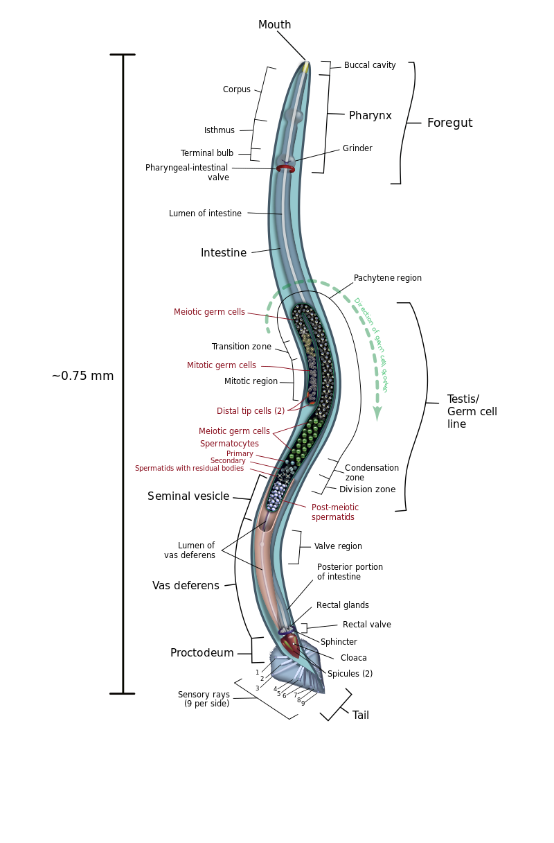
This is the simplest animal with a “brain”
Caenorphabditis elegans
C. elegans is one of the simplest organisms with a nervous system. This system comprises 302 neurons the pattern of which has been comprehensively mapped, in what is known as a connectome.
There are sensory neurons, motor neurons, and interconnecting neurons.
There are
16 chemical sensor neurons,
2 thermal sensors,
28 mechanical (touch) neurons,
4 light sensors,
and additional neurons and synapsis for learning and memory.

Slide 3
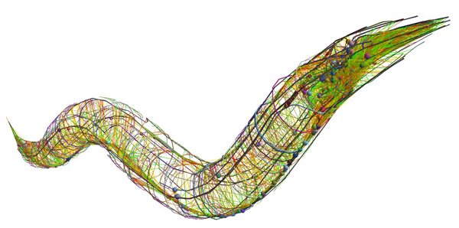
Caenorphabditis elegans
Dots represent the cell bodies of neurons; long lines represent the neurons' axons and dendrites.
Scientists were able to label every one of the 302 neurons as either a sensory neuron (one that collects information from the environment, such as temperature or pressure); a motor neuron that controls muscles; or an interneuron, which connects the two.

Slide 4
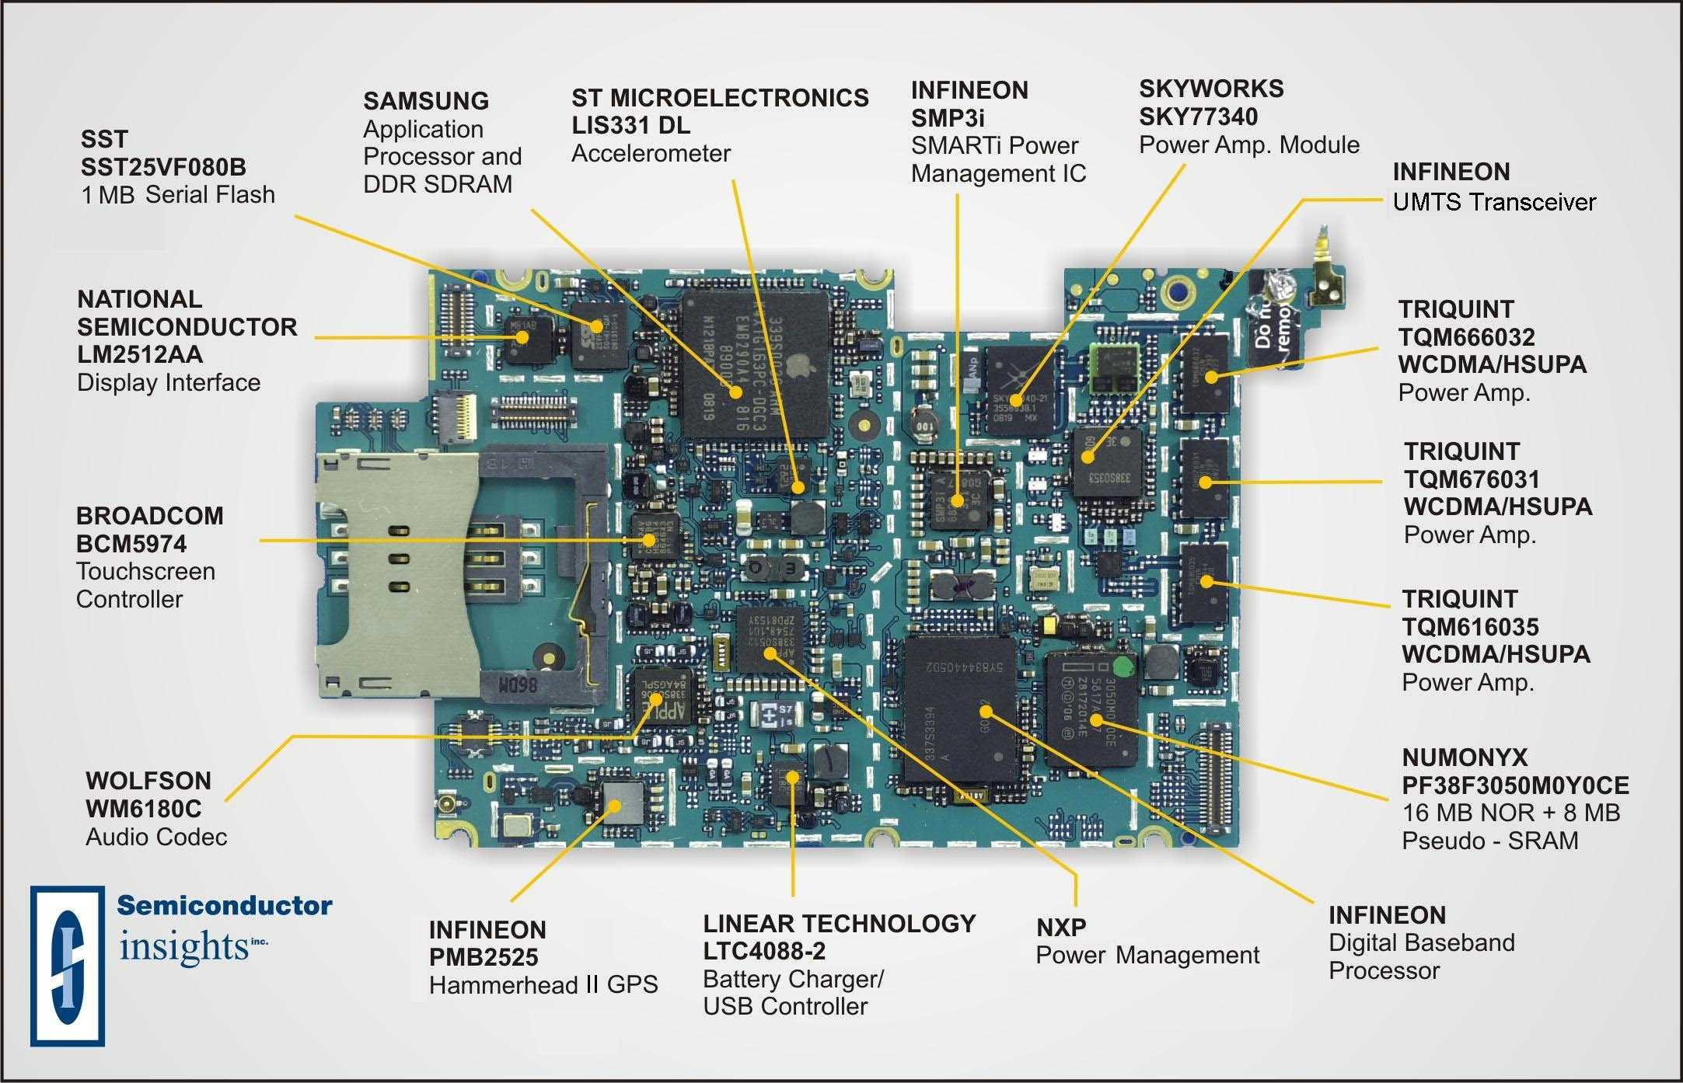
Inside an I-Phone
There are Sensors Everywhere!
Sensor
Sensor
Sensor
Sensor
Sensor
Sensor

Slide 5
What is an Operating System?
It’s the mechanism that connects the hardware’s inputs and outputs and provides an interface for a user.
The inputs and outputs are what determines the OS. As the hardware and user changes, so does the OS.
So let’s spend a few minutes looking at the history of computer hardware – from that we can see why the OS is what it is.

Slide 6
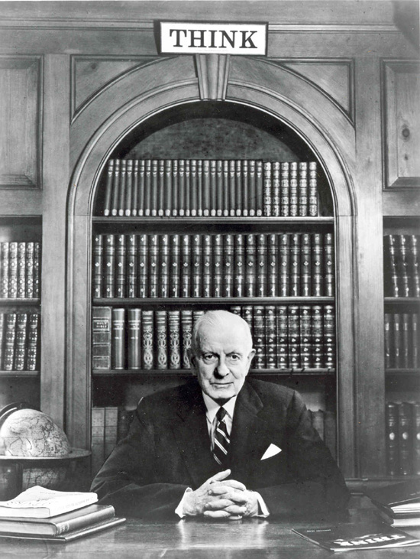
Really??
1943
T.J. Watson (created IBM): “ I think there is a world market for maybe five
computers.”
Fast forward … 1950
There are maybe 20 computers in the world
They were unbelievably expensive
Imagine this: machine time is more valuable than person time!
So: efficient use of the hardware is paramount
Operating systems are born to use this valuable resource

Slide 7
What is an Operating System?
Printer
Diskosaurus
CPU
Input Device
Memory
In the very beginning…
OS was just a library of code that you linked into your program; programs were loaded in their entirety into memory, and executed. Your program and the OS were one!
“OS” had an “API” that let you control the disk, control the printer, etc.
Interfaces were literally switches and blinking lights
When you were done running your program, you’d leave and turn the computer over to the next person

Slide 8
What is an Operating System?
Disk Controller
The diskosaurus was really slow
Add hardware so that the disk could operate without tying up the CPU
Disk controller
Hotshot programmers could now write code that:
Starts an I/O
Goes off and does some computing
Checks if the I/O is done at some later time
Upside
Helps increase (expensive) CPU utilization
Resident Monitor
Everyone was using the same library of code
Why not keep it in memory?
While we’re at it, make it capable of loading Program 4 while running Program 3 and printing the output of Program 2
SPOOLing – Simultaneous Peripheral Operations On-Line
What new requirements does this impose?

Slide 9
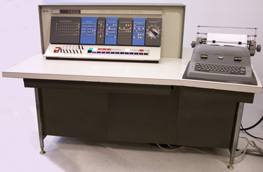
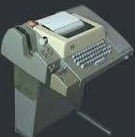
What is an Operating System?
The IBM 1620 – the machine on which I did my Ph.D. research.
The processor of the 1620 was listed at $64K, with another $40Kfor 20,000 digits of core storage and $10K for the for paper tape. Total cost of $114K or about $1M in today’s dollars.
Programming required loading pass 1 of the Fortran II compiler, then the source code, producing an intermediate tape, loading the 2nd pass of the compiler along with the intermediate tape.
Adding two 10-digit numbers together on the 1620 took 960µs, including loading the operands and storing the results. That’s about 0.001 MIPS.
Paper tape punch/reader.

Slide 10
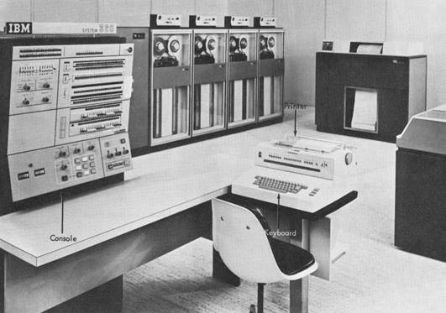
What is an Operating System?
To further increase system utilization, multiprogramming OSs were invented
keeps multiple runnable jobs loaded in memory at once
overlaps I/O of one job with computing of another
while one job waits for I/O completion, another job uses the CPU
IBM System 360
Can get rid of asynchronous I/O within individual jobs
Life of application programmer becomes simpler; only the OS programmer needs to deal with asynchronous events.
How do we tell when devices are done?
Interrupts
Polling
What new requirements does this impose?

Slide 11
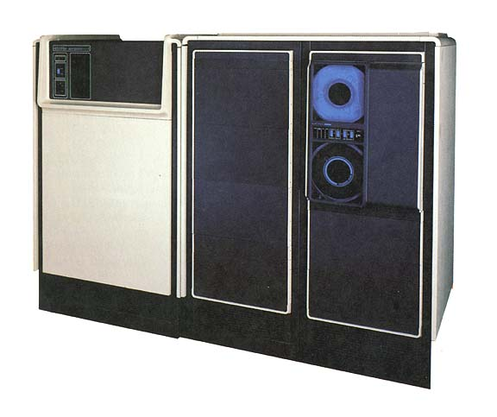
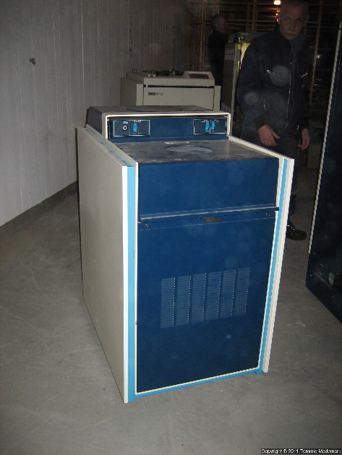
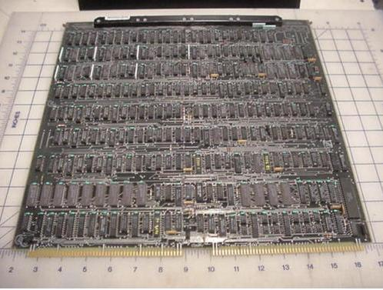
What is an Operating System?
1980 Data General MV8000 – first machine I worked on in my Software Engineering career.
1 MIPS processor, 1 Mbyte of memory, 32-bit address space.
Board is discreet logic – no microprocessors.
Disk is 200 Mbytes – size of a washing machine.

Slide 12
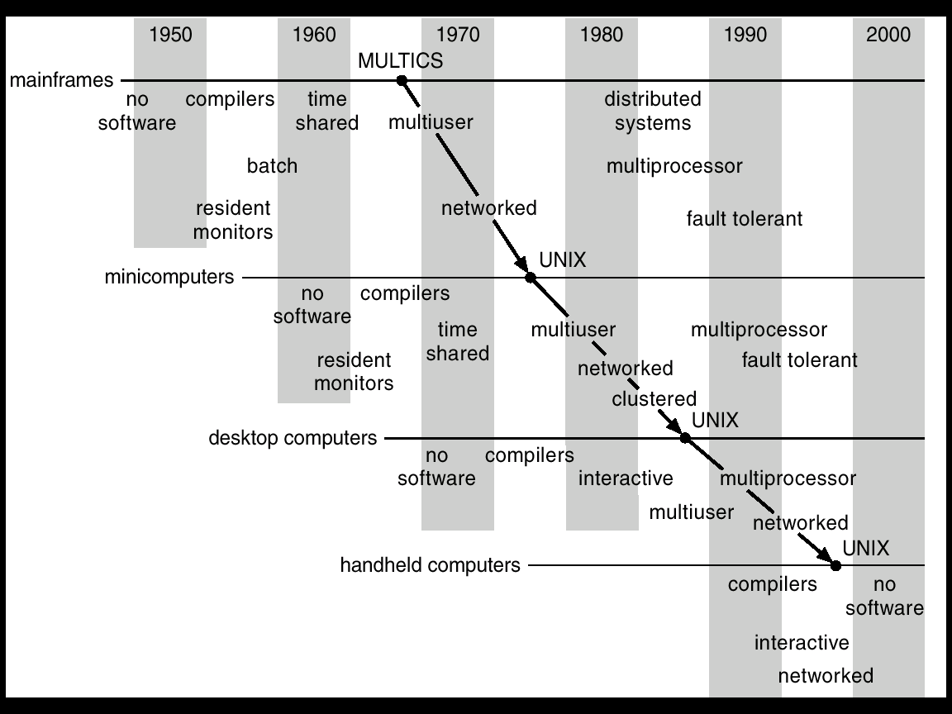
Operating System Genealogy

Slide 13
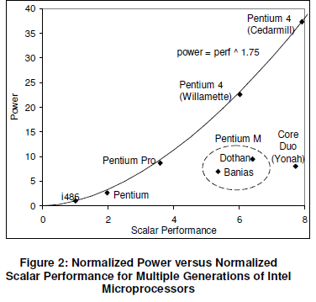
Operating System – Power Usage
The job of the OS is to make the most of the hardware presented to it!
OS must figure out a way to reduce power usage.

Slide 14
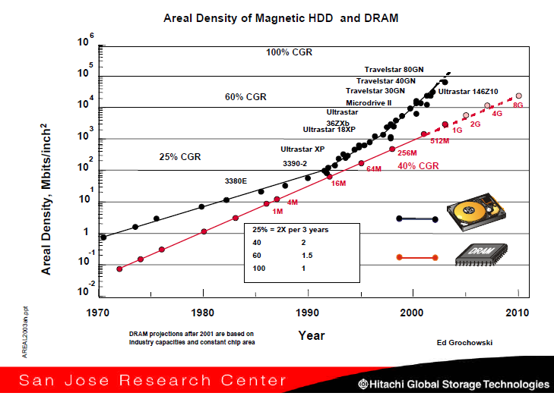
Operating System – Disk Characteristics
The job of the OS is to make the most of the hardware presented to it!
What is the relative performance win of putting more data on disk?

Slide 15
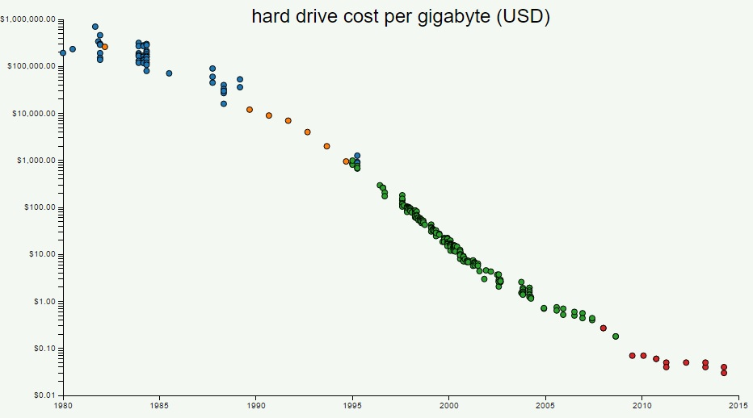
Operating System – Disk Characteristics
The job of the OS is to make the most of the hardware presented to it!

Slide 16
Operating System – Disk Characteristics
The job of the OS is to make the most of the hardware presented to it!
Disks are “big” and “cheap”, but they aren’t “close”.

Slide 17
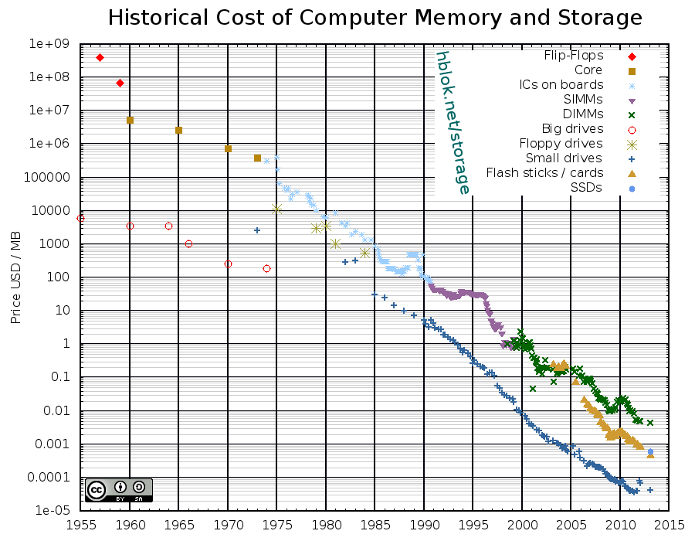
Operating System - Memory
The job of the OS is to make the most of the hardware presented to it!
Memory is cheap and fast – caches allow data to be kept close to the processor.

Slide 18
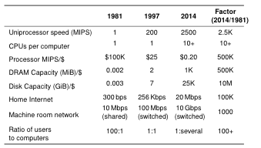
Operating System – Relative Performance
How all these speeds and sizes play together.
The job of the OS is to make the most of the hardware presented to it!

Slide 19
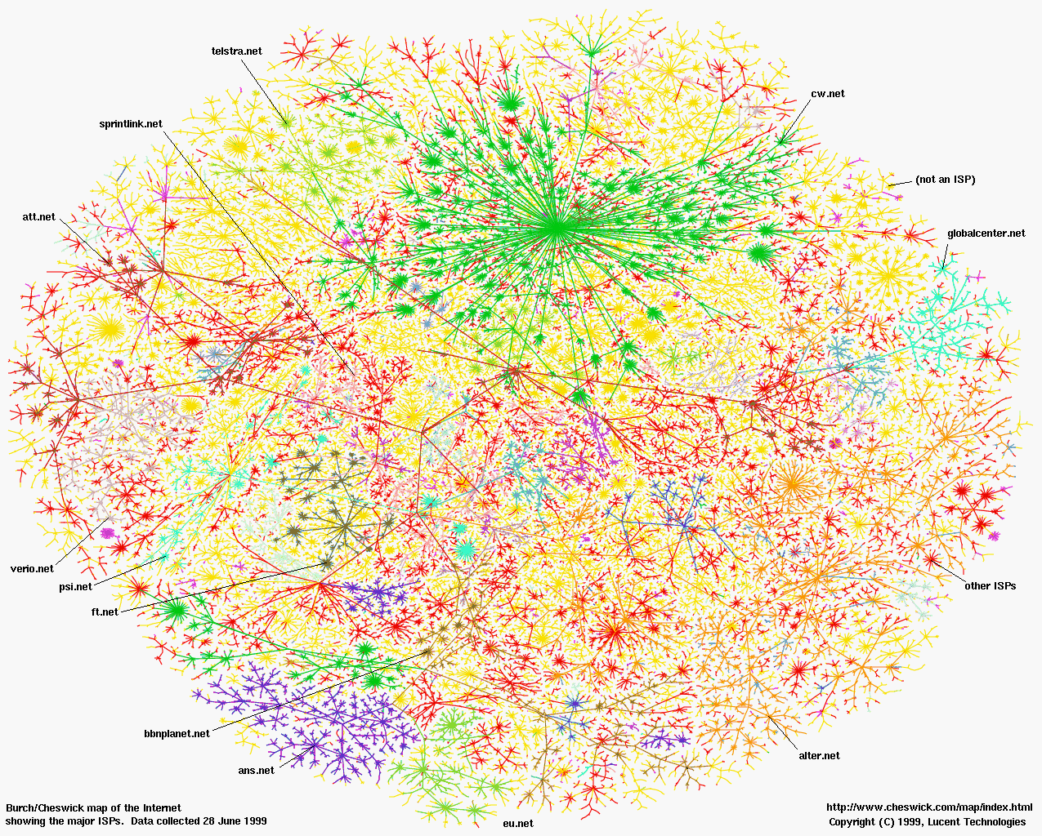
Operating System – the future?
A map of the 4 billion nodes in the Internet. How does the OS enable it to operate?
The intelligence is in the nodes, not in the connecting wires and network.

Slide 20
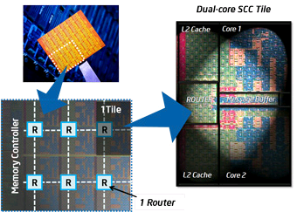
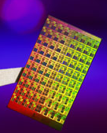
ManyCore Chips: The future is here
Operating System – the future?
Intel 80-core Enterprise chip (Feb 2007)
80 simple cores
Two FP-engines / core
Mesh-like network
100 million transistors
65nm feature size
Intel Single-Chip Cloud Computer (August 2010)
24 “tiles” with two cores/tile
24-router mesh network
4 DDR3 memory controllers
Hardware support for message-passing
Intel 10-core desktop chip (2016)

Slide 21
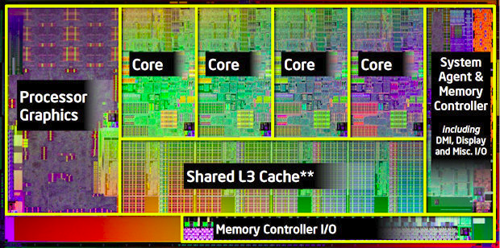
Operating System – the future?
Cache:
L1: 32K Inst, 32K Data (3 clock access)
L2: 256K (8 clock access)
Shared L3: 3MB – 20MB (not out yet)
Package: LGA 1155
1155 pins
95W design envelope
Transistor count:
504 Million (2 cores, 3MB L3)
2.27 Billion (8 cores, 20MB L3)

Slide 22
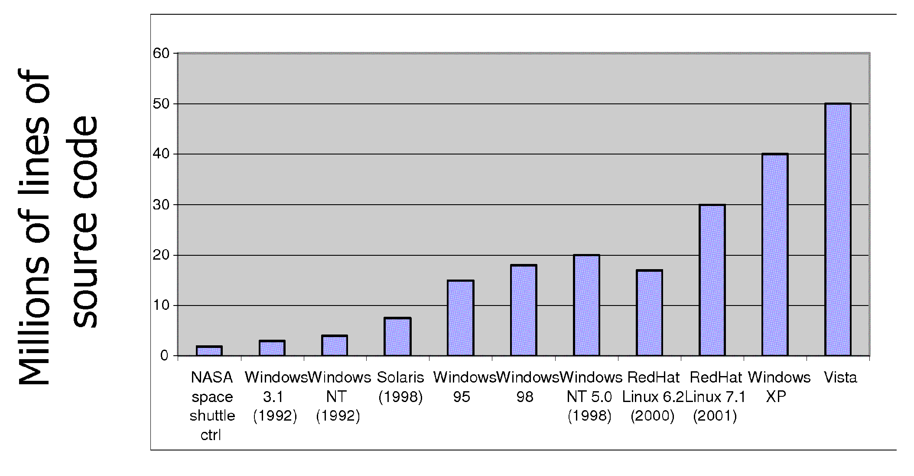
All this leads to Increasing Software Complexity
Operating System – the future?
http://www.informationisbeautiful.net/visualizations/million-lines-of-code/
Puts all this in perspective

Slide 23
Hardware Support For Fundamental OS Operations
Thread
Single unique execution context
Program Counter, Registers, Execution Flags, Stack ← Hardware support
Address Space with Translation
Programs execute in an address space that is distinct from the memory space of the physical machine ← Hardware support
Processes
An instance of an executing program is a process consisting of an address space and one or more threads of control ← Hardware support
Dual Mode (OS and user)/Protection
Only the “system” has the ability to access certain resources ← Hardware support
The OS and the hardware are protected from user programs and user programs are isolated from one another by controlling the translation from program virtual addresses to machine physical addresses

Slide 24
Hardware Support For Fundamental OS Operations
Thread
Special Word!
Certain special registers hold the context of thread
Stack pointer holds the address of the top of stack
Other conventions: Frame Pointer, Heap Pointer, Data
May be defined by the instruction set architecture or by compiler conventions
Thread: Single unique execution context
Program Counter, Registers, Execution Flags, Stack
A thread is executing on a processor when it is resident in the processor registers.
PC register holds the address of executing instruction in the thread.
Registers hold the root state of the thread.
The rest is “in memory”

Slide 25
Hardware Support For Fundamental OS Operations
Address Space with Translation
Address space ⇒ the set of accessible addresses + state associated with them:
For a 32-bit processor there are 2³² = 4 billion addresses
What happens when you read or write to an address?
Perhaps Nothing
Perhaps acts like regular memory
Perhaps ignores writes
Perhaps causes I/O operation
(Memory-mapped I/O)
Perhaps causes exception (fault)
These all depend on hardware support!
0xFFF…
stack
heap
Static Data
code
0x000…

Slide 26
Hardware Support For Fundamental OS Operations
Address Space with Translation
0xFFF…
stack
PC:
SP:
heap
Processor
registers
Static Data
instruction
Code Segment
0x000…
What’s in the code Segment?
What’s in the Static Data Segment?
What’s in the Stack Segment?
How is it allocated? How big is it?
What’s in the Heap Segment?
How is it allocated? How big?

Slide 27
Hardware Support For Fundamental OS Operations
Processes – especially multiple processes
Proc 1
Proc 2
Proc n
stack
…
heap
Static Data
OS
code
stack
heap
Static Data
code
stack
heap
Static Data
code

Slide 28
How can we give the illusion of multiple processors?
Hardware Support For Fundamental OS Operations
Processes – especially multiple processes
vCPU1
vCPU2
vCPU3
vCPU1
vCPU2
vCPU3
vCPU1
vCPU2
Shared Memory
Time
Assume a single processor. How do we provide the illusion of multiple processors?
Multiplex in time!
Each virtual “CPU” needs a structure to hold:
Program Counter (PC), Stack Pointer (SP)
Registers (Integer, Floating point, others…?)
How switch from one virtual CPU to the next?
Save PC, SP, and registers in current state block
Load PC, SP, and registers from new state block
What triggers switch?
Timer, voluntary yield, I/O, other things

Slide 29
Concurrency
Hardware Support For Fundamental OS Operations
Processes – especially multiple processes
The basic problem of concurrency involves resources:
Hardware: single CPU, single DRAM, single I/O devices
Multiprogramming API: processes think they have exclusive access to shared resources
OS has to coordinate all activity
Multiple processes, I/O interrupts, …
How can it keep all these things straight?
Basic Idea: Use Virtual Machine abstraction
Simple machine abstraction for processes
Multiplex these abstract machines

Slide 30
Concurrency
Hardware Support For Fundamental OS Operations
Processes – especially multiple processes
All virtual CPUs share same non-CPU resources
I/O devices the same
Memory the same
Consequence of sharing:
Each thread can access the data of every other thread (good for sharing, bad for protection)
Threads can share instructions (good for sharing, bad for protection)
Can threads overwrite OS functions?
This (unprotected) model is common in:
Embedded applications
Windows 3.1/Early Macintosh (switch only with yield)
Windows 95—ME (switch with both yield and timer)

Slide 31
Hardware Support For Fundamental OS Operations
Protection
Operating System must protect itself from user programs
Reliability: compromising the operating system generally causes it to crash
Security: limit the scope of what processes can do
Privacy: limit each process to the data it is permitted to access
Fairness: each should be limited to its appropriate share of system resources (CPU time, memory, I/O, etc)
It must protect User programs from one another
Primary Mechanism: limit the translation from program address space to physical memory space
Can only touch what is mapped into process address space
Additional Mechanisms:
Privileged instructions, in/out instructions, special registers
syscall processing, subsystem implementation
(e.g., file access rights, etc)

Slide 32
Hardware Support For Fundamental OS Operations
Protection
Process: execution environment with Restricted Rights
Address Space with One or More Threads
Owns memory (address space)
Owns file descriptors, file system context, …
Encapsulate one or more threads sharing process resources
Why processes?
Protected from each other!
OS Protected from them
Processes provides memory protection
Threads more efficient than processes (later)
Fundamental tradeoff between protection and efficiency
Communication easier within a process
Communication harder between processes
Application instance consists of one or more processes

Slide 33
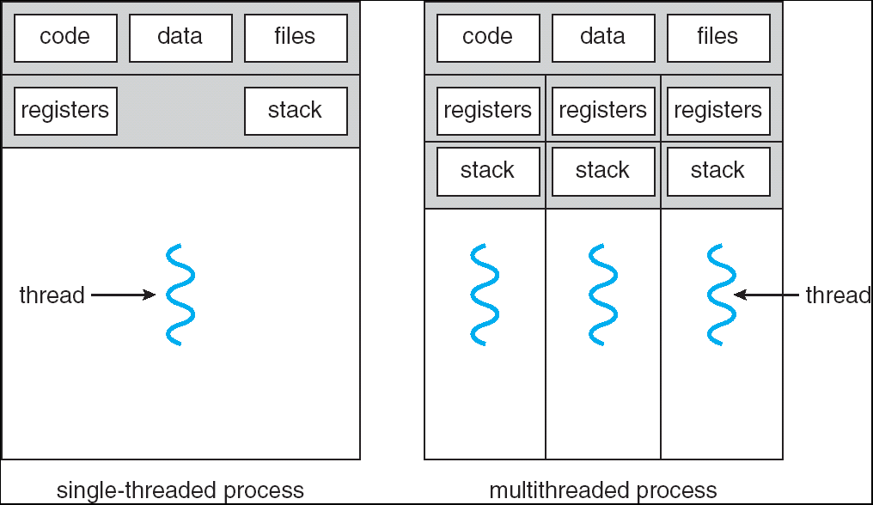
Single and Multithreaded Processes
Hardware Support For Fundamental OS Operations
Protection
Threads encapsulate concurrency: “Active” component
Address spaces encapsulate protection: “Passive” part
Keeps buggy program from trashing the system
Why have multiple threads per address space?

Slide 34
Hardware Support For Fundamental OS Operations
Protection
Hardware provides at least two modes:
“Kernel” mode (or “supervisor” or “protected”)
“User” mode: Normal programs executed
What is needed in the hardware to support “dual mode” operation?
a bit of state (user/system mode bit)
Certain operations / actions only permitted in system/kernel mode
In user mode they fail or trap
User→Kernel transition sets system mode AND saves the user PC
Operating system code carefully puts aside user state then performs the necessary operations
Kernel→User transition clears system mode AND restores appropriate user PC
return-from-interrupt

Slide 35
Hardware Support For Fundamental OS Operations
Protection
How can a user program safely get to the OS?
Syscall
Process requests a system service, e.g., exit
Like a function call, but “outside” the process
Does not have the address of the system function to call
Like a Remote Procedure Call (RPC) – for later
Marshall the syscall id and args in registers and exec syscall
Interrupt
External asynchronous event triggers context switch
eg. Timer, I/O device
Independent of user process
Trap or Exception
Internal synchronous event in process triggers context switch
e.g., Protection violation (segmentation fault), Divide by zero, …
All 3 are an UNPROGRAMMED CONTROL TRANSFER
Where does it go?

Slide 36
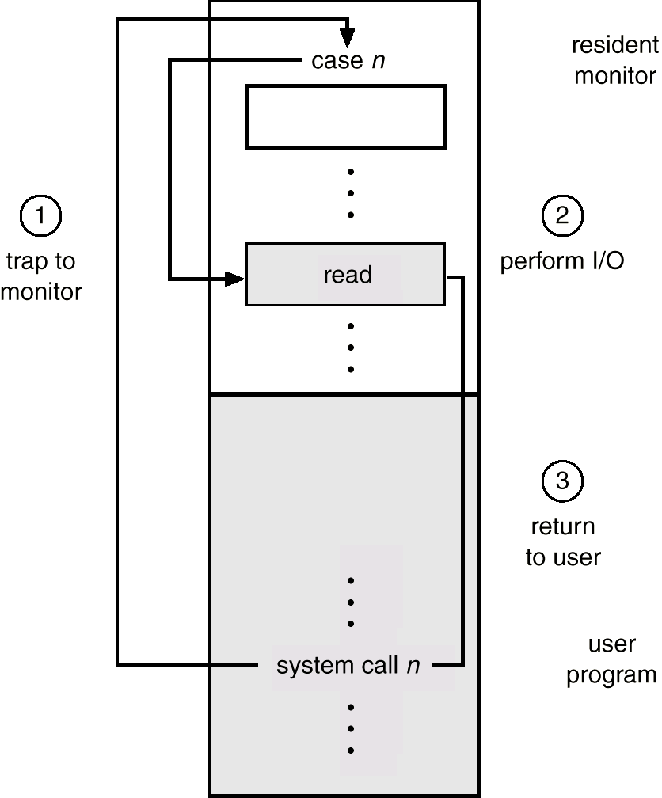
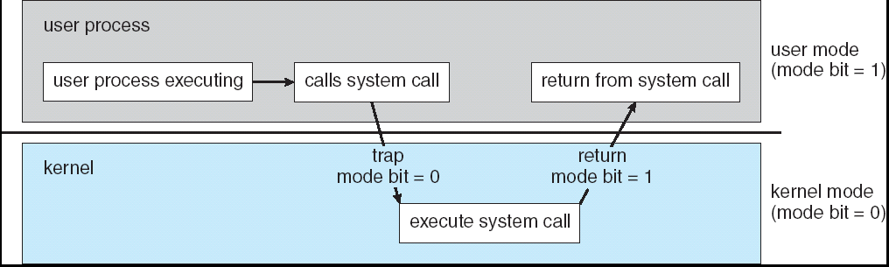
Hardware Support For Fundamental OS Operations
Protection
How can a user program safely get to the OS?
The goal is protecting the Operating System and others from malicious or ignorant users.
The User/Supervisor Mode and privileged instructions.
Concurrent threads might interfere with others. This leads to protection of resources by user/supervisor mode. These resources include:
I/O Define I/O instructions as privileged; they can be executed only in Supervisor mode. System calls get us from user to supervisor mode.

Slide 37
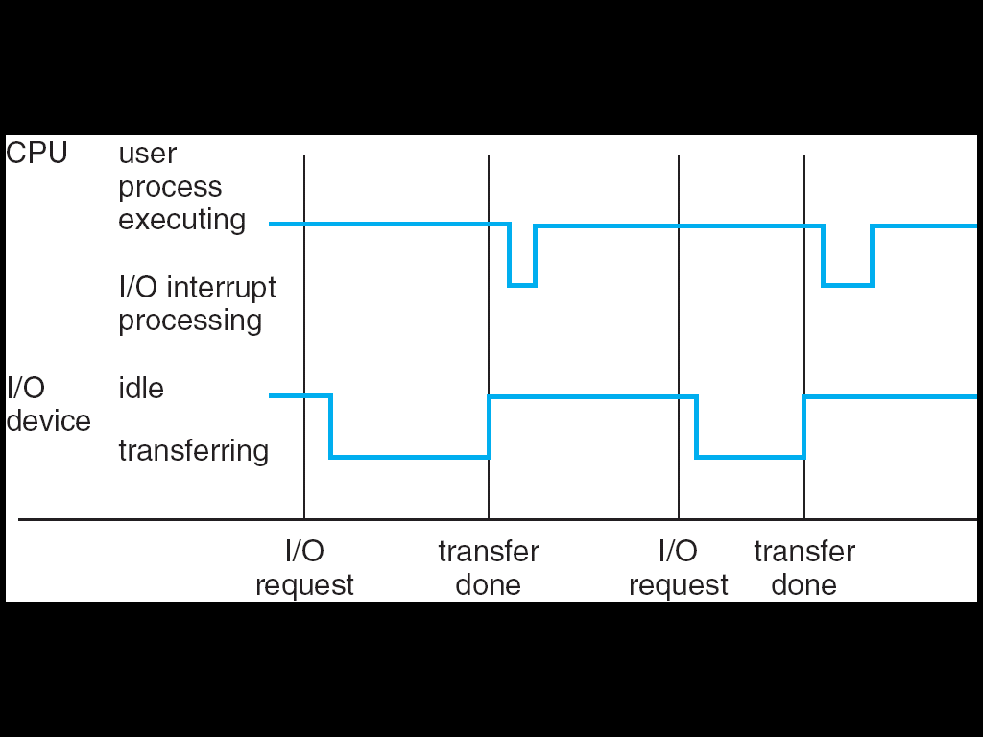
Hardware Support For Fundamental OS Operations
How Interrupts Work
Interrupt transfers control to the interrupt service routine generally, through the interrupt vector, which contains the addresses of all the service routines.
Interrupt architecture must save the address of the interrupted instruction.
Incoming interrupts are disabled while another interrupt is being processed to prevent a lost interrupt.
A trap is a software-generated interrupt caused either by an error or a user request.
An operating system is interrupt driven.

Slide 38
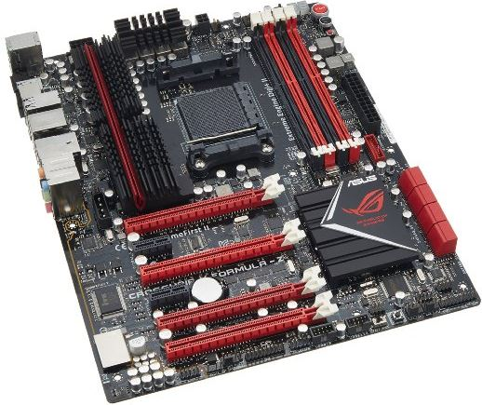
Hardware Support For Fundamental OS Operations
IO Support
These are the devices that make up a typical system.
Any of these devices can cause an electrical interrupt that grabs the attention of the CPU.

Slide 39
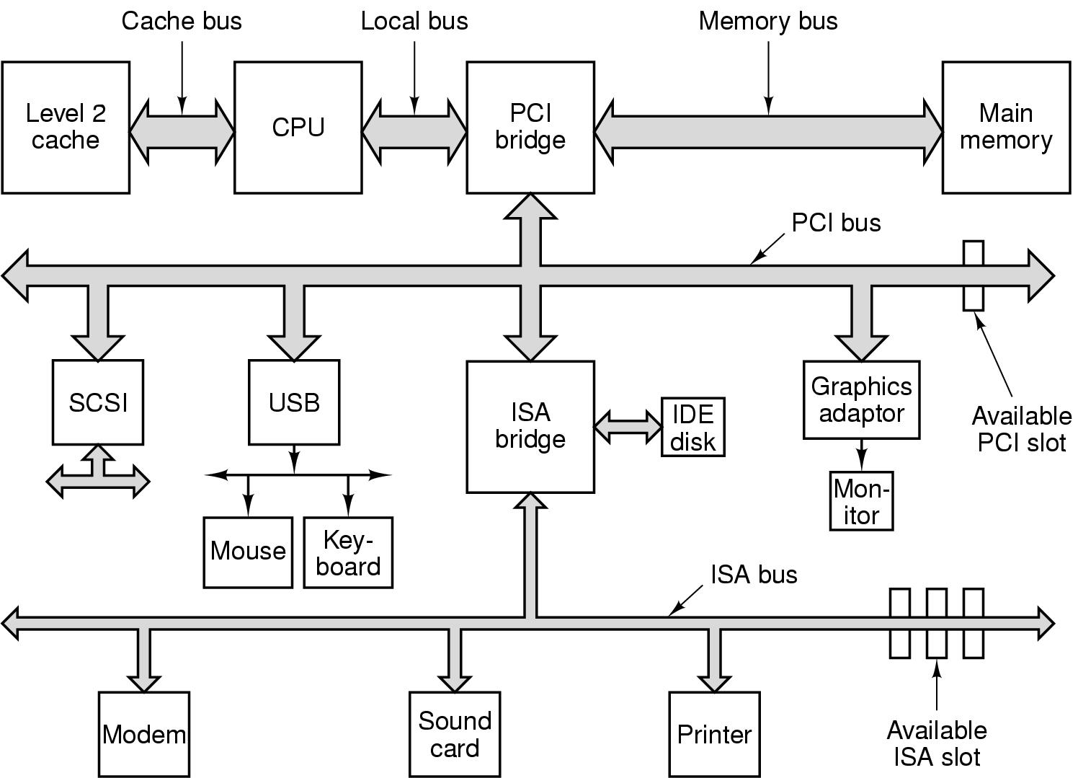
Hardware Support For Fundamental OS Operations
IO Support
These are the devices that make up a typical system.
Any of these devices can cause an electrical interrupt that grabs the attention of the CPU.

Slide 40
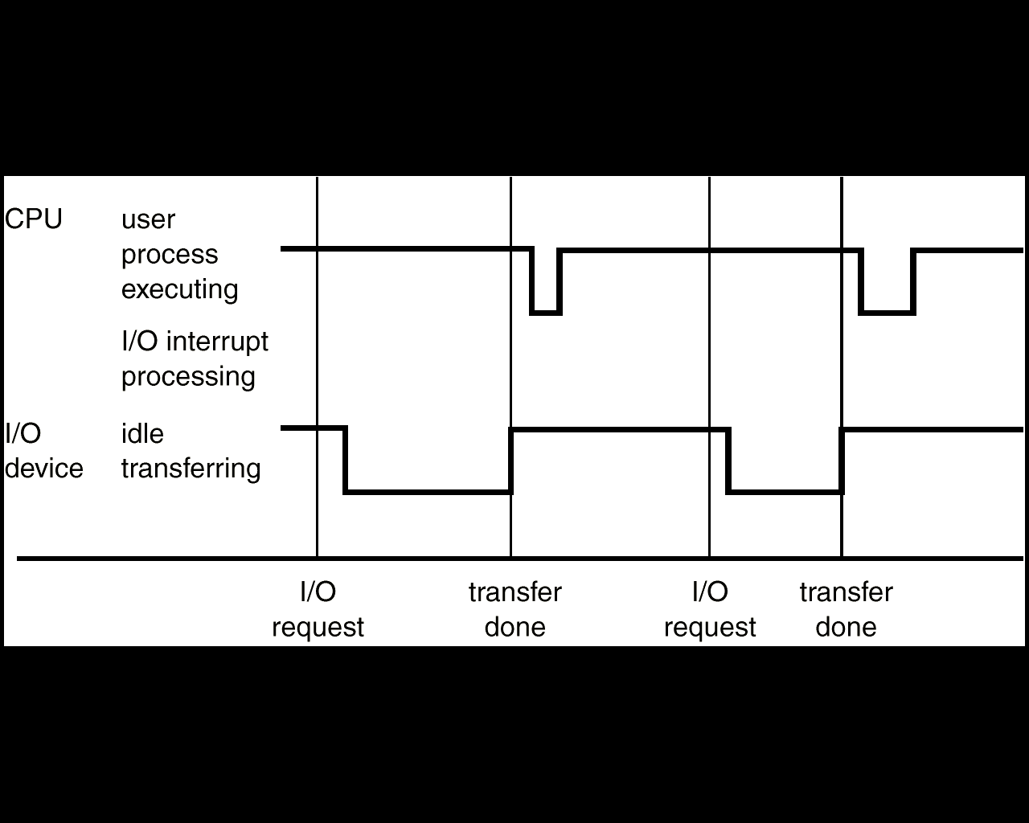
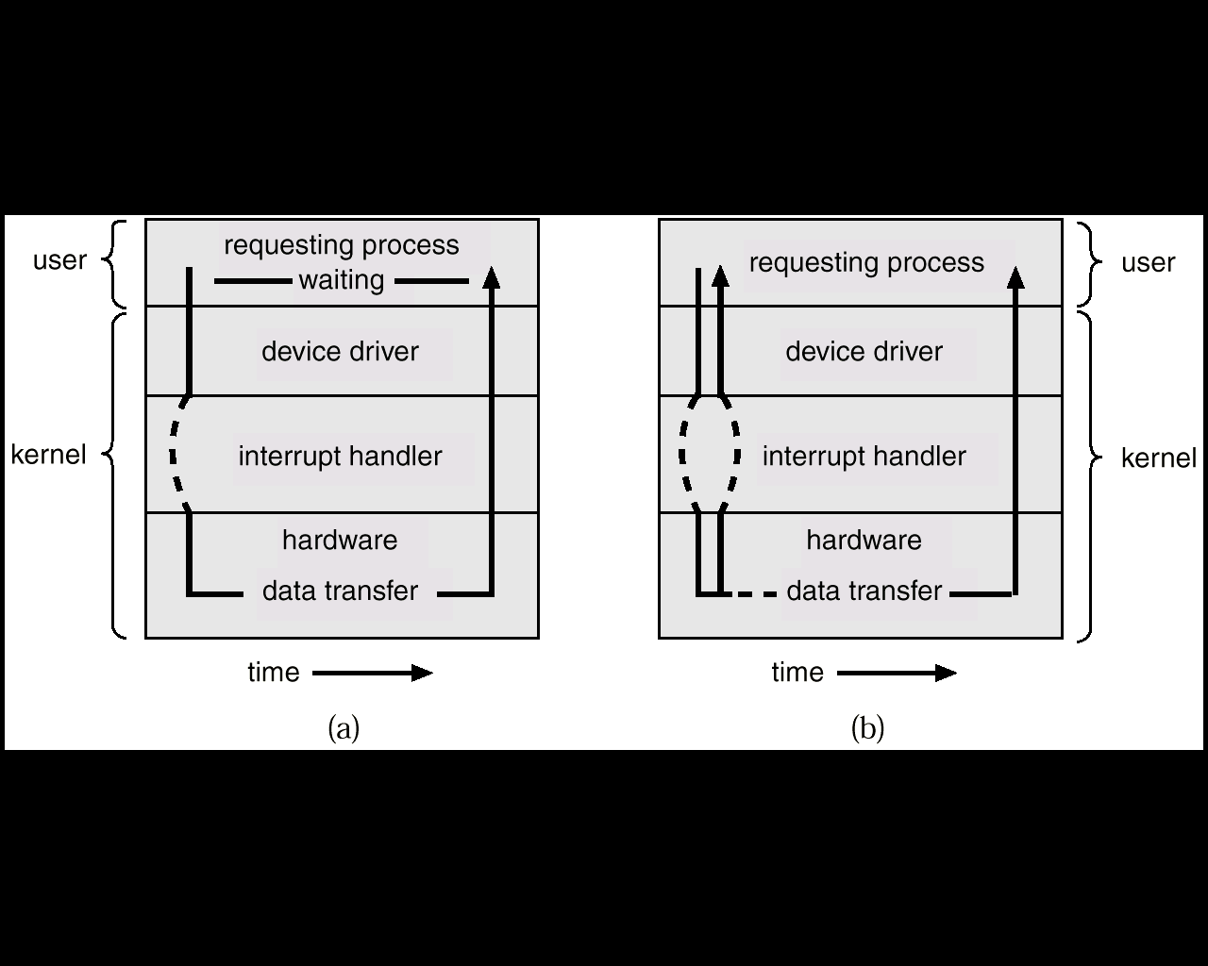
Hardware Support For Fundamental OS Operations
IO Support
Sequence of events for processing an IO request.
Comparing Synchronous and Asynchronous IO Operations

