Slide 1
OPERATING SYSTEMS STRUCTURES
Jerry Breecher

Slide 2
Operating System Structures
What Is In This Chapter?
System Components
System Calls
How Components Fit Together

Slide 3
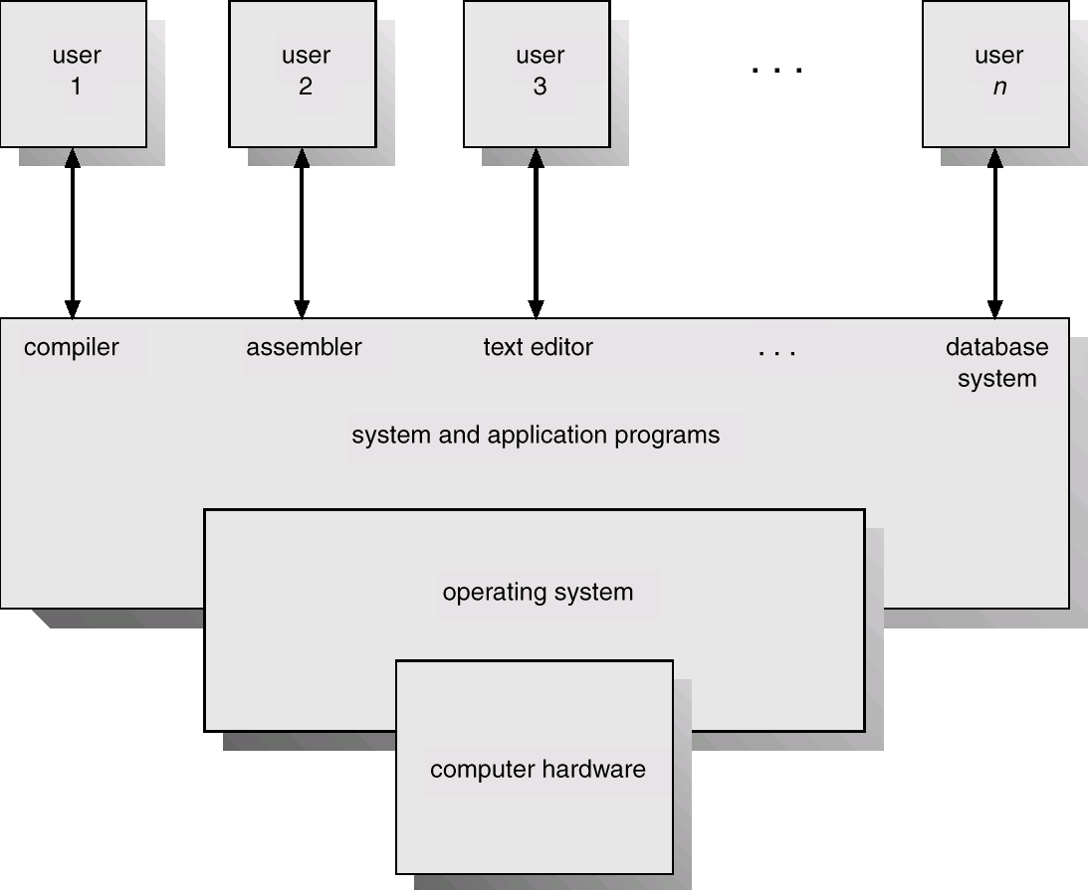
Operating System Structures
System Components
Humans
Program Interface
User Programs
O.S. Interface
O.S.
Hardware Interface/ Privileged Instructions
Disk/Memory/Screen

Slide 4
Operating System Structures
SYSTEM COMPONENTS
These are the pieces of the system we’ll be looking at:
Process Management
Main Memory Management
File Management
Cache Management
I/O System Management
Secondary Management
Networking
Protection System
Command-Interpreter System

Slide 5
Operating System Structures
PROCESS MANAGEMENT
A process is a program in execution: (A program is passive, a process active.)
A process has resources (CPU time, files) and attributes that must be managed.
One (or more) threads are the schedulable entities within a process.
Management of processes includes:
Thread Scheduling (priority, time management, . . . )
Creation/termination
Block/Unblock (suspension/resumption )
Synchronization
Communication
Deadlock handling
Debugging

Slide 6
Operating System Structures
MAIN MEMORY MANAGEMENT
Allocation/de-allocation for processes, files, I/O.
Maintenance of several processes at a time
Keep track of who's using what memory
Movement of process memory to/from secondary storage.
FILE MANAGEMENT
A file is a collection of related information defined by its creator. Commonly, files represent programs (both source and object forms) and data.
The operating system is responsible for the following activities in connections with file management:
File creation and deletion.
Directory creation and deletion.
Support of primitives for manipulating files and directories.
Mapping files onto secondary storage.
File backup on stable (nonvolatile) storage media.

Slide 7
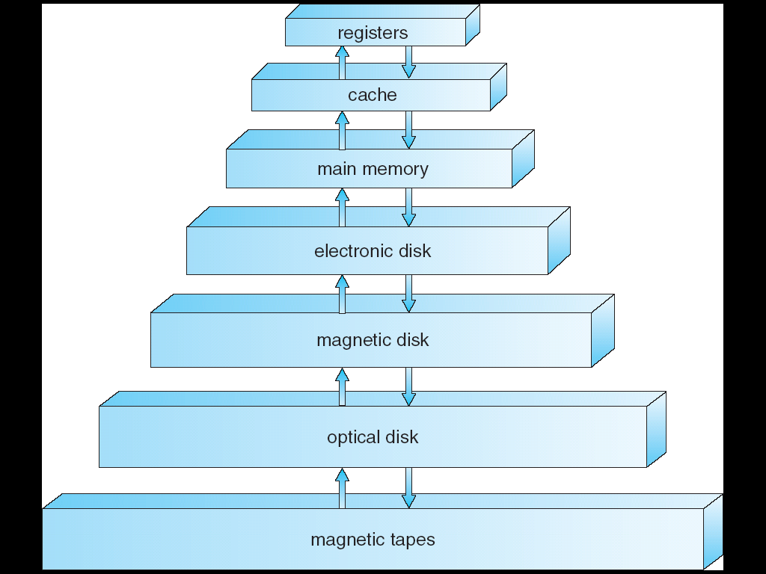
Operating System Structures
CACHE MANAGEMENT
Remember that memory hierarchy?
How to make the best use of the fast and expensive storage.
.
Fast and Expensive
Slow an Cheap

Slide 8
Operating System Structures
I/O MANAGEMENT
Buffer caching system ← part of caching management
Generic device driver code
Drivers for each device - translate read/write requests into disk position commands.
SECONDARY STORAGE MANAGEMENT
Disks, tapes, optical, ...
Free space management ( paging/swapping )
Storage allocation ( what data goes where on disk )
Disk scheduling

Slide 9
Operating System Structures
How Do These All Fit Together?
In essence, they all provide services for each other.
NETWORKING
Communication system between distributed processors.
Getting information about files/processes/etc. on a remote machine.
Can use either a message passing or a shared memory model.
PROTECTION
Of files, memory, CPU, etc.
Means controlling of access
Depends on the attributes of the file and user
SYSTEM PROGRAMS
Command Interpreters -- Program that accepts control statements (shell, GUI interface, etc.)
Compilers/linkers
Communications (ftp, telnet, etc.)

Slide 10
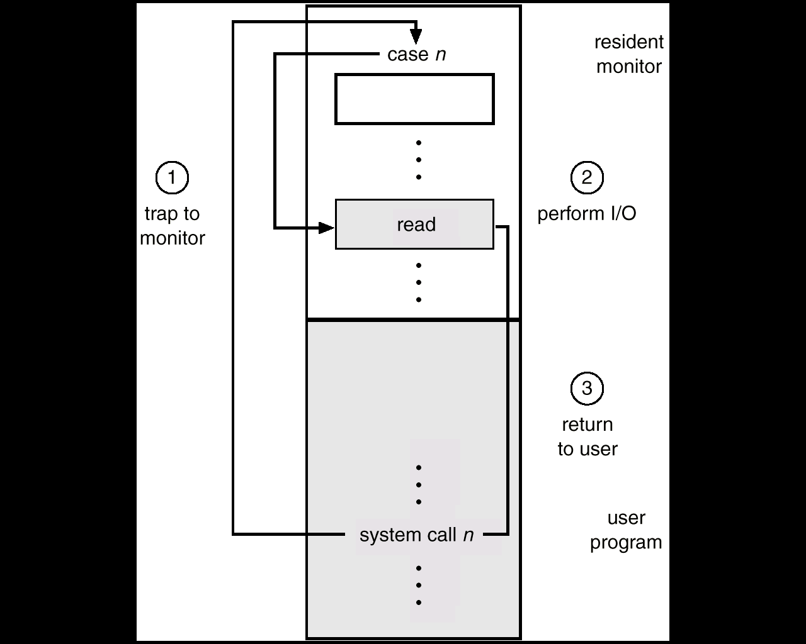
Operating System Structures
System Calls
A System Call is the main way a user program interacts with the Operating System.

Slide 11
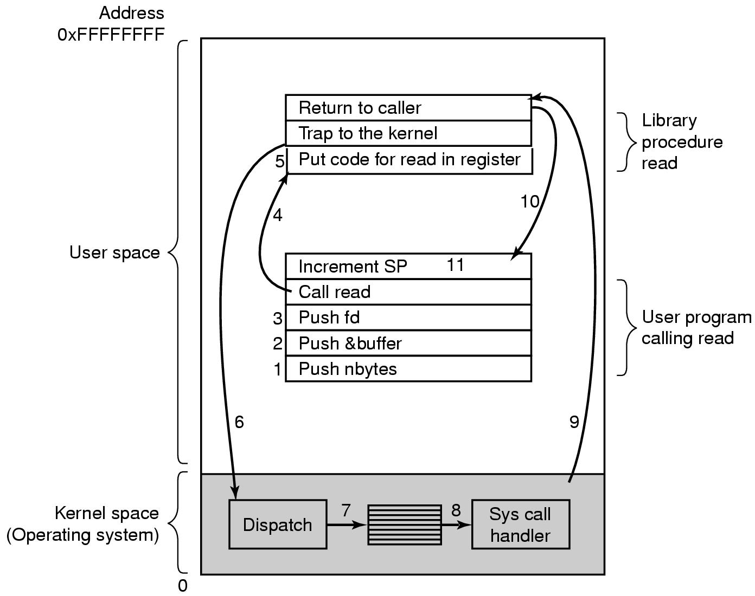
Operating System Structures
System Calls
HOW A SYSTEM CALL WORKS
Obtain access to system space
Do parameter validation
System resource collection ( locks on structures )
Ask device/system for requested item
Suspend waiting for device
Interrupt makes thread ready to run
Wrap-up
Return to user
There are 11 (or more) steps in making the linux system call
read (fd, buffer, nbytes)

Slide 12
Operating System Structures
How An Operating System Is Put Together
A SIMPLE STRUCTURE:
Example of MS-DOS.
Application Programming
Note how all layers can touch the hardware. Bad News!!
Resident System Programming
MS-DOS Drivers
ROM - BIOS Device Drivers

Slide 13
Operating System Structures
How An Operating System Is Put Together
A LAYERED STRUCTURE:
Example of Windows 2000.
System Services
Windows
MGR
& GDI
VM
Manager
Process
Manager
Security
Reference
Monitor
IO
Manager
Graphics
Device
Drivers
Windows 2000 Kernel
Hardware Abstraction Layer (HAL)

Slide 14
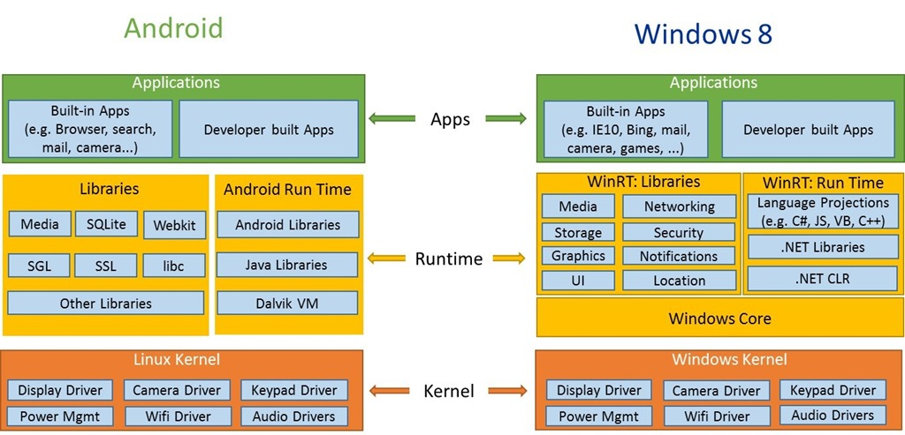
Operating System Structures
How An Operating System Is Put Together
A LAYERED STRUCTURE:.

