Slide 1
OPERATING SYSTEMS
PROCESSES
Jerry Breecher

Slide 2
OPERATING SYSTEM Processes
What Is In This Chapter?
Process Definition
Scheduling Processes – we’ll talk about scheduling threads later
What Do Processes Do?
Inter-process Communication

Slide 3
PROCESSES
Definitions
PROCESS CONCEPT:
A program is passive; a process active.
Attributes held by a process include
hardware state,
memory,
CPU,
progress (executing)
WHY HAVE PROCESSES?
Resource sharing ( logical (files) and physical(hardware) ).
Computation speedup - taking advantage of multiprogramming – i.e. example of a customer/server database system.
Modularity for protection.

Slide 4
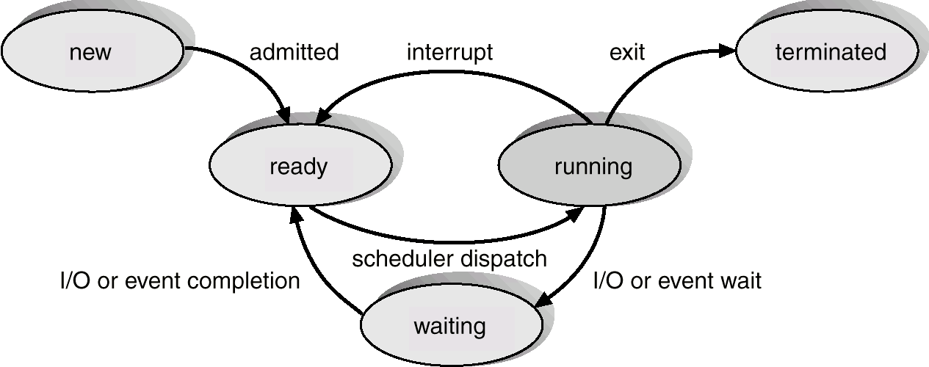
PROCESSES
PROCESS STATE
New The process is just being put together.
Running Instructions being executed. This running process holds the CPU.
Waiting For an event (hardware, human, or another process.)
Ready The process has all needed resources - waiting for CPU only.
Suspended Another process has explicitly told this process to sleep. It will be awakened when a process explicitly awakens it.
Terminated The process is being torn apart.

Slide 5
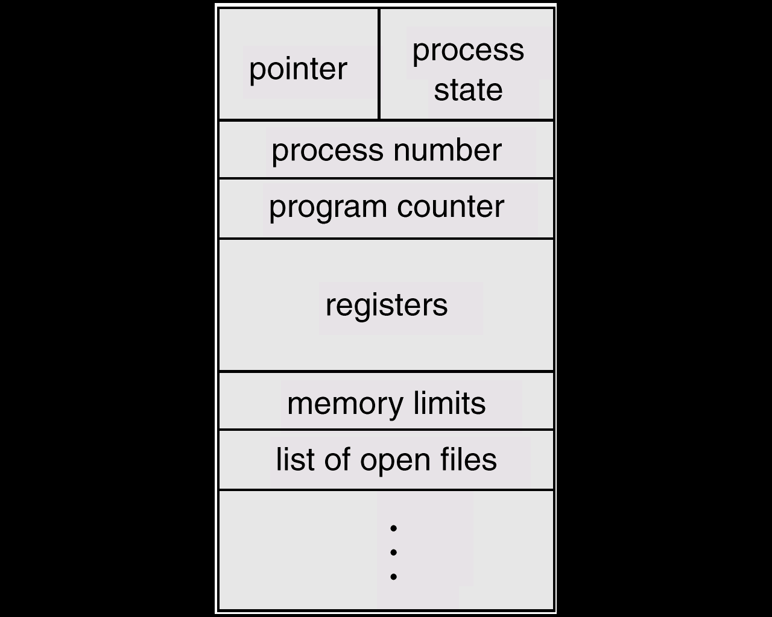
PROCESSES
Process State
PROCESS CONTROL BLOCK:
CONTAINS INFORMATION ASSOCIATED WITH EACH PROCESS:
It's a data structure holding:
PC, CPU registers,
memory management information,
accounting ( time used, ID, ... )
I/O status ( such as file resources ),
scheduling data ( relative priority, etc. )
Process State (so running, suspended, etc. is simply a field in the PCB ).

Slide 6
PROCESSES
Scheduling
Components
The act of Scheduling a process means changing the active PCB pointed to by the CPU. Also called a context switch.
A context switch is essentially the same as a process switch - it means that the memory, as seen by one process is changed to the memory seen by another process.
See Figure on Next Page (4.3)
SCHEDULING QUEUES:
(Process is driven by events that are triggered by needs and availability )
Ready queue = contains those processes that are ready to run.
I/O queue (waiting state ) = holds those processes waiting for I/O service.
What do the queues look like? They can be implemented as single or double linked. See Figure Several Pages from Now (4.4)

Slide 7
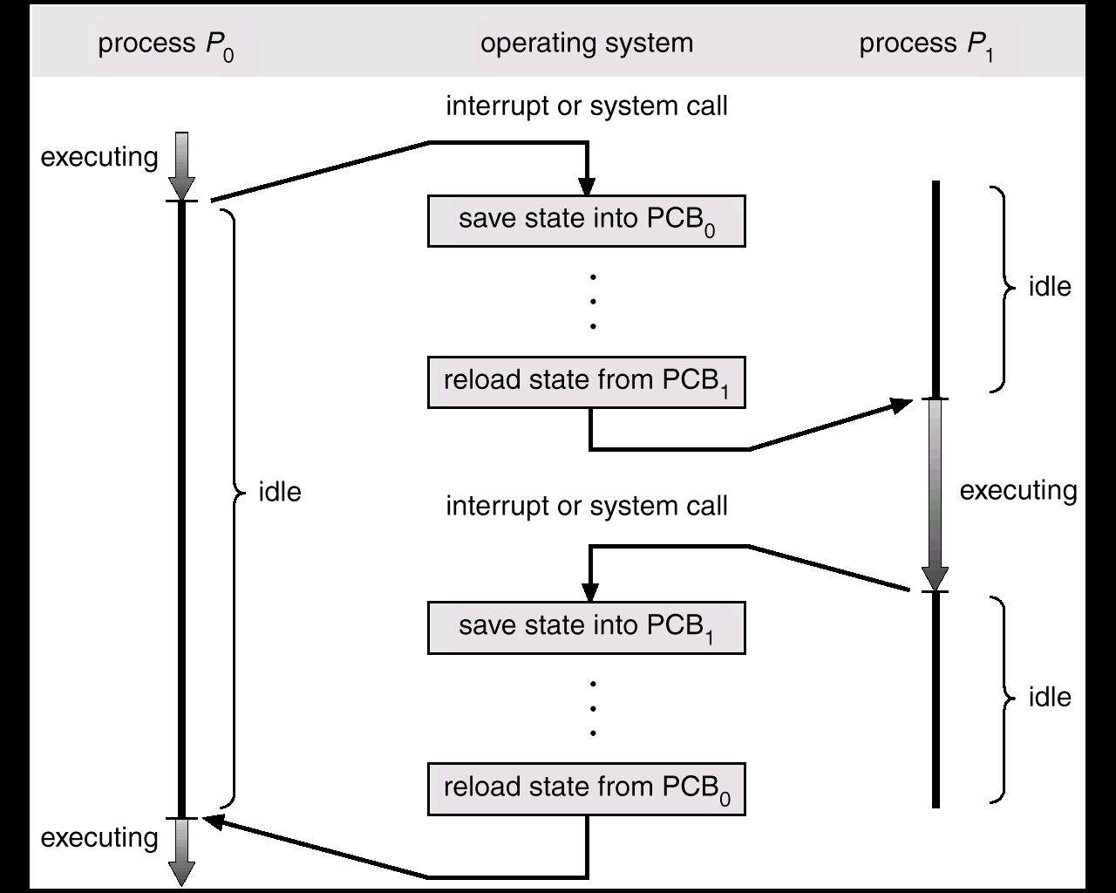
PROCESSES
Scheduling
Components
The CPU switching from one process to another.

Slide 8
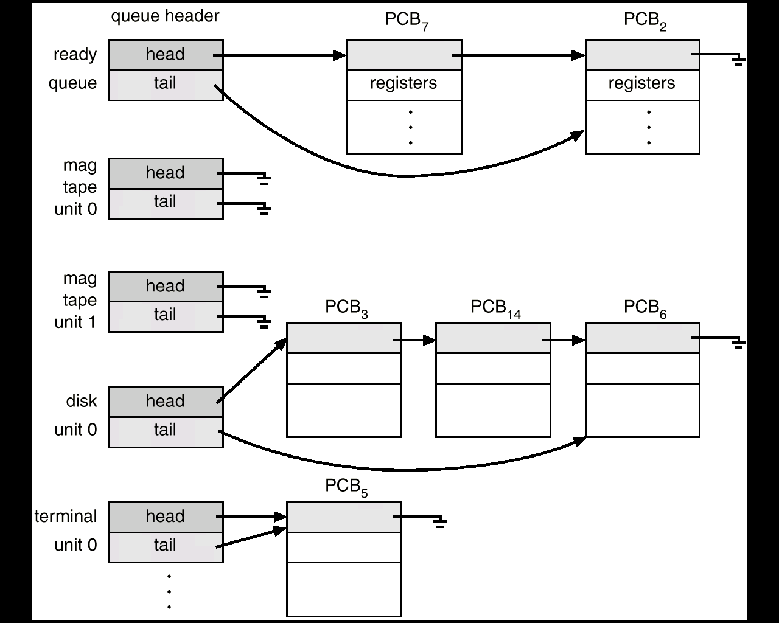
PROCESSES
Scheduling
Components
Ready Q
And
IO Q’s
Figure 4.4

Slide 9
PROCESSES
Scheduling
Components
LONG TERM SCHEDULER
Run seldom ( when job comes into memory )
Controls degree of multiprogramming
Tries to balance arrival and departure rate through an appropriate job mix.
SHORT TERM SCHEDULER
Contains three functions:
Code to remove a process from the processor at the end of its run.
a)Process may go to ready queue or to a wait state.
Code to put a process on the ready queue –
a)Process must be ready to run.
b)Process placed on queue based on priority.

Slide 10
PROCESSES
Scheduling
Components
SHORT TERM SCHEDULER (cont.)
Code to take a process off the ready queue and run that process (also called dispatcher).
a) Always takes the first process on the queue (no intelligence required)
b) Places the process on the processor.
This code runs frequently and so should be as short as possible.
MEDIUM TERM SCHEDULER
Mixture of CPU and memory resource management.
Swap out/in jobs to improve mix and to get memory.
Controls change of priority.

Slide 11
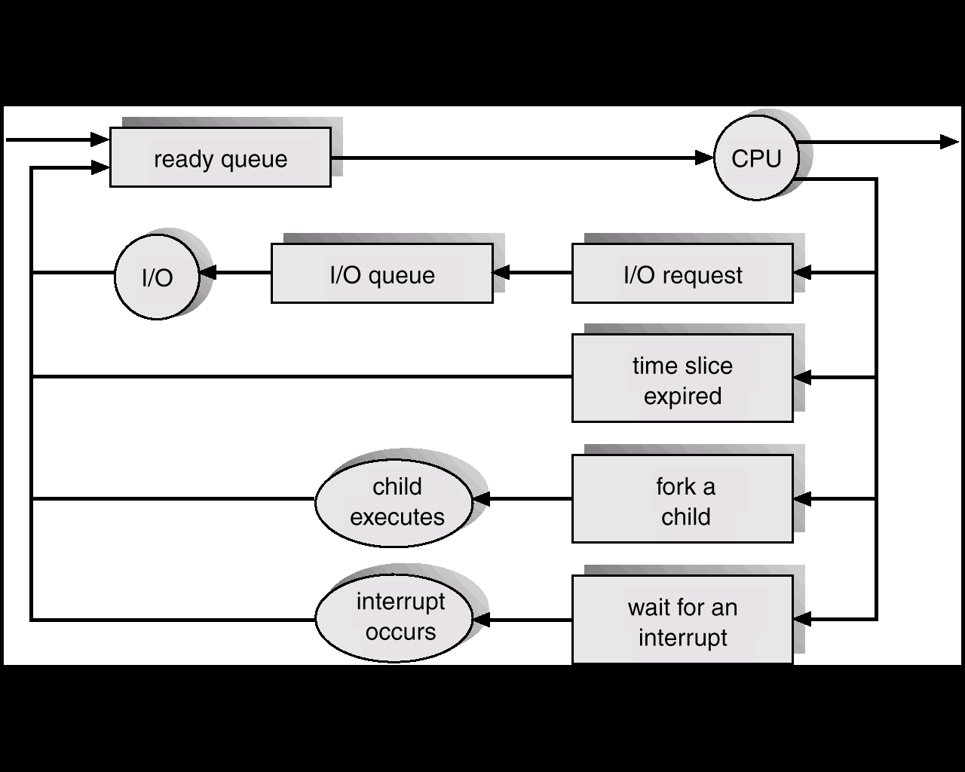
PROCESSES
Scheduling
Components
INTERRUPT HANDLER
In addition to doing device work, it also readies processes, moving them, for instance, from waiting to ready.
Short Term Scheduler
Medium Term Scheduler
Short Term Scheduler
How do all these scheduling components fit together?
Long Term Scheduler
Interrupt Handler
Fig 4.5

Slide 12
PROCESSES
Scheduling Processes
and Threads
What needs to be done on a process schedule?
What needs to be done on a thread schedule?
What is a context switch?

Slide 13
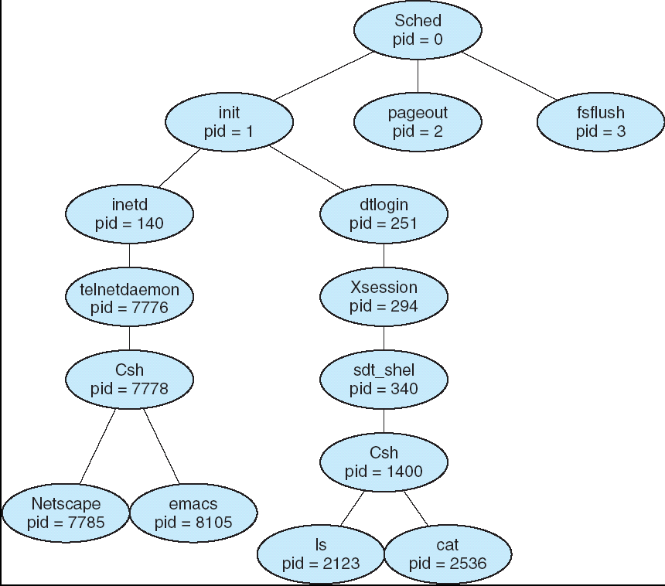
PROCESSES
Process
Relationships
Parent can run concurrently with child, or wait for completion.
Child may share all (fork/join) or part of parent's variables.
Death of parent may force death of child.
Processes are static (never terminate) or dynamic ( can terminate ).
Independent Execution is deterministic and reproducible. Execution can be stopped/ started without affecting other processes.
Cooperating Execution depends on other processes or is time dependent. Here the same inputs won't always give the same outputs; the process depends on other external states.

Slide 14
PROCESSES
Interprocess
Communication
This is how processes talk to each other.
There are basically two methods:
Shared memory (with a process "kick") -- fast/ no data transfer.
Message Passing -- distributed/ better isolation.
FUNCTIONALITY OF COMMUNICATION LINKS:
How are the links formed?
How many processes on each link?
How many links per pair of processes?
Capacity - buffer space - can messages be enqueued.
Message formats and sizes
Uni- or bidirectional
METHODS OF IMPLEMENTATION:
Direct or indirect - to process or mailbox.
Symmetric or asymmetric?
Buffering mechanism
Send by copy or by reference?
Fixed or variable size messages?

Slide 15
PROCESSES
Interprocess
Communication
DIRECT COMMUNICATION:
Need to know name of sender/receiver. Mechanism looks like this:
send ( Process_P, message ) ;
receive ( Process_Q , message );
receive ( id, message ) <-- from any sender
The Producer/Consumer Problem is a standard mechanism. One process produces items that are handed off to the consumer where they are "used".
repeat repeat
produce item receive( producer, nextp )
send( consumer, nextp) consume item
until false until false

Slide 16
PROCESSES
Interprocess
Communication
Other properties of Direct Communication:
Link established automatically (when send or receive requested.)
Only two processes in this form.
One link per pair of processes.
Generally Bi-directional
Receiver may not need ID of sender.
Disadvantage of Direct Communication:
The names of processes must be known - they can't be easily changed since they are explicitly named in the send and receive.

Slide 17
PROCESSES
Interprocess
Communication
INDIRECT COMMUNICATION
Processes communicate via a named mailbox rather than via a process name. Mechanism looks like this:
open( mailbox_name );
send ( mailbox_name, message );
receive ( mailbox_name, message);
Link is established if processes have a shared mailbox. So mailbox must be established before the send/receive.
More than two processes are allowed to use the same mailbox.
May cause confusion with multiple receivers - if several processes have outstanding receives on a mailbox, which one gets a message?

Slide 18
PROCESSES
Interprocess
Communication
BUFFERING:
Options include:
Zero -- sender must wait for recipient to get message. Provides a rendezvous.
Bounded -- sender must wait for recipient if more than n messages in buffer.
Unbounded -- sender is never delayed.
MESSAGE FORMAT:
Fixed, Variable, or Typed (as in language typing) size messages.
Send reference rather than copy (good for large messages).
Suspended vs. unsuspended sends.

Slide 19
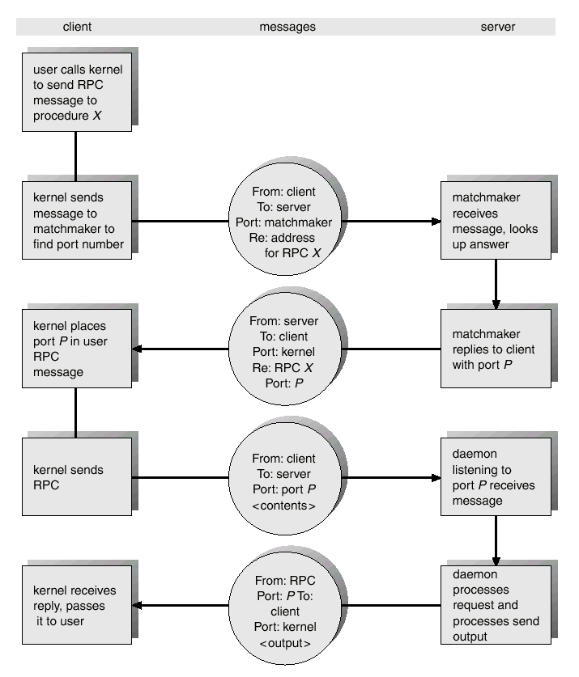
PROCESSES
Interprocess
Communication
Remote procedure call (RPC) abstracts procedure calls between processes on networked systems.
Stubs – client-side proxy for the actual procedure on the server.
The client-side stub locates the server and marshalls the parameters.
The server-side stub receives this message, unpacks the marshalled parameters, and peforms the procedure on the server.

Slide 20
PROCESSES
WRAPUP
We’ve looked in detail at how processes work. Specifically we’ve
Seen how they get scheduled (and studied schedulers in doing so),
Visited the actions that can be performed on objects,
Examined the extension of processes called threads,
Looked at how processes communicate with each other’

