Slide 1
OPERATING SYSTEMS
Threads
Jerry Breecher

Slide 2
OPERATING SYSTEM
Threads
What Is In This Chapter?
Overview
Multithreading Models
Threading Issues
Pthreads
Windows XP Threads
Linux Threads
Java Threads

Slide 3
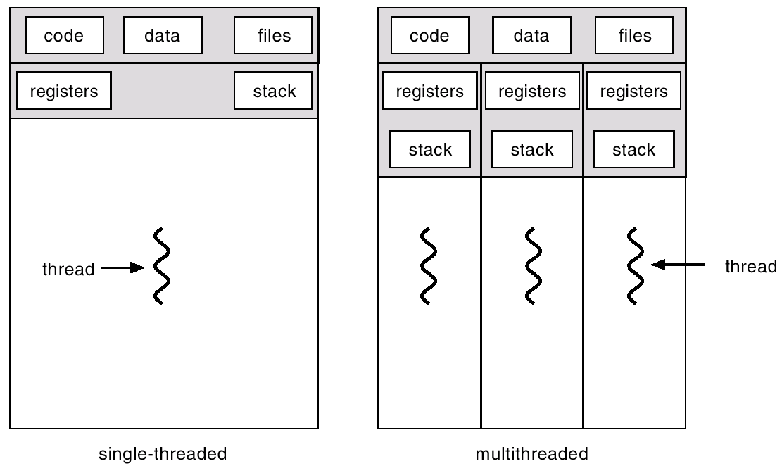
Single and Multithreaded Processes
THREADS

Slide 4
Benefits
THREADS
Responsiveness
Resource Sharing
Economy
Utilization of MP Architectures

Slide 5
User Threads
THREADS
Thread management done by user-level threads library
Examples
- POSIX Pthreads
- Mach C-threads
- Solaris threads
Kernel Threads
Supported by the Kernel
Examples
- Windows
- Solaris
- Tru64 UNIX
- BeOS
- Linux

Slide 6
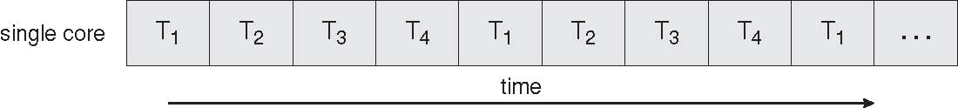
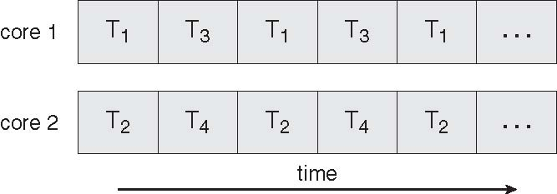
Scheduling
THREADS

Slide 7
Multithreading Models
THREADS
Many-to-One
One-to-One
How do user and kernel
threads map into each other?

Slide 8
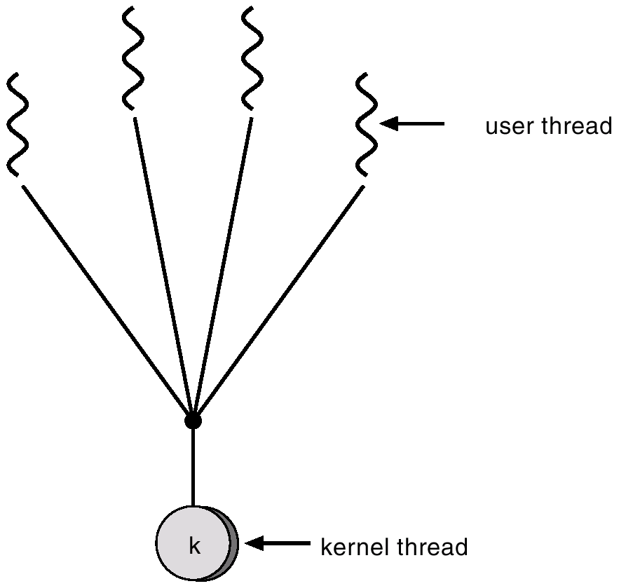
Many-to-One
THREADS
Many user-level threads mapped to single kernel thread.
Used on systems that do not support kernel threads.
Examples:
Solaris Green Threads
GNU Portable Threads

Slide 9
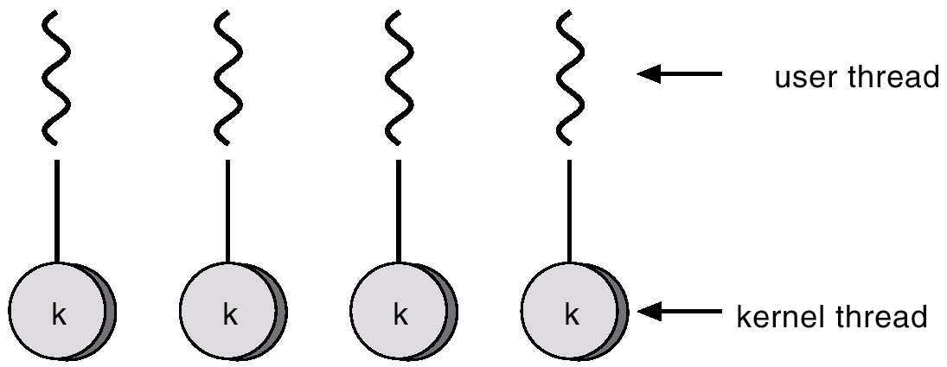
One-to-One
THREADS
Each user-level thread maps to kernel thread.
Examples
- Windows
- Linux

Slide 10
Threading Issues
THREADS
Semantics of fork() and exec() system calls
Does fork() duplicate only the calling thread or all threads?
Thread cancellation
Terminating a thread before it has finished
Two general approaches:
Asynchronous cancellation terminates the target thread immediately
Deferred cancellation allows the target thread to periodically check if it should be cancelled

Slide 11
Threading Issues
THREADS
Signal handling
Signals are used in UNIX systems to notify a process that a particular event has occurred
A signal handler is used to process signals
Signal is generated by particular event
Signal is delivered to a process
Signal is handled
Options:
Deliver the signal to the thread to which the signal applies
Deliver the signal to every thread in the process
Deliver the signal to certain threads in the process
Assign a specific thread to receive all signals for the process
Thread pools
Create a number of threads in a pool where they await work
Advantages:
Usually slightly faster to service a request with an existing thread than create a new thread
Allows the number of threads in the application(s) to be bound to the size of the pool

Slide 12
Threading Issues
THREADS
Thread specific data
Allows each thread to have its own copy of data
Useful when you do not have control over the thread creation process (i.e., when using a thread pool)
Scheduler activations
Many:Many models require communication to maintain the appropriate number of kernel threads allocated to the application
Scheduler activations provide upcalls - a communication mechanism from the kernel to the thread library
This communication allows an application to maintain the correct number kernel threads

Slide 13
Various Implementations
THREADS
PThreads
A POSIX standard (IEEE 1003.1c) API for thread creation and synchronization
API specifies behavior of the thread library, implementation is up to development of the library
Common in UNIX operating systems (Solaris, Linux, Mac OS X)
Windows Threads
Implements the one-to-one mapping
Each thread contains
A thread id
Register set
Separate user and kernel stacks
Private data storage area
The register set, stacks, and private storage area are known as the context of the threads

Slide 14
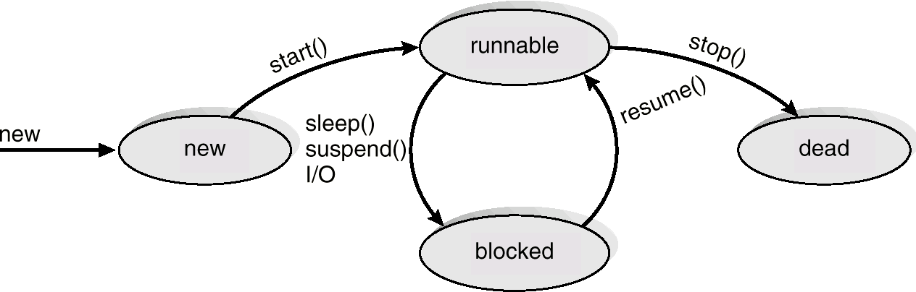
Various Implementations
THREADS
Linux Threads
Linux refers to them as tasks rather than threads
Thread creation is done through clone() system call
clone() allows a child task to share the address space of the parent task (process)
Java Threads
Java threads may be created by:
Extending Thread class
Implementing the Runnable interface
Java threads are managed by the JVM.

Slide 15
Threads
WRAPUP
We’ve looked in detail at how threads work. Specifically we’ve looked at:
Multithreading Models
Threading Issues
Pthreads
Windows XP Threads
Linux Threads
Java Threads

