Slide 1
OPERATING SYSTEMS
SCHEDULING
Jerry Breecher

Slide 2
CPU Scheduling
What Is In This Chapter?
This chapter is about how to get a process attached to a processor.
It centers around efficient algorithms that perform well.
The design of a scheduler is concerned with making sure all users get their fair share of the resources.
A bit of performance analysis.

Slide 3
CPU Scheduling
What Is In This Chapter?
Basic Concepts
Scheduling Criteria
Scheduling Algorithms
Multiple-Processor Scheduling
Real-Time Scheduling
Performance Analysis

Slide 4
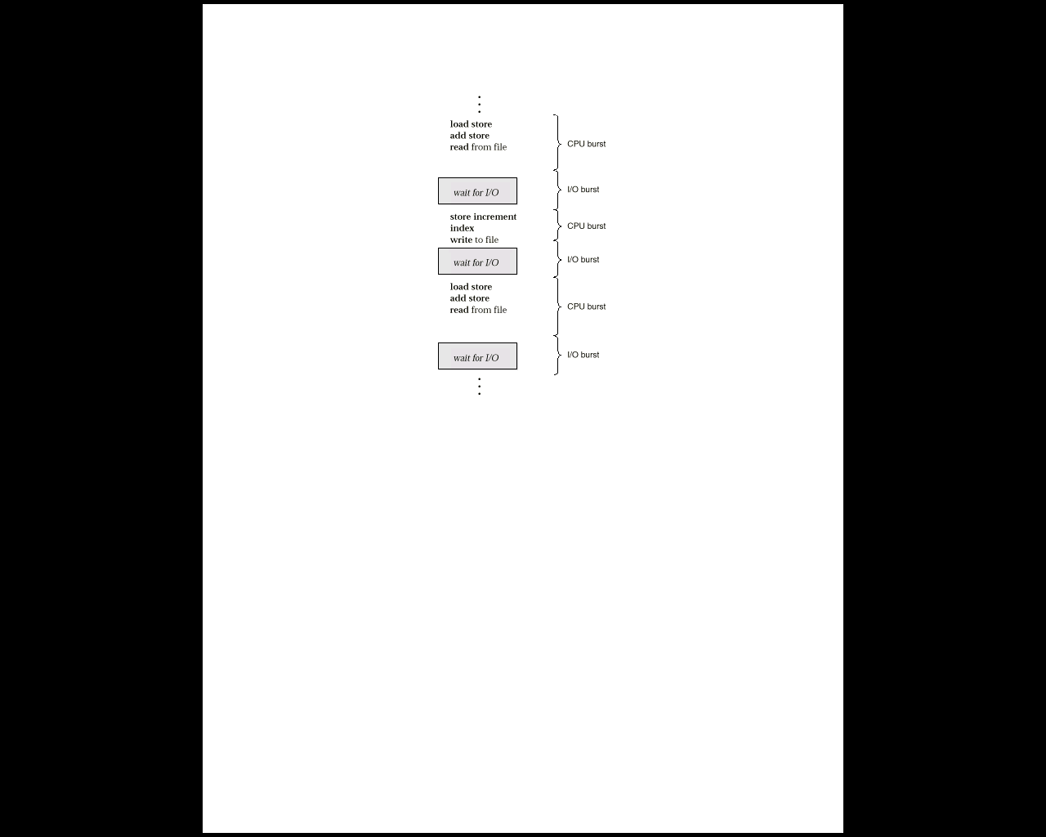
CPU SCHEDULING
Scheduling
Concepts
Multiprogramming A number of programs can be in memory at the same time. Allows overlap of CPU and I/O.
Jobs (batch) are programs that run without user interaction.
User (time shared) are programs that may have user interaction.
Process is the common name for both.
CPU - I/O burst cycle Characterizes process execution, which alternates, between CPU and I/O activity. CPU times are generally much shorter than I/O times.
Preemptive Scheduling An interrupt causes currently running process to give up the CPU and be replaced by another process.

Slide 5
CPU SCHEDULING
The Scheduler
Selects from among the processes in memory that are ready to execute, and allocates the CPU to one of them
CPU scheduling decisions may take place when a process:
1. Switches from running to waiting state
2. Switches from running to ready state
3. Switches from waiting to ready
4. Terminates
Scheduling under 1 and 4 is nonpreemptive
All other scheduling is preemptive

Slide 6
CPU SCHEDULING
The Dispatcher
Dispatcher module gives control of the CPU to the process selected by the short-term scheduler; this involves:
switching context
switching to user mode
jumping to the proper location in the user program to restart that program
Dispatch latency – time it takes for the dispatcher to stop one process and start another running

Slide 7
CPU SCHEDULING
Criteria For
Performance
Evaluation
Note usage of the words DEVICE, SYSTEM, REQUEST, JOB.
UTILIZATION The fraction of time a device is in use. ( ratio of in-use time / total observation time )
THROUGHPUT The number of job completions in a period of time. (jobs / second )
SERVICE TIME The time required by a device to handle a request. (seconds)
QUEUEING TIME Time on a queue waiting for service from the device. (seconds)
RESIDENCE TIME The time spent by a request at a device.
RESIDENCE TIME = SERVICE TIME + QUEUEING TIME.
RESPONSE TIME Time used by a system to respond to a User Job. ( seconds )
THINK TIME The time spent by the user of an interactive system to figure out the next request. (seconds)
The goal is to optimize both the average and the amount of variation. (but beware the ogre predictability.)

Slide 8
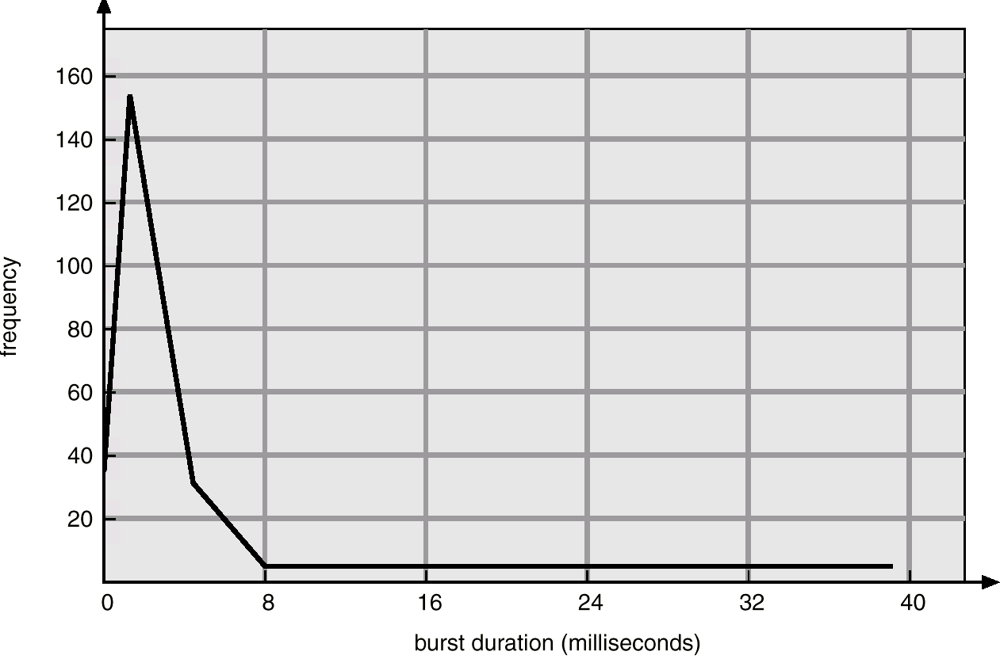
CPU SCHEDULING
Scheduling Behavior
Most Processes Don’t Use Up Their Scheduling Quantum!

Slide 9
CPU SCHEDULING
Scheduling
Algorithms
FIRST-COME, FIRST SERVED:
( FCFS) same as FIFO
Simple, fair, but poor performance. Average queueing time may be long.
What are the average queueing and residence times for this scenario?
How do average queueing and residence times depend on ordering of these processes in the queue?

Slide 10
CPU SCHEDULING
Scheduling
Algorithms
EXAMPLE DATA:
Process Arrival Service
Time Time
1 0 8
2 1 4
3 2 9
4 3 5
FCFS
P1
P2
P3
P4
0
8
12
21
26
Average wait = ( (8-0) + (12-1) + (21-2) + (26-3) )/4 = 61/4 = 15.25
Residence Time
at the CPU

Slide 11
CPU SCHEDULING
Scheduling
Algorithms
SHORTEST JOB FIRST:
Optimal for minimizing queueing time, but impossible to implement. Tries to predict the process to schedule based on previous history.
Predicting the time the process will use on its next schedule:
t( n+1 ) = w * t( n ) + ( 1 - w ) * T( n )
Here: t(n+1) is time of next burst.
t(n) is time of current burst.
T(n) is average of all previous bursts .
W is a weighting factor emphasizing current or previous bursts.

Slide 12
CPU SCHEDULING
Scheduling
Algorithms
PREEMPTIVE ALGORITHMS:
Yank the CPU away from the currently executing process when a higher priority process is ready.
Can be applied to both Shortest Job First or to Priority scheduling.
Avoids "hogging" of the CPU
On time sharing machines, this type of scheme is required because the CPU must be protected from a run-away low priority process.
Give short jobs a higher priority – perceived response time is thus better.
What are average queueing and residence times? Compare with FCFS.

Slide 13
CPU SCHEDULING
Scheduling
Algorithms
EXAMPLE DATA:
Process Arrival Service
Time Time
1 0 8
2 1 4
3 2 9
4 3 5
Preemptive Shortest Job First
P1
P2
P4
P1
P3
0
1
5
10
17
26
Average wait = ( (5-1) + (10-3) + (17-0) + (26-2) )/4 = 52/4 = 13.0

Slide 14
CPU SCHEDULING
Scheduling
Algorithms
PRIORITY BASED SCHEDULING:
Assign each process a priority. Schedule highest priority first. All processes within same priority are FCFS.
Priority may be determined by user or by some default mechanism. The system may determine the priority based on memory requirements, time limits, or other resource usage.
Starvation occurs if a low priority process never runs. Solution: build aging into a variable priority.
Delicate balance between giving favorable response for interactive jobs, but not starving batch jobs.

Slide 15
CPU SCHEDULING
Scheduling
Algorithms
ROUND ROBIN:
Use a timer to cause an interrupt after a predetermined time. Preempts if task exceeds it’s quantum.
Train of events
Dispatch
Time slice occurs OR process suspends on event
Put process on some queue and dispatch next
Use numbers in last example to find queueing and residence times. (Use quantum = 4 sec.)
Definitions:
Context Switch Changing the processor from running one task (or process) to another. Implies changing memory.
Processor Sharing Use of a small quantum such that each process runs frequently at speed 1/n.
Reschedule latency How long it takes from when a process requests to run, until it finally gets control of the CPU.

Slide 16
CPU SCHEDULING
Scheduling
Algorithms
ROUND ROBIN:
Choosing a time quantum
Too short - inordinate fraction of the time is spent in context switches.
Too long - reschedule latency is too great. If many processes want the CPU, then it's a long time before a particular process can get the CPU. This then acts like FCFS.
Adjust so most processes won't use their slice. As processors have become faster, this is less of an issue.

Slide 17
CPU SCHEDULING
Scheduling
Algorithms
EXAMPLE DATA:
Process Arrival Service
Time Time
1 0 8
2 1 4
3 2 9
4 3 5
Note:
Example violates rules for quantum size since most processes don’t finish in one quantum.
Round Robin, quantum = 4, no priority-based preemption
P1
P2
P3
P4
P1
P3
P4
P3
0
4
8
12
16
20
24
25
26
Average wait = ( (20-0) + (8-1) + (26-2) + (25-3) )/4 = 74/4 = 18.5

Slide 18
Performance Analysis
The Scheduler
Selects from among the processes in memory that are ready to execute, and allocates the CPU to one of them
CPU scheduling decisions may take place when a process:
1. Switches from running to waiting state
2. Switches from running to ready state
3. Switches from waiting to ready
4. Terminates
Scheduling under 1 and 4 is nonpreemptive
All other scheduling is preemptive

Slide 19
Performance Analysis
Queueing Lingo
A STOCHASTIC PROCESS is a mechanism that produces a collection of measurements which all occur, randomly, in the same range of values. It applies to the VALUE measured for an observation. The dictionary says, "random, statistical".
Stochastic processes are well behaved phenomena - they don't do things that are unpredictable or unplanned for.
Examples:
Throwing 2 dice always gives numbers in the range 2 - 12.
Actions of people are unpredictable ( unless the range of values is made very large.) Someone can always respond in a way you haven't predicted.

Slide 20
Performance Analysis
Queueing Lingo
THE POISSON PROCESS applies to WHEN an observation is made. It looks random; the arrival points are uniformly distributed across a time interval. Poisson processes can be defined by:
Event counting The distribution of the number of events occurring in
a particular time is a Poisson distribution.
Time between events The distribution of times between event occurrences is
exponential.
Example: Show how a random "look" leads to an exponential distribution. See the next page for a picture of these distributions.

Slide 21
Performance Analysis
Queueing Lingo
F(t) = exp(-t)
Exponential Curve
The time between events
F(k) = ( 5 / k! ) exp( -5 )
Poisson DIstribution
The number of events in a time interval.

Slide 22
Performance Analysis
Queueing Lingo
The interval between events
The number of events in a time interval.
25 Random Numbers between 1 - 100
7 12 13 15 22 31 33 40 40 42 44 44 46 48 52 54 56 60 61 69 71 74 89 94 95
Look at the intervals between numbers.
Are there more small intervals or large intervals?
Look at the count of numbers between 1 – 20, between 21 – 40, etc.
Is the count always the same?

Slide 23
Performance Analysis
Queueing Lingo
MEMORYLESS means that the probability of an event doesn't depend on its past. The above case highlights an example where the past does matter.
Examples: Which depend on the past, and which don't?
Throwing dice?
The number of sectors a disk seeks in order to satisfy a request?
The address of an instruction execution?
The measurement of the length of a table?

Slide 24
Properties of Queues
Performance Analysis
Customer Arrivals
The queue – A place where customers are stored before being serviced.
The device doing the actual service of the customers.
Customer Departures
Assumption: The mechanism is stochastic and memoryless
Assumption: Arrivals = departures. “Steady State”
Assumption: What matters are inter-arrival times and service times.

Slide 25
Performance Analysis
The Single Queue
If we have a single queue obeying certain properties, we can get all kinds of nice metrics. But, it must have those required properties!!
REQUIRED PROPERTIES:
Arrivals are random with a rate of X per time. ( Poisson – when we say this, we mean the inter-arrival time is exponentially distributed. ) [ Note that in steady state, throughput = arrival rate.] Many texts use λ for this.
Service times are random with a value of D. (Exponential ) [ Note this is the Demand we've seen before.] Many texts use μ for this. The rate of service is μ = 1/D.
There's the possibility of an infinite number of customers.
There's a single server.

Slide 26
Performance Analysis
The Single Queue
A Review of the Symbols:
Utilization: U = λ / μ
Arrival Rate: λ How “often” – the average rate that requests approach the Q.
Departure Rate: μ The rate at which requests complete service.
Throughput: X The rate that jobs complete.
Service Time: D Note this is 1 / μ
Little’s Law: U = X D From before U = λ / μ = X D This equation works for the device only. The CPU
Little’s Law: U = X T This equation works for the service center – that means the device + the wait queue.

Slide 27
Performance Analysis
The Single Queue
X = λ
X = λ
State with 0 in Queue
State with 1 in Queue
State with 2 in Queue
μ = 1/D
μ = 1/D
For simplification, in this particular case, the utilization U is related to throughput and demand by
U = X D
Note: U = λ / μ
p_{i} = U , p₀ = ( 1 – U )

Slide 28
Performance Analysis
The Single Queue
By Definition: A queue is defined to contain customers that are both waiting and being serviced.
In an equilibrium state, from the picture below, these equations can be formed:
μ p_{i} = λ p _{i-1}
p _{ι} = ( λ / μ ) p _{i−1}
p _{ι} = ( λ / μ )^{ι} p ₀ = U ^{ι} p ₀
The probability of having i customers in the queue is
p_{i} = ( 1 – U ) U ^{i}
[ Note p₀ = ( 1 - U ) so p _{i > 0} = U. But this is just the utilization we defined before.]
X = λ
X = λ
State with 0 in Queue
State with 1 in Queue
State with 2 in Queue
μ = 1/D
μ = 1/D

Slide 29
Performance Analysis
The Single Queue
The average number of customers in the queue (waiting and being serviced) is
From Little's Law ( N = X T ) in steady state, we can derive the average time spent at the queueing center ( both in the queue and being serviced ). Note what happens to this response time as the utilization increases!

Slide 30
Performance Analysis
The Single Queue
The average number of customers in the queue (waiting and being serviced) is
From Little's Law ( N = X T ) in steady state, we can derive the average time spent at the queueing center ( both in the queue and being serviced ). Note what happens to this response time as the utilization increases!

Slide 31
Performance Analysis
The Experiment
Here is the experiment we will run.
To start a process, execute the following:
taskset 0x1 ./sched 300 20 20 &
taskset, as shown here, will cause this process to run on processor 0
Then the program sched will run for 300 seconds, will try to get 20 milliseconds of CPU and then will sleep for 20 milliseconds.
By running sched in the background we will get a PID.
Use that pid in the program latency in this way “latency PID”
This will release all kinds of statistics about what this process sees.

Slide 32
CPU SCHEDULING
WRAPUP
We’ve looked at a number of different scheduling algorithms.
Which one works the best is application dependent.
General purpose OS will use priority based, round robin, preemptive
Real Time OS will use priority, no preemption.

