Slide 1
OPERATING SYSTEMS
FILE SYSTEMS
Jerry Breecher

Slide 2
FILE SYSTEMS
This material covers Silberschatz Chapters 10 and 11.
File System Interface
The user level (more visible) portion of the file system.
File Concept
Access methods
Protection
File System Implementation
The OS level (less visible) portion of the file system.
Directory Structure
Storage and Retrieval Methods
Free Space Management
Directory Implementation

Slide 3
FILE SYSTEMS INTERFACE
File Concept
A collection of related bytes having meaning only to the creator. The file can be "free formed", indexed, structured, etc.
The file is an entry in a directory.
The file may have attributes (name, creator, date, type, permissions)
The file may have structure ( O.S. may or may not know about this.) It's a tradeoff of power versus overhead. For example,
An Operating System understands program image format in order to create a process.
The UNIX shell understands how directory files look. (In general the UNIX kernel doesn't interpret files.)
Usually the Operating System understands and interprets file types.

Slide 4
FILE SYSTEMS INTERFACE
File Concept
A file can have various kinds of structure
None - sequence of words, bytes
Simple record structure
Lines
Fixed length
Variable length
Complex Structures
Formatted document
Relocatable load file
Who interprets this structure?
Operating system
Program

Slide 5
FILE SYSTEMS INTERFACE
File Concept
Attributes of a File
Name – only information kept in human-readable form
Identifier – unique tag (number) identifies file within file system
Type – needed for systems that support different types
Location – pointer to file location on device
Size – current file size
Protection – controls who can do reading, writing, executing
Time, date, and user identification – data for protection, security, and usage monitoring
Information about files is kept in the directory structure, which is maintained on the disk.

Slide 6
FILE SYSTEMS INTERFACE
File Concept
Blocking (packing) occurs when some entity, (either the user or the Operating System) must pack bytes into a physical block.
Block size is fixed for disks, variable for tape
Size determines maximum internal fragmentation
We can allow reference to a file as a set of logical records (addressable units) and then divide ( or pack ) logical records into physical blocks.
What does it mean to “open” a file??

Slide 7
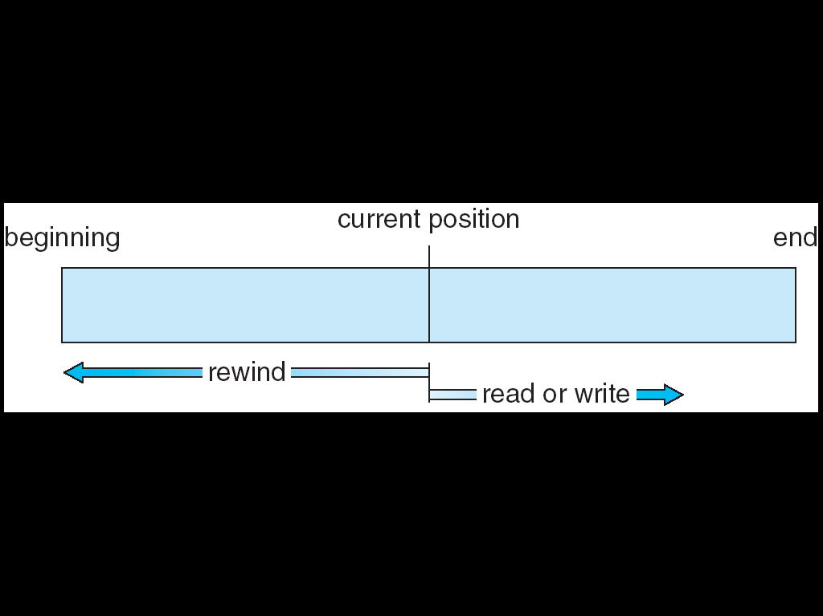
FILE SYSTEMS INTERFACE
Access
Methods
If files had only one "chunk" of data, life would be simple. But for large files, the files themselves may contain structure, making access faster.
SEQUENTIAL ACCESS
Implemented by the filesystem.
Data is accessed one record right after the last.
Reads cause a pointer to be moved ahead by one.
Writes allocate space for the record and move the pointer to the new End Of File.
Such a method is reasonable for tape

Slide 8
FILE SYSTEMS INTERFACE
Access
Methods
DIRECT ACCESS
The file is viewed as a numbered sequence of blocks or records.
There are no restrictions on which blocks are read/written in any order.
User now says "read n" rather than "read next".
"n" is a number relative to the beginning of file, not relative to an absolute physical disk location.
Method useful for disks.

Slide 9
FILE SYSTEMS INTERFACE
Access
Methods
OTHER ACCESS METHODS
Built on top of direct access and often implemented by a user utility.
Indexed ID plus pointer.
An index block says what's in each remaining block or contains pointers to blocks containing particular items. Suppose a file contains many blocks of data arranged by name alphabetically.
Example 1: Index contains the name appearing as the first record in each block. There are as many index entries as there are blocks.
Example 2: Index contains the block number where "A" begins, where "B" begins, etc. Here there are only 26 index entries.

Slide 10
FILE SYSTEMS INTERFACE
Access
Methods
Adams
Example 1: Index contains the name appearing as the first record in each block. There are as many index entries as there are blocks.
Example 2: Index contains the block number where "A" begins, where "B" begins, etc. Here there are only 26 index entries.
Arthur
Asher
Smith, John | data
Smith
Adams
Adams | Data
Baker
Arthur | Data
Charles
Asher | Data
Baker | Data
Saarnin
Saarnin | data
Smith, John | data

Slide 11
FILE SYSTEMS INTERFACE
Directory
Structure
Directories maintain information about files:
For a large number of files, may want a directory structure - directories under directories.
Information maintained in a directory:
Name The user visible name.
Type The file is a directory, a program image, a user file, a link, etc.
Location Device and location on the device where the file header is located.
Size Number of bytes/words/blocks in the file.
Position Current next-read/next-write pointers.
Protection Access control on read/write/ execute/delete.
Usage Open count
Usage time of creation/access, etc.
Mounting a filesystem occurs when the root of one filesystem is "grafted" into the existing tree of another filesystem.
There is a need to PROTECT files and directories.
Actions that might be protected include: read, write, execute, append, delete, list
In Memory only!

Slide 12
FILE SYSTEMS INTERFACE
Protection
File owner/creator should be able to control:
what can be done
by whom
Types of access
Read
Write
Execute
Append
Delete
List
Mode of access: read, write, execute
Three classes of users
RWX
a) owner access 7 ⇒ 1 1 1 RWX
b) group access 6 ⇒ 1 1 0
RWX
c) public access 1 ⇒ 0 0 1
Ask manager to create a group (unique name), say G, and add some users to the group.
For a particular file (say game) or subdirectory, define an appropriate access.
owner
group
public
chmod
761
game
Attach a group to a file “chgrp G game”

Slide 13
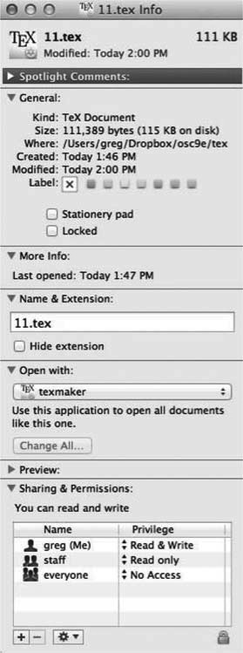
File info on Mac OS X
FILE SYSTEMS INTERFACE
Protection

Slide 14
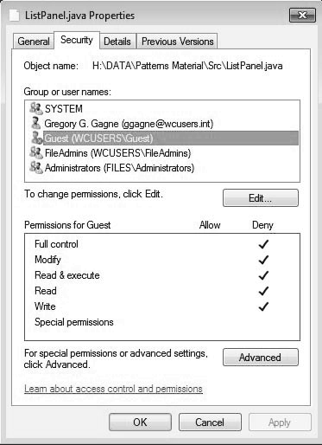
FILE SYSTEMS INTERFACE
Protection
Example on Windows 10

Slide 15
FILE SYSTEM IMPLEMENTATION
Layered File System
When talking about “the file system”, you are making a statement about both the rules used for file access, and about the algorithms used to implement those rules. Here’s a breakdown of those algorithmic pieces.
Application Programs The code that's making a file request.
Logical File System This is the highest level in the OS; it does protection, and security. Uses the directory structure to do name resolution.
File-organization Module Here we read the file control block maintained in the directory so we know about files and the logical blocks where information about that file is located.
Basic File System Knowing specific blocks to access, we can now make generic requests to the appropriate device driver.
IO Control These are device drivers and interrupt handlers. They cause the device to transfer information between that device and CPU memory.
Devices The disks / tapes / etc.

Slide 16
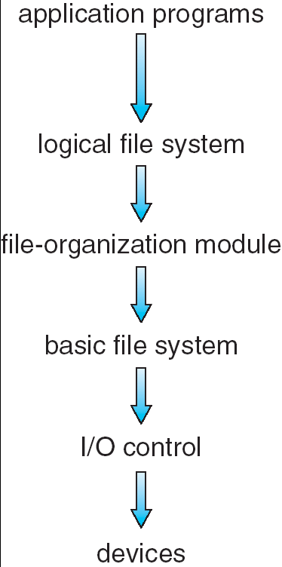
FILE SYSTEM IMPLEMENTATION
Layered File System
Handles the CONTENT of the file. Knows the file’s internal structure.
Handles the OPEN, etc. system calls. Understands paths, directory structure, etc.
Uses directory information to figure out blocks, etc. Implements the READ. POSITION calls.
Determines where on the disk blocks are located.
Interfaces with the devices – handles interrupts.

Slide 17
FILE SYSTEM IMPLEMENTATION
Three Example Systems
Presented on other slide sets are three examples of file systems.
Fat File System
Linux File System
Z502 File System

Slide 18
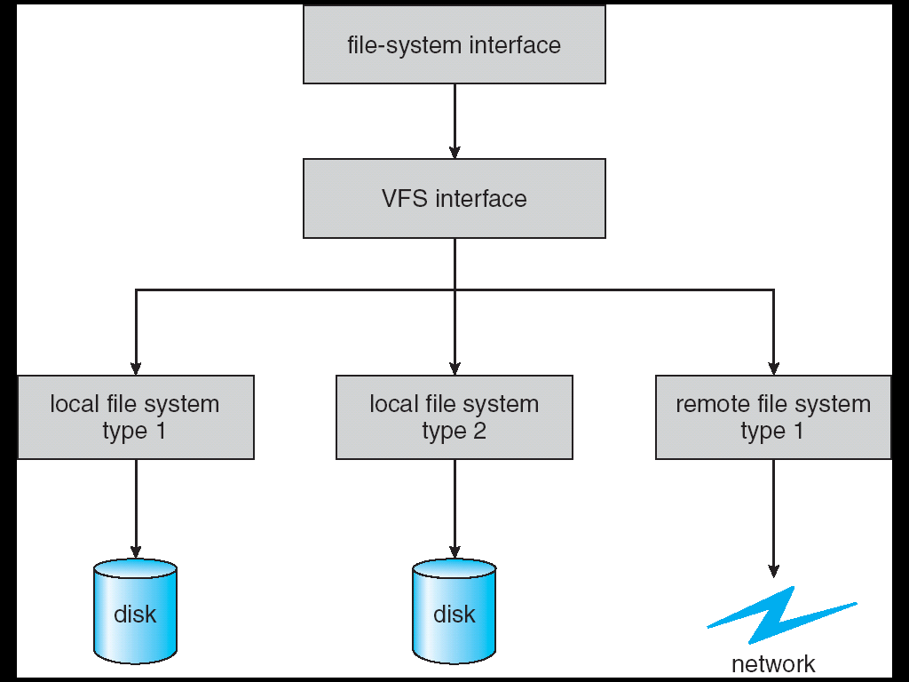
FILE SYSTEM IMPLEMENTATION
Virtual File Systems
Virtual File Systems (VFS) provide an object-oriented way of implementing file systems.
VFS allows the same system call interface (the API) to be used for different types of file systems.
The API is to the VFS interface, rather than any specific type of file system.

Slide 19
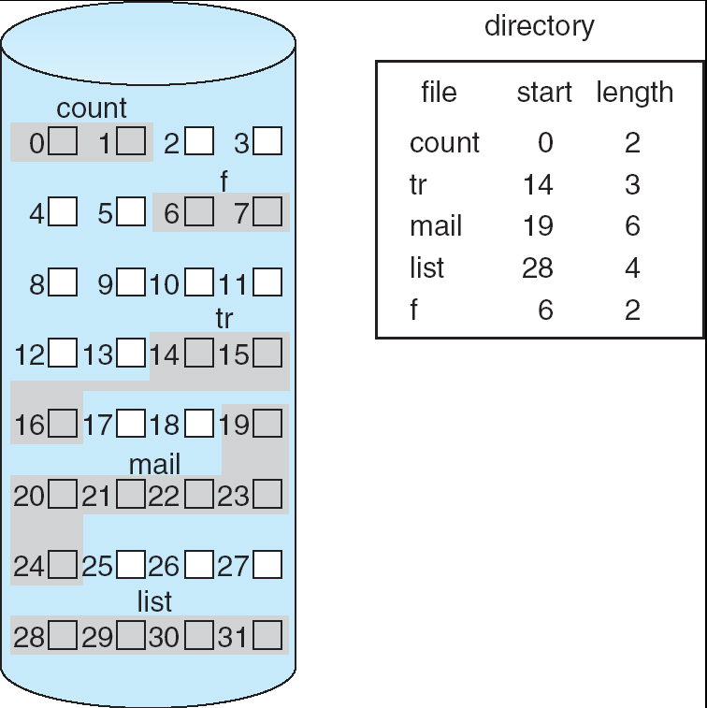
FILE SYSTEM IMPLEMENTATION
Storage (Retrieval)
Methods
CONTIGUOUS STORAGE
Method: Lay down the entire file on contiguous sectors of the disk. Define by a dyad <first block location, length >.
Accessing the file requires a minimum of head movement.
Easy to calculate block location: block i of a file, starting at disk address b, is b + i.
Difficulty is in finding the contiguous space, especially for a large file. Problem is one of dynamic allocation (first fit, best fit, etc.) which has external fragmentation. If many files are created/deleted, compaction will be necessary.
It's hard to estimate at create time what the size of the file will ultimately be. What happens when we want to extend the file --- we must either terminate the owner of the file, or try to find a bigger hole.

Slide 20
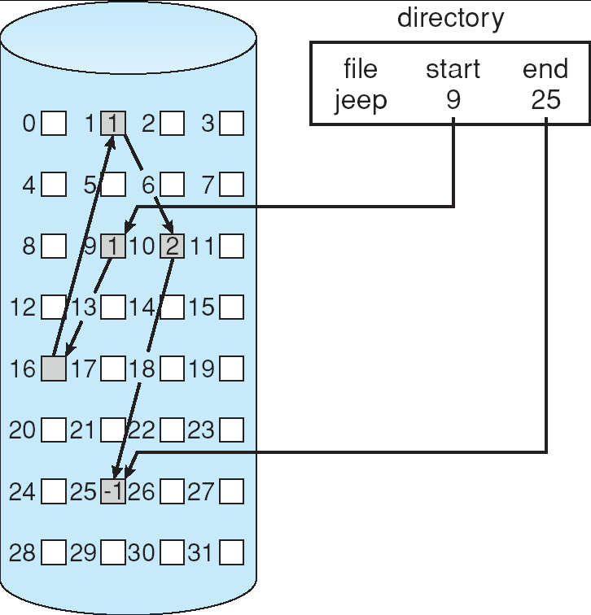
FILE SYSTEM IMPLEMENTATION
Storage (Retrieval)
Methods
LINKED STORAGE
Each file is a linked list of disk blocks, scattered anywhere on the disk.
At file creation time, simply tell the directory about the file. When writing, get a free block and write to it, enqueueing it to the file header.
There's no external fragmentation since each request is for one block.
Method can only be effectively used for sequential files.

Slide 21
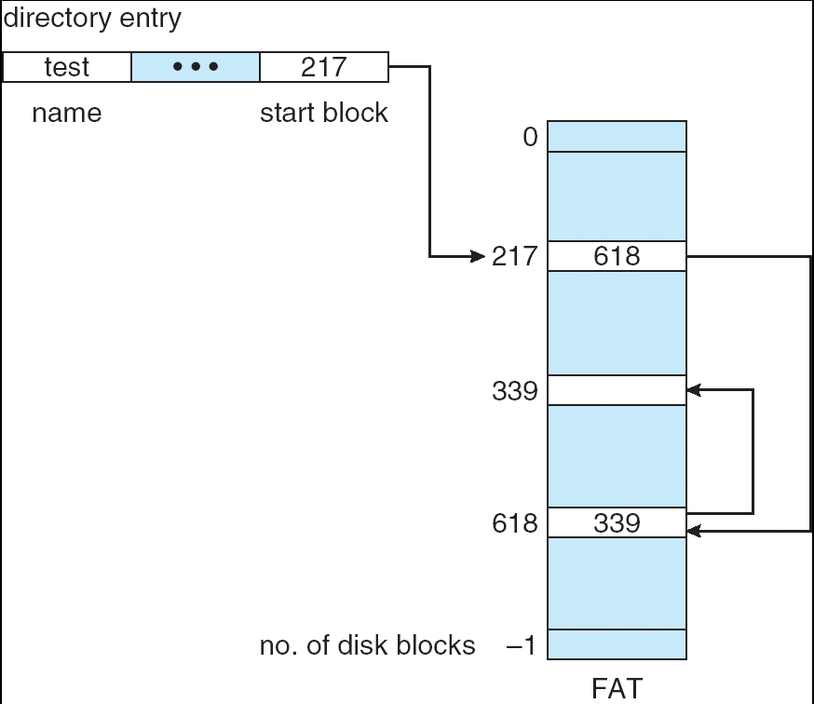
FILE SYSTEM IMPLEMENTATION
Storage (Retrieval)
Methods
LINKED STORAGE
Pointers use up space in each block. Reliability is not high because any loss of a pointer loses the rest of the file.
A File Allocation Table is a variation of this.
It uses a separate disk area to hold the links.
This method doesn't use space in data blocks. Many pointers may remain in memory.
A FAT file system is used by MS-DOS.

Slide 22
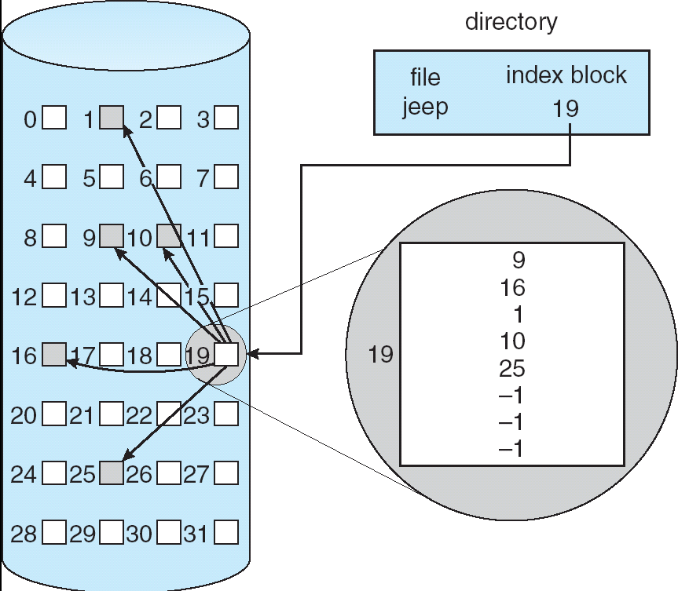
FILE SYSTEM IMPLEMENTATION
Storage (Retrieval)
Methods
INDEXED STORAGE
Each file uses an index block on disk to contain addresses of other disk blocks used by the file.
When the i th block is written, the address of a free block is placed at the i th position in the index block.
Method suffers from wasted space since, for small files, most of the index block is wasted. What is the optimum size of an index block?
If the index block is too small, we can:
Link several together
Use a multilevel index
UNIX keeps 12 pointers to blocks in its header. If a file is longer than this, then it uses pointers to single, double, and triple level index blocks.

Slide 23
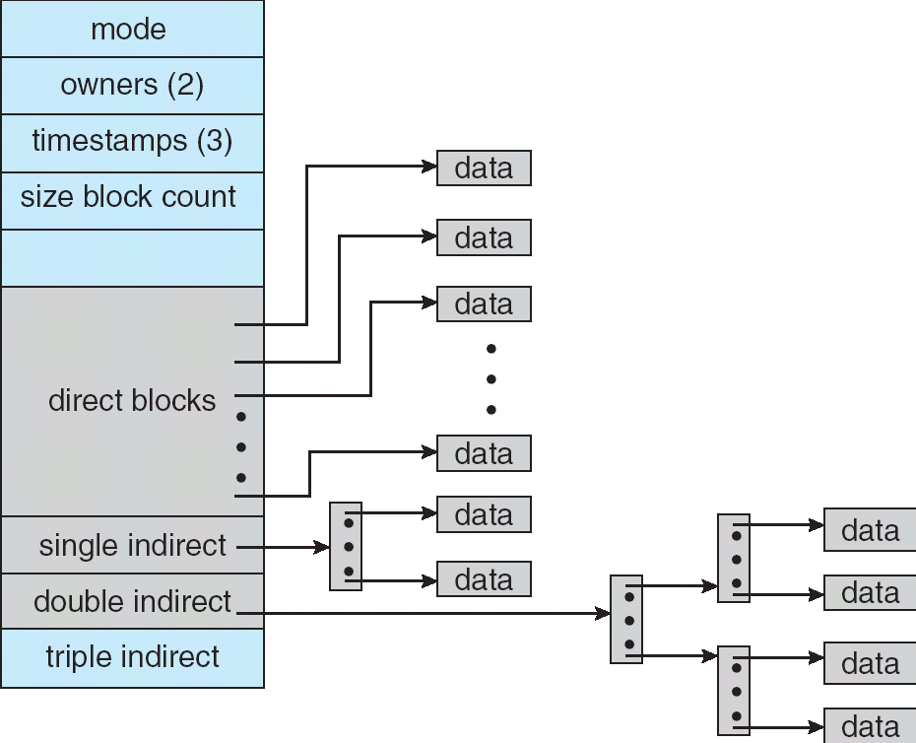
FILE SYSTEM IMPLEMENTATION
Storage (Retrieval)
Methods
Linux File Storage:
Note that various mechanisms are used here so as to optimize the technique based on the size of the file.

Slide 24
FILE SYSTEM IMPLEMENTATION
Storage (Retrieval)
Methods
PERFORMANCE ISSUES FOR THESE METHODS
It's difficult to compare mechanisms because usage is different. Let's calculate, for each method, the number of disk accesses to read block i from a file:
contiguous: 1 access from location start + i.
linked: i + 1 accesses, reading each block in turn. (is this a fair example?)
index: 2 accesses, 1 for index, 1 for data.

Slide 25
FILE SYSTEM IMPLEMENTATION
Free Space
Management
We need a way to keep track of space currently free. This information is needed when we want to create or add (allocate) to a file. When a file is deleted, we need to show what space is freed up.
BIT VECTOR METHOD
Each block is represented by a bit
1 1 0 0 1 1 0 means blocks 2, 3, 6 are free.
This method allows an easy way of finding contiguous free blocks. Requires the overhead of disk space to hold the bitmap.
A block is not REALLY allocated on the disk unless the bitmap is updated.
What operations (disk requests) are required to create and allocate a file using this implementation?

Slide 26
FILE SYSTEM IMPLEMENTATION
Free Space
Management
FREE LIST METHOD
Free blocks are chained together, each holding a pointer to the next one free.
This is very inefficient since a disk access is required to look at each sector.
GROUPING METHOD
In one free block, put lots of pointers to other free blocks. Include a pointer to the next block of pointers.
COUNTING METHOD
Since many free blocks are contiguous, keep a list of dyads holding the starting address of a "chunk", and the number of blocks in that chunk.
Format < disk address, number of free blocks >

Slide 27
FILE SYSTEM IMPLEMENTATION
Directory
Management
The issue here is how to be able to search for information about a file in a directory given its name.
Could have linear list of file names with pointers to the data blocks. This is:
simple to program BUT time consuming to search.
Could use hash table - a linear list with hash data structure.
Use the filename to produce a value that's used as entry to hash table.
Hash table contains where in the list the file data is located.
This decreases the directory search time (file creation and deletion are faster.)
Must contend with collisions - where two names hash to the same location.
The number of hashes generally can't be expanded on the fly.

Slide 28
FILE SYSTEM IMPLEMENTATION
Directory/File
Management
GAINING CONSISTENCY
Required when system crashes or data on the disk may be inconsistent:
Consistency checker - compares data in the directory structure with data blocks on disk and tries to fix inconsistencies. For example, What if a file has a pointer to a block, but the bit map for the free-space-management says that block isn't allocated.
Back-up- provides consistency by copying data to a "safe" place.
Recovery - occurs when lost data is retrieved from backup.

Slide 29
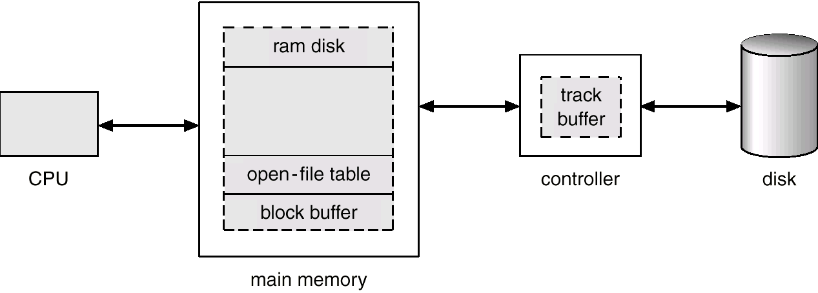
FILE SYSTEM IMPLEMENTATION
Efficiency and
Performance
THE DISK CACHE MECHANISM
There are many places to store disk data so the system doesn’t need to get it from the disk again and again.

Slide 30
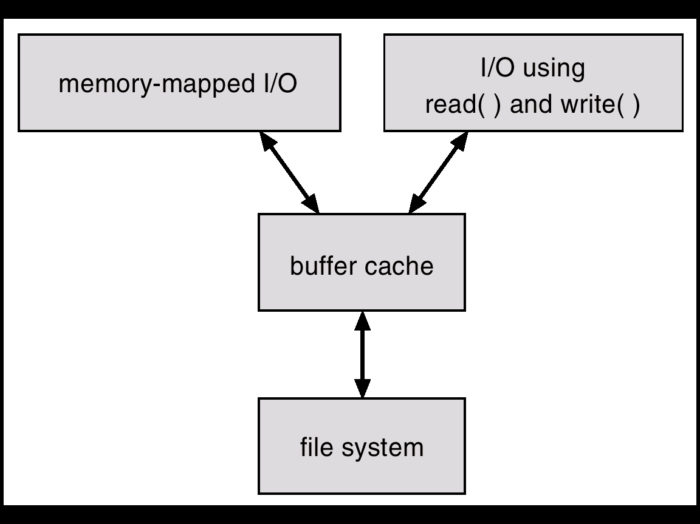
FILE SYSTEM IMPLEMENTATION
Efficiency and
Performance
THE DISK CACHE MECHANISM
This is an essential part of any well-performing Operating System.
The goal is to ensure that the disk is accessed as seldom as possible.
Keep previously read data in memory so that it might be read again.
They also hold on to written data, hoping to aggregate several writes from a process.
Can also be “smart” and do things like read-ahead. Anticipate what will be needed.

Slide 31
FILE SYSTEMS
Wrap Up
In this section we have looked at how the file is put together. What are the components that must be present in the file and implicitly, what procedures must be in the Operating System in order to act on these files.
We’ve also examined the internal structure of files.
This gives a file system knowledge about how to get around in the file – especially how to find the required data block.

