Slide 1
The UNIX File System
Contains sections on:
-- Directory Structure (Inode)
-- Storage Behavior
-- Allocation
Jerry Breecher

Slide 2
The UNIX File System
Used since 1970’s on UNIX.
Basis of today’s LINUX file systems
Original inode format appeared in BSD 4.1
Berkeley Standard Distribution Unix
Part of your heritage!
Similar structure for Linux Ext2/3
File Number is index into inode arrays
Multi-level index structure
Great for little and large files
Asymmetric tree with fixed sized blocks
Metadata associated with the file
Rather than in the directory that points to it
UNIX Fast File System (FFS) BSD 4.2 Locality Heuristics:
Block group placement
Reserve space
Scalable directory structure

Slide 3
File Concept
Attributes of a File
Name – only information kept in human-readable form
Identifier – unique tag (number) identifies file within file system
Type – needed for systems that support different types
Location – pointer to file location on device
Size – current file size
Protection – controls who can do reading, writing, executing
Time, date, and user identification – data for protection, security, and usage monitoring
Information about files is kept in the directory structure, which is maintained on the disk.

Slide 4
File Concept
What can we find out about a Linux File?
jbreecher@younger:~$ stat A_File
File: `A_File'
Size: 6491 Blocks: 16 IO Block: 4096 regular file
Device: 14h/20d Inode: 20938754 Links: 1
Access: (0600/-rw-------) Uid: ( 1170/jbreecher) Gid: ( 100/ users)
Access: 2006-11-15 15:38:17.000000000 -0500
Modify: 2006-09-27 17:44:10.000000000 -0400
Change: 2006-09-27 17:44:10.000000000 -0400
jbreecher@younger:~/public/os/Code$ stat protos.h
File: `protos.h'
Size: 2889 Blocks: 8 IO Block: 4096 regular file
Device: 14h/20d Inode: 28442631 Links: 1
Access: (0644/-rw-r--r--) Uid: ( 1170/jbreecher) Gid: ( 100/ users)
Access: 2006-11-16 03:56:17.000000000 -0500
Modify: 2006-08-27 12:45:57.000000000 -0400
Change: 2006-08-27 13:25:24.000000000 -0400

Slide 5
File Concept
Note: The command “LDE” – Linux Disk Editor – does amazing things but requires root privilege.
-rw-rw-rw- 1 jbreecherusers 56243 Mon Dec 18 14:25:40 2006
TYPE: regular file LINKS: 1 DIRECT BLOCKS= 0x002462CA
MODE: \0666 FLAGS: \10 0x002462CB
UID: 01170(jbreecher)ID: 00100(users) 0x002462CC
SIZE: 56243 SIZE(BLKS): 128 0x002462CD
0x002462CE
ACCESS TIME: Mon Dec 18 14:35:35 2006 0x002462CF
CREATION TIME: Mon Dec 18 14:25:40 2006 0x002462D0
MODIFICATION TIME: Mon Dec 18 14:25:40 2006 0x002462D1
DELETION TIME: Wed Dec 31 19:00:00 1969 0x002462D2
0x002462D3
0x002462D4
0x002462D5
INDIRECT BLOCK= 0x002462D6
2x INDIRECT BLOCK=
3x INDIRECT BLOCK=
Expanded on next page

Slide 6
File Concept
lde v2.6.1 : ext2 : /dev/mapper/VolGroup00-LogVol01
Inode: 1170636 (0x0011DCCC) Block: 2384586 (0x002462CA) 0123456789!@$%^
462CA000 74 68 69 73 20 6D 61 6E : 79 20 6E 6F 74 20 77 6F this many not wo
462CA010 72 6B 20 74 68 69 73 20 : 6D 61 6E 79 20 6E 6F 74 rk this many not
462CA020 20 77 6F 72 6B 20 74 68 : 69 73 20 6D 61 6E 79 20 work this many
462CA030 6E 6F 74 20 77 6F 72 6B : 20 74 68 69 73 20 6D 61 not work this ma
462CA040 6E 79 20 6E 6F 74 20 77 : 6F 72 6B 20 74 68 69 73 ny not work this
462CA050 20 6D 61 6E 79 20 6E 6F : 74 20 77 6F 72 6B 0A 74 many not work.t
462CA060 68 69 73 20 6D 61 6E 79 : 20 6E 6F 74 20 77 6F 72 his many not wor
lde v2.6.1 : ext2 : /dev/mapper/VolGroup00-LogVol01
Inode: 1170636 (0x0011DCCC) Block: 2384598 (0x002462D6) 0123456789!@$%^
462D6000 D7 62 24 00 D8 62 24 00 : 00 00 00 00 00 00 00 00 .b$..b$.........
462D6010 00 00 00 00 00 00 00 00 : 00 00 00 00 00 00 00 00 ................
462D6020 00 00 00 00 00 00 00 00 : 00 00 00 00 00 00 00 00 ................

Slide 7
Meet the Inode
file_number

Slide 8
Inode Metadata
User
Group
9 basic access control bits
- UGO x RWX
Setuid bit
- execute at owner permissions rather than user
Setgid bit
- execute at group’s permissions

Slide 9
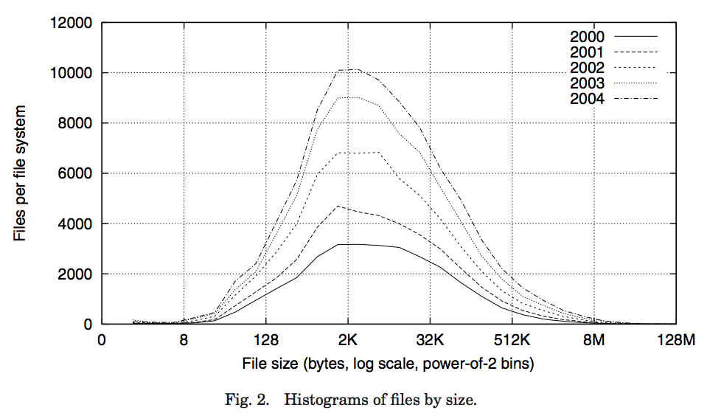
Data Storage
Small files: 12 pointers direct to data blocks
Direct pointers
4kB blocks ⇒ sufficient for files up to 48KB
Histogram of files by size

Slide 10
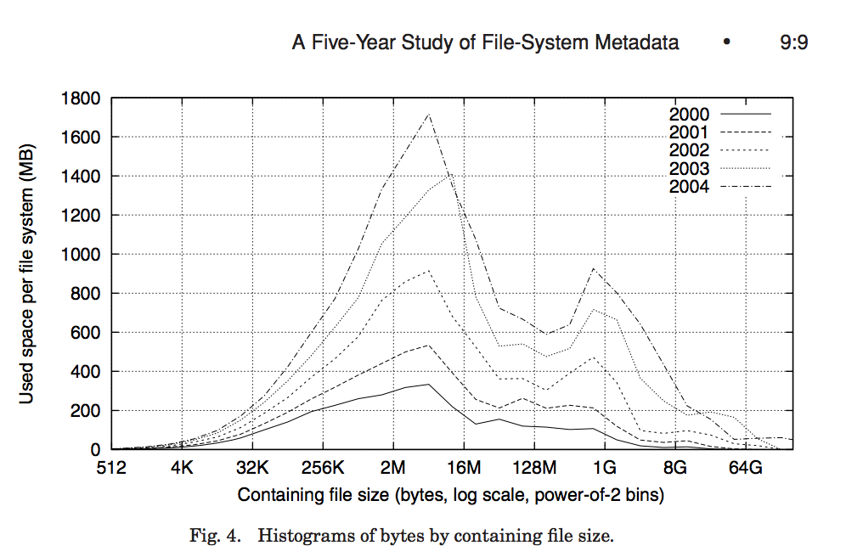
Data Storage
Large files: 1,2,3 level indirect pointers
Indirect pointers
- point to a disk block
containing only pointers
- 4 kB blocks => 1024 ptrs
=> 4 MB @ level 2
=> 4 GB @ level 3
=> 4 TB @ level 4
48 KB
+4 MB
+4 GB
+4 TB

Slide 11
Data Storage
Uses bitmap allocation in place of freelist
Attempts to allocate files contiguously
10% reserved disk space
Skip-sector positioning (mentioned next slide)
Problem: When creating a file, don’t know how big it will become (in UNIX, most writes are by appending)
How much contiguous space do you allocate for a file?
Just find some range of free blocks
Put each new file at the front of different range
To expand a file, you first try successive blocks in bitmap, then choose new range of blocks
Store files from same directory near each other

Slide 12
Modern Disks are Clever!
Today’s disks read ahead. So if the OS asks for only one block, the disk continues reading around the track and stores the remainder of the track in a Track Buffer. The user (or the OS) can then ask for the next disk block, and instead of having to rotate all the way around to get the next block, the disk can take it out of its buffer.
Skip Sector
Track Buffer
(Holds complete track)

Slide 13
Modern Disks are Clever!
In early UNIX and DOS/Windows’ FAT file system, headers stored in special array in outermost cylinders
Header not stored anywhere near the data blocks
To read a small file, seek to get header, seek back to data
Fixed size, set when disk is formatted
At formatting time, a fixed number of inodes are created
Each is given a unique number, called an “inumber”

Slide 14
Linux is Clever!
Move the header information to be closer to the data blocks
Often, inode for file stored in same “cylinder group” as parent directory of the file (makes an ls of that directory run fast)
Pros:
For small directories, can fit all data, file headers, etc. in same cylinder ⇒ no seeks!
File headers much smaller than whole block (a few hundred bytes), so multiple headers fetched from disk at same time
Reliability: whatever happens to the disk, you can find many of the files (even if directories disconnected)

Slide 15
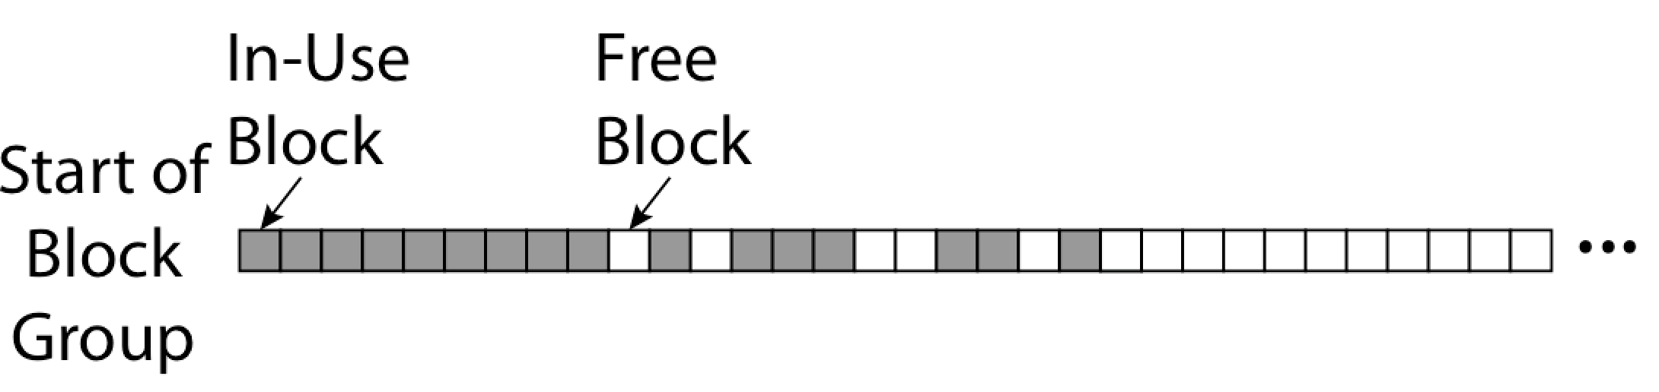
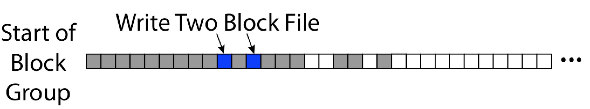
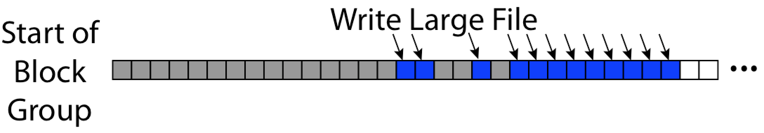
Linux Disk Allocation
Fills in the small holes at the start of block group
Avoids fragmentation, leaves contiguous free space at end

