Slide 1
OPERATING SYSTEMS
PROCESS SYNCHRONIZATION
Jerry Breecher

Slide 2
OPERATING SYSTEM Synchronization
What Is In This Chapter?
This is about getting processes to coordinate with each other.
How do processes work with resources that must be shared between them?
How do we go about acquiring locks to protect regions of memory?
How is synchronization really used?

Slide 3
OPERATING SYSTEM Synchronization
Topics Covered
Background
The Critical-Section Problem
Peterson’s Solution
Synchronization Hardware
Semaphores
Classic Problems of Synchronization
Synchronization Examples
Atomic Transactions

Slide 4
PROCESS SYNCHRONIZATION
The Producer
Consumer Problem
A producer process "produces" information "consumed" by a consumer process.
Here are the variables needed to define the problem:
#define BUFFER_SIZE 10
typedef struct {
DATA data;
} item;
item buffer[BUFFER_SIZE];
int in = 0; // Location of next input to buffer
int out = 0; // Location of next removal from buffer
int counter = 0; // Number of buffers currently full
Consider the code segments on the next page:
Does it work?
Are all buffers utilized?

Slide 5
PROCESS SYNCHRONIZATION
The Producer
Consumer Problem
#define BUFFER_SIZE 10
typedef struct {
DATA data;
} item;
item buffer[BUFFER_SIZE];
int in = 0;
int out = 0;
int counter = 0;
A producer process "produces" information "consumed" by a consumer process.
item nextProduced;
while (TRUE) {
while (counter == BUFFER_SIZE);
buffer[in] = nextProduced;
in = (in + 1) % BUFFER_SIZE;
counter++;
}
PRODUCER
item nextConsumed;
while (TRUE) {
while (counter == 0);
nextConsumed = buffer[out];
out = (out + 1) % BUFFER_SIZE;
counter--;
}
CONSUMER
producer
consumer

Slide 6
PROCESS SYNCHRONIZATION
The Producer
Consumer Problem
Note that counter++; ← this line is NOT what it seems!!
is really --> register = counter
register = register + 1
counter = register
At a micro level, the following scenario could occur using this code:
TO; Producer Execute register1 = counter register1 = 5
T1; Producer Execute register1 = register1 + 1 register1 = 6
T2; Consumer Execute register2 = counter register2 = 5
T3; Consumer Execute register2 = register2 - 1 register2 = 4
T4; Producer Execute counter = register1 counter = 6
T5; Consumer Execute counter = register2 counter = 4

Slide 7
//////////////////////////////////////////////////////////////////////////
// Adder - code executed by one of the threads
//////////////////////////////////////////////////////////////////////////
void *Adder(void *arg) {
int i;
for (i = 0; i < LoopCount; i++) {
GlobalVariable++;
} // End of for
} // End of Adder
.globl Adder
.type Adder, @function
Adder:
pushq %rbp
movq %rsp, %rbp
movq %rdi, -8(%rbp)
movl $0, -12(%rbp)
.L10:
movl -12(%rbp), %eax
cmpl LoopCount(%rip), %eax
jl .L13
jmp .L11
.L13:
incl GlobalVariable(%rip)
leaq -12(%rbp), %rax
incl (%rax)
jmp .L10
.L11:
leave
ret
.gcc ThreadsRunAmock.c -S
So why does ThreadsRunAmock.c give such strange behavior on a multiprocessor??

Slide 8
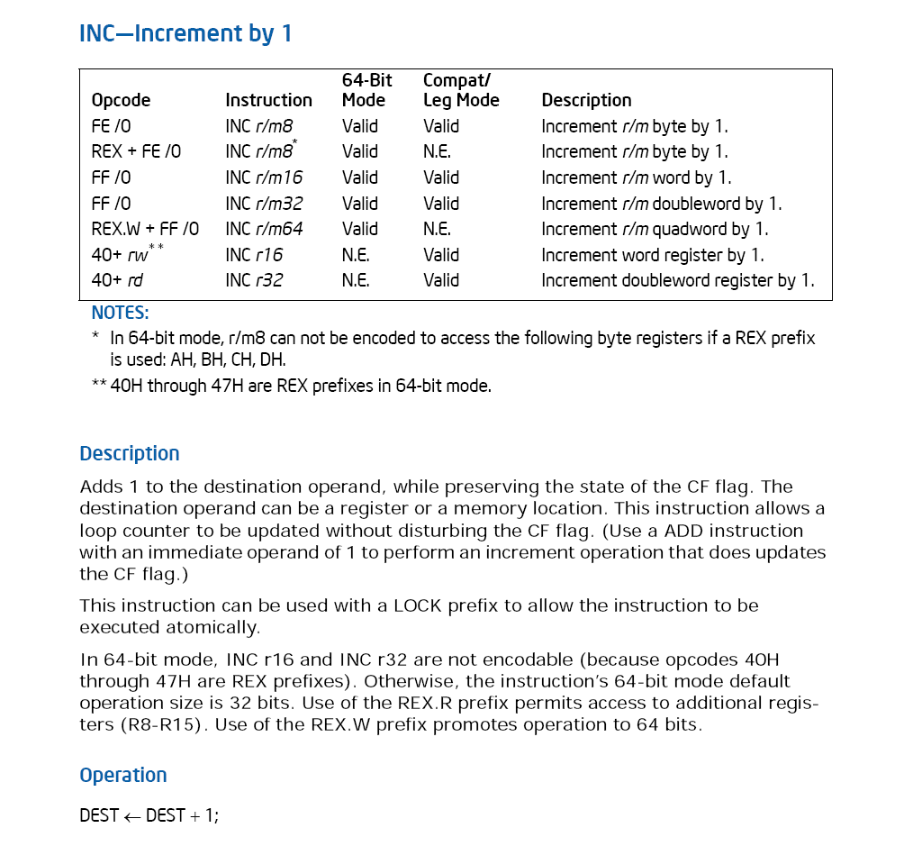
Intel Architecture Software Developer's Manual, Volume 2:
Instruction Set Reference Manual
This instruction is NOT atomic!!

Slide 9
PROCESS SYNCHRONIZATION
Critical Sections
A section of code, common to n cooperating processes, in which the processes may be accessing common variables.
A Critical Section Environment contains:
Entry Section Code requesting entry into the critical section.
Critical Section Code in which only one process can execute at any one time.
Exit Section The end of the critical section, releasing or allowing others in.
Remainder Section Rest of the code AFTER the critical section.

Slide 10
PROCESS SYNCHRONIZATION
Critical Sections
The critical section must ENFORCE ALL THREE of the following rules:
Mutual Exclusion: No more than one process can execute in its critical section at one time.
Progress: If no one is in the critical section and someone wants in, then those processes not in their remainder section must be able to decide in a finite time who should go in.
Bounded Wait: All requesters must eventually be let into the critical section.

Slide 11
PROCESS SYNCHRONIZATION
Two Processes
Software
Here’s an example of a simple piece of code containing the components required in a critical section.
do {
while ( turn ^= i );
/* critical section */
turn = j;
/* remainder section */
} while(TRUE);
Entry Section
Critical Section
Exit Section
Remainder Section

Slide 12
PROCESS SYNCHRONIZATION
Two Processes
Software
Here we try a succession of increasingly complicated solutions to the problem of creating valid entry sections.
NOTE: In all examples, i is the current process, j the "other" process. In these examples, envision the same code running on two processors at the same time.
TOGGLED ACCESS:
Algorithm 1
Are the three Critical Section Requirements Met?
do {
while ( turn ^= i );
/* critical section */
turn = j;
/* remainder section */
} while(TRUE);
The critical section must ENFORCE ALL THREE of the following rules:
Mutual Exclusion: No more than one process can execute in its critical section at one time.
Progress: If no one is in the critical section and someone wants in, then those processes not in their remainder section must be able to decide in a finite time who should go in.
Bounded Wait: All requesters must eventually be let into the critical section.
Notes:
Satisfies mutual exclusion, but not progress

Slide 13
PROCESS SYNCHRONIZATION
Two Processes
Software
FLAG FOR EACH PROCESS GIVES STATE:
Each process maintains a flag indicating that it wants to get into the critical section. It checks the flag of the other process and doesn’t enter the critical section if that other process wants to get in.
Algorithm 2
Shared variables
boolean flag[2]; initially flag [0] = flag [1] = false.
flag [i] = true ⇒ P_{i} ready to enter its critical section
Are the three Critical Section Requirements Met?
The critical section must ENFORCE ALL THREE of the following rules:
Mutual Exclusion: No more than one process can execute in its critical section at one time.
Progress: If no one is in the critical section and someone wants in, then those processes not in their remainder section must be able to decide in a finite time who should go in.
Bounded Wait: All requesters must eventually be let into the critical section.
do {
flag[i] := true; while (flag[j]) ; critical section
flag [i] = false;
remainder section
} while (1);
Notes:
Satisfies mutual exclusion, but not progress requirement.

Slide 14
PROCESS SYNCHRONIZATION
Two Processes
Software
FLAG TO REQUEST ENTRY:
Each processes sets a flag to request entry. Then each process toggles a bit to allow the other in first.
This code is executed for each process i.
This is Peterson’s
Solution
Algorithm 3
Shared variables
boolean flag[2]; initially flag [0] = flag [1] = false.
flag [i] = true ⇒ P_{i} ready to enter its critical section
Are the three Critical Section Requirements Met?
do {
flag [i]:= true; turn = j; while (flag [j] and turn == j) ;
critical section
flag [i] = false;
remainder section
} while (1);
Mutual Exclusion: No more than one process can execute in its critical section at one time.
Progress: If no one is in the critical section and someone wants in, then those processes not in their remainder section must be able to decide in a finite time who should go in.
Bounded Wait: All requesters must eventually be let into the critical section.
Notes:
Meets all three requirements; solves the critical-section problem for two processes.

Slide 15
Analysis of Peterson Solution
PROCESS SYNCHRONIZATION
CASE 1:
i
flag [i]:= true; turn = j; while (flag [j] and turn == j) ;
Result??
j
This thread doesn’t run
CASE 2:
i
flag [i]:= true;
turn = j; while (flag [j] and turn == j) ;
Result??
j
flag [j]:= true; turn = i;
while (flag [i] and turn == i) ;
Result??

Slide 16
PROCESS SYNCHRONIZATION
Analysis of Peterson Solution
CASE 3:
i
flag [i]:= true;
turn = j;
while (flag [j] and turn == j) ;
Result??
j
flag [j]:= true; turn = i; while (flag [i] and turn == i) ;
Result??
CASE 4:
i
flag [i]:= true;
turn = j;
while (flag [j] and turn == j) ;
Result??
j
flag [j]:= true;
turn = i; while (flag [i] and turn == i) ;
Result??

Slide 17
PROCESS SYNCHRONIZATION
So, What Happened?
We examined the Peterson algorithm – it looked good.
We ran the code for the Peterson Solution. It worked for small iterations, but for a large number of iterations it failed.
The algorithm is good, the hardware is “bad”. Or more accurately, our model of the hardware is not correct. What’s going on?
We are evaluating while (flag [j] and turn == j) ;
Here’s the code as generated on Windows with the complier command:
gcc ThreadsPeterson.c -S –o ThreadsPeterson.s
// L14:
// movl -4(%ebp), %eax
// movl _flag(,%eax,4), %eax
// testl %eax, %eax
// je L12
// movl _turn, %eax
// cmpl -4(%ebp), %eax
// je L14
//L12:
leave
ret
Here we evaluate first flag, and then turn..
Everything is great as long as flag and turn are consistent with each other. What if only one of the variables has been modified
as seen by the executing thread?
Notes:
Meets all three requirements; solves the critical-section problem for two processes.

Slide 18
PROCESS SYNCHRONIZATION
MFENCE
The Intel instruction MFENCE performs a serializing operation on all load and store instructions that were issued prior the MFENCE instruction. This serializing operation guarantees that every load and store instruction that precedes in program order the MFENCE instruction is globally visible before any load or store instruction that follows the MFENCE instruction is globally visible. The MFENCE instruction is ordered with respect to all load and store instructions, other MFENCE instructions, any SFENCE and LFENCE instructions, and any serializing instructions (such as the CPUID instruction).
Weakly ordered memory types can enable higher performance through such techniques as out-of-order issue, speculative reads, write-combining, and write-collapsing. The degree to which a consumer of data recognizes or knows that the data is weakly ordered varies among applications and may be unknown to the producer of this data. The MFENCE instruction provides a performance-efficient way of ensuring ordering between routines that produce weakly-ordered results and routines that consume this data.
It should be noted that processors are free to speculatively fetch and cache data from system memory regions that are assigned a memory-type that permits speculative reads (that is, the WB, WC, and WT memory types). The PREFETCHh instruction is considered a hint to this speculative behavior. Because this speculative fetching can occur at any time and is not tied to instruction execution, the MFENCE instruction is not ordered with respect to PREFETCHh or any of the speculative fetching mechanisms (that is, data could be speculative loaded into the cache just before, during, or after the execution of an MFENCE instruction).
Operation
Wait_On_Following_Loads_And_Stores_Until(preceding_loads_and_stores_globally_visible);
Notes:
Meets all three requirements; solves the critical-section problem for two processes.

Slide 19
Code for Peterson’s Algorithm
//////////////////////////////////////////////////////////////////////////
// Here's how the compiler generates code for the while line – and how we’ve
// added a synchronizing statement.
//
// L14:
// mfence ← Line Added
// movl -4(%ebp), %eax
// movl _flag(,%eax,4), %eax
// testl %eax, %eax
// je L12
// movl _turn, %eax
// cmpl -4(%ebp), %eax
// je L14
//L12:
leave
ret
//
//////////////////////////////////////////////////////////////////////////

Slide 20
Code for Peterson’s Algorithm
Here’s the total operation we perform here:
gcc ThreadsPeterson.c –o ThreadsPeterson // We find this fails
gcc ThreadsPeterson.c –S –o ThreadsPetersonNoFence.s
gcc ThreadsPeterson.c –S –o ThreadsPetersonFence.s
// We modify the Fence assembly code to add the mfence instruction
gcc ThreadsPetersonNoFence.s –o ThreadsPetersonNoFence
gcc ThreadsPetersonFence.s –o ThreadsPetersonFence
// Execute both programs

Slide 21
PROCESS SYNCHRONIZATION
Critical Sections
The hardware required to support critical sections must have (minimally):
Indivisible instructions (what are they?)
Atomic load, store, test instruction. For instance, if a store and test occur simultaneously, the test gets EITHER the old or the new, but not some combination.
Two atomic instructions, if executed simultaneously, behave as if executed sequentially.

Slide 22
PROCESS SYNCHRONIZATION
Hardware
Solutions
Disabling Interrupts: Works for the Uni Processor case only. WHY?
Atomic test and set: Returns parameter and sets parameter to true atomically.
while ( test_and_set ( lock ) );
/* critical section */
lock = false;
Example of Assembler code:
GET_LOCK: IF_CLEAR_THEN_SET_BIT_AND_SKIP <bit_address>
BRANCH GET_LOCK /* set failed */
------- /* set succeeded */
Must be careful if these approaches are to satisfy a bounded wait condition - must use round robin - requires code built around the lock instructions.

Slide 23
PROCESS SYNCHRONIZATION
Hardware
Solutions
// Note: On entry, edx register contains address of lock variable
Loop:
// move 1 into eax register
mov eax, 1
// xchg 1 with value contained in the lock variable
lock xchg DWORD PTR[edx], eax
// After the xchg, there are two possible conditions:
// If lock was originally =1 (locked) , after xchg lock = 1, eax = 1
// If lock was originally =0 (unlocked), after xchg lock = 1, eax = 0
// if eax is not zero, it means the lock was already held so try again
test eax, eax
jne Loop
// We now hold the lock
Using Intel
xchg instruction

Slide 24
PROCESS SYNCHRONIZATION
Hardware
Solutions
Boolean waiting[N];
int j; /* Takes on values from 0 to N - 1 */
Boolean key;
do {
waiting[i] = TRUE;
key = TRUE;
while( waiting[i] && key )
key = test_and_set( lock ); /* Spin lock */
waiting[ i ] = FALSE;
/****** CRITICAL SECTION ********/
j = ( i + 1 ) mod N;
while ( ( j != i ) && ( ! waiting[ j ] ) )
j = ( j + 1 ) % N;
if ( j == i )
lock = FALSE;
else
waiting[ j ] = FALSE;
/******* REMAINDER SECTION *******/
} while (TRUE);
Using Hardware
Test_and_set.

Slide 25
PROCESS SYNCHRONIZATION
Current Hardware
Dilemmas
We first need to define, for multiprocessors:
caches,
shared memory (for storage of lock variables),
write through cache,
write pipes.
The last software solution we did ( the one we thought was correct ) may not work on a cached multiprocessor. Why? { Hint, is the write by one processor visible immediately to all other processors?}
What changes must be made to the hardware for this program to work?

Slide 26
PROCESS SYNCHRONIZATION
Current Hardware
Dilemmas
Does the sequence below work on a cached multiprocessor?
Initially, location a contains A0 and location b contains B0.
a) Processor 1 writes data A1 to location a.
b) Processor 1 sets b to B1 indicating data at a is valid.
c) Processor 2 waits for b to take on value B1 and loops until that change occurs.
d) Processor 2 reads the value from a.
What value is seen by Processor 2 when it reads a?
How must hardware be specified to guarantee the value seen?
a: A0
b: B0

Slide 27
PROCESS SYNCHRONIZATION
Current Hardware
Dilemmas
We need to discuss:
Write Ordering: The first write by a processor will be visible before the second write is visible. This requires a write through cache.
Sequential Consistency: If Processor 1 writes to Location a "before" Processor 2 writes to Location b, then a is visible to ALL processors before b is. To do this requires NOT caching shared data.
The software solutions discussed earlier should be avoided since they require write ordering and/or sequential consistency.

Slide 28
PROCESS SYNCHRONIZATION
Current Hardware
Dilemmas
Hardware test and set on a multiprocessor causes
an explicit flush of the write to main memory and
the update of all other processor's caches.
Imagine needing to write all shared data straight through the cache.
With test and set, only lock locations are written out explicitly.
In not too many years, hardware will no longer support software solutions because of the performance impact of doing so.

Slide 29
PROCESS SYNCHRONIZATION
Semaphores
PURPOSE:
We want to be able to write more complex constructs and so need a language to do so. We thus define semaphores which we assume are atomic operations:
As given here, these are not atomic as written in "macro code". We define these operations, however, to be atomic (Protected by a hardware lock.)
FORMAT:
wait ( mutex ); <-- Mutual exclusion: mutex init to 1.
CRITICAL SECTION
signal( mutex );
REMAINDER
WAIT ( S ):
while ( S <= 0 );
S = S - 1;
SIGNAL ( S ):
S = S + 1;

Slide 30
PROCESS SYNCHRONIZATION
Semaphores
Semaphores can be used to force synchronization ( precedence ) if the preceeder does a signal at the end, and the follower does wait at beginning. For example, here we want P1 to execute before P2.
P1: P2:
statement 1; wait ( synch );
signal ( synch ); statement 2;

Slide 31
PROCESS SYNCHRONIZATION
Semaphores
We don't want to loop on busy, so will suspend instead:
Block on semaphore == False,
Wakeup on signal ( semaphore becomes True),
There may be numerous processes waiting for the semaphore, so keep a list of blocked processes,
Wakeup one of the blocked processes upon getting a signal ( choice of who depends on strategy ).
To PREVENT looping, we redefine the semaphore structure as:
typedef struct {
int value;
struct process *list; /* linked list of PTBL waiting on S */
} SEMAPHORE;

Slide 32
PROCESS SYNCHRONIZATION
Semaphores
typedef struct {
int value;
struct process *list; /* linked list of PTBL waiting on S */
} SEMAPHORE;
It's critical that these be atomic - in uniprocessors we can disable interrupts, but in multiprocessors other mechanisms for atomicity are needed.
Popular incarnations of semaphores are as "event counts" and "lock managers". (We'll talk about these in the next chapter.)
SEMAPHORE s;
wait(s) {
s.value = s.value - 1;
if ( s.value < 0 ) {
add this process to s.L;
block;
}
}
SEMAPHORE s;
signal(s) {
s.value = s.value + 1;
if ( s.value <= 0 ) {
remove a process P from s.L;
wakeup(P);
}
}

Slide 33
PROCESS SYNCHRONIZATION
Semaphores
DEADLOCKS:
· May occur when two or more processes try to get the same multiple resources at the same time.
P1: P2:
wait(S); wait(Q);
wait(Q); wait(S);
..... .....
signal(S); signal(Q);
signal(Q); signal(S);
· How can this be fixed?

Slide 34
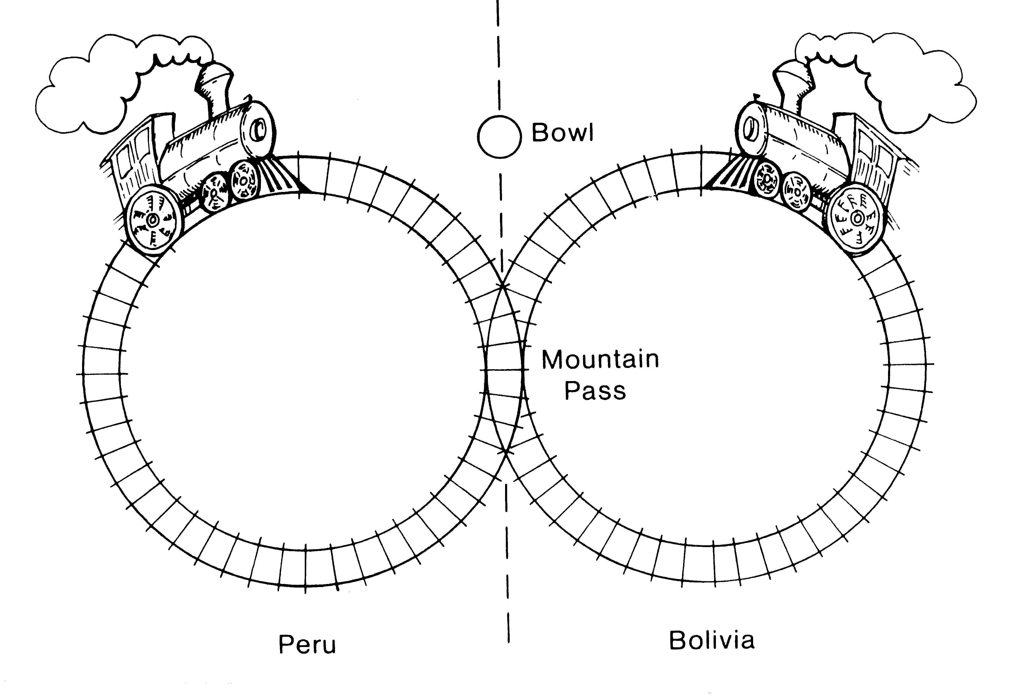
Railways in the Andes; A Practical Problem
PROCESS SYNCHRONIZATION
High in the Andes mountains, there are two circular railway lines. One line is in Peru, the other in Bolivia. They share a common section of track where the lines cross a mountain pass that lies on the international border (near Lake Titicaca?).
Unfortunately, the Peruvian and Bolivian trains occasionally collide when simultaneously entering the common section of track (the mountain pass). The trouble is, alas, that the drivers of the two trains are both blind and deaf, so they can neither see nor hear each other.

Slide 35
The two drivers agreed on the following method of preventing collisions. They set up a large bowl at the entrance to the pass. Before entering the pass, a driver must stop his train, walk over to the bowl, and reach into it to see it it contains a rock. If the bowl is empty, the driver finds a rock and drops it in the bowl, indicating that his train is entering the pass; once his train has cleared the pass, he must walk back to the bowl and remove his rock, indicating that the pass in no longer being used. Finally, he walks back to the train and continues down the line.
If a driver arriving at the pass finds a rock in the bowl, he leaves the rock there; he repeatedly takes a siesta and rechecks the bowl until he finds it empty. Then he drops a rock in the bowl and drives his train into the pass. A smart graduate from the University of La Paz (Bolivia) claimed that subversive train schedules made up by Peruvian officials could block the train forever.
Explain
The Bolivian driver just laughed and said that could not be true because it never happened.
Explain
Unfortunately, one day the two trains crashed.
Explain

Slide 36
Following the crash, the graduate was called in as a consultant to ensure that no more crashes would occur. He explained that the bowl was being used in the wrong way. The Bolivian driver must wait at the entry to the pass until the bowl is empty, drive through the pass and walk back to put a rock in the bowl. The Peruvian driver must wait at the entry until the bowl contains a rock, drive through the pass and walk back to remove the rock from the bowl. Sure enough, his method prevented crashes.
Prior to this arrangement, the Peruvian train ran twice a day and the Bolivian train ran once a day. The Peruvians were very unhappy with the new arrangement.
Explain
The graduate was called in again and was told to prevent crashes while avoiding the problem of his previous method. He suggested that two bowls be used, one for each driver. When a driver reaches the entry, he first drops a rock in his bowl, then checks the other bowl to see if it is empty. If so, he drives his train through the pass. Stops and walks back to remove his rock. But if he finds a rock in the other bowl, he goes back to his bowl and removes his rock. Then he takes a siesta, again drops a rock in his bowl and re-checks the other bowl, and so on, until he finds the other bowl empty. This method worked fine until late in May, when the two trains were simultaneously blocked at the entry for many siestas.
Explain

Slide 37
PROCESS SYNCHRONIZATION
Some Interesting
Problems
THE BOUNDED BUFFER ( PRODUCER / CONSUMER ) PROBLEM:
This is the same producer / consumer problem as before. But now we'll do it with signals and waits. Remember: a wait decreases its argument and a signal increases its argument.
BINARY_SEMAPHORE mutex = 1; // Can only be 0 or 1
COUNTING_SEMAPHORE empty = n; full = 0; // Can take on any integer value
producer:
do {
/* produce an item in nextp */
wait (empty); /* Do action */
wait (mutex); /* Buffer guard*/
/* add nextp to buffer */
signal (mutex);
signal (full);
} while(TRUE);
consumer:
do {
wait (full);
wait (mutex);
/* remove an item from buffer to nextc */
signal (mutex);
signal (empty);
/* consume an item in nextc */
} while(TRUE);

Slide 38
PROCESS SYNCHRONIZATION
Some Interesting
Problems
THE READERS/WRITERS PROBLEM:
This is the same as the Producer / Consumer problem except - we now can have many concurrent readers and one exclusive writer.
Locks: are shared (for the readers) and exclusive (for the writer).
Two possible ( contradictory ) guidelines can be used:
No reader is kept waiting unless a writer holds the lock (the readers have precedence).
If a writer is waiting for access, no new reader gains access (writer has precedence).
( NOTE: starvation can occur on either of these rules if they are followed rigorously.)

Slide 39
PROCESS SYNCHRONIZATION
Some Interesting
Problems
Writer:
do {
wait( wrt );
/* writing is performed */
signal( wrt );
} while(TRUE);
THE READERS/WRITERS PROBLEM:
BINARY_SEMAPHORE wrt = 1;
BINARY_SEMAPHORE mutex = 1;
int readcount = 0;
Reader:
do {
wait( mutex ); /* Allow 1 reader in entry*/
readcount = readcount + 1;
if readcount == 1 then wait(wrt ); /* 1st reader locks writer */
signal( mutex );
/* reading is performed */
wait( mutex );
readcount = readcount - 1;
if readcount == 0 then signal(wrt ); /*last reader frees writer */
signal( mutex );
} while(TRUE);
WAIT ( S ):
while ( S <= 0 );
S = S - 1;
SIGNAL ( S ):
S = S + 1;

Slide 40
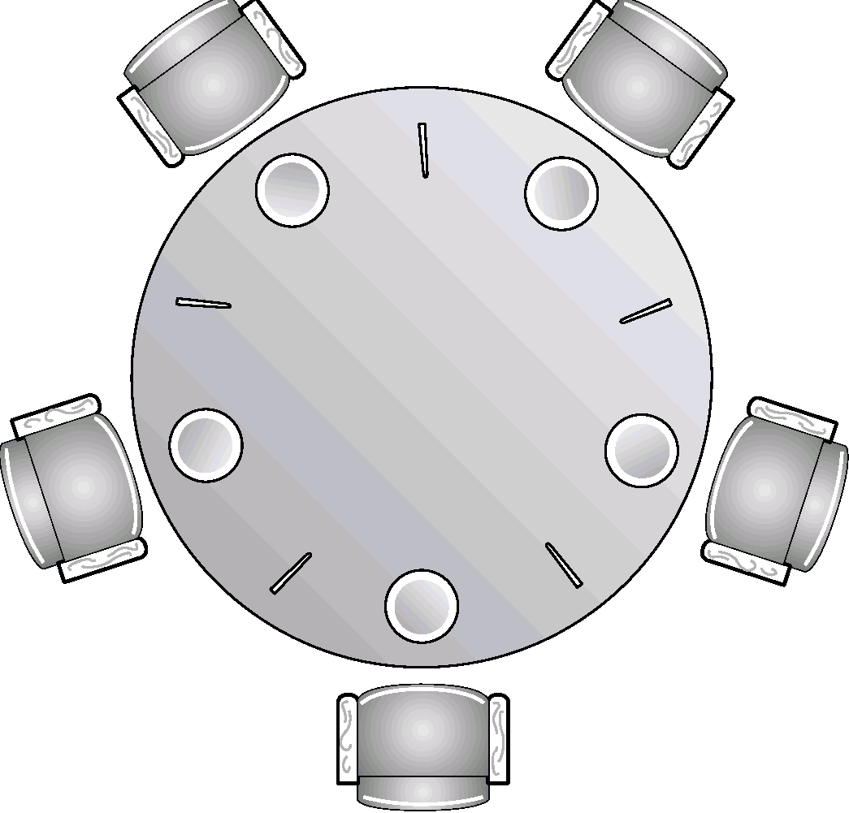
PROCESS SYNCHRONIZATION
Some Interesting
Problems
THE DINING PHILOSOPHERS PROBLEM:
5 philosophers with 5 chopsticks sit around a circular table. They each want to eat at random times and must pick up the chopsticks on their right and on their left.
Clearly deadlock is rampant ( and starvation possible.)
Several solutions are possible:
Allow only 4 philosophers to be hungry at a time.
Allow pickup only if both chopsticks are available. ( Done in critical section )
Odd # philosopher always picks up left chopstick 1st, even # philosopher always picks up right chopstick 1st.

Slide 41
PROCESS SYNCHRONIZATION
Critical Regions
High Level synchronization construct implemented in a programming language.
A shared variable v of type T, is declared as:
var v; shared T
Variable v is accessed only inside a statement:
region v when B do S
where B is a Boolean expression.
While statement S is being executed, no other process can access variable v.
Regions referring to the same shared variable exclude each other in time.
When a process tries to execute the region statement, the Boolean expression B is evaluated.
If B is true, statement S is executed.
If it is false, the process is delayed until B is true and no other process is in the region associated with v.
Entry Section
Shared Data
Exit Section
Critical Region

Slide 42
PROCESS SYNCHRONIZATION
Critical Regions
EXAMPLE: Bounded Buffer:
Shared variables declared as:
struct buffer {
int pool[n];
int count, in, out;
}
Producer process inserts nextp into the shared buffer:
region buffer when( count < n) { pool[in] = nextp; in:= (in+1) % n; count++; }
Consumer process removes an item from the shared buffer and puts it in nextc.
region buffer when (count > 0) { nextc = pool[out]; out = (out+1) % n; count--; }

Slide 43
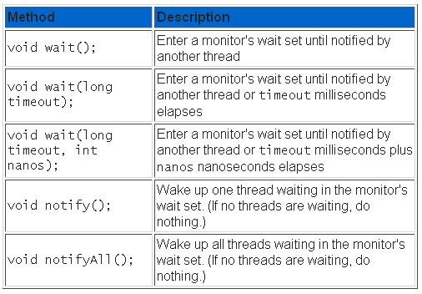
Java Usage
PROCESS SYNCHRONIZATION
Class Object declares five methods that enable programmers to access the Java virtual machine's support for the coordination aspect of synchronization.
These methods are declared public and final, so they are inherited by all classes. They can only be invoked from within a synchronized method or statement. In other words, the lock associated with an object must already be acquired before any of these methods are invoked.

Slide 44
Java Usage
PROCESS SYNCHRONIZATION
This is a very easy way to get synchronization in java.
// To make a method synchronized, simply add the synchronized
// keyword to its declaration:
public class SynchronizedCounter {
private int c = 0;
public synchronized void increment() {
c++;
}
public synchronized void decrement() {
c--;
}
public synchronized int value() {
return c;
}
}

Slide 45
Wrap up
PROCESS SYNCHRONIZATION
In this chapter we have:
Looked at many incarnations of the producer consumer problem.
Understood how to use critical sections and their use in semaphores.
Synchronization IS used in real life. Generally programmers don’t use the really primitive hardware locks, but use higher level mechanisms as we’ve demonstrated.

