Slide 1
OPERATING SYSTEMS
MEMORY MANAGEMENT
Jerry Breecher

Slide 2
OPERATING SYSTEM Memory Management
What Is In This Chapter?
Just as processes share the CPU, they also share physical memory. This chapter is about mechanisms for doing that sharing.

Slide 3
MEMORY MANAGEMENT
Just as processes share the CPU, they also share physical memory. This section is about mechanisms for doing that sharing.
EXAMPLE OF MEMORY USAGE:
Calculation of an effective address
Fetch from instruction
Use index offset
Example: ( Here index is a pointer to an address )
loop:
load register, index
add 42, register
store register, index
inc index
skip_equal index, final_address
branch loop
... continue ....

Slide 4
MEMORY MANAGEMENT
Definitions
The concept of a logical address space that is bound to a separate physical address space is central to proper memory management.
Logical address – generated by the CPU; also referred to as virtual address
Physical address – address seen by the memory unit
Logical and physical addresses are the same in compile-time and load-time address-binding schemes; logical (virtual) and physical addresses differ in execution-time address-binding scheme

Slide 5
MEMORY MANAGEMENT
Definitions
Relocatable Means that the program image can reside anywhere in physical memory.
Binding Programs need real memory in which to reside. When is the location of that real memory determined?
This is called mapping logical to physical addresses.
This binding can be done at compile/link time. Converts symbolic to relocatable. Data used within compiled source is offset within object module.
Compiler: If it’s known where the program will reside, then absolute code is generated. Otherwise compiler produces relocatable code.
Load: Binds relocatable to physical. Can find best physical location.
Execution: The code can be moved around during execution. Means flexible virtual mapping.

Slide 6
MEMORY MANAGEMENT
Binding Logical To Physical
Source
This binding can be done at compile/link time. Converts symbolic to relocatable. Data used within compiled source is offset within object module.
Can be done at load time. Binds relocatable to physical.
Can be done at run time. Implies that the code can be moved around during execution.
The next example shows how a compiler and linker actually determine the locations of these effective addresses.
Compiler
Object
Other Objects
Linker
Executable
Libraries
Loader
In-memory Image

Slide 7

MEMORY MANAGEMENT
Binding Logical To Physical
/*
* This code is designed to demonstrate the concept of virtual addressing.
* Follow this sequence to watch the magic happen before your eyes!
* gcc Hello.c -S -- this produces the assembly source code
* cat Hello.s -- you can see what is produced here
* gcc Hello.c -o Hello -- produces an executable
* objdump -d Hello -- prints out the machine level code
*/
#include <stdio.h>
void main() {
printf("Hello World\n");
}
This code is in the Sample section on linux – let’s try out this demonstration!

Slide 8
MEMORY MANAGEMENT
More Definitions
Dynamic loading
+ Routine is not loaded until it is called
+ Better memory-space utilization; unused routine is never loaded.
+ Useful when large amounts of code are needed to handle infrequently occurring cases.
+ No special support from the OS is required - implemented through program design.
Dynamic Linking
+ Linking postponed until execution time.
+ Small piece of code, stub, used to locate the appropriate memory-resident library routine.
+ Stub replaces itself with the address of the routine, and executes the routine.
+ Operating system needed to check if routine is in processes’ memory address.
+ Dynamic linking is particularly useful for libraries.
Memory Management Performs the above operations. Usually requires hardware support.

Slide 9
MEMORY MANAGEMENT
SINGLE PARTITION
ALLOCATION
BARE MACHINE:
No protection, no utilities, no overhead.
This is the simplest form of memory management.
Used by hardware diagnostics, by system boot code, real time/dedicated systems.
logical == physical
User can have complete control. Commensurably, the operating system has none.
DEFINITION OF PARTITIONS:
Division of physical memory into fixed sized regions. (Allows addresses spaces to be distinct = one user can't muck with another user, or the system.)
The number of partitions determines the level of multiprogramming. Partition is given to a process when it's scheduled.
Protection around each partition determined by
bounds ( upper, lower )
base / limit.
These limits are done in hardware.

Slide 10
MEMORY MANAGEMENT
SINGLE PARTITION
ALLOCATION
RESIDENT MONITOR:
Primitive Operating System.
Usually in low memory where interrupt vectors are placed.
Must check each memory reference against fence ( fixed or variable ) in hardware or register. If user generated address < fence, then illegal.
User program starts at fence -> fixed for duration of execution. Then user code has fence address built in. But only works for static-sized monitor.
If monitor can change in size, start user at high end and move back, OR use fence as base register that requires address binding at execution time. Add base register to every generated user address.
Isolate user from physical address space using logical address space.
Concept of "mapping addresses” shown on next slide.

Slide 11
MEMORY MANAGEMENT
SINGLE PARTITION
ALLOCATION
Limit
Register
Relocation
Register
MEMORY
CPU
Yes
<
+
Logical
Address
Physical
Address
No

Slide 12
MEMORY MANAGEMENT
CONTIGUOUS
ALLOCATION
All pages for a process are allocated together in one chunk.
JOB SCHEDULING
Must take into account who wants to run, the memory needs, and partition availability. (This is a combination of short/medium term scheduling.)
Sequence of events:
In an empty memory slot, load a program
THEN it can compete for CPU time.
Upon job completion, the partition becomes available.
Can determine memory size required ( either user specified or "automatically" ).

Slide 13
MEMORY MANAGEMENT
CONTIGUOUS
ALLOCATION
DYNAMIC STORAGE
(Variable sized holes in memory allocated on need.)
Operating System keeps table of this memory - space allocated based on table.
Adjacent freed space merged to get largest holes - buddy system.
ALLOCATION PRODUCES HOLES
OS
OS
OS
process 1
process 1
process 1
Process 2
Terminates
Process 4
Starts
process 4
process 2
process 3
process 3
process 3

Slide 14
MEMORY MANAGEMENT
CONTIGUOUS
ALLOCATION
HOW DO YOU ALLOCATE MEMORY TO NEW PROCESSES?
First fit - allocate the first hole that's big enough.
Best fit - allocate smallest hole that's big enough.
Worst fit - allocate largest hole.
(First fit is fastest, worst fit has lowest memory utilization.)
Avoid small holes (external fragmentation). This occurs when there are many small pieces of free memory.
What should be the minimum size allocated, allocated in what chunk size?
Want to also avoid internal fragmentation. This is when memory is handed out in some fixed way (power of 2 for instance) and requesting program doesn't use it all.

Slide 15
MEMORY MANAGEMENT
LONG TERM
SCHEDULING
If a job doesn't fit in memory, the scheduler can
wait for memory
skip to next job and see if it fits.
What are the pros and cons of each of these?
There's little or no internal fragmentation (the process uses the memory given to it - the size given to it will be a page.)
But there can be a great deal of external fragmentation. This is because the memory is constantly being handed cycled between the process and free.

Slide 16
MEMORY MANAGEMENT
COMPACTION
Trying to move free memory to one large block.
Only possible if programs linked with dynamic relocation (base and limit.)
There are many ways to move programs in memory.
Swapping: if using static relocation, code/data must return to same place. But if dynamic, can reenter at more advantageous memory.
OS
OS
OS
P1
P1
P1
P2
P3
P3
P2
P2
P3

Slide 17
MEMORY MANAGEMENT
PAGING
New Concept!!
Logical address space of a process can be noncontiguous; process is allocated physical memory whenever that memory is available and the program needs it.
Divide physical memory into fixed-sized blocks called frames (size is power of 2, between 512 bytes and 8192 bytes).
Divide logical memory into blocks of same size called pages.
Keep track of all free frames.
To run a program of size n pages, need to find n free frames and load program.
Set up a page table to translate logical to physical addresses.
Internal fragmentation.

Slide 18
Address Translation Scheme
MEMORY MANAGEMENT
PAGING
Address generated by the CPU is divided into:
Page number (p) – used as an index into a page table which contains base address of each page in physical memory.
Page offset (d) – combined with base address to define the physical memory address that is sent to the memory unit.
4096 bytes = 2^12 – it requires 12 bits to contain the Page offset
p
d

Slide 19
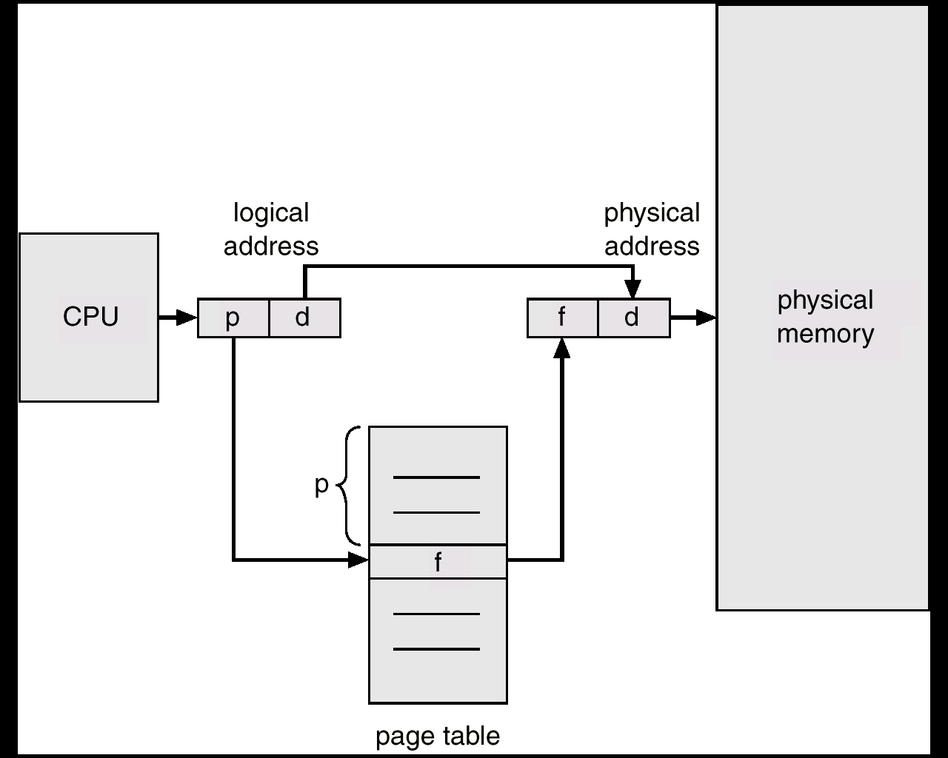
MEMORY MANAGEMENT
PAGING
Permits a program's memory to be physically noncontiguous so it can be allocated from wherever available. This avoids fragmentation and compaction.
Frames = physical blocks
Pages = logical blocks
Size of frames/pages is defined by hardware (power of 2 to ease calculations)
HARDWARE
An address is determined by:
page number ( index into table ) + offset
---> mapping into --->
base address ( from table ) + offset.

Slide 20
PAGING
MEMORY MANAGEMENT
0
Paging Example - 32-byte memory with 4-byte pages
4 I
j
k
l
0 a
1 b
2 c
3 d
8 m
n
o
p
0 5
1 6
2 1
3 2
4 e
5 f
6 g
7 h
12
16
8 I
9 j
10 k
11 l
Page Table
20 a
b
c
d
12 m
13 n
14 o
15 p
24 e
f
g
h
Physical Memory
28
Logical Memory

Slide 21
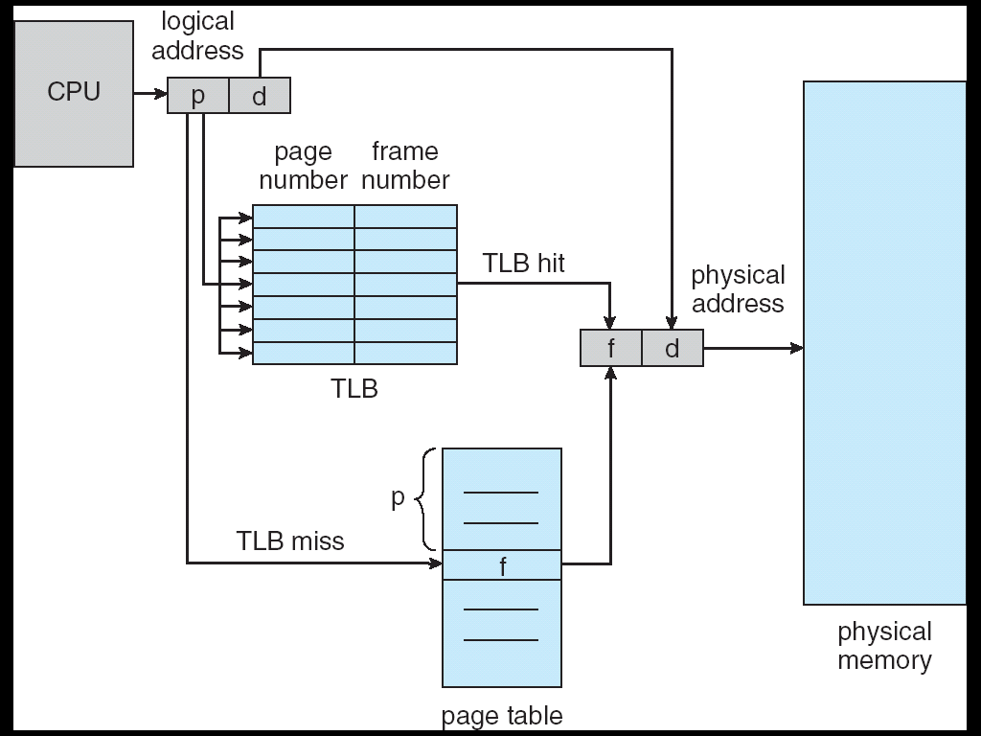
MEMORY MANAGEMENT
PAGING
A 32 bit machine can address 4 gigabytes which is 4 million pages (at 1024 bytes/page). WHO says how big a page is, anyway?
Could use dedicated registers (OK only with small tables.)
Could use a register pointing to table in memory (slow access.)
Cache or associative memory
(TLB = Translation Lookaside Buffer):
simultaneous search is fast and uses only a few registers.
IMPLEMENTATION OF THE PAGE TABLE
TLB = Translation Lookaside Buffer

Slide 22
MEMORY MANAGEMENT
PAGING
IMPLEMENTATION OF THE PAGE TABLE
Issues include:
key and value
hit rate 90 - 98% with 100 registers
add entry if not found
Effective access time = %fast * time_fast + %slow * time_slow
Relevant times:
2 nanoseconds to search associative memory – the TLB.
20 nanoseconds to access processor cache and bring it into TLB for next time.
Calculate time of access:
hit = 1 search + 1 memory reference
miss = 1 search + 1 mem reference(of page table) + 1 mem reference.

Slide 23
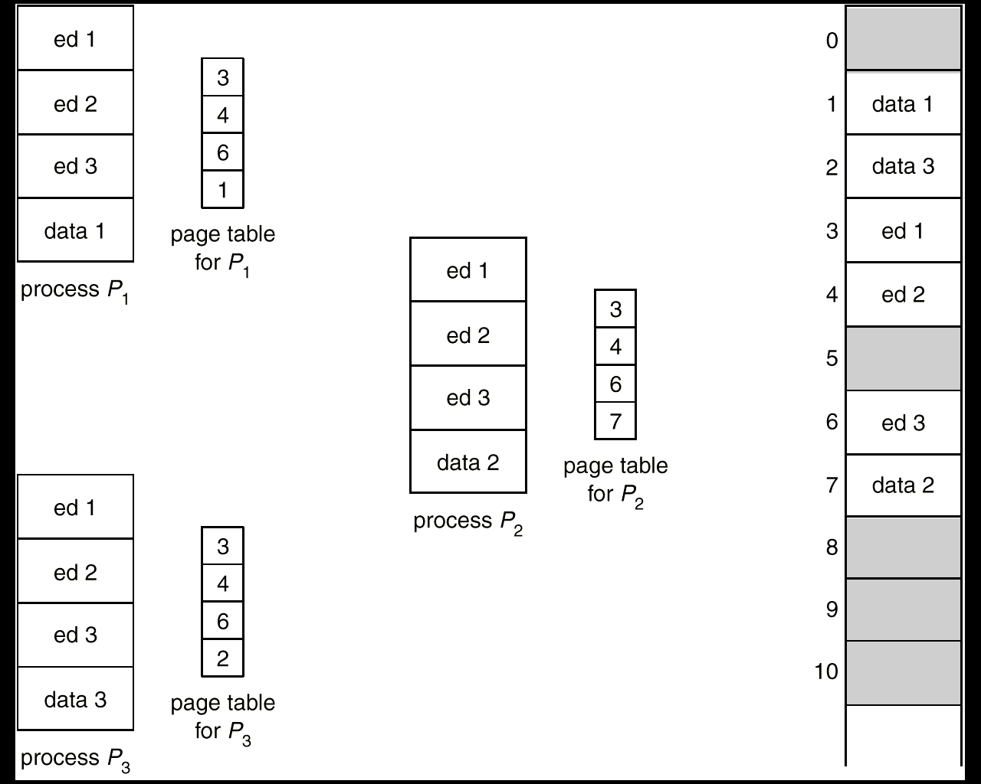
MEMORY MANAGEMENT
PAGING
SHARED PAGES
Data occupying one physical page, but pointed to by multiple logical pages.
Useful for common code - must be write protected. (NO write-able data mixed with code.)
Extremely useful for read/write communication between processes.

Slide 24
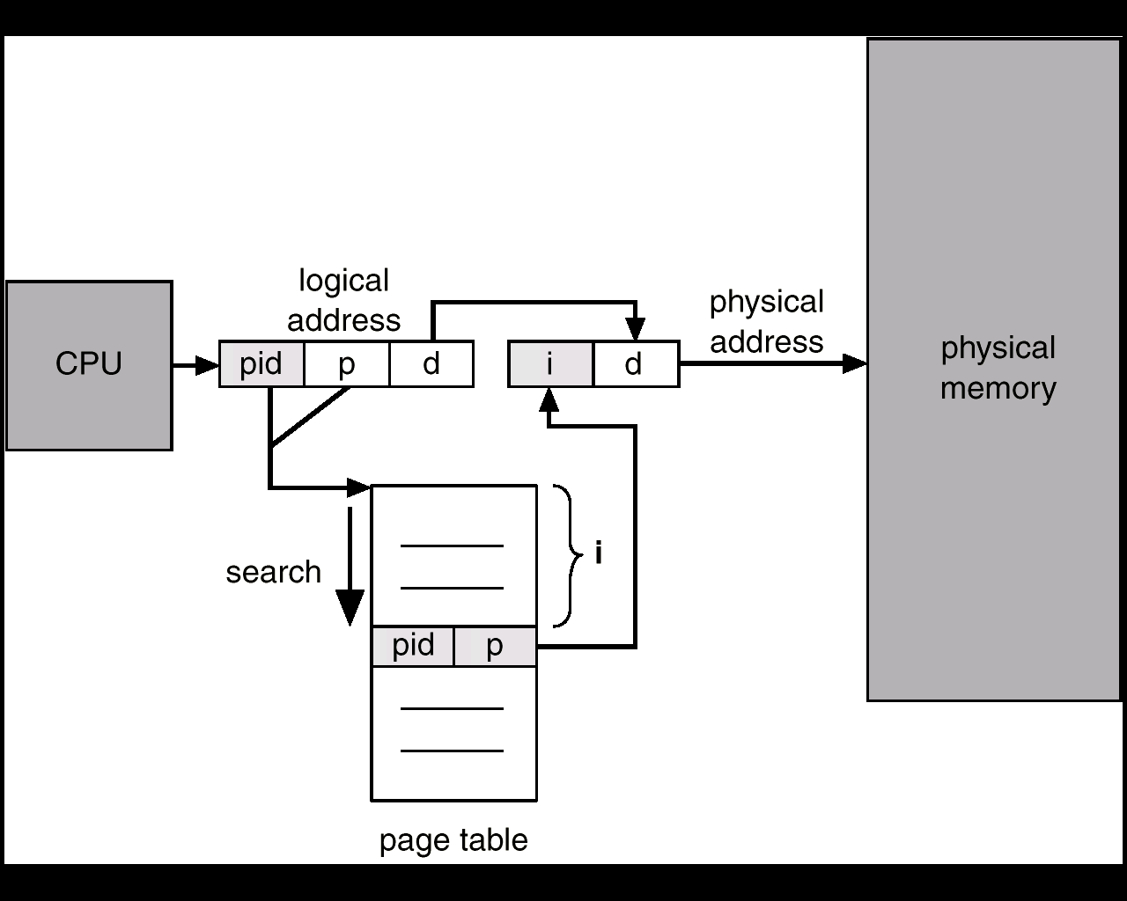
MEMORY MANAGEMENT
PAGING
INVERTED PAGE TABLE:
One entry for each real page of memory.
Entry consists of the virtual address of the page stored in that real memory location, with information about the process that owns that page.
Essential when you need to do work on the page and must find out what process owns it.
Use hash table to limit the search to one - or at most a few - page table entries.

Slide 25
MEMORY MANAGEMENT
PAGING
PROTECTION:
Bits associated with page tables.
Can have read, write, execute, valid bits.
Valid bit says page isn’t in address space.
Write to a write-protected page causes a fault. Touching an invalid page causes a fault.
ADDRESS MAPPING:
Allows physical memory larger than logical memory.
Useful on 32 bit machines with more than 32-bit addressable words of memory.
The operating system keeps a frame containing descriptions of physical pages; if allocated, then to which logical page in which process.

Slide 26
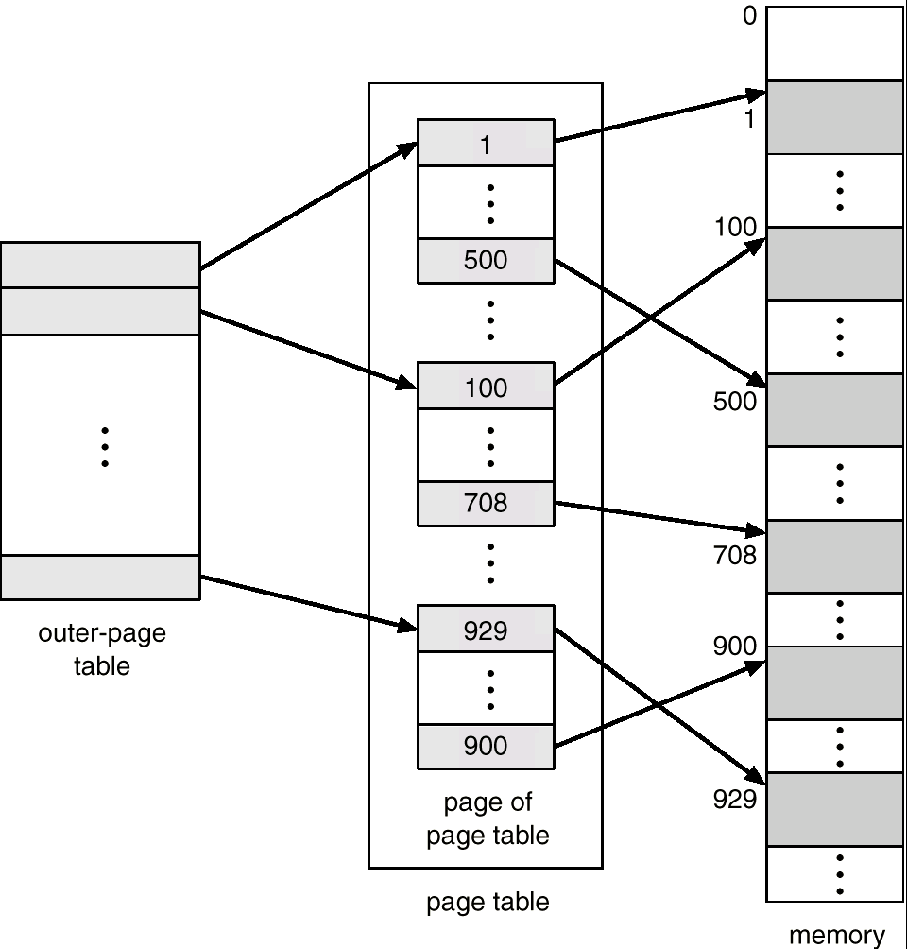
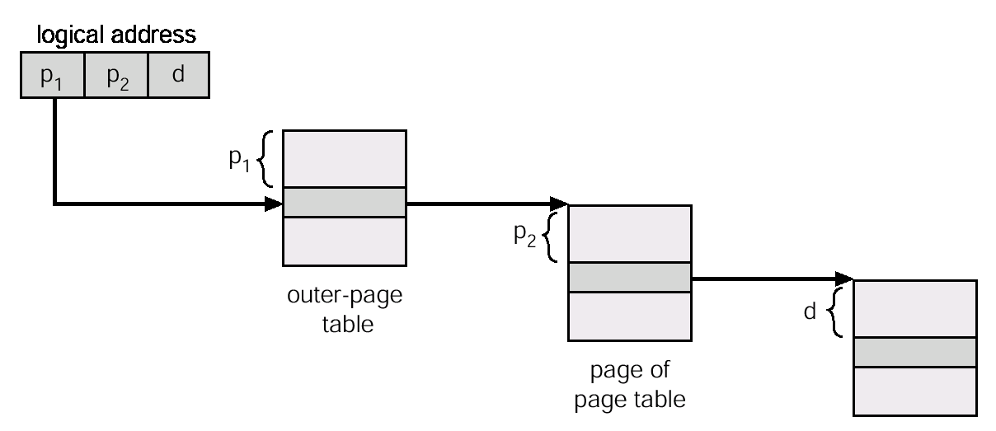
MEMORY MANAGEMENT
PAGING
MULTILEVEL PAGE TABLE
A means of using page tables for large address spaces.

Slide 27
MEMORY MANAGEMENT
Segmentation
USER'S VIEW OF MEMORY
A programmer views a process consisting of unordered segments with various purposes. This view is more useful than thinking of a linear array of words. We really don't care at what address a segment is located.
Typical segments include
global variables
procedure call stack
code for each function
local variables for each
large data structures
Logical address = segment name ( number ) + offset
Memory is addressed by both segment and offset.

Slide 28
MEMORY MANAGEMENT
Segmentation
HARDWARE -- Must map a dyad (segment / offset) into one-dimensional address.
Segment Table
Limit Base
CPU
S D
MEMORY
Logical
Address
Yes
<
+
Physical
Address
No

Slide 29
MEMORY MANAGEMENT
Segmentation
HARDWARE
base / limit pairs in a segment table.
0
1
2
3
4
Limit
1000
400
400
1100
1000
Base
1400
6300
4300
3200
4700
1
1
4
2
0
3
2
4
3
Logical Address Space
Physical Memory

Slide 30
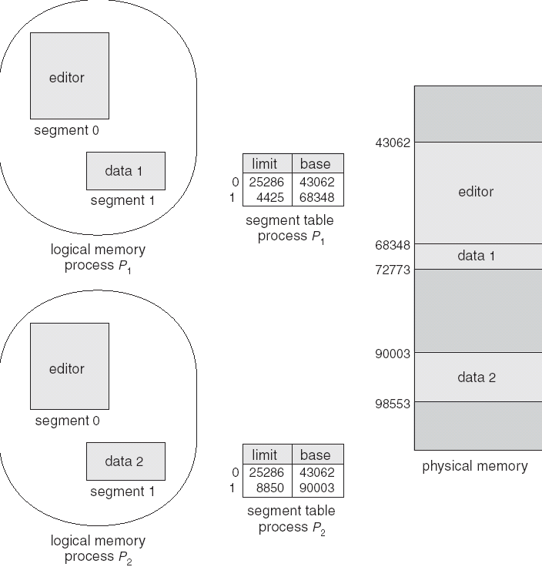
MEMORY MANAGEMENT
Segmentation
PROTECTION AND SHARING
Addresses are associated with a logical unit (like data, code, etc.) so protection is easy.
Can do bounds checking on arrays
Sharing specified at a logical level, a segment has an attribute called "shareable".
Can share some code but not all - for instance a common library of subroutines.
FRAGMENTATION
Use variable allocation since segment lengths vary.
Again have issue of fragmentation; Smaller segments means less fragmentation. Can use compaction since segments are relocatable.

Slide 31
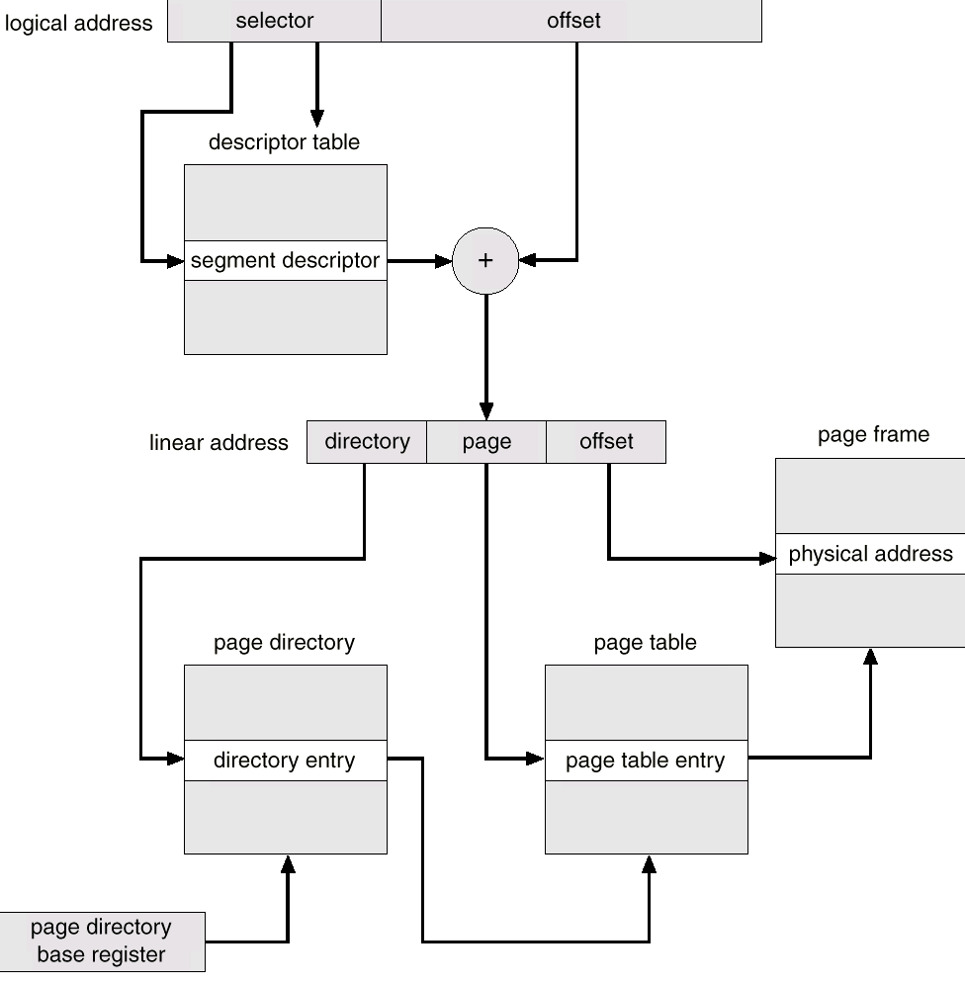
MEMORY MANAGEMENT
Segmentation
PAGED SEGMENTATION
Combination of paging and segmentation.
address =
frame at ( page table base for segment
+ offset into page table )
+ offset into memory
Look at example of Intel architecture.

Slide 32
MEMORY MANAGEMENT
WRAPUP
We’ve looked at how to do paging - associating logical with physical memory.
This subject is at the very heart of what every operating system must do today.

