Slide 1
OPERATING SYSTEMS
VIRTUAL MEMORY
Jerry Breecher

Slide 2
VIRTUAL MEMORY
WHY VIRTUAL MEMORY?
We've previously required the entire logical space of the process to be in memory before the process could run. We will now look at alternatives to this.
Most code/data isn't needed at any instant, or even within a finite time - we can bring it in only as needed.
VIRTUES
Gives a higher level of multiprogramming
The program size isn't constrained (thus the term 'virtual memory'). Virtual memory allows very large logical address spaces.
Swap sizes smaller.

Slide 3
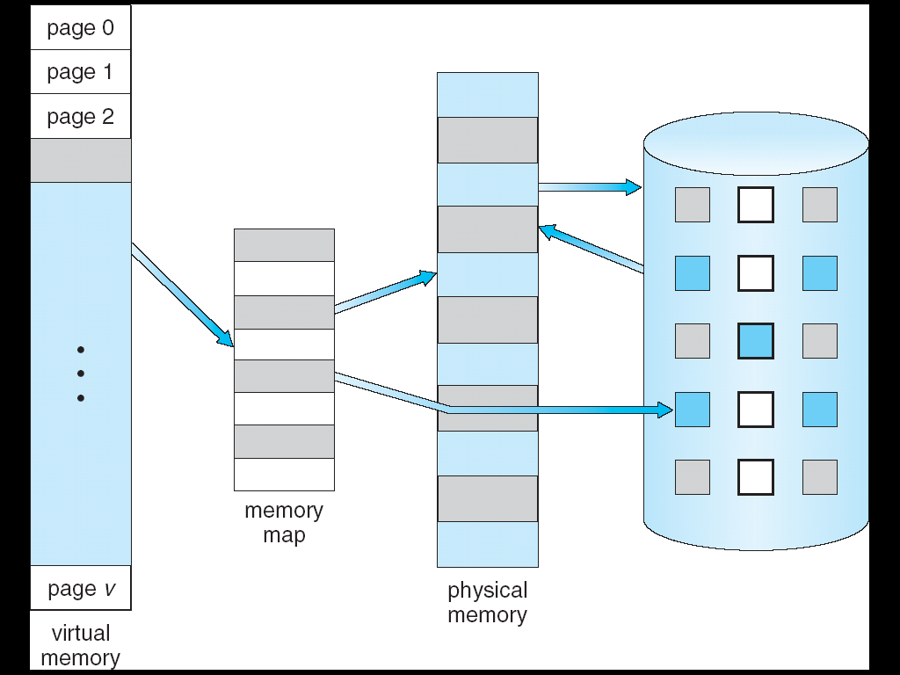
VIRTUAL MEMORY
Definitions
Virtual memory
The conceptual separation of user logical memory from physical memory. Thus we can have large virtual memory on a small physical memory.

Slide 4
VIRTUAL MEMORY
Definitions
Demand paging When a page is touched, bring it from secondary to main memory.
Overlays Laying of code data on the same logical addresses - this is the reuse of logical memory. Useful when the program is in phases or when logical address space is small.
Dynamic loading A routine is loaded only when it's called.

Slide 5
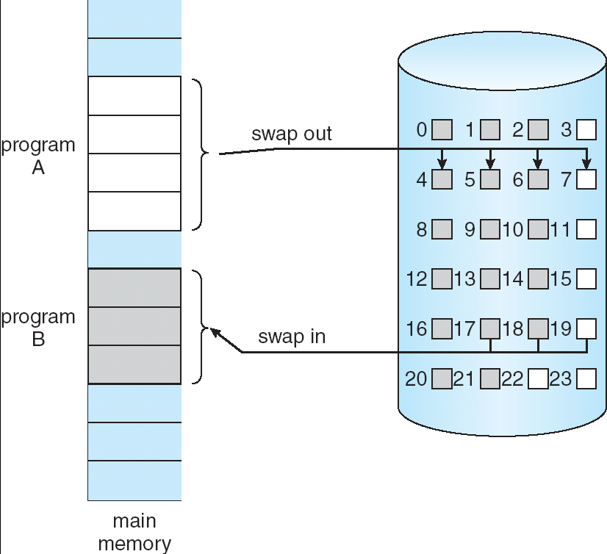
VIRTUAL MEMORY
Demand Paging
When a page is referenced, either as code execution or data access, and that page isn’t in memory, then get the page from disk and re-execute the statement.
Here’s migration between
memory and disk.

Slide 6
VIRTUAL MEMORY
Demand Paging
One instruction may require several pages. For example, a block move of data.
May page fault part way through an operation - may have to undo what was done. Example: an instruction crosses a page boundary.
Time to service page faults demands that they happen only infrequently.
Note here that the page table requires a "resident" bit showing that page is/isn't in memory. (Book uses "valid" bit to indicate residency. An "invalid" page is that way because a legal page isn't resident or because the address is illegal.
It makes more sense to have two bits - one indicating that the page is legal (valid) and a second to show that the page is in memory.
Frame #
valid-invalid bit
1
1
1
1
0
page table

0
Resident
valid-invalid bit
Frame #
1
1
0
0

Slide 7
VIRTUAL MEMORY
Demand Paging
STEPS IN HANDLING A PAGE FAULT
The process has touched a page not currently in memory.
Check an internal table for the target process to determine if the reference was valid (do this in hardware.)
If page valid, but page not resident, try to get it from secondary storage.
Find a free frame; a page of physical memory not currently in use. (May need to free up a page.)
Schedule a disk operation to read the desired page into the newly allocated frame.
When memory is filled, modify the page table to show the page is now resident.
Restart the instruction that failed
Do these steps using the figure you can see on the next page.

Slide 8
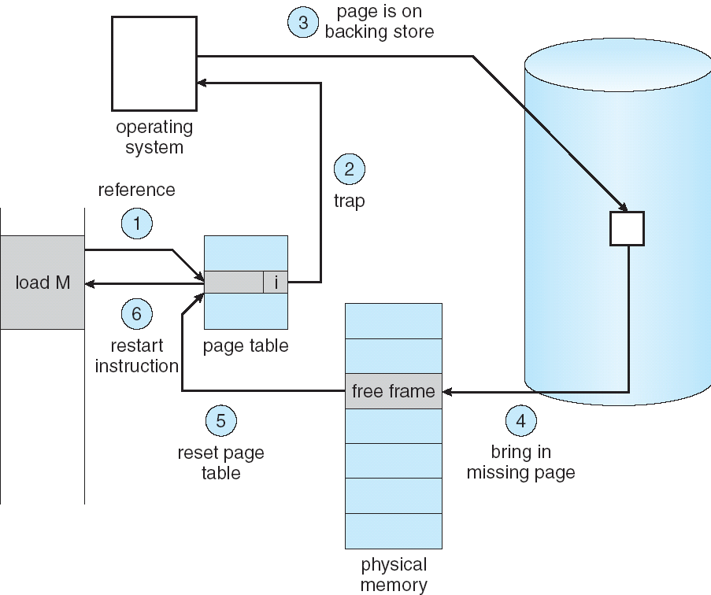
VIRTUAL MEMORY
Demand Paging

Slide 9
VIRTUAL MEMORY
Demand Paging
REQUIREMENTS FOR DEMAND PAGING (HARDWARE AND SOFTWARE ) INCLUDE:
Page table mechanism
Secondary storage (disk or network mechanism.)
Software support for fault handlers and page tables.
Architectural rules concerning restarting of instructions. (For instance, block moves across faulted pages.)

Slide 10
VIRTUAL MEMORY
Demand Paging
PERFORMANCE OF DEMAND PAGING
We are interested in the effective access time: a combination of "normal" and "paged" accesses.
It’s important to keep fraction of faults to a minimum. If fault ratio is "p", then
effective_access_time = ( 1 - p ) * memory_access_time
+ p * page_fault_time.
Calculate the time to do a fault as shown in the text:
fault time = 10 milliseconds ( why )
normal access = 100 nanoseconds ( why )
How do these fit in the formula?

Slide 11
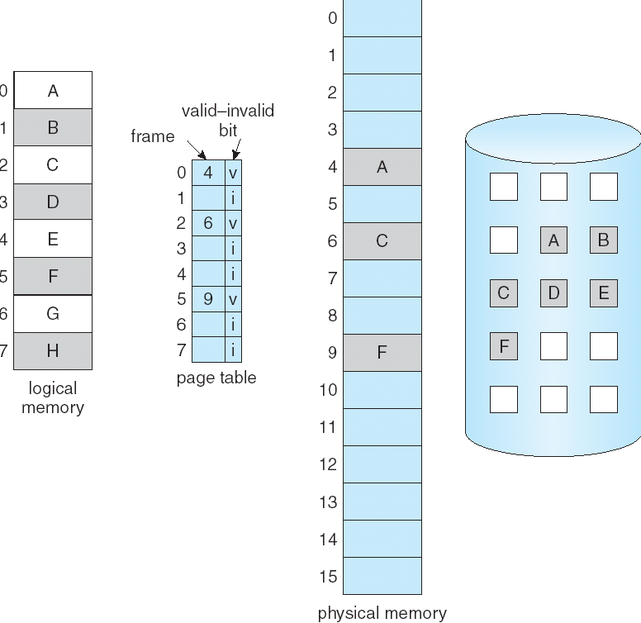
VIRTUAL MEMORY
The Picture When All Pages Are Not In Memory
Some of the pages belonging to this process are in memory, and some are on the disk.
A bit in the page table tells where to find the page.

Slide 12
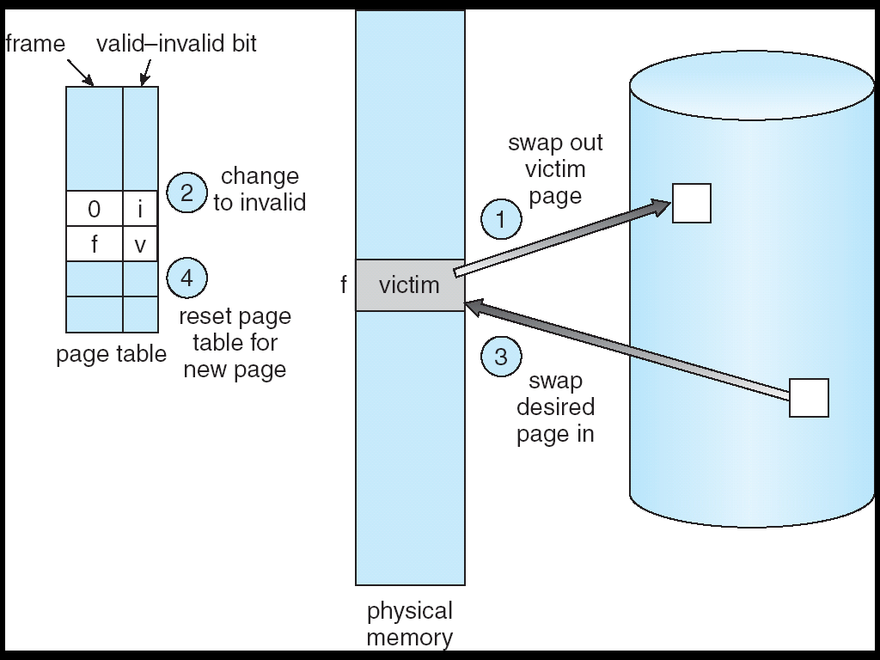
VIRTUAL MEMORY
Page Replacement
When we over-allocate memory, we need to push out something already in memory. Over-allocation may occur when programs need to fault in more pages than there are physical frames to handle.
Approach: If no physical frame is free, find one not currently being touched and free it. Steps to follow are:
1. Find requested page on disk.
2. Find a free frame.
a. If there's a free frame, use it
b. Otherwise, select a victim page.
c. Write the victim page to disk.
3. Read the new page into freed frame. Change page and frame tables.
4. Restart user process.
Hardware requirements include "dirty" or modified bit.

Slide 13
VIRTUAL MEMORY
Page Replacement
PAGE REPLACEMENT ALGORITHMS:
When memory is overallocated, we can either swap out some process, or overwrite some pages. Which pages should we replace?? <--- here the goal is to minimize the number of faults.
Here is an example reference string we will use to evaluate fault mechanisms:
Reference string: 1, 2, 3, 4, 1, 2, 5, 1, 2, 3, 4, 5
FIFO
Conceptually easy to implement; either use a time-stamp on pages, or organize on a queue. (The queue is by far the easier of the two methods.)
1
1
5
4
2
2
1
5
10 page faults
3
3
2
4
4
3

Slide 14
VIRTUAL MEMORY
Page Replacement
OPTIMAL REPLACEMENT
This is the replacement policy that results in the lowest page fault rate.
Algorithm: Replace that page which will not be next used for the longest period of time.
Impossible to achieve in practice; requires crystal ball.
Reference string: 1, 2, 3, 4, 1, 2, 5, 1, 2, 3, 4, 5
1
4
2
6 page faults
3
4
5

Slide 15
VIRTUAL MEMORY
Page Replacement
LEAST RECENTLY USED ( LRU )
Replace that page which has not been used for the longest period of time.
Results of this method considered favorable. The difficulty comes in making it work.
Implementation possibilities:
Time stamp on pages - records when the page is last touched.
Page stack - pull out touched page and put on top
Both methods need hardware assist since the update must be done on every instruction. So in practice this is rarely done.
Reference string: 1, 2, 3, 4, 1, 2, 5, 1, 2, 3, 4, 5
1
5
2
8 page faults
3
5
4
4
3

Slide 16
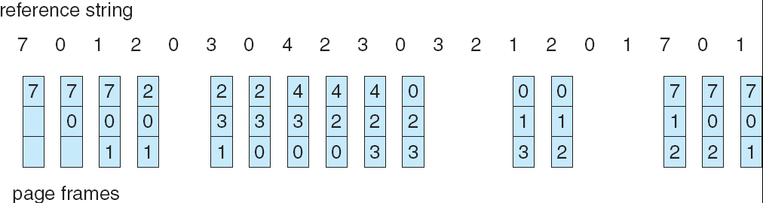
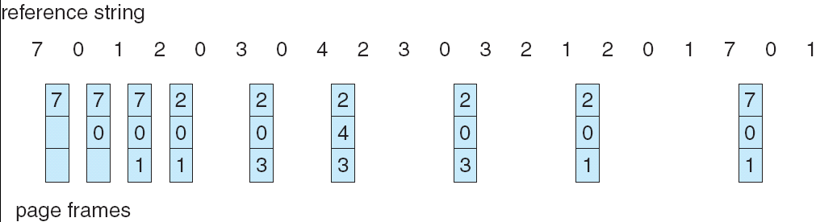
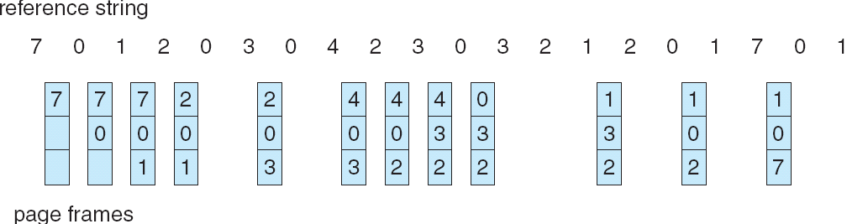
VIRTUAL MEMORY
Page Replacement
PAGE REPLACEMENT ALGORITHMS :
Using another string:
FIFO
OPTIMAL
LRU

Slide 17
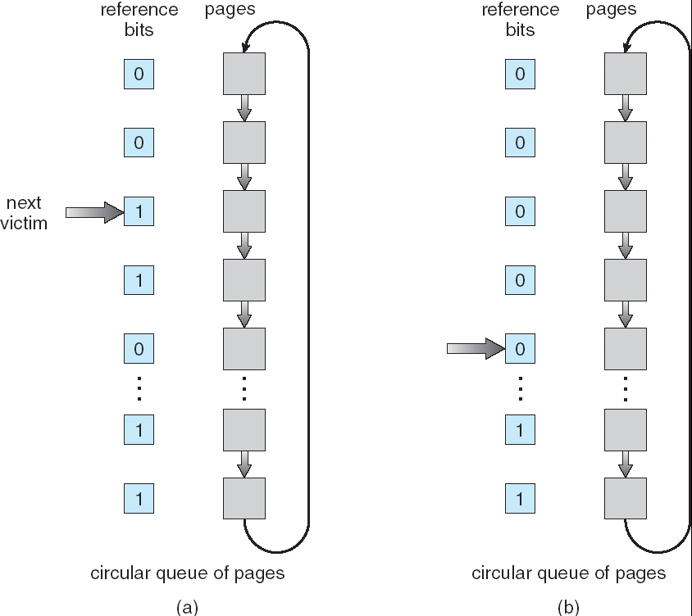
VIRTUAL MEMORY
Page Replacement
LRU APPROXIMATION
Uses a reference bit set by hardware when the page is touched. Then when a fault occurs, pick a page that hasn't been referenced.
Additional reference bits can be used to give some time granularity. Then pick the page with the oldest timestamp.
Second chance replacement: pick a page based on FIFO. If its reference bit is set, give it another chance. Envision this as a clock hand going around a circular queue. The faster pages are replaced, the faster the hand goes.
Maintain a modified bit, and preferentially replace unmodified pages.
Second-Chance (clock)
Page-Replacement Algorithm

Slide 18
VIRTUAL MEMORY
Page Replacement
ADD HOC ( OR ADD-ON ) ALGORITHMS
These methods are frequently used over and above the standard methods given above.
Maintain pools of free frames; write out loser at leisure
Occasional writes of dirties - make clean and then we can use them quickly when needed.
Write out and free a page but remember a page id in case the page is needed again - even though a page is in the free pool, it can be recaptured by a process (a soft page fault.)

Slide 19
VIRTUAL MEMORY
Page Allocation
ALLOCATION OF FRAMES:
What happens when several processes contend for memory? What algorithm determines which process gets memory - is page management a global or local decision?
A good rule is to ensure that a process has at least a minimum number of pages. This minimum ensures it can go about its business without constantly thrashing.
ALLOCATION ALGORITHMS
Local replacement -- the process needing a new page can only steal from itself. (Doesn't take advantage of entire picture.)
Global replacement - sees the whole picture, but a memory hog steals from everyone else
Can divide memory equally, or can give more to a needier process. Should high priority processes get more memory?

Slide 20
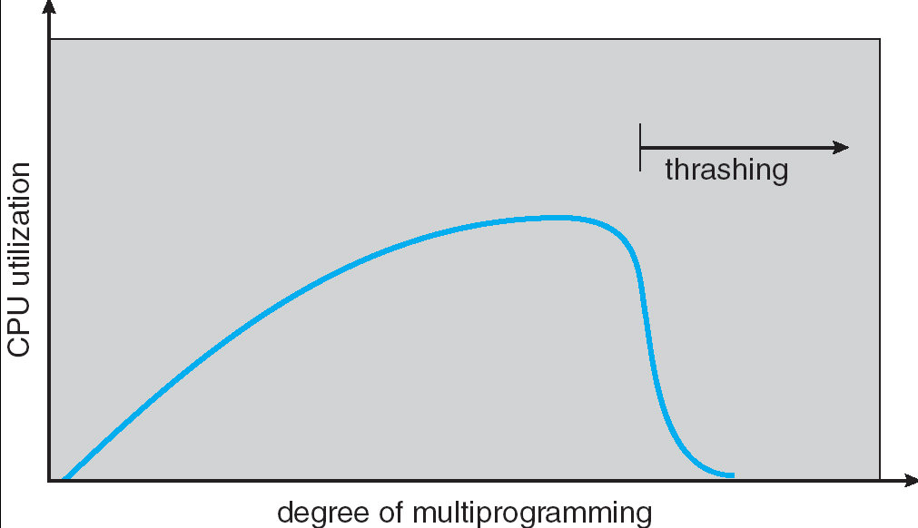
VIRTUAL MEMORY
Thrashing
Suppose there are too few physical pages (less than the logical pages being actively used). This reduces CPU utilization, and may cause increase in multiprogramming needs defined by locality.
A program will thrash if all pages of its locality aren’t present in the working set.
Two programs thrash if they fight each other too violently for memory.

Slide 21
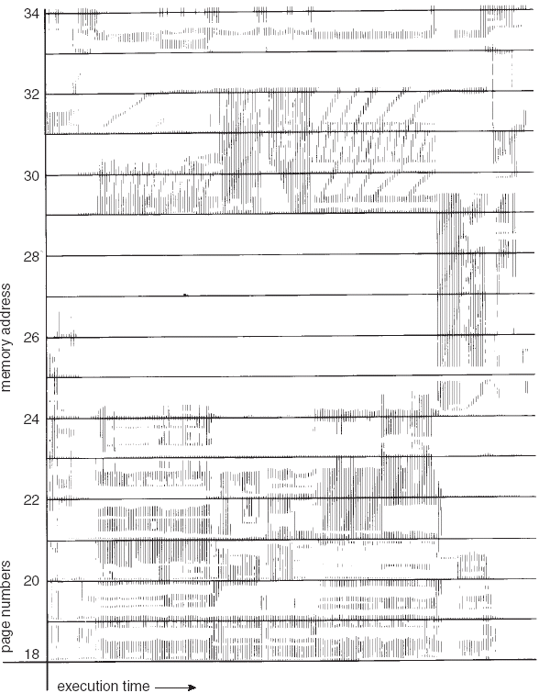
VIRTUAL MEMORY
Locality of Reference
Locality of reference: Programs access memory near where they last accessed it.

Slide 22
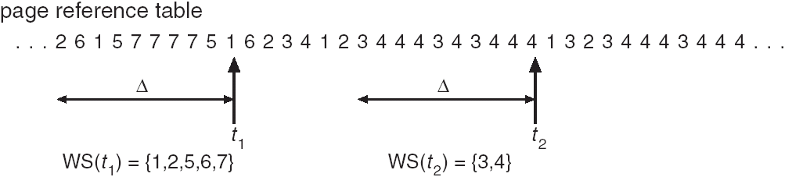
VIRTUAL MEMORY
Working Set Model
WORKING SET MODEL
The pages used by a process within a window of time are called its working set.
Changes continuously - hard to maintain an accurate number. How can the system use this number to give optimum memory to the process?

Slide 23
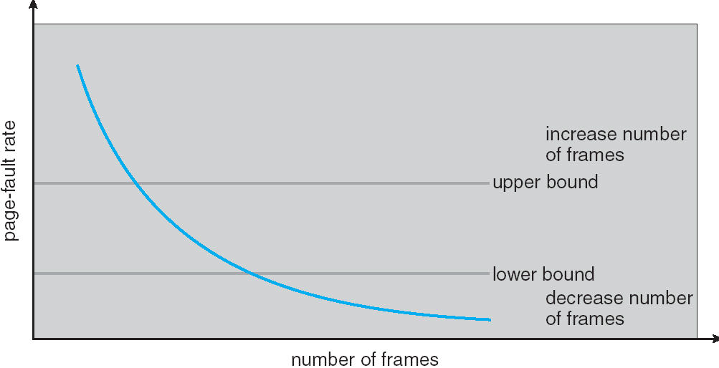
VIRTUAL MEMORY
Working Set Model
PAGE FAULT FREQUENCY
This is a good indicator of thrashing. If the process is faulting heavily, allocate it more frames. If faulting very little, take away some frames.

Slide 24
VIRTUAL MEMORY
Other Issues
PREPAGING
Bring lots of pages into memory at one time, either when the program is initializing, or when a fault occurs.
Uses the principle that a program often uses the page right after the one previously accessed (locality of reference.)
PAGE SIZE
If too big, there's considerable fragmentation and unused portions of the page.
If too small, table maintenance is high and so is I/O.
Has ramifications in code optimization.

Slide 25
VIRTUAL MEMORY
Other Issues
Memory Mapped IO
Allows file I/O to be treated as routine memory access by mapping a disk block to a page in memory
A file is initially read using demand paging. Multiple page-sized portions of the file are read from the file system into physical pages. Subsequent reads/writes to/from the file are treated as ordinary memory accesses.
Simplifies file access by treating file I/O through memory rather than read() write() system calls
Also allows several processes to map the same file allowing the pages in memory to be shared

Slide 26
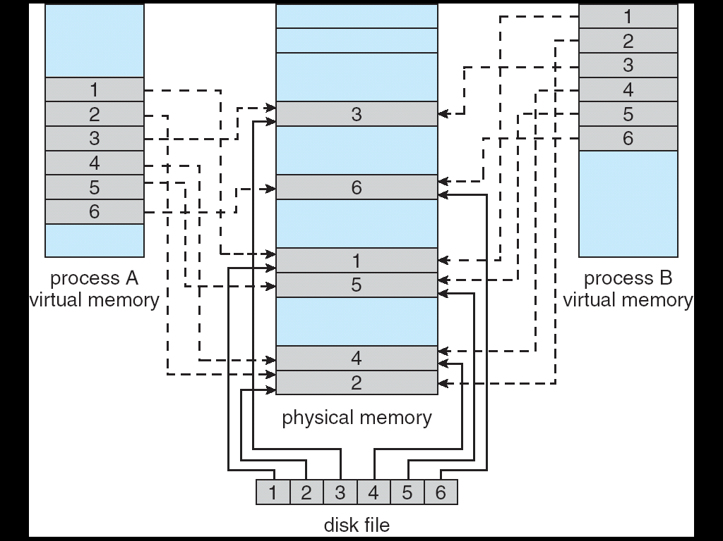
VIRTUAL MEMORY
Other Issues
Memory Mapped IO

Slide 27
VIRTUAL MEMORY
Other Issues
Program structure
int data [128,128];
Each row is stored in one page
Program 1
for (j = 0; j <128; j++) for (i = 0; i < 128; i++) data[i,j] = 0;
128 x 128 = 16,384 page faults
Program 2
for (i = 0; i < 128; i++) for (j = 0; j < 128; j++) data[i,j] = 0;
128 page faults
Which method should you program??

Slide 28
VIRTUAL MEMORY
Wrap up
Virtual memory is how we stuff large programs into small physical memories.
We perform this magic by using demand paging, to bring in pages only when they are needed.
But to bring pages into memory, means kicking other pages out, so we need to worry about paging algorithms.

