Slide 1
OPERATING SYSTEMS
Distributed System Structures
Jerry Breecher

Slide 2
DISTRIBUTED STRUCTURES
This chapter sets the foundation for our discussion about networks and distributed OS.
VOCABULARY
Tightly coupled systems Same clock, usually shared memory. Multiprocessors. Communication is via this shared memory.
Loosely coupled systems Different clock, use communication links. Distributed systems.
sites = nodes = computers = machines = hosts
Local The resources on your "home" host.
Remote The resources NOT on your "home" host.
Server A host at a site that has a resource used by a Client.

Slide 3
NETWORK STRUCTURES
Vocabulary
Network Operating Systems
Users are aware of multiplicity of machines. Access to resources of various machines is done explicitly by:
Remote logging into the appropriate remote machine (ssh, browser)
Transferring data from remote machines to local machines (browser, ssh)
Distributed Operating Systems
Users not aware of multiplicity of machines
Access to remote resources similar to access to local resources
Data Migration – transfer data by transferring entire file, or transferring only those portions of the file necessary for the immediate task
Computation Migration – transfer the computation, rather than the data, across the system

Slide 4
NETWORK STRUCTURES
Vocabulary
Clusters The hardware on which distributed systems run. A current buzzword. It allows more compute power, compared to a mainframe, by running on many inexpensive small machines.
Chapter 17 talks in great deal about distributed systems as a whole; meanwhile we'll discuss the components of these systems.

Slide 5
NETWORK STRUCTURES
Why
Distributed
OS?
Advantages of distributed systems:
Resource Sharing Items such as printers, specialized processors, disk farms, files can be shared among various sites.
Computation Speedup Load balancing - dividing up all the work evenly between sites. Making use of parallelism.
Reliability Redundancy. With proper configuration, when one site goes down, the others can continue. But this doesn't happen automatically.
Communications Messaging can be accomplished very efficiently. Messages between nodes are akin to IPCs within a UniProcessor.
Easier to talk/mail between users.

Slide 6
NETWORK STRUCTURES
Why
Distributed
OS?
Advantages of distributed systems:
Process Migration – Execute an entire process, or parts of it, at different sites
Load balancing – distribute processes across network to even the workload
Computation speedup – subprocesses can run concurrently on different sites
Hardware preference – process execution may require specialized processor
Software preference – required software may be available at only a particular site
Data access – run process remotely, rather than transfer all data locally

Slide 7
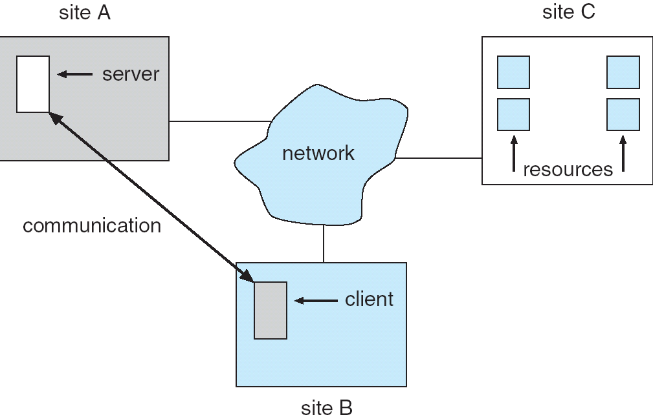
NETWORK STRUCTURES
Why
Distributed
OS?
Advantages of distributed systems:

Slide 8
NETWORK STRUCTURES
Wrap Up
This was a definition chapter. The purpose was to gain an understanding of the various pieces that go into networks.
We’ll use this as the basis for understanding how the distributed file system is implemented.

