Slide 1
OPERATING SYSTEMS
IO SYSTEMS
Jerry Breecher

Slide 2
IO SYSTEMS
This material covers Silberschatz Chapters 12 and 13.
Mass Storage - hardware
This is about Disk Behavior and Management.
Disk Characteristics
Space Management
RAID
Disk Attachment
IO Interface – how the OS interfaces to the hardware
The busses in the computer and how the O.S. interfaces to it.
Talking to the IO – Polling, Interrupts and DMA
Application IO Interface
Kernel IO Subsystem

Slide 3
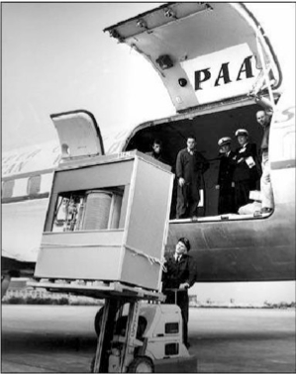
The First Commercial Disk Drive
1956
IBM RAMDAC computer included the IBM Model 350 disk storage system
5M (7 bit) characters
50 x 24” platters
Access time = < 1 second

Slide 4
Disk Characteristics
Mass-Storage Structure
A disk can be viewed as an array of blocks. In fact, a file system will want to view it at that logical level.
However, there's a mapping scheme from logical block address B, to physical address (represented by a track / sector pair.)
The smallest storage allocation is a block - nothing smaller can be placed on the disk. This results in unused space (internal fragmentation) on the disk, since quite often the data being placed on the disk doesn't need a whole block.

Slide 5
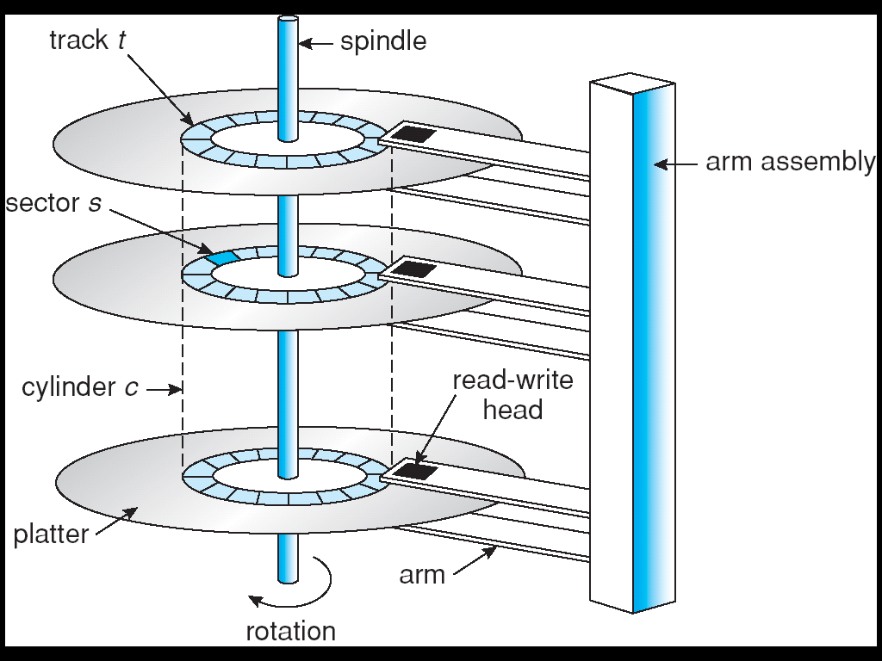
Disk Scheduling
Mass-Storage Structure
The components making up disk service time include:
time = setup + seek + rotation time + transfer + wrap-up
The methods discussed below try to optimize seek time but make no attempt to account for the total time. The ideal method would optimize the total time and many controllers are now able to accomplish this.

Slide 6
Disk Management
Mass-Storage Structure
Disk formatting Creates a logical disk from the raw disk. Includes setting aside chunks of the disk for booting, bad blocks, etc. Also provides information needed by the driver to understand its positioning.
Boot block That location on the disk that is accessed when trying to boot the operating system. It's a well-known location that contains the code that understands how to get at the operating system - generally this code has a rudimentary knowledge of the file system.
Bad blocks The driver knows how to compensate for a bad block on the disk. It does this by putting a pointer, at the location of the bad block, indicating where a good copy of the data can be found.
Swap Space Management The Operating System requires a contiguous space where it knows that disk blocks have been reserved for paging. This space is needed because a program can't be given unshared memory unless there's a backing store location for that memory.

Slide 7
Disk Management
Low-level formatting, or physical formatting — Dividing a disk into sectors that the disk controller can read and write
Each sector can hold header information, plus data, plus error correction code (ECC)
Usually 512 bytes of data but can be selectable
To use a disk to hold files, the operating system still needs to record its own data structures on the disk
Partition the disk into one or more groups of cylinders, each treated as a logical disk
Logical formatting or “making a file system”
To increase efficiency most file systems group blocks into clusters
Disk I/O done in blocks
File I/O done in clusters

Slide 8
Disk Management (Cont.)
Raw disk access for apps that want to do their own block management, keep OS out of the way (databases for example)
Boot block initializes system
The bootstrap is stored in ROM
Bootstrap loader program stored in boot blocks of boot partition
Methods such as sector sparing used to handle bad blocks

Slide 9
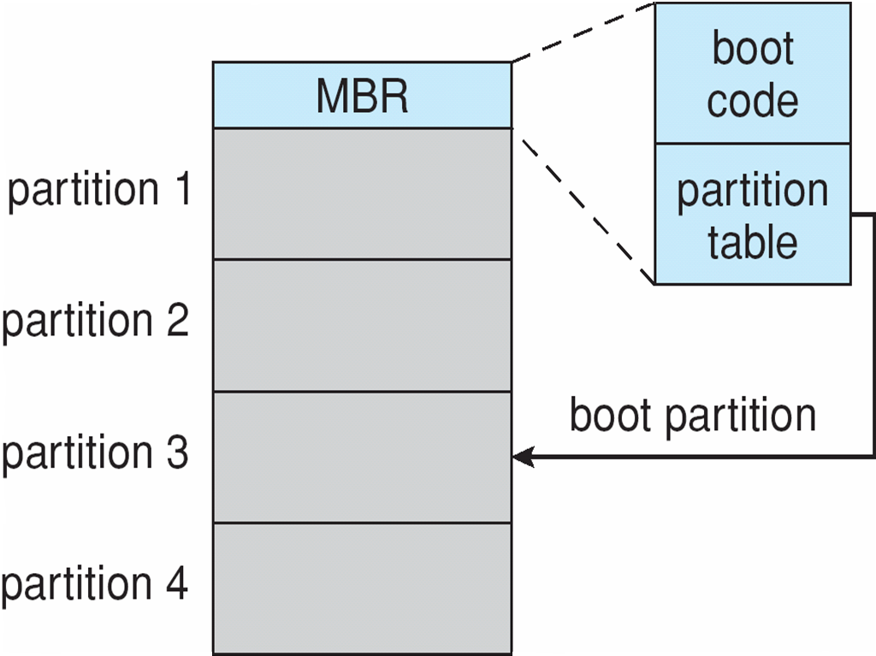
Booting from a Disk in Windows

Slide 10
Swap-Space Management
Swap-space — Virtual memory uses disk space as an extension of main memory
Less common now due to memory capacity increases
Swap-space can be carved out of the normal file system, or, more commonly, it can be in a separate disk partition (raw)
Swap-space management
4.3BSD allocates swap space when process starts; holds text segment (the program) and data segment
Kernel uses swap maps to track swap-space use
Solaris 2 allocates swap space only when a dirty page is forced out of physical memory, not when the virtual memory page is first created
File data written to swap space until write to file system requested
Other dirty pages go to swap space due to no other home
Text segment pages thrown out and reread from the file system as needed
What if a system runs out of swap space?
Some systems allow multiple swap spaces

Slide 11
Disk Attachment
Mass-Storage Structure
Host-attached storage
accessed through I/O ports talking to I/O busses
SCSI itself is a bus, up to 16 devices on one cable, SCSI initiator requests operation and SCSI targets perform tasks
Each target can have up to 8 logical units (disks attached to device controller
Fibre Channel (FC) is high-speed serial architecture
Can be switched fabric with 24-bit address space – the basis of storage area networks (SANs) in which many hosts attach to many storage units

Slide 12
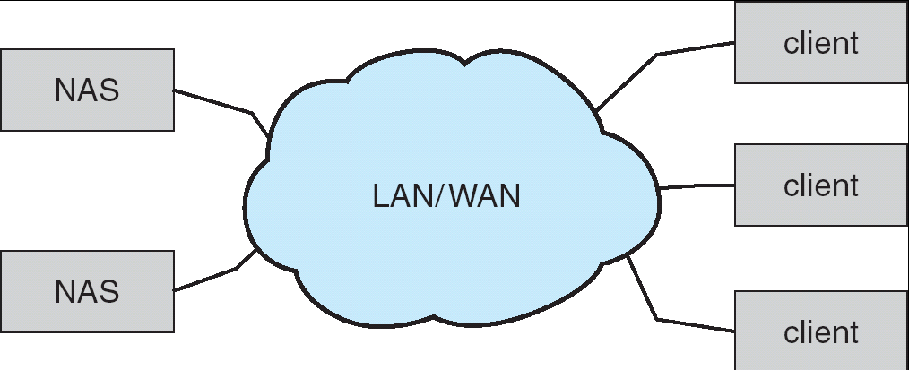
Disk Attachment
Mass-Storage Structure
Network-attached storage
Network-attached storage (NAS) is storage made available over a network rather than over a local connection (such as a bus)
NFS and CIFS are common protocols
Implemented via remote procedure calls (RPCs) between host and storage
New iSCSI protocol uses IP network to carry the SCSI protocol

Slide 13
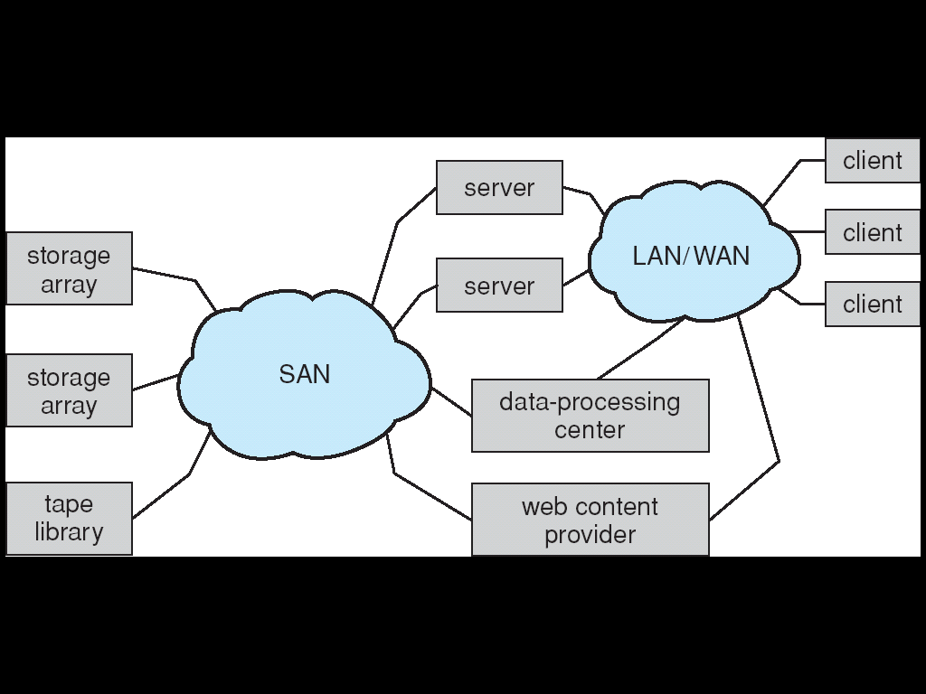
Disk Attachment
Mass-Storage Structure
Storage-Area Network
Common in large storage environments (and becoming more common)
Multiple hosts attached to multiple storage arrays - flexible

Slide 14
Reliability
Mass-Storage Structure
MIRRORING One way to increase reliability is to "mirror" data on a disk. Every piece of data is maintained on two disks - disk drivers must be capable of getting data from either disk. Performance issues: a read is faster since data can be obtained from either disk - writes are slower since the data must be put on both disks.
RAID Redundant Array of Inexpensive Disks: Rather than maintain two copies of the data, maintain one copy plus parity. For example, four disks contain data, and a fifth disk holds the parity of the XOR of the four data disks. Reads slower than mirroring, writes much slower. But RAID is considerably CHEAPER than mirroring.
DISK STRIPING Disks tend to be accessed unevenly - programs ask for a number of blocks from the same file, for instance. Accesses can be distributed more evenly by spreading a file out over several disks. This works well with RAID. Thus block 0 is on disk 0, block 1 is on disk 1, block 4 is on disk 0.
Consider how to recover from a failure on these architectures.

Slide 15
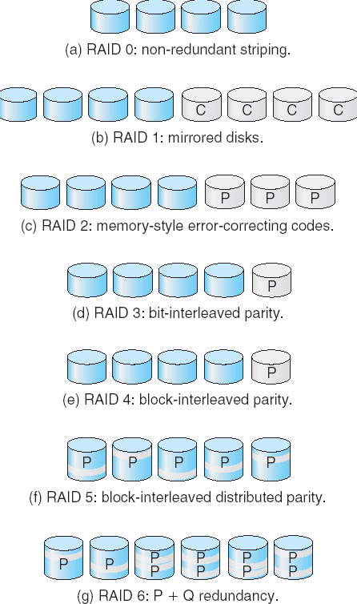
RAID
Mass-Storage Structure
These are the various levels of RAID.
The reliability increases with higher levels.
In practice, only levels 0, 1, 5 and 10 are typically used.
Several improvements in disk-use techniques involve the use of multiple disks working cooperatively.
Disk striping uses a group of disks as one storage unit.
RAID schemes improve performance and improve the reliability of the storage system by storing redundant data.
Mirroring or shadowing keeps duplicate of each disk.
Block interleaved parity uses much less redundancy.

Slide 16
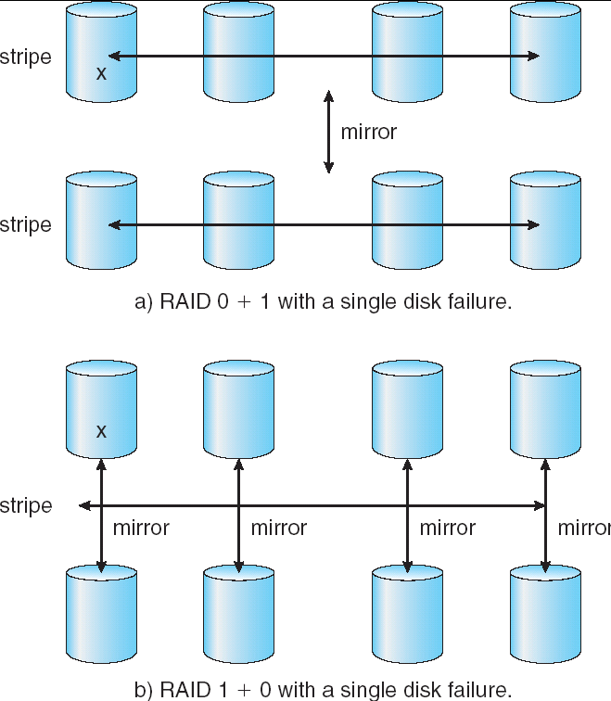
RAID
Mass-Storage Structure
RAID 10 becoming more and more popular.

Slide 17
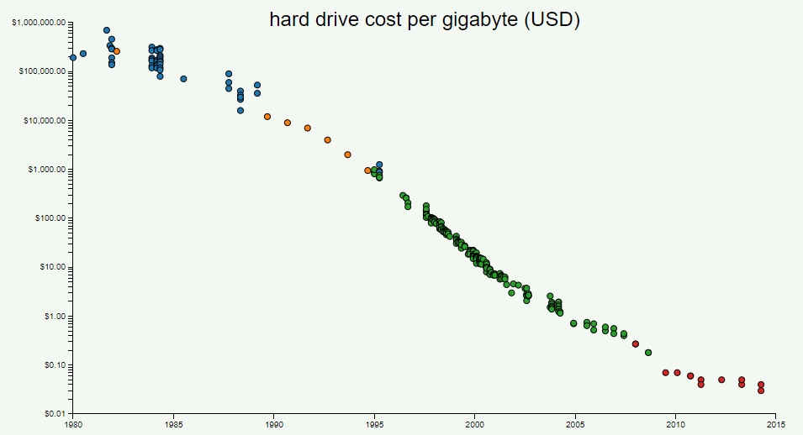
What Kind Of Storage Should You Use?
Mass-Storage Structure
Price per Gigabyte of DRAM, From 1980 to 2015
Price per Gigabyte of Hard Disk, From 1980 to 2015
Is it only about price?? Where does speed fit in?

Slide 18
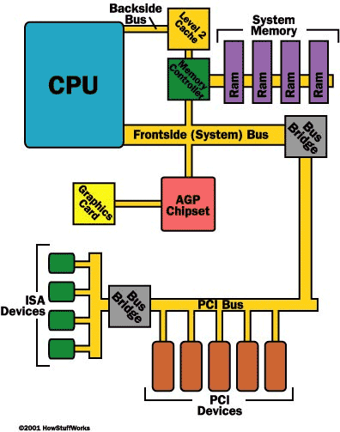
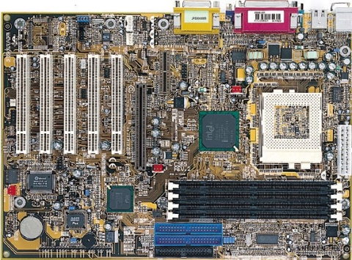
IO Hardware
IO SYSTEMS
Incredible variety of I/O devices
Common concepts
Port
Bus (daisy chain or shared direct access)
Controller (host adapter)
I/O instructions control devices
Devices have addresses, used by
Direct I/O instructions
Memory-mapped I/O

Slide 19
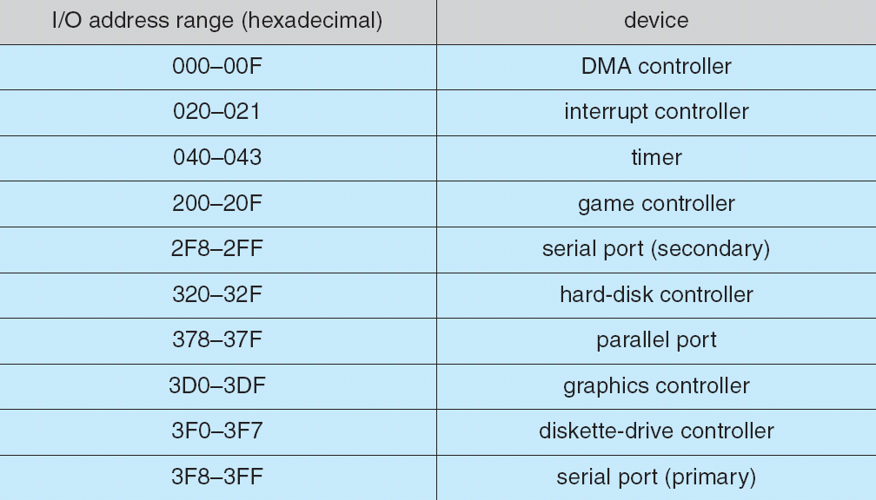
IO Hardware
IO SYSTEMS
Memory Mapped IO:
Works by associating a memory address with a device and a function on that device.

Slide 20
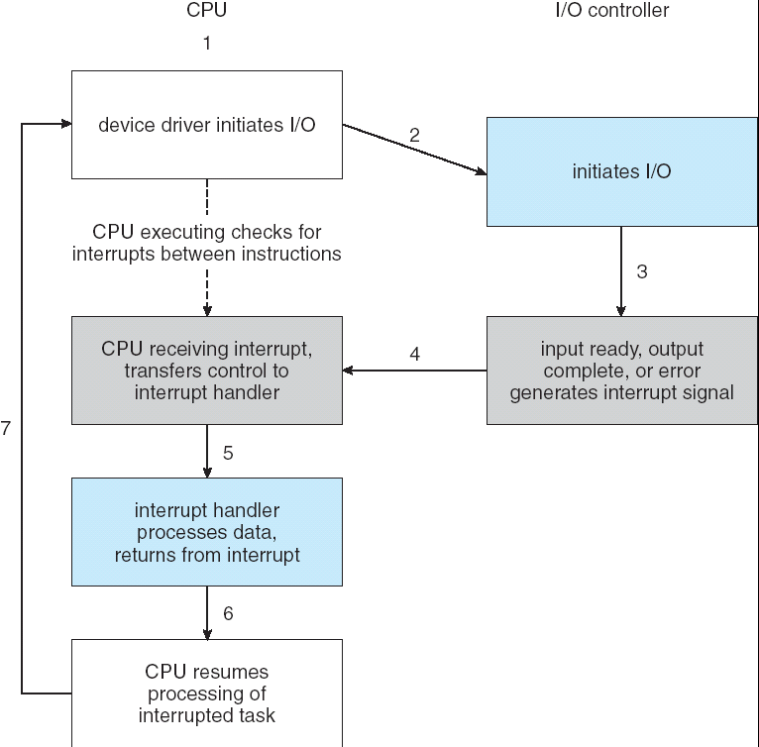
Polling and Interrupts
IO SYSTEMS
CPU Interrupt request line triggered by I/O device
Interrupt handler receives interrupts
Maskable to ignore or delay some interrupts
Interrupt vector to dispatch interrupt to correct handler
Based on priority
Some unmaskable
Interrupt mechanism also used for exceptions.

Slide 21
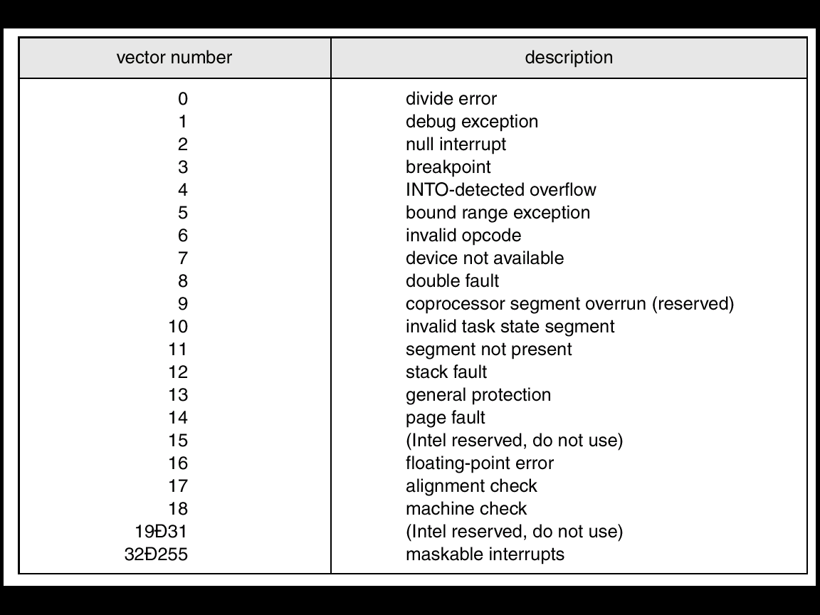
Polling and Interrupts
IO SYSTEMS
When you get an interrupt, you need to be able to figure out the device that gave you the interrupt.
These are the interrupt vectors for an Intel Processor.
Notice that most of these are actually exceptions.

Slide 22
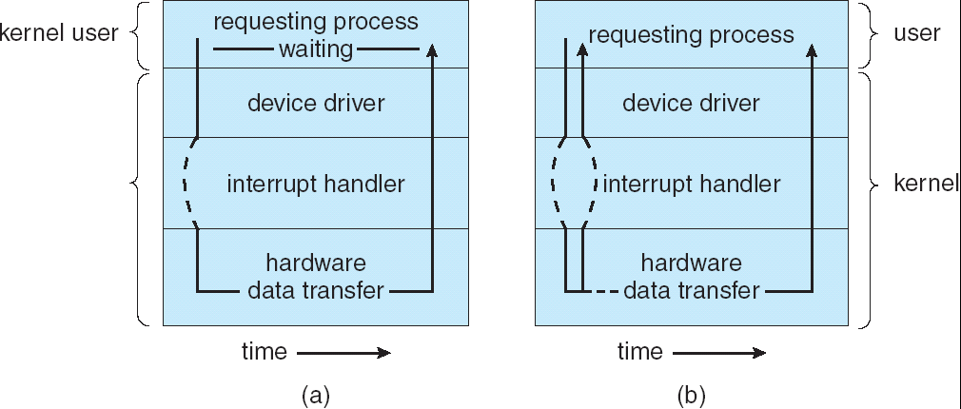
Synchronous or Asynchronous
IO SYSTEMS
Synchronous does the whole job – all at one time – data is obtained from the device by the processor.
Asynchronous has the device and the processor acting in time independent of each other.

Slide 23
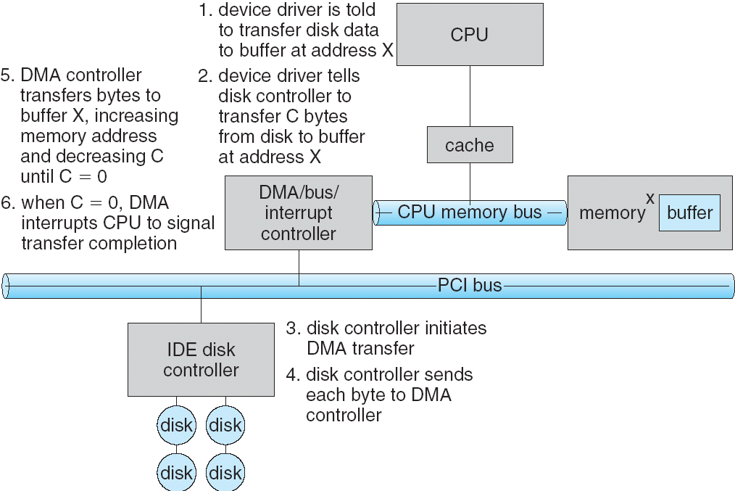
DMA
IO SYSTEMS
Used to avoid programmed I/O for large data movement
Requires DMA controller
Bypasses CPU to transfer data directly between I/O device and memory

Slide 24
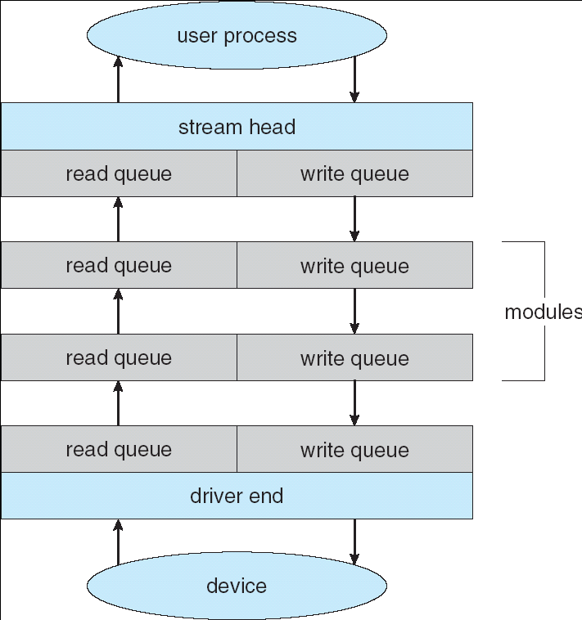
Streams
IO SYSTEMS
STREAM – a full-duplex communication channel between a user-level process and a device in Unix System V and beyond
A STREAM consists of:
- STREAM head interfaces
- driver end interfaces with the device - zero or more STREAM modules between them.
Each module contains a read queue and a write queue
Message passing is used to communicate between queues

Slide 25
Interfaces
IO SYSTEMS
Block and Character Devices
Typical for disks – use read(), write(), seek() sequence.
Network Devices
Clocks and Timers
The OS uses an incredible number of clock calls – many events are timestamped within the OS
Blocking and Non-Blocking IO
Non- Blocking: Some devices are started by the OS, and then proceed on without further OS intervention. The delay timer in our project works this way.
Blocking: Any Read-Device will be blocking since the program can’t proceed until it gets the information it wanted from the device.

Slide 26
Kernel IO Subsystem
IO SYSTEMS
Buffering
Used to interface between devices of different speeds (WiFi and disk for instance.)
Interface between operations having different data sizes. (small network packets as part of a bigger transfer.)
Users often read or write small number of bytes – but the disk wants 4096 bytes. The filesystem maintains this buffer.
Spooling
Kernel data structures – what needs to be maintained to
Support the device
Support an instance of opening the device.

Slide 27
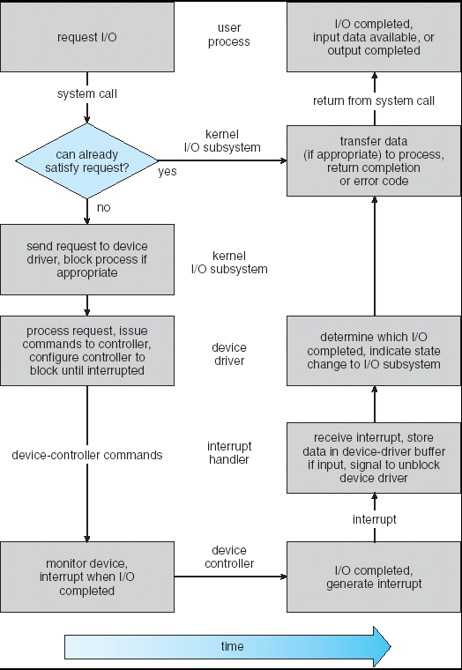
Kernel IO Subsystem
IO SYSTEMS
The steps in an IO request.

Slide 28
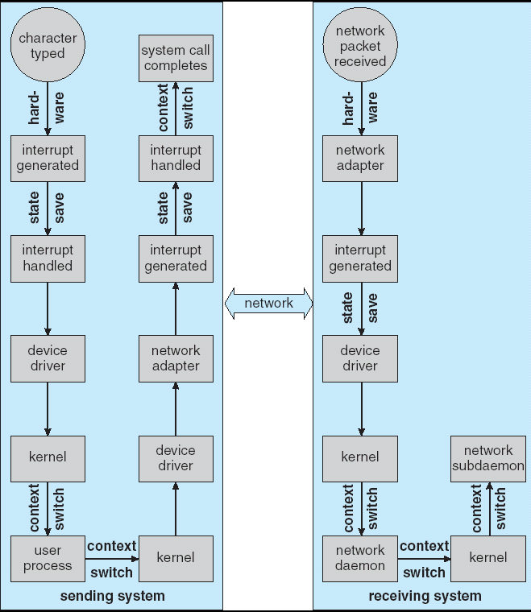
Performance
IO SYSTEMS
The steps required to handle a single keystroke across the network.

Slide 29
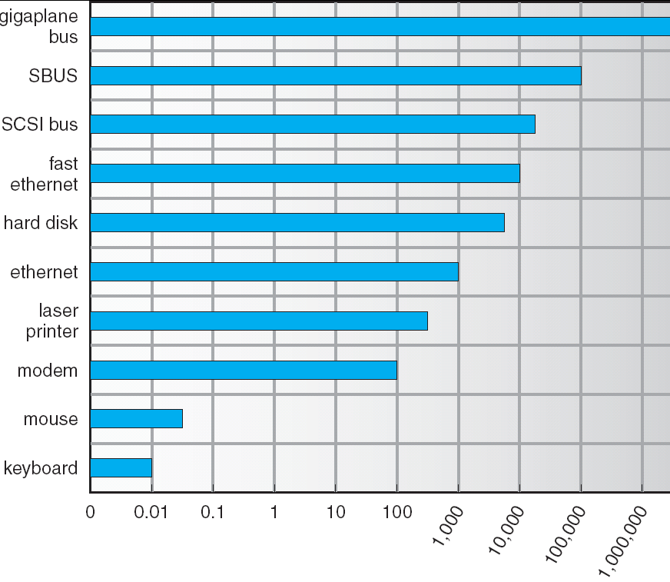
Performance
IO SYSTEMS
Throughput for various devices.
Figure 13.12

Slide 30
FILE SYSTEMS
Wrap Up
Mass Storage
This is about Disk Behavior and Management.
Disk Characteristics
Space Management
RAID
Disk Attachment
IO Interface
The busses in the computer and how the O.S. interfaces to it.
Talking to the IO – Polling, Interrupts and DMA
Application IO Interface
Kernel IO Subsystem

