Slide 1
OPERATING SYSTEMS
SECURITY
Jerry Breecher

Slide 2
SECURITY
In This Chapter:
The Security Problem
Program Threats
System and Network Threats
Cryptography as a Security Tool
User Authentication
Implementing Security Defenses
Firewalling to Protect Systems and Networks
Computer-Security Classifications
An Example: Windows XP

Slide 3
SECURITY
SECURITY ISSUES:
External protection of a system. A classified site goes to extraordinary lengths to keep things physically tight. Among the issues to be considered:
Unauthorized access Mechanism assuring only authorized individuals see classified materials.
Malicious modification or destruction
Accidental introduction of inconsistency.
Authentication How do we know the user is who she says she is. Can have passwords on domains.
Protection of passwords is difficult. Issues include:
It's very easy to guess passwords since people use simple and easily remembered words.
Need exists to change passwords continually.
Limiting number of tries before locking up.

Slide 4
SECURITY
Security Issues
Trojan Horse: A piece of code that misuses its environment. The program seems innocent enough, however when executed, unexpected behavior occurs.
Trap Doors: Inserting a method of breaching security in a system. For instance, some secret set of inputs to a program might provide special privileges.
Threat monitoring: Look for unusual activity. Once access is gained, how do you identify someone acting in an unusual fashion?
Audit Log: Record time, user, and type of access on all objects. Trace problems back to source.
Worms Use spawning mechanism; standalone programs.
Internet Worm: In the Internet worm, Robert Morse exploited UNIX networking features (remote access) as well as bugs in finger and sendmail programs. Grappling hook program uploaded main worm program.
Viruses Fragment of code embedded in a legitimate program. Mainly effects personal PC systems. These are often downloaded via e-mail or as active components in web pages.
Firewall A mechanism that allows only certain traffic between trusted and un-trusted systems. Often applied to a way to keep unwanted internet traffic away from a system.

Slide 5
SECURITY
Typical Security Attacks
ATTACK METHODS:
Attacks on a distributed system include:
Passive wiretapping. ( unauthorized interception/reading of messages )
Active wiretapping:
Modification Changing a portion of the message.
Spurious messages Introducing bogus messages with valid addresses and consistency criteria.
Site impersonation Claiming to be some other logical node.
Replay of previous transmission - repeating previous valid messages. (for example, authorization of cash withdrawal.)

Slide 6
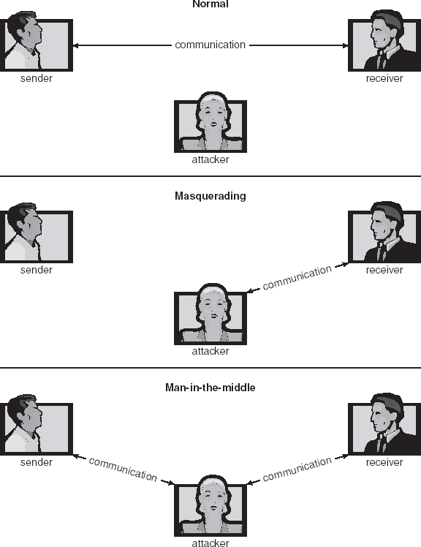
SECURITY
Typical Security Attacks
ATTACK METHODS:

Slide 7
SECURITY
Typical Security Attacks
ATTACK METHODS:
Trojan Horse
Code segment that misuses its environment
Exploits mechanisms for allowing programs written by users to be executed by other users
Spyware, pop-up browser windows, covert channels
Trap Door
Specific user identifier or password that circumvents normal security procedures
Could be included in a compiler
Logic Bomb
Program that initiates a security incident under certain circumstances
Stack and Buffer Overflow
Exploits a bug in a program (overflow either the stack or memory buffers)

Slide 8
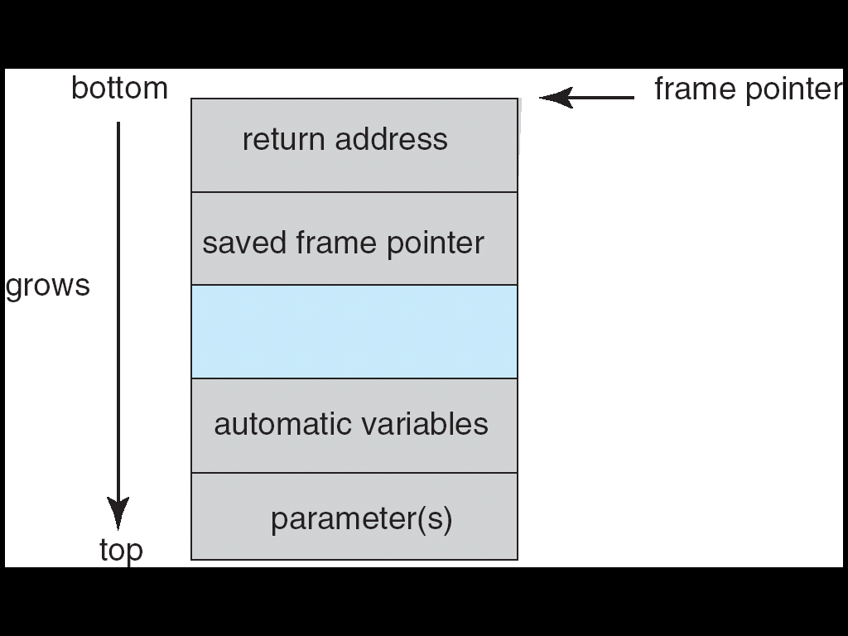
SECURITY
Typical Security Attacks
Example of Buffer Overflow Waiting To Happen:
#include <stdio.h>
#define BUFFER SIZE 256
int main(int argc, char *argv[])
{
char buffer[BUFFER SIZE];
int other_data;
if (argc < 2)
return -1;
else {
strcpy(buffer,argv[1]);
return 0;
}
}

Slide 9
SECURITY
Typical Security Attacks
Viruses
Code fragment embedded in legitimate program
Very specific to CPU architecture, operating system, applications
Usually borne via email or as a macro
Visual Basic Macro to reformat hard drive
Sub AutoOpen()
Dim oFS
Set oFS = CreateObject(’’Scripting.FileSystemObject’’)
vs = Shell(’’c:command.com /k format c:’’,vbHide)
End Sub

Slide 10
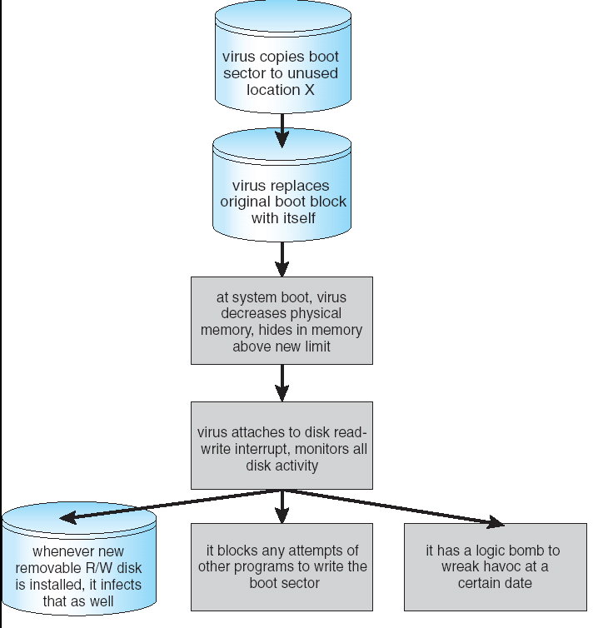
SECURITY
Typical Security Attacks
A Boot Sector Virus

Slide 11
SECURITY
Typical Security Attacks
System And Network Threats
Worms – use spawn mechanism; standalone program
Internet worm
Exploited UNIX networking features (remote access) and bugs in finger and sendmail programs. (See next slide)
Grappling hook program uploaded main worm program
Port scanning
Automated attempt to connect to a range of ports on one or a range of IP addresses
Denial of Service
Overload the targeted computer preventing it from doing any useful work
Distributed denial-of-service (DDOS) come from multiple sites at once

Slide 12
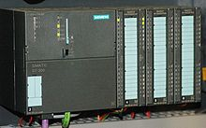
SECURITY
Stuxnet
Stuxnet is a computer worm discovered in June 2010. It initially spreads via Microsoft Windows, and targets Siemens industrial software and equipment.
Different variants of Stuxnet targeted five Iranian organizations, with the probable target widely suspected to be the uranium enrichment infrastructure in Iran.
It is initially spread using infected removable drives such as USB flash drives, and then uses other exploits and techniques to infect and update other computers inside private networks that are not directly connected to the Internet.
The malware has both user-mode and kernel-mode rootkit capability under Windows, and its device drivers have been digitally signed with the private keys of two certificates that were stolen from two separate companies. The driver signing helped it install kernel mode rootkit drivers successfully and therefore remain undetected for a relatively long period of time.
Once installed on Windows Stuxnet infects files belonging to Siemens' control software^{[3}and subverts a communication library. Doing so intercepts communications between software running under Windows and the target Siemens devices. The malware can install itself on PLC devices unnoticed.
Stuxnet malware periodically modifies a control frequency to and thus affects the operation of the connected centrifuge motors by changing their rotational speed.
This causes the centrifuges to be destroyed.
Siemens Simatic S7-300 PLC CPU with three I/O modules attached

Slide 13
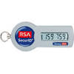
SECURITY
Authentication
Password stealing
– Easiest way is through social means
fake deposit slips
easily guessable passwords
calling people on the phone and asking for passwords (or Credit Card numbers, for that matter)
– Technological approaches also
simple one: leave program running on a terminal that fakes the login
sequence. Capture user name and password to a file and then exit
with a fake error message, returning control to the real login process
– Unix password files used to be openly available (encrypted password). Lends itself to brute-force cracking. Unfortunately some programs require access to the password file to run (e.g., mail) → also unfortunately Unix only uses first eight characters of password
SecurID – uses a preprogrammed string of characters

Slide 14
SECURITY
Authentication
Password stealing
– Easiest way is through social means
fake deposit slips
easily guessable passwords
calling people on the phone and asking for passwords (or Credit Card numbers, for that matter)
– Technological approaches also
simple one: leave program running on a terminal that fakes the login
sequence. Capture user name and password to a file and then exit
with a fake error message, returning control to the real login process
– Unix password files used to be openly available (encrypted password). Lends itself to brute-force cracking. Unfortunately some programs require access to the password file to run (e.g., mail) → also unfortunately Unix only uses first eight characters of password
SecurID – uses a preprogrammed string of characters

Slide 15
SECURITY
NSA Exploitation
Edward Snowden made public documents that reveal Government agencies:
consider it essential to be able to view encrypted data
have adopted a battery of methods in their assault on this biggest threats
Those methods include
control over setting of international encryption standards,
the use of supercomputers to break encryption with "brute force",
Collaboration with technology companies and internet service providers themselves
“Man in the middle” attacks on the communication channels themselves.

Slide 16
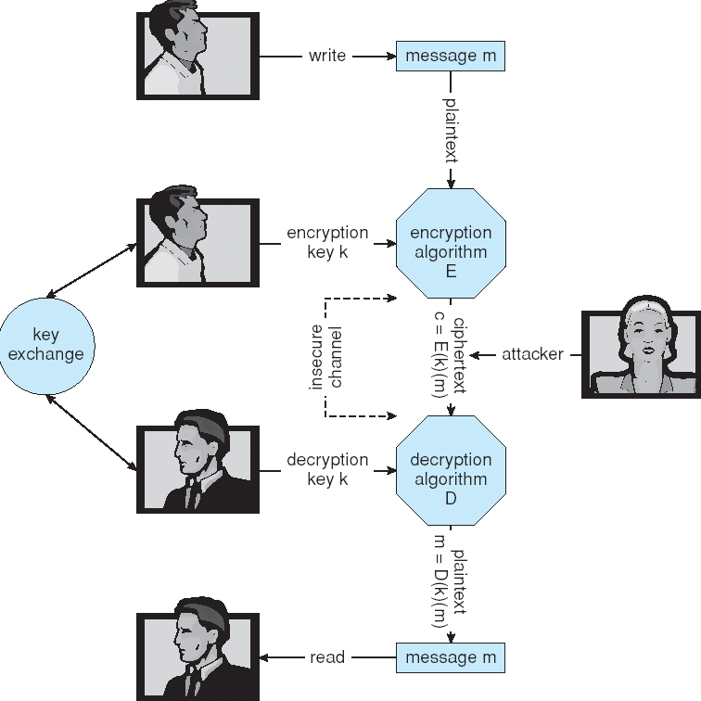
SECURITY
Cryptography
DEFINITIONS:
Encryption:
C = E( M, Ke )
E = Encyphering Algorithm
M = Message - plain text
Ke = Encryption key
C = Cyphered text
Decryption:
M = D( C, Kd )
D = Decyphering Algorithm
Kd = Decryption key

Slide 17
SECURITY
Cryptography
DEFINITIONS:
Cryptosystems are either Conventional or Public Key
Conventional is symmetric; Ke = Kd , so the key must be kept secret. Algorithms are simple to describe, but complex in the number of operations.
Public key is asymmetric; Ke != Kd , so Ke can be made public. Kd is secret and can't easily be derived from Ke .
Security against attack is either:
Unconditionally secure - Ke can't be determined regardless of available computational power.
Computationally secure: - calculation of Kd is economically unfeasible ( it would overwhelm all available computing facilities.)
The only known unconditionally secure system in common use!
Involves a random key that has the same length as the plain text to be encrypted.
The key is used once and then discarded. The key is exclusively OR'd with the message to produce the cypher.
Given the key and the cypher, the receiver uses the same method to reproduce the message.

Slide 18
SECURITY
Data Encryption Standard
DATA ENCRYPTION STANDARD ( DES ):
The official National Institute of Standards and Technology (NIST), (formerly the National Bureau of Standards) encryption for use by Federal agencies.
The source of security is the non-linear many-to-one function applied to a block of data. This function uses transposition and substitution. The algorithm is public, but the key (56 bits) is secret.
Computational power today can crack a 56 bit code.
In common use today is Triple DES in which 3 different keys are used, making the effective key length 168 bits.

Slide 19
SECURITY
Public Key Cryptosystems
The general principle is this:
1. Any RECEIVER A uses an algorithm to calculate an encryption key KEa and a decryption key KDa.
2. Then the receiver PUBLICIZES KEa to anyone who cares to hear. But the receiver keeps secret the decryption key KDa.
3. User B sends a message to A by first encrypting that message using the publicized key for that receiver A, KEa.
4. Since only A knows how to decrypt the message, it's secure.
KEa
KEb
Public Key Repository
KEc

Slide 20
SECURITY
Public Key Cryptosystems
To be effective, a system must satisfy the following rules:
Given plaintext and ciphertext, the problem of determining the keys is computationally complex.
It is easy to generate matched pairs of keys Ke, Kd that satisfy the property
D( E( M, Ke ), Kd ) = M.
This implies some sort of trapdoor, such that Ke and Kd can be calculated from first principles, but one can't be derived from the other.
The encryption and decryption functions E and D are efficient and easy to use.
Given Ke , the problem of determining Kd is computationally complex.
What is computationally difficult? Problems that can't easily be calculated in a finite time.
Examples include: factoring the product of two very large prime numbers; the knapsack problem.
These problems are NP complete - solution times are exponential in the size of the sample.

Slide 21
SECURITY
Public Key Cryptosystems
To be effective, a system must satisfy the following rules:
For almost all messages it must be computationally unfeasible to find ciphertext key pairs that will produce the message.
(In other words, an attacker is forced to discover the true (M,Ke) pair that was used to create the ciphertext C.)
Decryption is the inverse of encryption.
E( D( M, Kd ), Ke ) = D( E( M, Ke ), Kd )

Slide 22
SECURITY
Public Key Cryptosystems
AN EXAMPLE:
Two large prime numbers p and q are selected using some efficient test for primality. These numbers are secret:
The product n = p * q is computed.
The number Kd > max( p, q ) is picked at random from the set of integers that are relatively prime to and less than L(n) = ( p - 1 ) ( q - 1).
The integer Ke , 0 < Ke < L(n) is computed from L(n) and Kd such that Ke * Kd = 1 (mod L(n)).
Let p = 3, q = 11
n = 3 * 11 = 33.
L(n) = ( p - 1 ) ( q - 1 ) = 20.
Choose Kd > 11 and prime to 20.
Choose Kd = 13.
0 < Ke < 20
Ke = 17. (since 17 * 13 = 221 = 1 ( mod 20 ) )

Slide 23
SECURITY
Public Key Cryptosystems
AN EXAMPLE:
Separate the text to be encoded into chunks with values 0 - ( n - 1 ).
In our example, we'll use < space = 0, A = 1, B = 2, C = 3, D = 4, E = 5 >.
Then " B A D <sp> B E E " --> "21 04 00 25 05"
21 ^ 17 ( mod 33 ) = 21. 21 ^ 13 ( mod 33 ) = 21.
04 ^ 17 ( mod 33 ) = 16. 16 ^ 13 ( mod 33 ) = 04.
00 ^ 17 ( mod 33 ) = 00. 00 ^ 13 ( mod 33 ) = 00.
25 ^ 17 ( mod 33 ) = 31. 31 ^ 13 ( mod 33 ) = 25.
05 ^ 17 ( mod 33 ) = 14. 14 ^ 13 ( mod 33 ) = 05.
This whole operation works because, though n and Ke are known, p and q are not public. Thus Kd is hard to guess.
[Note: recently a 100 digit number was successfully factored into two prime numbers.]

Slide 24
SECURITY
Public Key Cryptosystems
AUTHENTICATION AND DIGITAL SIGNATURES:
Sender Authentication:
In a public key system, how does the receiver know who sent a message (since the receiver's encryption key is public)?
Suppose A sends message M to B:
A DECRYPTS M using A's Kd(A ) .
A attaches its identification to the message.
A ENCRYPTS the entire message using B's encryption, Ke(B)
C = E ( ( A, D( M, Kd(A) ) ), Ke(B) )
B decrypts using its private key Kd(A) to produce the pair A, D( M, Kd(A) ).
Since the proclaimed sender is A, B knows to use the public encryption key Ke(A).
Capture/Replay
In this case, a third party could capture / replay a message.
The solution is to use a rapidly changing value such as time or a sequence number as part of the message.

Slide 25
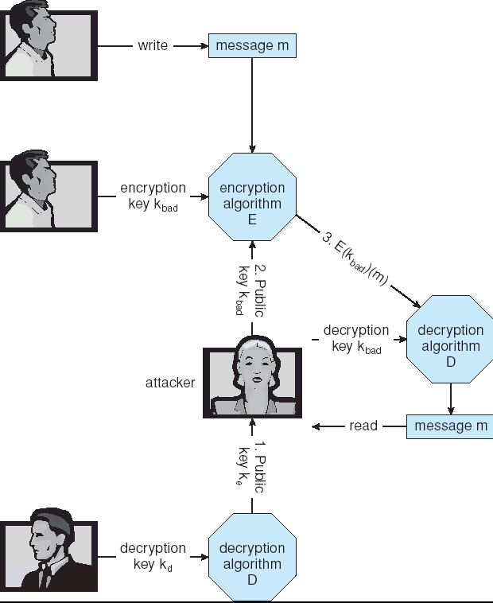
SECURITY
Public Key Cryptosystems
Man-in-the-middle Attack on Asymmetric Cryptography
Sender
Here are the attack steps for this scenario:
Sender wishes to send a message to Receiver.
S asks R for its encryption key.
When R returns key, that key is intercepted by the attacker who substitutes her key.
Sender encrypts message using this bogus key and returns it.
Since the attacker is the owner of this bogus key, the attacker can read the message.
Receiver

Slide 26
SECURITY
Private Key Cryptosystems
Quantum Key Distribution
A secure communication method which implements a cryptographic protocol involving components of quantum mechanics.
It enables two parties to produce a shared random secret key known only to them, which can then be used to encrypt and decrypt messages.
Heisenberg’s Uncertainty Principle says that it’s impossible to know both the orientation of a polarized photon and its position.
The sender (traditionally referred to as Alice) and the receiver (Bob) are connected by a quantum communication channel which allows quantum states to be transmitted.
For photons this channel is generally either an optical fibre or simply free space.
A good reference for this material is Wikipedia

Slide 27
SECURITY
Private Key Cryptosystems
Quantum Key Distribution
Uses two pairs of states, with each pair conjugate to the other pair, and the two states within a pair orthogonal to each other. Pairs of orthogonal states are referred to as a basis.
The usual polarization state pairs used are either the rectilinear basis of vertical (0°) and horizontal (90°), the diagonal basis of 45° and 135° or the circular basis of left- and right-handedness.
Any two of these bases are conjugate to each other, and so any two can be used in the protocol. In what follows, the rectilinear and diagonal bases are used.

Slide 28
SECURITY
Private Key Cryptosystems
Quantum Key Distribution
Alice creates a random bit (0 or 1) and then randomly selects one of her two bases (rectilinear or diagonal in this case) to transmit it in.
She then prepares a photon polarization state depending both on the bit value and basis, as shown in the adjacent table.
So for example a 0 is encoded in the rectilinear basis (+) as a vertical polarization state, and a 1 is encoded in the diagonal basis (x) as a 135° state.
Alice then transmits a single photon in the state specified to Bob, using the quantum channel.
This process is then repeated from the random bit stage, with Alice recording the state, basis and time of each photon sent.
Basis | 0 | 1
+
X

Slide 29
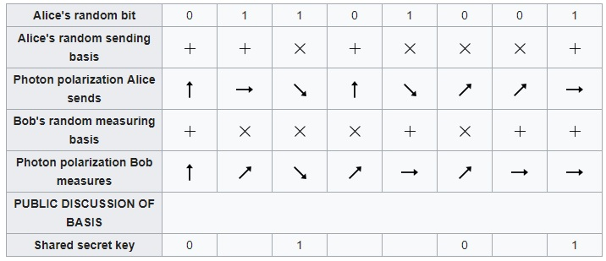
SECURITY
Private Key Cryptosystems
Quantum Key Distribution
When Bob measures in the rectilinear basis he gets a result of horizontal or vertical. If the photon was created as horizontal or vertical then this measures the correct state.
But if it was created as 45° or 135° then the rectilinear measurement instead returns either horizontal or vertical at random. Furthermore, after this measurement the photon is polarized in the state it was measured in (horizontal or vertical), with all information about its initial polarization lost.

Slide 30
SECURITY
Private Key Cryptosystems
Quantum Key Distribution
Bob doesn’t know the basis the photons were encoded in, all he can do is to select a basis at random to measure in, either rectilinear or diagonal. He does this for each photon he receives, recording the time, measurement basis used and measurement result.
After Bob has measured all the photons, he communicates with Alice over the public classical channel.
Alice broadcasts the basis each photon was sent in, and Bob the basis each was measured in. They both discard photon measurements (bits) where Bob used a different basis, which is half on average, leaving half the bits as a shared key.

Slide 31
SECURITY
Private Key Cryptosystems
Quantum Key Distribution
Bob doesn’t know the basis the photons were encoded in, all he can do is to select a basis at random to measure in, either rectilinear or diagonal. He does this for each photon he receives, recording the time, measurement basis used and measurement result.
After Bob has measured all the photons, he communicates with Alice over the public classical channel.
Alice broadcasts the basis each photon was sent in, and Bob the basis each was measured in. They both discard photon measurements (bits) where Bob used a different basis, which is half on average, leaving half the bits as a shared key.

Slide 32
SECURITY
Example - SSL
Insertion of cryptography at one layer of the ISO network model (the transport layer)
SSL – Secure Socket Layer (also called TLS)
Cryptographic protocol that limits two computers to only exchange messages with each other
Very complicated, with many variations
Used between web servers and browsers for secure communication (credit card numbers)
The server is verified with a certificate assuring client is talking to correct server
Asymmetric cryptography used to establish a secure session key (symmetric encryption) for bulk of communication during session
Communication between each computer uses symmetric key cryptography

Slide 33
SECURITY
Wrap Up
In this chapter we’ve looked at how to secure information that may be placed in hazardous public forums.
Data on the net is an excellent example here.

