Slide 1
OPERATING SYSTEMS
Distributed File Systems
Jerry Breecher

Slide 2
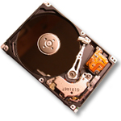
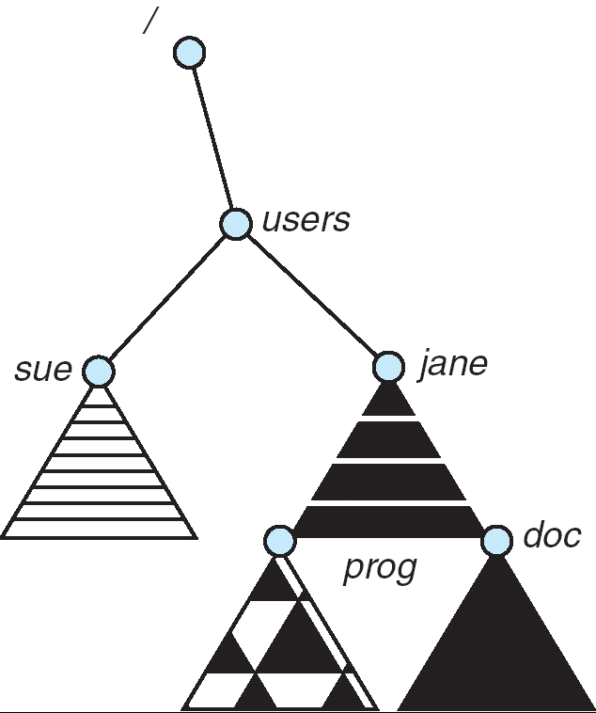
Distributed File Systems
Read File
Network
Data
Client
Server
Transparent access to files stored on a remote disk
Naming choices (always an issue):
Hostname:localname: Name files explicitly
No location or migration transparency
Mounting of remote file systems
Mounts remote file system by giving name and local mount point
Transparent to user: all reads and writes look like local reads and writes to user e.g. /users/sue/foo→/sue/foo on server
A single, global name space: every file in the world has unique name
Location Transparency: servers/files can move without involving user
mount
spot:/jane
mount
cory:/sue
mount
spot:/prog

Slide 3
Simple Distributed File System
Read (RPC)
Return (Data)
Client
Write (RPC)
Server
cache
ACK
Client
Remote Disk (may mean NO local disk) : Reads and writes forwarded to server
Use Remote Procedure Calls (RPC) to translate file system calls into remote requests
No local caching/can be caching at server-side
Advantage: Server provides completely consistent view of file system to multiple clients
Problems? Performance!
Going over network is slower than going to local memory
Lots of network traffic/not well pipelined
Server can be a bottleneck

Slide 4
Use of Caching to Reduce Network Load
Crash!
Crash!
read(f1)
→V1
Read (RPC)
cache
read(f1)→V1
read(f1)→V1
F1:V1
Return (Data)
read(f1)→V1
Client
Write (RPC)
cache
Server
F1:V1
F1:V2
ACK
cache
write(f1)
→OK
F1:V2
read(f1)→V2
Client
Idea: Use caching to reduce network load
In practice: use buffer cache at source and destination
Advantage: if open/read/write/close can be done locally, don’t need to do any network traffic…fast!
Problems:
Failure:
Client caches have data not committed at server
Cache consistency!
Client caches not consistent with server/each other

Slide 5
Failures
Crash!
What if server crashes? Can client wait until server comes back up and continue as before?
Any data in server memory but not on disk can be lost
Shared state across RPC: What if server crashes after seek? Then, when client does “read”, it will fail
Message retries: suppose server crashes after it does UNIX “rm foo”, but before acknowledgment?
Message system will retry: send it again
How does it know not to delete it again? (could solve with two-phase commit protocol, but NFS takes a more ad hoc approach)
Stateless protocol: A protocol in which all information required to process a request is passed with request
Server keeps no state about client, except as hints to help improve performance (e.g., a cache)
Thus, if server crashes and restarted, requests can continue where left off (in many cases)
What if client crashes?
Might lose modified data in client cache

Slide 6
Example: Network File System (NFS)
Three Layers for NFS system
UNIX filesystem API: open, read, write, close calls + file descriptors
VFS layer: distinguishes local from remote files
Calls the NFS protocol procedures for remote requests
NFS service layer: bottom layer of the architecture
Implements the NFS protocol
NFS Protocol: RPC for file operations on server
Reading/searching a directory
Manipulating links and directories
Accessing file attributes/reading and writing files
Write-through caching: Modified data committed to server’s disk before results are returned to the client
Lose some of the advantages of caching
Time to perform write() can be long
Need some mechanism for readers to eventually notice changes! (more on this later)

Slide 7
NFS Continued
NFS servers are stateless; each request provides all arguments require for execution
E.g. reads include information for entire operation, such as ReadAt(inumber,position), not Read(openfile)
No need to perform network open() or close() on file – each operation stands on its own
Idempotent: Performing requests multiple times has same effect as performing it exactly once
Example: Server crashes between disk I/O and message send, client resend read, server does operation again
Example: Read and write file blocks: just re-read or re-write file block – no side effects
Example: What about “remove”? NFS does operation twice and second time returns an advisory error

Slide 8
NFS Failure Model
Transparent to client system
Is this a good idea? What if you are in the middle of reading a file and server crashes?
Options – NFS provides both choices:
Hang until server comes back up (next week?)
Return an error (of course, most applications don’t know they are talking over a network)

Slide 9
NFS Cache Consistency
cache
F1 still ok?
F1:V2
F1:V1
No: (F1:V2)
Client
Write (RPC)
cache
ACK
F1:V2
cache
Server
F1:V2
Client
NFS protocol: weak consistency
Client polls server periodically to check for changes
Polls server for changes to data in last 3-30 seconds (tunable parameter)
Thus, when file is changed on one client, server is notified, but other clients use old version of file until timeout
What if multiple clients write to same file?
In NFS, can get either version (or parts of both)
Completely arbitrary

Slide 10
Sequential Ordering Constraints
Client 1:
Read: gets A
Write B
Read: parts of B or C
Client 2:
Read: gets A or B
Write C
Client 3:
Read: parts of B or C
Time
What sort of cache coherence can we expect?
One CPU changes file, and before it’s done, another CPU reads file
Example: Start with file contents = “A”
What would we actually want?
Assume we want distributed system to behave exactly the same as if all processes are running on single system
If read finishes before write starts, get old copy
If read starts after write finishes, get new copy
Otherwise, get either new or old copy
For NFS:
If read starts more than 30 seconds after write, get new copy; otherwise, could get partial update

Slide 11
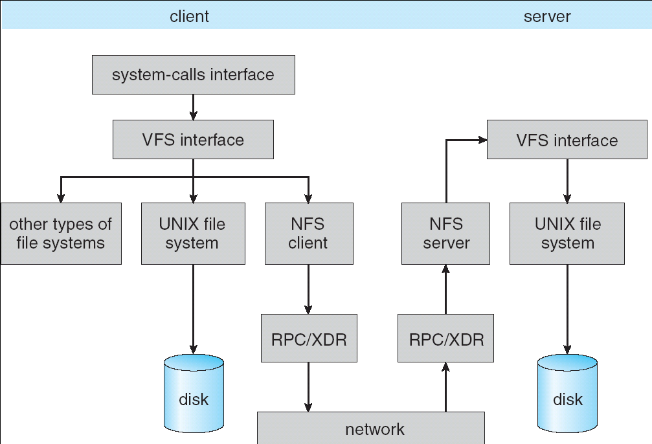
Implementation of NFS

Slide 12
NFS Pros and Cons
NFS Pros:
Simple, Highly portable
NFS Cons:
Sometimes inconsistent!
Doesn’t scale to large numbers of clients
Must keep checking to see if caches out of date
Server becomes bottleneck due to polling traffic

Slide 13
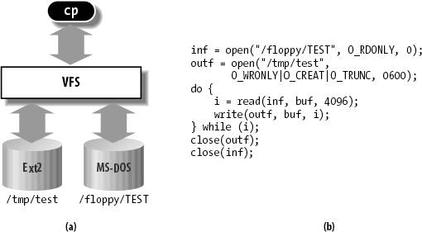
Virtual Filesystem (VFS)
Allows same code interface independent of underlying file system.
VFS: Virtual abstraction similar to local file system
Provides virtual superblocks, inodes, files, etc
Compatible with a variety of local and remote file systems
Provides object-oriented way of implementing file systems
VFS allows the same system call interface (the API) to be used for different types of file systems
The API is to the VFS interface, rather than any specific type of file system
In linux, “VFS” stands for “Virtual Filesystem Switch”

Slide 14
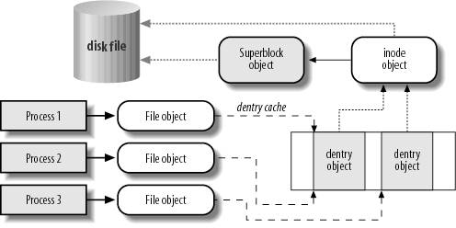
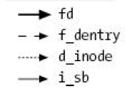
VFS Common File Model in Linux
Four primary object types for VFS:
superblock object: represents a specific mounted filesystem
inode object: represents a specific file
dentry object: represents a directory entry
file object: represents open file associated with process
There is no specific directory object (VFS treats directories as files)
May need to fit the model by faking it
Example: make it look like directories are files
Example: make it look like have inodes, superblocks, etc.

Slide 15

Network-Attached Storage and the CAP Theorem
Network
Consistency:
Changes appear to everyone in the same serial order
Availability:
Can get a result at any time
Partition-Tolerance
System continues to work even when network becomes partitioned
Consistency, Availability, Partition-Tolerance (CAP) Theorem: Cannot have all three at same time
Otherwise known as “Brewer’s Theorem”

Slide 16
Key Value Storage
Goal: Handle huge volumes of data, e.g., PetaBytes!
Store (key, value) tuples
Simple interface
put(key, value); // insert/write “value” associated with “key”
value = get(key); // get/read data associated with “key”
Used sometimes as a simpler but more scalable “database”

Slide 17





Key Values: Examples
Amazon:
Key: customerID
Value: customer profile (e.g., buying history, credit card, ..)
Facebook, Twitter:
Key: UserID
Value: user profile (e.g., posting history, photos, friends, …)
iCloud/iTunes:
Key: Movie/song name
Value: Movie, Song

Slide 18
Key-Value Storage Systems in Real Life
Amazon
DynamoDB: internal key value store used for Amazon.com (shopping cart)
Simple Storage System (S3)
BigTable/HBase/Hypertable: distributed, scalable data storage
Cassandra: “distributed data management system” (developed by Facebook)
Memcached: in-memory key-value store for small chunks of arbitrary data (strings, objects)
BitTorrent distributed file location: peer-to-peer sharing system

Slide 19
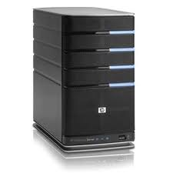
Key Value Store
Also called Distributed Hash Tables (DHT)
Main idea: partition set of key-values across many machines
key, value
…

Slide 20
Key Value Store: Challenges
…
Fault Tolerance: handle machine failures without losing data and without degradation in performance
Scalability:
Need to scale to thousands of machines
Need to allow easy addition of new machines
Consistency: maintain data consistency in face of node failures and message losses
Heterogeneity (if deployed as peer-to-peer systems):
Latency: 1ms to 1000ms
Bandwidth: 32Kb/s to 100Mb/s

Slide 21
Key Value Store: Questions
put(key, value): where to store a new (key, value) tuple?
get(key): where is the value for a given “key” stored?
And, do the above while providing
Fault Tolerance
Scalability
Consistency

Slide 22
Directory-Based Architecture
Have a node maintain the mapping between keys and the machines (nodes) that store the values associated with the keys
Master/Directory
put(K14, V14)
K5
N2
K14
N3
K105
N50
put(K14, V14)
K5
V5
K14
V14
K105
V105
…
N₁
N₂
N₃
N₅₀

Slide 23
Directory-Based Architecture
Have a node maintain the mapping between keys and the machines (nodes) that store the values associated with the keys
Master/Directory
get(K14)
V14
K5
N2
K14
N3
get(K14)
K105
N50
V14
K5
V5
K14
V14
K105
V105
…
N₁
N₂
N₃
N₅₀

Slide 24
Directory-Based Architecture
Having the master relay the requests → recursive query (previous slide)
Another method: iterative query (this slide)
Return node to requester and let requester contact node
Master/Directory
put(K14, V14)
N3
K5
N2
K14
N3
put(K14, V14)
K105
N50
K5
V5
K14
V14
K105
V105
…
N₁
N₂
N₃
N₅₀

Slide 25
Discussion: Recursive vs. Iterative Query
Master/Directory
Master/Directory
get(K14)
get(K14)
V14
K14
N3
N3
K14
N3
V14
Iterative
get(K14)
Recursive
get(K14)
V14
K14
V14
K14
V14
…
…
N1
N2
N3
N50
N1
N2
N3
N50
Recursive Query:
Advantages:
Faster, as typically master/directory closer to nodes
Easier to maintain consistency, as master/directory can serialize puts()/gets()
Disadvantages: scalability bottleneck, as all “Values” go through master/directory
Iterative Query
Advantages: more scalable
Disadvantages: slower, harder to enforce data consistency

Slide 26
Fault Tolerance
Replicate value on several nodes
Recursive replication
Usually, place replicas on different racks in a datacenter to guard against rack failures
Master/Directory
put(K14, V14)
K5
N2
N1, N3
K14
N1,N3
K105
N50
put(K14, V14), N1
put(K14, V14)
K14
V14
K5
V5
K14
V14
K105
V105
…
N₁
N₂
N₃
N₅₀

Slide 27
Fault Tolerance
Again, we can have
Iterative replication (this slide)
Master/Directory
put(K14, V14)
K5
N2
N1, N3
K14
N1,N3
K105
N50
put(K14, V14)
put(K14, V14)
K14
V14
K5
V5
K14
V14
K105
V105
…
N₁
N₂
N₃
N₅₀

Slide 28
Fault Tolerance
Or we can use recursive query and iterative replication…
Master/Directory
put(K14, V14)
K5
N2
K14
N1,N3
K105
N50
put(K14, V14)
put(K14, V14)
K14
V14
K5
V5
K14
V14
K105
V105
…
N₁
N₂
N₃
N₅₀

Slide 29
Scalability
More Storage: use more nodes
More Requests:
Can serve requests from all nodes on which a value is stored in parallel
Master can replicate a popular value on more nodes
Master/directory scalability:
Replicate it
Partition it, so different keys are served by different masters/directories
How do you partition?

Slide 30
Scalability: Load Balancing
Directory keeps track of the storage availability at each node
Preferentially insert new values on nodes with more storage available
What happens when a new node is added?
Cannot insert only new values on new node. Why?
Move values from the heavy loaded nodes to the new node
What happens when a node fails?
Need to replicate values from fail node to other nodes

Slide 31
Consistency
Need to make sure that a value is replicated correctly
How do you know a value has been replicated on every node?
Wait for acknowledgements from every node
What happens if a node fails during replication?
Pick another node and try again
What happens if a node is slow?
Slow down the entire put()? Pick another node?
In general, with multiple replicas
Slow puts and fast gets

Slide 32
Consistency (cont’d)
If concurrent updates (i.e., puts to same key) may need to make sure that updates happen in the same order
put(K14, V14’) and put(K14, V14’’) reach N1 & N3 in reverse order
What does get(K14) return?
Undefined!
Master/Directory
put(K14, V14’)
K5
N2
put(K14, V14’’)
K14
N1,N3
K105
N50
put(K14, V14’’)
put(K14, V14’)
put(K14, V14’')
put(K14, V14’)
K14
K14
V14
V14’
K5
V5
K14
K14
V14
V14’’
K105
V105
…
N₁
N₂
N₃
N₅₀

Slide 33
Large Variety of Consistency Models
Atomic consistency (linearizability): reads/writes (gets/puts) to replicas appear as if there was a single underlying replica (single system image)
Think “one updated at a time”
Transactions
Eventual consistency: given enough time all updates will propagate through the system
One of the weakest form of consistency; used by many systems in practice
Must eventually converge on single value/key (coherence)
And many others: causal consistency, sequential consistency, strong consistency, …

Slide 34
Quorum Consensus
Improve put() and get() operation performance
Define a replica set of size N
put() waits for acknowledgements from at least W replicas
get() waits for responses from at least R replicas
W+R > N
Why does it work?
There is at least one node that contains the update
Why might you use W+R > N+1?

Slide 35
Quorum Consensus Example
N=3, W=2, R=2
Replica set for K14: {N₁, N₃, N₄}
Assume put() on N₃ fails
put(K14, V14)
put(K14, V14)
put(K14, V14)
ACK
ACK
K14
V14
K14
V14
N₁
N₂
N₃
N₄

Slide 36
Quorum Consensus Example
Now, issuing get() to any two nodes out of three will return the answer
get(K14)
get(K14)
V14
NIL
K14
V14
K14
V14
N₁
N₂
N₃
N₄

Slide 37
Wrap-up (1/2)
DISTRIBUTED FILE SYSTEMS
Distributed File System:
Transparent access to files stored on a remote disk
Caching for performance
Cache Consistency: Keeping client caches consistent with one another
If multiple clients, some reading and some writing, how do stale cached copies get updated?
NFS: check periodically for changes
AFS: clients register callbacks to be notified by server of changes
Remote Procedure Call (RPC): Call procedure on remote machine
Provides same interface as procedure
Automatic packing and unpacking of arguments (in stub)

Slide 38
DISTRIBUTED FILE SYSTEMS
Wrap-up (2/2)
VFS: Virtual File System layer
Provides mechanism which gives same system call interface for different types of file systems
Key-Value Store:
Two operations
put(key, value)
value = get(key)
Challenges
Fault Tolerance → replication
Scalability → serve get()’s in parallel; replicate/cache hot tuples
Consistency → quorum consensus to improve put() performance

