Slide 1
Virtualization
Jerry Breecher

Slide 2
Virtualization
What is Virtualization?
vir•tu•al (adj): existing in essence or effect, though not in actual fact
Virtual systems
Abstract physical components using logical objects
Dynamically bind logical objects to physical configurations
Examples
Network – Virtual LAN (VLAN), Virtual Private Network (VPN)
Storage – Storage Area Network (SAN), LUN
Computer – Virtual Machine (VM), simulator

Slide 3
Virtualization
Overview
Virtual Machines
Virtualization Approaches
Processor Virtualization

Slide 4
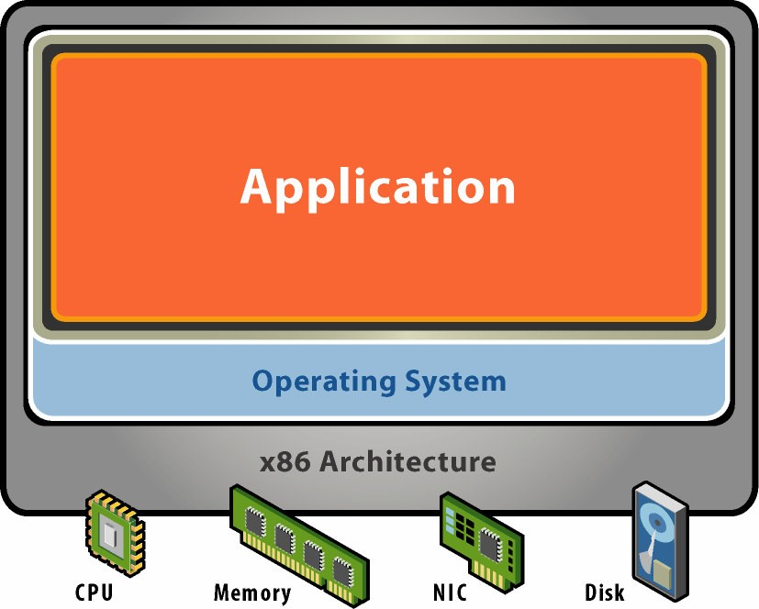
Virtualization
A Physical Machine
Physical Hardware
Processors, memory, chipset, I/O bus and devices.
(Physical resources often underutilized)
Software
Tightly coupled to hardware
Single active OS image
OS controls hardware

Slide 5
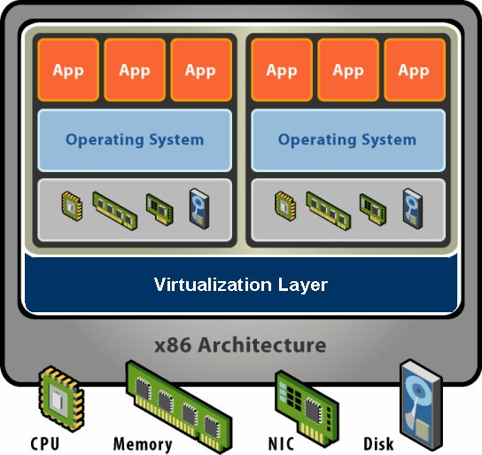
Virtualization
What is a Virtual Machine?
Virtualization Software
Extra level of indirection decouples hardware and OS
Multiplexes physical hardware across multiple guest VMs
Strong isolation between VMs
Manages physical resources, improves utilization
Hardware Level Abstraction
Virtual Hardware:
Processors, memory, etc.
Encapsulates all OS and application state.

Slide 6
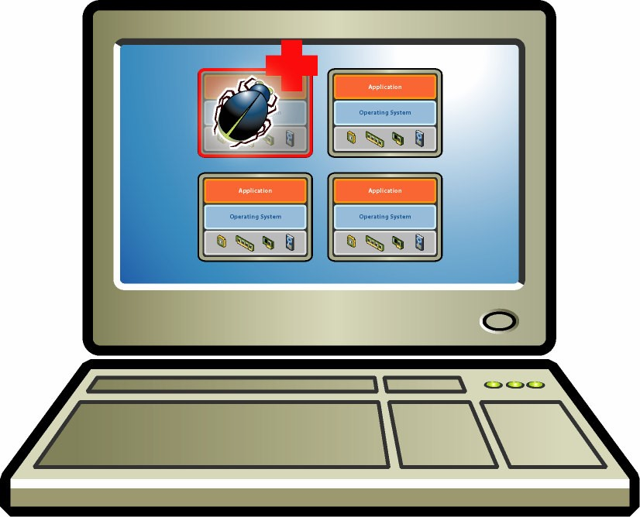
Virtualization
VM Isolation
VM Isolation
Run multiple VMs on single physical host
Processor hardware isolates VMs, e.g. MMU
Strong Guarantees
Software bugs, crashes, viruses within one VM cannot affect other VMs
Performance Isolation
Partition system resources
Example: VMware controls for reservation, limit, shares

Slide 7
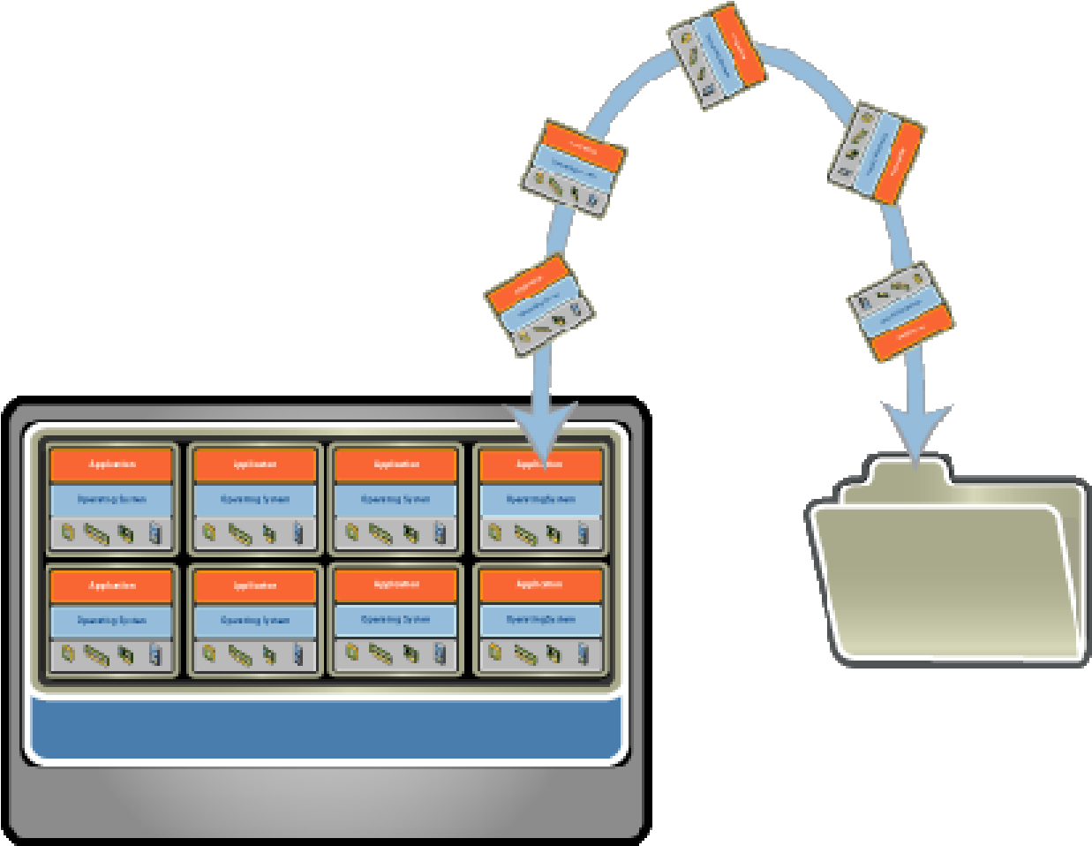
Virtualization
VM Encapsulation
Entire VM is a file
OS, applications, data
Memory and device state
Snapshots and Clones
Capture VM state on the fly and restore to point-in-time
Rapid system provisioning, backup, remote mirroring
Easy Content
Easy Content Distribution
Pre-configured apps, demos, Virtual utilities

Slide 8
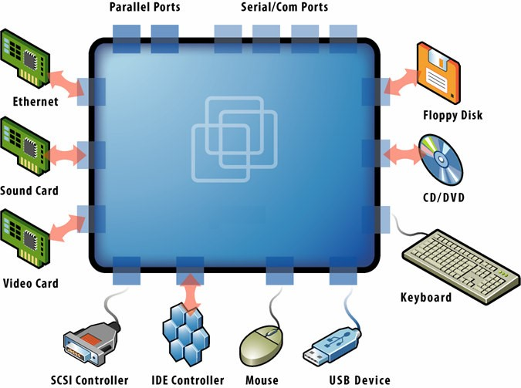
Virtualization
VM Compatibility
Hardware Independent
Physical hardware hidden by virtualization layer
Standard virtual hardware exposed to VM
Create Once, Run Anywhere.
No configuration issues
Migrate VMs between hosts
Legacy VMs
Run ancient OS on new hardware

Slide 9
Virtualization
Common Uses Today
Test and Development – Rapidly provision test and
development servers; store libraries of pre-configured test machines
Server Consolidation and Containment – Eliminate server sprawl by deploying systems into virtual machines that can run safely and move transparently across shared hardware
Business Continuity – Reduce cost and complexity by encapsulating entire systems into single files that can be replicated and restored onto any target server
Enterprise Desktop – Secure unmanaged PCs without compromising end-user autonomy by layering a security policy in software around desktop virtual machines

Slide 10
Virtualization
Overview
Virtual Machines
Virtualization Approaches
Virtual machine monitors (VMMs)
Virtualization platform types
Alternative system virtualizations
Processor Virtualization

Slide 11
Virtualization
What is a Virtual Machine Monitor?
The VMM provides an environment for programs which is essentially identical with the original machine; second, programs run in this environment show at worst only minor decreases in speed; and last, the VMM is in complete control of all system resources.
This idea has been around for IBM mainframes since the ’60s.

Slide 12
Virtualization
VMM Technology
So this is just like Java, right?
No, a Java VM is very different from the physical machine that runs it
A hardware-level VM reflects underlying processor architecture
Like a simulator or emulator that can run old Nintendo games?
No, they emulate the behavior of different hardware architectures
Simulators generally have very high overhead
A hardware-level VM utilizes the underlying physical processor directly

Slide 13
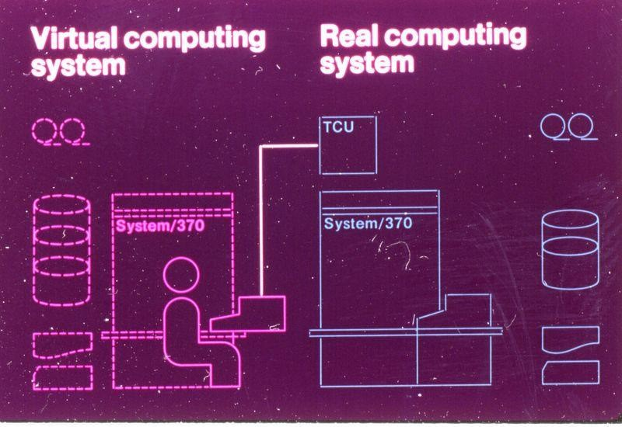
Virtualization
VMM from the Past
An Old Idea
Hardware-level VMs since ’60s
IBM S/360, IBM VM/370mainframe systems
Timeshare multiple single-user OS instances on expensive hardware
Classical VMM
Run VM directly on hardware
“Trap and emulate” model
From IBM VM/370 product announcement, ca. 197 for privileged instructions
Vendors had vertical control over proprietary hardware, operating systems, VMM

Slide 14
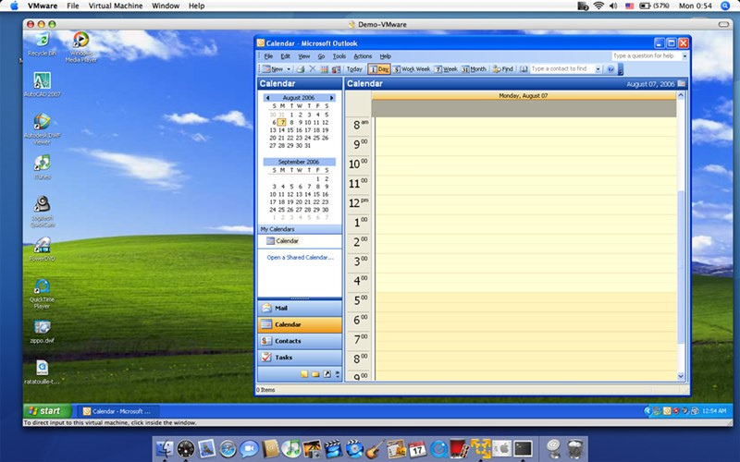
Virtualization
VMM from the Past
Renewed Interest
Academic research since ’90s
VMs for commodity systems
Server consolidation
VMM for x86
Industry-standard hardware, from laptops to datacenter
Run unmodified commodity VMware Fusion for Mac OS X running WinXP, 2006 guest operating systems
Significant challenges, e.g. “non-virtualizable” instructions
Pioneered by VMware in ’98

Slide 15
Virtualization
VMM Platform Types
Hosted Architecture
Install as application on existing x86 “host” OS, e.g. Windows, Linux, OS X
Small context-switching driver
Leverage host I/O stack and resource management
Examples: VMware Player/Workstation/Server, Microsoft Virtual PC/Server, Parallels Desktop
Bare-Metal Architecture
“Hypervisor” installs directly on hardware
Acknowledged as preferred architecture for high-end servers
Examples: VMware ESX Server, Xen, Microsoft Viridian (2008)

Slide 16
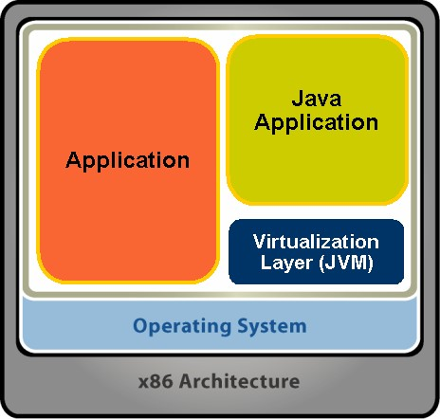
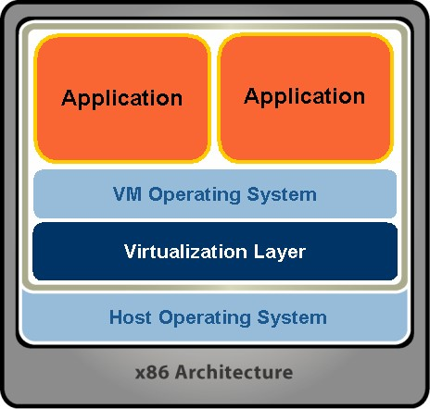
Virtualization
System Virtualization Alternatives
Virtual machines abstracted using a layer at different places
Language Level OS Level Hardware Level

Slide 17
Virtualization
System Virtualization Taxonomy
System Virtualization
Hardware Level
High-Level Language
•
Java
•
Microsoft .NET / Mono
•
Smalltalk
Bare-Metal/
Hosted
Hypervisor
•
Microsoft Virtual Server
•
HP Integrity VM
•
Microsoft Virtual PC
•
IBM zSeries z/VM
•
Parallels Desktop
•
VMware Player
•
VMware ESX Server
VMware Workstation
Emulators
•
Xen
•
•
VMware Server
•
Bochs
•
FreeBSD Jail
Microsoft VPC for Mac
•
•
HP Secure Resource
QEMU
Para-virtualization
Partitions
•

Slide 18
Virtualization
Overview
Virtual Machines
Virtualization Approaches
Processor Virtualization
Classical techniques
Software x86 VMM
Para-virtualization

Slide 19
Virtualization
Classical Instruction Virtualization
Trap and Emulate
Run guest operating system deprivileged (like being in user mode)
All privileged instructions trap into VMM
VMM emulates instructions against virtual state e.g. disable virtual interrupts, not physical interrupts
Resume direct execution from next guest instruction

Slide 20
Virtualization
Classical Memory Virtualization
Trap and Emulate
Run guest operating system deprivileged (like being in user mode)
All privileged instructions trap into VMM
VMM emulates instructions against virtual state e.g. disable virtual interrupts, not physical interrupts
Resume direct execution from next guest instruction

Slide 21
Virtualization
Classical Instruction Virtualization
Traditional VMM Approach
Extra Level of Indirection
Virtual ® “Physical” Guest maps VPN to PPN using primary page tables
“Physical” → Machine VMM maps PPN to MPN
Shadow Page Table
Composite of two mappings
For ordinary memory references Hardware maps VPN to MPN
Cached by physical TLB
VPN
guest
Shadow Page Table
PPN
Hardware TLB
VMM
MPN

Slide 22
Virtualization
Classical Memory Behavior
Shadow Page Table
Derived from primary page table in guest
VMM must keep primary and shadow coherent
Trace = Coherency Mechanism
Write-protect primary page table
Trap guest writes to primary
Update or invalidate corresponding shadow
Transparent to guest
Native Speed Except for Traps
No overhead in direct execution
Overhead = trap frequency × average trap cost
Trap Sources
Most frequent: Guest page table traces
Privileged instructions
Memory-mapped device traces

Slide 23
Virtualization
x86 Virtualization Challenges
Not Classically Virtualizable
x86 ISA includes instructions that read or modify privileged state
But which don’t trap in unprivileged mode
Example: POPF instruction
Pop top-of-stack into EFLAGS register
EFLAGS.IF bit privileged (interrupt enable flag)
POPF silently ignores attempts to alter EFLAGS.IF in unprivileged mode!
So no trap to return control to VMM
Deprivileging not possible with x86!

Slide 24
Virtualization
How to Virtualize x86?
Interpretation
Problem – too inefficient
x86 decoding slow
Code Patching
Problem – not transparent
Guest can inspect its own code
Binary Translation (BT)
Approach pioneered by VMware
Run any unmodified x86 OS in VM
Extend x86 Architecture

Slide 25
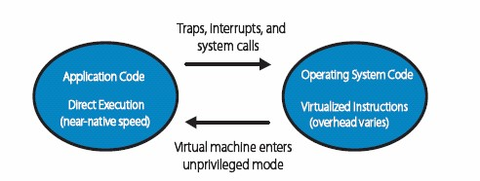
Virtualization
Software VMM: Binary Translation
Direct execute unprivileged guest application code
Will run at full speed until it traps, we get an interrupt, etc.
“Binary translate” all guest kernel code, run it unprivileged
Since x86 has non-virtualizable instructions, proactively transfer control to the VMM (no need for traps)
Safe instructions are emitted without change
For “unsafe” instructions, emit a controlled emulation sequence
VMM translation cache for good performance

Slide 26
Virtualization
How Does VMWare Do This?
Binary – input is x86 “hex”, not source
Dynamic – interleave translation and execution
On Demand – translate only what about to execute (lazy)
System Level – makes no assumptions about guest code
Subsetting – full x86 to safe subset
Adaptive – adjust translations based on guest behavior

Slide 27
Virtualization
How Does VMWare Do This?
Input: BB
55 ff 33 c7 03 ...
Each Translator Invocation
• Consume a basic block (BB)
• Produce a compiled code fragment (CCF)
Store CCF in Translation Cache
• Future reuse
• Capture working set of guest kernel
• Amortize translation costs
• Not “patching in place”
translator
Output: CCF
55 ff 33 c7 03 ...

Slide 28
Virtualization
How Does VMWare Do This?
80304a69 push %ebp
80403a6a push (%ebx)
80403a6c mov (%ebx), ffffffff
80403a72 mov %edx, %esp
80403a74 mov %esp, 81c(%ebx)
80403a7a push %edx
80403a7b mov %ebp, %eax
80403a7d call 80460ba4
25555b0 push %ebp
25555b1 push (%ebx)
25555b3 mov (%ebx), ffffffff
25555b9 mov %edx, %esp
25555bb mov %esp, 81c(%ebx)
25555c1 push %edx
25555c2 mov %ebp, %eax
25555c4 push 80403a82
25555c9 int 3a
25555cb data: 80460ba4
BB CCF
25555c4: push return address
25555c9: invoke translator on callee

Slide 29



Virtualization
Adaptive BT
Translated Code Is Fast
• Mostly IDENTICAL translations
• Runs “at speed”
Except Writes to Traced Memory
• Page fault (shown as !*!)
• Decode and interpret instruction
• Fire trace callbacks
• Resume execution
• Can take 1000’s of cycles
Translation
Cache
!*!
Invoke Translator

Slide 30





Virtualization
Adaptive BT: Fast Trace Handling
Detect and Track Trace Faults
Splice in TRACE Translation
• Execute memory access in software
• Avoid page fault
• No re-decoding
• Faster resumption
Faster Traces
• 10x performance improvement
• Adapts to runtime behavior
JMP
TRACE
Invoke
Translator

Slide 31
Virtualization
What is ParaVirtualization?
Full Virtualization
• No modifications to guest OS
• Excellent compatibility, good performance, but complex
Paravirtualization
Exports Simpler Architecture
is an enhancement of virtualization technology in which a guest OS is recompiled prior to installation inside a virtual machine.
allows for an interface to the virtual machine that can differ somewhat from that of the underlying hardware.
requires guest OS to be explicitly ported for the para-API — a conventional OS distribution that is not paravirtualization-aware cannot be run on top of a paravirtualizing VMM.

Slide 32
Virtualization
What is ParaVirtualization?
Full Virtualization
• No modifications to guest OS
• Excellent compatibility, good performance, but complex
Paravirtualization Exports Simpler Architecture
• Term coined by Denali project in ’01, popularized by Xen
• Modify guest OS to be aware of virtualization layer
• Remove non-virtualizable parts of architecture
• Avoid rediscovery of knowledge in hypervisor
• Excellent performance and simple, but poor compatibility
Ongoing Linux Standards Work
• “Paravirt Ops” interface between guest and hypervisor
• Small team from VMware, Xen, IBM LTC, etc.

Slide 33
Virtualization
What is ParaVirtualization?
System call
Guest
interface
OS
Guest
OS
Hypercalls
(
GOOD
)
Hypervisor
Hypervisor
NOT GOOD!
Hardware
Hardware
Full Virtualization Paravirtualization

Slide 34
Virtualization
Transparent Paravirtualization?
Same OS binary
VMI
VMI
Windows
Dom0
Linux
Xeno
Linux
Solaris
DomU
Linux
VMI
Linux
Xen 3.0.x
VMware ESX
Native
Native
Native

