Slide 1
Introduction to
Operating Systems
J. H. Wang
Sep. 11, 2017

Slide 2
Instructor and TA
Instructor
  Jenq-Haur Wang (王正豪)
  Associate Professor, CSIE, NTUT
  Office: R1534, Technology Building
  E-mail: jhwang@csie.ntut.edu.tw
  Homepage: http://www.ntut.edu.tw/~jhwang/
  Tel: ext. 4238
  Office Hour: 9:10-12:00am on Tuesdays and 9:10-12:00am on Wednesdays
TA
  Mr. Chen (@ R1424, Technology Building)
    E-mail: wirl2017 @ yahoo.com.tw

Slide 3
Course Overview
Course: Operating Systems
Time: 3:10-6:00pm on Tuesdays
Classroom: R1322, Technology Building
Prerequisite:
  Data Structures, Computer Organization
  Working knowledge of a high-level programming language for projects
Course webpage: http://www.ntut.edu.tw/~jhwang/OS/

Slide 4
Target Students
For those who
  Might not major in CSIE during undergraduate studies, but are interested in operating systems, and
  Are familiar with basic data structures, computer organization, and at least a high-level programming language, and
  Are preparing to investigate more technical details in selected advanced topics and recent developments in modern operating systems

Slide 5
Resources
Textbook: Operating System Concepts, 9th ed., by Abraham Silberschatz, Peter Baer Galvin, and Greg Gagne, John Wiley & Sons, Inc. (International Student Edition, imported by 新月) [OS9c]
  http://os-book.com/ (10th edition to be published in 2018)
  The 7th, 8th edition and Java edition are also acceptable
    Content new to the 9th edition will be mentioned when possible
References:
  Understanding the Linux Kernel, 3rd ed., by Daniel P. Bovet and Marco Cesati, O'Reilly, 2005. [ULK3]
  Distributed Systems: Principles and Paradigms, 2nd ed., by Andrew S. Tanenbaum and Maarten van Steen, Prentice-Hall, 2006. [DS2]
  Papers, online documents, and other related materials

Slide 6
Teaching
Lectures
About 4-5 homework and program assignments
  Should be turned in within two weeks
  Submission site to be confirmed later
One mid-term exam
One term project
  system implementation or paper presentation (more on this later)

Slide 7
Grading Policy
(Tentative) Grading policy
  Written and programming exercises: ~40%
  Midterm exam: ~30%
  Term project: ~30%
For those not familiar with the “midterm alert”,
  Rule#1: ! (∀x, alerted(x) => failed(x))
  Rule#2: ! (∀x, !alerted(x) => !failed(x)
  Conclusion: pay attention to your own potential score range as early as possible!

Slide 8
Course Description
Introduction to basic components in operating systems
  Process management and coordination
  Memory management
  Storage management
Advanced topics (depending on schedule)
  Distributed systems
  Virtual machines
  Case studies and recent developments

Slide 9
Outline & Schedule
Outline: [OS9c]
  Basics (Ch. 1-2)
    Introduction
    System structures
  Process management (Ch. 3-7)
    Process concept
    Multithreaded programming
    Process scheduling
    Synchronization
    Deadlocks
  Memory management (Ch. 8-9)
    Memory management strategies
    Virtual memory management

Slide 10
Outline & Schedule (Cont’d)
Outline (cont’d)
  Storage management (Ch. 10-13)
    File system
    Secondary storage structure
    I/O systems
  System protection and security (Ch. 14-15)
  Case studies (Ch. 16-18)
    Linux, Windows 7, Influential OS
Reorganized and integrated throughout the text
  Real-time systems
  Storage management
Removed from International Student Edition
and moved into “Advanced Topics” in 9th ed.
  Virtual machines
  Distributed systems

Slide 11
Outline & Schedule (Cont’d)
Outline: [DS2]
  Introduction
  Architectures
  Processes
  Communication
  Naming

Slide 12
Outline & Schedule (Cont’d)
Outline: (cont’d) [DS2]
  Synchronization
  Consistency and replication
  Fault tolerance
  Security
  Distributed object-based systems
  Distributed file systems
  Distributed Web-based systems
  Distributed Coordination-based systems

Slide 13
Outline & Schedule (Cont’d)
(Tentative) Schedule
  Basics: 1-2 wks
  Process management: 4-5 wks
  Memory management: 3-4 wks
  Storage management: 1-2 wks
  Distributed systems: 3-4 wks
  Term project presentation: 2-3 wks
  Advance topics: 1-2 wks (if time permits)

Slide 14
Recent Growth in Fundamental Areas
Multicore systems
Mobile computing
Virtualization

Slide 15
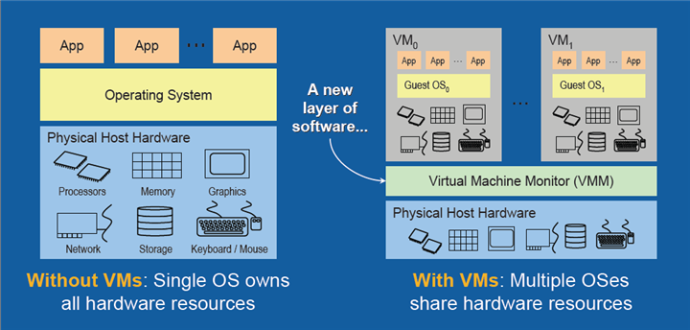
Virtualization
[Source: The Advantages of Using Virtualization Technology in the Enterprise, by Thomas Burger, Intel Developer Zone]

Slide 16
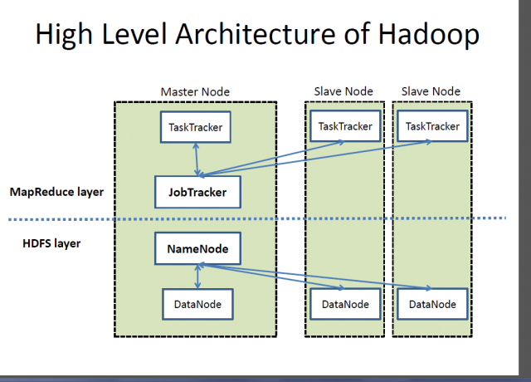
Hadoop Architecture

Slide 17
More on Programming Exercises
Selected from “Programming Problems” at the end of each chapter
  Process management
  Inter-process communication: shared memory, message passing
  Multi-threaded programs
  Semaphores
  Tracing system calls
  Modifying Linux kernel modules
  …

Slide 18
More on the Term Project
1. System Implementation
  Making changes to the kernel and performing tests
    E.g.: Networking, file systems, …
  Implementation and comparison of selected OS components
    E.g.: CPU scheduling, disk scheduling,
    deadlock avoidance, memory page replacement algorithms, ...
2. Paper presentation
  Presentation of academic papers (conference proceedings, journals)
    OS: ACM SOSP, USENIX OSDI, …
    Distributed systems: ACM PODC, ICDCS, …
  Focused survey of recent technical developments in selected OS components on various platforms
    E.g.: smart phones, mobile computing, cloud computing, wearable devices, …
The score depends on the quality and technical depth in the presentation

Slide 19
Thanks for Your Attention!

