Slide 1
Twitter User Gender Classification
By: Luke Barsotti

Slide 2
Problem Statement
Can a twitter user’s gender be predicted, based on the text of their tweets and/or profile description?
Notes:
Got the dataset from Kaggle

Slide 3
Initial Metrics
20,050 rows (tweets)
Cut down to 13,804
5367 Female
4653 Male
3784 Brand
Original model (not mine) was about 60% accurate
Notes:
Took out unknowns, and classifications that were not 100% confident
39% female
34% male
27% brand

Slide 4
Strategy
3 different Multinomial Naïve Bayes classifiers
Tweet text only
Profile description only
Tweet/description combo
SciKit Learn
MultinomialNB from sklearn.naive_bayes
Random train/test split
Vectorize
Stop words?
Notes:
Commonly used for classifying text into pre-determined bins
What we used in class for NLP lesson
Standard english stop words actually ended up making the classifiers less accurate, except on the combination (maybe because tweets are so short?)

Slide 5
Performance
Tweet text only:
~57% accuracy
Profile description only:
~62% accuracy
Tweet/description combo:
~67% accuracy

Slide 6
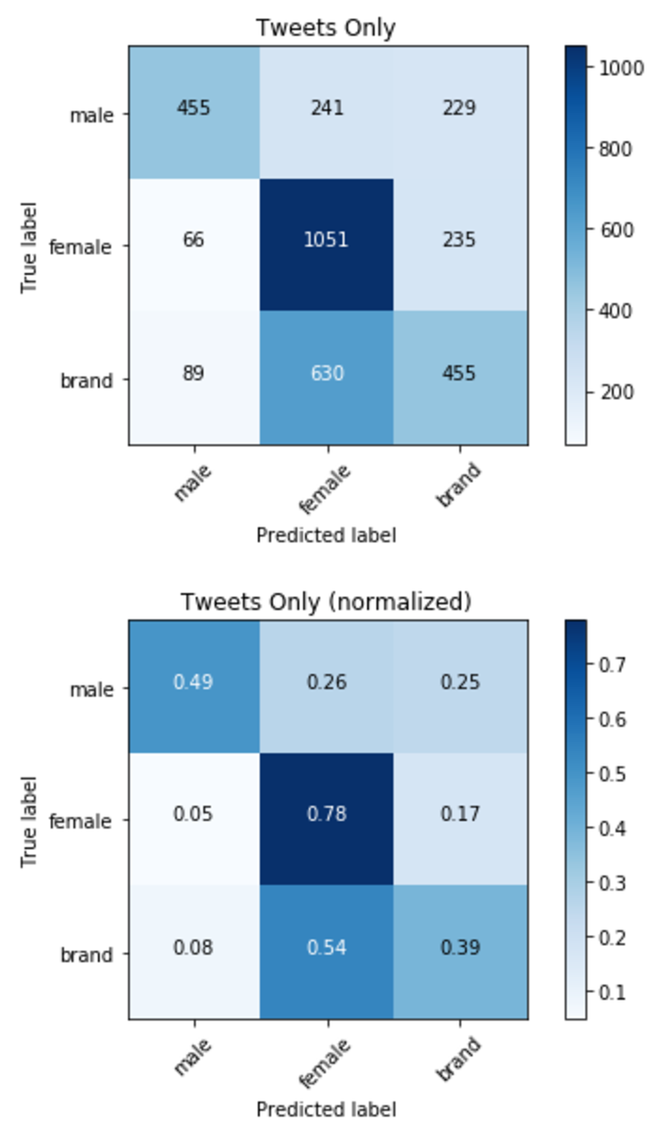
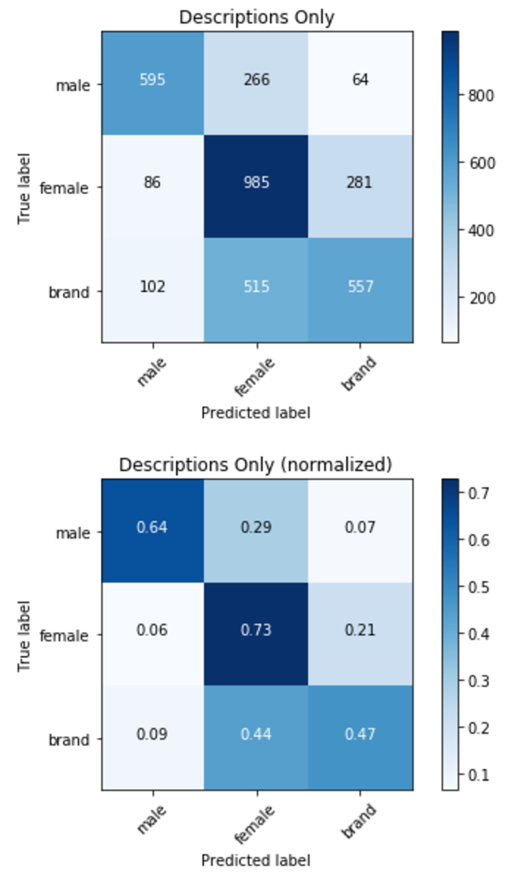
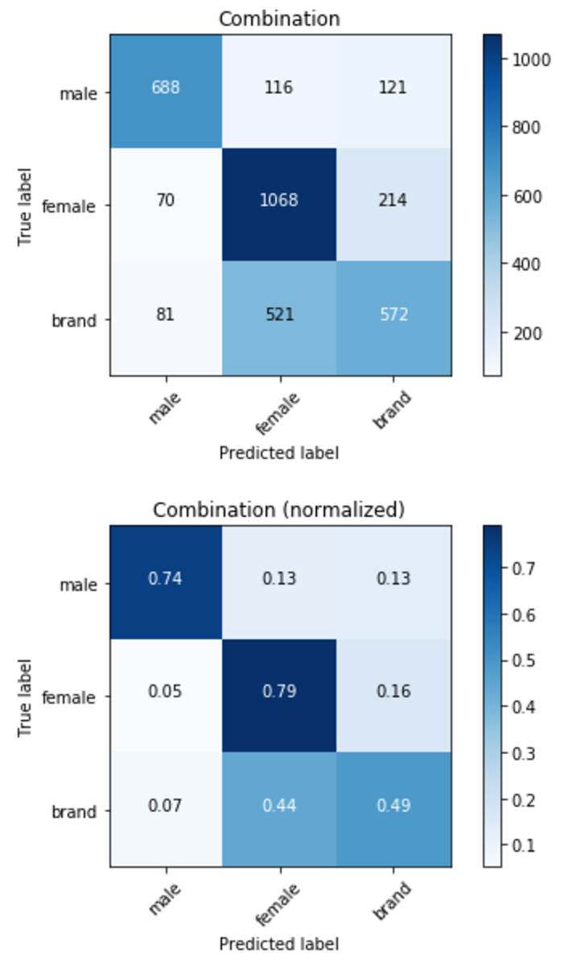
Confusion Matrices

Slide 7
Conclusions
Most accurate predictor was the combination of tweet and profile description.
I might have beat the model
All 3 models seem to overfit on female classifications
All 3 seem to have trouble with brands
Notes:
Can’t say for sure since this was an exploratory data set, not a competition dataset on Kaggle

Slide 8
Next Steps
Play around with test/train splits
See if other fields can make the model more accurate
Notes:
Maybe do a less random train/test split?
Maybe tweet count or sidebar color?

Slide 9
Sources
Dataset from Kaggle:
https://www.kaggle.com/crowdflower/twitter-user-gender-classification
Original Model:
https://www.crowdflower.com/using-machine-learning-to-predict-gender/

