Slide 1


Course Lecturer:
Haruna Musa
(hgarko@gmail.com)
PRELIMINARIES
Department of Software Engineering, FUD - 2020/2021

Slide 2
Course Objectives
The goals are to introduce the fundamental constructs of contemporary programming languages and to provide student with the tools necessary for the critical evaluation of existing and future programming languages.

Slide 3
Course Grading
Coursework: 30%
-Course Work 1: 15%
      Starting Date: Due Date:
      -Course Work 2: 15%
      Starting Date: Due Date:
Exam: 70%
-Mode: Essay style
Date: will be communicated later

Slide 4
Introduction
Before we begin discussing the concepts of programming languages, we must consider a few preliminaries.
First, we explain some reasons why computer science students and professional software developers should study general concepts of language design and evaluation. This discussion is especially valuable for those who believe that a working knowledge of one or two programming languages is sufficient for computer scientists.
Then, we briefly describe the major programming domains. Next, because the course will evaluates language constructs and features, we present a list of criteria that can serve as a basis for such judgments.

Slide 5
REASONS FOR STUDYING CONCEPTS OF PROGRAMMING LANGUAGES
Increased capacity to express ideas
Improved background for choosing appropriate languages
Increased ability to learn new languages
Better understanding of the significance of implementation
Better use of languages that are already known.
Overall advancement of computing.

Slide 6
PROGRAMMING DOMAINS
Computers have been applied to a myriad of different areas, from controlling nuclear power plants to providing video games in mobile Phones.
Because of this great diversity in computer use, programming languages with very different goals have been developed.
In this section, we briefly pointed out a few of the areas of computer applications and their associated languages

Slide 7
Scientific Applications
The first digital computers, which appeared in the late 1940s and early 1950s, were invented and used for scientific applications. Typically, the scientific applications of that time used relatively simple data structures, but required large numbers of floating-point arithmetic computations.
The most common data structures were arrays and matrices; the most common control structures were counting loops and selections.
The first language for scientific applications was Fortran. ALGOL 60 and most of its descendants were also intended to be used in this area, although they were designed to be used in related areas as well.

Slide 8
Business Applications
The use of computers for business applications began in the 1950s.
Special computers were developed for this purpose, along with special languages.
The first successful high-level language for business was COBOL (ISO/IEC, 2002) the initial version of which appeared in 1960.
It probably still is the most commonly used language for these applications.

Slide 9
Business languages are characterized by facilities for producing elaborate reports, precise ways of describing and storing decimal numbers and character data, and the ability to specify decimal arithmetic operations.

Slide 10
Artificial Intelligence
Artificial intelligence (AI) is a broad area of computer applications characterized by the use of symbolic rather than numeric computations.
Symbolic computation means that symbols, consisting of names rather than numbers, are manipulated.
Also, symbolic computation is more conveniently done with linked lists of data rather than arrays.
The first widely used programming language developed for AI applications was the functional language Lisp (McCarthy et al., 1965), which appeared in 1959

Slide 11
Web Software
The World Wide Web is supported by an eclectic collection of languages, ranging from markup languages, such as HTML, which is not a programming language, to general-purpose programming languages, such as Java.
Because of the pervasive need for dynamic Web content, some computation capability is often included in the technology of content presentation.
This functionality can be provided by embedding programming code in a HTML document. Such code is often in the form of a scripting language, such as JavaScript or PHP (Tatroe, 2013).

Slide 12
LANGUAGE EVOLUTION CRITERIA
As noted previously, the purpose of this course is to examine carefully the underlying concepts of the various constructs and capabilities of programming languages.
We will also evaluate these features, focusing on their impact on the software development process, including maintenance.
To do this, we need a set of evaluation criteria. Such a list of criteria is necessarily controversial, because it is difficult to get even two computer scientists to agree on the value of some given language characteristic relative to others.

Slide 13
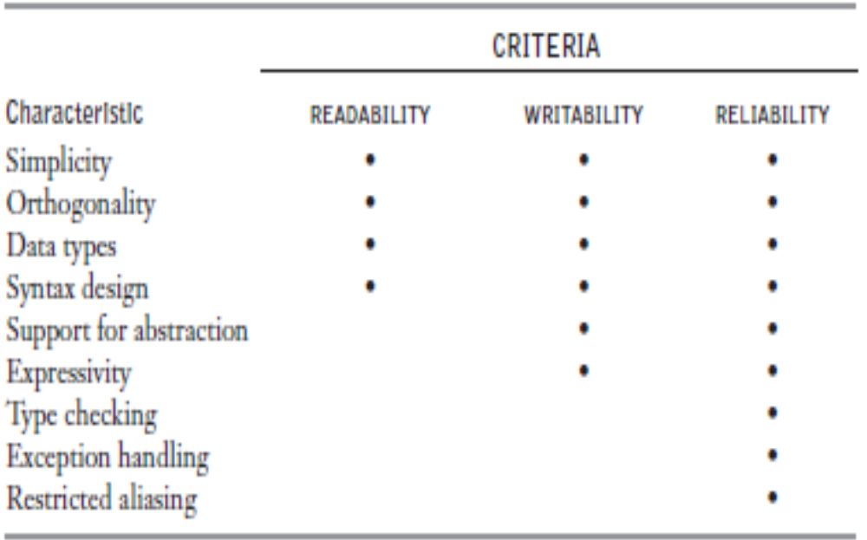
Some of the characteristics that influence three of the four most important of these criteria are shown in Table below

Slide 14
INFLUENCES ON LANGUAGE DESIGN
In addition to those factors described in the previous Section, several other factors influence the basic design of programming languages.
The most important of these are
  Computer architecture and
  Programming design methodologies.

Slide 15
Computer Architecture
The basic architecture of computers had a profound effect on language design.
Most of the popular languages of the past 60 years have been designed around the prevalent computer architecture, called the von Neumann architecture, after one of its originators, John von Neumann (pronounced
“von Noyman”).
These languages are called imperative languages. In a von Neumann computer, both data and programs are stored in the same memory.

Slide 16
The central processing unit (CPU), which executes instructions, is separate from the memory.
Therefore, instructions and data must be transmitted, or piped, from memory to the CPU.
Results of operations in the CPU must be moved back to memory.
Nearly all digital computers built since the 1940s have been based on the von Neumann architecture.

Slide 17
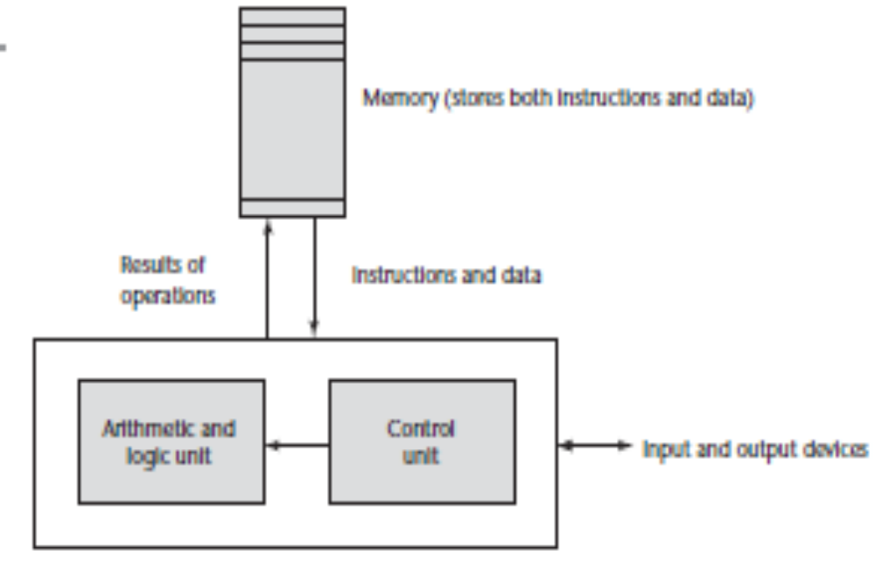

Slide 18
Programming Design Methodologies
The late 1960s and early 1970s brought an intense analysis, begun in large part by the structured- programming movement, of both the software development process and programming language design.
An important reason for this research was the shift in the major cost of computing from hardware to software, as hardware costs decreased and programmer costs increased.

Slide 19
LANGUAGE CATEGORIES
Programming languages are often categorized into four bins: imperative, functional, logic, and object oriented.
However, we do not consider languages that support object- oriented programming to form a separate category of languages.
Although the object- oriented software development paradigm differs significantly from
the procedure-oriented paradigm usually used with imperative languages, the extensions to an imperative language required to support object-oriented programming are not intensive.

Slide 20
For example, the expressions, assignment statements, and control statements of C and Java are nearly identical (On the other hand, the arrays, subprograms, and semantics of Java are very different from those of C.)
Similar statements can be made for functional languages that support object- Oriented programming.
Some authors refer to scripting languages as a separate category of programming languages.

Slide 21
However, languages in this category are bound together more by their implementation method, partial or full interpretation, than by a common language design.
The languages that are typically called scripting
languages, among them Perl, JavaScript (Flanagan, 2011), and Ruby, are imperative languages in every sense.
A logic programming language is an example of a rule-based language.

Slide 22
In an imperative language, an algorithm is specified in great detail, and the specific order of execution of the instructions or statements must be included.
In a rule-based language, however, rules are specified in no particular order, and the language implementation system must choose an order in which the rules are used to produce the desired result.
This approach to software development is radically different from those used with the other two categories of languages and clearly requires a completely different kind of language.

Slide 23
Prolog, the most commonly used logic programming language, and logic programming.
In recent years, a new category of languages has emerged, the markup/programming hybrid languages.
Markup languages are not programming languages.For instance, HTML, the most widely used markup language, is used to specify the layout of information in Web documents.
However, some programming capability has crept into some extensions to HTML and XML.

Slide 24
Among these are the Java Server Pages Standard Tag Library (JSTL) and eXtensible Stylesheet Language Transformations (XSLT).

Slide 25
Implementation Methods
Two of the primary components of a computer
are its internal memory and its processor.
The internal memory is used to store programs and data.
The processor is a collection of circuits that provides a realization of a set of primitive operations, or machine instructions, such as those for arithmetic and logic operations.
In most computers, some of these instructions, which are sometimes called macroinstructions, are actually implemented with a set of instructions called microinstructions, which are defined at an even lower level.

Slide 26
The machine language of the computer is its set of instructions.
In the absence of other supporting software, its own machine language is the only language that most hardware computers “understand.”
Theoretically, a computer could be designed and built with a particular high-level language as its machine language, but it would be very complex and expensive.
Furthermore, it would be highly inflexible, because it would be difficult (but not impossible) to use it with other high-level languages.

Slide 27
A language implementation system cannot be the only software on a computer.
Also required is a large collection of programs, called the operating system, which supplies higher-level primitives than those of the machine language.
These primitives provide system resource management, input and output operations, a file management system, text and/or program editors, and a variety of other commonly needed functions.

Slide 28
Programming Environments
A programming environment is the collection of tools used in the development of software.
This collection may consist of only a file system, a text editor, a linker, and a compiler. Or it may include a large collection of integrated tools, each accessed through a uniform user interface.
In the latter case, the development and maintenance of software is greatly enhanced.
Therefore, the characteristics of a programming language are not the only measure of the software development capability of a system.

Slide 29
Exercises
Read more

