Slide 1


Course Lecturer:
Haruna Musa
(hgarko@gmail.com)
Evolution of some Major Programming languages
Department of Software Engineering, FUD - 2020/2021

Slide 2
INTRODUCTION
This chapter describes the development of a collection of programming languages.
It explores the environment in which each was designed and focuses on the contributions of the language and the motivation for its development. Overall language descriptions are not included;
rather, we discuss only some of the new features introduced by each language of particular interest are the features that most influenced subsequent languages or the field of computer science.

Slide 3
ZUSE’S PLANKALKÜL
The first programming language discussed in this chapter is highly unusual in several respects. For one thing, it was never implemented.
Furthermore, although developed in 1945, its description was not published until 1972.
Because so few people were familiar with the language, some of its capabilities did not appear in other languages until 15 years after its development.

Slide 4
Historical Background
Between 1936 and 1945, German scientist Konrad Zuse (pronounced “Tsoozuh”) built a series of complex and sophisticated computers from electromechanical relays.
By early 1945, Allied bombing had destroyed all but one of his latest models, the Z4, so he moved to a remote Bavarian village, Hinterstein, and his research group members went their separate ways.
Working alone, Zuse embarked on an effort to develop a language for expressing computations for the Z4, a project he had begun in 1943 as a proposal for his Ph.D. dissertation.

Slide 5
He named this language Plankalkül, which means program calculus.
In a lengthy manuscript dated 1945 but not published until 1972 (Zuse, 1972), Zuse defined Plankalkül and wrote algorithms in the language to solve a wide variety of problems.

Slide 6
Language Overview
Plankalkül was remarkably complete, with some of its most advanced features in the area of data structures. The simplest data type in Plankalkül was the single bit.
Integer and floating-point numeric types were built from the bit type.
The floating-point type used twos-complement notation and the “hidden bit” scheme currently used to avoid storing the most significant bit of the normalized fraction part of a floating-point value.

Slide 7
In addition to the usual scalar types, Plankalkül included arrays and records called structs in the C-based languages.
The records could include nested records.
Although the language had no explicit goto, it did include an iterative statement similar to the Ada for.
It also had the command Fin with a superscript that specified an exit out of a given number of iteration loop nestings or to the beginning of a new iteration cycle.
Plankalkül included a selection statement, but it did not allow an else clause.

Slide 8
One of the most interesting features of Zuse’s programs was the inclusion of mathematical expressions showing the current relationships between program variables.
These expressions stated what would be true during execution at the points in the code where they appeared.
Zuse’s manuscript contained programs of far greater complexity than any written prior to 1945.

Slide 9
Included were programs to sort arrays of numbers; test the connectivity of a given graph; carry out integer and floating-point operations, including square root; and perform syntax analysis on logic formulas that had parentheses and operators in six different levels of precedence.

Slide 10
Perhaps most remarkable were his 49 pages of algorithms for playing chess, a game in which he was not an expert.
If a computer scientist had found Zuse’s description of Plankalkül in the early 1950s,
the single aspect of the language that would have hindered its implementation as defined would have been the notation.
Each statement consisted of either two or three lines of code.
The first line was most like the statements of current languages.

Slide 11
The second line, which was optional, contained the subscripts of the array references in the first line.
The same method of indicating subscripts was used by Charles Babbage in programs for his Analytical Engine in the middle of the nineteenth century.
The last line of each Plankalkül statement contained the type names for the variables mentioned in the first line.
This notation is quite intimidating when first seen.

Slide 12
The second line, which was optional, contained the subscripts of the array references in the first line.
The same method of indicating subscripts was used by Charles Babbage in programs for his Analytical Engine in the middle of the nineteenth century.
The last line of each Plankalkül statement contained the type names for the variables mentioned in the first line.
This notation is quite intimidating when first seen.

Slide 13
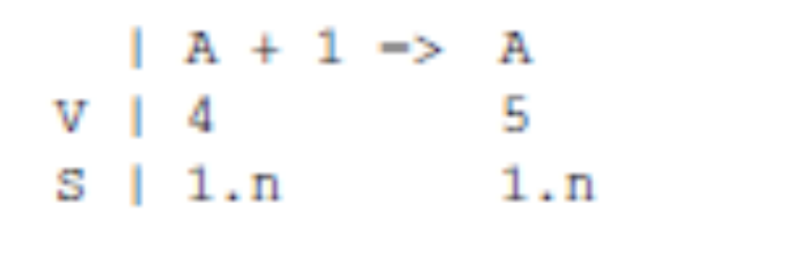
The following example assignment statement, which assigns the value of the expression A[4] +1 to A[5], illustrates this notation.
The row labeled V is for subscripts, and the row labeled S is for the data types. In this example, 1.n means an integer of n bits:

Slide 14
PSEUDOCODES
First, note that the word pseudocode is used here in a different sense than its contemporary meaning.
We call the languages discussed in this section pseudocodes because that’s what they were named at the time they were developed and used (the late 1940s and early 1950s).
However, they are clearly not pseudocodes in the contemporary sense
The computers that became available in the late 1940s and early 1950s were far less usable than those of today.

Slide 15
In addition to being slow, unreliable, expensive, and having extremely small memories, the machines of that time were difficult to program because of the lack of supporting software.
There were no high-level programming languages or even assembly languages, so programming was done in machine code, which is both tedious and error prone.
These are standard problems with all machine languages and were the primary motivations for inventing assemblers and assembly languages.

Slide 16
In addition, most programming problems of that time were numerical and required floating-point arithmetic operations and indexing of some sort to allow the convenient use of arrays.
Neither of these capabilities, however, was included in the architecture of the computers of the late 1940s and early 1950s.
These deficiencies naturally led to the development of somewhat higher-level languages.

Slide 17
Short Code
The first of these new languages, named Short Code, was developed by John Mauchly in 1949 for the BINAC computer, which was one of the first successful stored-program electronic computers.
Short Code was later transferred to a UNIVAC I computer (the first commercial electronic computer sold in the United States) and, for several years, was one of the primary means of programming those machines.

Slide 18
Although little is known of the original Short Code because its complete description was never published, a programming manual for the UNIVAC I version did survive (Remington-Rand, 1952).
It is safe to assume that the two versions were very similar.
The words of the UNIVAC I’s memory had 72 bits, grouped as 12 six-bit bytes.
Short Code consisted of coded versions of mathematical expressions that were to be evaluated.

Slide 19
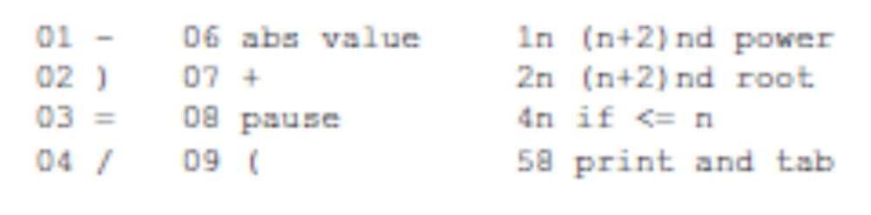
The codes were byte-pair values, and many equations could be coded in a word.
The following operation codes were included:

Slide 20
Speedcoding
machine languages to include floating-point operations. The Speedcoding system developed by John Backus for the IBM 701 is an example of such a system (Backus, 1954).
The Speedcoding interpreter effectively converted the 701 to a virtual three-address floating-point calculator.
The system included pseudoinstructions for the four arithmetic operations on floating-point data, as well as operations such as square root, sine, arc tangent, exponent, and logarithm.

Slide 21
Conditional and unconditional branches and input/output conversions were also part of the virtual architecture.
To get an idea of the limitations of such systems, consider that the remaining usable memory after loading the interpreter was only 700 words and that the add instruction took 4.2 milliseconds to execute.
On the other hand, Speedcoding included the novel facility of automatically incrementing address registers.
This facility did not appear in hardware until the UNIVAC 1107 computers of 1962.
Because of such features, matrix multiplication could be done in 12 Speedcoding instructions.

Slide 22
Backus claimed that problems that could take two weeks to program in machine code could be programmed in a few hours using Speedcoding.

Slide 23
The UNIVAC “Compiling” System
Between 1951 and 1953, a team led by Grace Hopper at UNIVAC developed a series of “compiling” systems named A-0, A-1, and A-2
He expanded a pseudocode into machine code subprograms in the same way as macros are expanded into assembly language.
The pseudocode source for these “compilers” was still quite primitive, although even this was a great improvement over machine code because it made source programs much shorter.

Slide 24
The IBM 704 and FORTRAN
Certainly one of the greatest single advances in computing came with the introduction of the IBM 704 in 1954, in large measure because its capabilities prompted the development of Fortran.

Slide 25
Historical Background
One of the primary reasons why the slowness of interpretive systems was tolerated from the late 1940s to the mid-1950s was the lack of floating-point hardware in the available computers.
All floating-point operations had to be simulated in software, a very time-consuming process.
The announcement of the IBM 704 system, with both indexing and floating-point instructions in hardware, heralded the end of the interpretive era, at least for scientific computation.

Slide 26
The inclusion of floating-point hardware removed the hiding place for the cost of interpretation.
Design Process
Even before the 704 system was announced in May 1954, plans were begun for Fortran.
By November 1954, John Backus and his group at IBM had produced the report titled “The IBM Mathematical FORmula TRANslating System: “FORTRAN” (IBM, 1954).

Slide 27
This document described the first version of Fortran, which we refer to as Fortran 0, prior to its implementation.
It also boldly stated that Fortran would provide the efficiency of hand-coded programs and the ease of programming of the interpretive pseudocode systems.
Fortran would provide the efficiency of hand-coded programs and the ease of programming of the interpretive pseudocode systems.

Slide 28
In another burst of optimism, the document stated that Fortran would eliminate coding errors and the debugging process.
Based on this premise, the first Fortran compiler included little syntax error checking

Slide 29
The environment in which Fortran was developed was as follows:
(1) Computers had small memories and were slow and relatively unreliable;
(2) the primary use of computers was for scientific computations;
(3) there were no existing efficient and effective ways to program computers; and
(4) because of the high cost of computers compared to the cost of programmers, speed of the generated object code was the primary goal of the first Fortran compilers.

Slide 30
Fortran I Overview
Fortran 0 was modified during the implementation period, which began in January 1955 and continued until the release of the compiler in April 1957.
The implemented language, which we call Fortran I, is described in the first Fortran Programmer’s Reference Manual, published in October 1956 (IBM, 1956).

Slide 31
Fortran I included;
input/output formatting,
variable names of up to six characters (it had been just two in Fortran 0),
user-defined subroutines, although they could not be separately compiled, the If selection statement, and the Do loop statement.

Slide 32
All of Fortran I’s control statements were based on 704 instructions.
There were no data-typing statements in the Fortran I language.
Variables whose names began with I, J, K, L, M, and N were implicitly integer type, and all others were implicitly floating-point.
The choice of the letters for this convention was based on the fact that at that time scientists and engineers used letters as variable subscripts, usually i, j, and k.

Slide 33
The most audacious claim made by the Fortran development group during the design of the language was that the machine code produced by the compiler would be about half as efficient as what could be produced by hand.
This, more than anything else, made skeptics of potential users and prevented a great deal of interest in Fortran before its actual release.

Slide 34
the Fortran development group nearly achieved its goal in efficiency.
The largest part of the 18 worker-years of effort used to construct the first compiler had been spent on optimization, and the results were remarkably effective.
The early success of Fortran is shown by the results of a survey made in April 1958.
At that time, roughly half of the code being written for 704s was being written in Fortran, in spite of the skepticism of most of the programming world only a year earlier.

Slide 35
Fortran II
The Fortran II compiler was distributed in the spring of 1958.
It fixed many of the bugs in the Fortran I compilation system and added some significant features to the language
Fortran I’s lack of independent-compilation capability, coupled with the poor reliability of the
704, placed a practical restriction on the length of programs to about 300 to 400 lines
Longer programs had a poor chance of being compiled completely before a machine failure occurred.

Slide 36
Fortrans IV, 77, 90, 95, 2003, and 2008
A Fortran III was developed, but it was never widely distributed.
Fortran IV, however, became one of the most widely used programming languages of its time.
It evolved over the period 1960 to 1962 and was standardized as Fortran 66, although that name was rarely used.
Fortran IV was an improvement over Fortran II in many ways.

Slide 37
Among its most important additions were explicit type declarations for variables, a logical If construct, and the capability of passing subprograms as parameters to other subprograms.
Fortran IV was replaced by Fortran 77, which became the new standard in 1978 (ANSI, 1978a).
Fortran 77 retained most of the features of Fortran IV and added character string handling, logical loop control statements, and an If with an optional Else clause.

Slide 38
Fortran continue to evolve through the versions 90, 95, 2003.
The latest version of Fortran, Fortran 2008, added support for blocks to define local scopes, co-arrays, which provide a parallel execution model, and the DO CONCURRENT construct, to specify loops without interdependencies.

Slide 39
Exercises
Group Coursework
Give a presentation on fortran language

