Slide 1
A 3DIC system to aid in the acceleration of systems that employ multiple instances of artificial neural networks
Status Apr 2017
Lee B. Baker
Advisor: Paul Franzon
Notes:
I suspect most of us have seen reports on self-driving cars.
But how can a car determine whats in its surroundings?
One piece of technology that is and will be used is Artificial neural networks
These artificial neural networks allow the vehicle to recognize street signs, other vehicles, pedestrians, edges of the road, all the things you might need to safely navigate a 2-ton car.
The ability for artificial neural networks to perform that function in a timely fashion within reasonable power and space constraints is what I am going to talk about today.

Slide 2
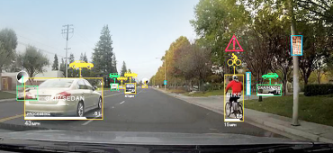

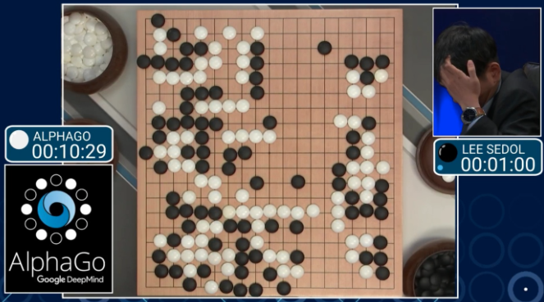
Introduction
Recently Artificial Neural networks (NN) have demonstrated superior performance in classification and function approximation
Deep Neural Networks (DNN) have been very successful in image processing applications ^{[Kri12]}
it is anticipated that DNNs will be employed more and more in self-driving cars
http://www.hackerboards.com
http://www.BGR.com
Reinforcement learning is gaining popularity
alphaGo employed reinforcement learning with deep neural networks ^{[Mad14]}
http://www.engadget.com
Notes:
Now I mentioned self driving cars,
but recently ANN’s have also demonstrated efficacy when employed as a part of face recognition, text recognition and game playing systems
These ANN’s have demonstrated significant improvements over current state of the art.
Some example uses of ANN’s are the google car and you may also have recently seen the Go game system AlphaGo, which recently “beat” a Go master.
So ANN’s are being deployed as we speak and we should therefore consider them to be in the ascent phase of the technology life cycle.

Slide 3
Introduction
Many applications will and do require multiple NN engines running at or near real-time
car or drone scanning in many directions during navigation
cloud server processing multiple images when searching
reinforcement learning requires multiple state-action value calculations during optimal policy searches
text recognition system processing multiple pages of text
Notes:
Many applications require information to be provided at or near real time or simply have large volumes of data to process.
This means these systems will require multiple ANN’s to be running concurrently
A vehicle will need real time feedback on its surroundings.
A cloud server performing text or image searches must provide feedback in seconds.
Text recognition may not have a real-time requirement but just the volume of work requires we process in parallel
to complete the work in a reasonable time

Slide 4
Problem
Many applications will/do have power, space and weight limitations
drone
server rack has building cooling limitations
Useful Neural Networks are big
lots of memory and computations ➔ bandwidth
local SRAM consumes too much silicon
locally and fully connected networks are bandwidth limited
To achieve near or at real-time processing, current solutions require high power and high real-estate
GPU solutions have large real-estate and power requirements (~100-200W)
ASIC’s target smaller network sizes and/or specific NN’s
ASIC’s often employ SRAM which consumes a high percentage of silicon
Both have memory bandwidth limitations
Notes:
The problem is having a system implement multiple of these ANN’s in real time.
Effective ANN’s are big, they contains lots of neurons.
Current implementations typically employ graphics processors or application specific integrated circuits.
GPU solutions have large real-estate and power requirements when supporting useful NN’s (GPU ~100W)
ASIC’s on the other hand can be designed to efficiently perform the ANN processing but they typically target smaller network sizes and/or specific NN’s
So there isn't currently a solution out there that can support processing multiple ANN’s in real time within reasonable power and size constraints.

Slide 5
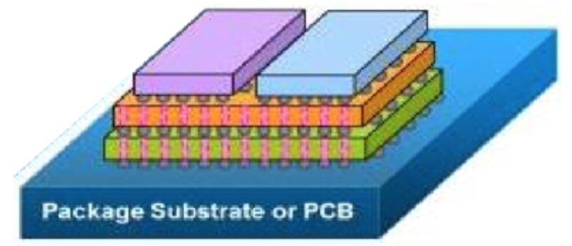
Solution
3DIC Architecture
reduces energy and area
increase connectivity and bandwidth
3D-DRAM
provide high bandwidth and large storage
minimize dependency on SRAM to allow available silicon to be focused on processing
eliminate NN size restrictions imposed by local SRAM
Data Structures
data structures to ensure neural network data can be accessed efficiently from primary storage (DRAM)
maintain constant access to DRAM to avoid dependency on local SRAM
Specialized processing layers
provide special functions to aid in acceleration of target neural networks
avoid local memory imposing NN size limitations
focus available silicon on processing requirements
http://www.semiwiki.com
Notes:
This work proposes taking advantage of 3D IC technology.
This 3D architecture will include a custom organized 3D DRAM to store the neural network and Data structures designed to access that DRAM effectively.
The proposal also includes custom processing layers to perform the NN computations.
Using DRAM addresses the large network size requirement
and the 3D architecture ensures we can address bandwidth, space and power issues.
The custom processing layers will be targeted toward a family of ANN’s

Slide 6
Contribution
Research uniquely organized 3DIC DRAM
research bank and page organization for a family of neural networks
maintain efficient read and writing
Research and propose Data Structures to exploit DRAM capacity
in conjunction with DRAM organization
data structures organized to allow efficient streaming of data directly to processing layers
employ data duplication
Propose 3D architecture to take advantage of DRAM bandwidth
memory management to manage configuration and algorithm operations and coalesced accesses
processing layer contains special functions for a family of NN’s
Notes:
The primary contributions of this work is
- a custom organized 3DIC DRAM allowing us to provide the necessary memory bandwidth to process multiple ANN’s in real time
- data structures for storing parameters and neuron activation values
- a 3D architecture which will ensure the bandwidth provided by the custom memory can be processed at line rate by a processing layer customized to the functions required to process the target ANN’s
Combining these contributions will allow us to demonstrate a significant performance improvement overcurrent solutions

Slide 7
Outline
What are artificial Neural networks
Target Neural networks
State-of-the-art
Proposed Architecture
Problem
Solution
Preliminary Work
3DIC DRAM and data structures
3D Stack Bus
Processing Layer
Research Plan
Summary

Slide 8
Target ANN Type’s
This work will focus on the following ANNs :
Deep Neural Network Classifiers
ANN in Reinforcement Learning
Cogent Confabulation
Brain-state-in-a-Box
Our research will involve analyzing memory access and processing requirements
Notes:
DNN classifiers because of their performance in image recognition
ANN in reinforcement learning because of their use as value function approximator
and finally Cogent Confabulation and BsB because of their joint efficacy in a text recognition system

Slide 9
Outline
What are artificial Neural networks
Target Neural networks
State-of-the-art
Proposed Architecture
Problem
Solution
Preliminary Work
3DIC DRAM and data structures
3D Stack Bus
Processing Layer
Research Plan
Summary

Slide 10
Problem
System solution requiring multiple NN’s
Consider a system that requires ~8 DNNs^{[Boj16]}
~16Gb of memory
~100W per GPU suggests >800W total power
Real-Time
Image needs to be processed ~16mS (60 frames/sec)
Allowing ~10mS for classification requires ~1700GFLOPS¹
Required Memory bandwidth ~54Tbps
Current 3D-DRAM memory technology bandwidth
HMC – SERDES~2Tbps
HBM – wide DDR ~2Tbps
Tezzaron DiRAM4 – wide DDR – 4Tbps

Slide 11
Solution
Utilize DRAM as the primary processing memory
allows support of locally and fully connected NNs
improves NN size support with near deterministic performance
not optimal for NNs that take advantage of locality
Processing Layer can be customized
PE layer designed to support application specific accuracy, algorithm etc.

Slide 12
Solution
Architecture includes:
Custom organized 3D-DRAM specification
allows constant streaming of data to PE avoiding local storage
Data Structures specific to each ANN
Management Layer for configuration and control
Processing layer(s) targeted toward a family of ANNs
array of processing engines (PE) with special streaming functions
PE includes small SIMD unit to process non hot-spot functions and provide some generality
3D solution contained within the footprint of available DRAM
allows use of TSV’s for memory interface
PE provides 32 execution lanes within the footprint
minimal use of local SRAM allows PE and manager logic to fit within footprint
Notes:
Mention multiported
Memory layers, control layer and processing layer could use different technology
SSF’s will operate directly on data read from stack bus
To increase bus widths, increase bandwidth while minimizing interface power
provide access to entire page rather than cache-line
there will be power considerations by not taking advantage of some reuse of data in local memory but I believe the performance benefits will outweigh the disadvantages
Special streaming functions will also have the ability to operate on data in processing layers expected small amount of local memory
avoid DRAM page open latency by using a highly banked DRAM and arranging data in memory to allow back-to-back page opens
Careful consideration of layer state and kernel parameters required to maximize DRAM bandwidth

Slide 13
Solution Block Diagram
Total downstream B/W
131Tbps
Array of processing engines
(PE)
Custom organized DRAM
Management Layer

Slide 14
Potential Customers
Google current have their own solution in the datacenter space
Tensor processing unit is a custom ASIC
large local SRAM and a large array (64K) of 8-bit MACs
lower DRAM bandwidth
High percentage of their NNs are MLP and LSTM and smaller percentage (5%) are CNNs
CNNs take advantage of locality and are suited to using large local SRAM
it may be the case that as MLP and LSTM have many fully/locally connected layers, they are impacted by a low main memory bandwidth
3D DRAM System could provide performance improvement in accelerating MLPs and LSTM
provide the bandwidth to support the bulk of the NNs processed in their datacenters
a custom 3D solution could provide a PE layer to support the target resolution
perhaps work with google to integrate 8/16-bit PE similar to their TPU

Slide 15
3D Configuration
Custom organized DRAM
Management
Layer
Array of processing engines
(PE)

Slide 16
System Column
Each column includes:
port into 3D-DRAM
Manager for configuration, DRAM reading, writing and data duplication
PE
Idea is to read and write mainly from DRAM
no assumptions on data reuse (kernels or input)
input or weight reuse would be more optimal but we are providing a more flexible high bandwidth solution
Solution includes instructions to describe operations required for a group of neurons
operations performed by PE
PE operates on two streams from manager e.g. weight/input
where input and weights reside in DRAM
where to write results including duplication to other columns
Notes:
1.7 102 OPS
assume 1GHz
1700 OP/cycle => 2048 execution units
each of the 64 ports needs to support 32 execution lanes
Note:
Initial discussion with 3D-DRAM supplier suggests idea is achievable

Slide 17
System Column
A processing column includes:
DRAM port
Manager
process set of instructions which implement a NN
manage configuration of PE and communication of results
PE
take data from Manager/DRAM via stack bus
operate on data at line rate to generate neuron activations
silicon focused on processing required not storage

Slide 18
Instruction Format
Instruction must describe operations for processing a group of neurons
convolution of weights and input
Relu or Sigmoid to generate activation
where and how to read weights
where and how to read prior activations
where and how to save neuron activations
Instruction formed from four descriptors
PE operation
Weight read operation
Input read operation
Write-Back operation
Instruction decoder generates control messages from descriptors:
Operation descriptors sent via OOB configuration packets to PE to configure SIMD and stOp
Write descriptor sent to a Return Data processor describing where result from PE should be sent
Read descriptors sent to memory modules to stream data to PE

Slide 19
Instruction
Includes four descriptors
operation
memory read (2)
result write

Slide 20
Instruction Format
Instructions formed from a set of descriptors
Descriptors for:
Operations
memory Read
memory Write
access method
Operation descriptor
defines SIMD and stOp operations
SIMD and StOp operation stored in PE instruction memory
descriptors point to instructions in PE IM
Memory read and write Descriptor
sets start address
describes how address is accessed
bank/page/word increment order
how data is transferred to stack bus and on to PE
memory descriptor points to an access descriptor that is stored in manager memory
expect commonality amongst access methods so many descriptors may point to same access descriptor
Access descriptor
not used in the actual instruction
expect some commonality between memory read and writes so avoid replicating access descriptor

Slide 21
3D Stack Bus

Slide 22
Stack Bus
Each processing column has a downstream and upstream stack bus
Downstream 2048¹ bit running at 1GHz providing131Tbps raw system bandwidth
Upstream bus 512² bits running at 1GHz
result bandwidth ~1/100th of operand bandwidth

Slide 23
Stack Bus
Downstrean and upstream buses
Buses carry control packets and data packets
packets will be multiple clock cycles
Control packets used to configure PE
special function and SIMD operations
result information
Data Packets will carry arguments for special functions
data to will be multiple cycles of two 32-bit words
Notes:
result information such as unicast or multicast, destination page
Return bus can be driven by all layers
research will determine if bus is arbitrated or whether each layer buffers and forwards

Slide 24
Processing Layer

Slide 25
Special Functions in PE
Special Functions are designed to operate on data from the Stack bus
operate at line rate from downstream bus
perform computations directly as data is read from memory
avoid need for large local SRAM in PE
result is passed to “small” local memory or registers for later processing by SIMD
result sent to upstream bus
Notes:
StreamingOps can also designed to operate on data from registers (or small local memory)
many ANN’s share a common kernel (CNNs) or operate on same input ROI
in some cases, storing the kernel or ROI in local memory may avoid unnecessary DRAM reads and IO energy
first convolution could be performed on kernel streamed from DRAM and further convolutions use local memory for one of the arguments
on PE the objective will be to maintain low ratio of local memory to processing
May consider small cache on Controller layer although this will still consume Stack bus TSV power

Slide 26
PE Status
FMA streaming operation functionality coded
SIMD has yet to be integrated
a wrapper around SIMD allows system to operate normally except SIMD doesn’t process neuron outputs
SV environment generates PE configuration packets and streams neuron weights and inputs to PE
Result verified by examining result packet on upstream stack bus

Slide 27
Management Layer

Slide 28
Manager
Ensure data can be streamed efficiently from DRAM
Operates on a custom instruction set
instructions describe all that is necessary to process a group of neurons
avoid need for large local SRAM in PE
System requires data duplication
NoC designed to multicast neuron activations to other managers
Notes:
StreamingOps can also designed to operate on data from registers (or small local memory)
many ANN’s share a common kernel (CNNs) or operate on same input ROI
in some cases, storing the kernel or ROI in local memory may avoid unnecessary DRAM reads and IO energy
first convolution could be performed on kernel streamed from DRAM and further convolutions use local memory for one of the arguments
on PE the objective will be to maintain low ratio of local memory to processing
May consider small cache on Controller layer although this will still consume Stack bus TSV power

Slide 29
Manager Status
Basic functionality except Memory read and Write are coded
Manager instructions generated from python script
instructions include a group of descriptors that specify:
PE operation
source of weights and inputs
where to write results
python script generates readmem files
SV
environment still generates neuron weights and inputs to PE
Manager code generates configuration packets from instructions
Manager code takes results from upstream stack bus and constructs NoC packets for writes to local memory and other manager memory

Slide 30
Verification Block diagram

Slide 31
Instruction Communication

Slide 32
NoC Signaling

