Slide 1

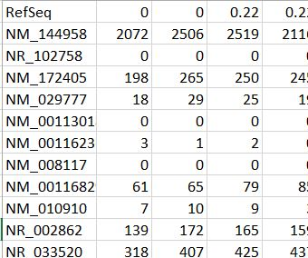
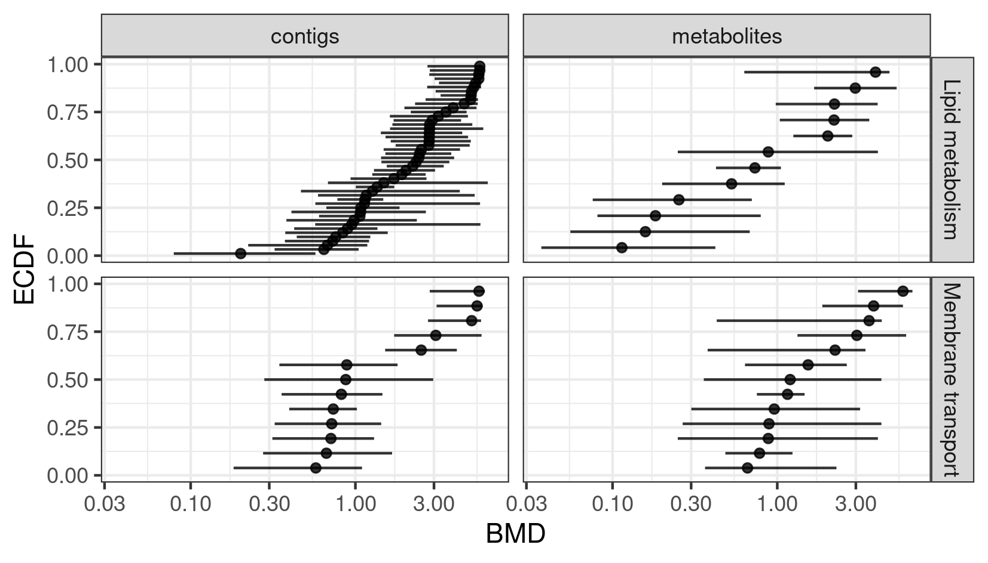
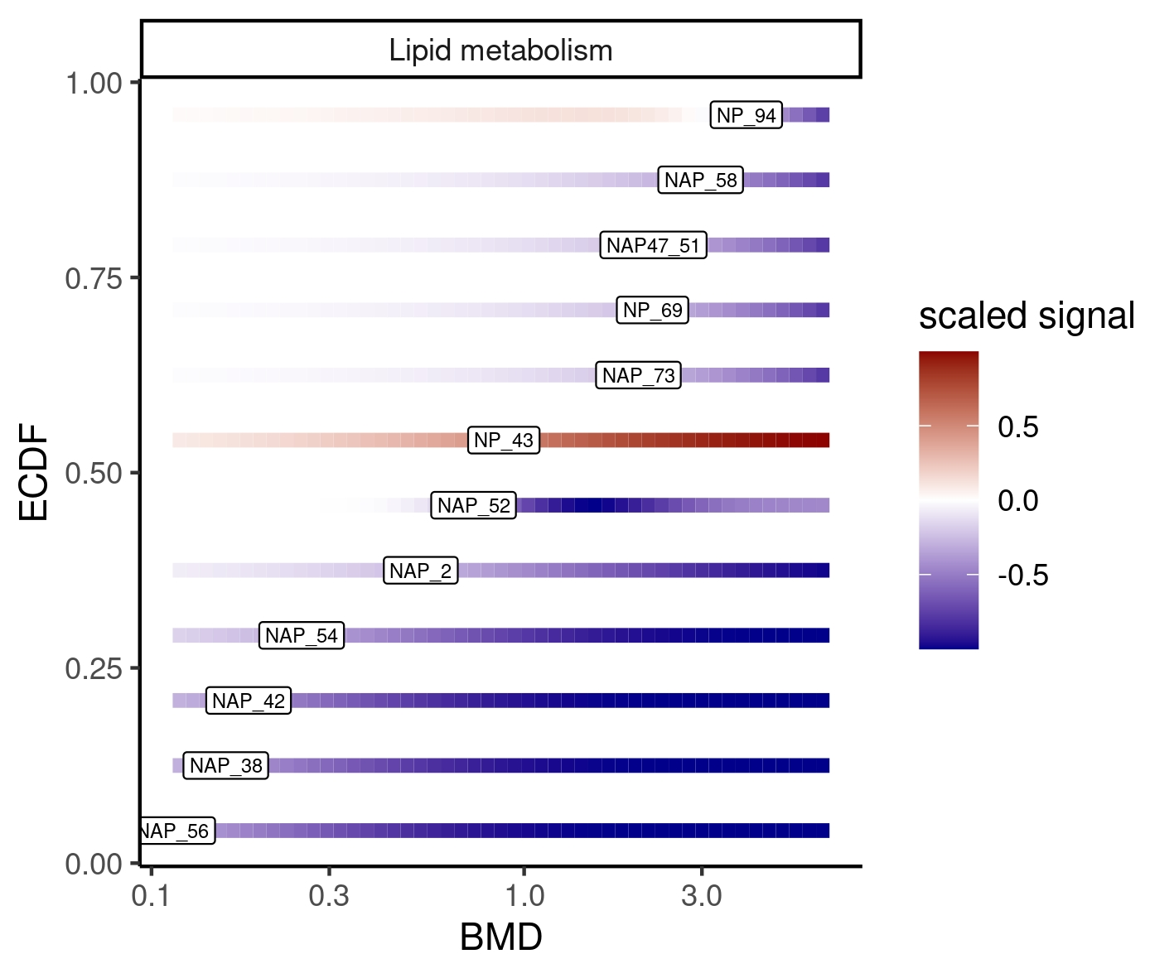
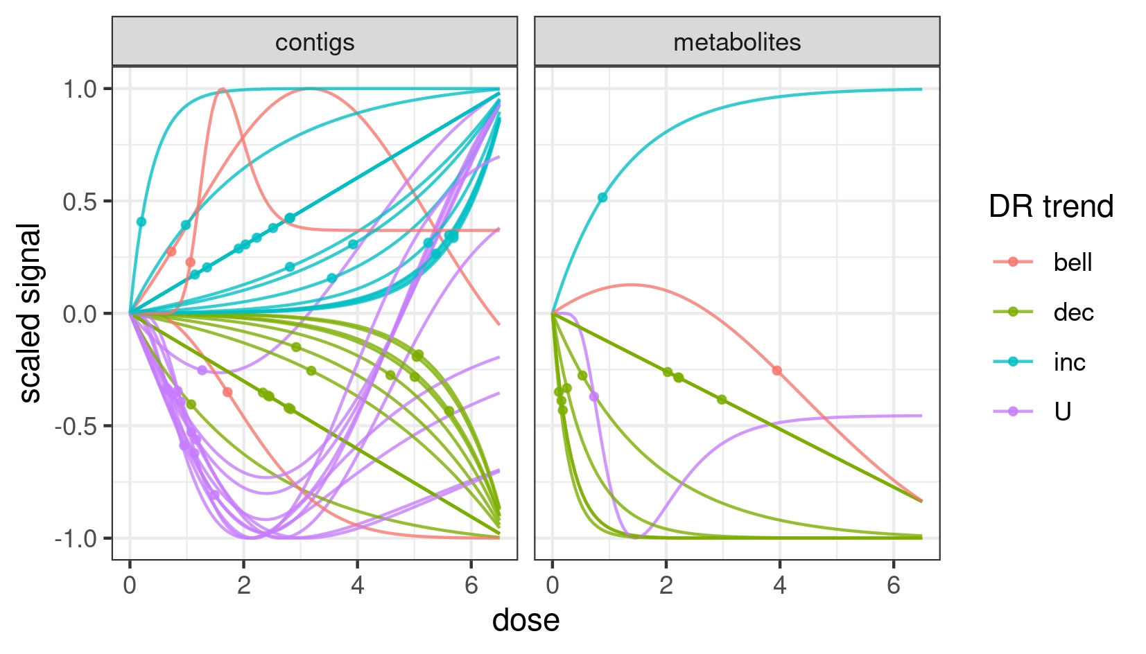
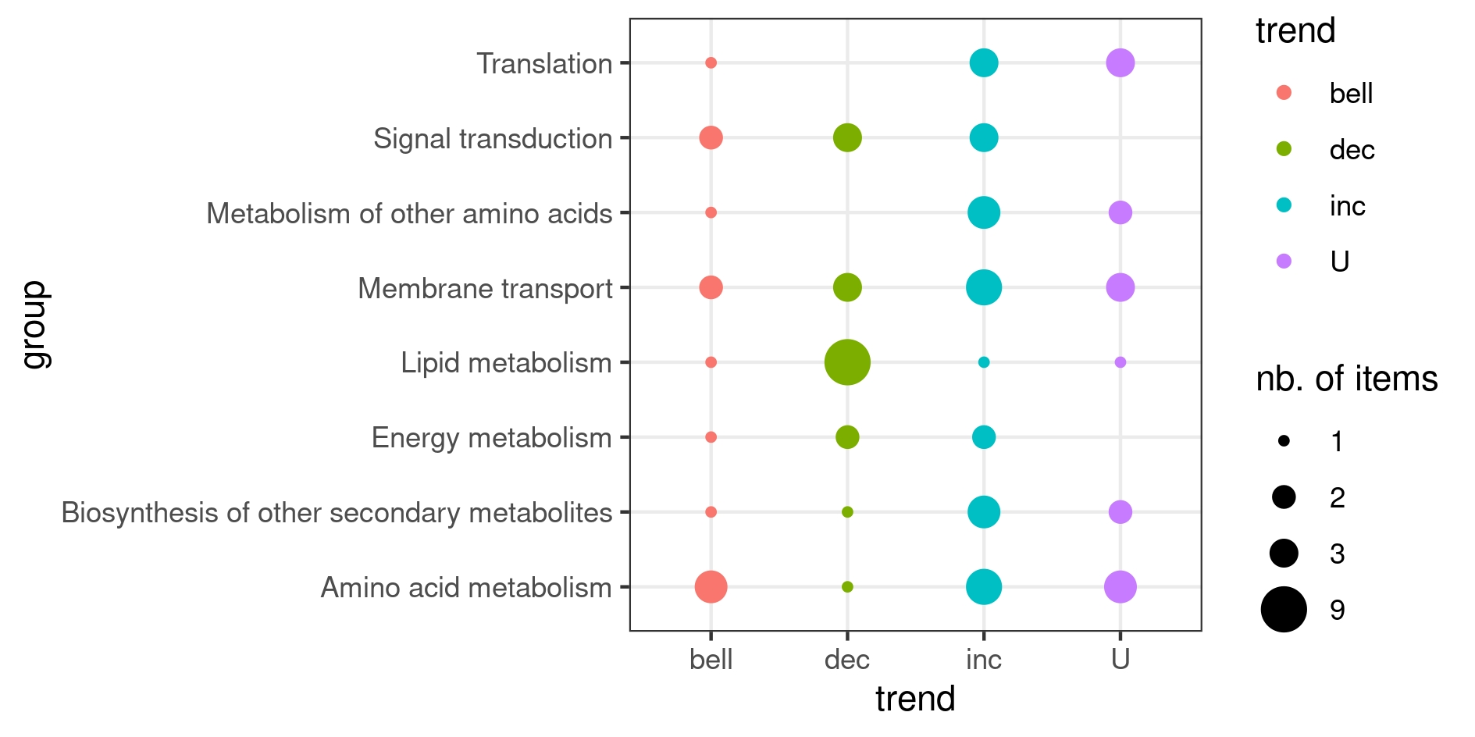
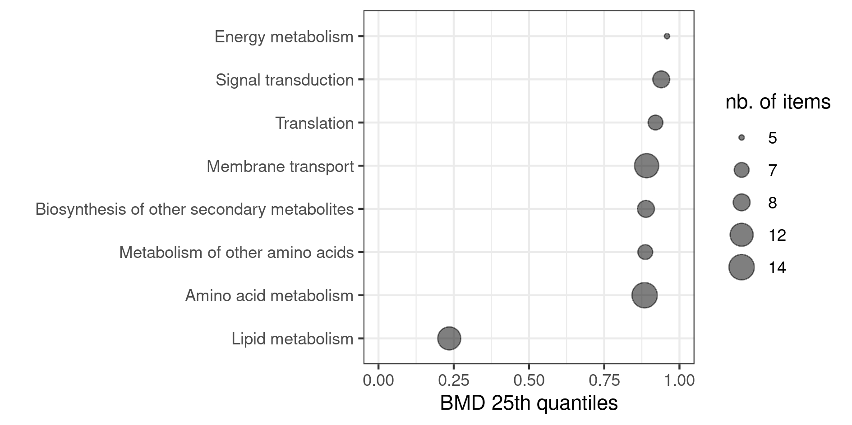
DRomics :: CHEAT SHEET
Other functions to help the interpretation of results within a multi-level approach using a unique biological annotation
Written by the authors of the DRomics package - Updated in june 2024
See https://lbbe.univ-lyon1.fr/fr/dromics
Licensed under CC-BY-SA Marie Laure Delignette-Muller
Functions taking as a first argument extendedres, a dataframe with the main workflow results, optionally gathering results obtained at different experimental (different molecular levels, different time points, different pre-exposure histories, …) extended with additional columns coding for the biological annotation of items and optionally for the experimental level. Some lines of the workflow results can be replicated for items having more than one annotation. The selectgroups() and bmdfilter() functions can be used to focus on groups or items before producing the plot. See help pages for a complete description of functions illustrated below.
Format of data
Identifiers of items (contigs, probes, metabolites, …)
Data can be imported from a .txt file containing one row per item after a first row giving the doses or concentrations for each sample, with the first column corresponding to the identifier of each item.
Alternatively an R object of class data.frame can be directly given as input, corresponding to the output of read.table(file, header = FALSE) on a file described as above. formatdata4DRomics() can be used to help formatting such an R object.
BMD plot
Tested doses or concentrations
bmdplot(extendedres, add.CI, facetby, facetby2, shapeby, colorby, add.label, BMD_log_transfo)
BMD plot with gradient
Signal (counts of reads,continuous signal in log2, …)
bmdplotwithgradient(extendedres, xmin, xmax, scaling, facetby, facetby2, shapeby, line.size, add.label, BMD_log_transfo)
Dose-response curves plot
Workflow for analysis of data
curvesplot(extendedres, xmin, xmax, scaling, facetby, facetby2, colorby, line.size, dose_log_transfo, addBMD)
See below the functions with their main arguments (see help pages for their complete description).
Step 1: import, check and pretreatment
microarraydata(file, norm.method = c("cyclicloess", "quantile", "scale", "none"))
RNAseqdata(file, transfo.method = c("rlog", "vst"))
continuousomicdata(file)
continuousanchoringdata(file)
PCAdataplot(omicdata, batch, label)
Step 2: selection of significantly responsive items
itemselect(omicdata, select.method = c("quadratic", "linear", "ANOVA"),
FDR = 0.05)
Step 3: dose-response modelling for responsive items
drcfit(itemselect, information.criterion = c("AICc", "BIC", "AIC"))
Step 4: computation of benchmark doses
bmdcalc(f, z = 1, x = 10)
Step 5: bootstrap to compute BMD confidence intervals
bmdboot(r, niter = 1000, conf.level = 0.95)
Sensitivity plot
Trend plot
sensitivityplot(extendedres, group, colorby, BMDsummary = c("first.quartile", "median", "median.and.IQR"), BMD_log_transfo)
trendplot(extendedres, group, facetby)
Typical script for the workflow
o <- RNAseq(datafilename)
PCAdataplot(o)
s <- itemselect(o)
f <- drcfit(s)
r <- bmdcalc(f)
b <- bmdboot(r)
b$res
Each function of this workflow returns a S3 class object that can be printed and plotted using print() and plot() functions.
Targetted items can be explored whatever they are or not in the selection using targetplot(items, f).
Notes:
<numéro>

