Slide 1

On the Integration of Heterogeneous Data Sources for the Collaborative Internet of Things
Federico Montori, Luca Bedogni, Luciano Bononi
Department of Computer Science and Engineering (DISI)
University of Bologna, Italy
{federico.montori2, luca.bedogni4, luciano.bononi}@unibo.it
Presented by: Federico Montori
IEEE 2nd Internal Forum on Research and Technologies for Society and Industry, Technologies for smarter societies (RTSI)
Bologna, 7,8,9 September 2016
Track: IoT and Big Data: Efficient Management of Sensor/Cloud Integration.

Slide 2
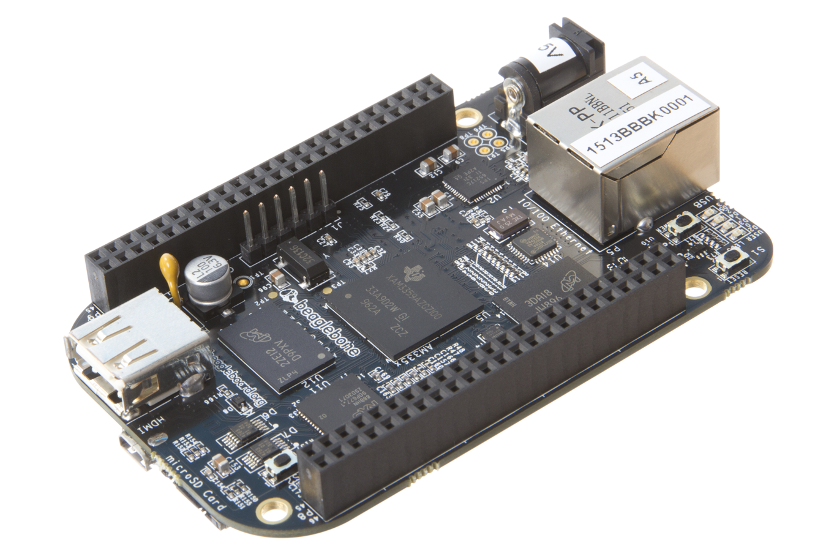
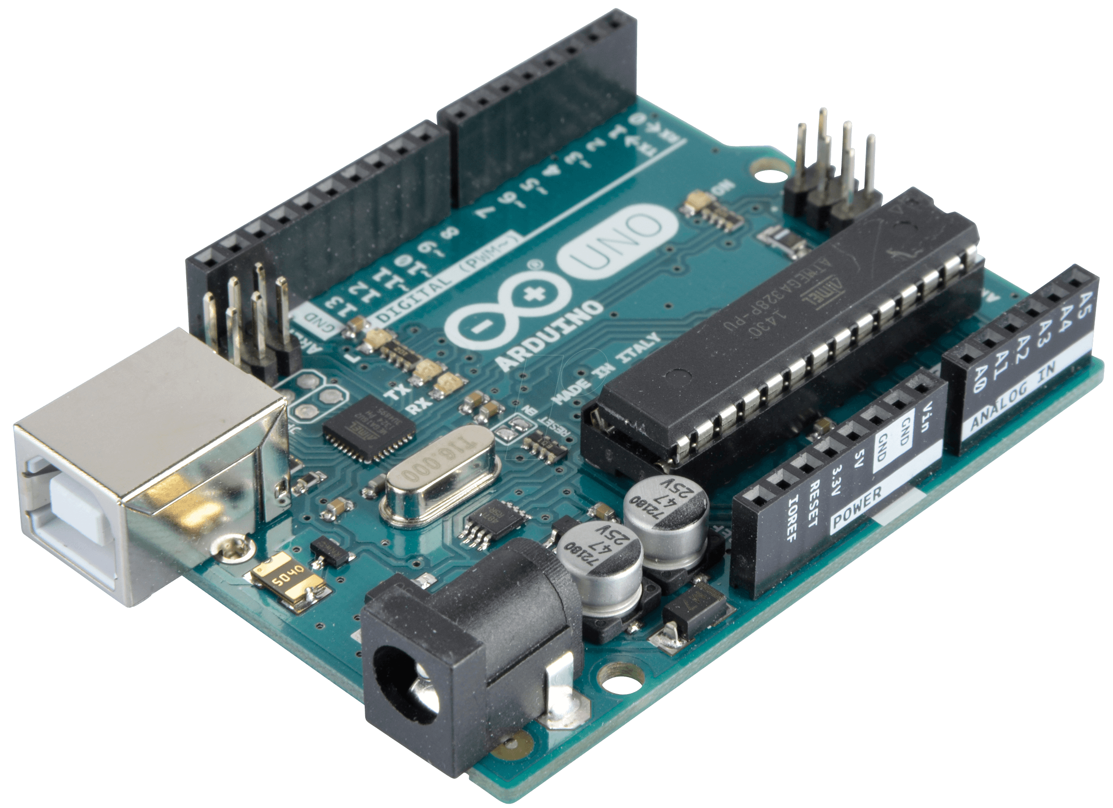
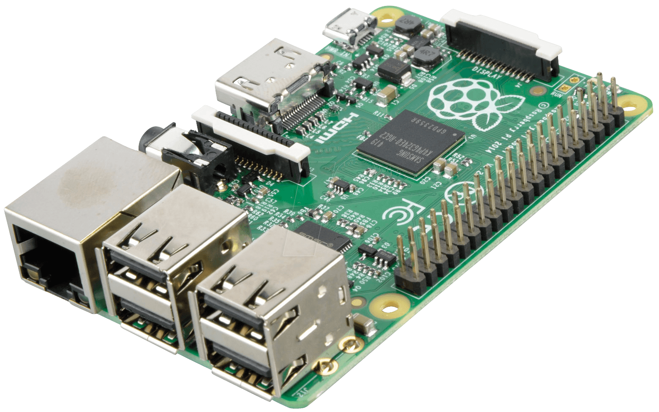

IoT and DIY crowdsense
IoT faced an enormous growth during the last years.
Makers can build their own sensing solutions at a lower and lower cost and can upload easily the produced data to an Open Data platform such as ThingSpeak.
BeagleBone Black ~85$
Arduino UNO ~28$
ESP 8266 ~10$
Raspberry PI ~50$

Slide 3

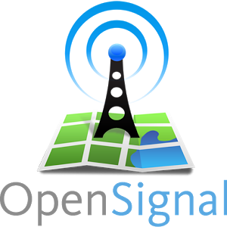


Open Data growth
Open data are a possible solution for privates and companies willing to share their useful sensed data.
Data is released either by privates (non-reliable) or environmental agencies and institutions (reliable) through data platforms in which sensed data is updated periodically.
As an example: ThingSpeak data streams
ESP 8266 first version
ESP 8266 programmable
through Arduino SDK

Slide 4
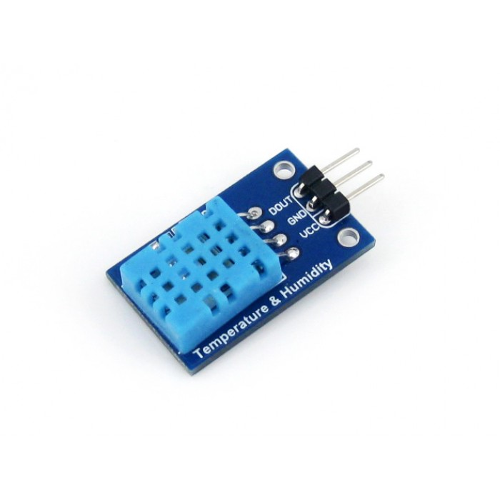
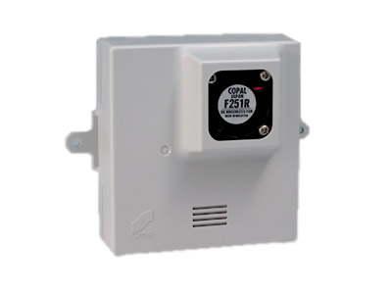
Collaborative IoT
What if users want to retrieve sensed data in order to build their own services? Sometimes they cannot afford home made and/or ad-hoc solutions:
High cost of some sensors
Inability in dealing with complex development
No infrastructure
DHT 11
Temperature and
Humidity Sensor
~ 4 $
Kanomax PS-2
Pollen Sensor
~ 1980 $
We propose the Collaborative IoT to cope with such restrictions.

Slide 5
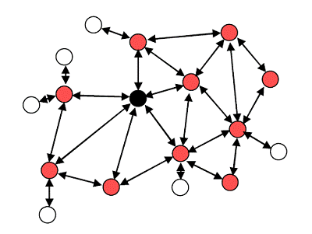
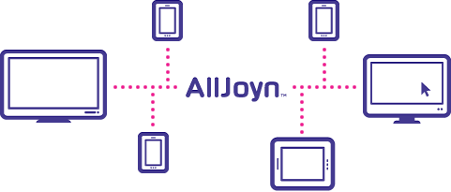
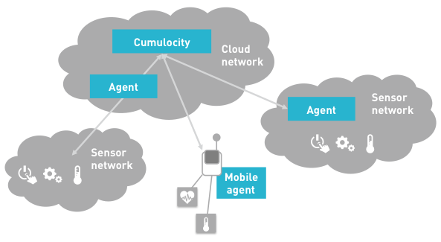
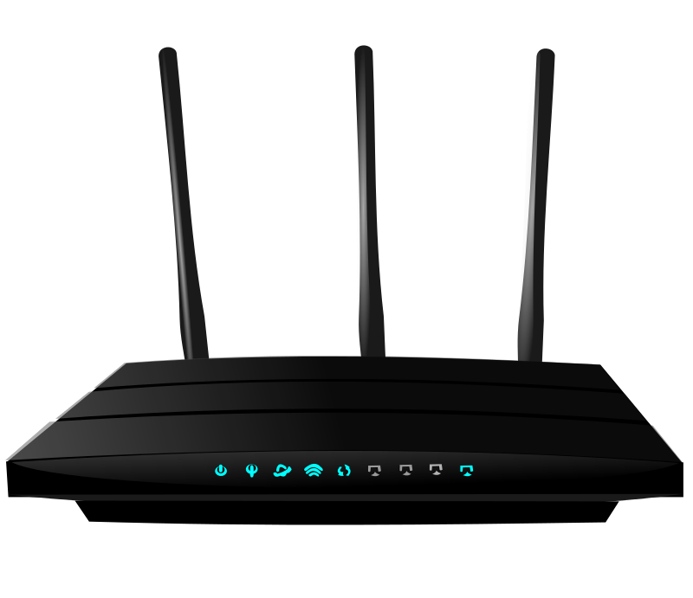
Isolated ecosystems
Existing ecosystems are hardly able to communicate between each other due to protocol heterogeneity and different data structure.
We propose an unification platform using a standard raw data structure.
Ad-Hoc ZigBee Network
AllJoyn Network
Fog Layer
DIY Home Automation WiFi Network
Cumulocity Network

Slide 6
Our Aim
In order to face the amount of connected devices forecasted, we need to provide an easy accessibility to raw data and services for the end users.
Within the scope of standardization of Collaborative IoT using open data we propose:
Cooperative paradigm.
Standardized raw data structure.
Example of data unification coming from open data platforms.
An adaptable architecture, including any role for end users.

Slide 7
Meet ThingSpeak and SparkFun
ThingSpeak:
Open source data platform
28806 public streams
~15% is geolocalized
More popular in Europe
SparkFun:
Microcontroller seller
3575 public streams
~62% is geolocalized
More popular in United States
Importance of merging sources:
Increase coverage
Increase sampling number
Increase fields of application

Slide 8
Data Unification
Stream ID:
in TS is a progressive number, in SF a string of 20 random ASCII characters.
Stream Name:
in both platforms is decided by the owner and might carry useful information about the stream.
Geolocalization:
in TS is given in GPS coordinates, in SF in GPS coordinates of the center of the city.
Tags:
user-defined tags facilitating the categorization of data.
Creation Timestamp:
when the stream was created; in some cases the first updates have been erased.
Field Name:
User-defined name for the measurement.
Value:
Value of the measurement
Timestamp
Class?
1..N
We created a unified database with the common information from the two platforms.
Precision?
Area of Validity?

Slide 9
User roles
In order to adapt with the preexisting architectures we identified the following use cases for a final user point of view.
User publishing sensor raw data onto public Open Data Clouds
User publishing sensor raw data directly onto our data cloud.
User consuming raw data from our data cloud and building its own application, possibly using data generated by its own sensors as well.
User aggregating raw data, either obtained from our data cloud and its own sensors in order to build a service for other users and publishing it onto a service orchestrator in our architecture.
User consuming directly a service already aggregated.

Slide 10
Architectural Model
User publishing on Open Data Platforms / User publishing in our Data Platfom / User aggregating data as a service
User consuming from his private sensor / User consuming from raw data orchestrator / User consuming a service

Slide 11
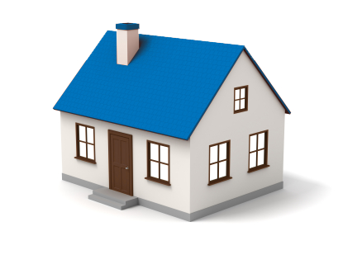
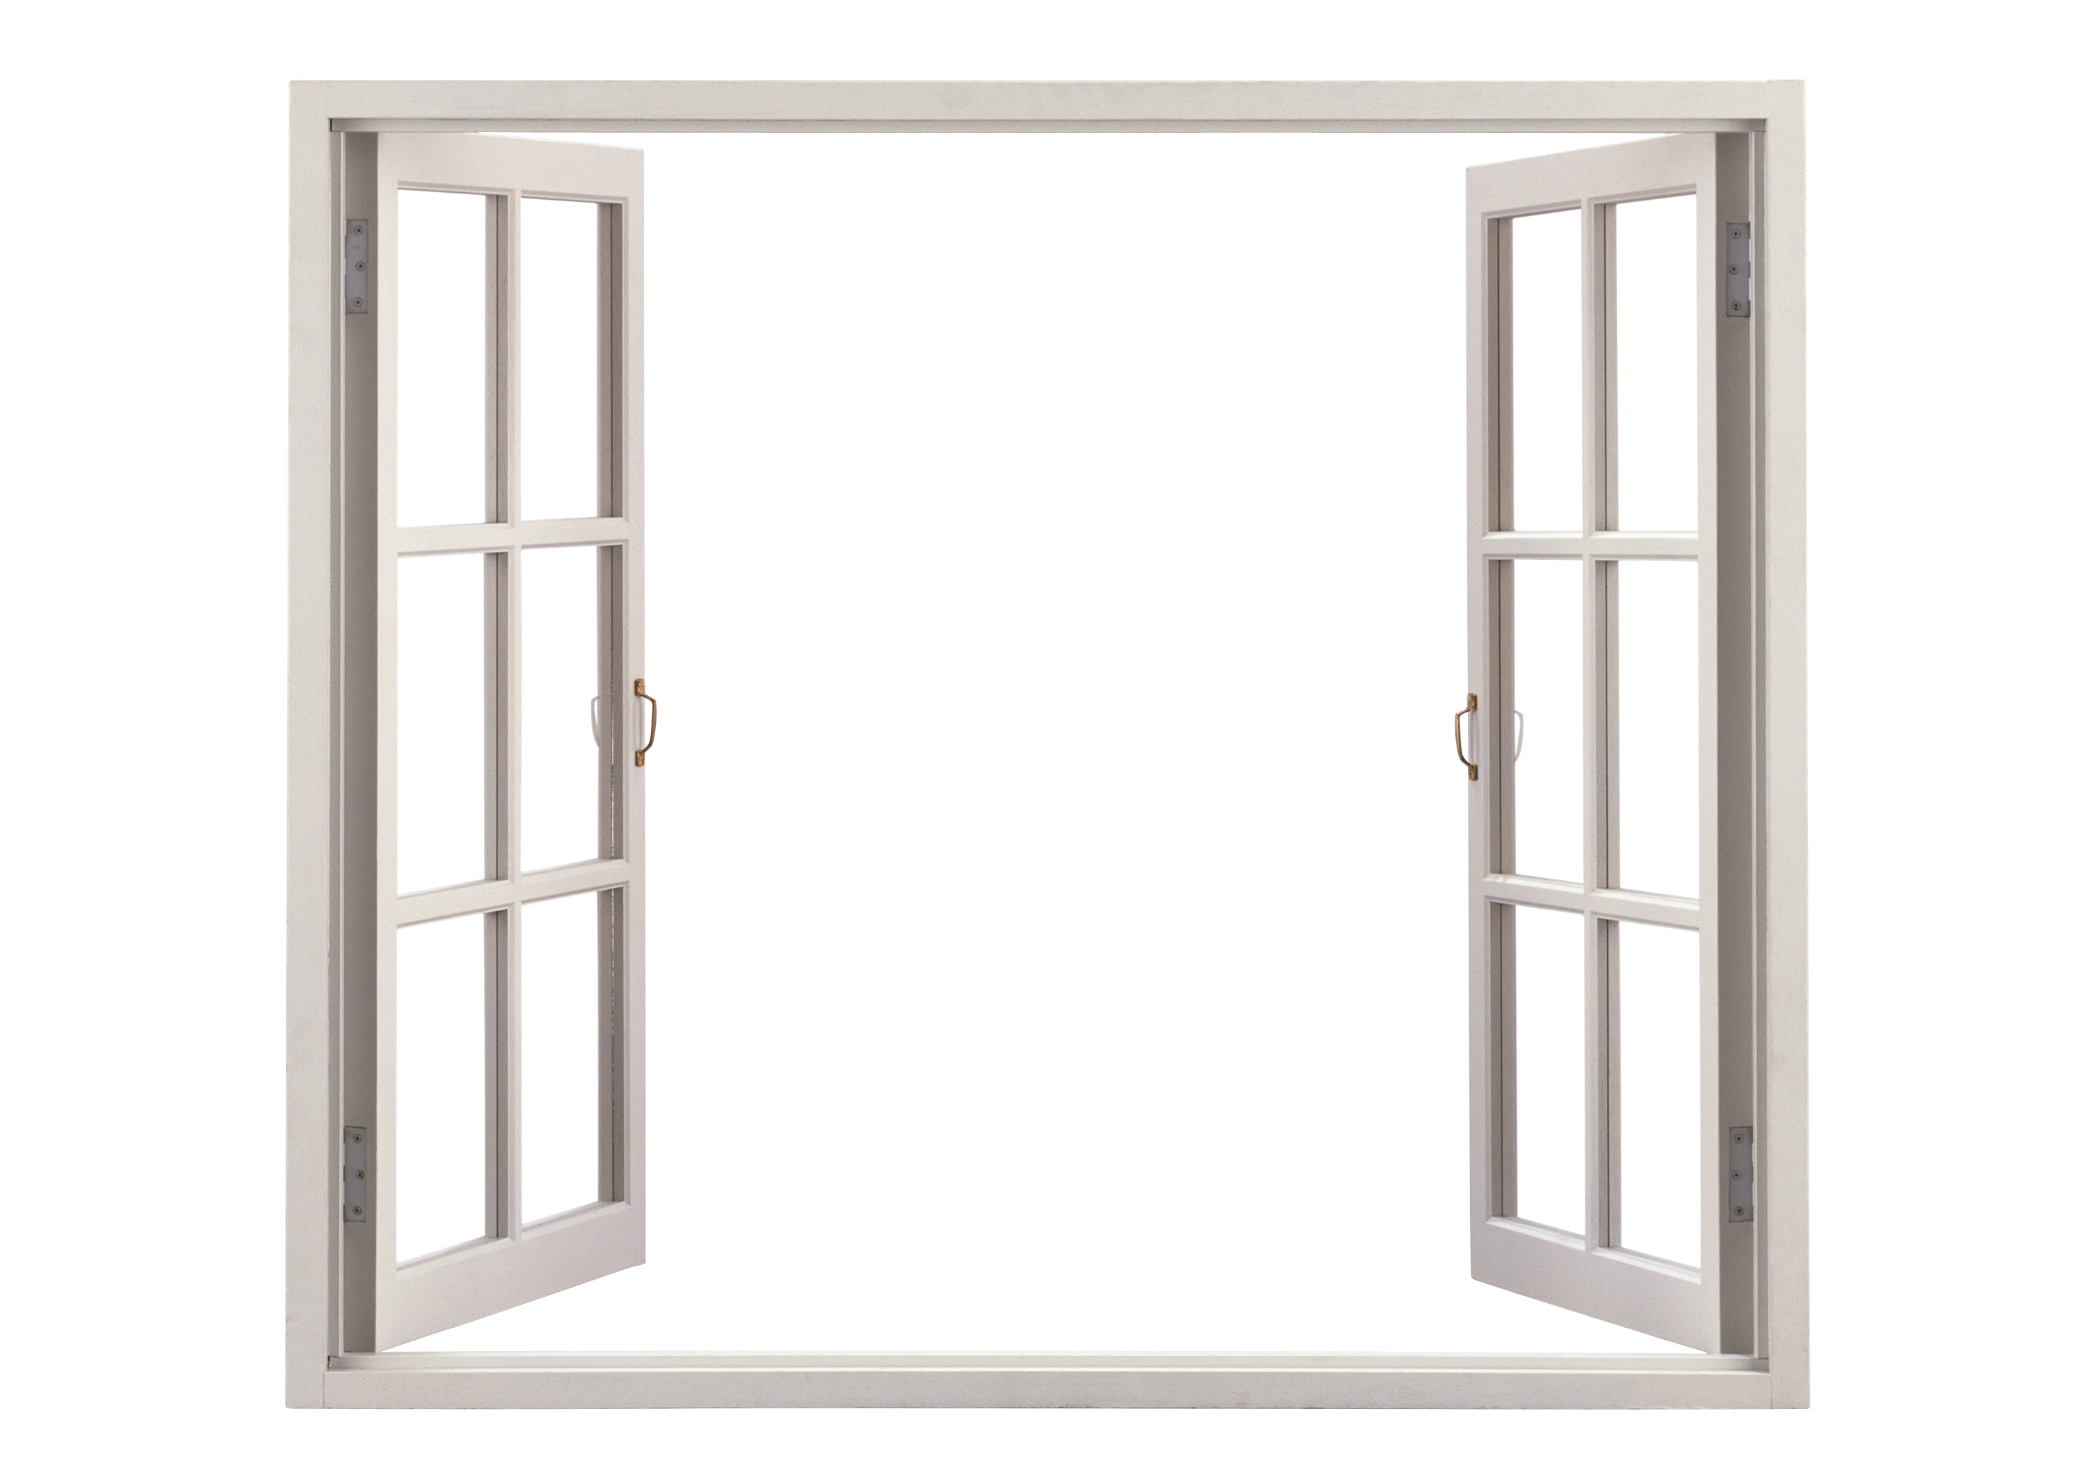
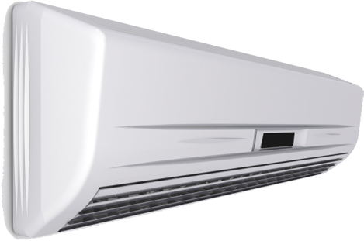
Simple Example application
Owned Temperature
Sensor
Non-owned near
Pollen sensor
It's hot
High concentration
Low concentration
Open the window
not facing the sun
Turn on air
conditioning
Both electricity consumption and allergy safety are considered.

Slide 12
Conclusions
Future Work
In this paper we have studied the challenging topic of data integration between heterogeneous data sources for the Internet of Things.
We analyzed the differences, and proposed a new architecture to integrate them together, along with the ability to deliver custom made services to the end users.
Machine learning algorithm to classify sensed data in order to facilitate data search.
Integrate governmental and more specialized data.
Implement efficient orchestration capabilities.
Incentives.

