Slide 1



Background Information
Software funded by Linda O. Mearns originally through the Weather and Climate Impacts Assessment Science Program (http://www.assessment.ucar.edu).
Project impetus from Rick Katz.
Primary goal is to shorten learning curve for atmospheric scientists to apply extreme value analysis (EVA) in their work when appropriate.
Two R (http://www.r-project.org) packages: extRemes (command-line) and in2extRemes (GUI for some extRemes functions).
Web page for extRemes and in2extRemes (http://www.ral.ucar.edu/staff/ericg/extRemes).

Slide 2
Background Information
Tutorials for extRemes and in2extRemes
Gilleland, E. and R. W. Katz, 2016. extRemes 2.0: An Extreme Value Analysis Package in R. Journal of Statistical Software, 72 (8), 1 - 39, DOI: 10.18637/jss.v072.i08 (https://www.jstatsoft.org/article/view/v072i08).
Gilleland, E. and Katz, R. W., 2016: in2extremes: Into the R Package extremes - Extreme Value Analysis for Weather and Climate Applications. NCAR Technical Note, NCAR/TN-523+STR, 102 pp., DOI: 10.5065/D65T3HP2 (http://dx.doi.org/10.5065/D65T3HP2).

Slide 3
Background Information
Other EVA software (not just R packages, but mostly):
List of EVA software at http://www.ral.ucar.edu/staff/ericg/softextreme.php
Gilleland, E., 2016. Computing Software. Chapter 25 In Extreme Value Modeling and Risk Analysis: Methods and Applications. Edts. Dipak K. Dey and Jun Yan, CRC Press, Boca Raton, Florida, U.S.A., pp. 505 - 515.
Gilleland, E. and Ribatet, M., 2015. Reinsurance and extremal events. In: Computational Actuarial Science with R. Ed. A. Charpentier, Chapman & Hall/CRC the R series, Boca Raton, Florida, U.S.A., pp. 257 - 286.
Gilleland, E., M. Ribatet and A. G. Stephenson, 2013. A software review for extreme value analysis. Extremes, 16 (1), 103 - 119, DOI: 10.1007/s10687-012-0155-0 (available online at http://www.springerlink.com/openurl.asp?genre=article&id=doi:10.1007/s10687-012-0155-0).
Stephenson, A. and E. Gilleland, 2005. Software for the Analysis of Extreme Events: The Current State and Future Directions. Extremes, 8, 87 - 109.

Slide 4
fevd
Main function for all (univariate) extreme value distribution (EVD) fitting
fevd(x, data, threshold = NULL, threshold.fun = ~1, location.fun = ~1, scale.fun = ~1, shape.fun = ~1, use.phi = FALSE, type = c("GEV", "GP", "PP", "Gumbel", "Exponential"),
method = c("MLE", "GMLE", "Bayesian", "Lmoments"), initial = NULL, span, units = NULL,
time.units = "days", period.basis = "year",
na.action = na.fail, optim.args = NULL,
priorFun = NULL, priorParams = NULL,
proposalFun = NULL, proposalParams = NULL,
iter = 9999, weights = 1, blocks = NULL,
verbose = FALSE)
It’s not as bad as it looks!

Slide 5
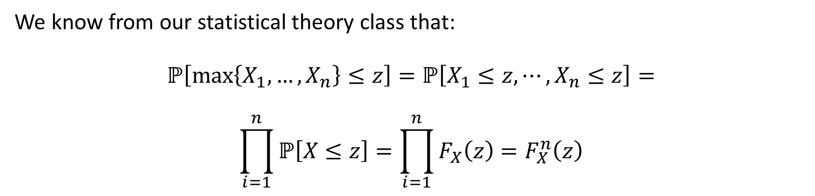
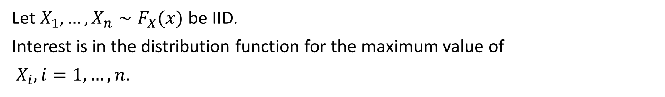
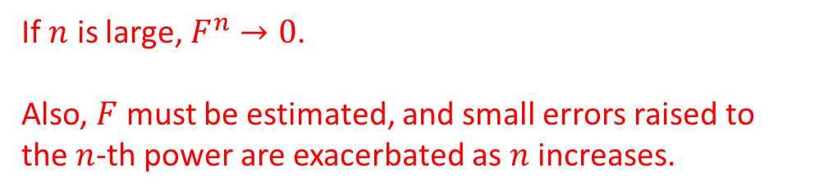
Modeling Block Maxima
Let $X_{1},…,X_{n}∼F_{X}(x)$ be IID.
Interest is in the distribution function for the maximum value of
$X_{i}, i=1,…,n$.
We know from our statistical theory class that:
$$ℙ\left[\max\left\{X_{1},…,X_{n}\right\}≤z\right]=ℙ\left[X_{1}≤z,⋯,X_{n}≤z\right]=$$
$$\prod_{i=1}^{n}{ℙ\left[X≤z\right]=\prod_{i=1}^{n}{F_{X}\left(z\right)}}=F_{X}^{n}\left(z\right)$$
If $n$ is large, $F^{n}→0$.
Also, $F$ must be estimated, and small errors raised to the $n$-th power are exacerbated as $n$ increases.

Slide 6

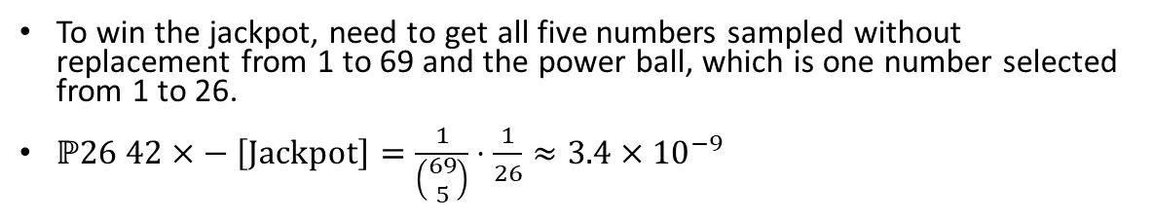
Modeling Block Maxima
To win the jackpot, need to get all five numbers sampled without replacement from 1 to 69 and the power ball, which is one number selected from 1 to 26.
$ℙ26 42×− \left[\text{Jackpot}\right]=\frac{1}{\left(\begin{matrix}69 \\ 5\end{matrix}\right)}⋅\frac{1}{26}≈3.4×{10}^{−9}$

Slide 7
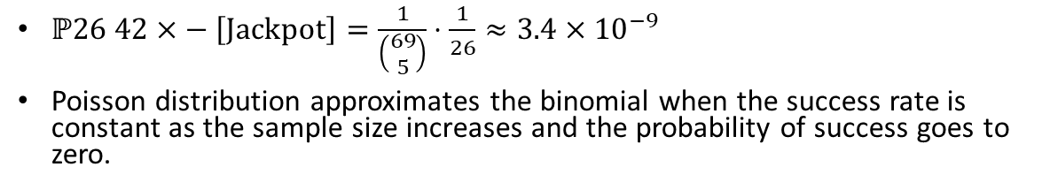
Modeling Block Maxima
$ℙ26 42×− \left[\text{Jackpot}\right]=\frac{1}{\left(\begin{matrix}69 \\ 5\end{matrix}\right)}⋅\frac{1}{26}≈3.4×{10}^{−9}$
Poisson distribution approximates the binomial when the success rate is constant as the sample size increases and the probability of success goes to zero.

Slide 8
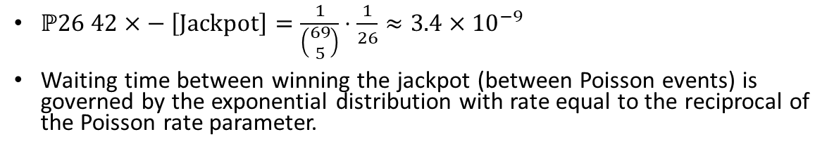
Modeling Block Maxima
$ℙ26 42×− \left[\text{Jackpot}\right]=\frac{1}{\left(\begin{matrix}69 \\ 5\end{matrix}\right)}⋅\frac{1}{26}≈3.4×{10}^{−9}$
Waiting time between winning the jackpot (between Poisson events) is governed by the exponential distribution with rate equal to the reciprocal of the Poisson rate parameter.

Slide 9
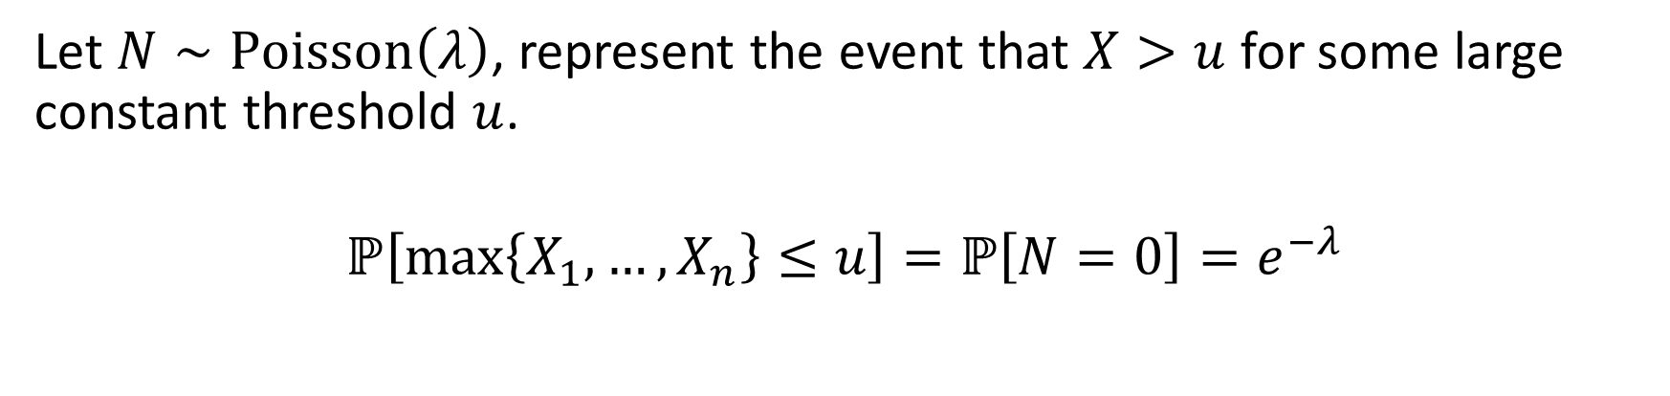
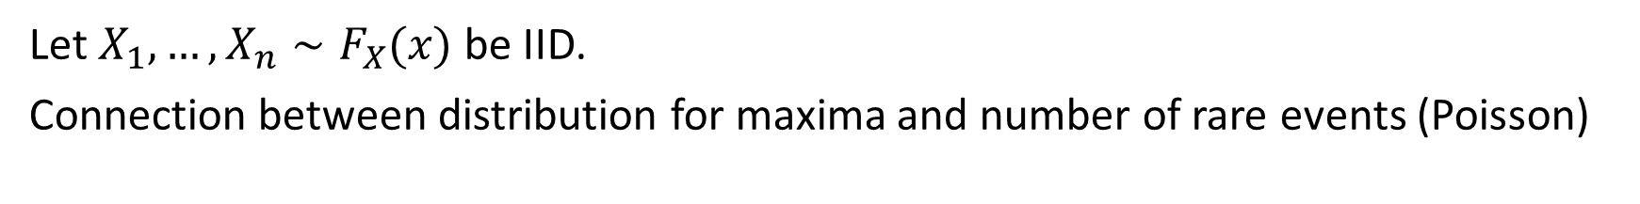
Modeling Block Maxima
Let $X_{1},…,X_{n}∼F_{X}(x)$ be IID.
Connection between distribution for maxima and number of rare events (Poisson)
Let $N∼\text{Poisson}\left(λ\right)$, represent the event that $X>u$ for some large constant threshold $u$.
$$ℙ\left[\max\left\{X_{1},…,X_{n}\right\}≤u\right]=ℙ\left[N=0\right]=e^{−λ}$$

Slide 10

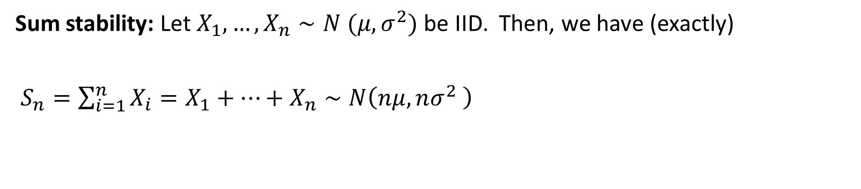
Modeling Block Maxima
Sum stability: Let $X_{1},…,X_{n}∼N (μ,σ^{2})$ be IID. Then, we have (exactly)
$S_{n}=\sum_{i=1}^{n}{X_{i}}=X_{1}+⋯+X_{n}∼N\left(nμ,nσ^{2} \right)$
That is,
$$\frac{S_{n}−nμ}{\sqrt{n}σ}∼N\left(0,1\right)$$

Slide 11
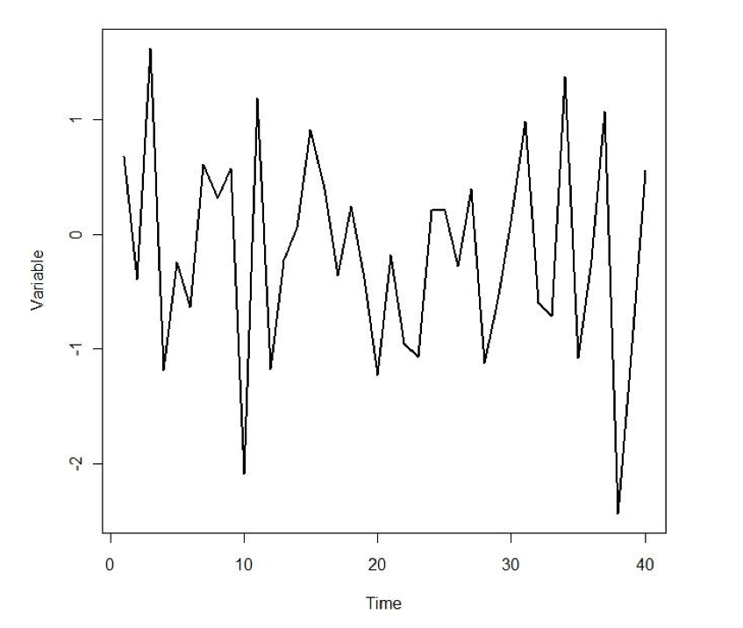
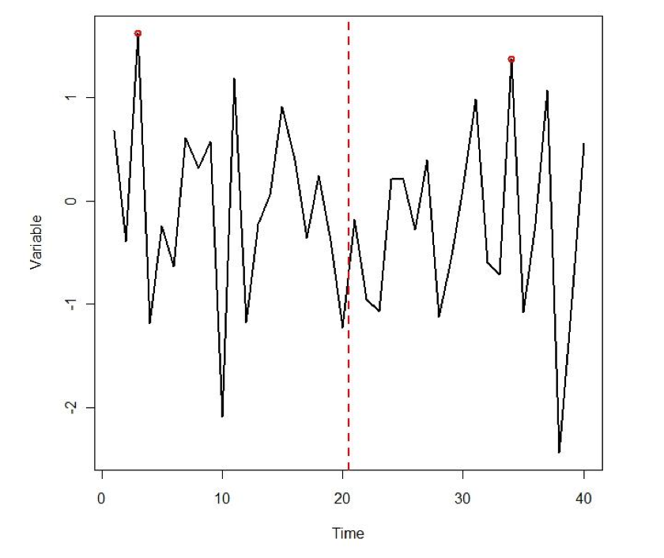
Modeling Block Maxima
Maximum Value

Slide 12
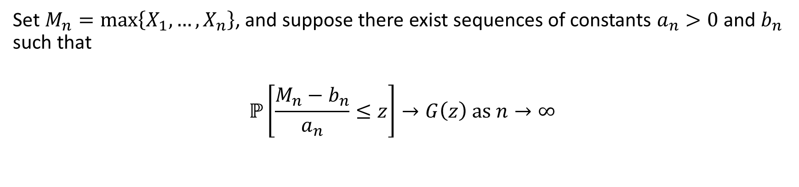
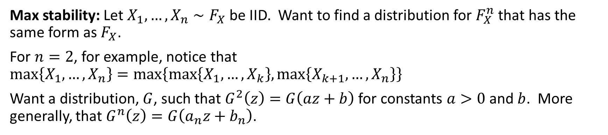
Modeling Block Maxima
Max stability: Let $X_{1},…,X_{n}∼F_{X}$ be IID. Want to find a distribution for $F_{X}^{n}$ that has the same form as $F_{X}$.
For $n=2$, for example, notice that $\max\left\{X_{1},…,X_{n}\right\}=\max\left\{\max\left\{X_{1},…,X_{k}\right\},\max\left\{X_{k+1},…,X_{n}\right\}\right\}$
Want a distribution, $G$, such that $G^{2}\left(z\right)=G\left(az+b\right)$ for constants $a>0$ and $b$. More generally, that $G^{n}\left(z\right)=G\left(a_{n}z+b_{n}\right)$.
Set $M_{n}=\max\left\{X_{1},…, X_{n}\right\}$, and suppose there exist sequences of constants $a_{n}>0$ and $b_{n}$ such that
$$ℙ\left[\frac{M_{n}−b_{n}}{a_{n}}≤z\right]→G\left(z\right) \text{as} n→∞$$

Slide 13
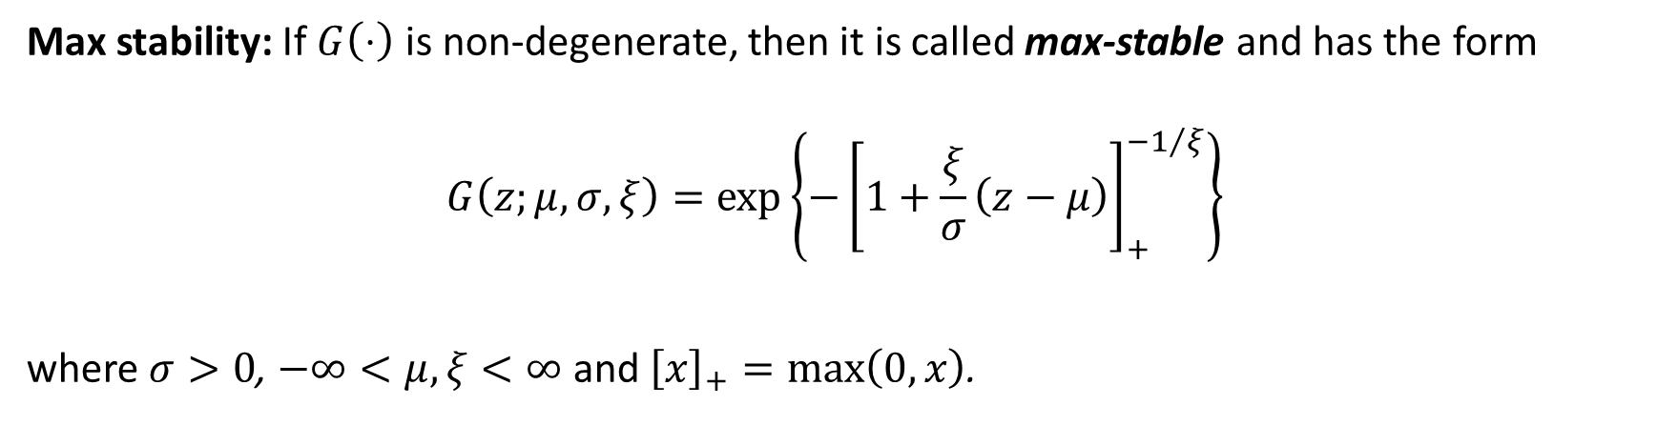
Modeling Block Maxima
Max stability: If $G\left(⋅\right)$ is non-degenerate, then it is called max-stable and has the form
$$G\left(z;μ,σ,ξ\right)=\exp\left\{−{\left[1+\frac{ξ}{σ}\left(z−μ\right)\right]}_{+}^{−1/ξ}\right\}$$
where $σ>0$, $−∞<μ,ξ<∞$ and ${\left[x\right]}_{+}=\max\left(0,x\right)$.
Disguises a lot!

Slide 14

Modeling Block Maxima
$G\left(z;μ,σ,ξ\right)=$
$$\exp\left\{−{\left[1+\frac{ξ}{σ}\left(z−μ\right)\right]}^{−1/ξ}\right\}⋅I_{\left(−∞,μ−σ/ξ\right]}\left(z\right)⋅I_{\left(−∞,0\right)}\left(ξ\right)+$$
$$\exp\left\{−\exp\left(\frac{z−μ}{σ}\right)\right\}⋅I_{\left\{0\right\}}\left(ξ\right)+$$
$$\exp\left\{−{\left[1+\frac{ξ}{σ}\left(z−μ\right)\right]}^{−1/ξ}\right\}⋅I_{\left[μ−σ/ξ,∞\right)}\left(z\right)⋅I_{\left(0,∞\right)}\left(ξ\right)$$

Slide 15
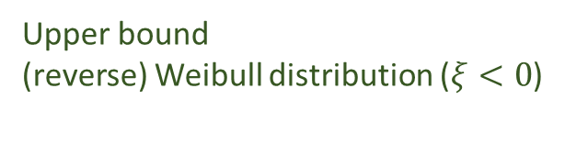


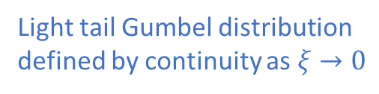
Modeling Block Maxima
$G\left(z;μ,σ,ξ\right)=$
$$\exp\left\{−{\left[1+\frac{ξ}{σ}\left(z−μ\right)\right]}^{−1/ξ}\right\}⋅I_{\left(−∞,μ−σ/ξ\right]}\left(z\right)⋅I_{\left(−∞,0\right)}\left(ξ\right)+$$
$$\exp\left\{−\exp\left(\frac{z−μ}{σ}\right)\right\}⋅I_{\left\{0\right\}}\left(ξ\right)+$$
$$\exp\left\{−{\left[1+\frac{ξ}{σ}\left(z−μ\right)\right]}^{−1/ξ}\right\}⋅I_{\left[μ−σ/ξ,∞\right)}\left(z\right)⋅I_{\left(0,∞\right)}\left(ξ\right)$$
Upper bound
(reverse) Weibull distribution ($ξ<0$)
Light tail Gumbel distribution
defined by continuity as $ξ→0$
Heavy-tail Fréchet distribution ($ξ>0$)

Slide 16
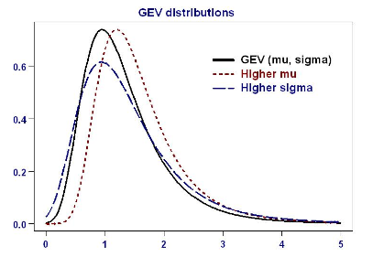


Modeling Block Maxima
$𝔼\left[X\right]=μ−\frac{σ\left(1−Γ\left(1−ξ\right)\right)}{ξ}$, for $ξ<1$
$𝕍\left[X\right]=\frac{σ^{2}\left(Γ\left(1−2ξ\right)−Γ^{2}\left(1−ξ\right)\right)}{ξ^{2}}$, for $ξ<\frac{1}{2}$

Slide 17
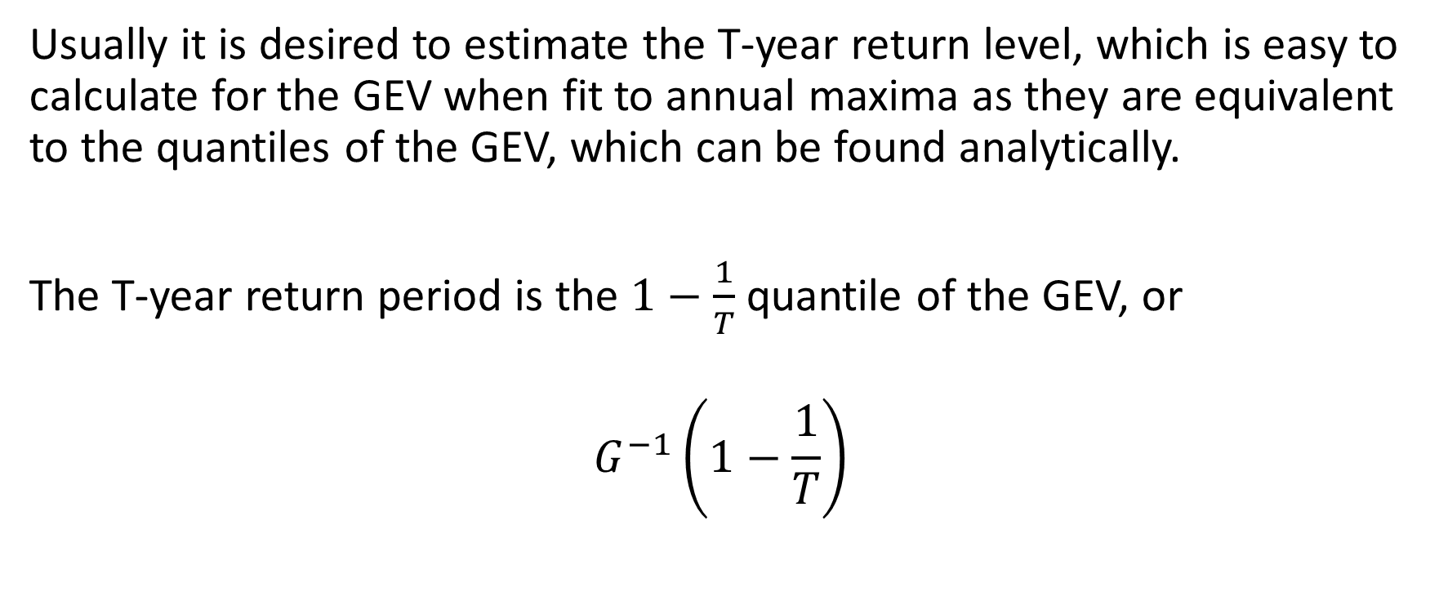
GEV Return Levels
Usually it is desired to estimate the T-year return level, which is easy to calculate for the GEV when fit to annual maxima as they are equivalent to the quantiles of the GEV, which can be found analytically.
The T-year return period is the $1−\frac{1}{T}$ quantile of the GEV, or
$$G^{−1}\left(1−\frac{1}{T}\right)$$

Slide 18
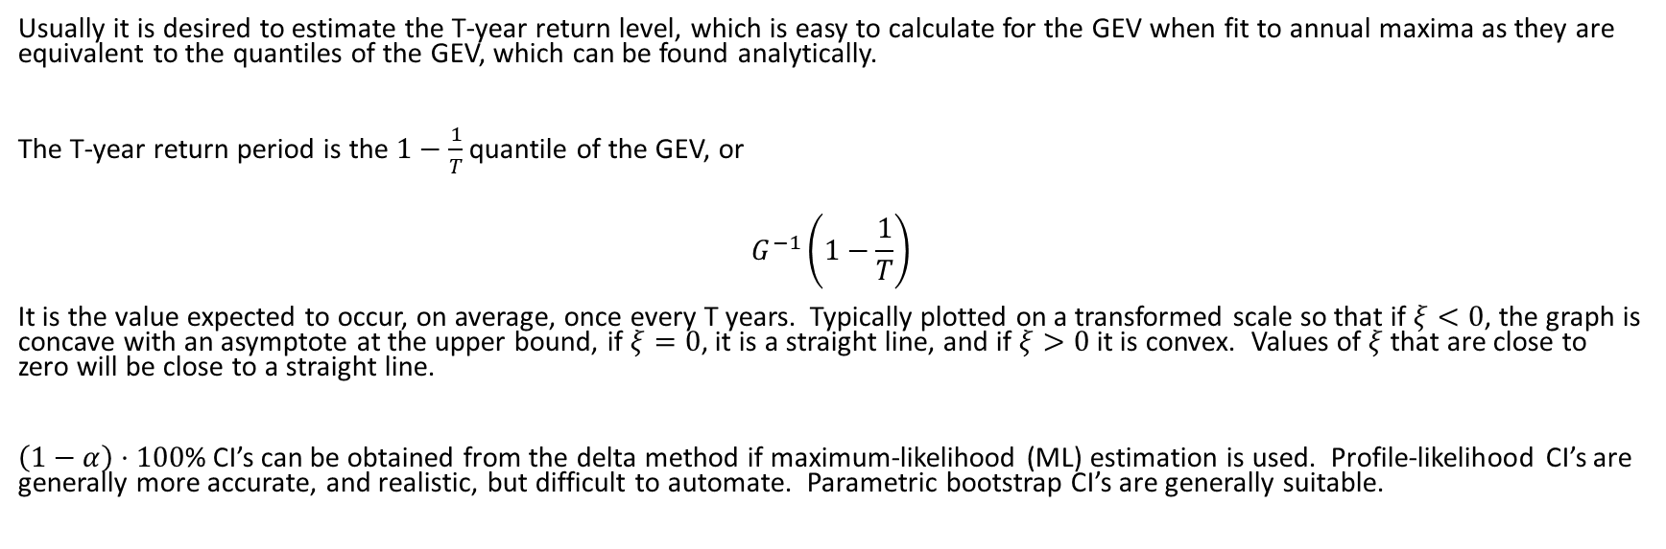
GEV Return Levels
Usually it is desired to estimate the T-year return level, which is easy to calculate for the GEV when fit to annual maxima as they are equivalent to the quantiles of the GEV, which can be found analytically.
The T-year return period is the $1−\frac{1}{T}$ quantile of the GEV, or
$$G^{−1}\left(1−\frac{1}{T}\right)$$
It is the value expected to occur, on average, once every T years. Typically plotted on a transformed scale so that if $ξ<0$, the graph is concave with an asymptote at the upper bound, if $ξ=0$, it is a straight line, and if $ξ>0$ it is convex. Values of $ξ$ that are close to zero will be close to a straight line.
$\left(1−α\right)⋅100$% CI’s can be obtained from the delta method if maximum-likelihood (ML) estimation is used. Profile-likelihood CI’s are generally more accurate, and realistic, but difficult to automate. Parametric bootstrap CI’s are generally suitable.

Slide 19
Modeling Block Maxima
GEV distribution
Fit GEV directly to maxima over long blocks (e.g., annual)
Advantages of modeling block maxima
Generally do not need to explicitly model annual or diurnal cycles
Generally do not need to worry about temporal dependence
Quantiles are easy to find and are equivalent to the T-period return level

Slide 20
fevd
Fit GEV to block maxima using MLE
Samples of size 100 of maxima of standard normal distributed samples
Zmax <- matrix( rnorm( 100 * 1000 ), 1000, 100 )
dim( Zmax )
Zmax <- apply( Zmax, 2, max )
dim( Zmax )

Slide 21
fevd
Fit GEV to block maxima using MLE
Load the library
library( extRemes )
fit <- fevd( Zmax )
fit
Do the fit
See a summary of the fit

Slide 22
fevd
Fit GEV to block maxima using MLE
Look at diagnostic plots for the fit
plot( fit )
ci( fit, type = “parameter” )
distill( fit )
strip( fit )
Obtain CI’s for the GEV parameters
See just the parameter estimates and some other information (useful for multiple fits, e.g., thousands of locations)
Same as distill(), but simpler (only parameter estimates shown)

Slide 23
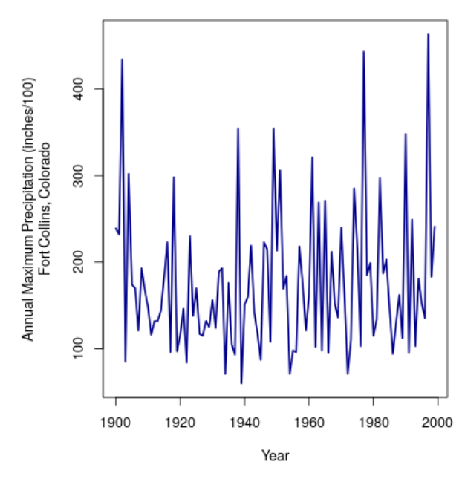
Fitting the GEV to data
Fort Collins annual maximum precipitation (inches)
library( “extRemes” )
data( “ftcanmax” )
plot(ftcanmax, type="l", lwd=2,
ylab = "Annual Maximum Precipitation (inches/100)\nFort Collins, Colorado", col = "darkblue")

Slide 24
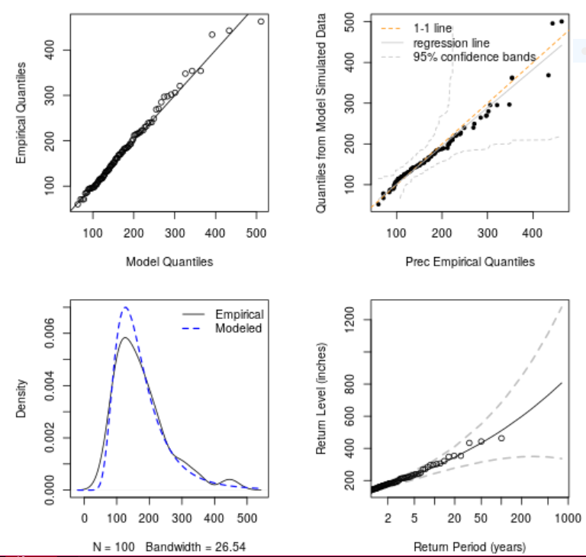
Fitting the GEV to data
Fort Collins annual maximum precipitation (inches)
fit <- fevd( Prec, data = ftcanmax, units = “inches/100" )
fit
plot( fit )
[1] "Estimation Method used: MLE"
Negative Log-Likelihood Value: 565.4816
Estimated parameters:
location scale shape
134.66520 53.28089 0.17363
Standard Error Estimates:
location scale shape
6.16877130 4.87901653 0.09195688
Estimated parameter covariance matrix.
location scale shape
location 38.0537393 17.06709037 -0.208376947
scale 17.0670904 23.80480234 -0.086937257
shape -0.2083769 -0.08693726 0.008456068
AIC = 1136.963
BIC = 1144.779

Slide 25
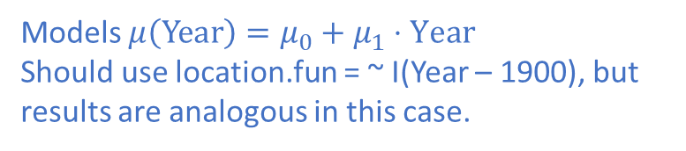
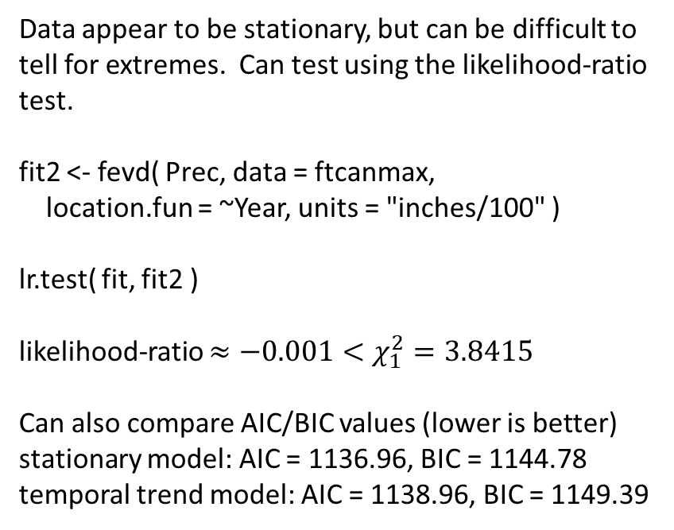
Fitting the GEV to data
Fort Collins annual maximum precipitation (inches)
Data appear to be stationary, but can be difficult to tell for extremes. Can test using the likelihood-ratio test.
fit2 <- fevd( Prec, data = ftcanmax,
location.fun = ~Year, units = "inches/100" )
lr.test( fit, fit2 )
likelihood-ratio $≈−0.001<χ_{1}^{2}=3.8415$
Can also compare AIC/BIC values (lower is better)
stationary model: AIC = 1136.96, BIC = 1144.78
temporal trend model: AIC = 1138.96, BIC = 1149.39
Models $μ\left(\text{Year}\right)=μ_{0}+μ_{1}⋅\text{Year}$
Should use location.fun = ~ I(Year – 1900), but results are analogous in this case.

Slide 26
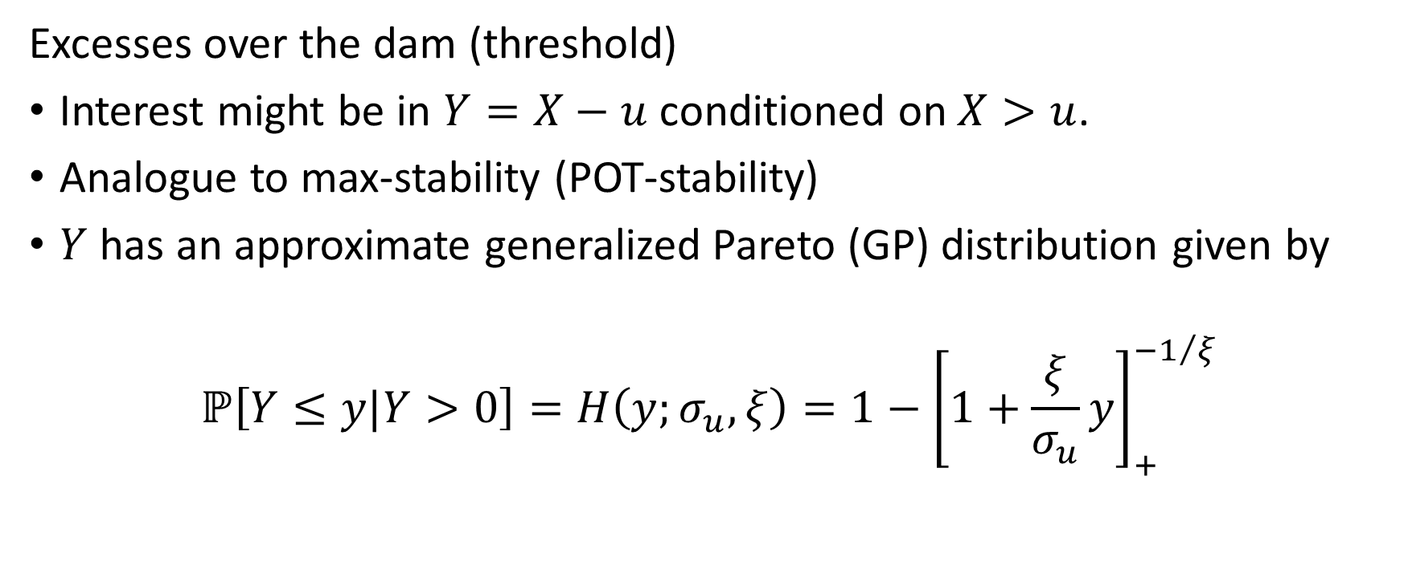
Modeling Excesses over a Threshold
Excesses over the dam (threshold)
Interest might be in $Y=X−u$ conditioned on $X>u$.
Analogue to max-stability (POT-stability)
$Y$ has an approximate generalized Pareto (GP) distribution given by
$$ℙ\left[Y≤y|Y>0\right]=H\left(y;σ_{u},ξ\right)=1−{\left[1+\frac{ξ}{σ_{u}}y\right]}_{+}^{{−1}/ξ}$$

Slide 27
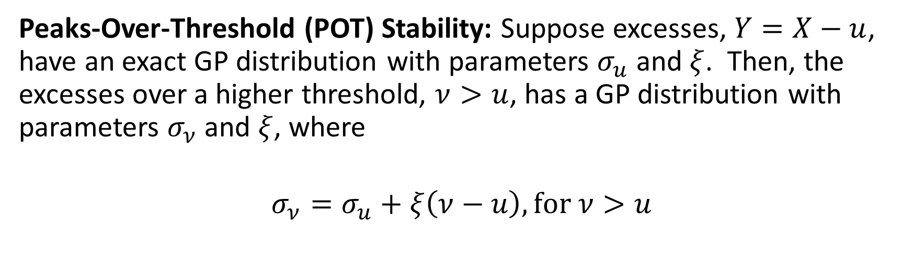
Modeling Excesses over a Threshold
Peaks-Over-Threshold (POT) Stability: Suppose excesses, $Y=X−u$, have an exact GP distribution with parameters $σ_{u}$ and $ξ$. Then, the excesses over a higher threshold, $ν>u$, has a GP distribution with parameters $σ_{ν}$ and $ξ$, where
$$σ_{ν}=σ_{u}+ξ\left(ν−u\right), \text{for} ν>u$$

Slide 28
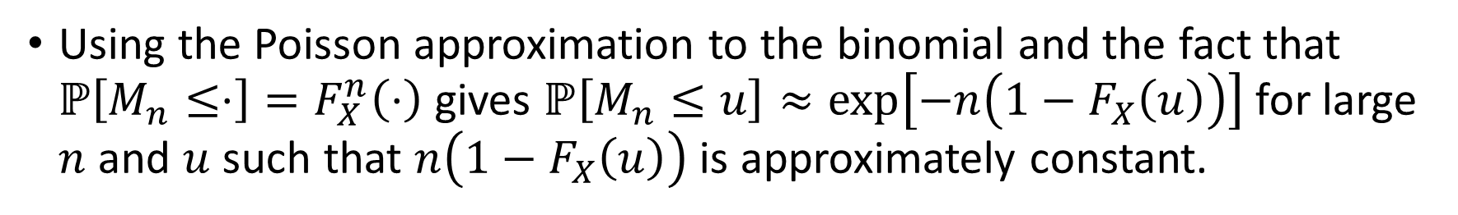

Connection between GP and GEV
Suppose $M_{n}=Z∼\text{GEV}\left(μ,σ,ξ\right)$.
We already saw the connection between $M_{n}$ and the Poisson
Note that the binomial success probability, that $X>u$, is given by $ℙ\left[X>u\right]=1−F_{X}\left(u\right)$.
Using the Poisson approximation to the binomial and the fact that $ℙ\left[M_{n}≤⋅\right]=F_{X}^{n}\left(⋅\right)$ gives $ℙ\left[M_{n}≤u\right]≈\exp\left[−n\left(1−F_{X}\left(u\right)\right)\right]$ for large $n$ and $u$ such that $n\left(1−F_{X}\left(u\right)\right)$ is approximately constant.

Slide 29
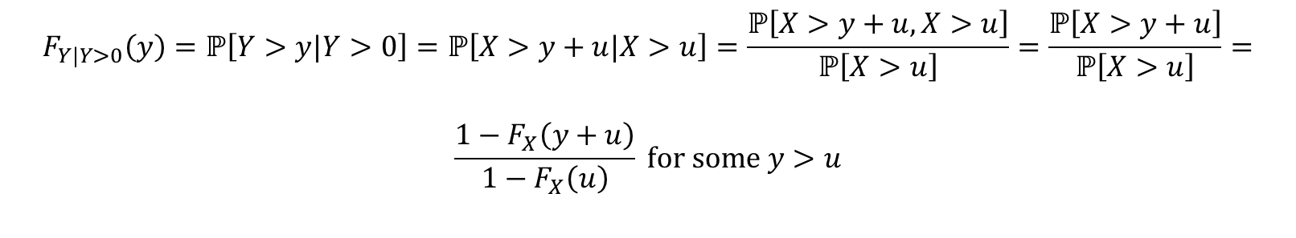
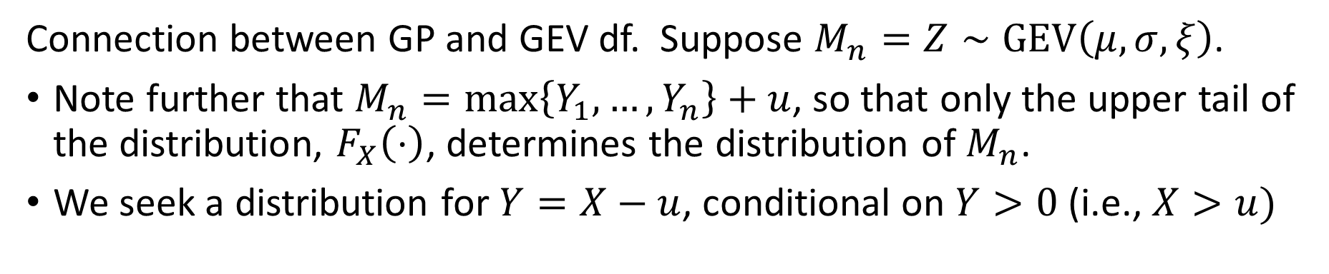
Connection between GP and GEV
Connection between GP and GEV df. Suppose $M_{n}=Z∼\text{GEV}\left(μ,σ,ξ\right)$.
Note further that $M_{n}=\max\left\{Y_{1},…,Y_{n}\right\}+u$, so that only the upper tail of the distribution, $F_{X}\left(⋅\right)$, determines the distribution of $M_{n}$.
We seek a distribution for $Y=X−u$, conditional on $Y>0$ (i.e., $X>u)$
$$F_{Y|Y>0}\left(y\right)=ℙ\left[Y>y|Y>0\right]=ℙ\left[X>y+u|X>u\right]=\frac{ℙ\left[X>y+u,X>u\right]}{ℙ\left[X>u\right]}=\frac{ℙ\left[X>y+u\right]}{ℙ\left[X>u\right]}=$$
$$\frac{1−F_{X}\left(y+u\right)}{1−F_{X}\left(u\right)} \text{for} \text{some} y>u$$

Slide 30

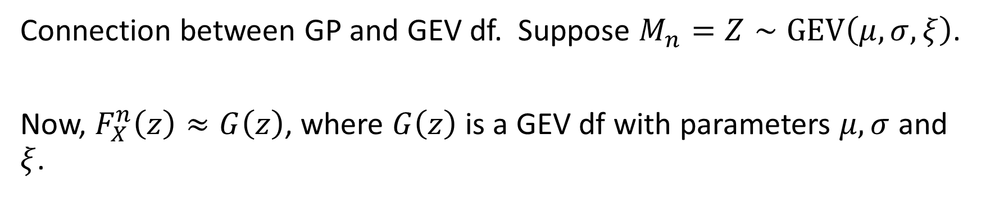
Connection between GP and GEV
Connection between GP and GEV df. Suppose $M_{n}=Z∼\text{GEV}\left(μ,σ,ξ\right)$.
Now, $F_{X}^{n}\left(z\right)≈G\left(z\right)$, where $G\left(z\right)$ is a GEV df with parameters $μ,σ$ and $ξ$.
So,
$$n⋅\log{F_{X}\left(z\right)≈−{\left[1+\frac{ξ}{σ}\left(z−μ\right)\right]}^{−1/ξ}}$$

Slide 31

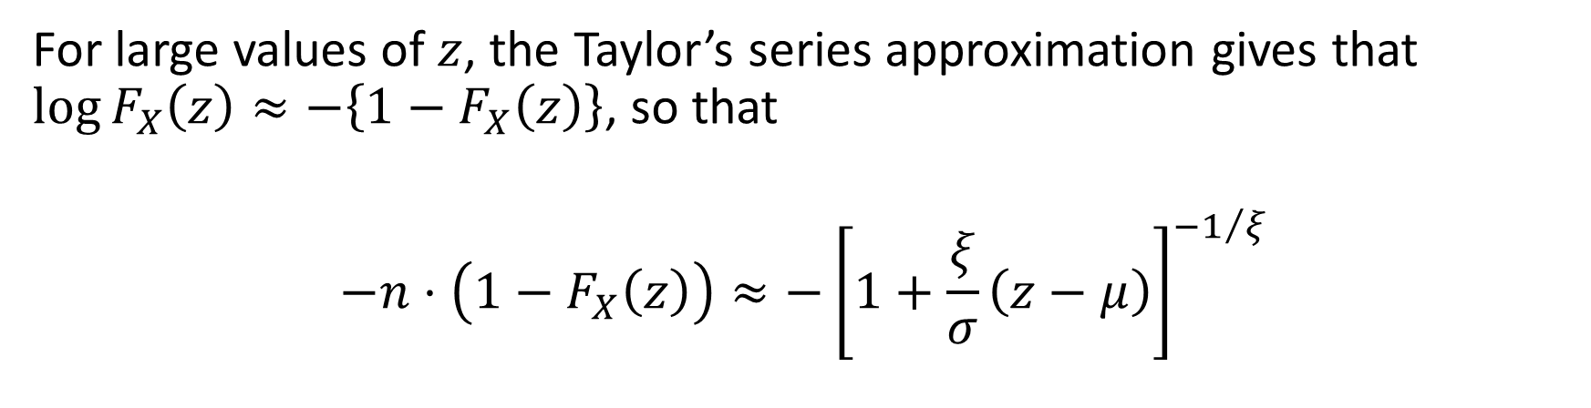
Connection between GP and GEV
For large values of $z$, the Taylor’s series approximation gives that $\log{F_{X}\left(z\right)}≈−\left\{1−F_{X}\left(z\right)\right\}$, so that
$$−n⋅\left(1−F_{X}\left(z\right)\right)≈−{\left[1+\frac{ξ}{σ}\left(z−μ\right)\right]}^{−1/ξ}$$
Thus,
$$1−F_{X}\left(u\right) ≈\frac{1}{n}{\left[1+\frac{ξ}{σ}\left(u−μ\right)\right]}^{−1/ξ}$$

Slide 32

Connection between GP and GEV
Putting it all together
$$ℙ\left[Y>y|Y>0\right]=\frac{1−F_{X}\left(y+u\right)}{1−F_{X}\left(u\right)}≈$$
$$1−F_{X}\left(u\right) ≈\frac{\frac{1}{n}{\left[1+\frac{ξ}{σ}\left(y+u−μ\right)\right]}^{−1/ξ}}{\frac{1}{n}{\left[1+\frac{ξ}{σ}\left(u−μ\right)\right]}^{−1/ξ}}$$

Slide 33
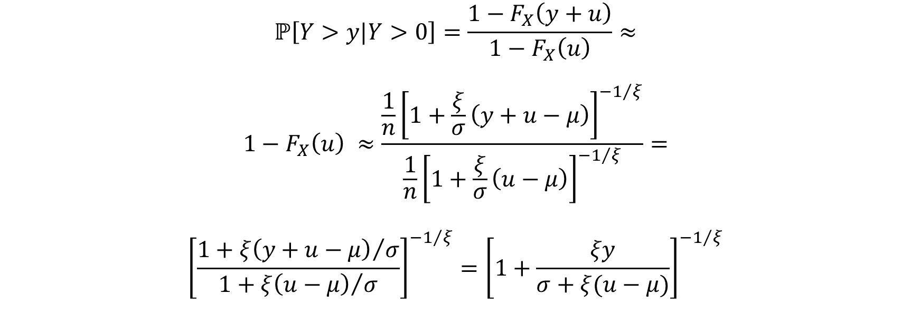
Connection between GP and GEV
$$ℙ\left[Y>y|Y>0\right]=\frac{1−F_{X}\left(y+u\right)}{1−F_{X}\left(u\right)}≈$$
$$1−F_{X}\left(u\right) ≈\frac{\frac{1}{n}{\left[1+\frac{ξ}{σ}\left(y+u−μ\right)\right]}^{−1/ξ}}{\frac{1}{n}{\left[1+\frac{ξ}{σ}\left(u−μ\right)\right]}^{−1/ξ}}=$$
$${\left[\frac{{1+ξ\left(y+u−μ\right)}/σ}{1+{ξ\left(u−μ\right)}/σ}\right]}^{−1/ξ}={\left[1+\frac{ξy}{σ+ξ(u−μ)}\right]}^{−1/ξ}$$

Slide 34
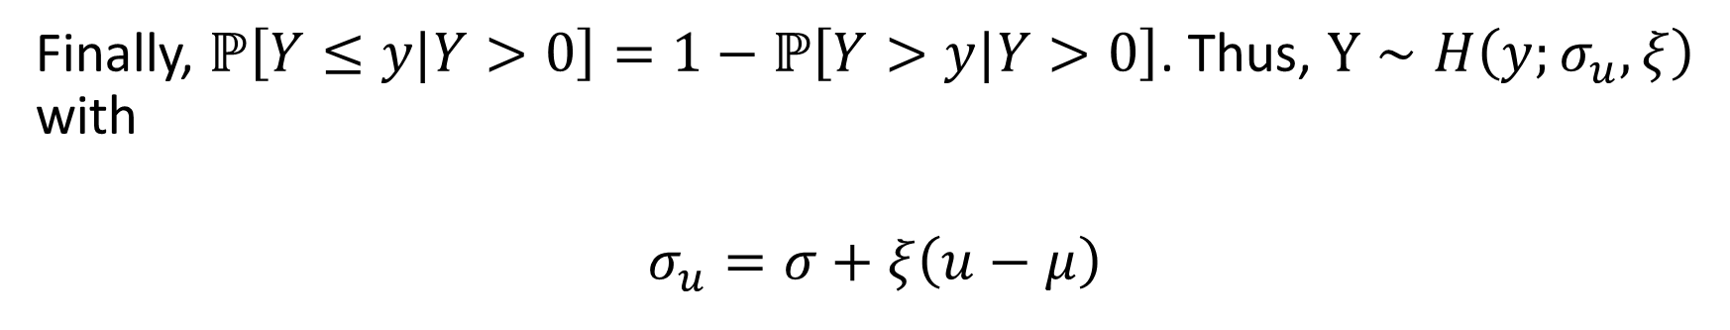
Connection between GP and GEV
Finally, $ℙ\left[Y≤y|Y>0\right]=1−ℙ\left[Y>y|Y>0\right]$. Thus, $Y∼H\left(y;σ_{u},ξ\right)$ with
$$σ_{u}=σ+ξ\left(u−μ\right)$$

Slide 35

GPD Return Levels
The GPD quantiles, like those for the GEV, are easy to find. However, they do not correspond directly to the T-year return level. Need to first estimate $ℙ\left[X>u\right]$, and then it is straightforward to estimate return levels.

Slide 36
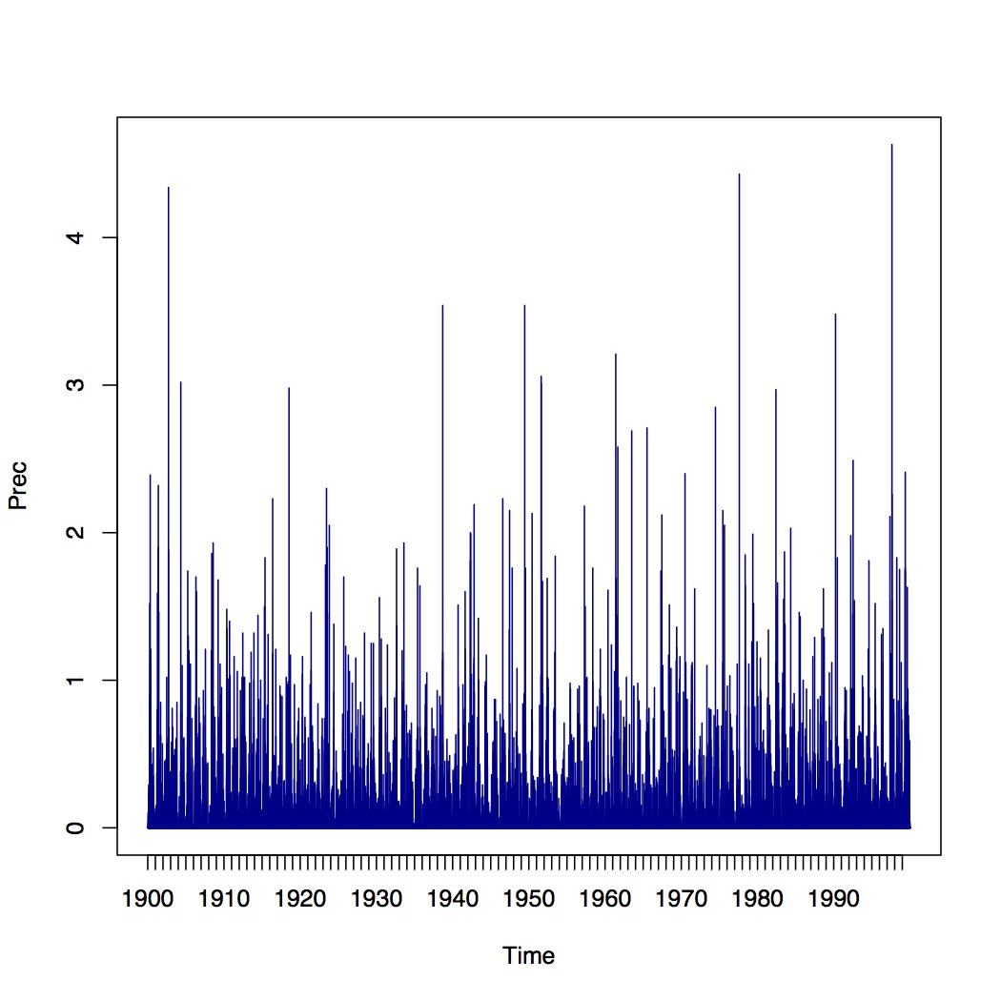
fevd
Fort Collins, Colorado daily precipitation (inches) 1900 to 1999

Slide 37
fevd
Fort Collins, Colorado daily precipitation (inches) 1900 to 1999
Fit a GP distribution to the data
fit <- fevd( Prec, data = Fort,
threshold = 0.395, type = "GP", units = "inches” )

Slide 38
fevd
Fort Collins, Colorado daily precipitation (inches) 1900 to 1999
Fit a GP distribution to the data
plot( fit )

Slide 39
fevd
Fort Collins, Colorado daily precipitation (inches) 1900 to 1999
plot( fit, type = “trace” )

Slide 40
Frequency of Extremes
Number of days that maximum daily temperature (deg. F) in Fort Collins, Colorado exceeds 95 degrees F.
data(FCwx)
tempGT95 <- c(aggregate(FCwx$MxT,
by = list(FCwx$Year),
function(x) sum(x > 95, na.rm = TRUE))$x)
yr <- unique(FCwx$Year)

Slide 41
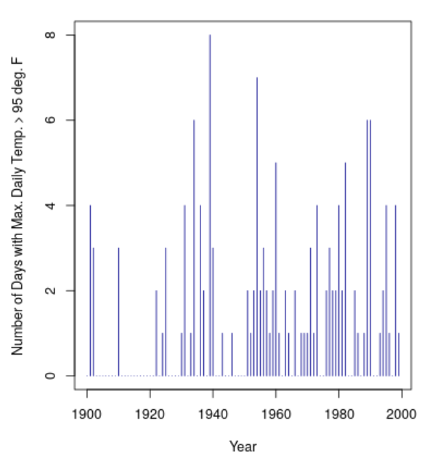
Frequency of Extremes
Number of days that maximum daily temperature (deg. F) in Fort Collins, Colorado exceeds 95 degrees F.
plot(yr, tempGT95,
type = "h",
col = "darkblue",
xlab = "Year",
ylab =
"Number of Days with Max. Daily Temp. > 95 deg. F")

Slide 42
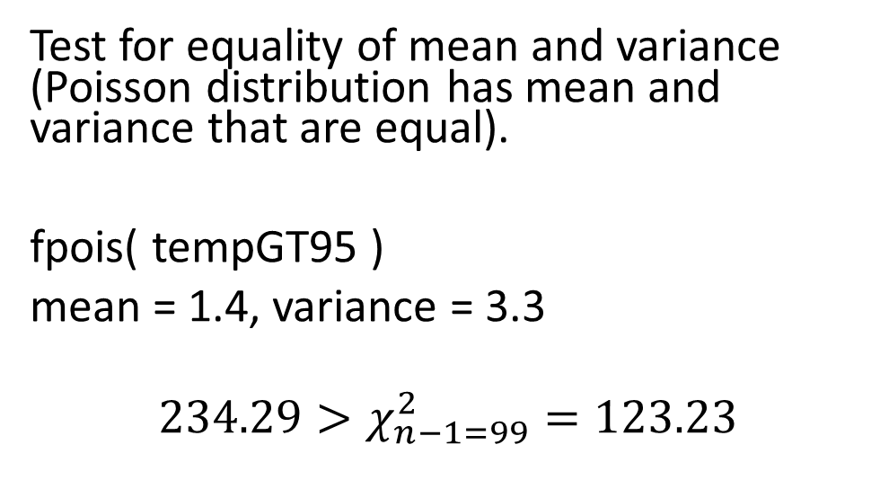
Frequency of Extremes
Number of days that maximum daily temperature (deg. F) in Fort Collins, Colorado exceeds 95 degrees F.
Test for equality of mean and variance (Poisson distribution has mean and variance that are equal).
fpois( tempGT95 )
mean = 1.4, variance = 3.3
$$234.29>χ_{n−1=99}^{2}=123.23$$

Slide 43
Frequency of Extremes
Number of days that maximum daily temperature (deg. F) in Fort Collins, Colorado exceeds 95 degrees F.
Call:
glm(formula = tempGT95 ~ yr, family = poisson())
Deviance Residuals:
Min 1Q Median 3Q Max
-2.1390 -1.4250 -0.8085 0.4722 4.1276
Coefficients:
Estimate Std. Error z value Pr(>|z|)
(Intercept) -22.103934 5.924385 -3.731 0.000191 ***
yr 0.011483 0.003024 3.797 0.000146 ***
---
Signif. codes: 0 ‘***’ 0.001 ‘**’ 0.01 ‘*’ 0.05 ‘.’ 0.1 ‘ ’ 1
(Dispersion parameter for poisson family taken to be 1)
Null deviance: 228.36 on 99 degrees of freedom
Residual deviance: 213.46 on 98 degrees of freedom
AIC: 362.15
Number of Fisher Scoring iterations: 6
Perhaps distribution is inhomogeneous. Does seem to have higher frequency with year.
fit <- glm(tempGT95~yr, family = poisson())
summary(fit)

Slide 44
fevd
Fort Collins, Colorado daily precipitation (inches) 1900 to 1999
Fit a Poisson Point Process to the data
fit <- fevd( Prec, Fort,
threshold = 0.395, type = "PP", units = "inches” )

Slide 45
fevd
Fort Collins, Colorado daily precipitation (inches) 1900 to 1999
plot( fit )
See Smith, R. L. and Shively, T. S., 1995. A point process approach to modeling trends in tropospheric ozone. Atmospheric Environment, 29, 3489 – 3499.
Also: http://www.stat.unc.edu/postscript/rs/var.pdf

Slide 46
Threshold Selection
Plot parameter estimates over a range of thresholds
Generalized Pareto
data( “Denversp” )
threshrange.plot( x = Denversp$Prec,
r = c( 0.1, 0.95 ) )
Range of thresholds

Slide 47
Threshold Selection
Plot parameter estimates over a range of thresholds
Specify type = “PP”
Poisson Point Process
data( “Tphap” )
threshrange.plot( x =
Tphap$MaxT,
r = c( 106, 110 ), type = “PP”,
nint = 30 )
Change number of thresholds over the specified range

Slide 48
Declustering
Sky Harbor airport, Phoenix, Arizona July to August maximum temperatures ( ºF)

Slide 49
Declustering
Sky Harbor airport, Phoenix, Arizona July to August maximum temperatures ( ºF)
extremalindex( Tphap$MaxT, threshold = 105 )
θ | Number of Clusters | Run Length
0.21 | 234 | 2

Slide 50
Declustering
Sky Harbor airport, Phoenix, Arizona July to August maximum temperatures ( ºF)
y <- decluster( Tphap$MaxT,
threshold = 105,
r = 2 )
y
plot( y )

Slide 51
Declustering
Sky Harbor airport, Phoenix, Arizona July to August maximum temperatures ( ºF)

Slide 52
Declustering
Sky Harbor airport, Phoenix, Arizona July to August maximum temperatures ( ºF)
extremalindex( y, threshold = 105 )
θ | Number of Clusters | Run Length
1 | 229 | 3

Slide 53
Declustering
Sky Harbor airport, Phoenix, Arizona July to August maximum temperatures ( ºF)
Tphap2 <- Tphap
Tphap2$MaxT.dc <- c( y )
fit <- fevd( MaxT.dc, threshold = 105,
data = Tphap2, type = "PP",
time.units = "62/year",
units = "deg F” )

Slide 54
Declustering
Sky Harbor airport, Phoenix, Arizona July to August maximum temperatures ( ºF)

Slide 55
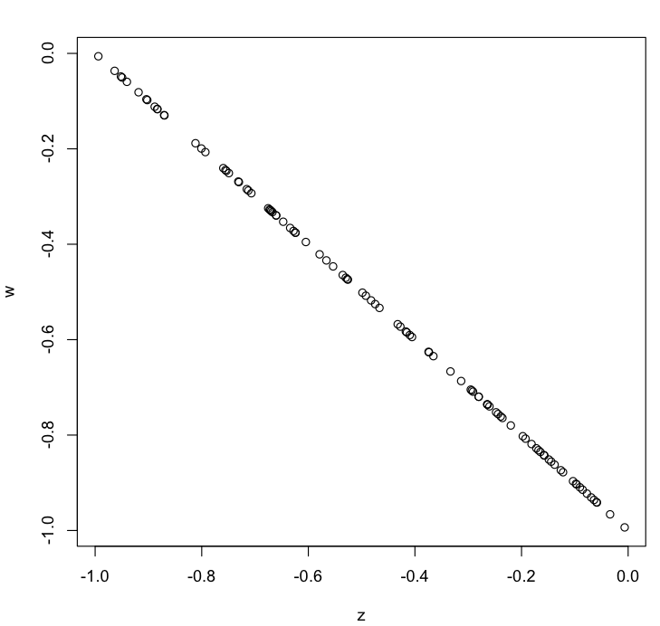
Tail dependence
Example where a random variable is completely dependent in terms of the variables, but completely tail independent (from Reiss and Thomas (2007) p. 75.
z <- runif( 100, -1, 0 )
w <- -1*(1 + z)
taildep( z, w, u = 0.8 )
taildep.test( z, w )
Reiss, R.-D. and Thomas, M., 2007. Statistical Analysis of Extreme Values: with applications to insurance, finance, hydrology and other fields. Birkhäuser, 530pp., 3rd edition.

Slide 56
Future Plans
New bootstrap options (testing stage)
Currently only parametric bootstrap with percentile method is available via ci() function
Multiple options for regular bootstrap using the distillery package
m < n bootstrap
iid and block bootstrap options
Multiple choices for estimated intervals (e.g., BCa, basic, bootstrap-t, normal, etc.)
Test-inversion bootstrap also using distillery package
New bivariate EVA functionality (with help from Dan Cooley; early stage)
Other … (thinking stage; funding dependent)

Slide 57
For more information…
extRemes tutorial: Gilleland, E. and R. W. Katz, 2016. extRemes 2.0: An Extreme Value Analysis Package in R. Journal of Statistical Software, 72 (8), 1 - 39, DOI: 10.18637/jss.v072.i08.
Rick Katz’s web page preserved: https://ral.ucar.edu/projects/extremes/Extremes/

