Slide 1




TRM Compliance Check
Naod Abraham

Slide 2

TABLE OF CONTENTS
Introduction
Key Features and Achievements
Challenges and Learnings
Sample HTML Results

Slide 3
INTRODUCTION
Project Overview
My Project is a Python based automation tool designed to verify TRM Compliance. It reads the provided YAML file containing the entries and check each version against the TRM database. Then determines whether it’s InCompliance. The results are then rendered into a HTML report for easy review.
Objectives
Automate a repetitive and time-consuming compliance verification task
Ensure consistent and accurate reporting of TRM status
Provide a clear, shareable output that can be used by others
Relevance
This tool streamlines a process that’s typically manual and error-prone. By automating the compliance check and generating a visual report, it saves time, reduces human error, and improves transparency across teams that rely on TRM data.

Slide 4



The program starts by reading a YAML file containing TRM entries. Each entry contains metadata such as a tool id and version which are used to verify compliance
YAML Parsing
Using Selenium WebDriver, the tool navigates each entry’s TRM webpage and scrapes the compliance status directly from the site. Ensuring up-to-date and accurate results.
Selenium Automation
Key Features & Achievements
My biggest achievement was completing this project a week before the program ended, even though I started late. This reflects my commitment and ability to efficiently deliver results
Early Completion

Slide 5
Challenges & Learnings
Python and HTML Skills
Adapting to Full-Time Work
In-Person Engagement
Although I came into this project with experience in Python and HTML, I encountered new challenges that pushed me to expand my skills. Debugging issues and optimizing my code led me to discover new libraries, methods, and practices I hadn’t used before.
This was my first full time role, and it taught me a lot about how to structure my day, manage expectations, and contribute meaningfully. Over the six weeks, I learned how to balance productivity with communication
One of the biggest personal challenges was commuting to the office regularly. While I wanted to connect and network more in person. The long drive made it difficult to attend as much as I hoped. To stay engaged, I made an effort to connect remotely.

Slide 6
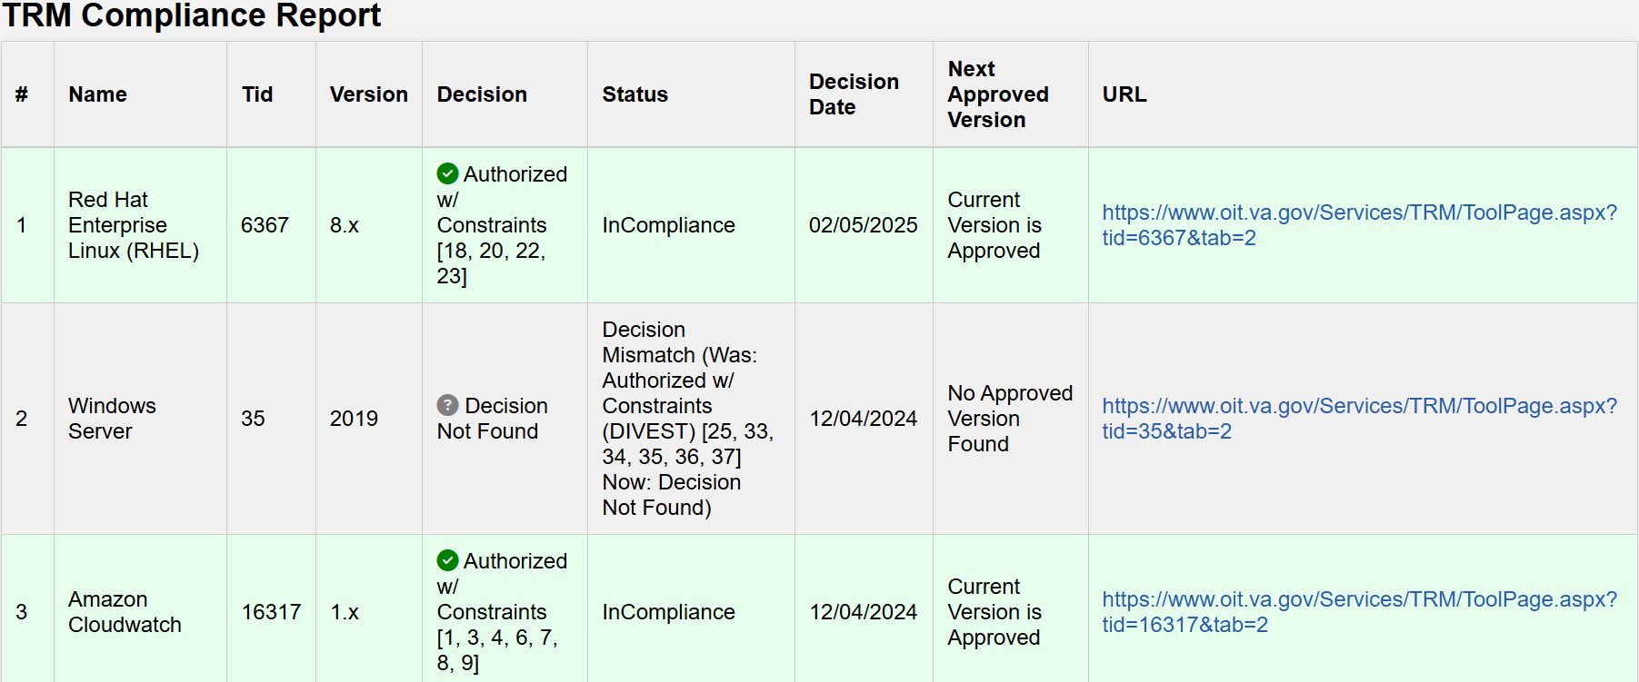
Sample HTML Results

Slide 7
THANK YOU!

