Slide 4
Full lifecycle of a microservice: how to realize a fault-tolerant and reliable architecture and deliver it as a Docker container or in a Cloud environment
Luigi Bennardis

Slide 5
Abstract
It will be shown, step by step, the full lifecycle development process of a microservice. From architectural (database per service) and technological (Spring Boot) aspects to delivery related scenarios (development, Cloud or dockerized environments), in an ecosystem context where microservices are each other reliable and fault tolerant (Eureka service registry, Ribbon load balancing, Spring Cloud).

Slide 6
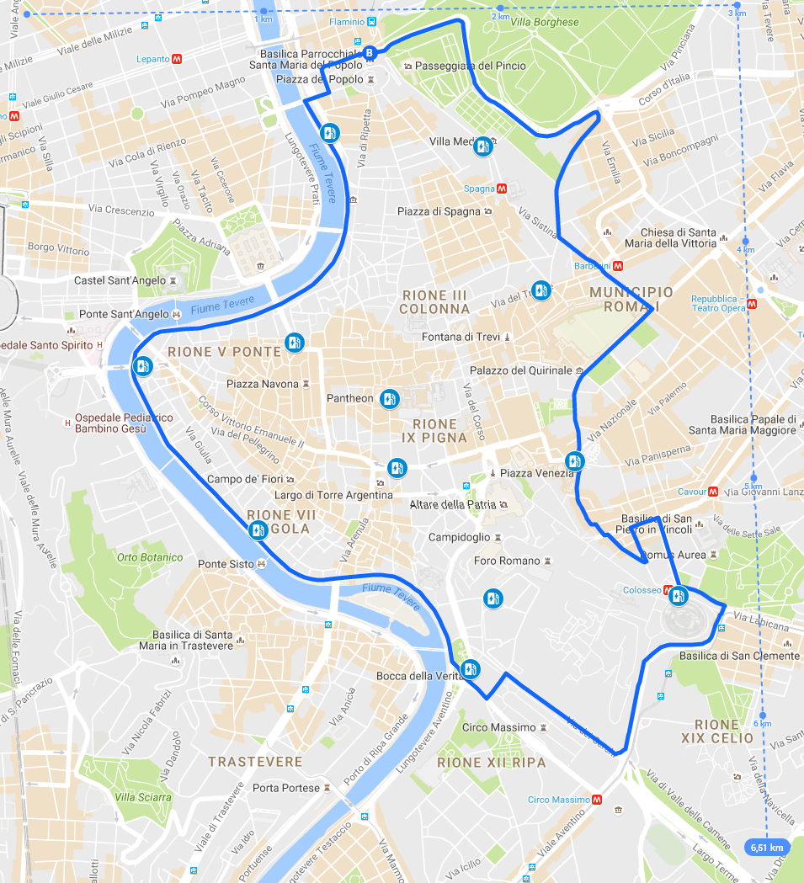
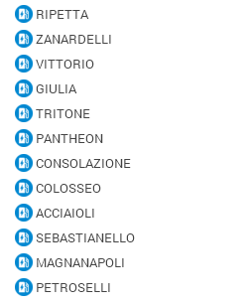
Abstract

Slide 7
Business context

Slide 8
Requirements
Funtional
Non-Functional
Design
Service loosely coupled
Indipendence of each service at develop, deploy and scale out time
Technological
Flexible deployment in environemt
Local
Containerizing
Cloud based
Realize data consistency with asynchronous non-blocking operations
Poliglot persistence with different data store
System
Simple infrastructure scale-out (no stop services)
Flexible not coded service resolution (service discovery)
Client side Load Balancing (non load balancing configuration needs- simple add instance)

Slide 9
Requirements
Project Management related
Deliver software faster
Eventually embrace new technology adopting them quickly with the minimum impact to the system
Teams distributed geographically
Optimizing skill distribution (avoid techical skill where it is not necessary -QA)
Each team with specific skills characterization

Slide 10
Requirements fullfilment: Design Pattern
MICROSERVICE: OVERVIEW
How all these requirements could be accomplished defining the right
Microservices
build a system based on microservices architecture could lead
Use of different technology inside each service i.e. database engine (neo4j; relational, no sql)
If one of the part of the system need to improve or scale up we can decide to use a different technological stack without impacts on the system
In a context of on-demand provisioning system (PWS) it is possible to apply this scaling only for those services that need it with a more efficient control of the costs
In the wors of «it’s not often thata an architectural approach can be closely correlated to an almost immediate cost saving»
Ease of deployment vs monolitic architecture that require the whole application to be deployed in order to release change (it doesn’t matter how wide are the changes) scenario that could be large impact (time for repuplish a service) and high risk
Microservice enable that a change to a single service colud be immediatly deployed isolated from the rest of the system and fast rollbacked
It is not a silver bullet or a free lunch
gestione di puù sistemi middleware (overhead in management)
gestione della transazionalità in modo applicativo (overhead in coding )

Slide 11
Pattern: Database per service /MICROSERVICE : IMPLEMENTING THE DATABASE PER SERVICE PATTERN
Which database architecture for a microservice design pattern: DATABASE PER SERVICE PATTERN
We want to realize:
Services loosely coupled that can develop, deployed and scaled indipendently
Business transactions that need to update data ownd by multiple services
Some queriesmust join data owned by multiple services
Different service have different data store requirements
With a Database per service pattern it is possible to achieve:
Each microservice’s persistence data private to that service accessible only via its API
To keep data private in case of relational database such are the option:
Private-table-per service (lowest overhead)
Schema-per_service (makes clear ownership)
Database-server-per-service (for highly throughput service – neo4j)
To enforce encapsulation with different database user id to each service so developers wil not temped to bypass a service api and access it’s data directly

Slide 12
Pattern: Database per service /MICROSERVICE : IMPLEMENTING THE DATABASE PER SERVICE PATTERN
Benefits of this pattern
Ensure that the servicesa are loosely couples changes to one service’s database dos not impact any other services
Each service can use the type of database that is best suited to its need (neo4j social graph, elasticsearch for text serches,etc)
Drawbacks
Distributed business transaction that span multiple services could be not implemented (CAP theorem and many modern database does not support them NoSql)
Implementing queries that join data that are now in multiple datanìbase is challenging
An overall more complex programming model
Solution to drawbacks:
Data consistency across multiple services could be enabled without distributed transaction with a Event Driven Architecture with services that publish events when update their data and other services that update their own data subscribing these events
Application side join (tha applicatyion perform the join rather than database) CQRS maintaining one or more materialized views that contain data from multiple services these views are kept by services that subscribes to events that each service publish wheh it update its data.
Related patterns as way to atomically update state and publish event.
Event sourcing
Database triggers
Transaction log tailing

Slide 14
Pattern: Database per service /MICROSERVICE : IMPLEMENTING THE DATABASE PER SERVICE PATTERN
http/rest
BOOKING
INSTANCE #1
@ HTTP 7111

Slide 15
Requirements fullfilment: Technology stack
DESIGN PATTERN |  | TECHNOLOGY STACK
CORE MICROSERVICE |  | SPRING BOOT
DATABASE PER SERVICE | EVENT DRIVEN ARCHITECTURE | SPRING CLOUD STREAM
 | MATERIALIZED VIEW
 | ??? COMPENSATION | SPRING CLOUD BATCH
 | REST API | SPRING BOOT DATA REST
DATA ACCESS | RELATIONAL DATABASE (MYSQL-H2) | SPRING BOOT JPA
 | NO SQL DATABASE (MONGO DB) | SPRING MONGO DB
CONFIGURATION |  | SPRING CONFIG
CLOUD BASE ARCHITECTURE |  | SPRING CLOUD
SERVICE DISCOVERY |  | NETFLIX EUREKA
LOAD BALANCING |  | NETFLIX RIBBON
MESSAGE BROKER |  | APACHE KAFKA

Slide 16
Technology stack
Spring boot
One technology that lets you focus on getting things done is one of the newer members of the Spring
ecosystem: the Spring Boot project. This project has two main benefits. The first benefit is that Spring Boot
dramatically simplifies application configuration by taking Convention over Configuration (CoC) in Spring
applications to a whole new level. Spring Boot has a feature called auto-configuration that intelligently
provides a set of default behaviors that are driven by what jars are on the classpath. For example, if you
include database jars on the classpath then Spring Boot will define DataSource and JdbcTemplate beans
unless you have already defined them. As a result, it’s remarkably easy to get a new micro-service up and
running with little or no configuration while preserving the ability to customize your application.
The second benefit of Spring Boot is that it simplifies deployment by letting you package your application as
an executable jar containing a pre-configured embedded web container (Tomcat or Jetty). This eliminates the
need to install and configure Tomcat or Jetty on your servers. Instead, to run your micro-service you simply
need to have Java installed. Moreover, the executable jar format provides uniform and self-contained way of
packaging and running JVM applications regardless of type, which simplifies operations. If necessary, you can,
however, configure Spring Boot to build a war file. Let’s illustrate these features by developing a Spring Boot
version of the user registration microservice.
Spring Cloud stream

Slide 17
Technology stack
SPRING CLOUD STREAM
Spring Cloud Stream is a framework for building message-driven microservices. Spring Cloud Stream builds upon Spring Boot to create DevOps friendly microservice applications and Spring Integration to provide connectivity to message brokers. Spring Cloud Stream provides an opinionated configuration of message brokers, introducing the concepts of persistent pub/sub semantics, consumer groups and partitions across several middleware vendors. This opinionated configuration provides the basis to create stream processing applications.
Enter, Spring Cloud Stream, an event-driven microservices framework powered by Spring portfolio of projects underneath that enables continuous delivery for data-centric applications. The core premise of Spring Cloud Stream is, Spring Integration meets Spring Boot and that together evolves into a lightweight event-driven microservices framework.
This new GA release allows users to:
Develop using simplified programming model
Create, unit-test, and manage data microservices in isolation
Focus on application business logic and the messaging middleware access comes out-of-the-box, for free
Build upon powerful common abstractions to customize core fundamental capabilities including middleware binding, data partitioning, client-consumer grouping, and pluggable binder API

Slide 18
Technology stack
SPRING BOOT JPA - Hibernate
Object/Relational Mapping
Hibernate ORM enables developers to more easily write applications whose data outlives the application process. As an Object/Relational Mapping (ORM) framework, Hibernate is concerned with data persistence as it applies to relational databases (via JDBC). Unfamiliar with the notion of ORM? Read here.
JPA Provider
In addition to its own "native" API, Hibernate is also an implementation of the Java Persistence API (JPA) specification. As such, it can be easily used in any environment supporting JPA including Java SE applications, Java EE application servers, Enterprise OSGi containers, etc.
Idiomatic persistence
Hibernate enables you to develop persistent classes following natural Object-oriented idioms including inheritance, polymorphism, association, composition, and the Java collections framework. Hibernate requires no interfaces or base classes for persistent classes and enables any class or data structure to be persistent.
High Performance
Hibernate supports lazy initialization, numerous fetching strategies and optimistic locking with automatic versioning and time stamping. Hibernate requires no special database tables or fields and generates much of the SQL at system initialization time instead of at runtime.
Hibernate consistently offers superior performance over straight JDBC code, both in terms of developer productivity and runtime performance.
Scalability
Hibernate was designed to work in an application server cluster and deliver a highly scalable architecture. Hibernate scales well in any environment: Use it to drive your in-house Intranet that serves hundreds of users or for mission-critical applications that serve hundreds of thousands.
Reliable
Hibernate is well known for its excellent stability and quality, proven by the acceptance and use by tens of thousands of Java developers.
Extensibility
Hibernate is highly configurable and extensible.

Slide 19
Technology stack
SPRING DATA MONGO DB
Introduction
The Spring Data MongoDB project provides integration with the MongoDB document database. Key functional areas of Spring Data MongoDB are a POJO centric model for interacting with a MongoDB DBCollection and easily writing a Repository style data access layer.
Features
Spring configuration support using Java based @Configuration classes or an XML namespace for a Mongo driver instance and replica sets.
MongoTemplate helper class that increases productivity performing common Mongo operations. Includes integrated object mapping between documents and POJOs.
Exception translation into Spring’s portable Data Access Exception hierarchy
Feature Rich Object Mapping integrated with Spring’s Conversion Service
Annotation based mapping metadata but extensible to support other metadata formats
Persistence and mapping lifecycle events
Low-level mapping using MongoReader/MongoWriter abstractions
Java based Query, Criteria, and Update DSLs
Automatic implementation of Repository interfaces including support for custom finder methods.
QueryDSL integration to support type-safe queries.
Cross-store persistance - support for JPA Entities with fields transparently persisted/retrieved using MongoDB
Log4j log appender
GeoSpatial integration
Map-Reduce integration
JMX administration and monitoring
CDI support for repositories
GridFS support

Slide 20
Technology stack
SPRING CONFIG
SPRING CLOUD
Spring Cloud provides tools for developers to quickly build some of the common patterns in distributed systems (e.g. configuration management, service discovery, circuit breakers, intelligent routing, micro-proxy, control bus, one-time tokens, global locks, leadership election, distributed sessions, cluster state). Coordination of distributed systems leads to boiler plate patterns, and using Spring Cloud developers can quickly stand up services and applications that implement those patterns. They will work well in any distributed environment, including the developer's own laptop, bare metal data centres, and managed platforms such as Cloud Foundry.
Features
Spring Cloud focuses on providing good out of box experience for typical use cases and extensibility mechanism to cover others.
Distributed/versioned configuration
Service registration and discovery
Routing
Service-to-service calls
Load balancing
Circuit Breakers
Global locks
Leadership election and cluster state
Distributed messaging

Slide 21
Technology stack
Spring Cloud Config
Spring Cloud Config provides server and client-side support for externalized configuration in a distributed system. With the Config Server you have a central place to manage external properties for applications across all environments. The concepts on both client and server map identically to the Spring Environment and PropertySource abstractions, so they fit very well with Spring applications, but can be used with any application running in any language. As an application moves through the deployment pipeline from dev to test and into production you can manage the configuration between those environments and be certain that applications have everything they need to run when they migrate. The default implementation of the server storage backend uses git so it easily supports labelled versions of configuration environments, as well as being accessible to a wide range of tooling for managing the content. It is easy to add alternative implementations and plug them in with Spring configuration.
SPRING CLOUD
Spring Cloud provides tools for developers to quickly build some of the common patterns in distributed systems (e.g. configuration management, service discovery, circuit breakers, intelligent routing, micro-proxy, control bus, one-time tokens, global locks, leadership election, distributed sessions, cluster state). Coordination of distributed systems leads to boiler plate patterns, and using Spring Cloud developers can quickly stand up services and applications that implement those patterns. They will work well in any distributed environment, including the developer's own laptop, bare metal data centres, and managed platforms such as Cloud Foundry.
Features
Spring Cloud focuses on providing good out of box experience for typical use cases and extensibility mechanism to cover others.
Distributed/versioned configuration
Service registration and discovery
Routing
Service-to-service calls
Load balancing
Circuit Breakers
Global locks
Leadership election and cluster state
Distributed messaging

Slide 22
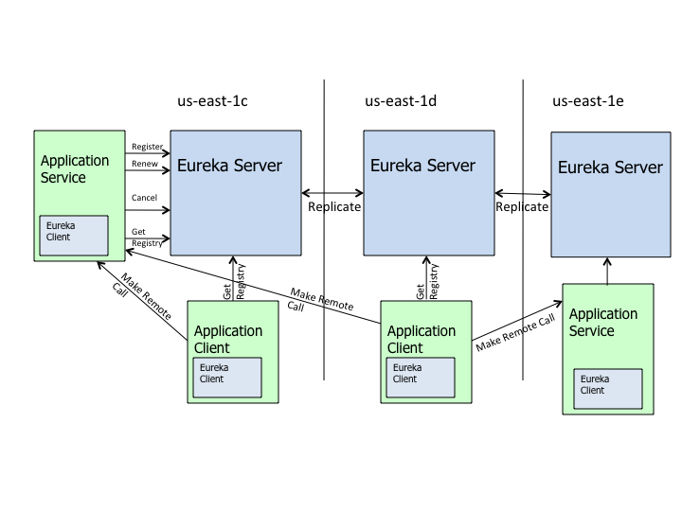
Technology stack
NETFLIX EUREKA
Eureka is a REST (Representational State Transfer) based service that is primarily used in the AWS cloud for locating services for the purpose of load balancing and failover of middle-tier servers. We call this service, the Eureka Server. Eureka also comes with a Java-based client component,theEureka Client, which makes interactions with the service much easier. The client also has a built-in load balancer that does basic round-robin load balancing. At Netflix, a much more sophisticated load balancer wraps Eureka to provide weighted load balancing based on several factors like traffic, resource usage, error conditions etc to provide superior resiliency.
The architecture above depicts how Eureka is deployed at Netflix and this is how you would typically run it. There is one eureka cluster per region which knows only about instances in its region. There is at the least one eureka server per zone to handle zone failures.
Services register with Eureka and then send heartbeats to renew their leases every 30 seconds. If the client cannot renew the lease for a few times, it is taken out of the server registry in about 90 seconds. The registration information and the renewals are replicated to all the eureka nodes in the cluster. The clients from any zone can look up the registry information (happens every 30 seconds) to locate their services (which could be in any zone) and make remote calls.

Slide 23
Technology stack
NETFLIX RIBBON
Ribbon provides software load balancers to communicate with cluster of servers. The load balancers provide the following basic functionalities:
Supply the public DNS name or IP of individual servers to communication client
Rotate among a list of servers according to certain logic
Certain load balancers can also provide advanced features like
Establishing affinity between clients and servers by dividing them into zones (like racks in a data center) and favor servers in the same zone to reduce latency
Keeping statistics of servers and avoid servers with high latency or frequent failures
Keeping statistics of zones and avoid zones that might be in outage
Utilizing the advanced features requires using one of the client provided in Ribbon as it has integration with load balancer and provides input to the load balancer statistics

Slide 24
Requirements fullfilment: Lifecycle process
LIFECYCLE
DEVELOPMENT
UNIT TEST
INTEGRATION
TEST
QUALITY ASSURANCE
PRODUCTION
(CLOUD)
SERVICES
CONFIGURATION
MANAGEMENT
GITHUB
JENKINS@OPENSHIFT
BUILD
AUTOMATION
ECLIPSE
ECLIPSE
DOCKERHUB
PIVOTAL WEB
SERVICES
SOLUTION
DELIVERY
DOCKER
PAAS
H2 / MYSQL
MYSQL
MYSQL AS A SERVICE
LOCAL
BACKING
SERVICES
MONGODB
MONGODB AS A SERVICE
KAFKA
KAFKA AS A SERVICE

Slide 25
Requirements fullfilment: Lifecycle process
LIFECYCLE
DEVELOPMENT
UNIT TEST
INTEGRATION
TEST
QUALITY ASSURANCE
PRODUCTION
(CLOUD)
SERVICES
CONFIGURATION
MANAGEMENT
GITHUB
JENKINS@OPENSHIFT
BUILD
AUTOMATION
ECLIPSE
ECLIPSE
DOCKERHUB
PIVOTAL WEB
SERVICES
SOLUTION
DELIVERY
DOCKER
PAAS
H2 / MYSQL
MYSQL
MYSQL AS A SERVICE
LOCAL
BACKING
SERVICES
MONGODB
MONGODB AS A SERVICE
KAFKA
KAFKA AS A SERVICE

Slide 26
Lifecycle process
DEVELOPMENT
UNIT TEST
INTEGRATION TEST
QUALITY ASSURANCE
PRODUCTION
http/rest
BOOKING
INSTANCE #1
@ HTTP 7111

Slide 27
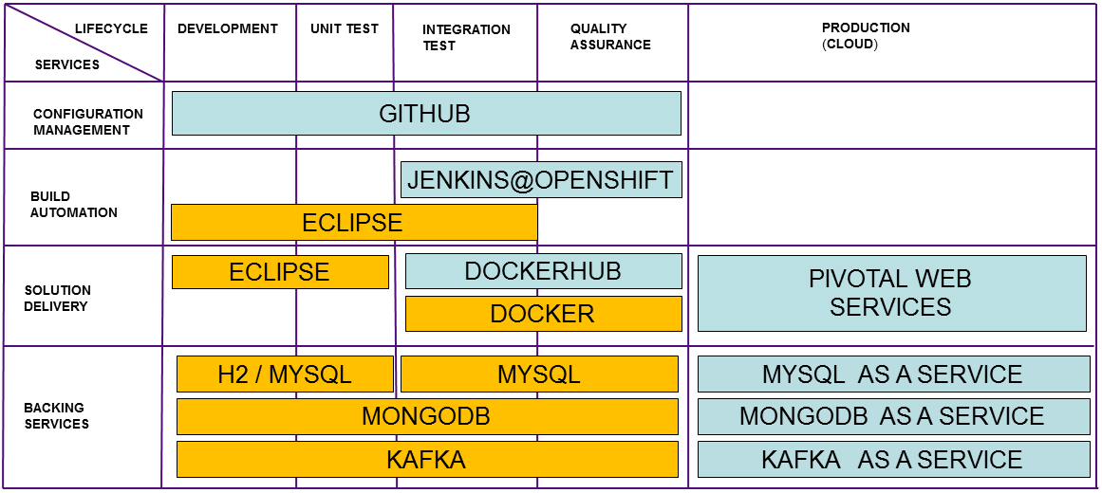
DEVELOPMENT / UNIT TEST
Binding data services
Configuration
Different file
H2 in memry database
https://spring.io/guides/gs/accessing-data-rest/
https://spring.io/guides/gs/accessing-data-jpa/
http://blog.netgloo.com/2014/10/27/using-mysql-in-spring-boot-via-spring-data-jpa-and-hibernate/
Demo

Slide 28
INTEGRATION TEST
Docker local
Special images with data specific for test
Mysql introduce configuration properties
Docker file
Maven directives
Start docker
Follow demo docker

Slide 29
Docker
Introduction to Docker
Docker is a new way to containerize applications that is becomingly increasingly popular. It allows you to
package a microservice in a standardized portable format that’s independent of the technology used to
implement the service. At runtime it provides a high degree of isolation between different services. However,
unlike virtual machines, Docker containers are extremely lightweight and as a result can be built and started
extremely quickly. A container can typically be built in just a few seconds and starting a container simply
consists of starting the service’s process(es).
Docker runs on a variety of platforms. It runs natively on Linux. You can also run Docker on Windows and Mac
OSX using Boot2Docker, which runs the Docker daemon in a VirtualBox VM. Some clouds also have added
extra support for Docker. For example, not only can you run Docker inside your EC2 instances but you can also
use Elastic Beanstalk to run Docker containers. Amazon also recently announced the Amazon EC2 Container
Service, which is a hosted Docker container management service. Google Cloud also has support for Docker.
The two main Docker concepts are image, which is a portable application packaging format, and container,
which is a running image and consists of one or more sandboxed processes. Let’s first look at how images
work.

Slide 30
Docker
Docker image
A Docker image is read-only file system image of an operating system and an application. It’s analogous to an
AWS EC2 AMI. An image is self-contained and will run on any Docker installation. You can create an image
from scratch but normally an image is created by starting a container from existing base image, installing
applications by executing the same kinds of commands you would use when configuring a regular machine,
such as apt-get install –y and then saving the container as a new image. For example, to create an image
containing a Spring Boot based application, you could start from a vanilla Ubuntu image, install the JDK and
then install the executable JAR.
In many ways, building a Docker image is similar to building an AMI. However, while an AMI is a blob of bits,
a Docker image has a layered structure that dramatically reduces the amount of time needed to build and
deploy a Docker image. An image consists of a sequence of layers. When building an image, each command
that changes the file system (e.g. apt-get install) create a new layer that references it’s parent layer.
This layered structure has two important benefits. First it enables of sharing of layers between images, which
means that Docker does not need to move an entire image over the network. Only those layers that don’t exist
on the destination machine need to be copied, which usually results in a dramatic speedup. Another important
benefit of the layered structure is that Docker aggressively caches layers when building an image. When reexecuting
a command against an input layer Docker tries to skip executing the command and instead reuses
the already built output layer. As a result, building an image is usually extremely fast.

Slide 31
QUALITY ASSURANCE
Docker hub
at the end of integration phase….
Porpouse
Specific database images with data ready to be used for specific unit or integration tests
Improve the response to critic bug fixing and realize a faster fixing
Collection of specific container to face different bug fixing or non regression scenarios
Jenkins@openshift
description

Slide 32
Docker Hub
Docker Hub is a cloud-based registry service which allows you to link to code repositories, build your images and test them, stores manually pushed images, and links to Docker Cloud so you can deploy images to your hosts. It provides a centralized resource for container image discovery, distribution and change management,user
Docker Hub provides the following major features:
Image Repositories: Find, manage, and push and pull images from community, official, and private image libraries.
Automated Builds: Automatically create new images when you make changes to a source code repository.
Webhooks: A feature of Automated Builds, Webhooks let you trigger actions after a successful push to a repository.
Organizations: Create work groups to manage access to image repositories.
GitHub and Bitbucket Integration: Add the Hub and your Docker Images to your current workflows.
and team collaboration, and workflow automation throughout the development pipeline.

Slide 33
Docker Hub
Use Official Repositories
Docker Hub contains a number of Official Repositories. These are public, certified repositories from vendors and contributors to Docker. They contain Docker images from vendors like Canonical, Oracle, and Red Hat that you can use as the basis to building your applications and services.
With Official Repositories you know you’re using an optimized and up-to-date image that was built by experts to power your applications.
Work with Docker Hub image repositories
Docker Hub provides a place for you and your team to build and ship Docker images.
You can configure Docker Hub repositories in two ways:
Repositories, which allow you to push images from a local Docker daemon to Docker Hub, and
Automated Builds, which link to a source code repository and trigger an image rebuild process on Docker Hub when changes are detected in the source code.
You can create public repositories which can be accessed by any other Hub user, or you can create private repositories with limited access you control.
Docker commands and Docker Hub
Docker itself provides access to Docker Hub services via the docker search, pull, login, and pushcommands.
.

Slide 34
Jenkins@Openshift
Red Hat OpenShift
OpenShift is Red Hat's Platform-as-a-Service (PaaS) that allows developers to quickly develop, host, and scale applications in a cloud environment.
Continuous Integration with Jenkins
Jenkins is a full featured continuous integration (CI) server that can run builds, tests, and other scheduled tasks and integrate with your dockerhub and github applications.

Slide 35
DEVELOPER #1
DEVELOPER #2
INTEGRATION MANAGER
JENKINS
@OPENSHIFT
GITHUB
DOCKERHUB
QUALITY ASSURANCE MANAGER
/devBranch#1
/devBranch#2
/devBranch#1
/devBranch#2
Unit Test:: COMPLETED
/QABranch
Integration Test:: COMPLETED
[Ask for a
build]
/QABranch
Unit Test:: COMPLETED
EAR
DOCKERFILE
[Ask for building
an image]
Docker Image:: AVAILABLE
/QABranch::
EAR
/QABranch::
DOCKERFILE
[Docker get image]
[Image available]

Slide 36
QUALITY ASSURANCE
Docker Hub
Jenkins@openshift

Slide 37
PRODUCTION
Pivotal Web Services
Backimg services
Yml file
Create from interface
By cf tool
Database as a Service Pattern

Slide 39
Event driven architecture: transaction issues
Distributed data management
Data access become more complex when we move to a microservice architecture . Not only because the data access is private to each microservice(encasulation/loosely coupled -> indipendent evolution) but also because of the use of different dabase used by microservices. A microservice based architecture often use a mixture of SQL and NoSql Dataabse the so called poliglot persistence approch. This has many benefits: ,ore convinent datamodel according business requirements and better performance and scalability but introduce distributed data transaction challenge: implement business transaction that maintain consistency acrosso multiple services. And implement queries that retrieve data from multiple services.
Maintain data consistency across microservices (by exchanging events)
Having applied the Database per Service pattern. Each service has its own database. Some business transactions, however, span multiple service so you need a mechanism to ensure data consistency across services.
Use an event-driven, eventually consistent approach. Each service publishes an event whenever it update it’s data. Other service subscribe to events. When an event is received, a service updates it’s data
This pattern has the following benefits:
It enables an application to maintain data consistency across multiple services without using distributed transactions
This solution has the following drawbacks:
The programming model is more complex
Introduction of a message broker (overhead of management)
Transaction model: example of base model
High Reliability of message broker
Scheduler definition and implementation details
poliglot persistance pattern implementation

Slide 40
Event driven architecture: transaction issues
Having applied the Database per Service pattern. Each service has its own database. Some business transactions, however, span multiple service so you need a mechanism to ensure data consistency across services.
Use an event-driven, eventually consistent approach. Each service publishes an event whenever it update it’s data. Other service subscribe to events. When an event is received, a service updates it’s data
This pattern has the following benefits:
It enables an application to maintain data consistency across multiple services without using distributed transactions
This solution has the following drawbacks:
The programming model is more complex
Introduction of a message broker (overhead of management)
Transaction model: example of base model
High Reliability of message broker
Scheduler definition and implementation details
poliglot persistance pattern implementation

Slide 41
Event driven architecture: transaction issues
Transaction model: example of base model
Each business transaction will consist of a series of steps each of these cocnsists of a microservice updating a business entity and publishing an event yhat trigger the next step.
The message brojer guarantees that ebìvents are delivered at least once
Events will be used alo to maintain materialized views that joins data owned by different services.
Drawbacks of this approch:
Programming model more complex
The need of implementing compansating transaction to recover from application/infrastructure failures
Ato mitigate infrastructure failure coming from message broker: mitigating High Reliability of message broker
Scheduler definition and implementation details
poliglot persistance pattern implementation

Slide 42
Event driven architecture System landscape
http/rest
Message Broker - Apache Kafka
BOOKING
MANAGEMENT
MATERIALIZED VIEW
MySql
MySql
MongoDB

Slide 43
Apache Kafka
The project aims to provide a unified, high-throughput, low-latency platform for handling real-time data feeds. The design is heavily influenced by transaction logs. It is a messaging system, similar to traditional messaging systems like RabbitMQ, ActiveMQ, MQSeries, but it’s ideal for log aggregation, persistent messaging, fast (_hundreds_ of megabytes per second!) reads and writes, and can accommodate numerous clients
A Kafka broker cluster consists of one or more servers where each may have one or more broker processes running. Apache Kafka is designed to be highly available; there are no masternodes. All nodes are interchangeable. Data is replicated from one node to another to ensure that it is still available in the event of a failure.
In Kafka, a topic is a category, similar to a JMS destination or both an AMQP exchange and queue. Topics are partitioned, and the choice of which of a topic’s partition a message should be sent to is made by the message producer. Each message in the partition is assigned a unique sequenced ID, its offset. More partitions allow greater parallelism for consumption, but this will also result in more files across the brokers.
Producers send messages to Apache Kafka broker topics and specify the partition to use for every message they produce. Message production may be synchronous or asynchronous. Producers also specify what sort of replication guarantees they want.
Consumers listen for messages on topics and process the feed of published messages. As you’d expect if you’ve used other messaging systems, this is usually (and usefully!) asynchronous.
Like Spring XD and numerous other distributed system, Apache Kafka uses Apache Zookeeper to coordinate cluster information. Apache Zookeeper provides a shared hierarchical namespace (called znodes) that nodes can share to understand cluster topology and availability (yet another reason that Spring Cloud has forthcoming support for it..).
Zookeeper is very present in your interactions with Apache Kafka. Apache Kafka has, for example, two different APIs for acting as a consumer. The higher level API is simpler to get started with and it handles all the nuances of handling partitioning and so on. It will need a reference to a Zookeeper instance to keep the coordination state.

Slide 44
SERVICE A
BOOKING
SERVICE B
MANAGEMENT
SERVICE C
MATERIALIZED VIEW
TOPIC #1
TOPIC #2
TOPIC #3
<PUBLISH>
<SUBSCRIBE>
<SUBSCRIBE>
<PUBLISH>
<SUBSCRIBE>
<SUBSCRIBE>
<PUBLISH>
<SUBSCRIBE>
<SUBSCRIBE>

Slide 45
Wiring Microservice: Discovery Service
Discovery services provided by Eureka
PROBLEM: DECOUPLIG REALIZED ALSO WITH SERVICE DISCOVERY WITHOUT P2P WIRING
Go ahead p2p wiring :EUREKA: DEFINITION

Slide 46
Wiring Microservice: Discovery Service
BOOKING
http/rest
<SERVICE CONSUMER>
EUREKA
BOOKING
INSTANCE #1
@ HTTP 7111

Slide 48
Microservice: Load Balancing
Ribbon
Lod balancing without configuing load balancer adding reference of the new services
Made only with the deploy of a new service
Implementation details

Slide 49
Load balancing: system landscape
BOOKING
http/rest
<SERVICE CONSUMER>
RIBBON
BOOKING
EUREKA
INSTANCE #2
@ HTTP 7113
INSTANCE #1
@ HTTP 7111
INSTANCE #3
@ HTTP 7115

Slide 53
System landscape
BOOKING
HTTP 7113
BOOKING
HTTP 7111
http/rest
BOOKING
<SERVICE CONSUMER>
RIBBON
EUREKA
HTTP 7111
MANAGEMENT
MATERIALIZED VIEW
BOOKING
INSTANCE #1
@ HTTP 7111
INSTANCE #2
@ HTTP 7113
INSTANCE #3
@ HTTP 7115

Slide 54
System landscape
http/rest
<SERVICE CONSUMER>
RIBBON
EUREKA
HTTP 7111
HTTP 7113
HTTP 7111
BOOKING
BOOKING
BOOKING
MANAGEMENT
MATERIALIZED VIEW

Slide 55
System landscape
BOOKING
http/rest
<SERVICE CONSUMER>
RIBBON
EUREKA
BOOKING
MANAGEMENT
MATERIALIZED VIEW

Slide 56
System landscape
BOOKING
http/rest
<SERVICE CONSUMER>
RIBBON
EUREKA
HTTP 7111
HTTP 7113
HTTP 7111
BOOKING
BOOKING
BOOKING
MANAGEMENT
MATERIALIZED VIEW

