Slide 1
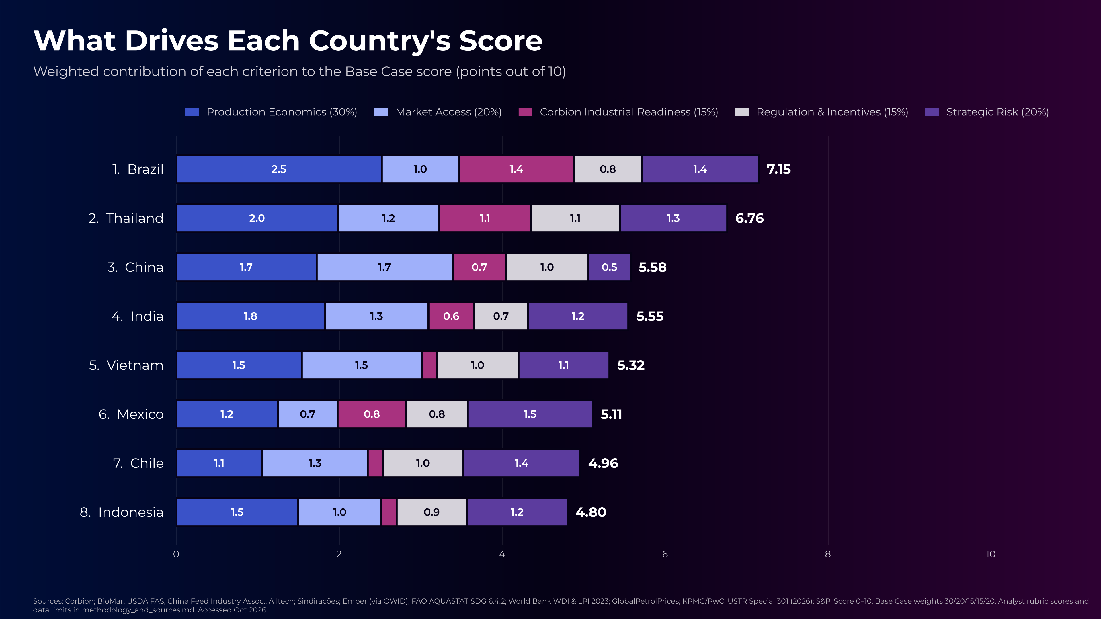
Notes:
Brazil leads on Production Economics (2.5 pts) and Corbion Readiness (1.4). Thailand is the most balanced profile. China has the largest Market Access block (1.7) but the smallest Strategic Risk block (0.5). Vietnam, Chile and Indonesia barely score on Corbion Readiness because Corbion has no plant there. Updated with v2 data (Oct 2026).

