Slide 1

CRITICAL DESIGN REVIEW
CanSat Project
Rocket Sistas!
Lucia Eve, Simon, Serena, Oscar & Jessica
Notes:
Updated Work Breakdown Structure
2. Updated schedule
3. Product and configuration overview (block diagram showing interfaces)
4. CAD designs or detailed sketches if it is not reasonable to have a CAD design
5. Simulations on rocket parameters
6. Circuit design
7. Plan for manufacturing, assembly, integration and tests

Slide 2
Presentation overview
1. Updated Work Breakdown Structure
2. Updated schedule
3.Product and configuration overview
4.CAD designs
5. Simulations on rocket parameters
7.Plan for manufacturing, assembly, integration and tests
6. Circuit design

Slide 3
1.UPDATED FOUR Work Segments
Software & Communication
LUCIA EVE
Electronic Design
SIMON
Eject Mechanism
SERENA & JESSICA
Structure & Mechanic Components
OSCAR
Notes:
1. Software & Communication (Lucia-Eve/Simon)
2. Electronic Design (Lucia-Eve/Simon)
3. Eject Mechanism (Serena/Jessica)
4. Structure & Mechanic Components (Oscar)

Slide 4
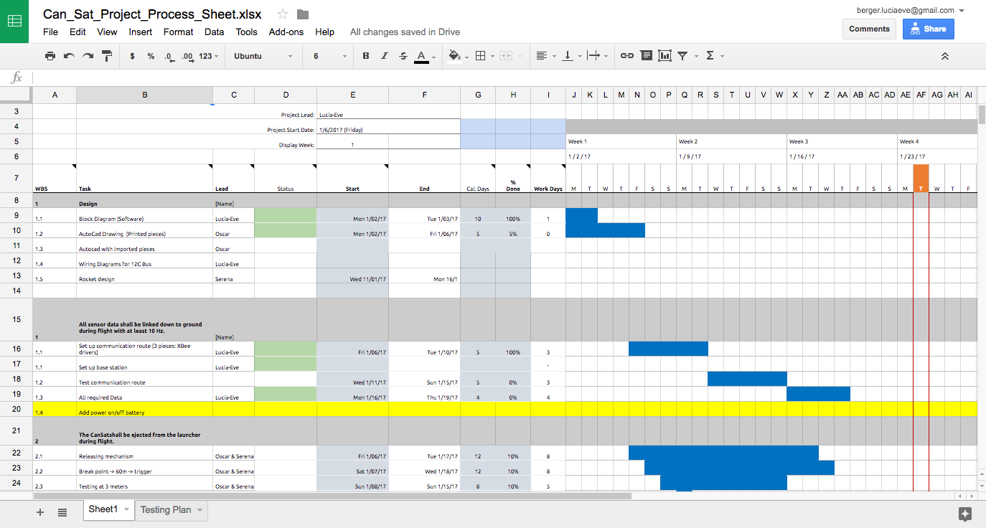
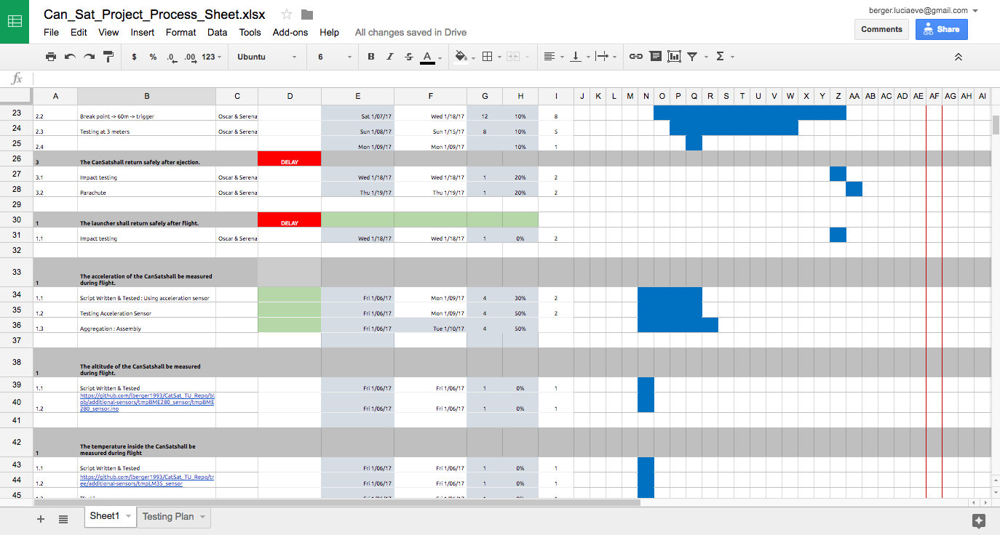
1.GANT SCHEDULE

Slide 5



2. KeY TASKS
WEEK 1
WEEK 2
WEEK 3
WEEK4
Block Diagram (Software)
Brainstorm Ejection
Preliminary sketches
I2C Wiring Diagram
Arduino UNO Assembly
Ejection Mechanism final
Equations
Rocket Design
Circuit Design
Circuit Assembly
Parachute Testing
Fins Design & CAD
Reliability Testing
Circuit Assembly (Cont.)
3D Printing
Fins Assembly

Slide 6
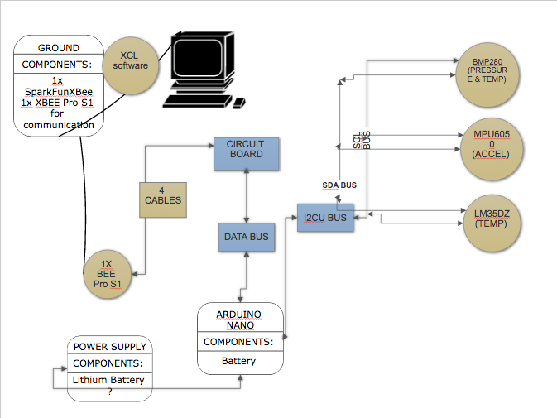
3.0 Product and configuration overview
SERVOS

Slide 7
3.1 SOFTWARE configuration overview
SETUP FUNCTION
void setup() {
initXBee();
initB280();
Wire.begin();
initMPU6050();
Serial.begin(9600);
}
LOOP FUNCTION
void loop() {
Serial.print(counter);
Serial.print(";");
getTmpLM35();
readTemp();
getBaro();
Wire.beginTransmission(MPU_ADDR;
Wire.write(WHO_AM_I);
Wire.endTransmission();
Wire.requestFrom(MPU_ADDR,1);
getAcc();
getGyro();
delay(1000);
}

Slide 8
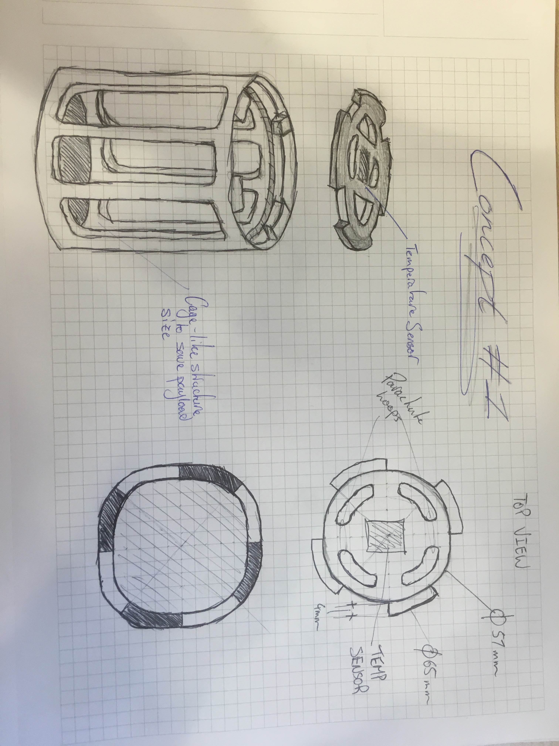
4.0 INITIAL Drawing

Slide 9
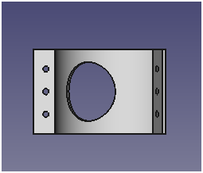
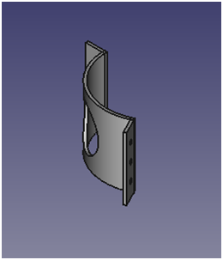
4.1 CAD (Preliminary)
Fin Portion of Structure

Slide 10
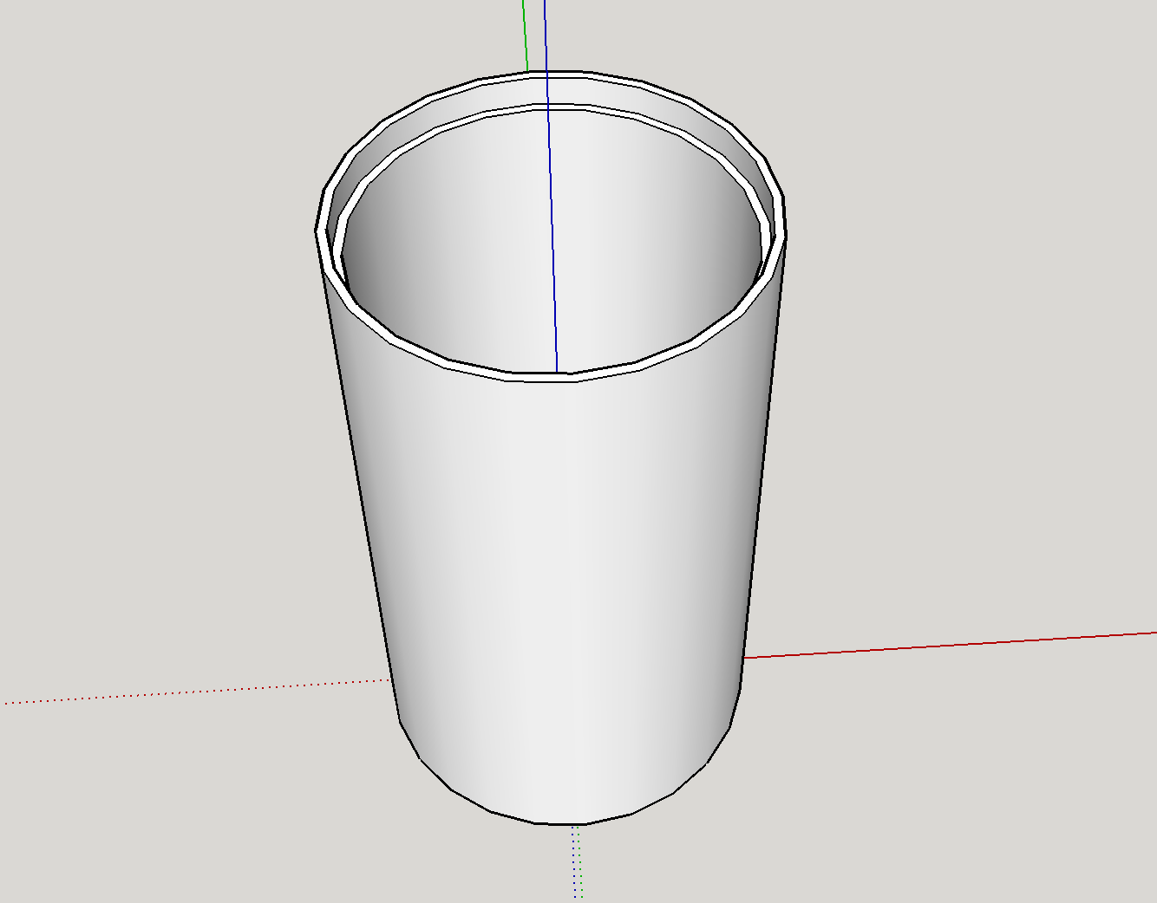
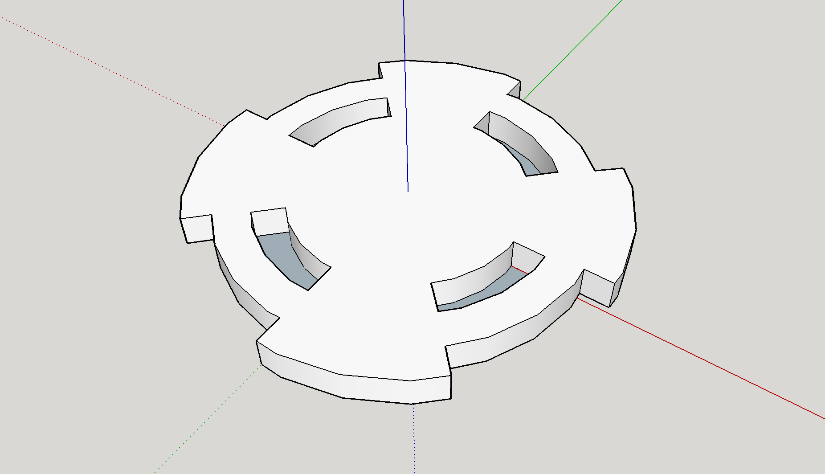
4.2 CAD Implementations
Bottom Portion of Structure

Slide 11
5.0 Rocket design
Dimensions and characteristics (fixed parameters)
Propulsion performances: design parameter of water volume
Aerodinamic design -> Optimal fins (tbd) (+ optimal nose (ideally..) parabolic design -> manifacture)

Slide 12
5.1 Rocket dimensions and fixed parameters
Total dry mass M= 840 g (assumed maximum weight of the satellite)
Total Volume tanks V=5.062 l
Pressured air at 8 bar
Outside pressure (atmospheric pressure at sl) 1.01325 bar
Variable parameter for the propulsion system :
Volume Ratio VR = Volume of water / Tank Volume

Slide 13
5.2 Computations (values at assumed VR=1:3)
APPLIED PRINCIPLES:
Boyle’s law -> pressure of air at empty tank (no water) p=5.333 bar
Bernoulli ->
velocity of water v= 23.094 m/s
Constant mass flow rate through the nozzle -> vel_exit = 41.056 m/s
Equivalent velocity -> v_eq = 51.578 m/s
Ciolkovskij equation -> Δv = 56.814 m/s
OBTAINED PERFORMANCES:
Burn out time (time of water discharge)
t=0.233 s
Thrust = 374.212 N
I = 87030.0 Ns
Isp = 5.258 s
Apogee altitude h= 121.55 m (...formulas to be checked)

Slide 14
5.3 Simulation Results
Parameters | Results
Bottle Volume 5062 cc Diameter 77 mm Water Fill 1687 cc Launch Pressure 800 Kpa (116 PSI, 7.90 Bar) Nozzle diameter 15.0 mm Nozzle viscous losses 0.16 Dry mass 840.0 grams Coefficient of drag 0.75 | Launch and thrust phase Initial thrust 254.1N Initial burn acceleration 90.8 m/s² (9.3G) Average acceleration 128.7 m/s² (13.1G) Burnout Burnout after 0.294 s Burnout Velocity 37.9 m/s Burnout Altitude 4.4 m Burnout acceleration 141.7 (14.4G) Drag force at burnout 1.7 newton (0.2kgf) Deceleration due to drag 0.2G Speed increase due to air pulse 6.8m/s Drag-free coast 73.1 m apogee at 77.5 m , t=4.2 s Actual apogee at 66.49 m, t=3.77 s http://cjh.polyplex.org/rockets/simulation/simulate.cgi

Slide 15
5.4 Ejection Mechanism
- Concept 1: Separation of the rocket stage and the payload stage through a double mechanical mechanism using wind-up ‘arms’ that will unravel the locks that connect the two main sections of the rocket (see hand sketch).
Concept 2: two servo’s connected to an board computer situated inside the nose of the rocket. The arms connected to the servo’s will be modified to form an hook like arm connected to a latch on the inside of the rocket. Using an accelerometer to disconnect the arms once acceleration is equal to 0 m/s - Release of the CanSat by using rubber bands to ensure the ejection at the apogee by providing an initial velocity. Safe landing with parachute. - Second parachute for the rocket and the upper stage (connected by a string).

Slide 16
6.1 HIGH LEVEL I2c Wiring Diagram

Slide 17
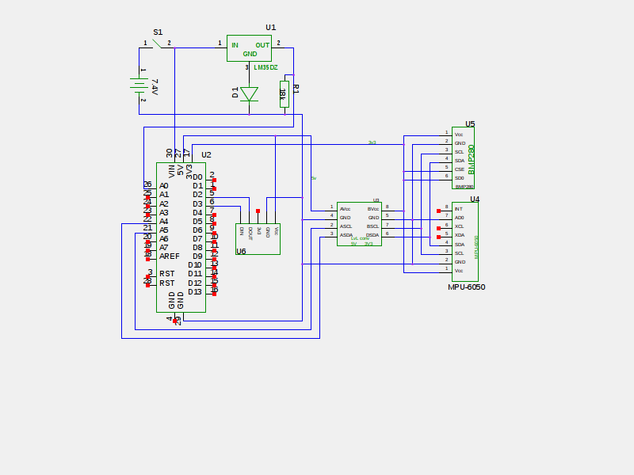
6.2 Circuit Design

Slide 18
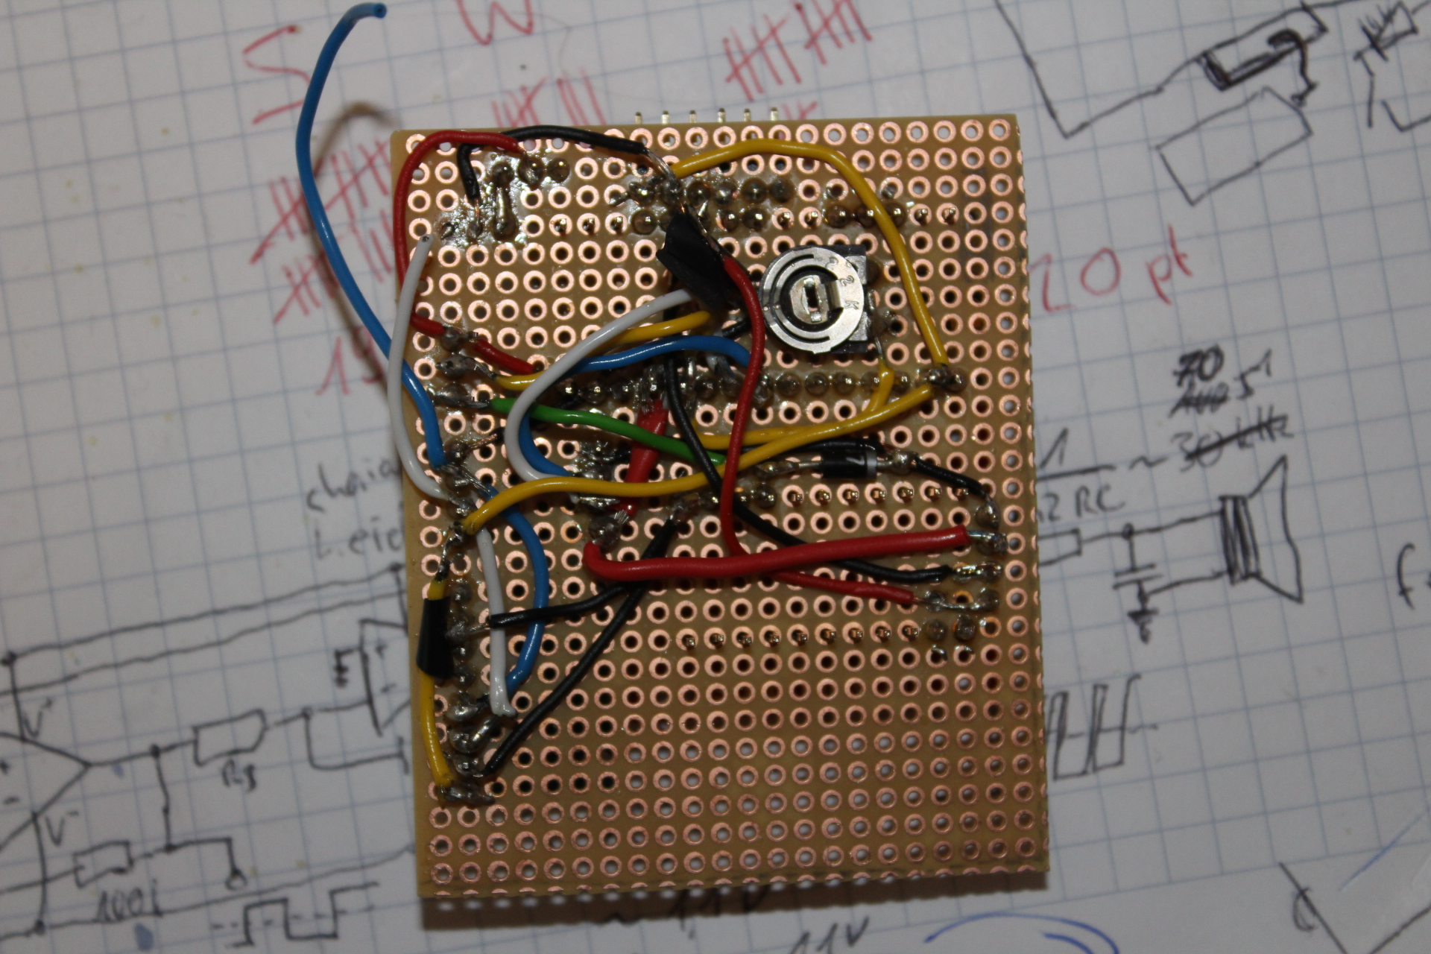
6.3 Circuit Design Realized

Slide 19
7.0 Testing
Date | Testing Component | Tests | Status | Status | Status | Test Results
1/17/2017 | Software Testing | X Bee Communication |  |  |  | COMPLETE
 |  | Acceleration breakpoint Test |  |  |  | INCOMPLETE
 |  | Sensor Relability Testing |  |  |  | INCOMPLETE
 |  | CSV/Graph format correct? |  |  |  | INCOMPLETE
1/17/2017 | Electronics Testing | Power Supply Testing (able to switch on/off) |  |  |  | INCOMPLETE
 |  | APOG testing |  |  |  | INCOMPLETE
 |  | Temperature Testing (Freezing?) |  |  |  | INCOMPLETE
 |  |  |  |  |  | INCOMPLETE
1/17/2017 | Mechanical Testing | Ejection Testing (at 10 m ?) |  |  |  | INCOMPLETE
 |  | Parachuete Ejection (at 10 m) |  |  |  | INCOMPLETE
 |  |  |  |  |  | INCOMPLETE
 |  |  |  |  |  | INCOMPLETE
Payload Components |  | Mechanical Components
Component | Weight (g) | Component | Weight (g)
Circuit Comp | 23 | Can | UNKNOWN
Power Source | 35 | Parachuete | UNKNOWN
Servo | 10
Wiring/ etc | 10
TOTAL | 78

Slide 20
7.1 Assembly

