Slide 1

GNN-Enabled Trustworthy Sensor Fusion for Smart Agriculture
SU Yihang, LIU Bohan
1155173753, 1155173765
Information Engineering
The Chinese University of Hong Kong

Slide 2
Table of Contents
Introduction
Motivation
System Overview
Data Workflow
Three-Stage Model Architecture
Experiment Settings
Results
Discussion
Expected Timeline
2

Slide 3
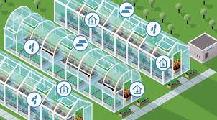
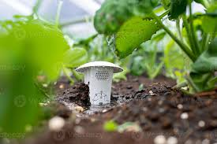
Introduction
Propose a trustworthy sensor fusion system specifically for smart agriculture
Input: Sensor data from different sensors in a same area (e.g. greenhouse, farm)
Output: Conditions of this area (temperature, humidity, etc.) fused from sensor data + Confidence level of each sensor
Long Short-Term Memory (LSTM) + Graph Neural Network (GNN) => Spatiotemporal
Develop a specific hardware setting => Data collection + Feasibility verification
3

Slide 4
Motivation
Harsh environments induce frequent sensor drift/failure
Location/weather disruptions degrade data availability
Cascading errors in decision-making pipelines
Space info: nearer sensors should have more similarity
Time info: data from the same sensor should not change abruptly
Spatiotemporal info in sensor fusion => Confident condition result
4

Slide 5
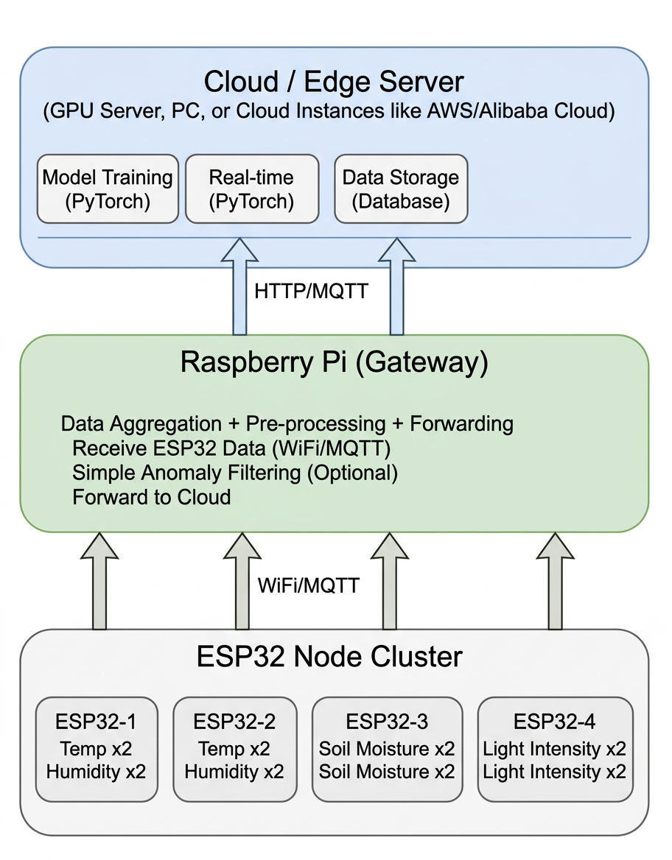
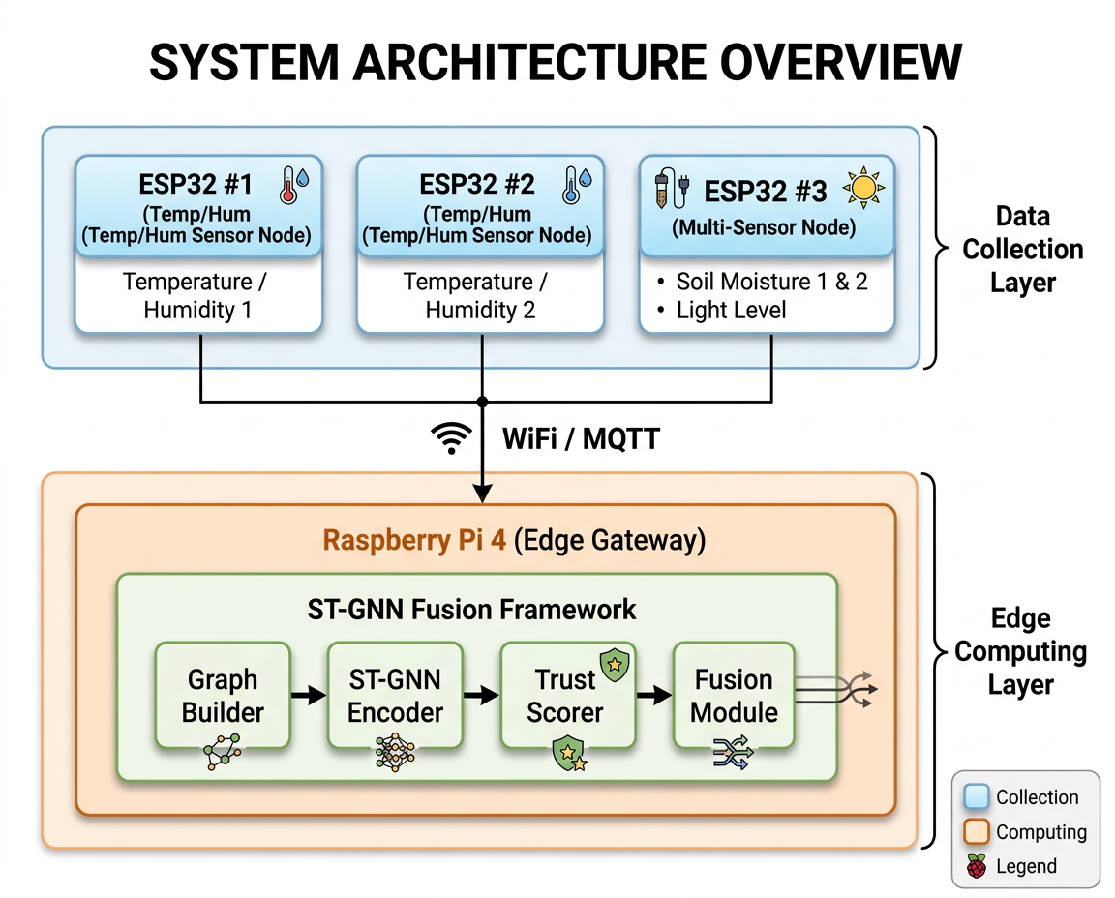
System Overview
Ultimate goal: Edge system
For now: Model offloaded to cloud
5

Slide 6
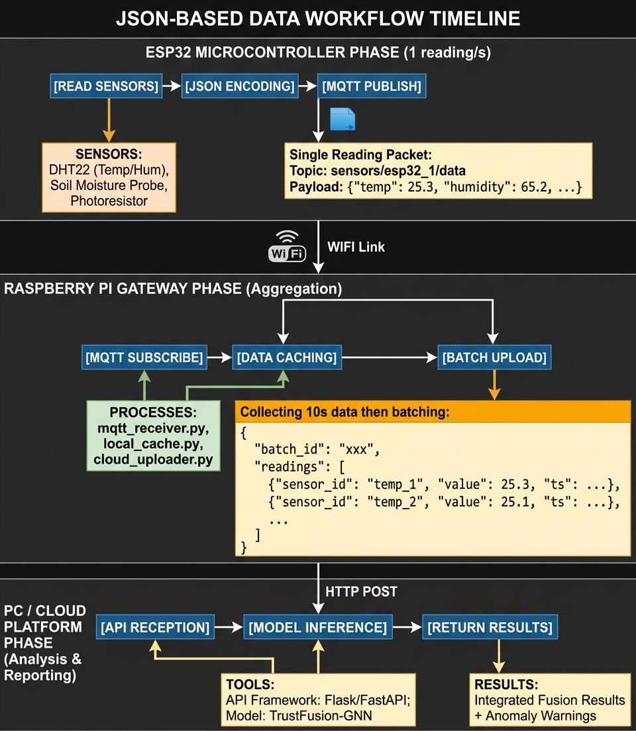
Data Workflow
Communication:
MQTT for Pi & ESP32
HTTP REST for Pi & Cloud
Data workflow design
json-based
Process in the PC / cloud phase
On a RTX3090
Training + Inference
6

Slide 7
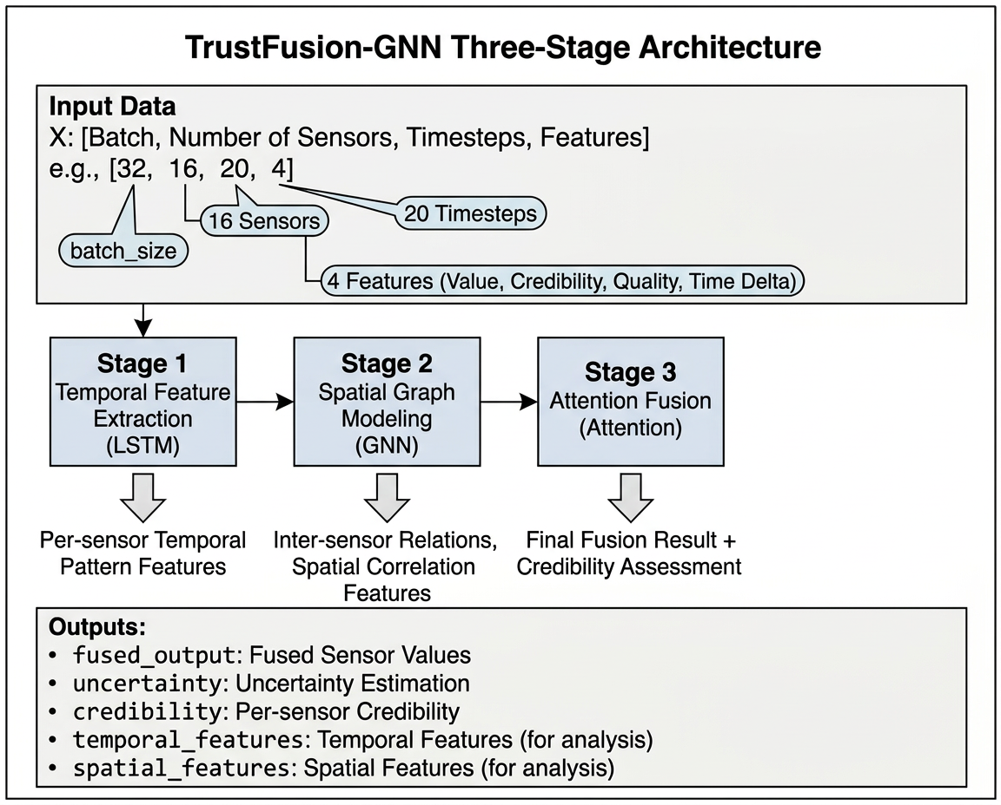
Three-Stage Model Architecture
What we do in the PC / cloud phase?
The TrustFusion-GNN Three-Stage Architecture
7

Slide 8
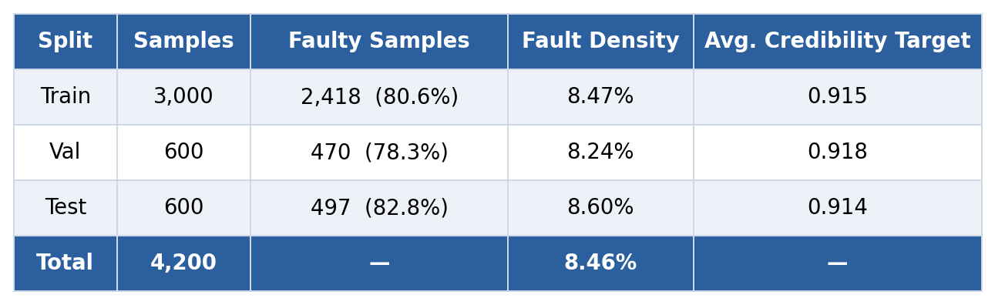
Experiment Settings
Sensors used: DHT22 Temperature & Humidity Sensor; 3-pin Capacitive Soil Moisture Sensor (non-metallic anti-oxidation probe); BH1750 Ambient Light Sensor
6 balanced fault types: BIAS; DRIFT; NOISE; RANDOM; SPIKE; STUCK_AT
Window: 30 time-steps; Epochs: 15; Early stopping patience: 5
8

Slide 9
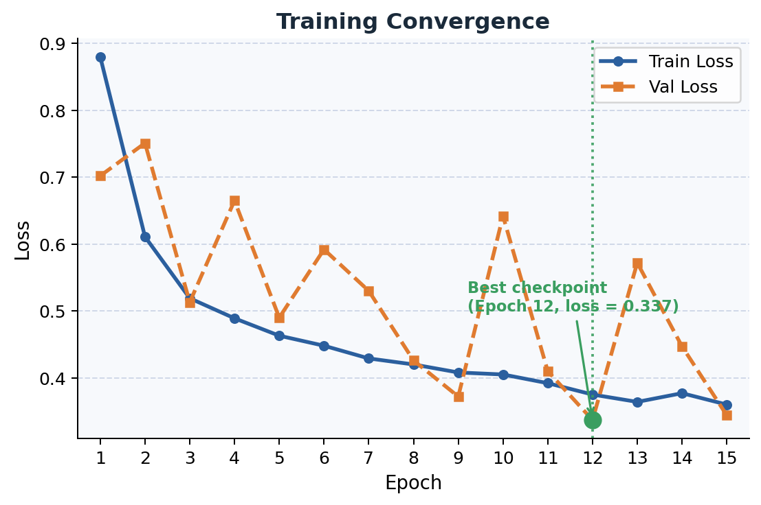
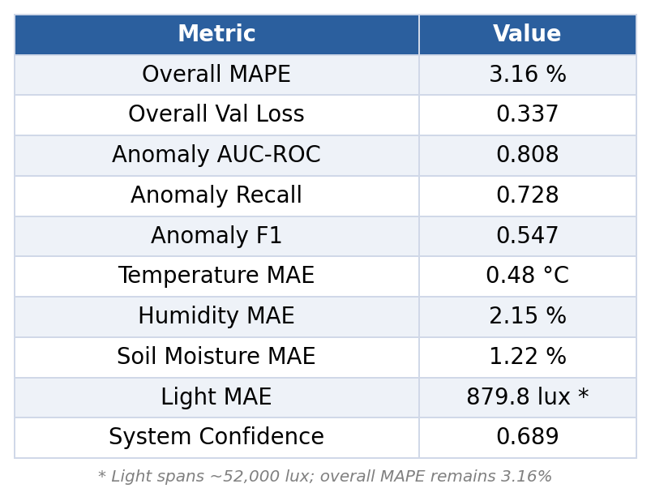
Results
Train loss drops 59% over 15 epochs; best checkpoint at Epoch 12 (val loss = 0.337)
Overall fusion MAPE of 3.16%; anomaly detection AUC-ROC = 0.808
9

Slide 10
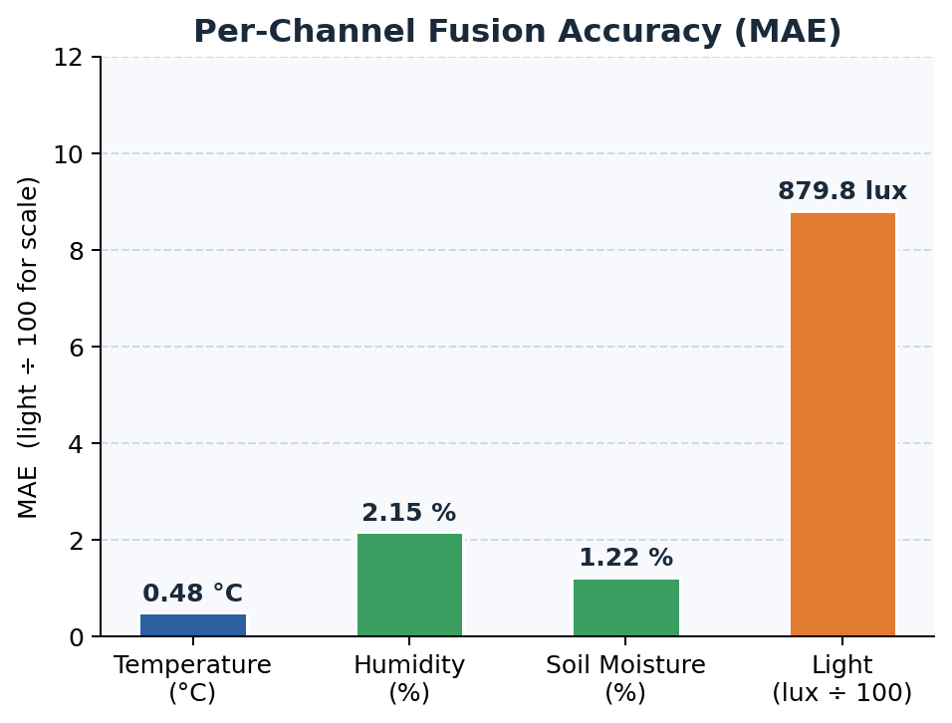
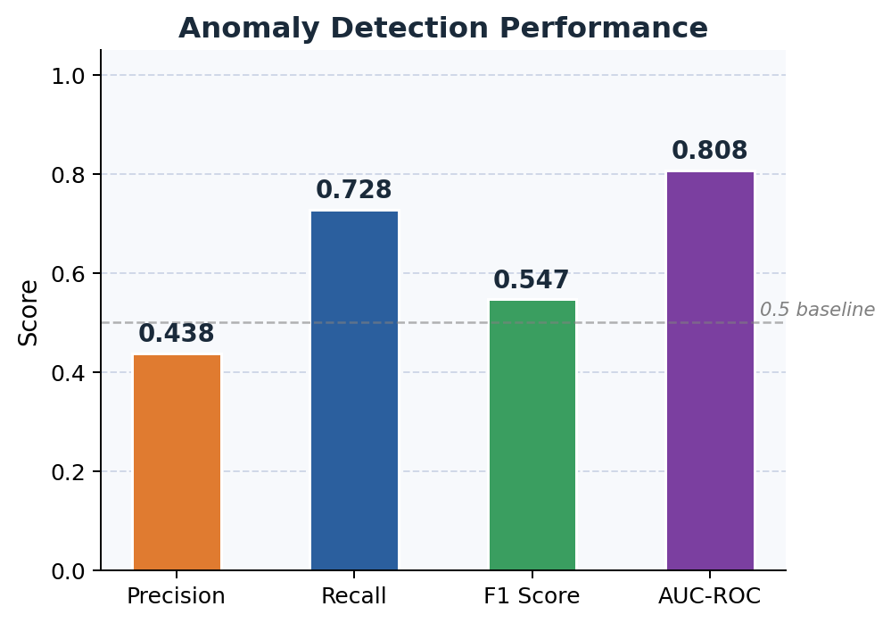
Discussion
Temperature and soil moisture channels achieve clinically meaningful accuracy (MAE < 1.5); light's large absolute MAE is a scale artifact (52,000 lux range), not a model failure
High recall (0.728) vs. lower precision (0.438) reflects a deliberate safety trade-off: in fault-tolerant IoT systems, missing a real fault is more costly than a false alarm
10

Slide 11
Expected Timeline
Time | Schedule
Week 1-2 | Identify the problem and design a solution
Week 3-4 | Hardware prepare and system workflow design
Week 5-6 | Implement the training and inference code in the cloud phase
Week 7-8 | Construct and deploy the hardware; write corresponding codes
Week 9-10 | Collect data and train the model; experiment and verify
Week 10-11 | Quantize the trained model to fully run on edge
11

Slide 12


Q&A
12

