Slide 1

GNN-Enabled Trustworthy Sensor Fusion for Smart Agriculture
SU Yihang, LIU Bohan
1155173753, 1155173765
Information Engineering
The Chinese University of Hong Kong

Slide 2
Table of Contents
Recap: What we want to do
Recap: Why we want to do this
How we want to do this
What we have done
What will we do next
Expected Timeline
2

Slide 3
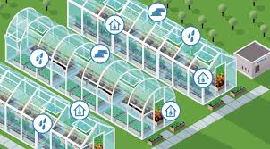
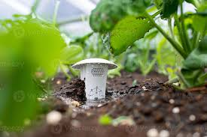
Recap: What we want to do
Propose a trustworthy sensor fusion system specifically for smart agriculture
Input: Sensor data from different sensors in a same area (e.g. greenhouse, farm)
Output: Conditions of this area (temperature, humidity, etc.) fused from sensor data + Confidence level of each sensor
Long Short-Term Memory (LSTM) + Graph Neural Network (GNN) => Spatiotemporal
Develop a specific hardware setting => Data collection + Feasibility verification
3

Slide 4
Recap: Why we want to do this
Harsh environments induce frequent sensor drift/failure
Location/weather disruptions degrade data availability
Cascading errors in decision-making pipelines
Space info: nearer sensors should have more similarity
Time info: data from the same sensor should not change abruptly
Spatiotemporal info in sensor fusion => Confident condition result
4

Slide 5
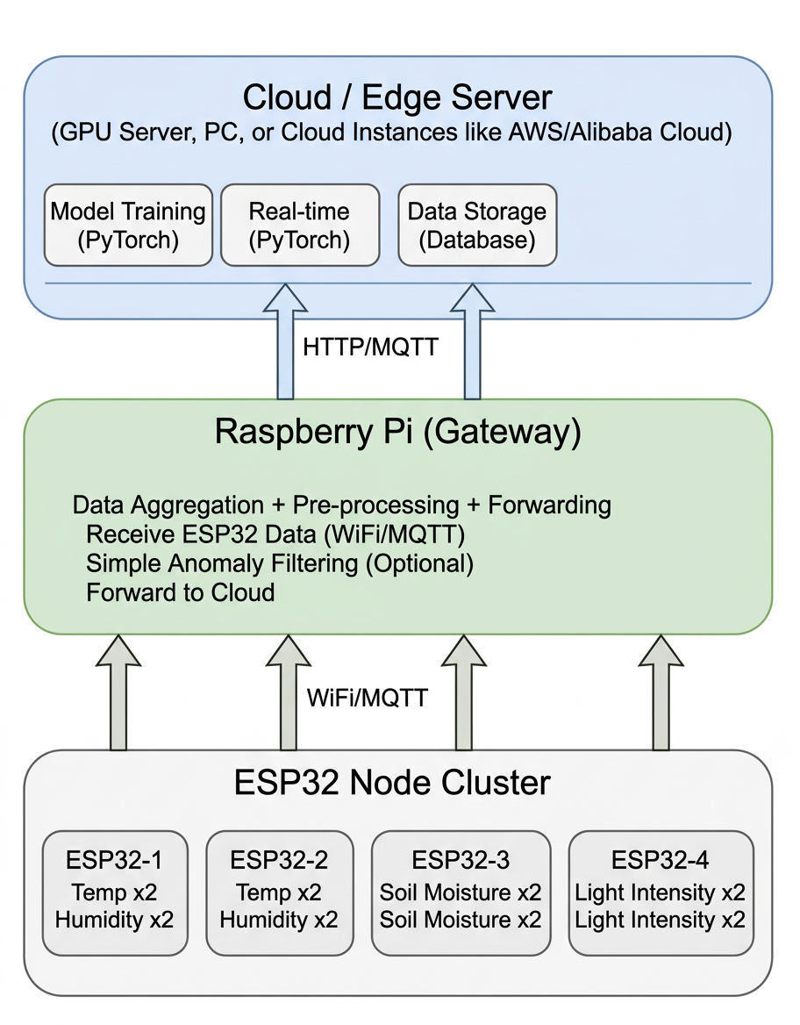
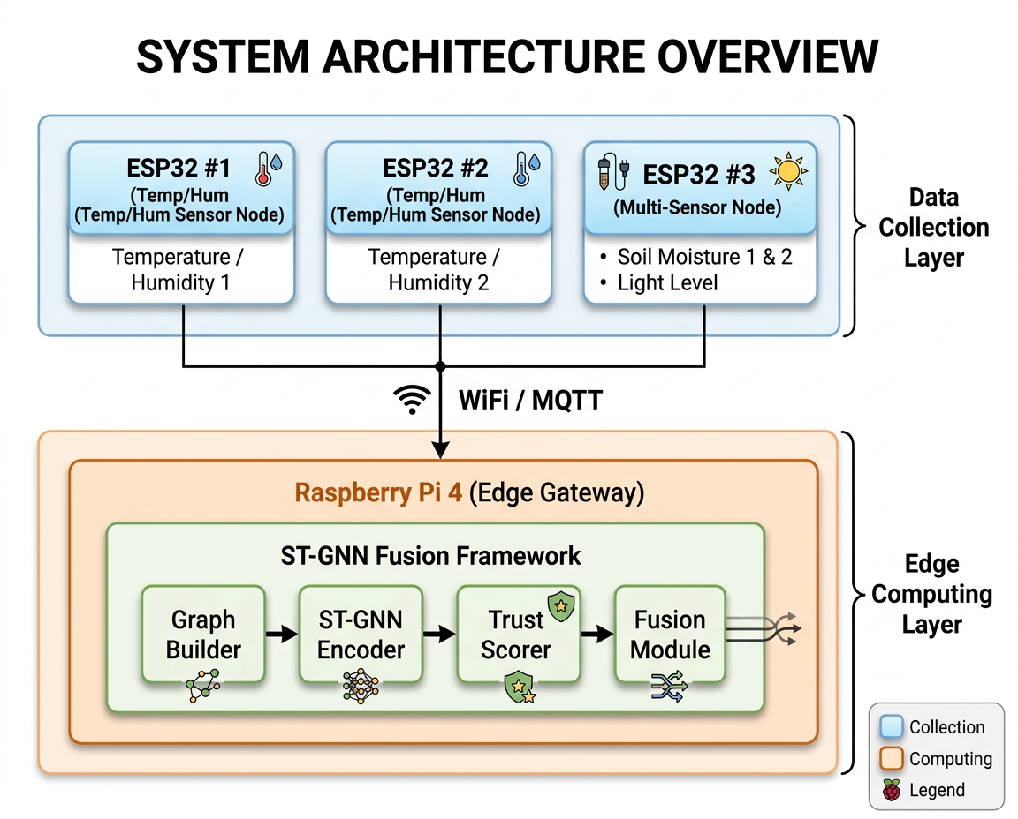
How we want to do this
Ultimate goal: Edge system
For now: Compute offloaded to cloud
5

Slide 6
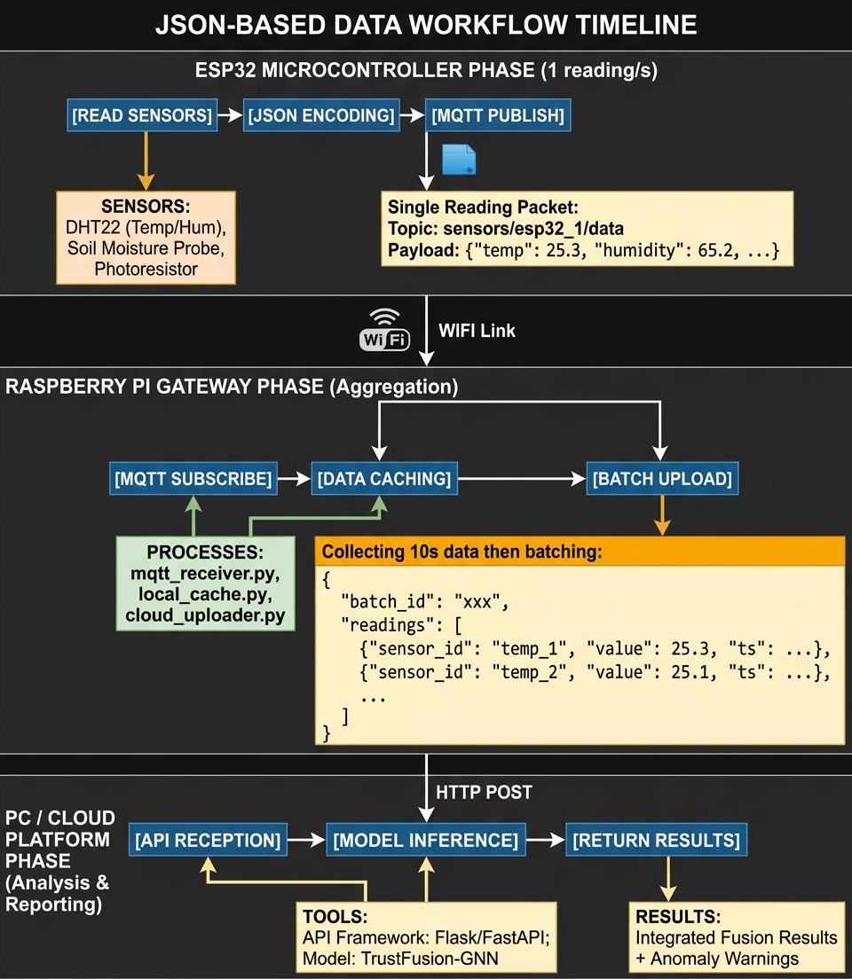
What we have done
Hardware preparation:
Raspberry pi, Sensors, ESP32, etc.
Full system architecture and data workflow design
json-based
Entire process in the PC / cloud phase
On a RTX3090
Training + Inference
6

Slide 7
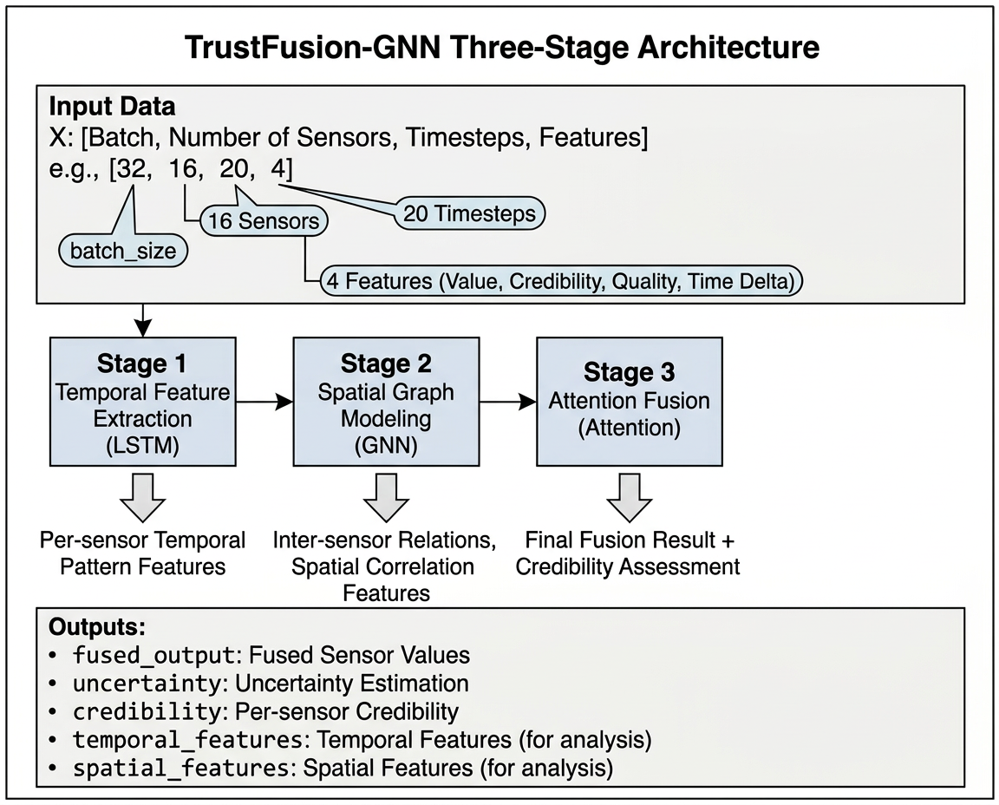
What we have done: Three-Stage Architecture
What we do in the PC / cloud phase?
The TrustFusion-GNN Three-Stage Architecture
7

Slide 8
What will we do next
Write forwarding code on Raspberry pi
Construct and deploy the hardware (ESP32 sensor nodes)
Arduino code for sensor nodes
Collecting data and training with the full pipeline
Experiment and verification
[Optional] Quantize the trained model to fully run on edge
8

Slide 9
Expected Timeline
Time | Schedule
Week 1-2 | Identify the problem and design a solution
Week 3-4 | Hardware prepare and system workflow design
Week 5-6 | Implement the training and inference code in the cloud phase
Week 7-8 | Construct and deploy the hardware; write corresponding codes
Week 9-10 | Collect data and train the model; experiment and verify
Week 10-11 | Quantize the trained model to fully run on edge
9

Slide 10


Q&A
10

