Slide 1

EBR
Electronic Batch Record

Slide 2
What is an electronic batch record?
Electronic batch records (EBRs) are digital tools that track and monitor batch production throughout the manufacturing process.
Unlike manually curated paper-based records, EBRs automatically capture data in real-time and verify processes

Slide 3
Advantages of EBR?
This streamlines batch manufacturing
Reduces the likelihood of human errors
Allows life science companies to improve compliance
Faster information exchange and retrieval

Slide 4
Who Performs Operations?
Admins configure the Batch Information.
Operators Initiate the Batch and Perform activities
In the next topic going to explain How operators perform activates.

Slide 5
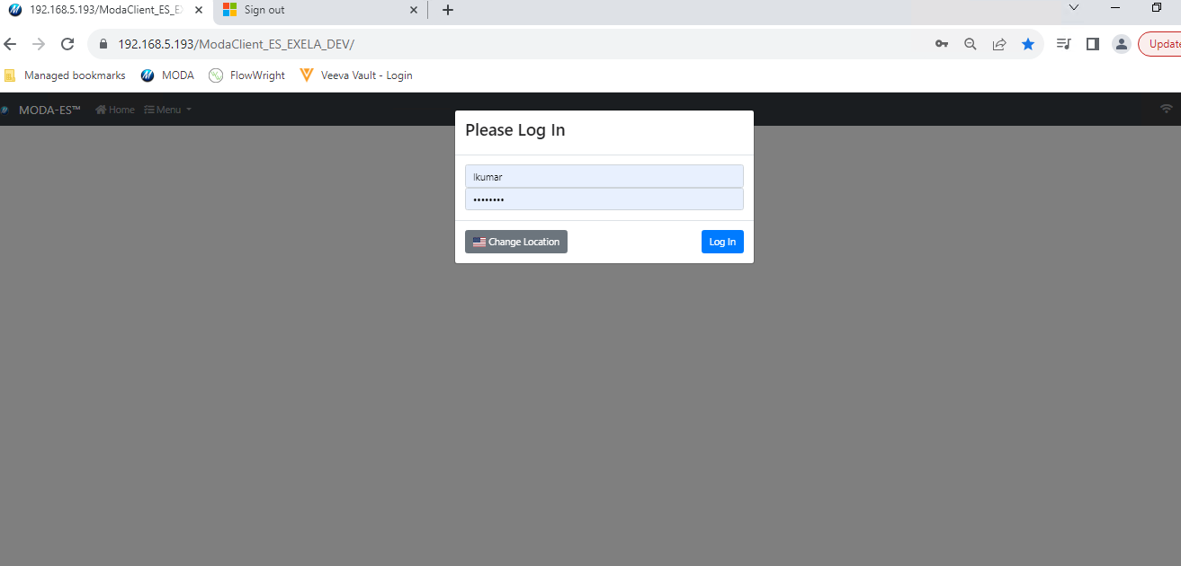
How to access EBR?

Slide 6
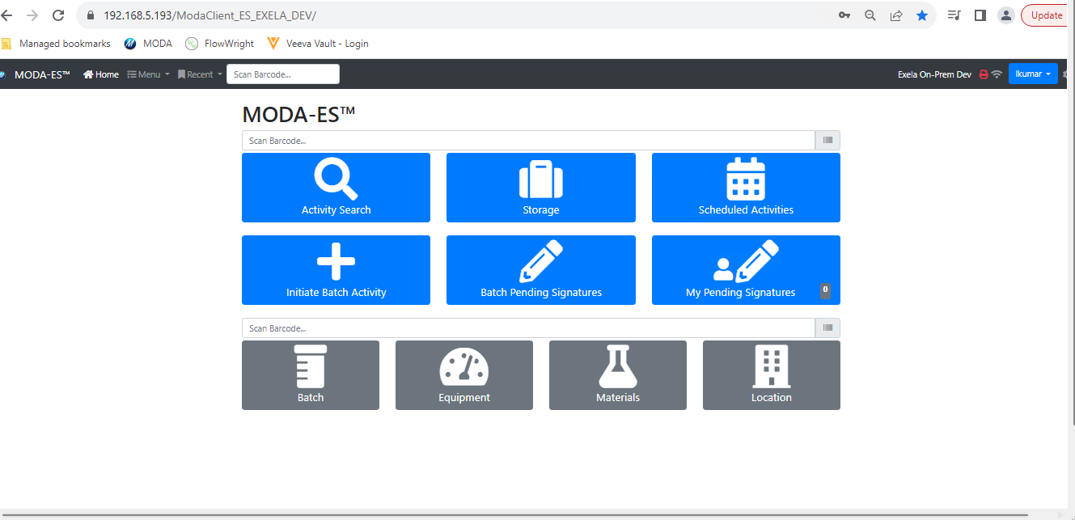
How to Select Batch?
Click on Batch

Slide 7
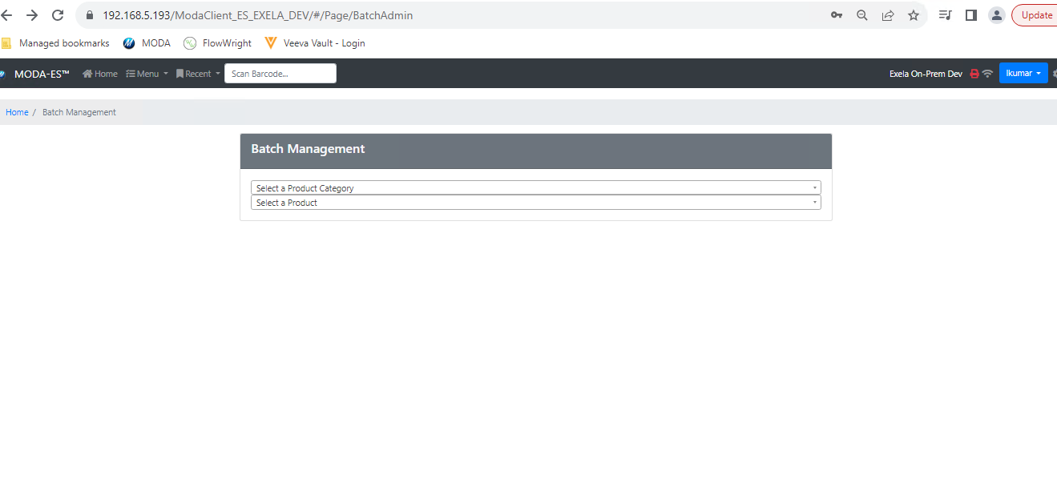
How to select Batch?

Slide 8
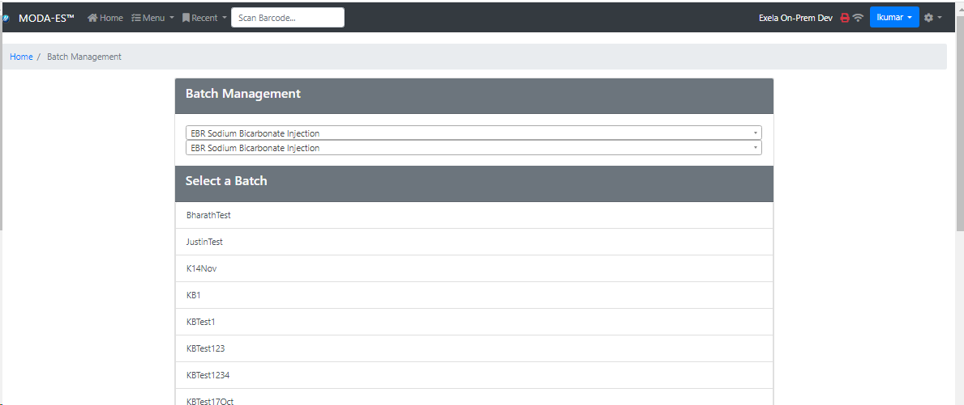
Batch Management and Selection?

Slide 9
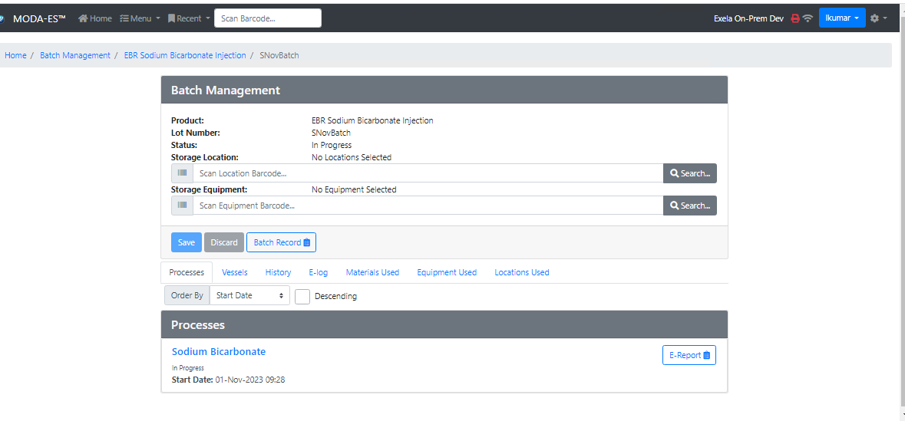
Select the Process?

Slide 10
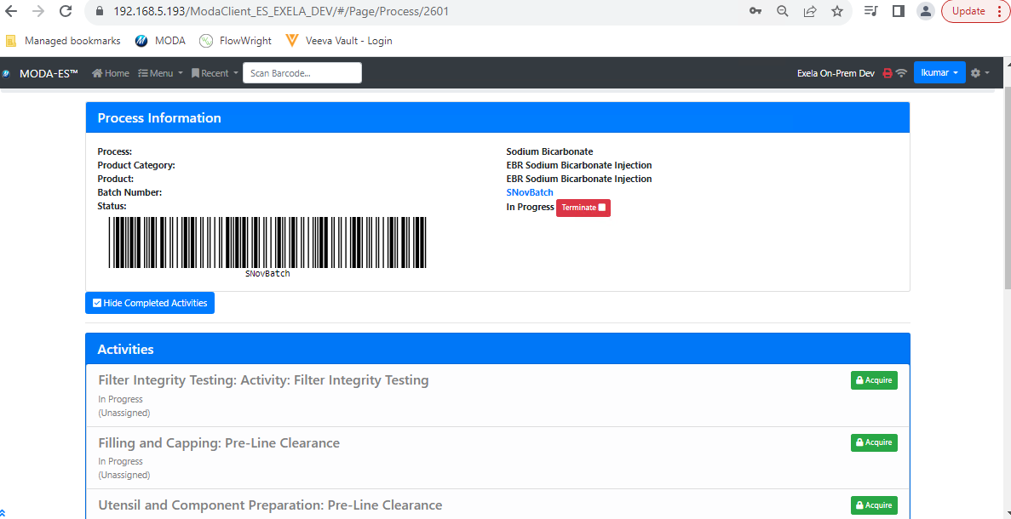
Operators need to select his activity

Slide 11
Process / Activities
We have different sections in Paper batch record. Like Automated Tray Vial counter, Pre-line clearance, Post-clearance, Compounding, Filling and capping, Inspection, Utensil and Component preparation and Vial Washing, etc.
We will have same sections in the EBR but called them as processes or activities.
We called these sections as Activities. These activity will perform by operators.
Operators will select the activity and record the data in EBR system.

Slide 12
Next explanation in practical with one activity selection?

Slide 13
EBR QA Review
After manufacturing is completed QA team will perform QA Review. It is work in progress

Slide 14
Any Questions?

Slide 15
THANK YOU

