Slide 1
Mapping Maternal Ancestors
Lauren Hendricks
GEOG 590
June 4, 2018

Slide 2
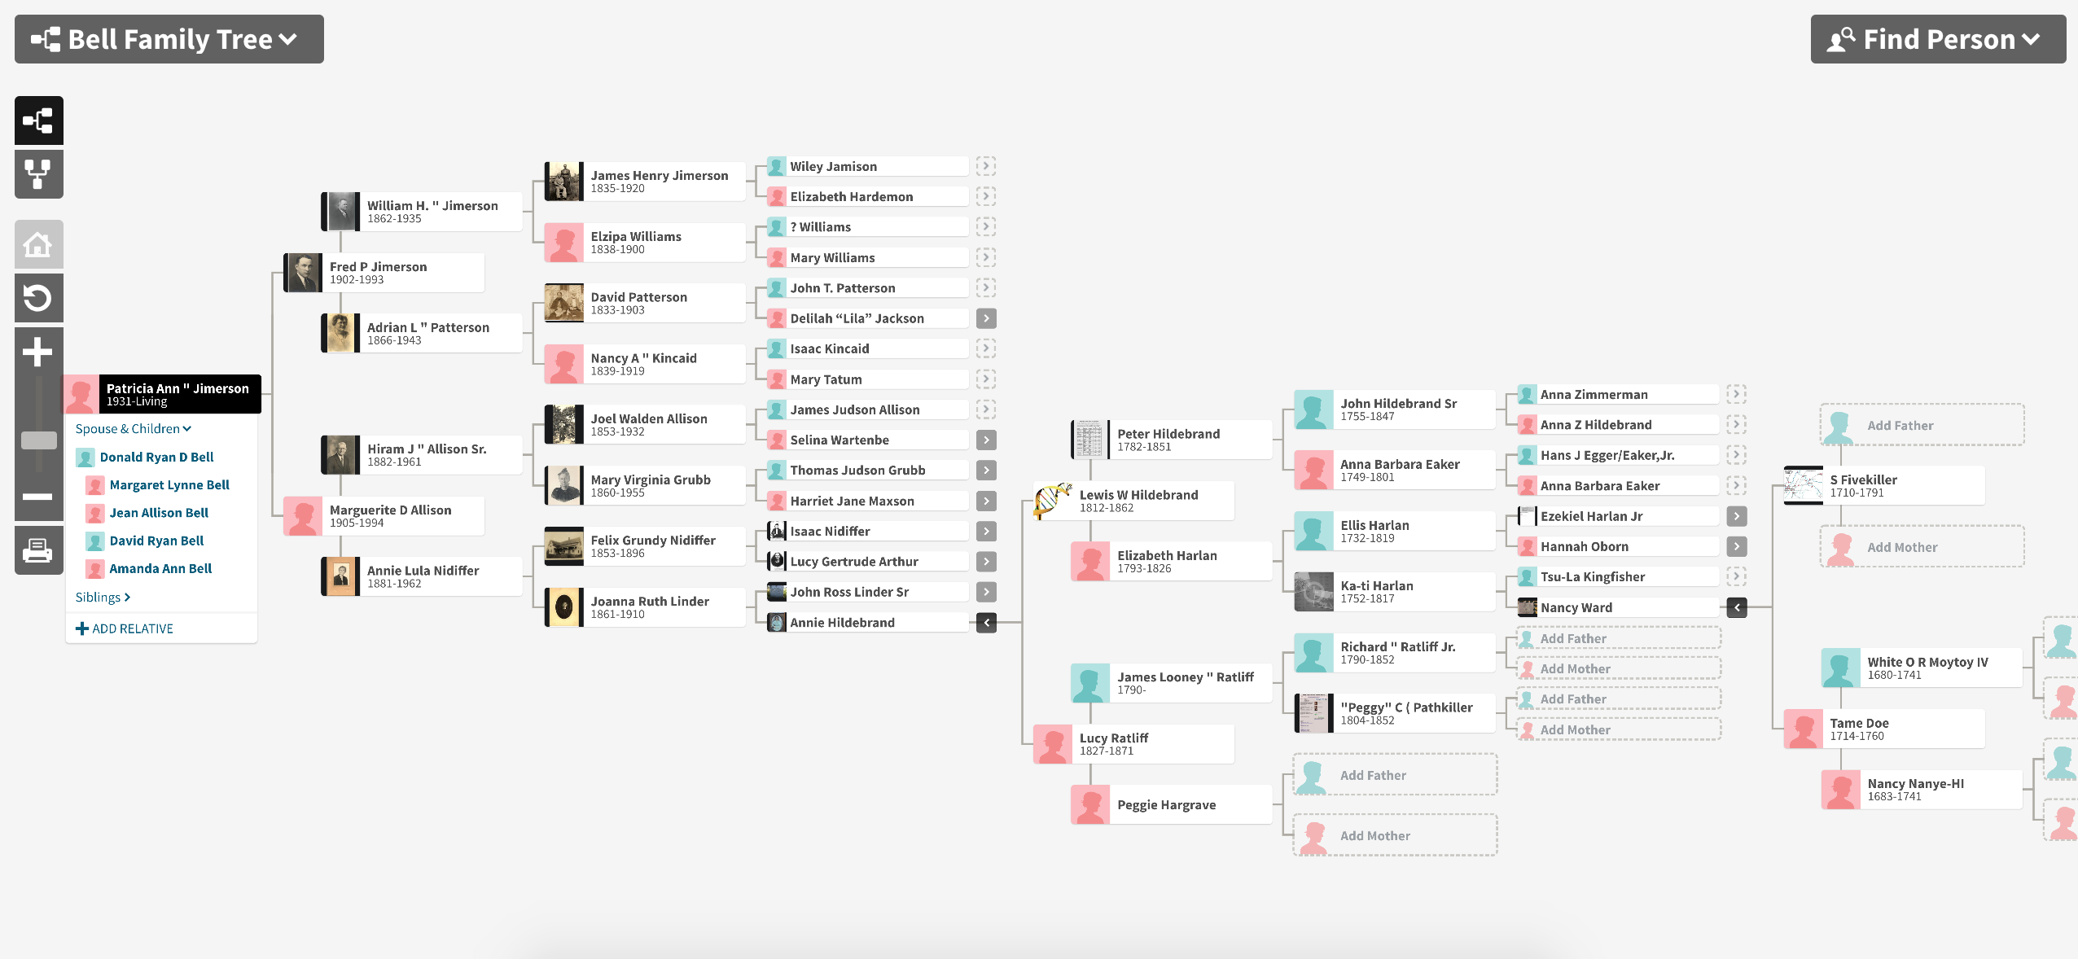

Slide 3
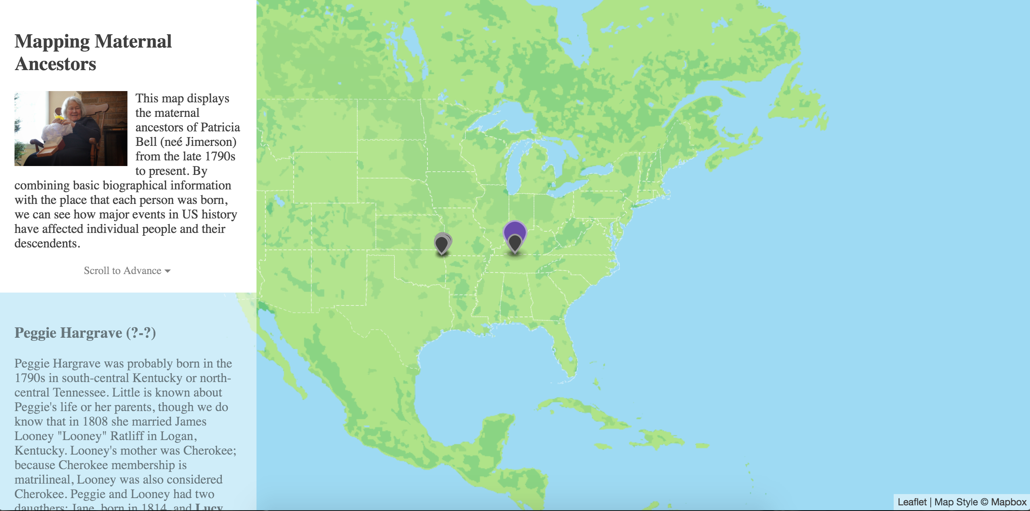
http://pages.uoregon.edu/lhendri2/GEOG590_WebMapping/AncestorMap/AncestorMapCode_Scrolling.html

