Slide 1
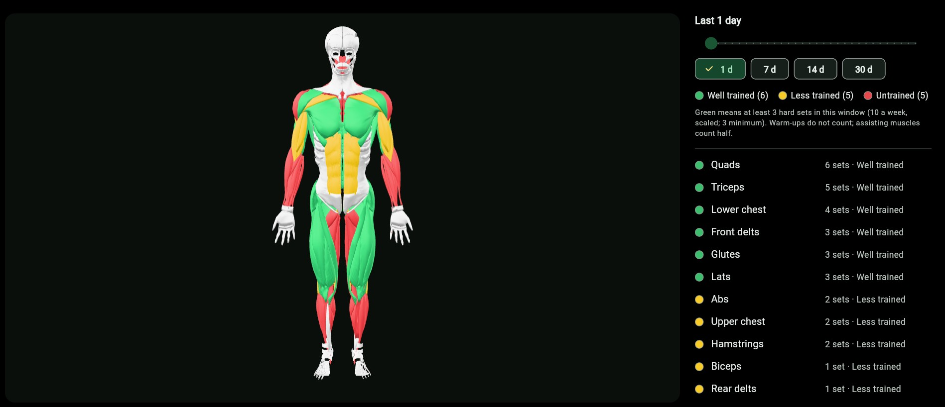
LionFit
SOUTHEASTERN LOUISIANA UNIVERSITY · CMPS 401
An AI workout planner and tracker built around the equipment at the Pennington Rec Center
Flutter (Web + Android) · Supabase · 3D muscle map
Notes:
LionFit plans and tracks workouts for SELU students using only the equipment that actually exists at Pennington. This deck walks through the app's structure, the database schema, what works today, and what comes next.

Slide 2
What LionFit does
1
2
3
4
Plans around real equipment
Logs every set
Shows what you trained
Suggests the next load
Weekly plans (3–7 days) use only what Pennington stocks, with swaps when a machine is busy.
Weight in lb or kg, reps, set type and RPE or RIR. Each set is one database row.
A 3D body colored red, yellow or green by how much each muscle group was worked.
Uses your own history (volume, estimated 1RM, effort) to pick the next weight.
Card 4 is designed and the math is built and tested, but nothing on screen uses it yet.

Slide 3
How the app is put together
FLUTTER APP · one codebase for Web and Android
SUPABASE · hosted backend
Screens (lib/features)
Shared core (lib/core)
Backend
Landing, login, sign-up
Home
Log a workout (/log)
Muscle map (/map)
Riverpod state + go_router
Green/gold theme, light + dark
Supabase client + auth
Auth: email + password
Postgres: 8 tables
Row Level Security on every user table
Triggers keep the muscle-map rollup current
8 migrations, all applied
HTTPS
supabase_flutter
Training engine (pure Dart, unit-tested)
Estimated 1RM, volume, load rounding to real dumbbells/plates
Next-load progression from RPE/RIR
Muscle status: untrained / less trained / well trained
Notes:
The app never talks to Postgres directly. Every request goes through supabase_flutter with the public anon key, and Row Level Security decides what each signed-in user can see.

Slide 4
Database schema (rough)
auth.users
user_workouts
rec_center_equipment
user_health_metrics
id (PK)
email
password (hashed)
managed by Supabase Auth
1 : N
id (PK)
user_id → auth.users
scheduled_date
goal · week_index · plan_variation
equipment_type (unique key)
label · quantity
availability_status
is_verified
load_increments_lb[ ]
id (PK)
user_id → auth.users
day · steps · heart rate
source: manual / fitbit
1 : 1
1 : N
uses
profiles
workout_logs
exercises
muscle_group_intensity
id (PK, = auth.users.id)
display_name
role: member | admin
unit_preference (lb/kg)
effort_preference (RPE/RIR)
goal · days_per_week
id (PK) · one row per set
workout_id → user_workouts
exercise_id → exercises
set_index · set_type
weight + unit (weight_lb generated)
reps · rpe · rir
client_uuid (offline retry key)
N : 1
id (PK) · slug · name
primary_muscle_groups[ ]
secondary_muscle_groups[ ]
required_equipment[ ]
movement_pattern · is_active
PK (user_id, day, muscle_group)
set_count · total_volume
normalized_intensity 0–1
filled by trigger, read-only
trigger
Supabase Auth
Private: owner-only (RLS)
Shared catalog: admin writes
Notes:
Three kinds of table. Grey is Supabase's own auth table. Green tables are private: Row Level Security only returns rows where user_id is the signed-in user, and that includes admins. Gold tables are the shared catalog: everyone reads, only admins write. muscle_group_intensity is never written by the app; a statement-level trigger on workout_logs recomputes it for the affected day.

Slide 5
Who can see what
Data | Member | Admin (e.g. Pao)
exercises, rec_center_equipment | read | read + write
your own workouts, sets, health data | read + write | read + write
someone else's workouts or health data | none | none
your own role | cannot change | changed only in SQL editor
Admin manages content, not people
Postgres Row Level Security enforces this, not a hidden button. An admin who queries another student's sets gets zero rows back.
The role lives in profiles.role, which the app has no permission to update, so a user cannot promote themselves.

Slide 6
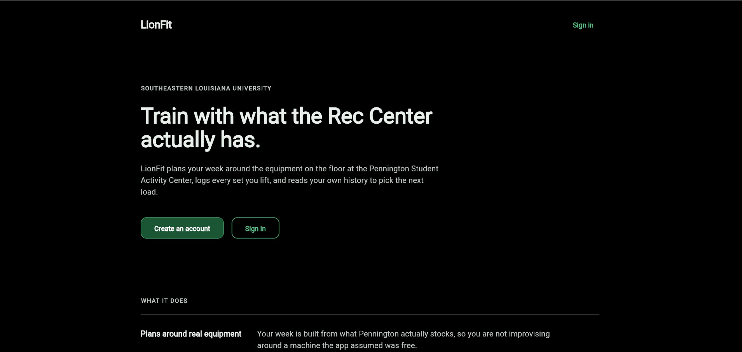
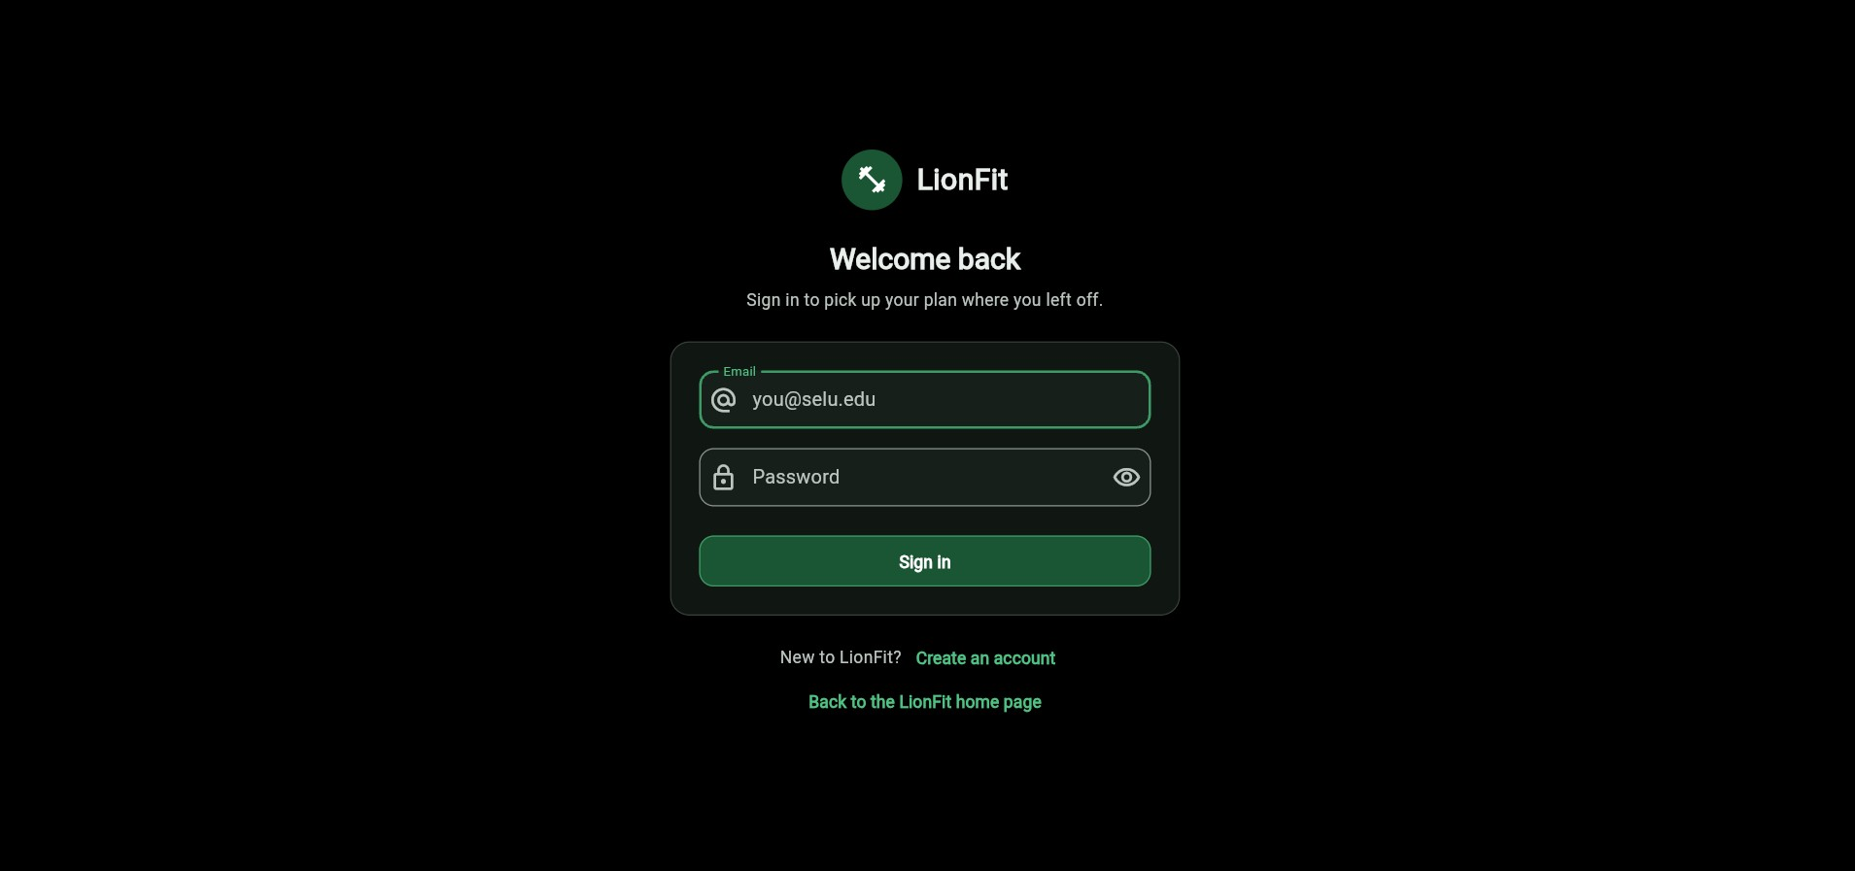
On the web: landing page and sign-in
Landing page: what the app is, with create-account and sign-in buttons
Sign-in: email + password through Supabase Auth
Two themes ship together. Dark (black, #1A5634 green, #F8CB28 gold) is shown here; light uses white, #0B4022 and #BF9C1F. The app follows the device setting.

Slide 7
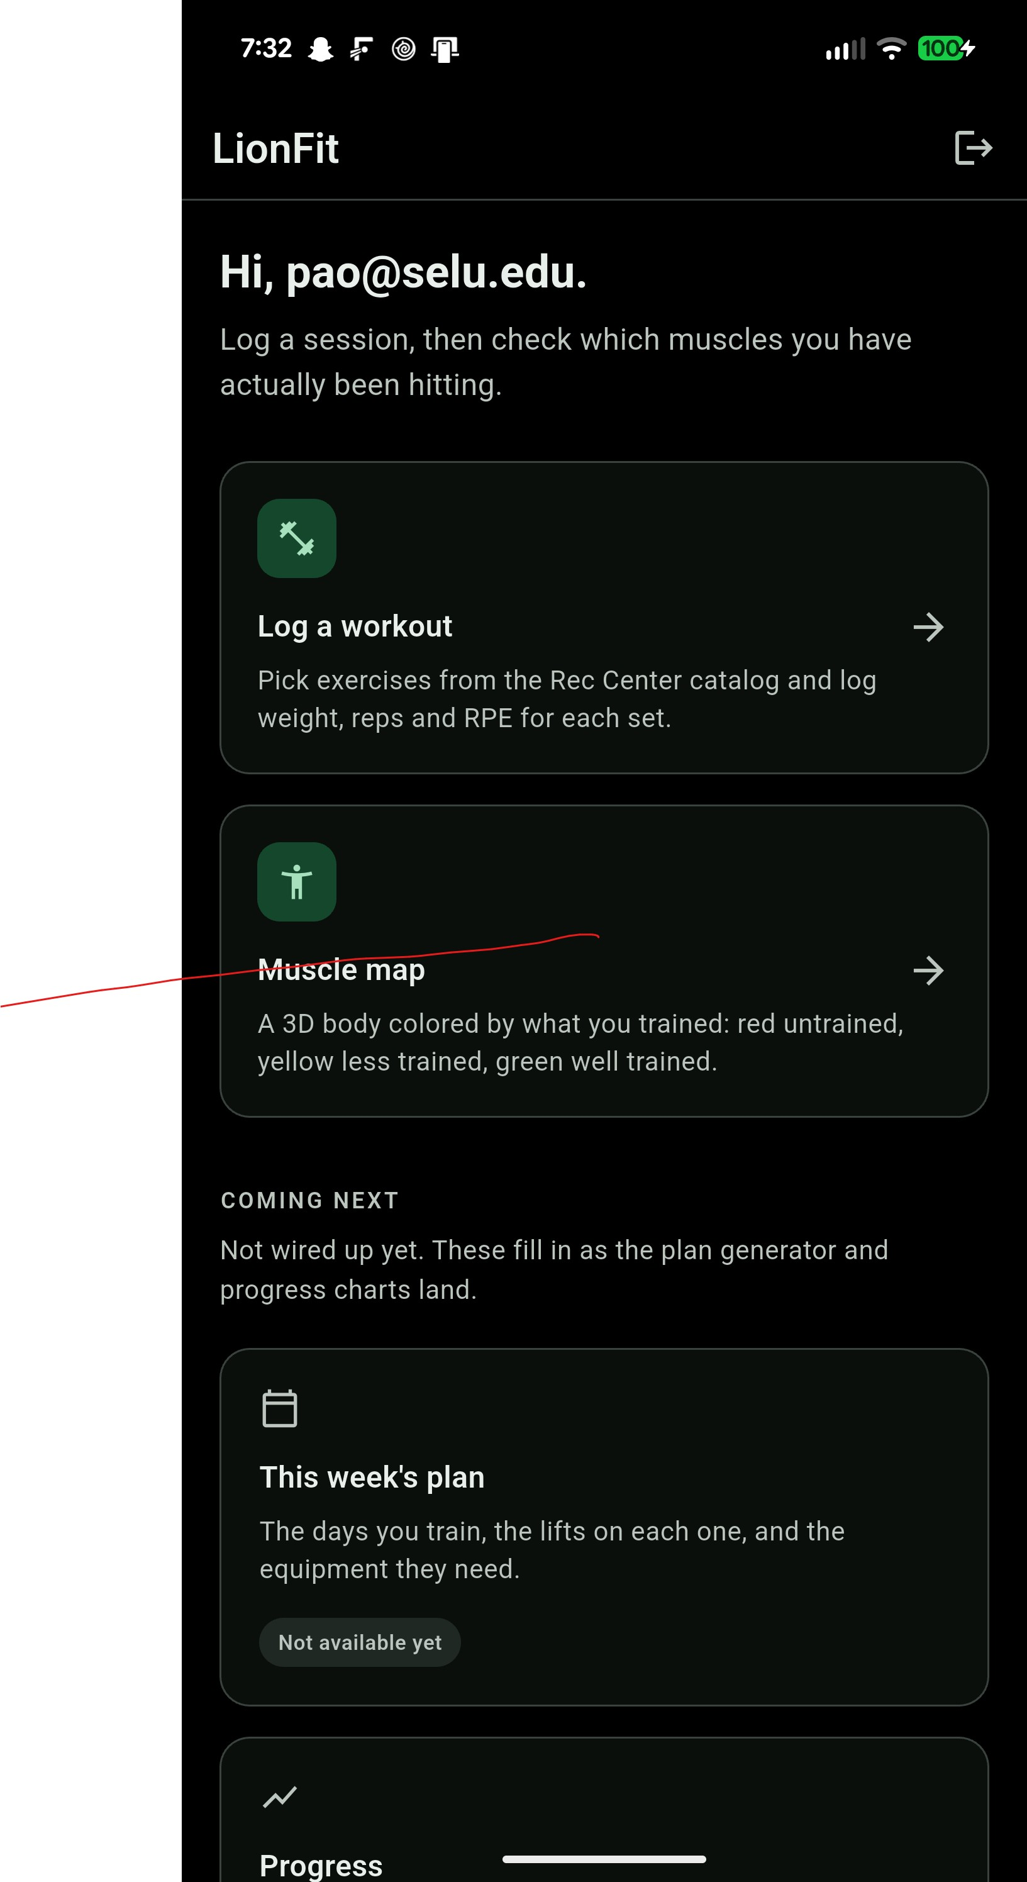
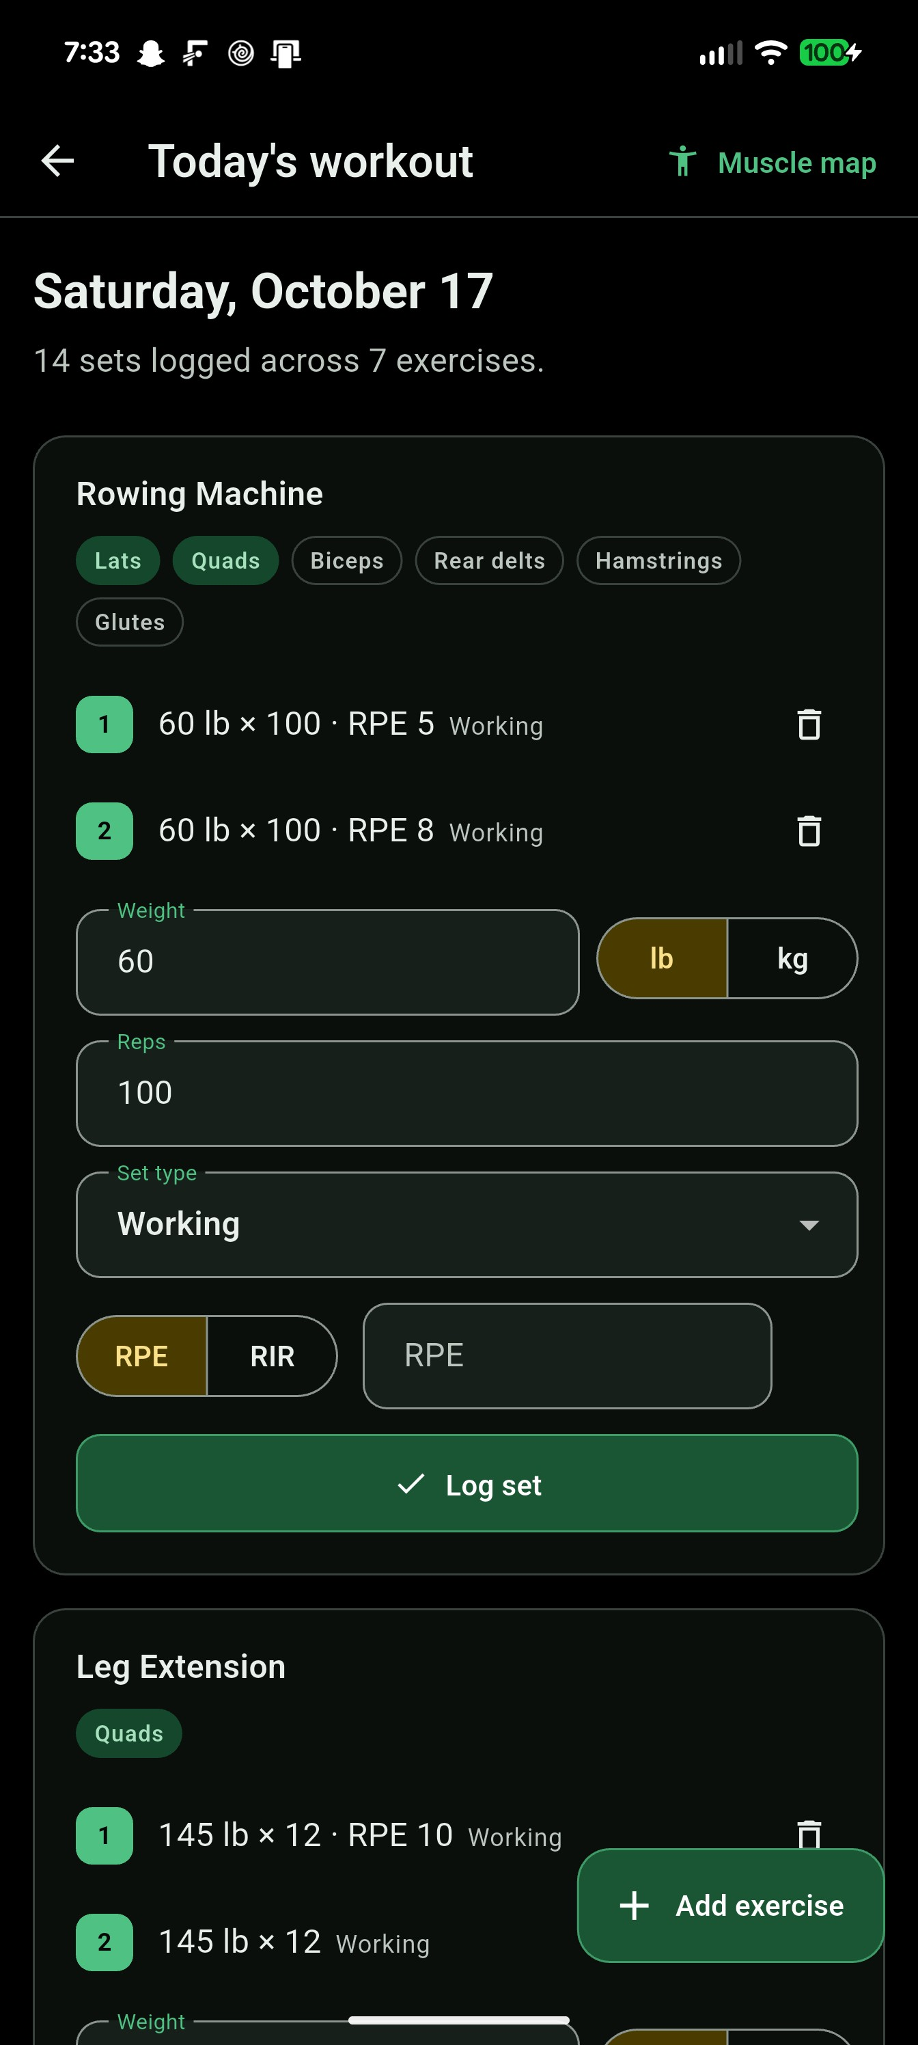
On a phone: home and the workout logger
1
Home
Two working features up top; planned ones marked "Not available yet".
2
Pick an exercise
Searchable catalog, filtered by muscle group.
3
Log each set
Weight (lb or kg), reps, set type, RPE or RIR.
4
Saved instantly
Every set is a row in workout_logs; tap the bin to delete it.

Slide 8
The 3D muscle map
Green: well trained
At or above target sets
Yellow: less trained
Some work, under target
Red: untrained
No hard sets in the window
Target: 10 hard sets a week, scaled to the window length, minimum 3.
Counting: warm-ups skipped; helper muscles count half a set.
1-day window after one session: 6 groups well trained, 5 less trained, 5 untrained
Notes:
The model's 16 muscle materials are recolored in Dart before the model is loaded, so the same code works on web and Android. The colors come straight from the sets logged in workout_logs.

Slide 9
What works right now
209
76
29
16
automated tests passing
exercises in the catalog
equipment rows (14 are demo)
muscle groups on the 3D map
Sign up, sign in, sign out (email + password)
Landing and home screens, light + dark green/gold theme
Log a workout: pick exercises, log weight, reps, set type, RPE/RIR
3D muscle map with a 1–30 day window
Database live: 8 migrations, RLS on every user table
Training math: e1RM, volume, next-load progression (tested, not yet on screen)
Equipment is partly placeholder data until the Rec Center floor walk; demo rows are tagged "DEMO".

Slide 10
What is still to come
1
2
3
4
Verify the gym
Plan generator
Load suggestions
Progress charts
Floor walk at Pennington; replace demo equipment with real counts
3–7 day weekly plans by goal, varied every 1–2 weeks
Show the next-weight recommendation on the logger
Per-exercise line graphs (fl_chart)
5
6
7
8
Offline logging
Health data
Rest timer
Equipment swaps
Queue sets when Rec Center signal drops, sync later
Fitbit heart rate + steps, with manual entry fallback
Customizable, with Android background notifications
"Machine busy?" suggests an alternative exercise

Slide 11
Try it yourself
flutter pub get
flutter run -d chrome --dart-define-from-file=.env
flutter test
Full steps in presentation/UserGuide.docx

