Slide 1
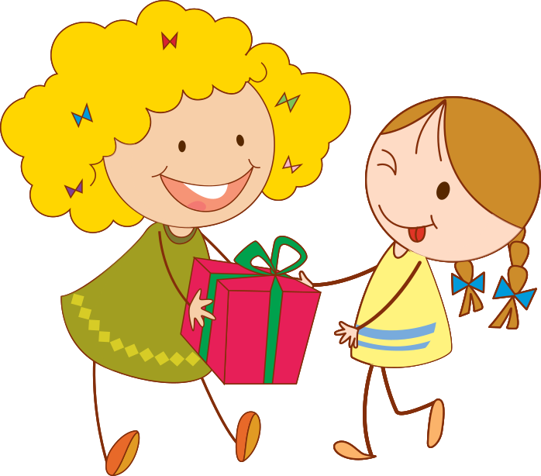
Kids’ Gift
Tracker

Slide 2







Charlie
&
Ozzy
Charlie
&
Ozzy
Charlie
&
Charlie
Ozzy
&
Ozzy
Charlie
&
Ozzy

