Slide 1
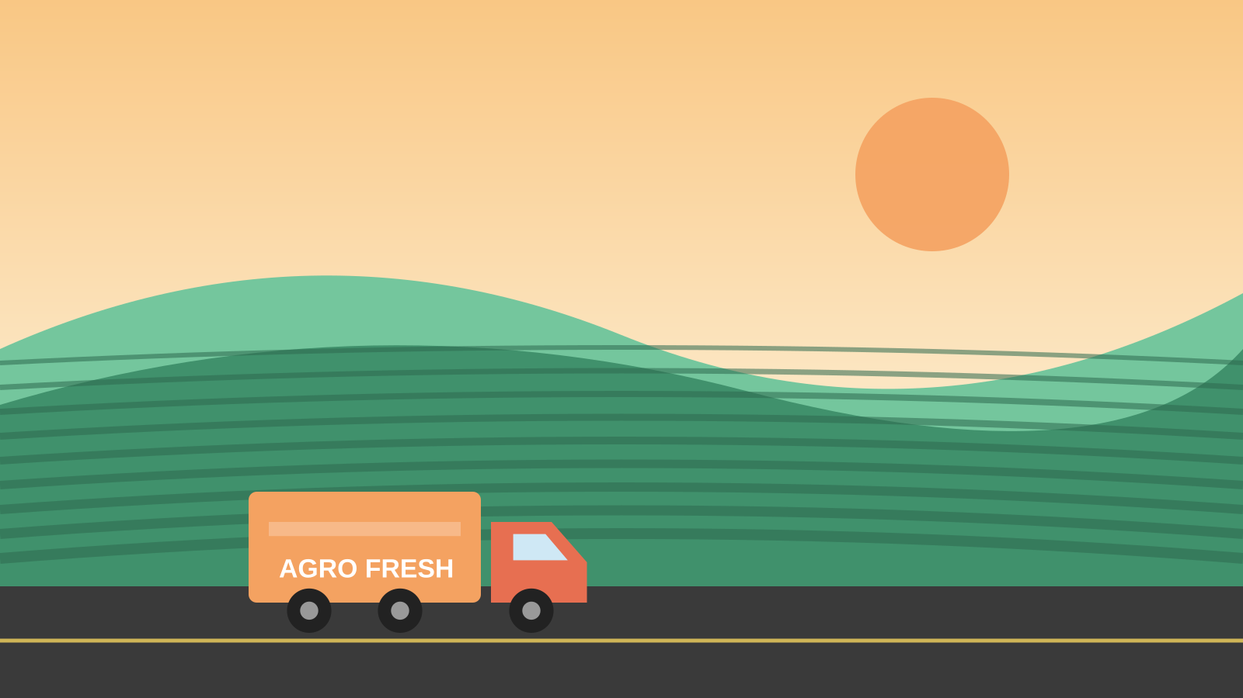
MINI PROJECT
Agro Products Transportation System
L. Bindulatha
Farm to market, delivered fresh
Notes:
Welcome. Introduce the project title and yourself.

Slide 2



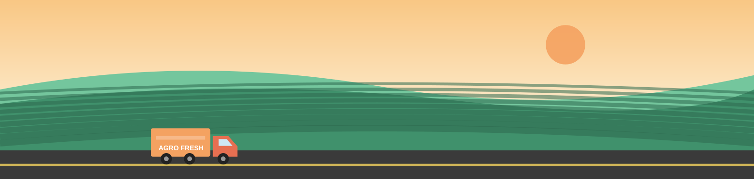


Introduction
02
Farmers grow valuable crops, but getting them to buyers on time is a challenge.
The Agro Products Transportation System is a web application that connects farmers, transporters and buyers to plan and track the movement of produce.
Coffee
Pepper
Ginger
Cashew Nuts
Turmeric
Cotton
Groundnuts
Green Chillies
Agro Products Transportation System | L. Bindulatha
Notes:
Products handled: coffee, pepper, ginger, cashew nuts, turmeric, cotton, groundnuts, green chillies.

Slide 3




Problem Statement
03
Agro products move through a slow, manual and unorganised transport process.
Delays
Manual records
No coordination
Poor visibility
Perishables like green chillies spoil when delivery is late.
Paper and phone-call bookings cause errors and lost data.
Farmers, transporters and buyers lack one common platform.
Order status and transport costs are hard to track.
Agro Products Transportation System | L. Bindulatha

Slide 4




Proposed Solution
04
A simple web system to book, assign and track every agro delivery in one place.
Farmer
Booking
Transport
Delivery
Adds produce & quantity
Transport request created
Truck assigned & dispatched
Buyer receives & status updates
Agro Products Transportation System | L. Bindulatha

Slide 5




Technologies Used
05
HTML5
CSS3
JavaScript
Local Storage
Structure of pages, forms and tables
Responsive layout, colours and animations
Logic, validation and dynamic updates
Saves orders in the browser, no server needed
Agro Products Transportation System | L. Bindulatha

Slide 6




Main Features
06
Product catalogue
Easy booking
Vehicle allocation
Coffee, pepper, ginger, cashew, turmeric, cotton, groundnuts, green chillies
Add produce, quantity and destination
Assign trucks to each order
Status tracking
Saved data
Responsive UI
Pending, in transit, delivered
Orders stay after refresh via local storage
Works on phone, tablet and PC
Agro Products Transportation System | L. Bindulatha

Slide 7
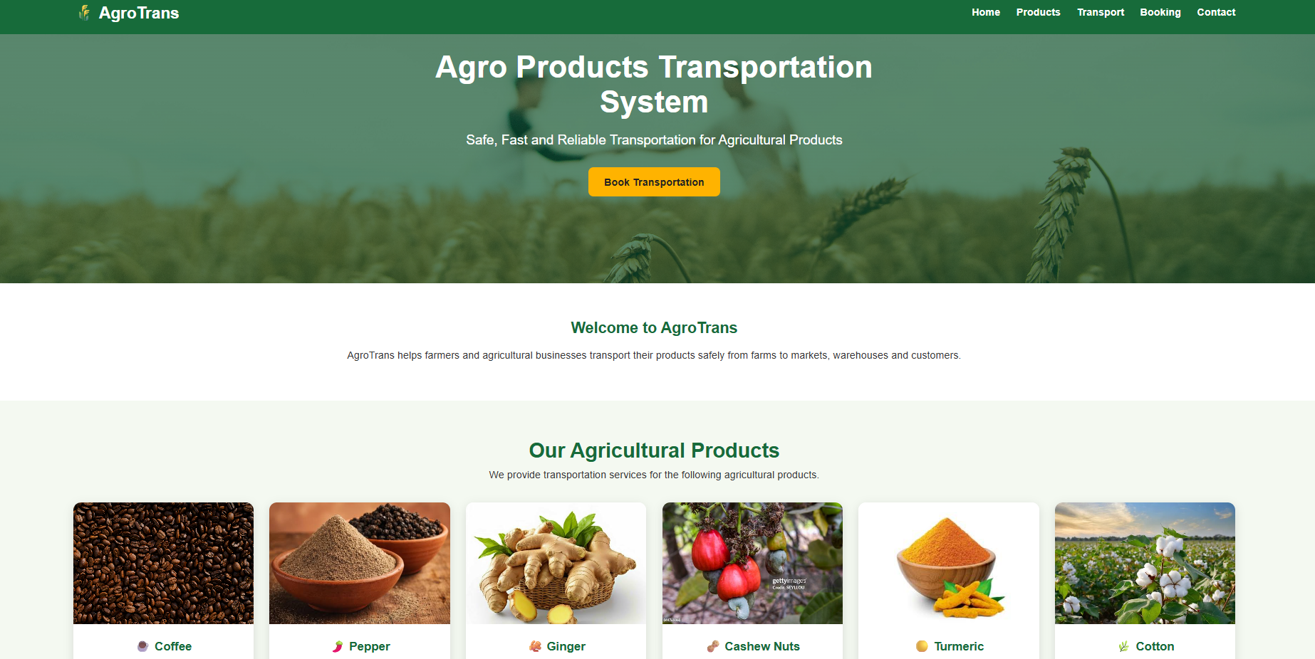
Live Demo
07
1
Open index.html in the browser
2
Add a product and quantity
3
Create a transport booking
Insert project screenshot here
4
Assign a truck and update status
5
Refresh: data stays saved
Notes:
Run the live demo of the project here.

Slide 8
Conclusion
08
The Agro Products Transportation System makes moving farm produce organised, faster and easy to track.
Built with HTML, CSS, JavaScript and local storage.
Handles eight key crops from farm to buyer.
Future scope: GPS tracking, online payments, database backend.
Thank you!
https://inspiring-hamster-4ec1f7.netlify.app/
Agro Products Transportation System | L. Bindulatha

