Slide 1
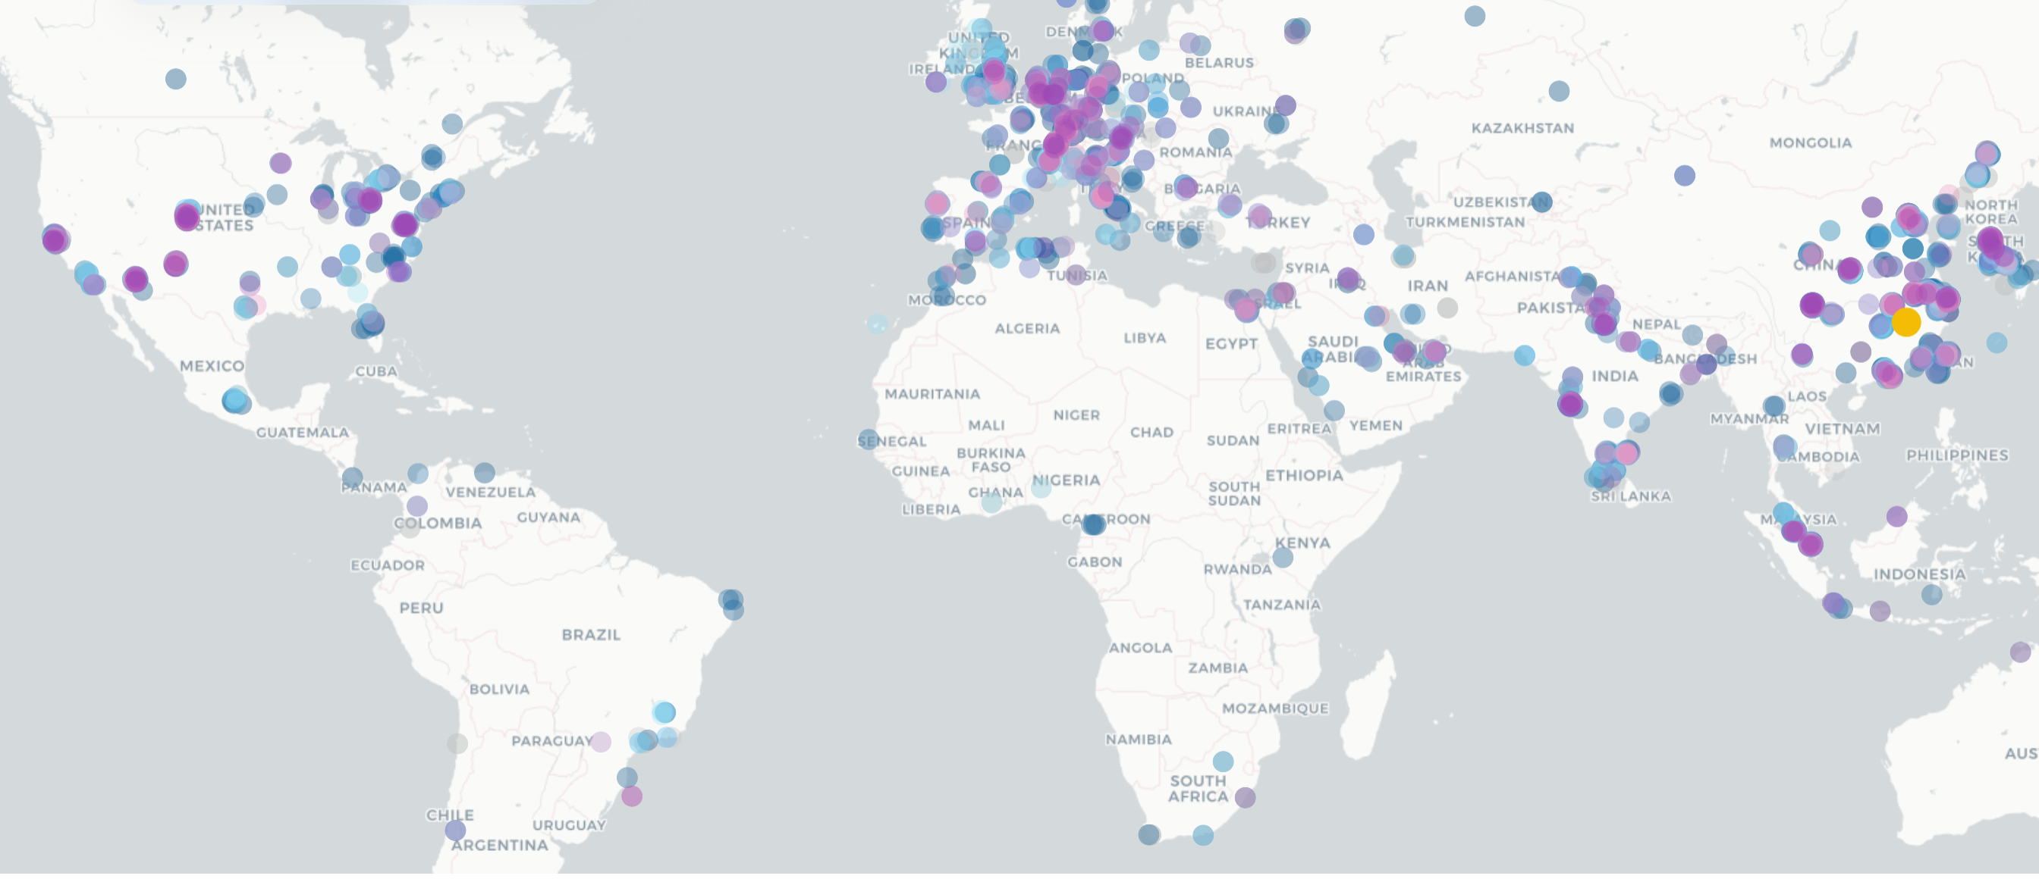
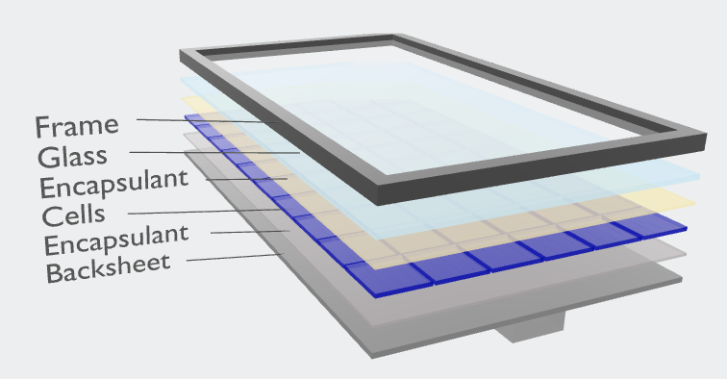


Slide 2
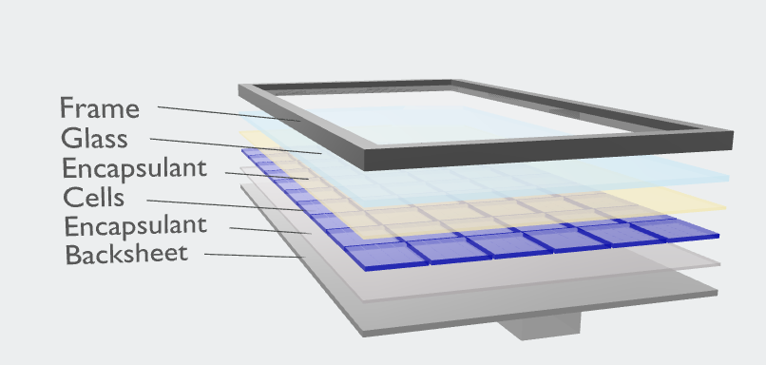

Slide 3
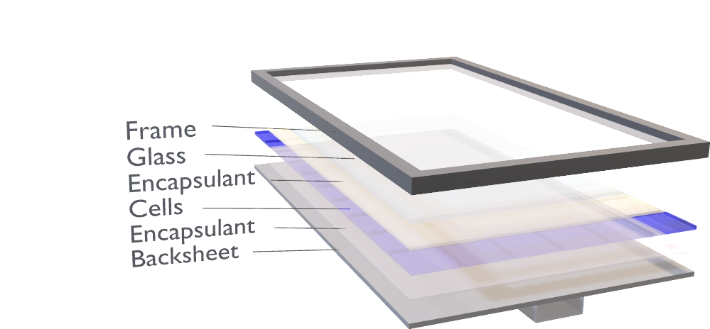

Slide 4
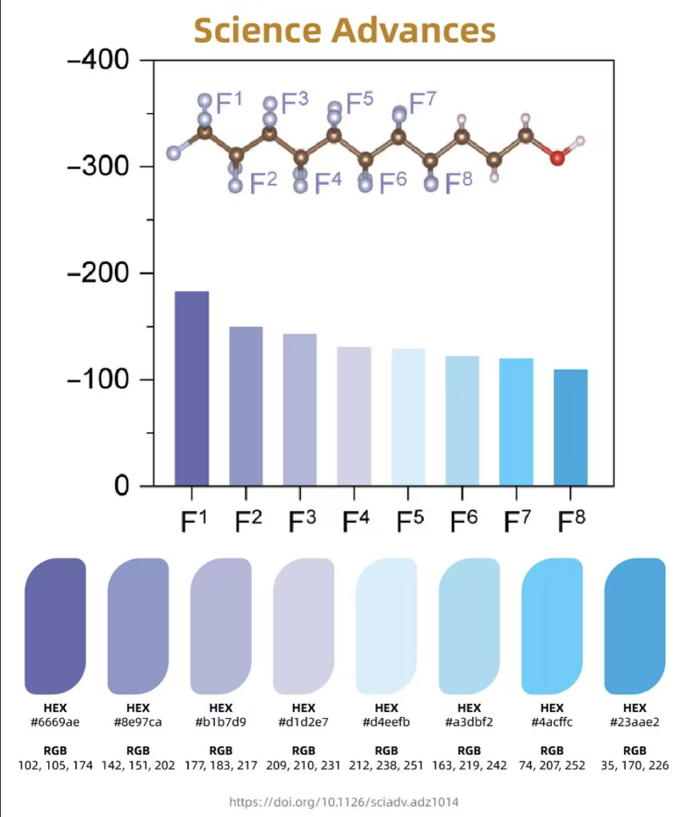

Slide 5
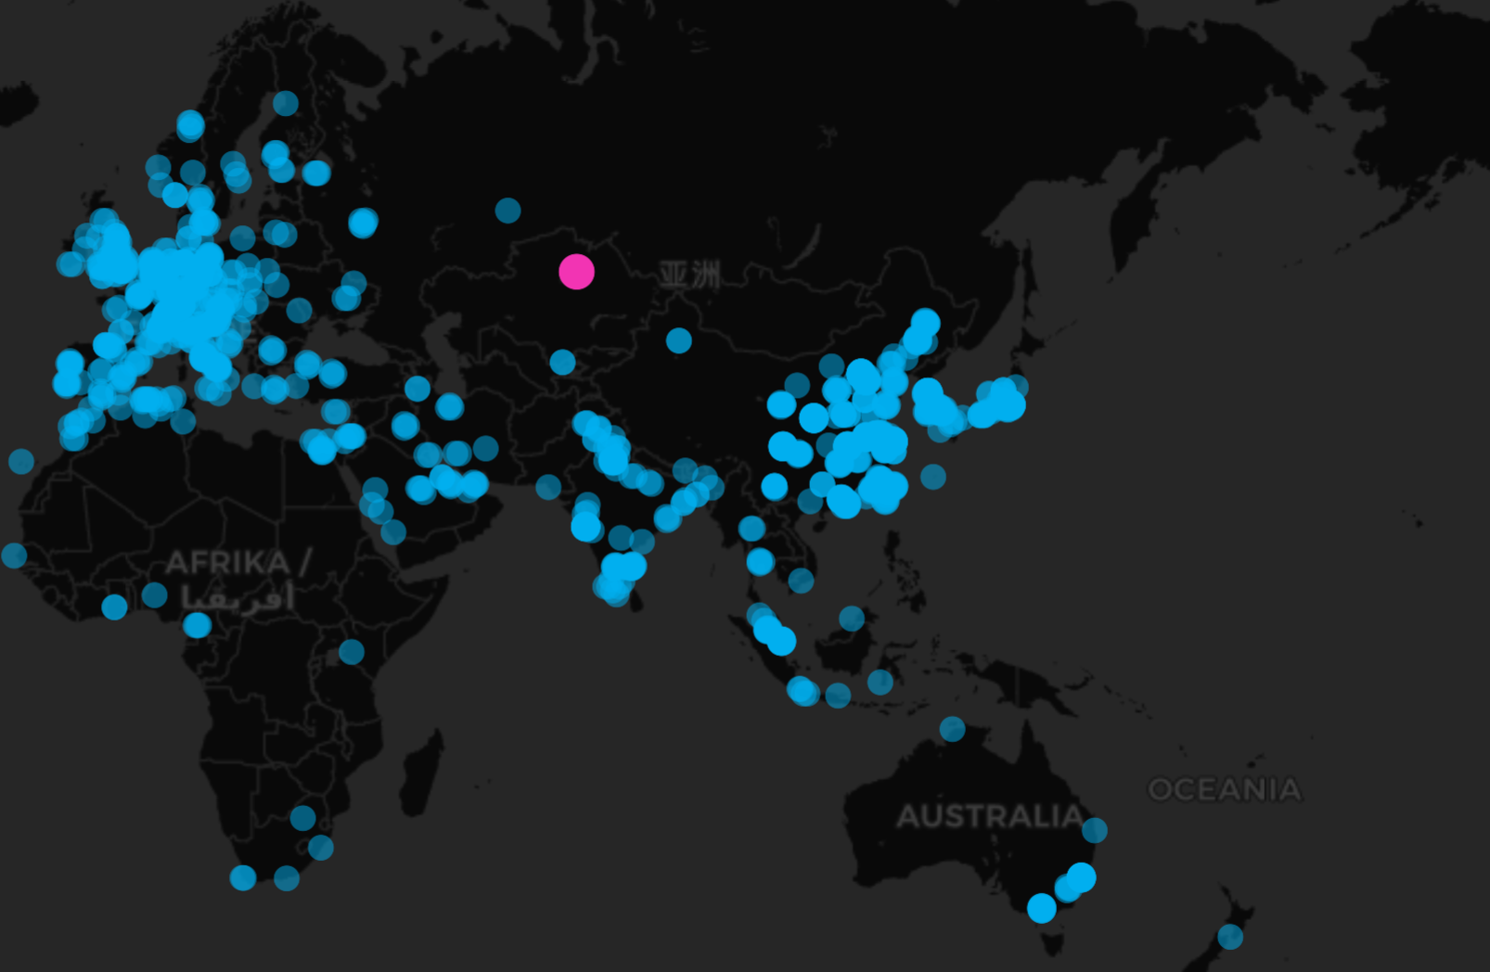
fasgaewga

Slide 6
stressor
mechanism
failure
Loss and loss
stressor
mechanism
failure
Loss and loss
stressor
mechanism
failure
Loss and loss

